Slide 1
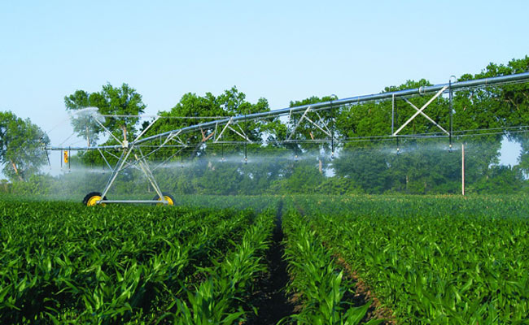
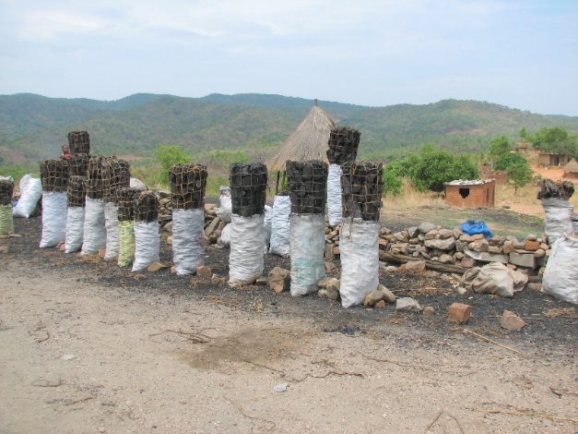
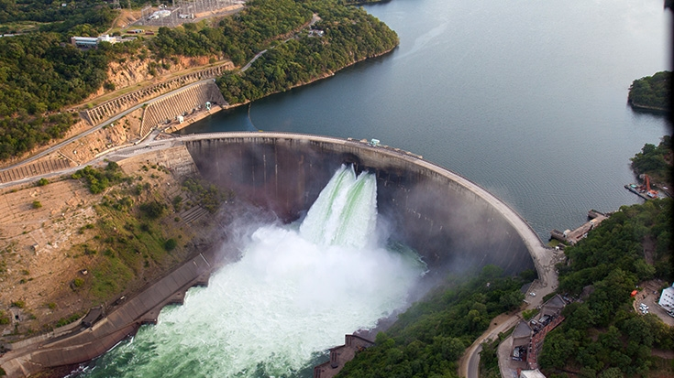
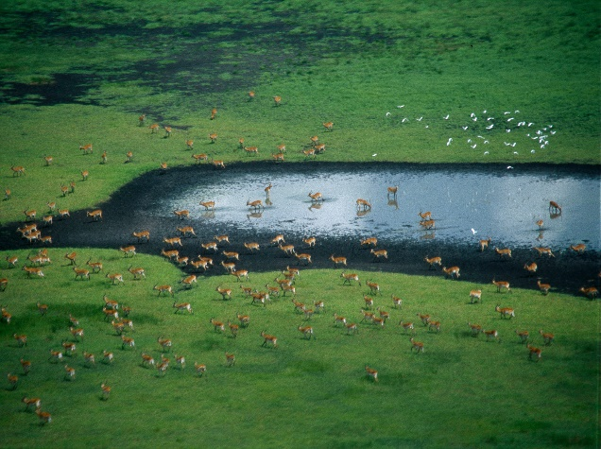
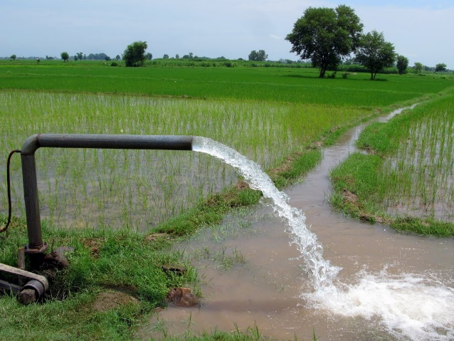
Exercise 8: Changing input data
Peter Burek, Mikhail Smilovic, Luca Guillaumot
International Institute for Applied Systems Analysis
Research Scholars at
Water Program

Slide 2

Changing input data
0. What you need
What is netCDF
Display netCDF files
Change ksat2 (saturated soil conductivity layer 2) in ArcGIS
Notes:
Improvement in resolution of CWatM model for basin analysis to show more details locally.

Slide 3
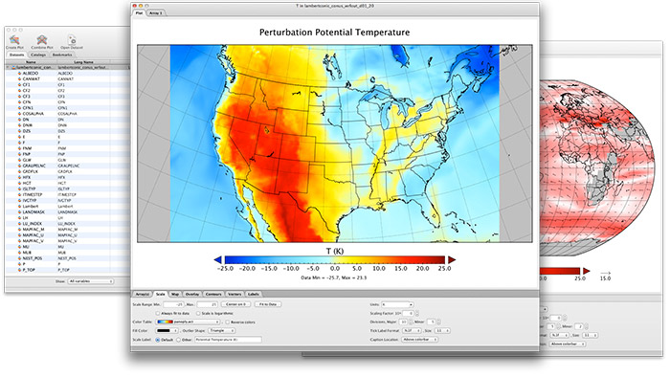
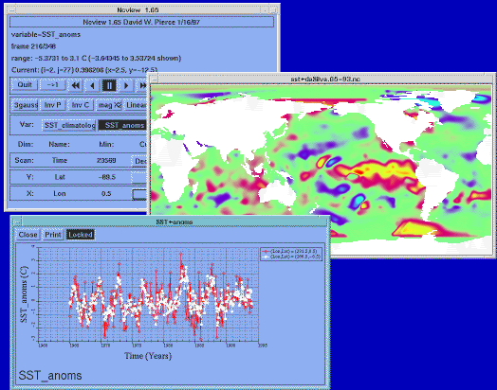
Changing input data
0. What you need
A Geoinformation System e.g. QGIS, ArcGIS
A way to display netCDF files easily e.g.: PANOPLY on Windows https://www.giss.nasa.gov/tools/panoply/ ncview on Linux:
Notes:
Improvement in resolution of CWatM model for basin analysis to show more details locally.

Slide 4
Changing input data
What is netCDF
NetCDF (Network Common Data Form) is a data format like .tif, .jpg
NetCDF is a set of librariesand self-describing, machine-independent data formats that support the creation, access, and sharing of array-oriented scientific data
Mainly used by the meteorological community
Advantage:
netCDF is self-describing, portable, flexible
netCDF is public domain, well documented and used by a growing number of organizations
High efficiency in reading and processing netCDF files (it is fast)
A netCDF file can contain timeseries of spatial data in a compressed way
Disadvantage:
Not so easy to handle
Notes:
Improvement in resolution of CWatM model for basin analysis to show more details locally.

Slide 5
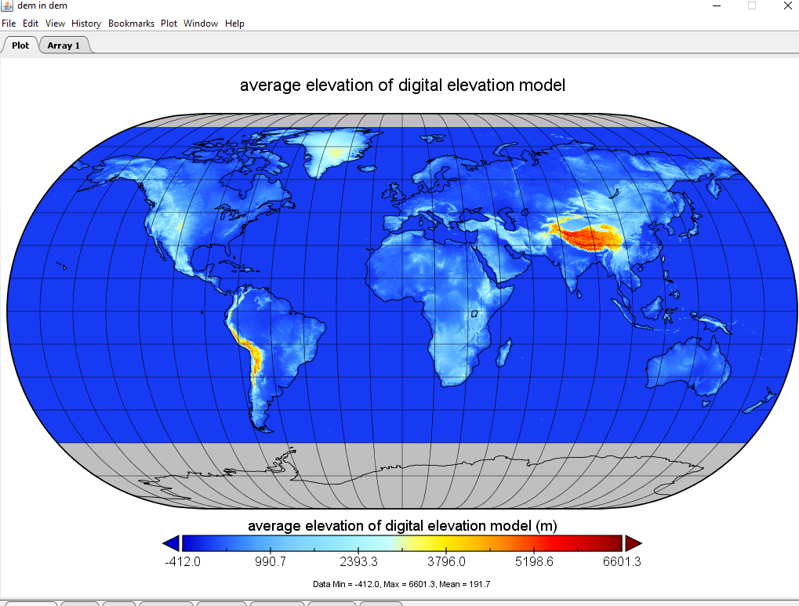
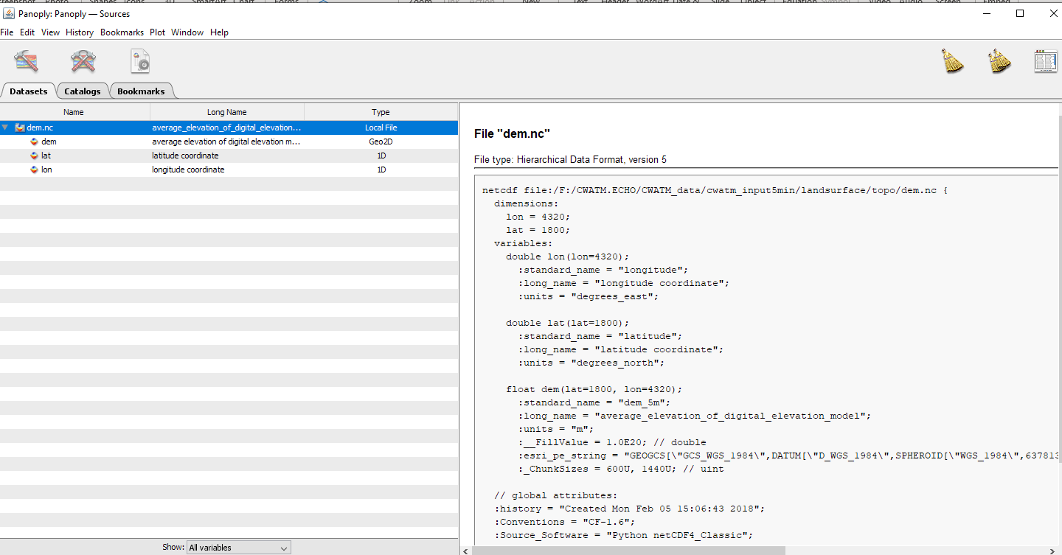
Changing input data
Metainformation e.g. - dimension (here without time) - unit
- description
Examples of netCDF
Digital elevation (source:SRTM) ../CWATM_data/cwatm_input5min/landsurface/topo/dem.nc
Variables - latitude
- longitude
- elevation
Notes:
Improvement in resolution of CWatM model for basin analysis to show more details locally.

Slide 6
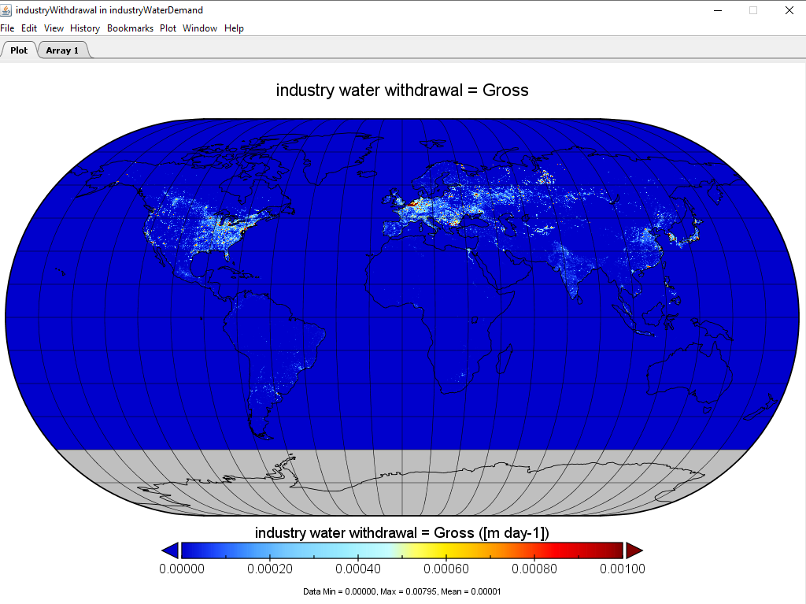
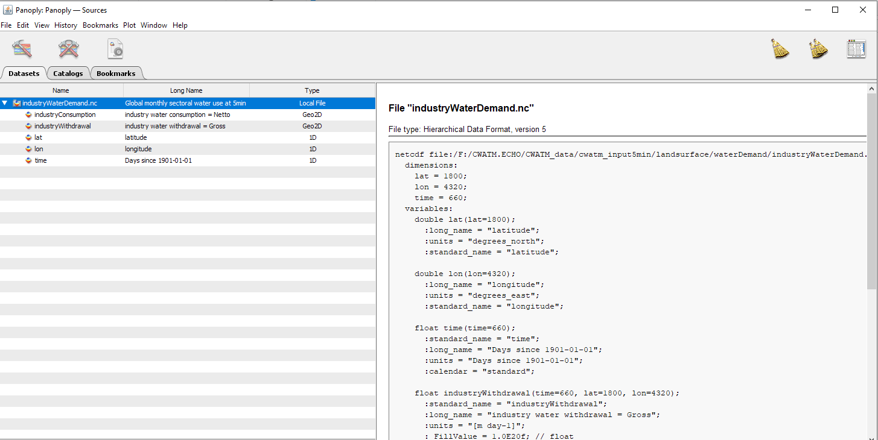
Changing input data
Metainformation e.g. - dimension (here with time) - unit
- description
Examples of netCDF
Monthly industry water demand (calculation Wada et al. 2014) ../CWATM_data/cwatm_input5min/landsurface/waterDemand/industryWaterDemand.nc
Variables
- latitude
- longitude
- time
- 2 variables
Notes:
Improvement in resolution of CWatM model for basin analysis to show more details locally.

Slide 7
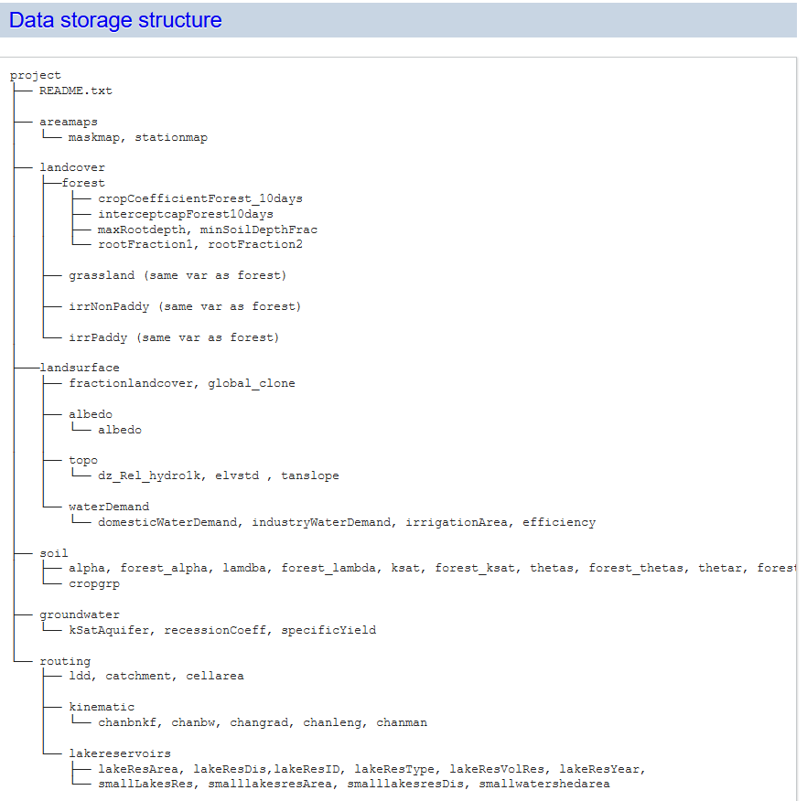
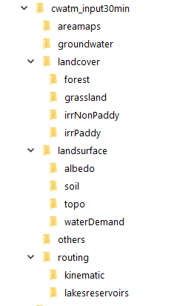
Changing input data
Take a look at dataset
Take a look at: https://cwatm.iiasa.ac.at/data.html
Take a look at ../CWATM_data/cwatm_input30min
Notes:
Improvement in resolution of CWatM model for basin analysis to show more details locally.

Slide 8
Changing input data
Metainformation e.g. - dimension (here with time) - unit
- description
Changing values with CDO (Linux)
CDO (Climate Data Operators)
https://code.mpimet.mpg.de/projects/cdo/
CDO is a collection of command line Operators to manipulate and analyse netCDF data.
There are more than 600 operators available
cdo expr, ‘ksat2 = ksat2_o * 2’ ksat2.nc ksat22.nc
Multiplying values by two
Notes:
Improvement in resolution of CWatM model for basin analysis to show more details locally.

Slide 9
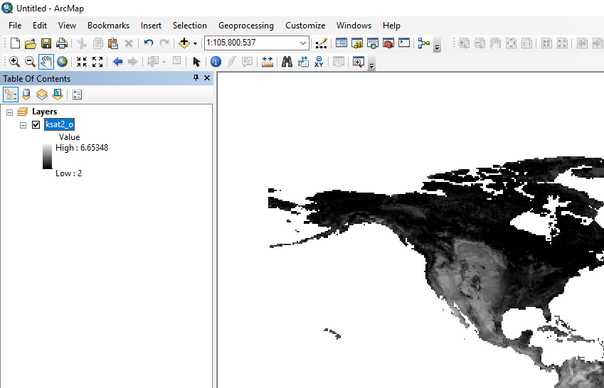
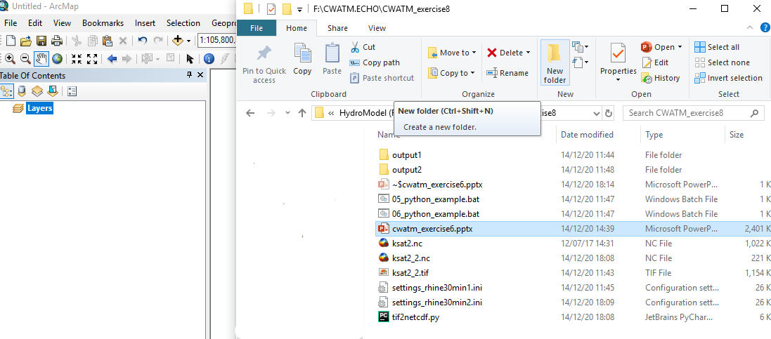
Changing input data
Changing values with ArcGis
Open Arcgis
Drop ksat2.nc into “Table of content”
Notes:
Improvement in resolution of CWatM model for basin analysis to show more details locally.

Slide 10
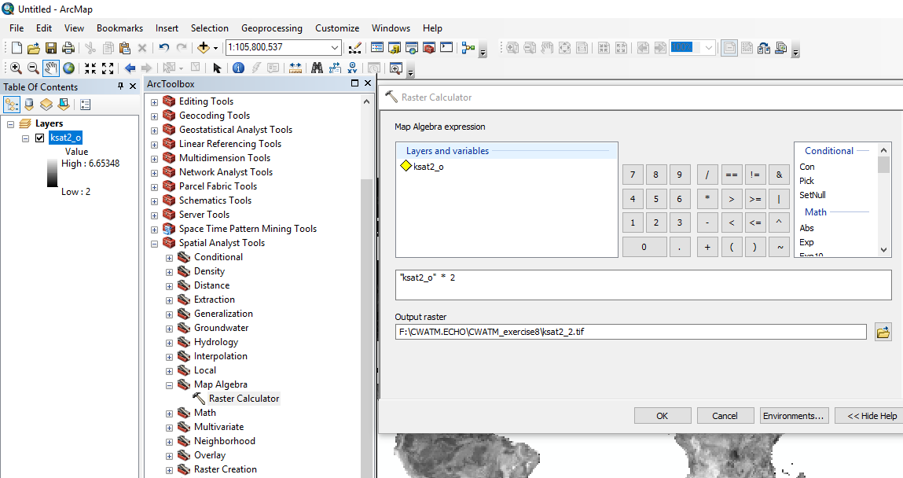
Changing input data
Changing values with ArcGis
Open toolbox – Spatial Analyst Tool – Map Algebra – Raster calc.
Put in: “ksat2_o” *2
Put in output raster – into the folder of CWATM_exercise8
You have to choose a different name than ksat2_2.tif if there is already a ksat2_2.tif in this folder
Notes:
Improvement in resolution of CWatM model for basin analysis to show more details locally.

Slide 11
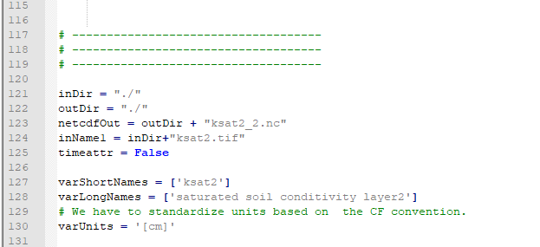
Changing input data
Convert file from .tif to netcdf
Run tif2nc.bat
This will run python tif2netcdf.py
Output is ksat2_2.nc
tif2netcdf.py
Notes:
Improvement in resolution of CWatM model for basin analysis to show more details locally.

Slide 12
Changing input data
Convert file from .tif to netcdf
Run tif2nc.bat
This will run python tif2netcdf.py
Output is ksat2_2.nc
Notes:
Improvement in resolution of CWatM model for basin analysis to show more details locally.

Slide 13
Changing input data
Run CWatM twice to see the difference
Run 01_python_example.bat
or python ../CWATM_model/CWatM/run_cwatm.py settings_rhine30min1.ini -l
Output in output1
Run 02_python_example.bat
or python ../CWATM_model/CWatM/run_cwatm.py settings_rhine30min2.ini -l
Output in output2
Notes:
Improvement in resolution of CWatM model for basin analysis to show more details locally.

Slide 14


Changing input data
Run CWatM twice to see the difference
Run 01_python_example.bat
or python ../CWATM_model/CWatM/run_cwatm.py settings_rhine30min1.ini -l
Output in output1
Run 02_python_example.bat
or python ../CWATM_model/CWatM/run_cwatm.py settings_rhine30min2.ini -l
Output in output2
Difference settings_rhine30min2.ini vs. settings_rhine30min2.ini
Notes:
Improvement in resolution of CWatM model for basin analysis to show more details locally.

Slide 15
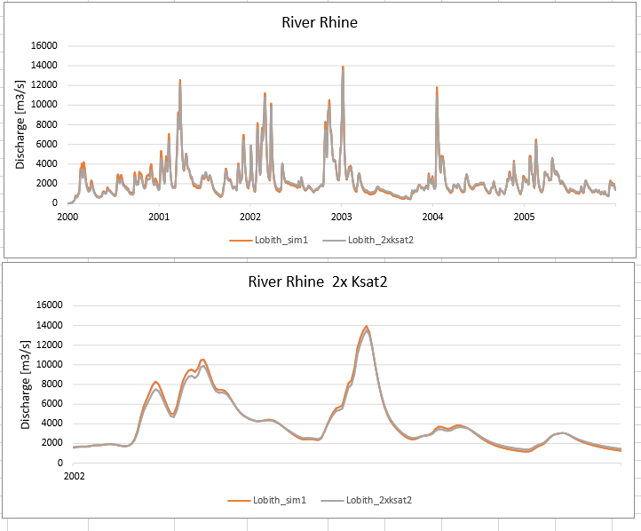
Changing input data
Have a look at rhine8.xlsx to see the difference
Notes:
Improvement in resolution of CWatM model for basin analysis to show more details locally.

