Slide 1
CH3
CH2
CH3
CH
CH3
CH2
C
CH
CH
CH2
CH2
CH3
CH
CH3
CH3
CH3
CH3

Slide 2
CH3
CH3
CH
CH3
CH3
CH
CH3
CH2
CH
C
CH2
CH
CH
CH3
CH2
CH2
CH3

Slide 3
CH3
CH
CH2
CH3
CH3
CH2
C
CH3
CH3
C
CH3
CH2
CH2
CH
CH
C
CH3
CH3
C
CH3

Slide 4
CH2
CH2
CH2
CH3
CH3
CH
CH
CH2
CH2
CH2

Slide 5
CH2
CH
CH
CH3
CH
CH
CH3

Slide 6
OH
CH3
C
CH3
CH3

Slide 7
HCOO
CH2
CH3
CH2
CH2

Slide 8
CHO
CH3

Slide 9
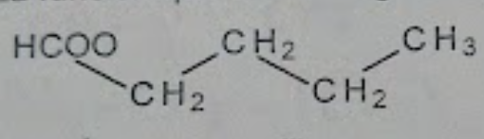

Slide 10
CH3
CH2
CH3
CH2
(CH2)3
CH
CH3
CH
N
CH3
CH3
CH
CH3

Slide 11
CH3
CH3
CH3
CH3
C
CH2
CH
CH
CH2
O
CH3
C
CH3
CH3
CH2
CH3

Slide 12
NH2
CH3
CH3
CH2
CH
CH
CH3
CH2

Slide 13
CONH2
CH2
CH
CH3
CH3
CH2
CH2

Slide 14
Sn
CH2
CH
CH3
CH2
COO
CH2
CH2
CH3
2

Slide 15
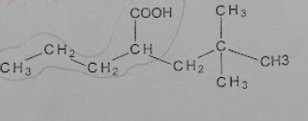
C
CH
CH2
CH3

Slide 16
CH3
CH2
CH3
OH
CH
CH3
CH2
C
C
C
CH3
CH2
CH2
CH2
CH2
CH2
CH3
CH
CH3
CH2
CH3
CH3
CH3

Slide 17
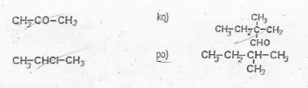
C
CH
CH2
CH3

Slide 18

C
CH
CH2
CH3

Slide 19
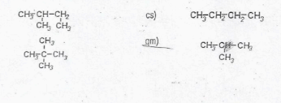
C
CH
CH2
CH3

Slide 20

C
CH
CH2
CH3

Slide 21
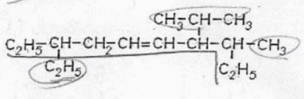
C
CH
CH2
CH3

Slide 22
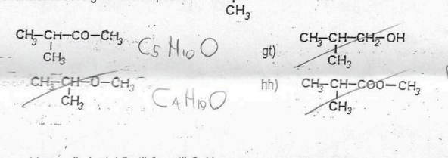
C
CH
CH2
CH3

Slide 23

C
CH
CH2
CH3

Slide 24
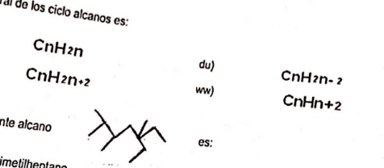
C
CH
CH2
CH3

Slide 25
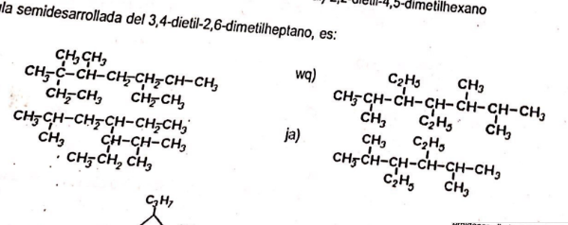
C
CH
CH2
CH3

Slide 26
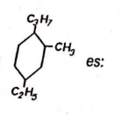
C
CH
CH2
CH3

Slide 27
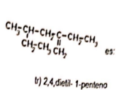
C
CH
CH2
CH3

Slide 28
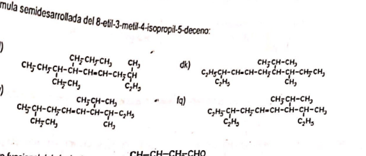
C
CH
CH2
CH3

Slide 29
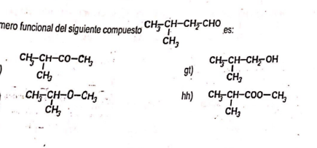
C
CH
CH2
CH3

Slide 30
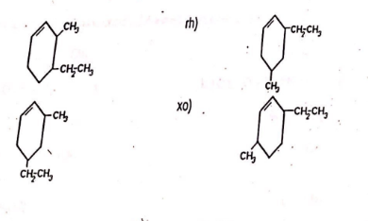
C
CH
CH2
CH3

Slide 31
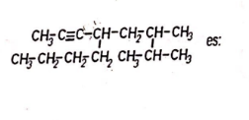
C
CH
CH2
CH3

Slide 32
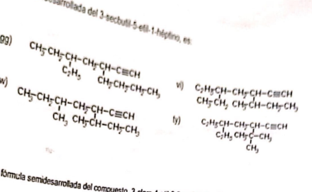
C
CH
CH2
CH3

Slide 33
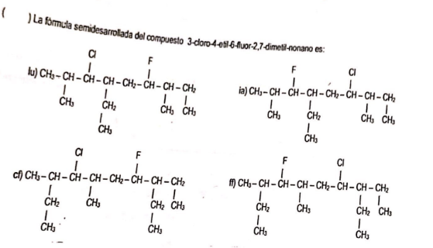
C
CH
CH2
CH3

Slide 34
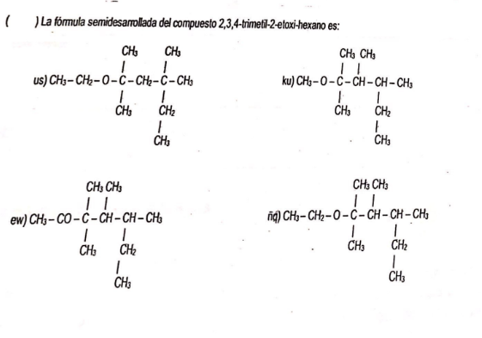
C
CH
CH2
CH3

Slide 35
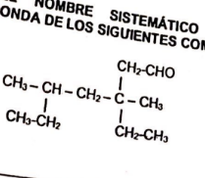
C
CH
CH2
CH3

Slide 36
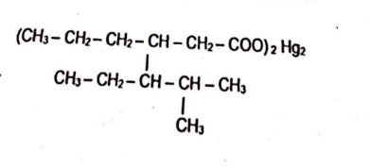
C
CH
CH2
CH3

Slide 37
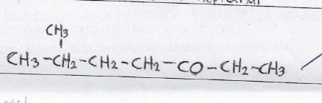
CH3
CH2
CH2
CH2
CO
CH3
CH2
CH3

