Slide 1

From Hand-Tuning to Architecture Search
CNN design, transfer learning and zero-cost NAS for satellite land-use classification (EuroSAT)
Emilio Yared · Joe Missisian — Group 7
Master 2 Artificial Intelligence and Data Engineering
AIDE500 — Programming for AI

Slide 2
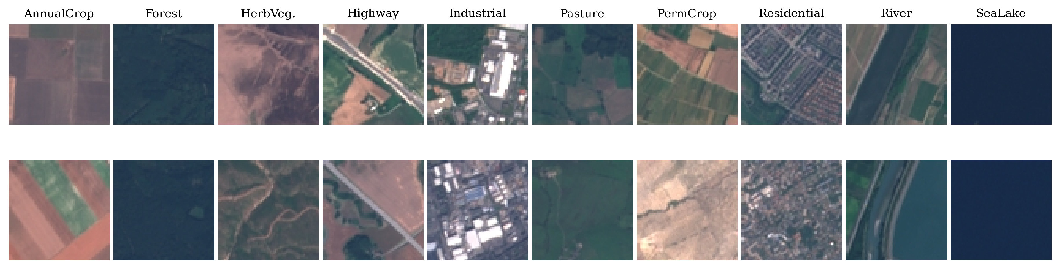
Problem and dataset
EuroSAT RGB: 27,000 Sentinel-2 tiles, 64×64 px, 10 land-use classes
Fixed stratified split 70/15/15 (18,900 / 4,050 / 4,050), normalization from the train split only
Classes defined by texture and color; several are visually close (crops, vegetation, pasture)
Three questions
How far can a CNN trained from scratch go? (Tasks 1–2)
What does ImageNet pretraining bring? (Task 3)
Can the manual design be automated cheaply? (zero-cost NAS)

Slide 3
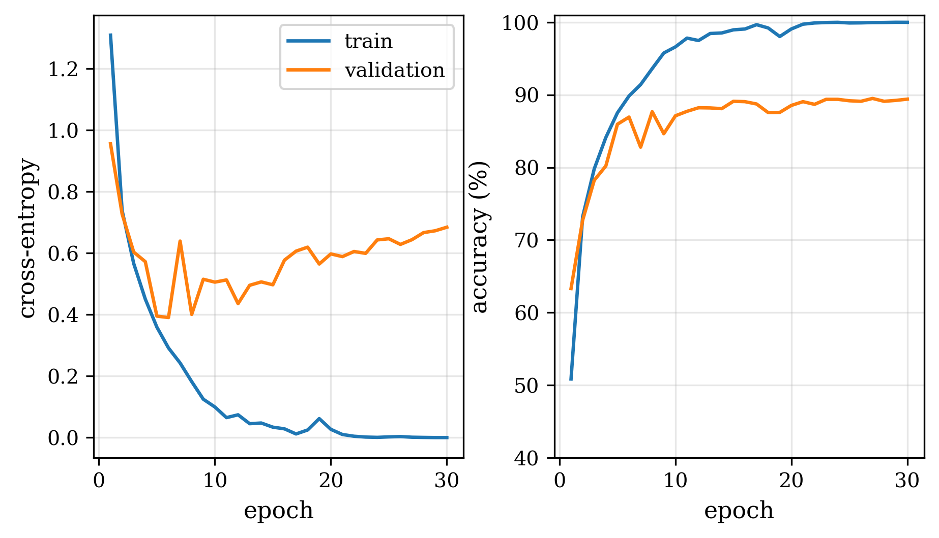
Task 1 — Baseline CNN
90.15%
10.5 pts
test accuracy
generalization gap
3 × Conv3×3 → ReLU → MaxPool (32/64/128 ch.), FC 8192 → 256 → 10, 2.19M params
SGD momentum 0.9, lr 0.01, batch 64, 30 epochs
Main confusions: Highway → River, PermanentCrop → HerbaceousVeg.
Train loss keeps falling while the validation loss is minimal at epoch 6: the network memorizes the training set.

Slide 4
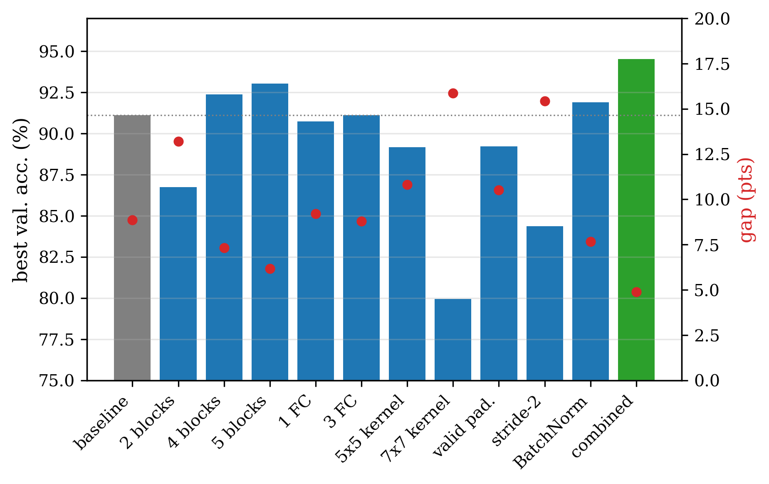
Task 2a — Architecture, one factor at a time
Depth matters most: 5 blocks → receptive field 94 px (the whole tile) and fewer params (1.24M vs 2.19M)
Large kernels hurt: 7×7 → 79.95%
Valid padding and stride-2 lose information
BatchNorm: +0.8 pt, smoother training
Combined (5 blocks, 3×3, same padding, max-pool, BN): 94.52% val., gap halved

Slide 5
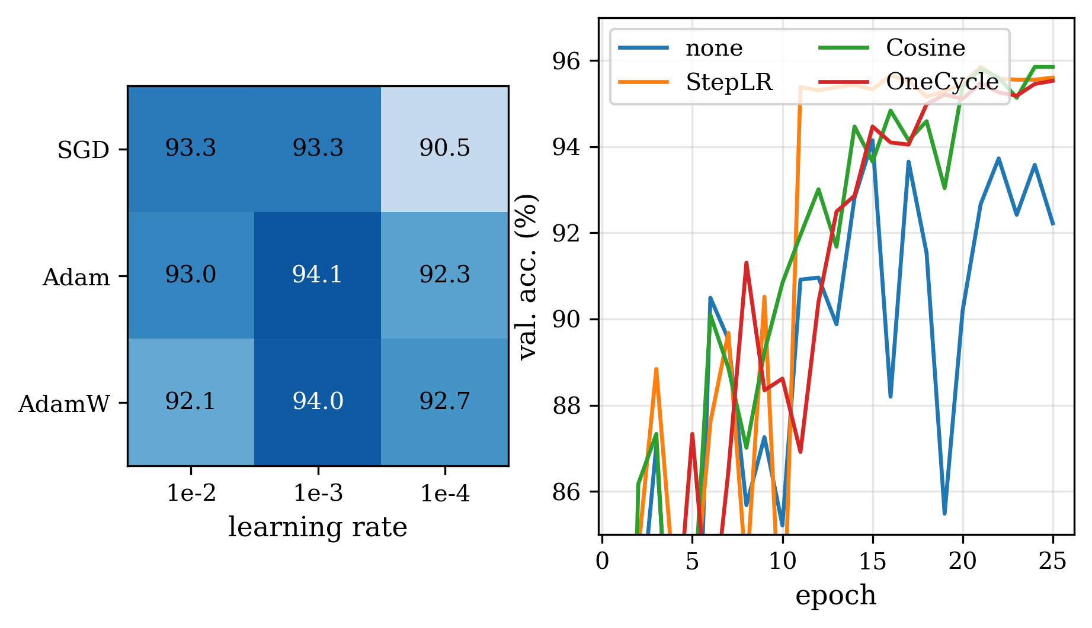
Task 2b — Optimizers, learning rates, schedulers
3 optimizers × 3 learning rates, 25 epochs
lr 1e-3 best for all; 1e-2 unstable for Adam/AdamW, 1e-4 too slow for SGD
Adam 1e-3: best and fastest (94.15%)
Schedulers add +1.4–1.7 pts: small steps at the end remove the oscillations
Recipe Adam + StepLR: 96.22% test
Left: peak validation accuracy (%) per optimizer and learning rate. Right: Adam lr 1e-3 with each scheduler.

Slide 6
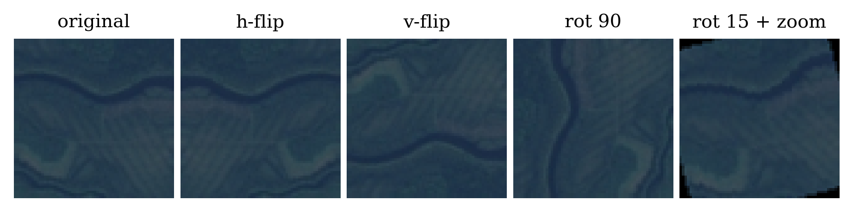
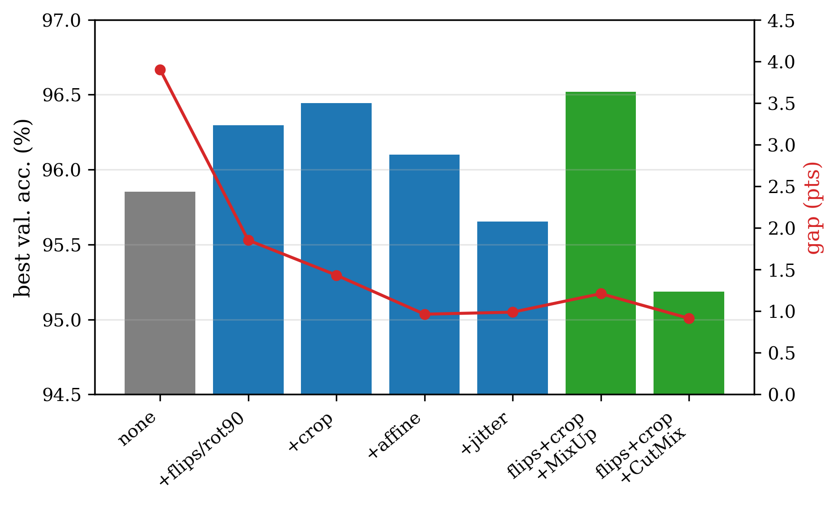
Task 2c — Data augmentation
No "up" in satellite images: vertical flips and 90° rotations keep the label
Color carries the class → weak color jitter only
MixUp / CutMix written by hand:
loss = lam*CE(out, y_a) + (1-lam)*CE(out, y_b)
Gap measured on clean training images: 3.9 → ≈1 pt. Affine creates black corners; CutMix needs longer training.
Best: flips + crop + MixUp → 97.04% test

Slide 7
Task 2 — Comparison table (selection)
NB | Configuration | Params | Latency (ms) | Peak val. (%) | Gap (pts)
NB2 | baseline | 2.19M | 0.380 | 91.11 | 8.87
NB2 | 2 blocks | 4.22M | 0.302 | 86.74 | 13.21
NB2 | 5 blocks | 1.24M | 0.635 | 93.04 | 6.17
NB2 | 7×7 kernels | 2.61M | 0.771 | 79.95 | 15.87
NB2 | stride-2 | 2.19M | 0.321 | 84.37 | 15.43
NB2 | BatchNorm | 2.19M | 0.523 | 91.90 | 7.68
NB2 | combined | 1.24M | 0.735 | 94.52 | 4.89
NB | Configuration | Params | Latency (ms) | Peak val. (%) | Gap (pts)
NB3 | SGD lr 1e-2 | 1.24M | 0.694 | 93.28 | 5.49
NB3 | Adam lr 1e-3 | 1.24M | 0.694 | 94.15 | 2.47
NB3 | Adam + StepLR | 1.24M | 0.694 | 95.85 | 3.31
NB4 | no augmentation | 1.24M | 0.694 | 95.85 | 3.90
NB4 | flips + crop | 1.24M | 0.694 | 96.44 | 1.43
NB4 | + MixUp | 1.24M | 0.694 | 96.52 | 1.21
NB4 | + CutMix | 1.24M | 0.694 | 95.19 | 0.91
Latency: one image on a T4 GPU. Gap: train − validation accuracy at the best epoch (NB4: clean training images). The full table (31 runs) is in the report.
90.15 → 95.36%
96.22%
97.04%
architecture (NB2)
+ Adam & StepLR (NB3)
+ augmentation & MixUp (NB4)

Slide 8
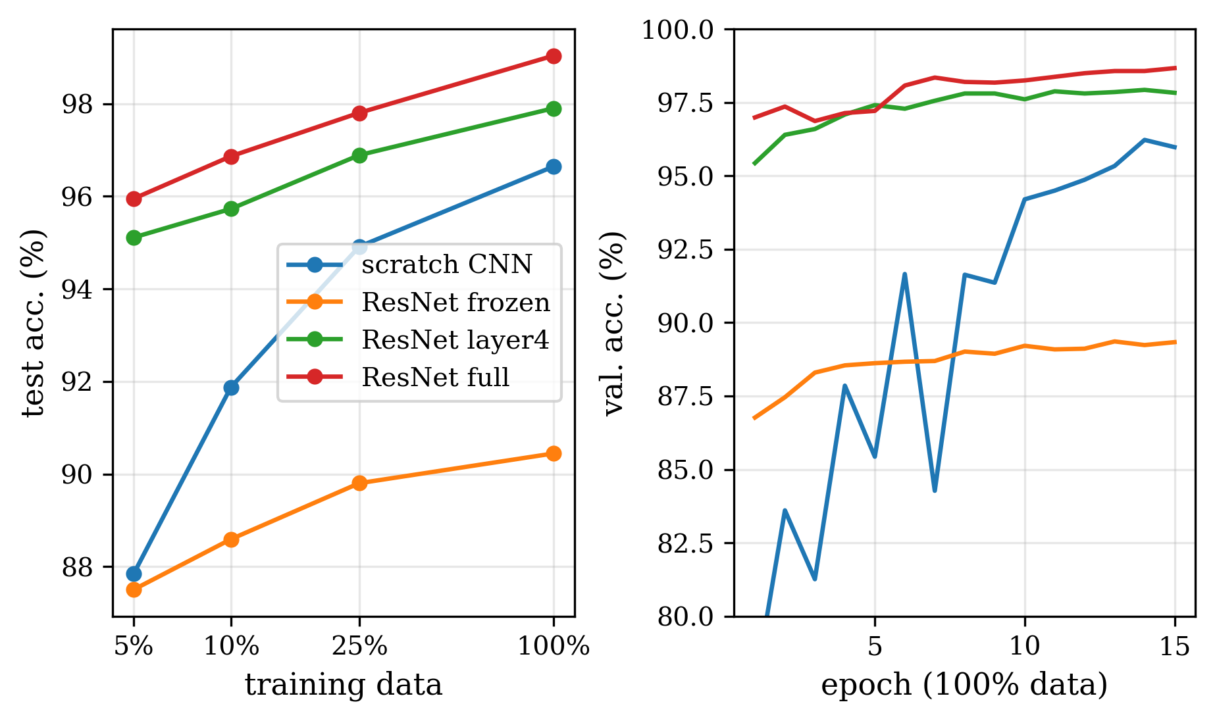
Task 3 — Transfer learning with ResNet-18
ImageNet ResNet-18, images resized to 128×128
Freeze with requires_grad = False; new head Dropout → Linear(512, 10)
lr 1e-4 for pretrained layers, 1e-3 for the head
Full fine-tuning: 99.04%, and 95.95% with 5% of the data (945 images)
Converges in 1 epoch (scratch: 6)
Frozen saturates at ≈90%: unfreezing layer4 recovers most of the gain
Cost: 9× params, 3× latency
Test acc. (%) | 5% | 10% | 25% | 100%
Scratch CNN | 87.85 | 91.88 | 94.91 | 96.64
ResNet frozen | 87.51 | 88.59 | 89.80 | 90.44
ResNet layer4 | 95.11 | 95.73 | 96.89 | 97.90
ResNet full | 95.95 | 96.86 | 97.80 | 99.04

Slide 9
Zero-cost NAS — NASWOT (Mellor et al., ICML 2021)
Judge an architecture at initialization, on one mini-batch, in ≈0.1 s — no training
Binary code c_i of each image: which ReLUs are active
Same code = same linear region → the network cannot separate the two images
High score = images well separated → the network trains well
Implemented with forward hooks on every nn.ReLU
Compared with SynFlow, SNIP, grad-norm and #params
def naswot_score(net, inputs):
B = inputs.size(0)
K = torch.zeros(B, B, dtype=torch.float64)
def hook(module, inp, out):
x = (inp[0].view(B, -1) > 0).double()
K.add_(x @ x.t() + (1-x) @ (1-x).t())
for m in net.modules():
if isinstance(m, nn.ReLU):
m.register_forward_hook(hook)
with torch.no_grad():
net(inputs)
return torch.linalg.slogdet(K)[1]
K_H[i, j] = N_A − d_H(c_i, c_j)
score s = log |K_H|
Simplified from NB6.1

Slide 10
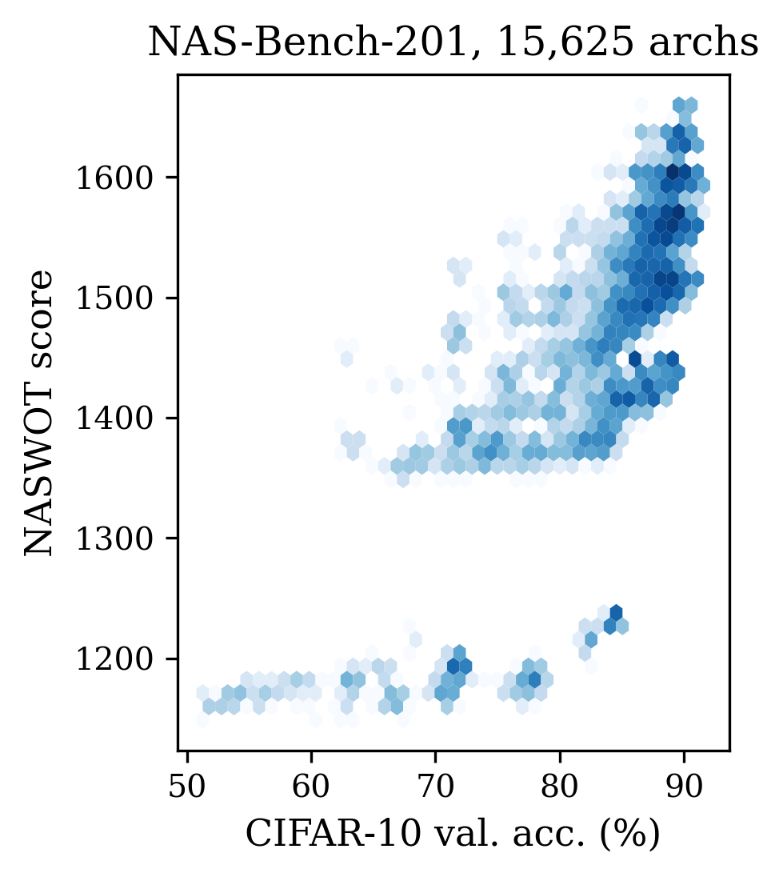
Step 1 — Reproducing the paper on NAS-Bench-201
Kendall τ | CIFAR-10 | CIFAR-100 | ImageNet16-120*
ours | 0.602 | 0.640 | 0.600
paper | 0.574 | 0.611 | 0.549
Search, test acc. (%) | CIFAR-10 | CIFAR-100 | ImageNet16-120*
NASWOT (N=10) — ours | 92.39 ± 1.20 | 68.63 ± 2.31 | 41.29 ± 3.94
NASWOT (N=10) — paper | 92.44 ± 1.13 | 68.62 ± 2.04 | 41.31 ± 4.11
NASWOT (N=100) — ours | 92.83 ± 0.94 | 69.52 ± 1.67 | 43.18 ± 2.95
NASWOT (N=100) — paper | 92.81 ± 0.99 | 69.48 ± 1.70 | 43.10 ± 3.16
Random — ours | 87.04 ± 12.94 | 61.36 ± 12.17 | 33.54 ± 9.52
Random — paper | 86.61 ± 13.46 | 60.83 ± 12.58 | 33.13 ± 9.66
NASWOT search matches Table 2 of the paper within ≈0.1 pt → our implementation is correct
15,625 networks with known trained accuracy. Our re-implementation has exactly the official number of parameters for 300/300 architectures.
* ImageNet16-120 is not on Kaggle: scored with CIFAR-100 images at 16×16.

Slide 11
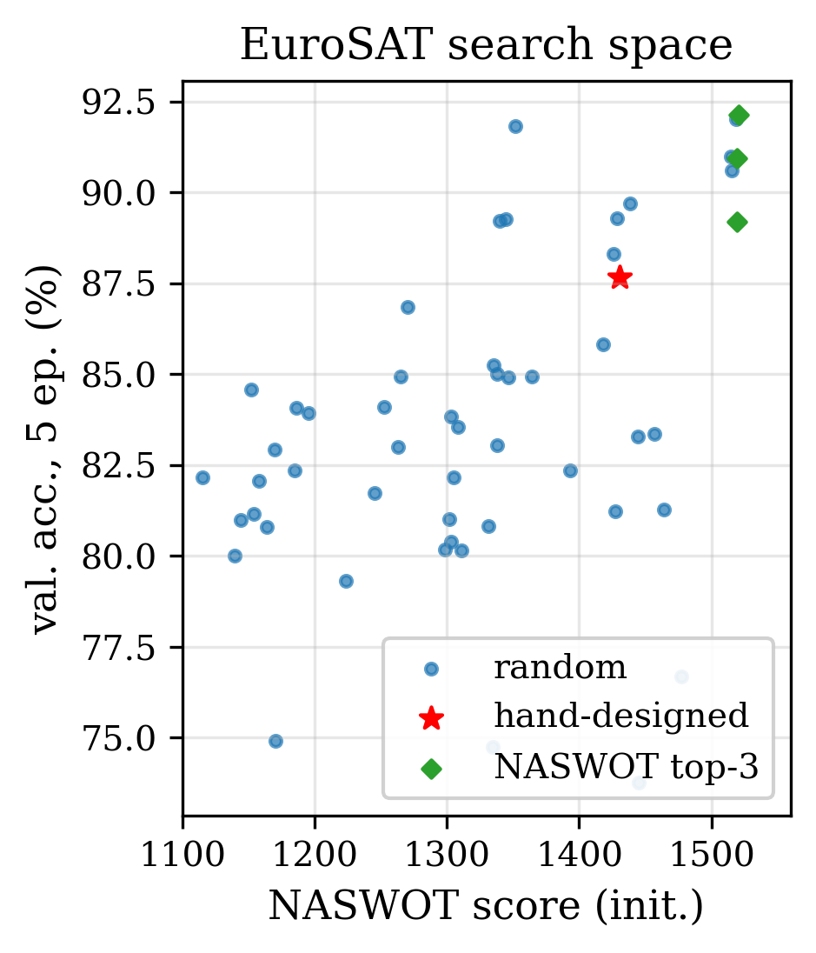
Step 2 — Zero-cost NAS on EuroSAT
Search space = the Task 2 knobs: 2–5 blocks, kernel 3/5/7 per block, width 16/32/64, BN, pool/stride, skip → 8,640 CNNs
51 networks trained 5 epochs to check the proxies (Spearman ρ):
 | NASWOT | SynFlow | SNIP | grad-norm | #params
ρ | 0.43 | 0.09 | 0.51 | 0.56 | -0.13
Search: 1000 networks scored in 153 s, then the top-3 trained
NASWOT top-3: 90.8% mean (5 epochs) vs random 83.3%, hand-designed 87.7%
Full recipe | Test acc. | Params | Latency | Search GPU
Hand-designed | 96.72% | 1.24M | 0.76 ms | 203 min
NAS winner | 97.43% | 1.99M | 1.31 ms | 17 min
Winner: 5 blocks, kernels 5-3-3-3-3, width 64, BN, max-pool, residual → better than our design with 12× less GPU time

Slide 12
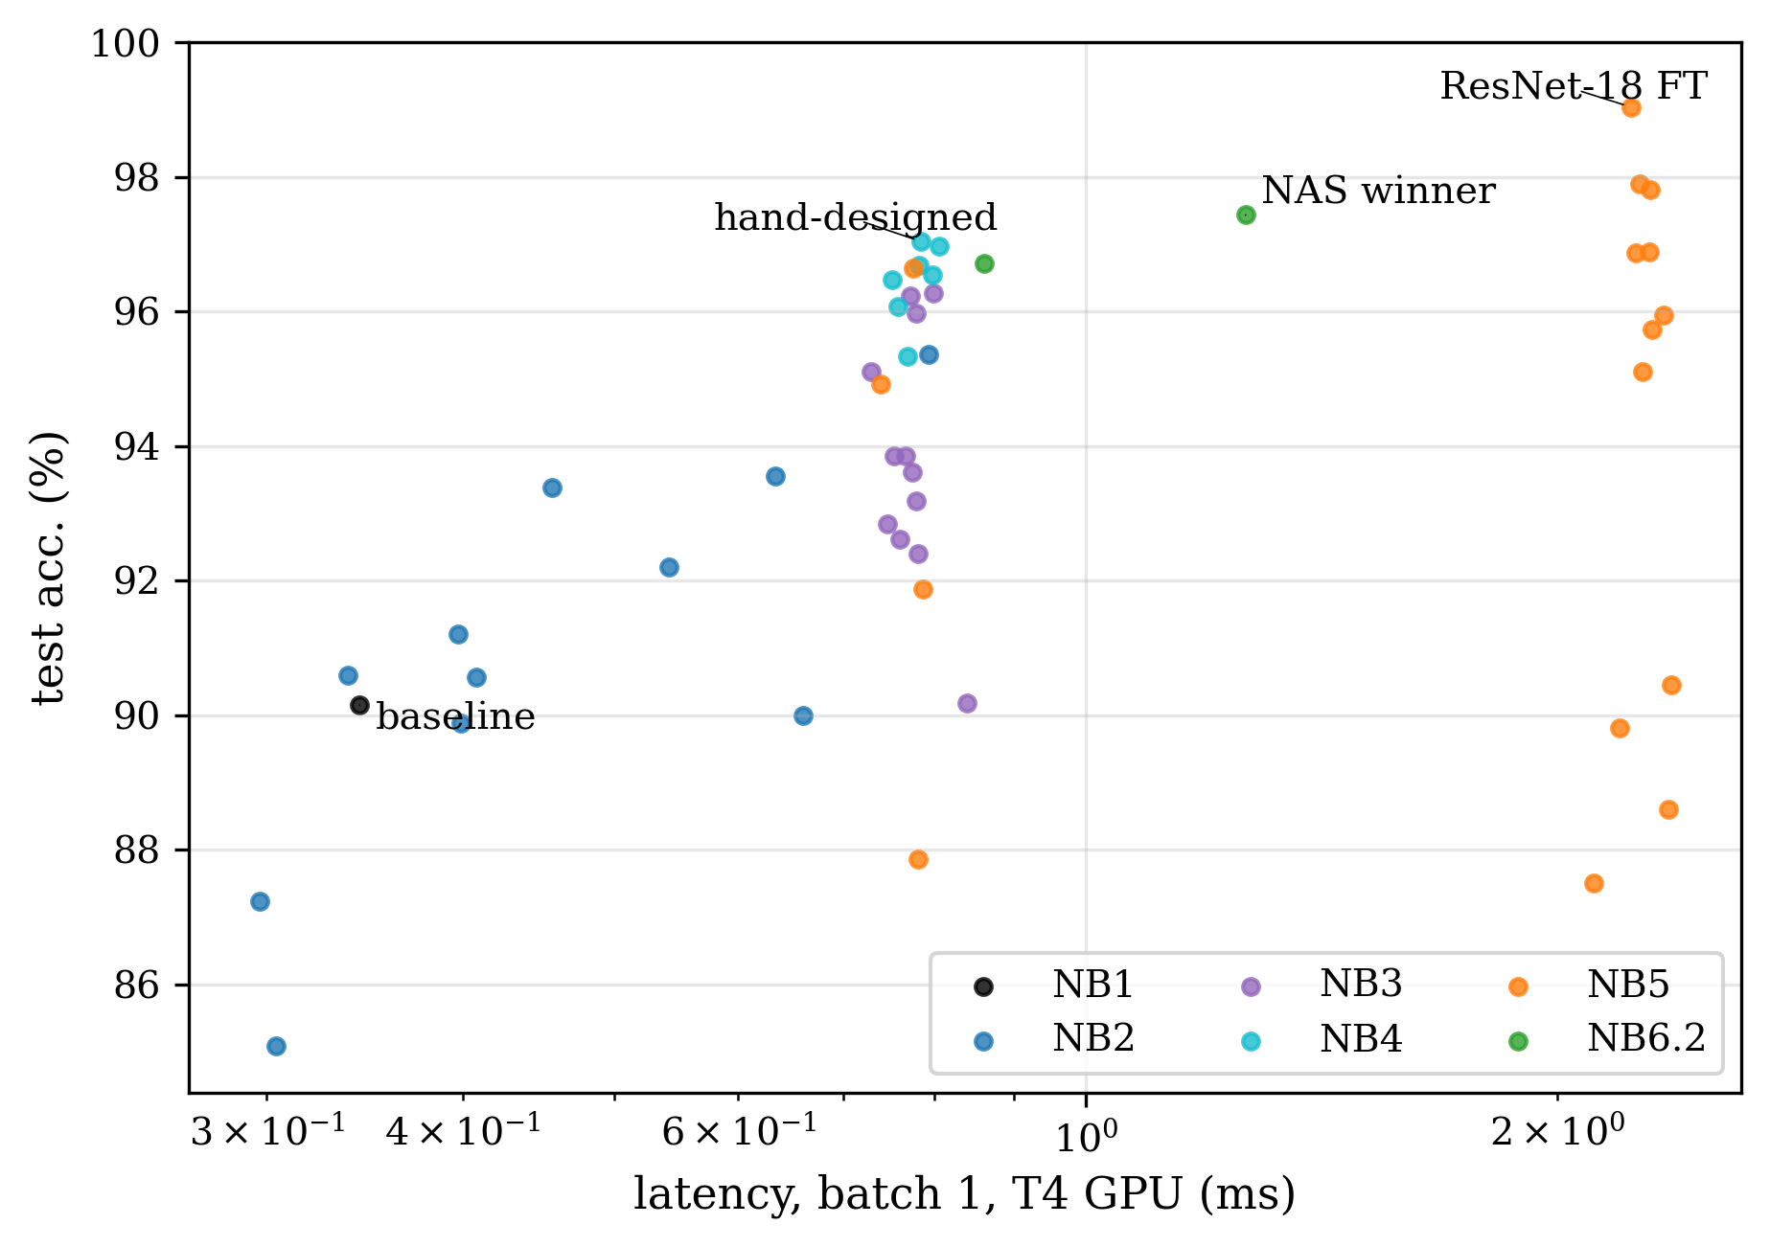
Final comparison — all 50 checkpoints (NB7)
Model | Test acc. | F1 | Params | Latency
Baseline | 90.15 | 89.75 | 2.19M | 0.34 ms
Hand-designed | 97.04 | 96.97 | 1.24M | 0.79 ms
NAS winner | 97.43 | 97.36 | 1.99M | 1.26 ms
ResNet-18 FT | 99.04 | 98.99 | 11.18M | 2.23 ms
Every checkpoint re-evaluated on the same 4,050 test images
Trade-off: the NAS winner is 1.6× slower than the hand-designed CNN, ResNet-18 3× slower
ResNet-18 is the most accurate, the scratch CNNs the fastest

Slide 13
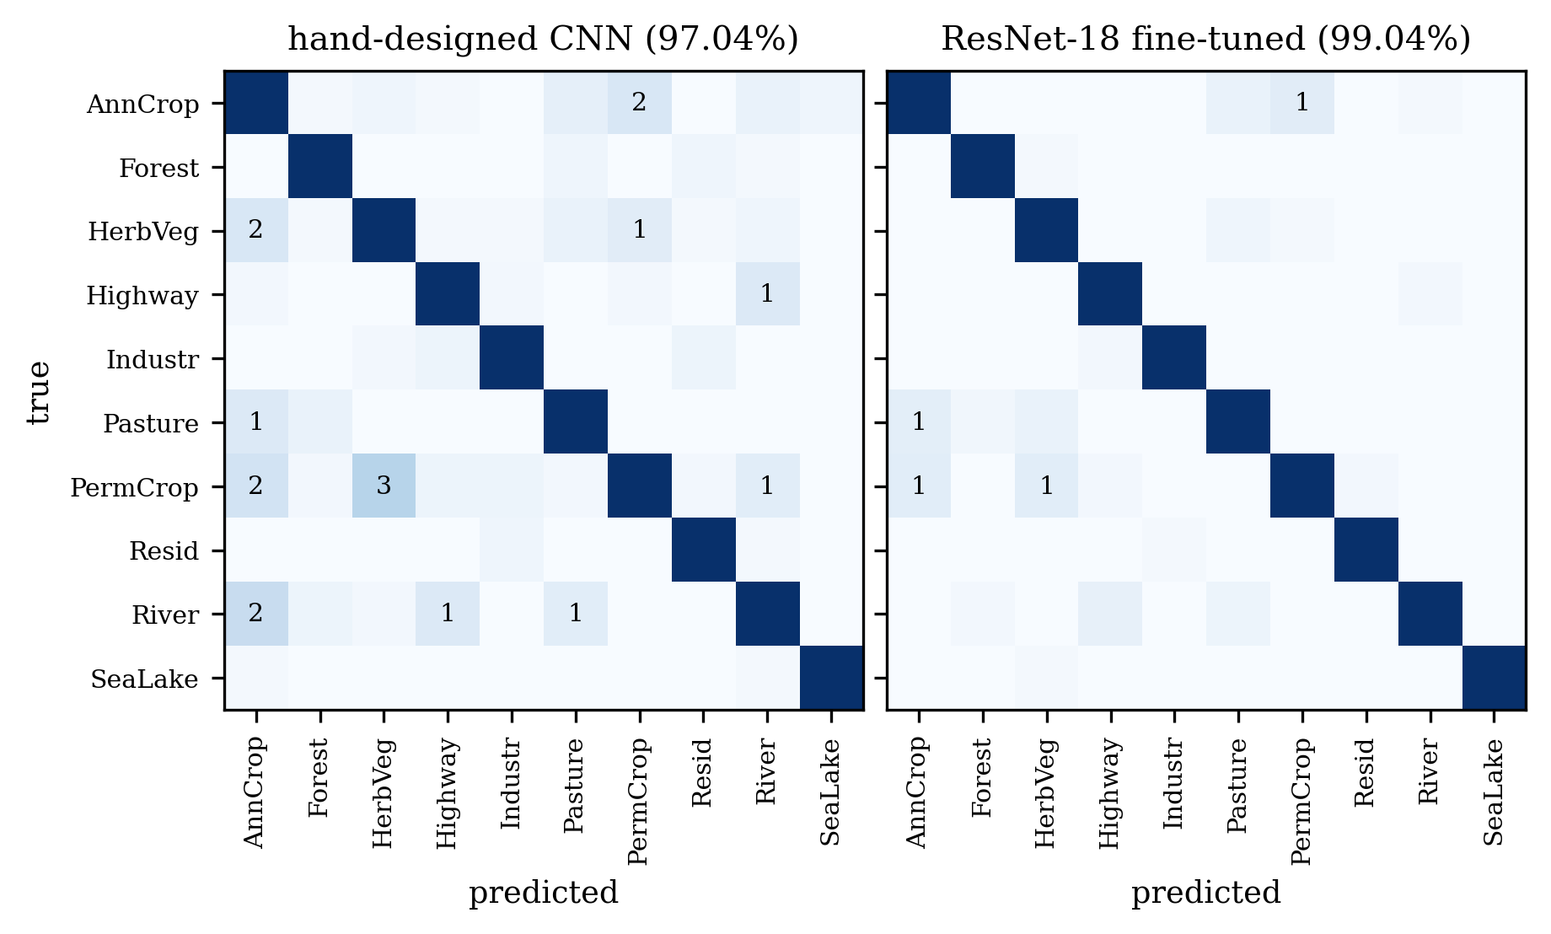
Where do the models still fail?
120
errors — hand-designed CNN
39
errors — ResNet-18 fine-tuned
Remaining errors: agricultural classes (PermanentCrop / HerbaceousVeg. / AnnualCrop / Pasture)
ResNet makes different mistakes from the scratch CNNs
14 images wrong for all models: mixed land uses

Slide 14
Conclusions
90.15 → 97.04%
99.04%
97.43%
hand-tuning a CNN from scratch
fine-tuned ResNet-18 (95.95% with 5% of the data)
zero-cost NAS, 17 GPU-min vs 203
Findings
Limitations
Depth and small kernels, Adam with a decaying lr, orientation-invariant augmentation
Transfer learning is the most accurate and by far the best with little data — at 9× the size
Zero-cost NAS reproduced on NAS-Bench-201, then found a CNN better than ours
One seed per configuration; repeated runs vary by ≈0.3–1 pt → only large effects are conclusive
EuroSAT NAS ground truth = a 5-epoch training
ImageNet16 scored with substitute images
Live demo (NB7): load any checkpoint, classify an image, change lr / activation / loss / augmentation and retrain in seconds

Slide 15
Thank you — questions?
Notebooks NB0–NB7 · 50 checkpoints · report and figures generated from the saved results
Emilio Yared · Joe Missisian — Group 7

