Slide 1


Designing CNNs for Satellite Image Classification
MINI-PRESENTATION · SCIENTIFIC ENGLISH FOR AI
Hand-design, transfer learning and training-free architecture search on EuroSAT
Emilio Yared
Master 2 Artificial Intelligence and Data Engineering · Presented to Dr. Zeinab Abbas

Slide 2
Outline of the presentation
Introduction
Methods
Results
Conclusion
Hand-design
slide 4
Hand-design vs transfer
slide 6
Objective
slide 3
EuroSAT data, three approaches
slide 4
Transfer learning
slide 4
Final comparison
slide 9
Conclusion
slide 10
Training-free search (NASWOT)
slide 5
NASWOT vs 5 strategies
slide 7
Questions
slide 11
Search on EuroSAT
slide 8
Each box is one part of the talk; an arrow shows which earlier part it builds on.

Slide 3
Objective
27,000
satellite images, 10 land-use classes (EuroSAT)
Problem
Designing a neural network by hand is slow: every new idea requires a complete training run.
Objective: compare three ways of building a classifier
Design a CNN by hand, step by step
Reuse a network pretrained on ImageNet
Search the architecture automatically, without training
800 GPUs
for 28 days: cost of the first automatic search (Zoph & Le, 2017)

Slide 4
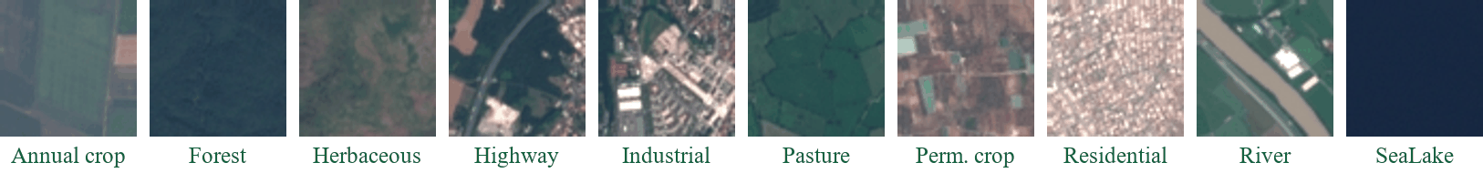
Method: data and three approaches
Same split for all models: 18,900 training · 4,050 validation · 4,050 test images
01
02
03
Hand-design
Baseline CNN improved one factor at a time: depth, kernels, optimiser, augmentation
Transfer learning
ResNet-18 pretrained on ImageNet, fine-tuned with 5% to 100% of the data
Training-free search
NASWOT scores 1,000 untrained networks in seconds; only the best one is trained

Slide 5
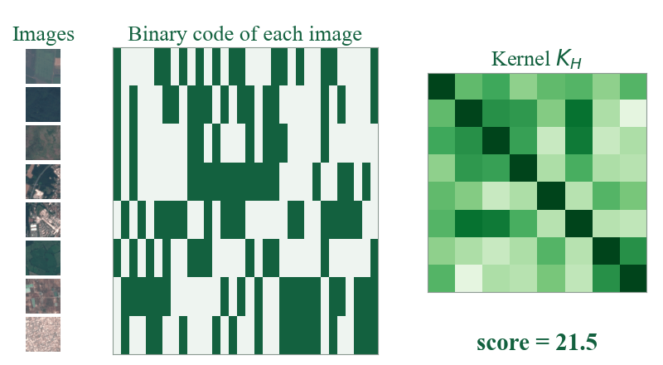
Method: how can a network be judged without training?
01
Take an untrained network
and pass one batch of 128 images through it
02
Record which ReLU units are active
this gives a binary code for every image
03
Compare the codes of all images
different codes = the network can separate the images
Validated first on NAS-Bench-201
15,625 networks whose trained accuracy is already known, which allows a fair comparison with 5 other search strategies.
score s = log |K_H|

Slide 6
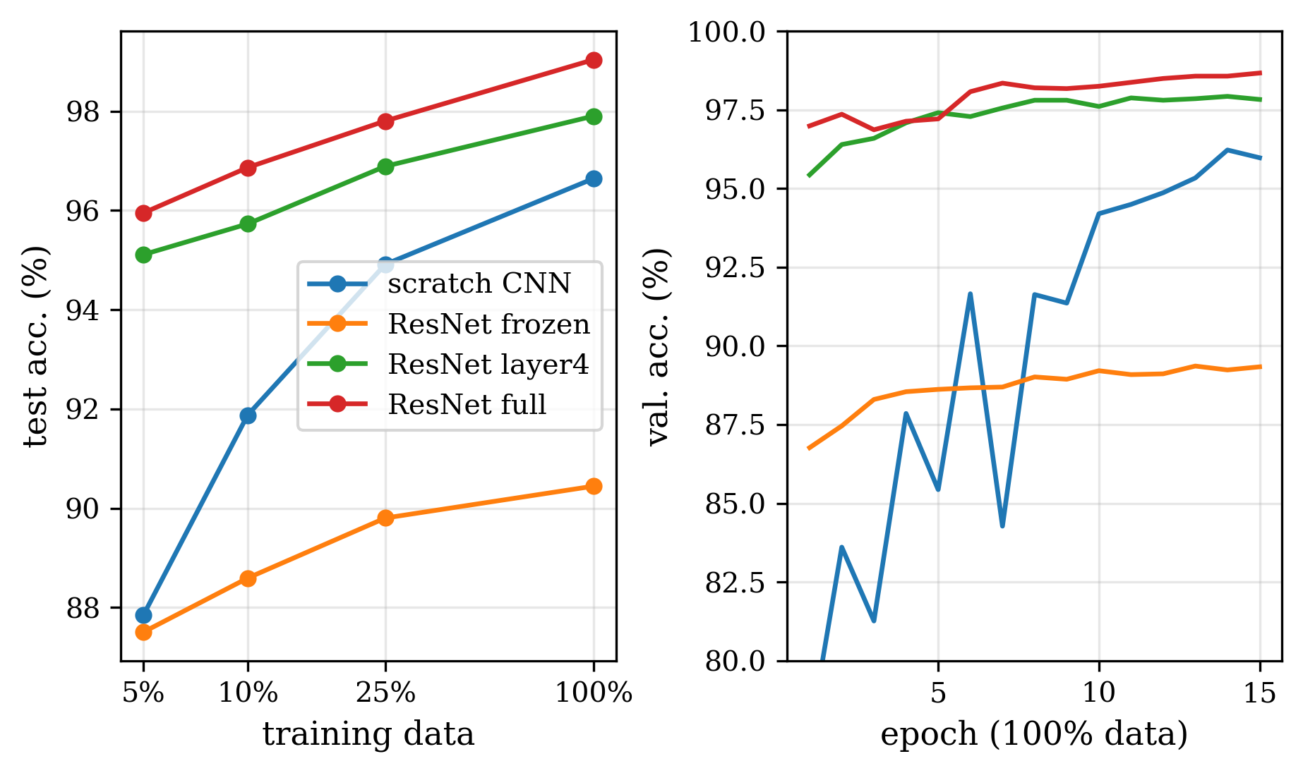
Results: hand-design and transfer learning
90.2% → 97.0%
hand-designed CNN after the step-by-step study
99.0%
ResNet-18 fully fine-tuned: the most accurate model
96.0%
ResNet-18 with only 5% of the data (947 images)
Test accuracy versus amount of training data

Slide 7
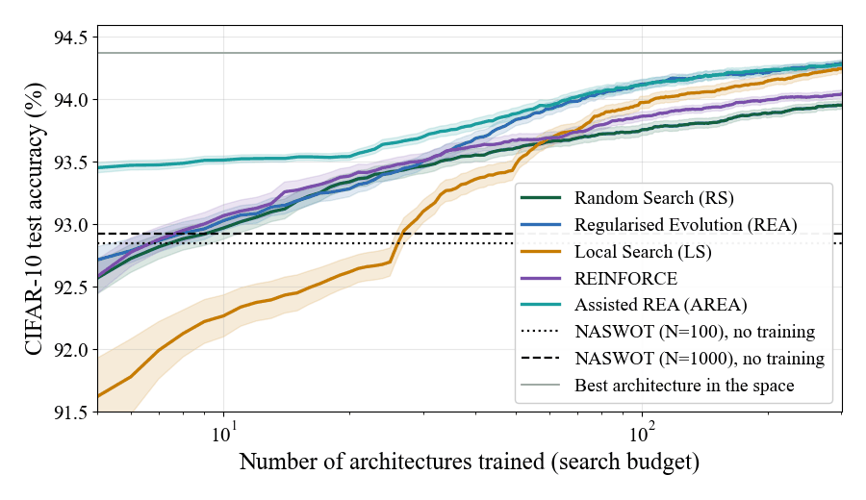
Results: NASWOT compared with five search strategies
Published NASWOT results reproduced within 0.1 point
NASWOT without training: 92.9%, as good as training 10 random networks
Evolution with 100 trained networks: 94.1%, better but far more expensive
NASWOT + evolution is best with small budgets: 93.5% vs 93.0% after 10 networks
200 runs per strategy on NAS-Bench-201 (CIFAR-10)

Slide 8
Results: automatic search on EuroSAT
Criterion | Hand-designed | NASWOT winner
Test accuracy | 96.72% | 97.43%
Parameters | 1.24 M | 1.99 M
Latency per image | 0.76 ms | 1.31 ms
GPU time for the design | 203 min | 17 min
+0.7 pt
more accurate than our own design
12× less
GPU time than manual design
Search space: 8,640 CNNs · 1,000 networks scored in 153 s · only the top 3 trained
The search rediscovered our manual conclusions (deep network, small kernels, batch normalisation) and added residual connections.

Slide 9
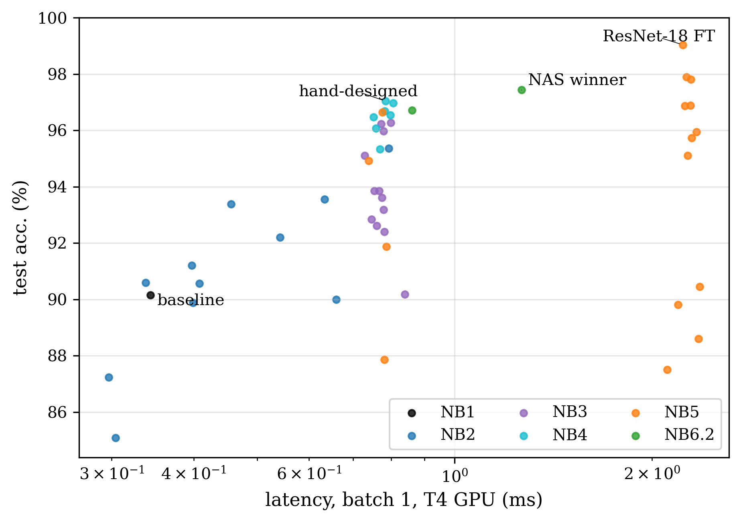
Results: no single model is best on every criterion
Model | Accuracy | Size
Baseline CNN | 90.15% | 2.19 M
Hand-designed | 97.04% | 1.24 M
NASWOT winner | 97.43% | 1.99 M
ResNet-18 | 99.04% | 11.18 M
ResNet-18 is the most accurate, but 9× larger
The CNNs from scratch are the fastest
All 50 models tested on the same 4,050 images

Slide 10
Conclusion
01
02
03
Transfer learning
Gives the highest accuracy (99.0%) and works even with very little data.
Training-free search
Found a better CNN than our manual design, with 12 times less GPU time.
A fast filter
NASWOT does not replace training: combined with evolution, it gives the best results.
Future work: several random seeds, the 13 spectral bands of EuroSAT, and a latency constraint in the search.

Slide 11
Thank you for your attention
Questions are welcome
Emilio Yared · Master 2 Artificial Intelligence and Data Engineering

