Slide 1
IoT Testavimas
Emilis Ruzveltas 3k. 5gr.

Slide 2
Kas yra IoT (Daiktų internetas)?
Daiktai ar objektai yra prijungiami prie interneto.
Renkama ir apdorojama įvairi informacija.
Žmogus gali valdyti įrenginius nuotoliniu būdu.

Slide 3
Kur tai pritaikoma?
Sensoriniai prietaisai matuoja mūsų sveikatą, stebi mūsų aktyvumą, rutiną ir pan.
Prie interneto prijungti namai sumažins komunalinius mokesčius, primins, kada palaistyti gėles, praneš, kai baigsis atsargos šaldytuve ir pan.
Išmanūs miestai padės vairuotojams lengviau rasti automobilių statymo vietas, realiu laiku fiksuos ir spręs neramumus skirtingose miesto dalyse ir t. t

Slide 4
7 IoT testavimo aspektai

Slide 5
1) Patogumas ir aiškumas:
We need to make sure the usability of each of the device used here.
The medical healthcare tracking device used should be portable enough to be moved into different segments of the medical.
The equipment should be smart enough to push not only the notifications but also the error messages, warnings etc.
The system should have an option to log all the events to provide clarity to the end users. If it is not capable of doing that, the system should push those as well to a database to store it.
The notifications should be shown and handling of the display should be done properly in the devices [computers/mobile devices].
Usability in terms of displaying data, processing data, pushing job tasks from the devices should be tested thoroughly.

Slide 6
2) IoT Saugumas:
IoT Security challenges: IoT is data centric where all the devices/system connected operate based on the data that is available.
When it comes to the data flow between devices, there is always a chance that the data can be accessed or read when getting transferred.
From a testing standpoint, we need to check if the data is protected/encrypted when getting transferred from one device to the other.
Wherever, there is an UI, we need to make sure there is a password protection on it.

Slide 7
3) Ryšiai tarp prietaisų:
As it is a healthcare solution, connectivity plays a vital role.
The system has to be available all the time and should have seamless connectivity with the stakeholders.
As per connectivity, two things are very important to test;
Connectivity, transfer of data, receiving job tasks from the devices should be seamless when the connection is UP and running.
The other condition is the connection down scenario. Doesn’t matter how robust is the system and the network, there are chances that the system will go offline. Being a tester, we should test the offline conditions as well. Once the system is not available on the network, there has to be an alert which can prompt the physicians so that they can start to monitor the health conditions manually not depending on the system till it is up. On the other hand, there has to be a mechanism in the system which can store all the data in it during the offline period. Once the system comes online, all that data should get propagated. Data loss should not be there in any condition.

Slide 8
4) Našumas:
When we are talking about a system for a healthcare domain, we need to make sure the system is scalable enough for the whole hospital.
When the testing is carried out, it is done for 2-10 patients at a time and the data is propagated to 10-20 devices.
When the whole hospital is connected and 180-200 patients are connected to the system, the data that is propagated is much bigger than the tested data.
As testers, we need to make sure the system performs the same even though the added data is propagated.
We should also test the monitoring utility to display the system usage, power usage, temperature etc.

Slide 9
5) Suderinamumas:
Looking at the complex architecture of an IoT system, compatibility testing is a must.
Testing items such as, multiple operating system versions, browser types and respective versions, generations of devices, communication modes [For e.g. Bluetooth 2.0, 3.0] is necessary for IoT compatibility testing.

Slide 10
6) Pilotinis testavimas:
As far as the IoT is concerned, Pilot testing is a must.
Only testing in Lab makes sure the product/system works fine. But, this may backfire badly when exposed to real-time conditions/steps/scenarios.
During pilot testing, the system is exposed to a limited number of users in the real field. They use the application and give feedbacks on the system.
These comments come in handy making the application robust enough for the production deployment.

Slide 11
7) Regresinis testavimas:
IoT is a combination of multiple protocols, devices, operating systems, firmware, hardware, networking layers etc.
When an upgrade is performed, be it for the system or for any of the involved items as stated above, thorough regression testing should be carried out/strategy should be adopted so as overcome upgrade related issues.

Slide 12
IoT testavimo iššūkiai
1) „Geležies – soft‘o“ junginys
IoT is an architecture, which is closely coupled among various hardware and software components. It is not only the software applications that makes the system but also the hardware ones, sensors, communication gateways etc. too play a vital role.
Only functionality testing does not help in completely certifying the system. There is always a dependency on each other in terms of the environment, data transfer etc. So, it becomes a tedious job as compared to testing a generic system [only software/hardware component].

Slide 13
2) Įrenginių tarpusavio bendravimas
As this is an architecture between different set(s) of hardware and software, it becomes mandatory that they talk to each other in real time/near real time. When they both integrate with each other, things such as security, backward compatibility, upgrade issues becomes a challenge for the testing team.

Slide 14
3) Vartotojo sąsaja
The IoT is spread across devices belonging to every platform [iOS, Android, Windows, linux]. Now, testing that out on devices can be done but testing it on all possible devices is almost impossible.
We cannot omit the possibility of the UI being accessed from a device which we don’t possess or simulate. That’s a challenge which is tough to overcome.

Slide 15
4) Interneto pasiekiamumas
Network connection plays a vital role as IoT is all about the data being communicated in faster speeds all the time. IoT architecture has to be tested in all kinds of network connectivity/speeds.
To test this, virtual network simulators are mostly used to vary the network load, connectivity, stability etc. But, real time data/network is always a new scenario and testing team doesn’t know where the bottleneck would develop in the long run.

Slide 16
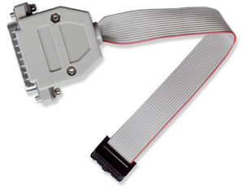

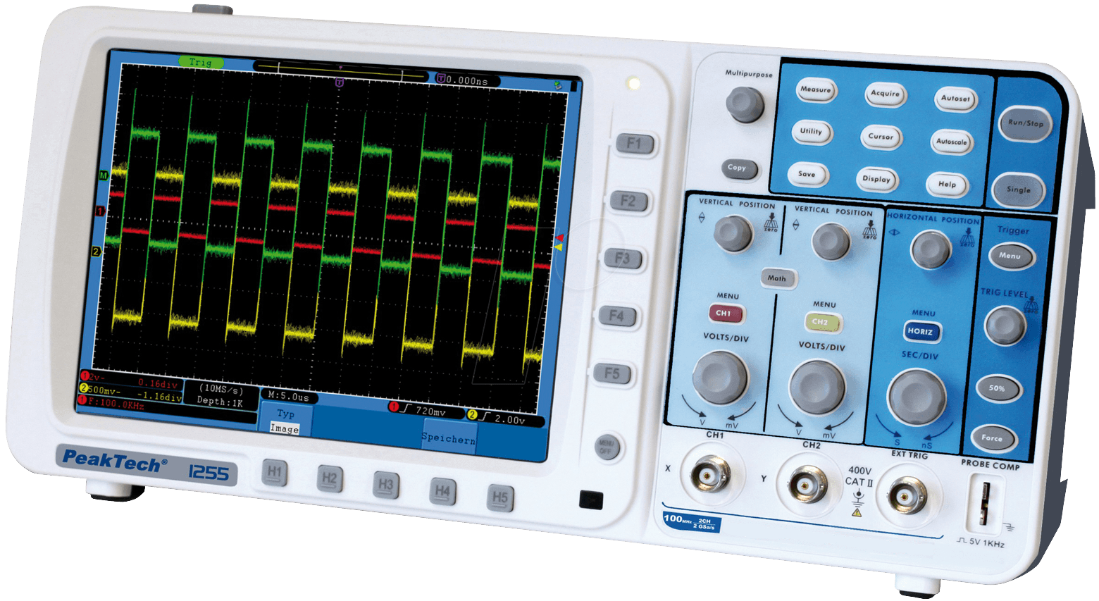

IoT Testavimo įrankiai

Slide 17
IoT Testavimo įrankiai
JTAG jungtis

Slide 18
IoT Testavimo įrankiai
JTAG jungtis
Osciloskopas

Slide 19
Apibendrinant...
IoT testing approach can be different based on the system/architecture involved. Testers should concentrate more on the Test-As-A-User [TAAS] approach rather than testing based on the requirements.
One more major player in IoT testing is the Integration testing. IoT is successful if the Integration test plan is accurate and robust enough to catch flaws in the system.
IOT testing may be a tough/challenging job but, it is also very exciting as well for the testing team to certify such a complicated mesh of devices, protocols, hardware, operation systems, firmware etc.

