Slide 1


{ Cascading Style Sheet }
PEMROGRAMAN WEB – UPVJT - 2018

Slide 2
CSS
CSS - Cascading Style Sheet adalah suatu teknik penulisan kode untuk memperindah dan mempermudah dalam pengkodean HTML dengan tujuan untuk memperindah tampilan situs
CSS memisahkan presentation sebuah dokumen dari content dokumen itu sendiri
CSS memudahkan pembuatan dan pemeliharaan dokumen web
Setiap User Agent mempunyai default style sheet Pendefinisian rule CSS pada sebuah dokumen akan menimpa rule pada default style sheet

Slide 3
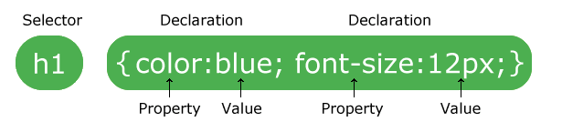
CSS Syntax
Style sheet didefinisikan dalam bentuk rule, terdiri dari:
Selector
Declaration : property & value

Slide 4
CSS Syntax
Contoh rule :
h1 { color: blue }
Keterangan:
Selector : h1
Property : color
Value : blue
Seluruh elemen (tag) HTML dapat digunakan sebagai selector

Slide 5
Gaya penulisan CSS
Inline Style Sheet (di dalam elemen HTML)
<p style="color: green">
Embedded Style Sheet (di dalam dokumen HTML)
<style type="text/css"> h1 {color: blue} </style>
Linked Style Sheet (di file eksternal)
<link rel="stylesheet" type="text/css" href="http://myblog.com/home.css">
<style type="text/css"> @import url(http://myblog.com/home.css); </style>
Isi file eksternal sama dengan kode di antara tag
<style> </style>
Default Style Sheet (style default dari browser)

Slide 6
Grouping & Inheritance
Grouping (pengelompokan) :
Selector :
h1, h2, h3 { font-family: arial }
Declaration :
h1 { font-weight: bold; font-size: 14pt }
Value : h1 { font: bold 12pt arial }
Inheritance (pewarisan) :
Bila style tidak didefinisikan, maka akan digunakan definisi style dari induknya

Slide 7
Grouping & Inheritance
<!DOCTYPE html>
<html>
<head>
<title>Inheritace</title>
</head>
<body>
<div style="color:red">
<h1>Warna Merah dari Inheritance parent</h1>
</div>
</body>
</html>

Slide 8
Type of Selector
Tag (elemen) HTML
div {backround-color: red}
Class
.gray {color: #333}
ID
#gray {color: #333}
Kontekstual
h1 i {color: navy}
div.mhs .alamat b {color: green}

Slide 9
Type of Selector
<style>
span.blue {
color: blue;
}
</style>
. . . .
<div class="blue">AUTHOR</h1>
<span class="blue">JACK SPARROW</span>

Slide 10
Type of Selector
<style type="text/css">
span { color: blue; }
div { color: blue; }
</style>
……………………………………………………………………
<style type="text/css">
span, div { color: blue; }
</style>

Slide 11
Pseudo Class
Pseudo class dapat digunakan sebagai selector meskipun class-nya tidak terdapat di kode HTML
Untuk menyatakan style yang digunakan jika suatu kondisi eksternal dikenakan pada elemen HTML (misalnya di-klik mouse)
Sintaks pseudo class :
selector:pseudo-class {property: value}
Anchor (<a>) pseudo class :
:link
:visited
:hover
:active
:focus
Contoh :
a:link { color: red }
a:visited { color: green }
a:hover { color: blue }
a:active { color: purple }
a:focus { color: yellow }
a.mhs:link { color: maroon }

Slide 12
Pseudo Element
Untuk menyatakan style yang digunakan terhadap suatu kondisi tipografi, bukan struktur (misalnya baris pertama)
Pseudo element :
:first-letter
:first-line
Contoh :
p:first-letter { font-size: 200%; float: left}
p:frist-line { color: green }
h1.mhs:first-letter { font-size: 20pt }

Slide 13
CSS Properties
Font
Color & Background
Text
List
Box Model
Visual Formatting Model (normal & float)
User Interface & Downloadable Font
Media Types
Visual Effects
Positioning Scheme

Slide 14
Font
font-family: <fontname>
p {font-family: Arial, Verdana, "Times New Roman"}
font-style: normal | italic
p {font-style: italic}
font-variant: normal | small-caps
p {font-variant: small-caps}
font-weight: normal | bold | bolder | lighter | 100–900
p {font-weight: bold}
p {font-weight: 400}
font-size: xx-small | x-small | small | medium | large | x-large | xx-large
font-size: larger | smaller
font-size: <length> | <percentage>
p {font-size: large} p {font-size: smaller}
p {font-size: 200px} p {font-size: 150%}
font: [<style>||<variant>||<weight>]? <size>[/<line-height>]? <family>
font: caption | icon | menu | message-box | small-caption | status-bar
p {font: italic 12pt "Helvetica Nue", serif}
p {font: bold italic large Palatino, serif}

Slide 15
Color & Background
color: <color>
p {color: red}
p {color: #448F2C}
p {color: rgb(255,0,0)}
p {color: rgb(100%,50%,25%)}
p {color: #f25}
background-color: <color> | transparent
body {background-color: transparent}
background-image: <url> | none
body {background-image: none}
body {background-image: url(http://www.site.com/logo.gif)}
background-repeat: repeat | repeat-x | repeat-y | no-repeat
body {background-repeat: no-repeat}
background-attachment: scroll | fixed
body {background-attachment: fixed}
background-position: [<percentage>|<length>]{1,2}
background-position: [ top | center | bottom] || [ left | center | right]
body {background-position: 50%}
body {background-position: 200px 50%}
body {background-position: center}
body {background-position: right bottom}
background: [ <color> || <image> || <repeat> || <attachment> || <position> ]
body {background: url("chess.png") gray 50% repeat fixed }

Slide 16
Text
text-indent: <length> | <percentage>
p {text-indent: 5em}
text-align: left | right | center | justify
p {text-align: justify}
text-decoration: none | [ underline || overline || line-through || blink ]
p {text-decoration: underline overline}
text-shadow: none | [ <color> || <length> <length> <length>? ]
h1 {text-shadow: 3px 3px 5px red}
text-transform: capitalize | uppercase | lowercase | none
h1 {text-transform: capitalize}
letter-spacing: none | <length>
p {letter-spacing: 3px}
p {letter-spacing: -1px}
word-spacing: none | <length>
p {word-spacing: 2em}
line-height: normal | <number> | <length> | <percentage>
p {line-height: 1.5}
white-space: normal | pre | nowrap
p {white-space: pre}

Slide 17

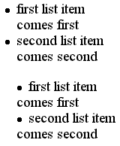
LIST
list-style-type: disc | circle | square | decimal | decimal-leading-zero | lower-roman | upper-roman | lower-alpha | lower-latin | upper-alpha | upper-latin | none
ul {list-style-type: circle}
list-style-image: <url> | none
ul {list-style-image: url(smiley.gif)}
list-style-position: inside | outside
ul {list-style-position: inside}
list-style: <style> || <position> || <image>
ol {list-style: lower-alpha outside url(smiley.gif)}
outside
inside

Slide 18
DIV – Box Model
margin-[top|right|bottom|left]: <length> | <percentage> | auto
div {margin-top: 10px}
div {margin-right: 20%}
div {margin-bottom: -5px}
div {margin-left: 20pt}
margin: [ <length> | <percentage> | auto ]{1,4}
div {margin: 3em}
div {margin: 1em 2em}
div {margin: 5em 2em 3em}
div {margin: 8em 4em 15em 10em}
padding-[top|right|bottom|left]: <length> | <percentage> | auto
div {padding-top: 10px}
div {padding-right: 20%}
div {padding-bottom: -5px}
div {padding-left: 20pt}
padding: [ <length> | <percentage> | auto ]{1,4}
div {padding: 8em 4em 15em 10em}
border-[top|right|bottom|left]-width: thin | medium | thick | <length>
div {border-top-width: thin}
div {border-right-width: 6px}
div {border-bottom-width: 2em}
div {border-left-width: 10}
border-width: <width>{1,4}
div {border-width: thin medium 10 20}

Slide 19
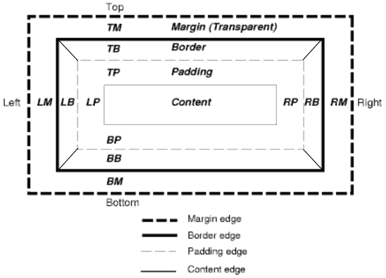
Box Model

Slide 20
border-[top|right|bottom|left]-color: <color>
div {border-top-color: green} div {border-right-color: #ff66cc}
div {border-bottom-color: rgb(0,128,0)} div {border-left-color: #ee3}
border-color: <color>{1,4} | transparent
div {border-color: green #ff66cc rgb(128,128,128) #ee3}
border-[top|right|bottom|left]-style: hidden | double | solid | dashed | dotted | ridge | outset | groove | inset | none
div {border-top-style: double} div {border-right-style: solid}
div {border-bottom-style: outset div {border-left-style: dashed}
border-style: <style>{1,4}
div {border-style: solid dashed solid dotted}
border-[top|right|bottom|left]: <width> || <style> || <color>
div {border-top: solid red}
div {border-right: thick double}
div {border-bottom: red dashed blue}
div {border-left: outset 10}
border: <width> || <style> || <color>
div {border: red solid 1}
width: <length> | <percentage> | auto
img {width: 40%}
height: <length> | <percentage> | auto
img {height: 100px}

Slide 21
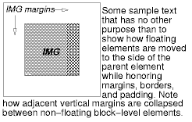
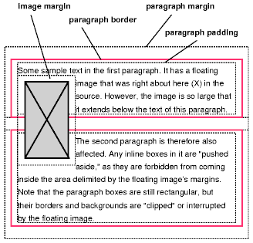
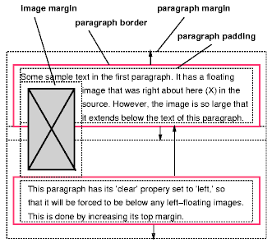
Box Model
display: inline | block | list-item | none
p {display: block}
b {display: inline}
li {display: list-item}
img {display: none}
float: left | right | none
img {float: left}
clear: left | right | both | none
img {float: left}
<img style='float: left'>
<img style='float: left'>
<img style='float: left'>
<p style='clear: left'>

Slide 22
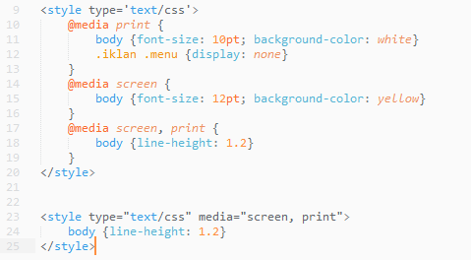
Media Types
Recognized medias :
all, aural, braille, embossed, handheld, print, projection, screen, tty, tv

Slide 23
More
Allitebooks.com
W3school.com
Css-trics.com

Slide 24
TUGAS
Buat sebuah tampilan halaman web yang berisi informasi CV anda.
Gunakan 960 grid system.
Yang dikumpulkan:
Desain halaman web
File tampilan (html dan css)
Ketentuan:
Tugas Individu
No bootstrap

Slide 25
Pengumpulan
Minggu depan:
Desain halaman CV
Minggu selanjutnya:
Halaman web

