Slide 1
Microsoft's new movie studio
EMILLY MURUGI NJUE
10 MARCH 2023

Slide 2
Background
Microsoft sees all the big companies creating original video content and they want to get in on the fun. They have decided to create a new movie studio, but they don’t know anything about creating movies.
With the im.db database and the bom movie gross we can explore what types of films are currently doing the best at the box office and the income being made.

Slide 3
Objectives
Explore what type of films are doing the best in the box office currently
Come up with actionable insights .

Slide 4
Data exploration
In the im.db database:
the timeframe of the data is from 2010 to 2019
Total data points: 590848
In the bom_movie_gross.csv file:
the timeframe of the data is from 2010 to 2018
Total data points: 16935

Slide 5
IM.DB Data
I took the first 20 datasets in the im.db data frame and worked with them.
The most loved genre of movies by the viewers was the Action, Adventure, Sci-fi genre.
A total of 1,841,066 viewers loved movies in this genre and it was with a rating of 8.8
Drama, Music genre was the least liked by the viewers with a total of 680,116

Slide 6
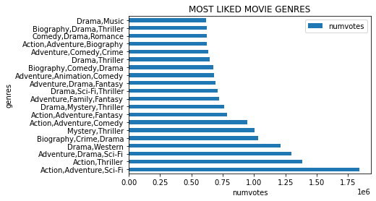
JOB TYPE ANALYSIS

Slide 7
Bom_Movie_Gross.csv
In this file, we see the amount of money the box office made both within its country and in international countries(domestic gross and foreign gross)

Slide 8
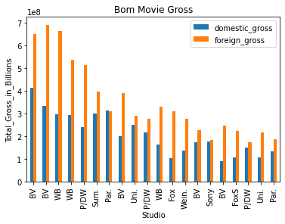
I compare the amount made in the country and the amount made by foreign countries. Each studio that produced a movie earned a higher income in foreign countries compared to the domestic one.

Slide 9
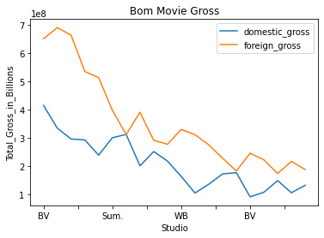

Slide 10
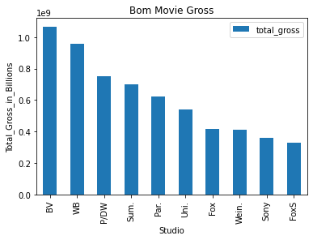
In addition, I compute the domestic and foreign gross to have the total made in different studios by the box office.

Slide 11
The total amount earned by the box office in the bom.movie_gross is 246,480,115,968 (246 Billion).

Slide 12
Conclusion
In conclusion, Microsoft should go ahead and start the new movie studio.
It is an investment that will bear fruits and earn the company income.

Slide 13
Recommendation
After the analysis of what type of films are doing well in the box office, this is what I recommend:
Microsoft’s new movie studio should strive to create action, adventure, sci-fi movies
It's a genre that can have a wide reach across many different audiences and captivate with its mix of engaging characters, thrilling set-pieces and general sense of escapism.
These movies should not only be released to the domestic country but also worldwide.
This is because the gross earned by foreign countries is more compared to when the movie is only released domestically.

Slide 14
THANK YOU

