Slide 1
Week1
Sampling and Markov Chains

Slide 2
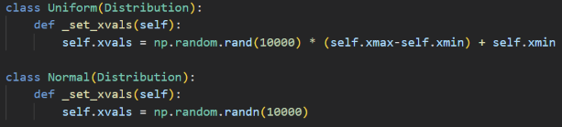
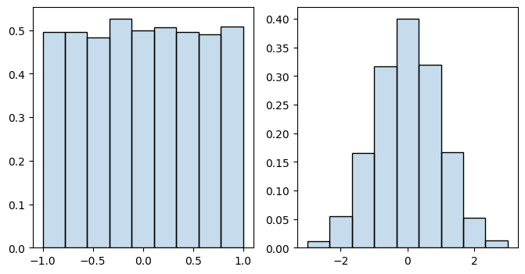

Sampling from known distribution
Normal distribution:
$$p\left(x\right)=\frac{1}{\sqrt{2πσ}}exp⁡\left[−\frac{{\left(x−x_{center}\right)}^{2}}{2σ^{2}}\right]$$

Slide 3
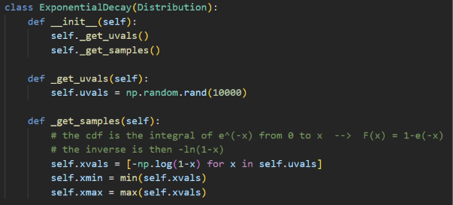
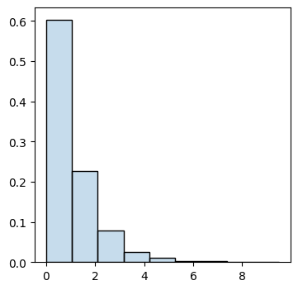
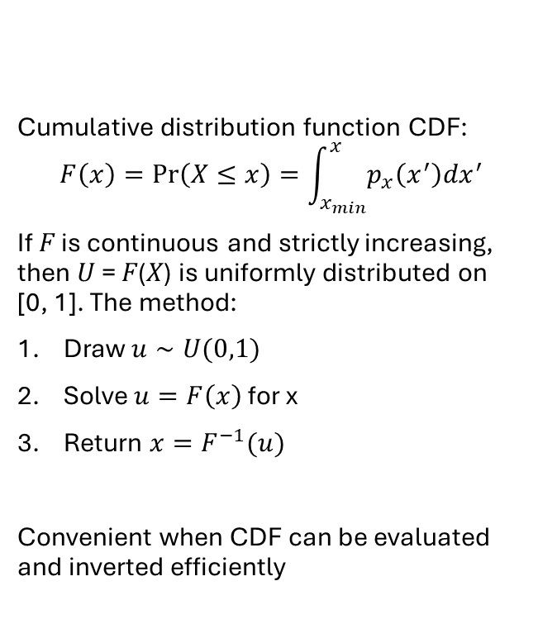
Inverse transform method
Cumulative distribution function CDF:
$$F\left(x\right)=\operatorname{Pr}\left(X≤x\right)=\int_{x_{min}}^{x}{p_{x}\left(x^{′}\right)dx^{′}}$$
If 𝐹 is continuous and strictly increasing, then 𝑈 = 𝐹(𝑋) is uniformly distributed on
[0, 1]. The method:
Draw $u∼U(0,1)$
Solve $u=F\left(x\right)$ for x
Return $x=F^{−1}(u)$
Convenient when CDF can be evaluated and inverted efficiently

Slide 4
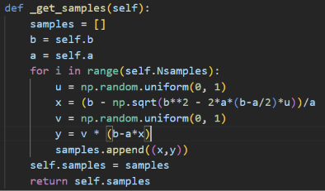
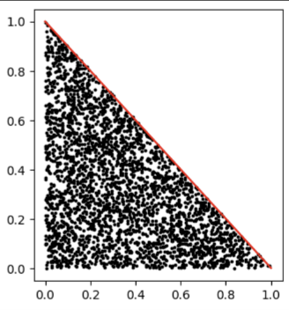
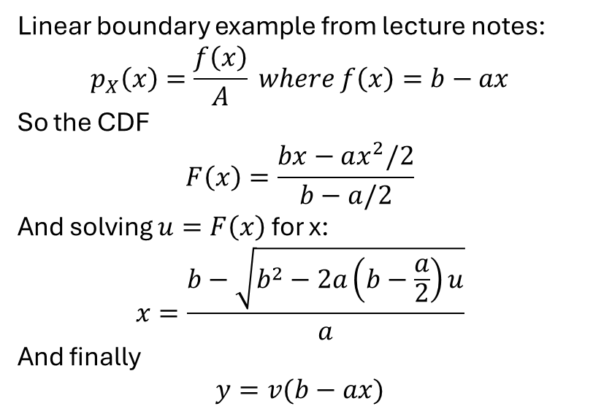
Inverse transform method
Linear boundary example from lecture notes:
$$p_{X}\left(x\right)=\frac{f\left(x\right)}{A} where f\left(x\right)=b−ax$$
So the CDF
$$F\left(x\right)=\frac{bx−ax^{2}/2}{b−a/2}$$
And solving $u=F\left(x\right)$ for x:
$$x=\frac{b−\sqrt{b^{2}−2a\left(b−\frac{a}{2}\right)u}}{a}$$
And finally
$$y=v(b−ax)$$
Cumulative distribution function CDF:
$$F\left(x\right)=\operatorname{Pr}\left(X≤x\right)=\int_{x_{min}}^{x}{p_{x}\left(x^{′}\right)dx^{′}}$$
If 𝐹 is continuous and strictly increasing, then 𝑈 = 𝐹(𝑋) is uniformly distributed on
[0, 1]. The method:
Draw $u∼U(0,1)$
Solve $u=F\left(x\right)$ for x
Return $x=F^{−1}(u)$
Convenient when CDF can be evaluated and inverted efficiently

Slide 5
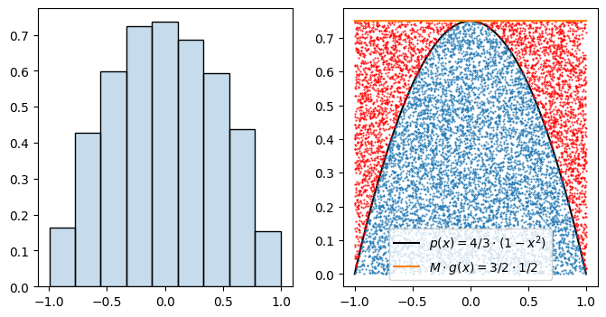
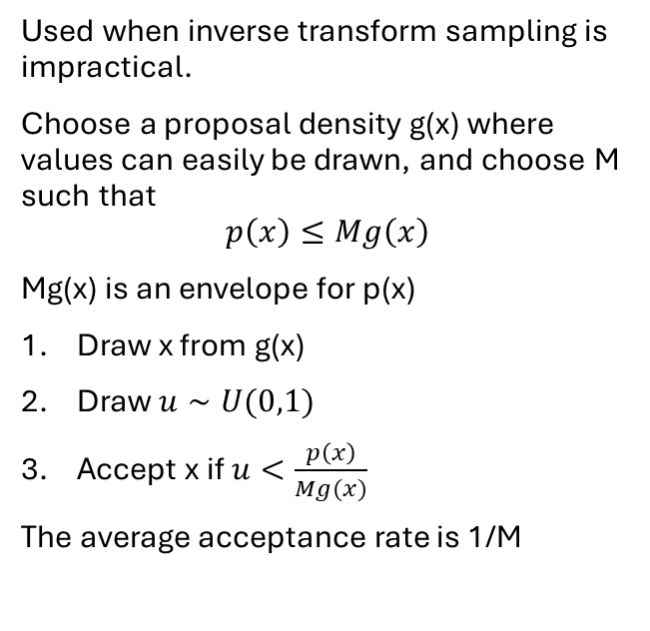
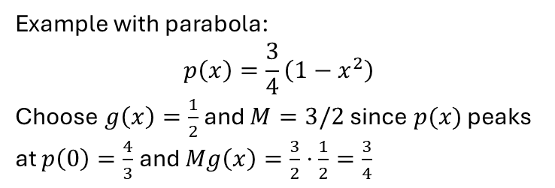
Rejection sampling
Example with parabola:
$$p\left(x\right)=\frac{3}{4}\left(1−x^{2}\right)$$
Choose $g\left(x\right)=\frac{1}{2}$ and $M=3/2$ since $p(x)$ peaks at $p\left(0\right)=\frac{4}{3}$ and $Mg\left(x\right)=\frac{3}{2}⋅\frac{1}{2}=\frac{3}{4}$
Used when inverse transform sampling is impractical.
Choose a proposal density g(x) where values can easily be drawn, and choose M such that
$$p\left(x\right)≤Mg\left(x\right)$$
Mg(x) is an envelope for p(x)
Draw x from g(x)
Draw $u∼U(0,1)$
Accept x if $u<\frac{p\left(x\right)}{Mg(x)}$
The average acceptance rate is 1/M

Slide 6
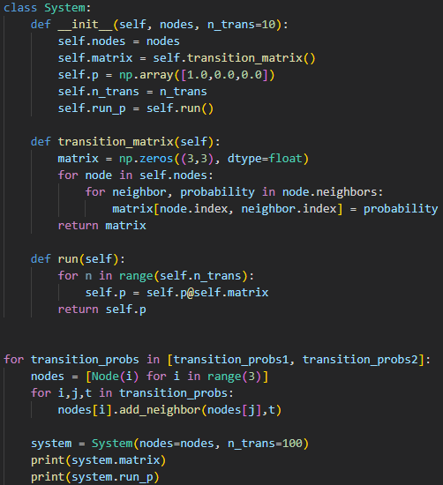
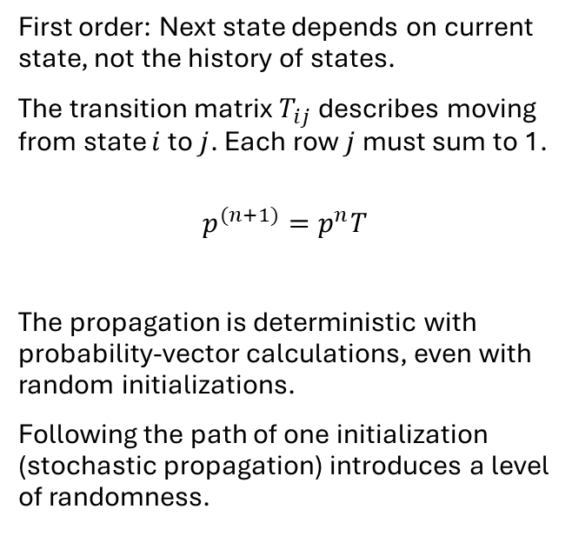
Markov Chains
First order: Next state depends on current state, not the history of states.
The transition matrix $T_{ij}$ describes moving from state $i$ to $j$. Each row $j$ must sum to 1.
$$p^{(n+1)}=p^{n}T$$
The propagation is deterministic with probability-vector calculations, even with random initializations.
Following the path of one initialization (stochastic propagation) introduces a level of randomness.

Slide 7
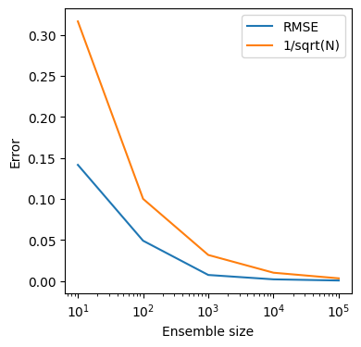
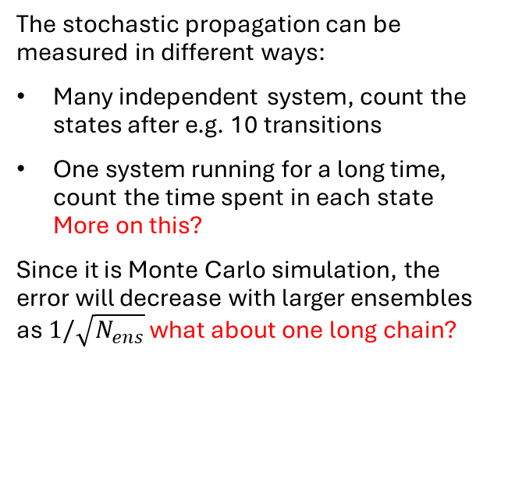
Markov Chains
The stochastic propagation can be measured in different ways:
Many independent system, count the states after e.g. 10 transitions
One system running for a long time, count the time spent in each state
More on this?
Since it is Monte Carlo simulation, the error will decrease with larger ensembles as $1/\sqrt{N_{ens}}$ what about one long chain?

