Slide 1
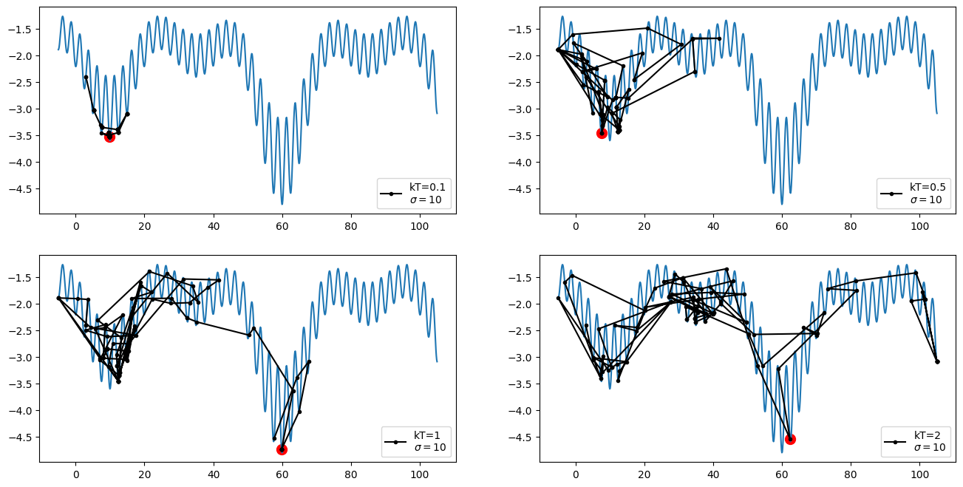
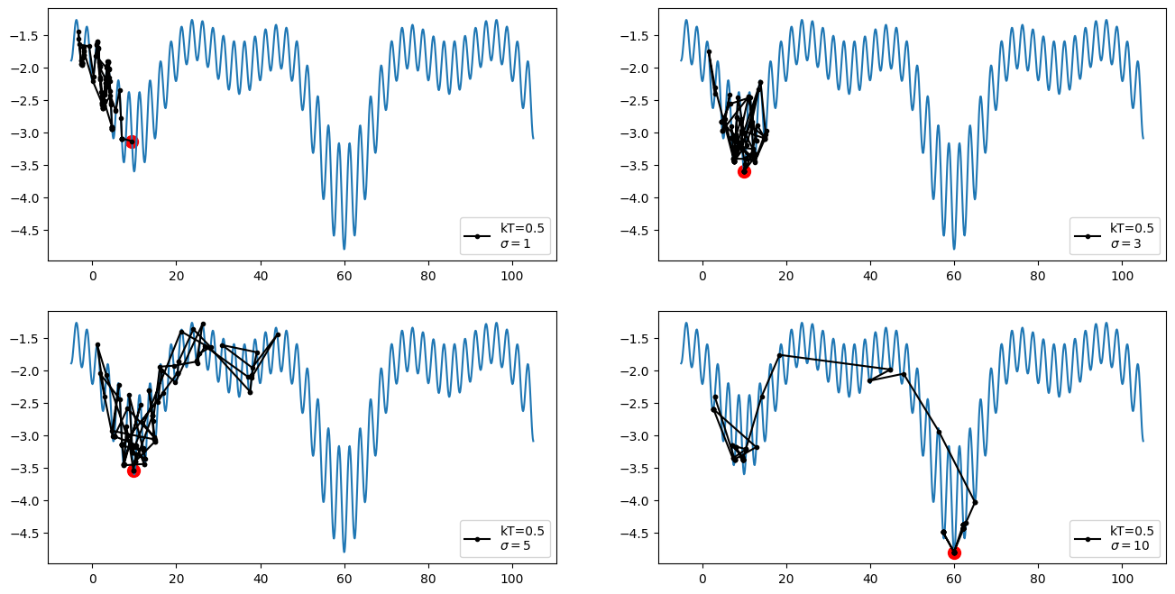
Random Structure Search
Top 4:
Here we see how much can be explored in 100 steps with σ=10, changing only the temperature.
With higher T, more steps with an increase in energy are accepted in the acceptance criterion, because we divide by a larger number.
Example:
exp(-1/0.1) = 0.000045
exp(-1/2) = 0.60
Bottom 4:
Here we see how much can be explored in 100 steps with kT=0.5, changing only the width of the normal distribution for x’.
For the smaller sigma, the steps on the x-axis are small.
With larger sigma, the steps on the x-axis are bigger.
Conclusion:
One could assume that a smaller temperature kT<0.5 with a wider distribution σ>10 yields a faster convergence rate.
FYI: All start out at x=3. The red dot records the state with the lowest energy that was visited.

