Slide 1
Week3
Optimization

Slide 2
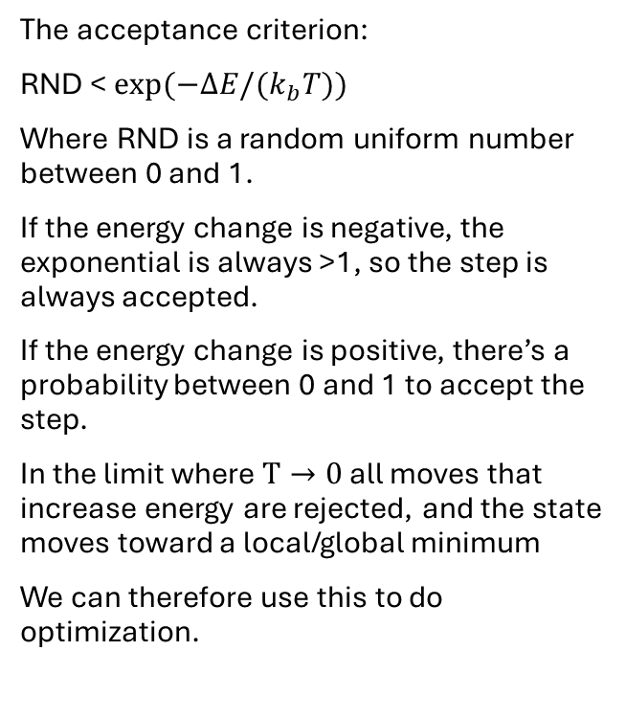


Metropolis Monte Carlo search
The acceptance criterion:
RND < $\exp{(−ΔE/(k_{b}T)})$
Where RND is a random uniform number between 0 and 1.
If the energy change is negative, the exponential is always >1, so the step is always accepted.
If the energy change is positive, there’s a probability between 0 and 1 to accept the step.
In the limit where $T→0$ all moves that increase energy are rejected, and the state moves toward a local/global minimum
We can therefore use this to do optimization.
When searching for a local minimum, the basin of attraction is the collection of all initializations that end at that local minimum.

Slide 3
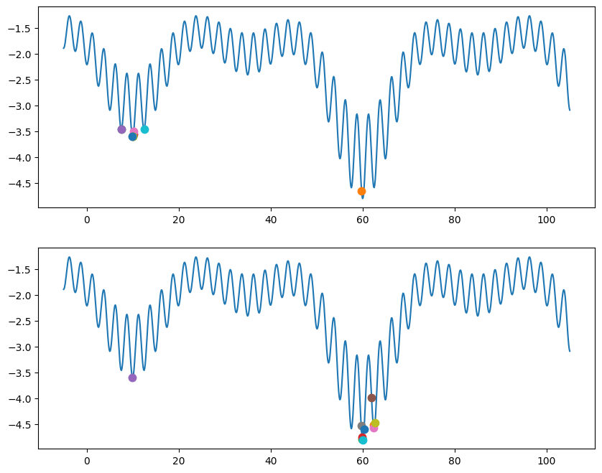
Random Structure Search
Running random structure search on the graphs below, choosing x’ = x + NormalDist(0, σ=10). They both ran for 100 steps.
Very simple method
Generate the system in a random configuration.
If 1d choosing a random x.
If d-dimensional, choosing a random vector r.
Perform a local optimization, such as Metropolis Monte Carlo search
Record the optimized configuration, if it has the lowest energy thus far.
Repeat 1-3 as much a computationally affordable.
Report the lowest energy found
kT = 0.2
kT = 2

Slide 4
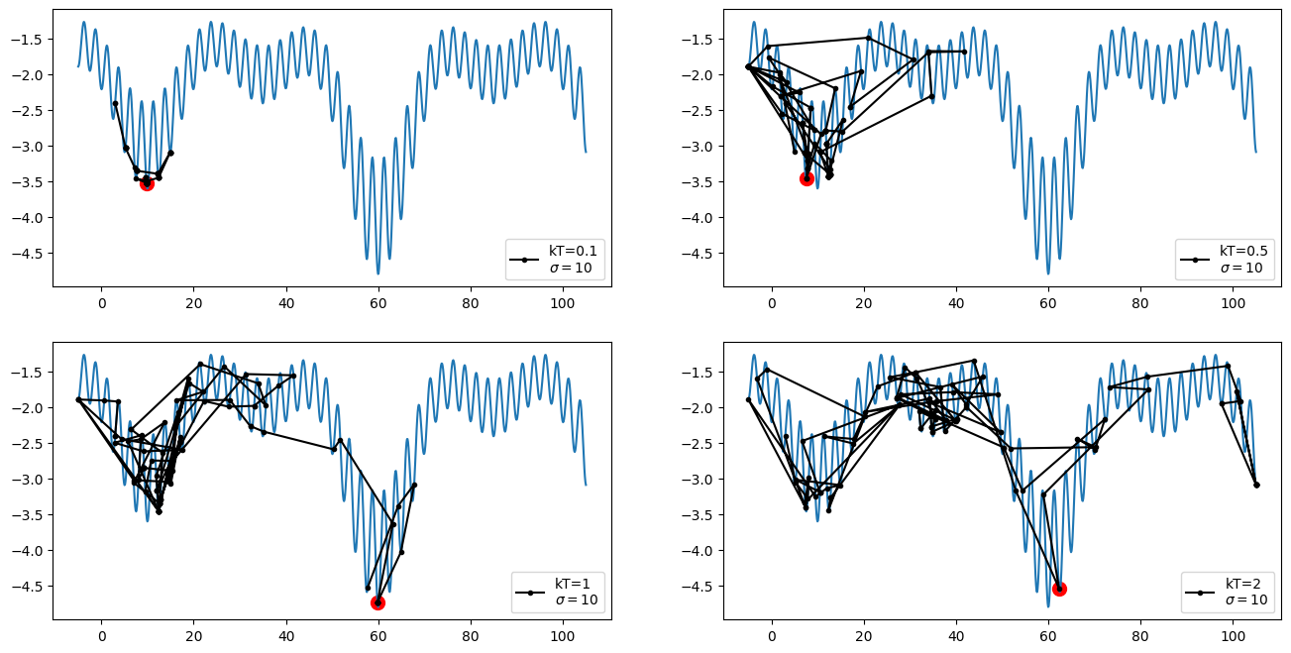
Random Structure Search
Here we see how much can be explored in 100 steps with σ=10, changing only the temperature.
With higher T, more steps with increasing energy are accepted in the acceptance criterion, because we divide by a larger number.
Ex:
exp(-1/0.1) = 0.000045
exp(-1/2) = 0.60
kT = 0.2

Slide 5
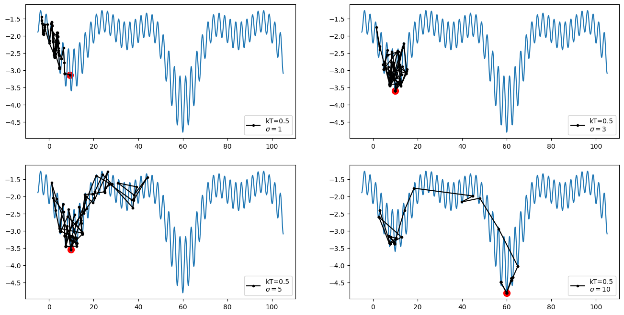
Random Structure Search
Here we see how much can be explored in 100 steps with kT=0.5, changing only the width of the normal distribution for x’.
For the smaller sigma, the steps on the x-axis are small.
With larger sigma, the steps on the x-axis are bigger.
kT = 0.2

Slide 6
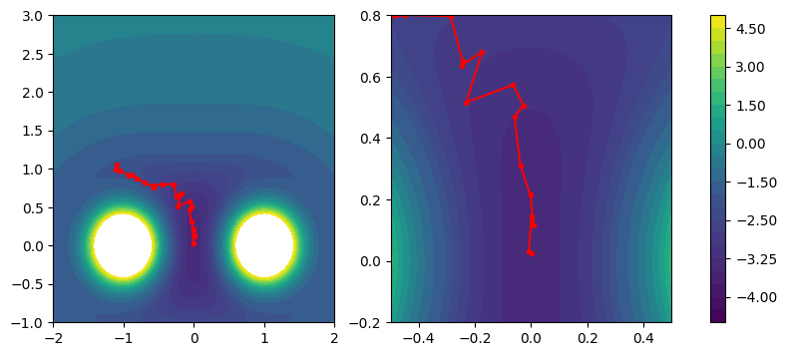

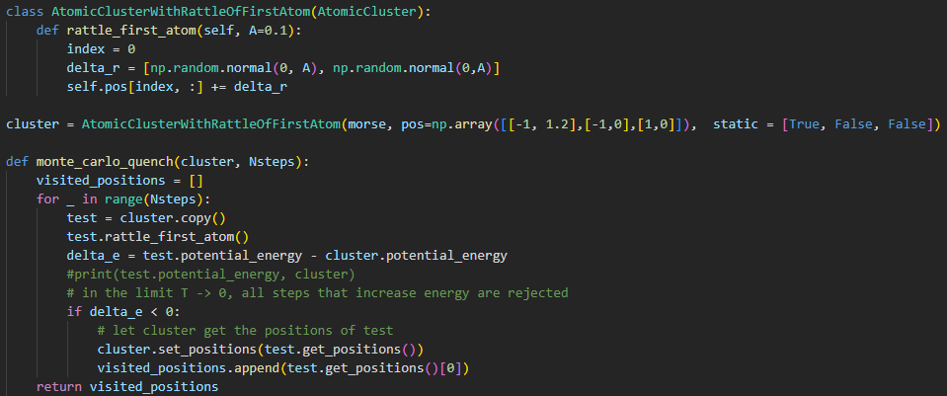
The Morse Potential
An exercise using the Morse Potential as a possible energy landscape to optimize.
In a system of three atoms: Fixing two atoms and letting the last move leads to a minimization of the atoms’ placement via the Morse Potential.
‘Rattling’ the free atom and using Metropolis Monte Carlo at zero temperature to optimize the system, we generate a path as seen in the figure.

Slide 7
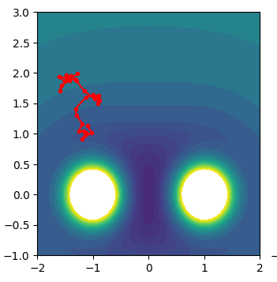
The Morse Potential
Moving
test = cluster.copy()
outside the for loop
The first test (copy) would be some crazy move, and then the Monte Carlo probably won't accept it, and the position of the free atom doesn't change. In the next iteration, test.rattle_first_atom() rattles the crazy position, and NOT where the free atom actually is (still at initial point). Then we take another crazy step, perhaps also in the wrong direction, we don't accept it, and now test is very far away from the minimum.
At some point, the step might be accepted, but the overall rattles would cause the path to almost randomly walk around the potential surface.

Slide 8
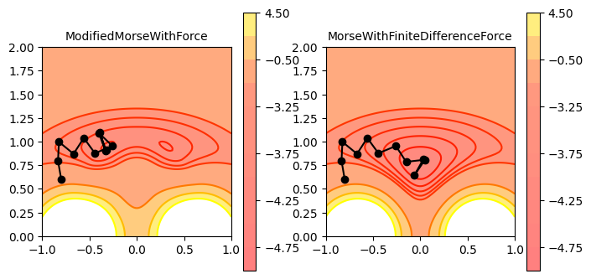
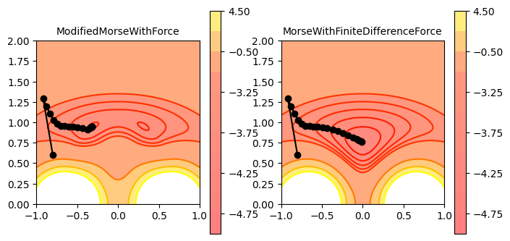
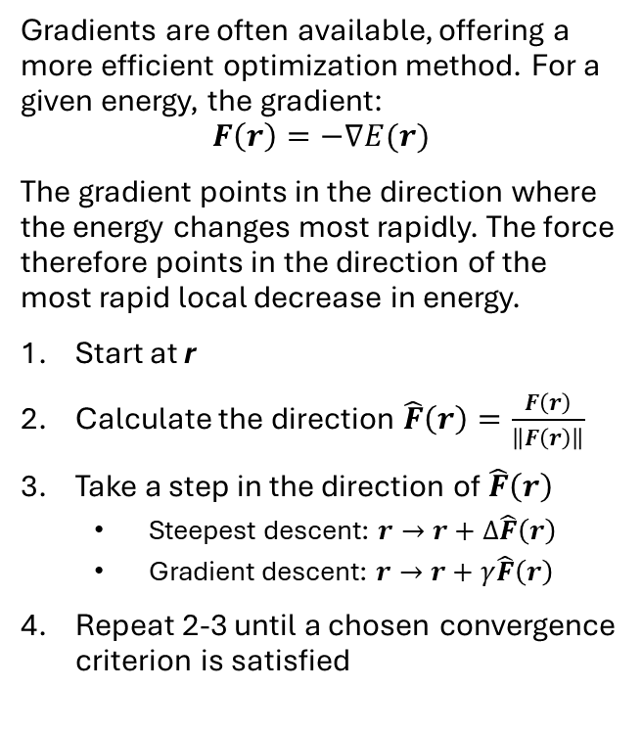
Steepest descent and gradient descent
Fixed step, bouncing around minimum
Gradients are often available, offering a more efficient optimization method. For a given energy, the gradient:
$$F\left(r\right)=−∇E(r)$$
The gradient points in the direction where the energy changes most rapidly. The force therefore points in the direction of the most rapid local decrease in energy.
Start at r
Calculate the direction $\hat{F}\left(r\right)=\frac{F\left(r\right)}{\left\|F\left(r\right)\right\|}$
Take a step in the direction of $\hat{F}\left(r\right)$
  Steepest descent: $r→r+Δ\hat{F}\left(r\right)$
  Gradient descent: $r→r+γ\hat{F}\left(r\right)$
Repeat 2-3 until a chosen convergence criterion is satisfied
Fixed step but gradient gets smaller

Slide 9
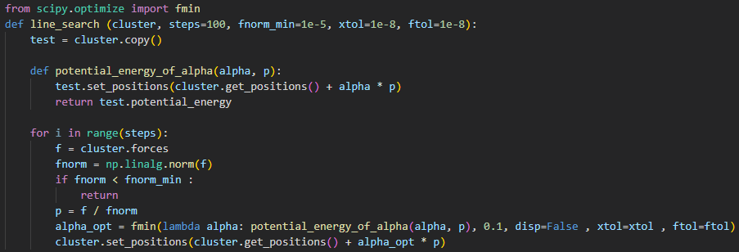
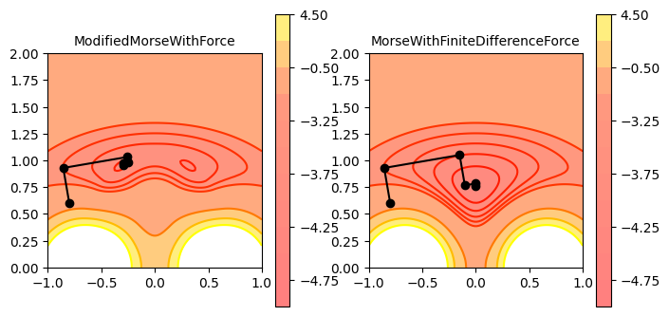
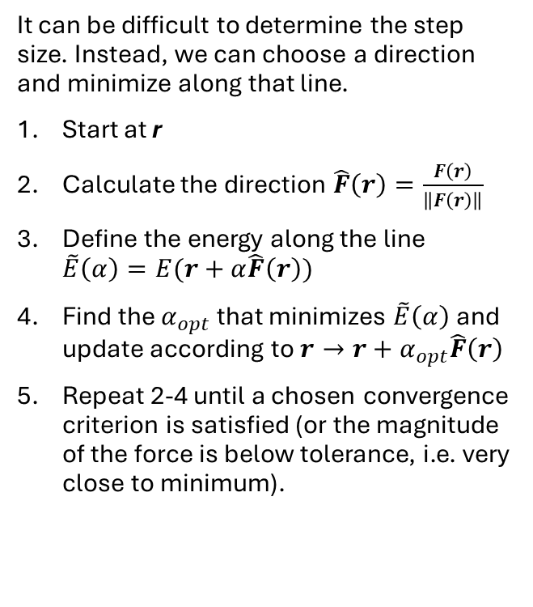
Line search
It can be difficult to determine the step size. Instead, we can choose a direction and minimize along that line.
Start at r
Calculate the direction $\hat{F}\left(r\right)=\frac{F\left(r\right)}{\left\|F\left(r\right)\right\|}$
Define the energy along the line $\tilde{E}\left(α\right)=E(r+α\hat{F}\left(r\right))$
Find the $α_{opt}$ that minimizes $\tilde{E}\left(α\right)$ and update according to $r→r+α_{opt}\hat{F}\left(r\right)$
Repeat 2-4 until a chosen convergence criterion is satisfied (or the magnitude of the force is below tolerance, i.e. very close to minimum).

Slide 10
Second-order Methods
Newton step
Much faster (as in fewer steps needed) than step-size methods

Slide 11
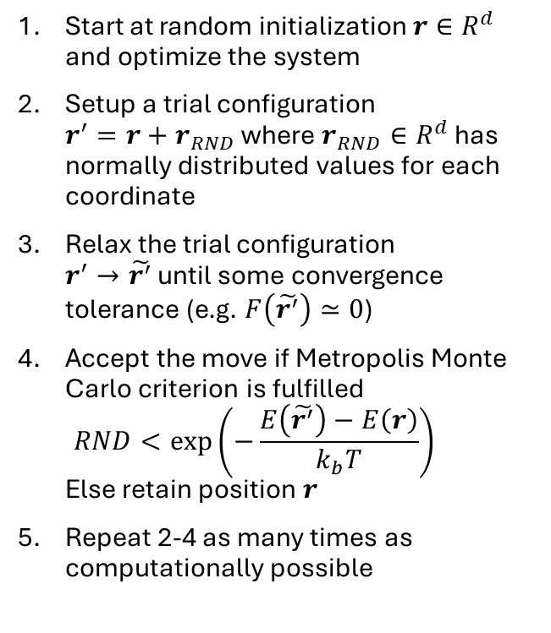
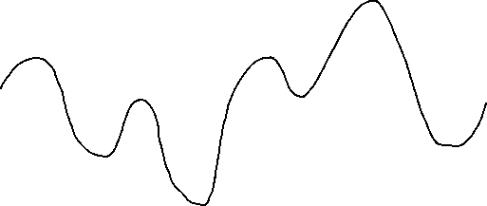
Basin Hopping
Start at random initialization $r∈R^{d}$ and optimize the system
Setup a trial configuration
$r^{′}=r+r_{RND}$ where $r_{RND}∈R^{d}$ has normally distributed values for each coordinate
Relax the trial configuration
$r^{′}→\tilde{r^{′}}$ until some convergence tolerance (e.g. $F\left(\tilde{r^{′}}\right)≃0$)
Accept the move if Metropolis Monte Carlo criterion is fulfilled
$RND<\exp\left(−\frac{E\left(\tilde{r^{′}}\right)−E\left(r\right)}{k_{b}T}\right)$
Else retain position $r$
Repeat 2-4 as many times as computationally possible
Because we relax the trial configuration before applying acceptance criterion, the Metropolis Monte Carlo no longer jumps in between the extremes (blue) but simplifies the basins to distinct energy levels (red)

Slide 12
Basin Hopping
Coding example?

