Slide 1
Week4
Molecular Dynamics

Slide 2
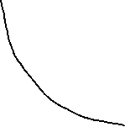
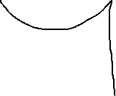



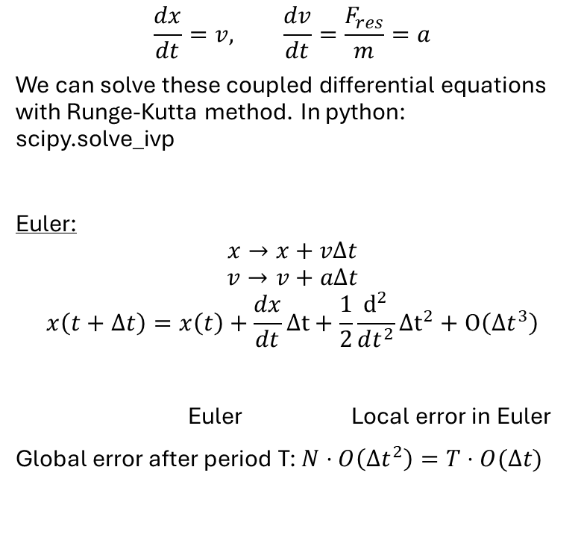
Integration
$$\frac{dx}{dt}=v, \frac{dv}{dt}=\frac{F_{res}}{m}=a$$
We can solve these coupled differential equations with Runge-Kutta method. In python: scipy.solve_ivp
Euler:
$$x→x+vΔt$$
$$v→v+aΔt$$
$$x\left(t+Δt\right)=x\left(t\right)+\frac{dx}{dt}Δt+\frac{1}{2}\frac{d^{2}}{dt^{2}}Δt^{2}+O\left(Δt^{3}\right)$$
Euler Local error in Euler
Global error after period T: $N⋅O\left(Δt^{2}\right)=T⋅O(Δt)$

Slide 3

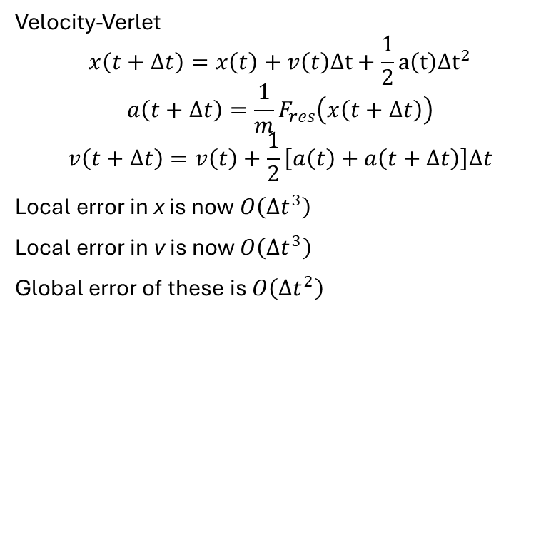
Integration
Velocity-Verlet
$$x\left(t+Δt\right)=x\left(t\right)+v\left(t\right)Δt+\frac{1}{2}a\left(t\right)Δt^{2}$$
$$a\left(t+Δt\right)=\frac{1}{m}F_{res}\left(x\left(t+Δt\right)\right)$$
$$v\left(t+Δt\right)=v\left(t\right)+\frac{1}{2}\left[a\left(t\right)+a\left(t+Δt\right)\right]Δt$$
Local error in x is now $O\left(Δt^{3}\right)$
Local error in v is now $O\left(Δt^{3}\right)$
Global error of these is $O\left(Δt^{2}\right)$
Recap:
Euler: Local truncation error $O(Δt^{2})$ and global error $O\left(Δt\right)$; first order accurate.
Velocity-Verlet: Local truncation error $O(Δt^{3})$ and global error $O\left(Δt^{2}\right)$; second-order accurate.
For sufficiently small steps $\left(Δt\right)$, Velocity-Verlet is substantially more accurate, and better suited for long MD trajectories.

Slide 4
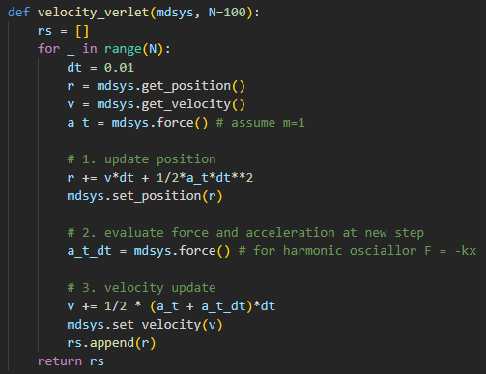
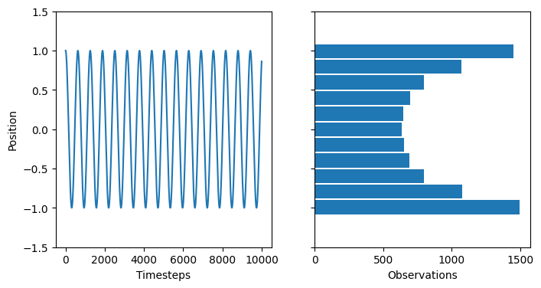
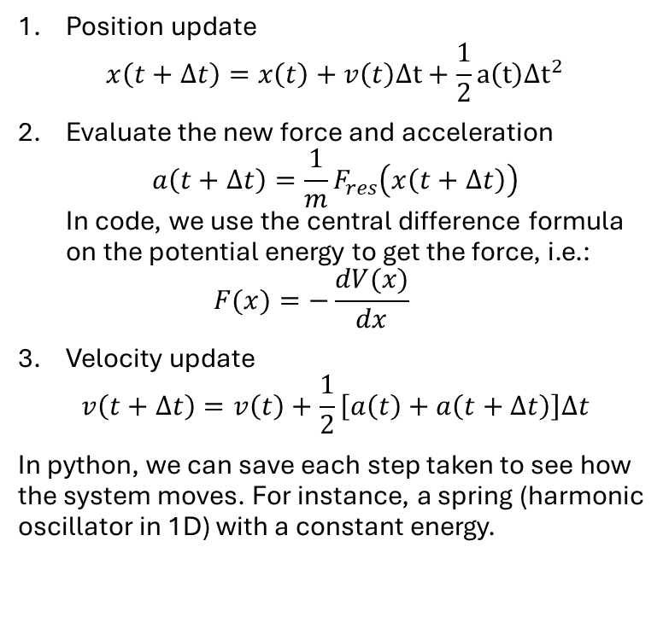
Velocity-Verlet
Position update
$x\left(t+Δt\right)=x\left(t\right)+v\left(t\right)Δt+\frac{1}{2}a\left(t\right)Δt^{2}$
Evaluate the new force and acceleration
$a\left(t+Δt\right)=\frac{1}{m}F_{res}\left(x\left(t+Δt\right)\right)$
In code, we use the central difference formula on the potential energy to get the force, i.e.:
$F(x)=−\frac{dV(x)}{dx}$
Velocity update
$v\left(t+Δt\right)=v\left(t\right)+\frac{1}{2}\left[a\left(t\right)+a\left(t+Δt\right)\right]Δt$
In python, we can save each step taken to see how the system moves. For instance, a spring (harmonic oscillator in 1D) with a constant energy.

Slide 5

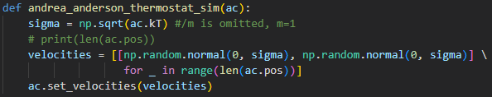

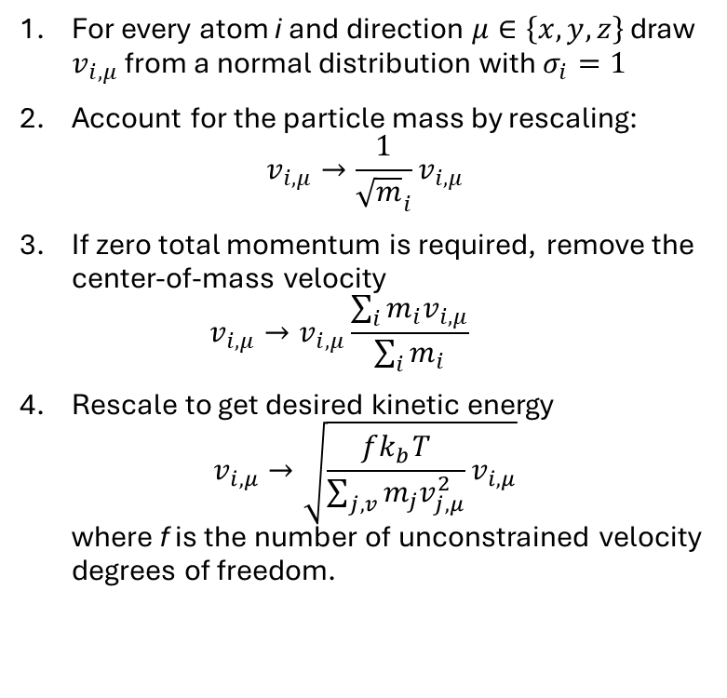
Thermostat
For every atom i and direction $μ∈\left\{x,y,z\right\}$ draw $v_{i,μ}$ from a normal distribution with $σ_{i}=1$
Account for the particle mass by rescaling:
$v_{i,μ}→\frac{1}{{\sqrt{m}}_{i}}v_{i,μ}$
If zero total momentum is required, remove the center-of-mass velocity
$v_{i,μ}→v_{i,μ}\frac{\sum_{i}{m_{i}v_{i,μ}}}{\sum_{i}{m_{i}}}$
Rescale to get desired kinetic energy
$v_{i,μ}→\sqrt{\frac{fk_{b}T}{\sum_{j,v}{m_{j}v_{j,μ}^{2}}}v_{i,μ}}$
where f is the number of unconstrained velocity degrees of freedom.
For a small system, this exact velocity rescaling is not equivalent to canonical sampling.
In this course, we instead draw from the Maxwell-Boltzmann distribution:
$$v_{i,μ}∼𝒩\left(0,\sqrt{\frac{k_{b}T}{m_{i}}}\right)$$
This is referred to as the Andrea-Anderson thermostat in the exercises.

Slide 6
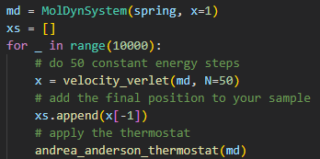
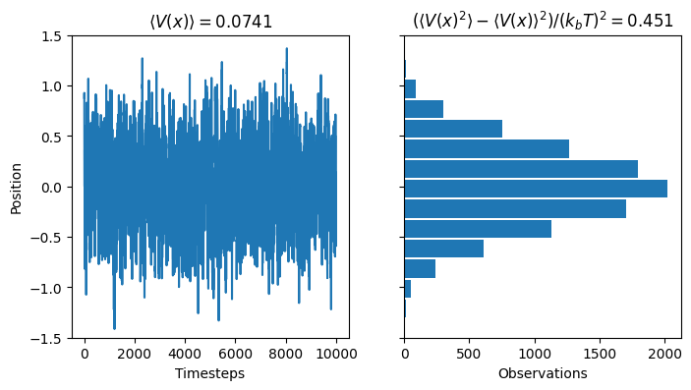

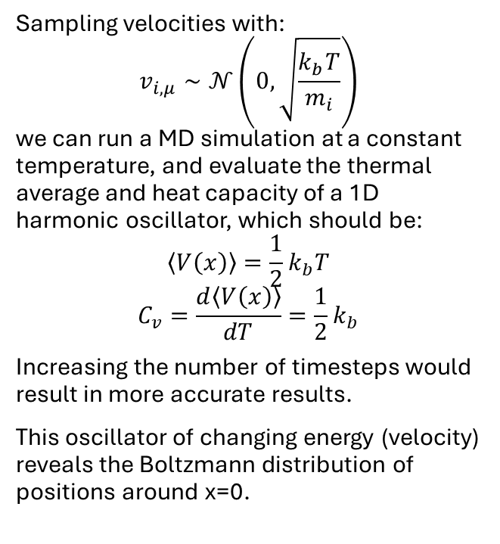
Thermostat
Sampling velocities with:
$$v_{i,μ}∼𝒩\left(0,\sqrt{\frac{k_{b}T}{m_{i}}}\right)$$
we can run a MD simulation at a constant temperature, and evaluate the thermal average and heat capacity of a 1D harmonic oscillator, which should be:
$$\left\langle V\left(x\right)\right\rangle =\frac{1}{2}k_{b}T$$
$$C_{v}=\frac{d\left\langle V\left(x\right)\right\rangle }{dT}=\frac{1}{2}k_{b}$$
Increasing the number of timesteps would result in more accurate results.
This oscillator of changing energy (velocity) reveals the Boltzmann distribution of positions around x=0.

Slide 7
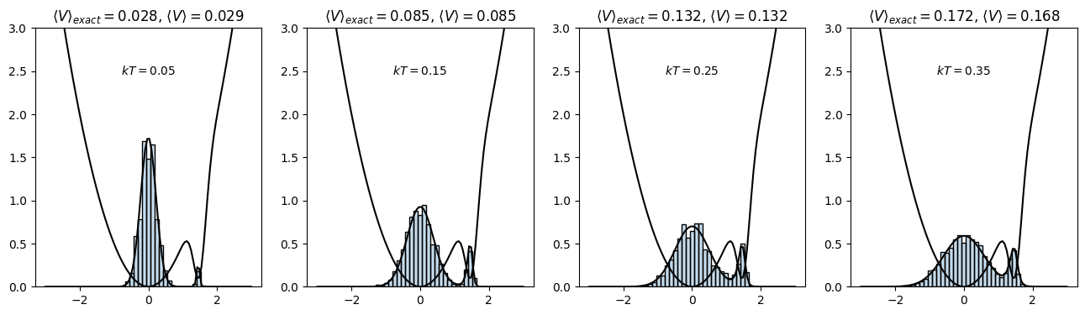
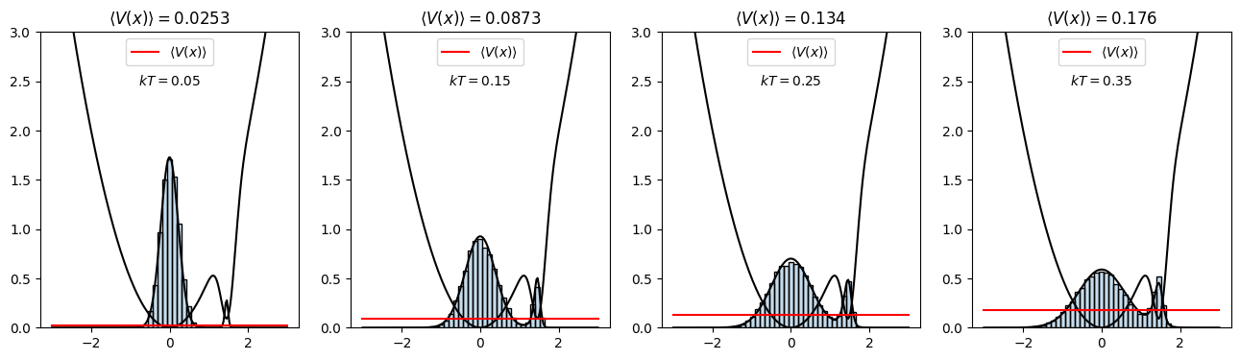
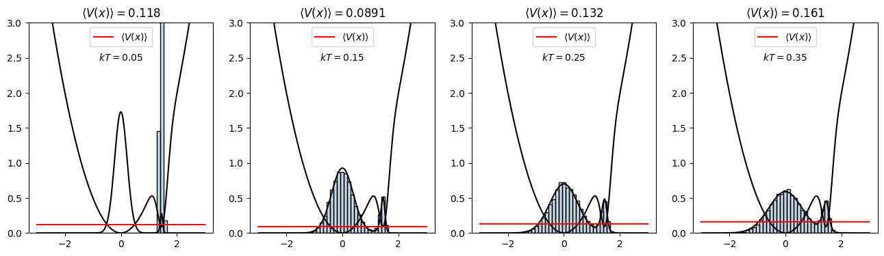
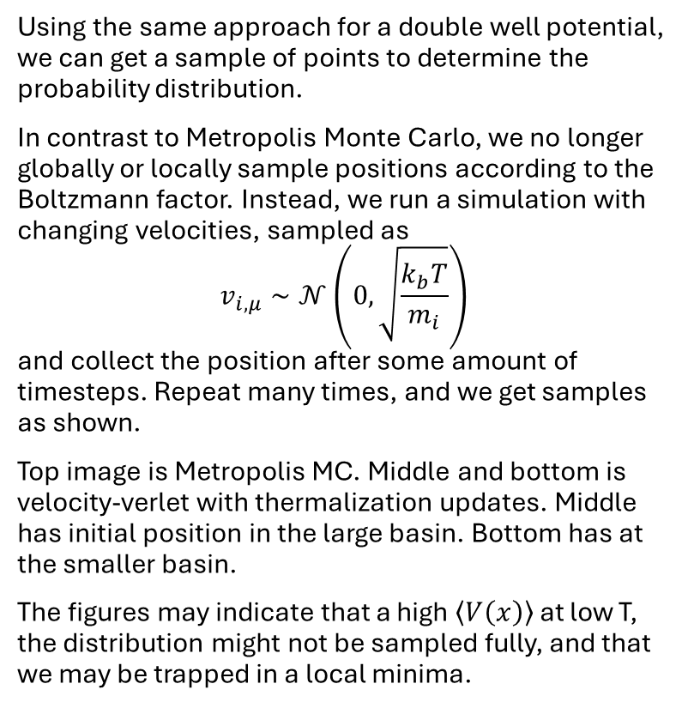
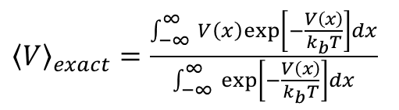
Thermostat
Using the same approach for a double well potential, we can get a sample of points to determine the probability distribution.
In contrast to Metropolis Monte Carlo, we no longer globally or locally sample positions according to the Boltzmann factor. Instead, we run a simulation with changing velocities, sampled as
$$v_{i,μ}∼𝒩\left(0,\sqrt{\frac{k_{b}T}{m_{i}}}\right)$$
and collect the position after some amount of timesteps. Repeat many times, and we get samples as shown.
Top image is Metropolis MC. Middle and bottom is velocity-verlet with thermalization updates. Middle has initial position in the large basin. Bottom has at the smaller basin.
The figures may indicate that a high $\left\langle V\left(x\right)\right\rangle$ at low T, the distribution might not be sampled fully, and that we may be trapped in a local minima.
${\left\langle V\right\rangle }_{exact}=\frac{\int_{−∞ }^{∞}{V\left(x\right)exp\left[−\frac{V\left(x\right)}{k_{b}T}\right]dx}}{\int_{−∞ }^{∞}{\exp\left[−\frac{V\left(x\right)}{k_{b}T}\right]dx}}$
From statistical
physics

Slide 8
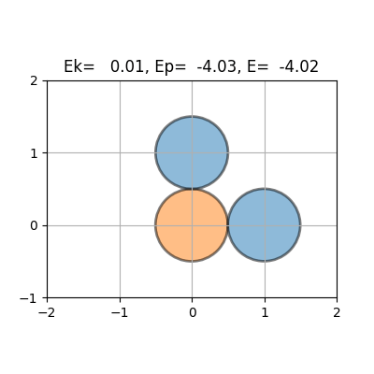
MD simulations
Using the velocity-verlet and sampling velocities from the Andrea-Anderson thermostat, we can sample the positions from interacting atoms via the Morse potential and create an animation such as this one.
In the simulation, we see how the free atoms start to move together by attraction and gain velocity.
As they get close to equilibrium, they still have high velocity (conservation of energy). They therefore bounce back and drift away from the static atom.

Slide 9
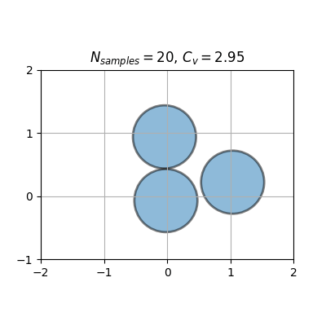
MD simulations
Doing the same simulations but with only free atoms, we see how the atoms move around each other.
This is at kT = 0.25
When calculating the average energy (and consequently heat capacity), we may want to skip the early samples while the system is still equilibrating. This is not done here, but is on the figure next slide.

Slide 10
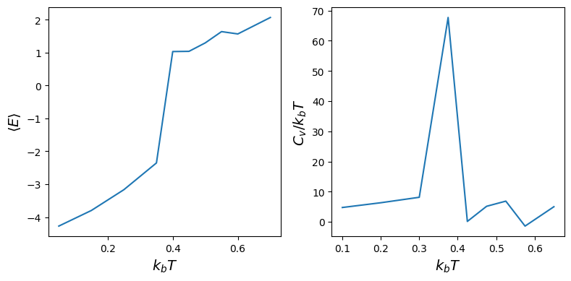
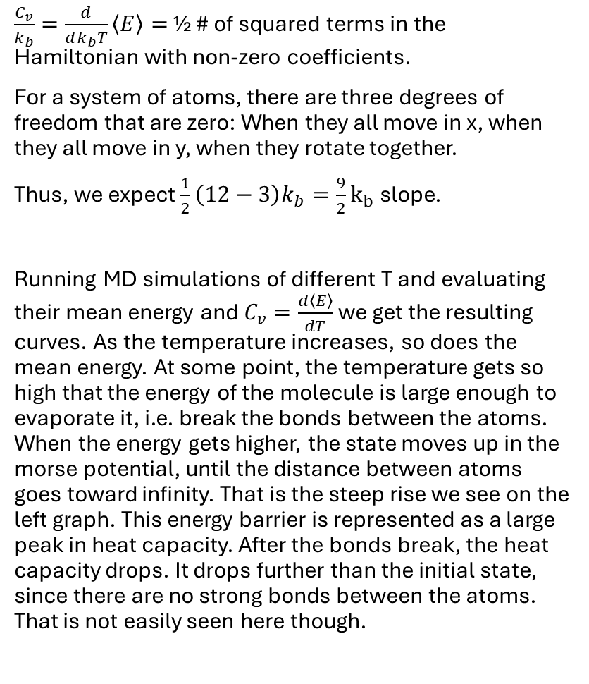
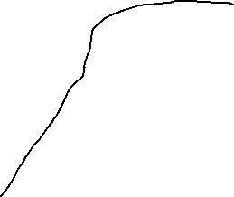
Evaporation
$\frac{C_{v}}{k_{b}}=\frac{d}{dk_{b}T}\left\langle E\right\rangle =$ ½ # of squared terms in the Hamiltonian with non-zero coefficients.
For a system of atoms, there are three degrees of freedom that are zero: When they all move in x, when they all move in y, when they rotate together.
Thus, we expect $\frac{1}{2}\left(12−3\right)k_{b}=\frac{9}{2}k_{b}$ slope.
Running MD simulations of different T and evaluating their mean energy and $C_{v}=\frac{d\left\langle E\right\rangle }{dT}$ we get the resulting curves. As the temperature increases, so does the mean energy. At some point, the temperature gets so high that the energy of the molecule is large enough to evaporate it, i.e. break the bonds between the atoms. When the energy gets higher, the state moves up in the morse potential, until the distance between atoms goes toward infinity. That is the steep rise we see on the left graph. This energy barrier is represented as a large peak in heat capacity. After the bonds break, the heat capacity drops. It drops further than the initial state, since there are no strong bonds between the atoms. That is not easily seen here though.
Energy high enough to evaporate the bonds

Slide 11
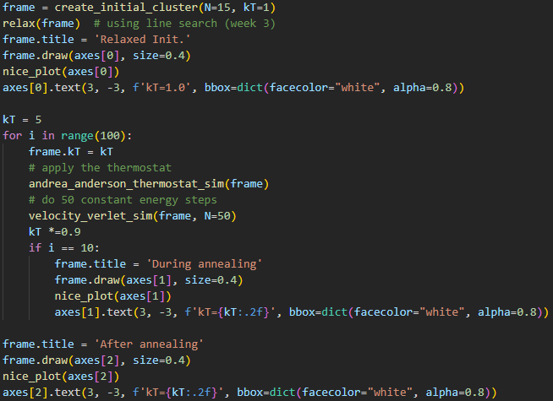
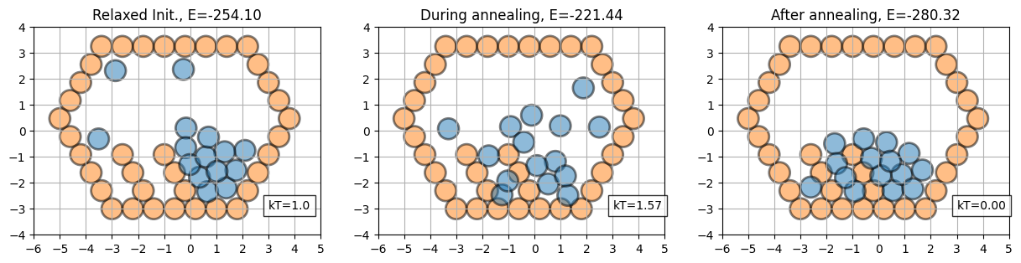
Simulated annealing
Initialize system at high T, and let atoms have random velocities
Evolve the system at high temperatures to explore high-energy regions.
Cool the system
The system explores lower-energy regions and may settle into a low-energy minimum.
At sufficiently low T, stop simulation and analyze. The resulting structure is a candidate low-energy configuration.

