Slide 1
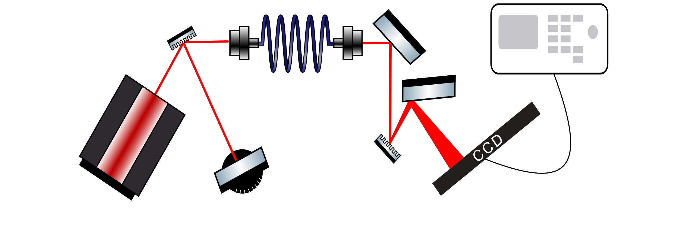
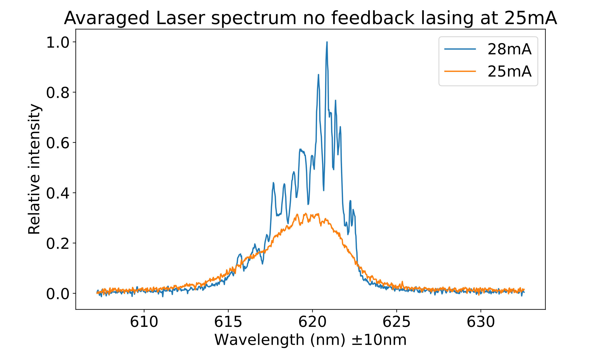
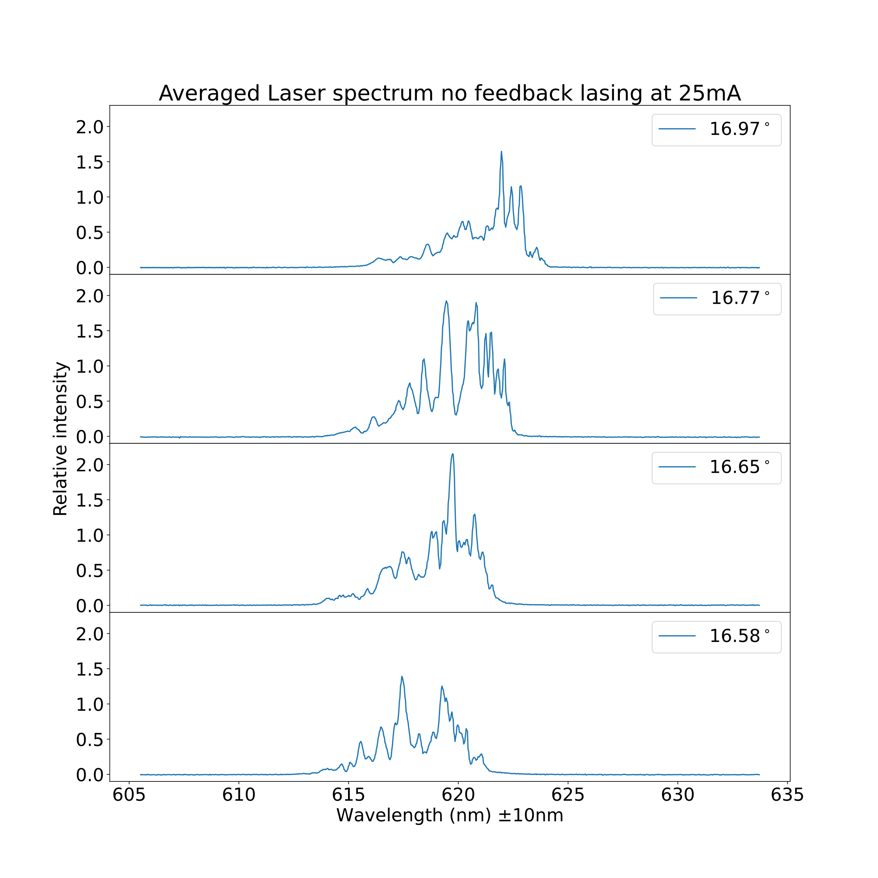
Optical Feedback
Introduction
For this project we built our own external cavity diode laser (ECDL) and Czerny-Turner Spectrometer, to measure the effects that optical feedback has on the output of a diode laser. The output of the ECDL was used as an input for the spectrometer, which visualized our results using an oscilloscope and a CCD we programmed.
A diode laser emits light by sending electrons through a semiconductor-type material. This material lets excited electrons deexcite through an energy gap making them emit light with the wavelength of the energy that’s around or higher than the energy gap.
Setup
The setup that was used for the experiments

