Slide 1
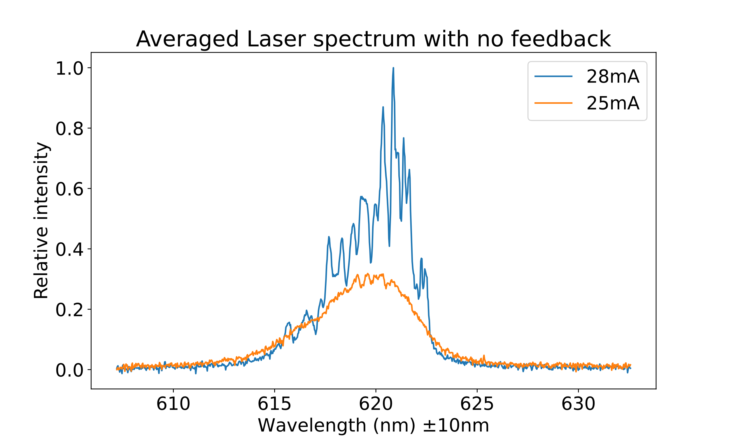
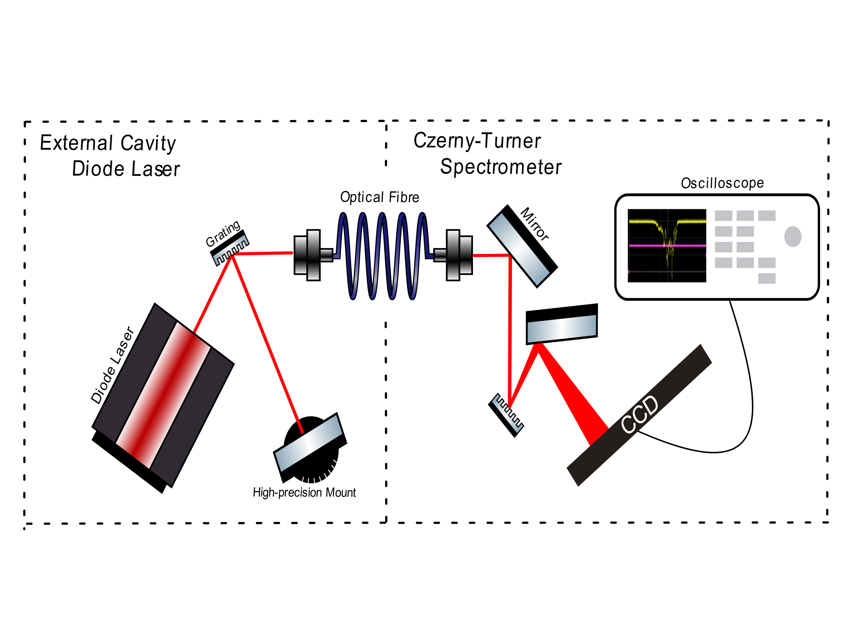
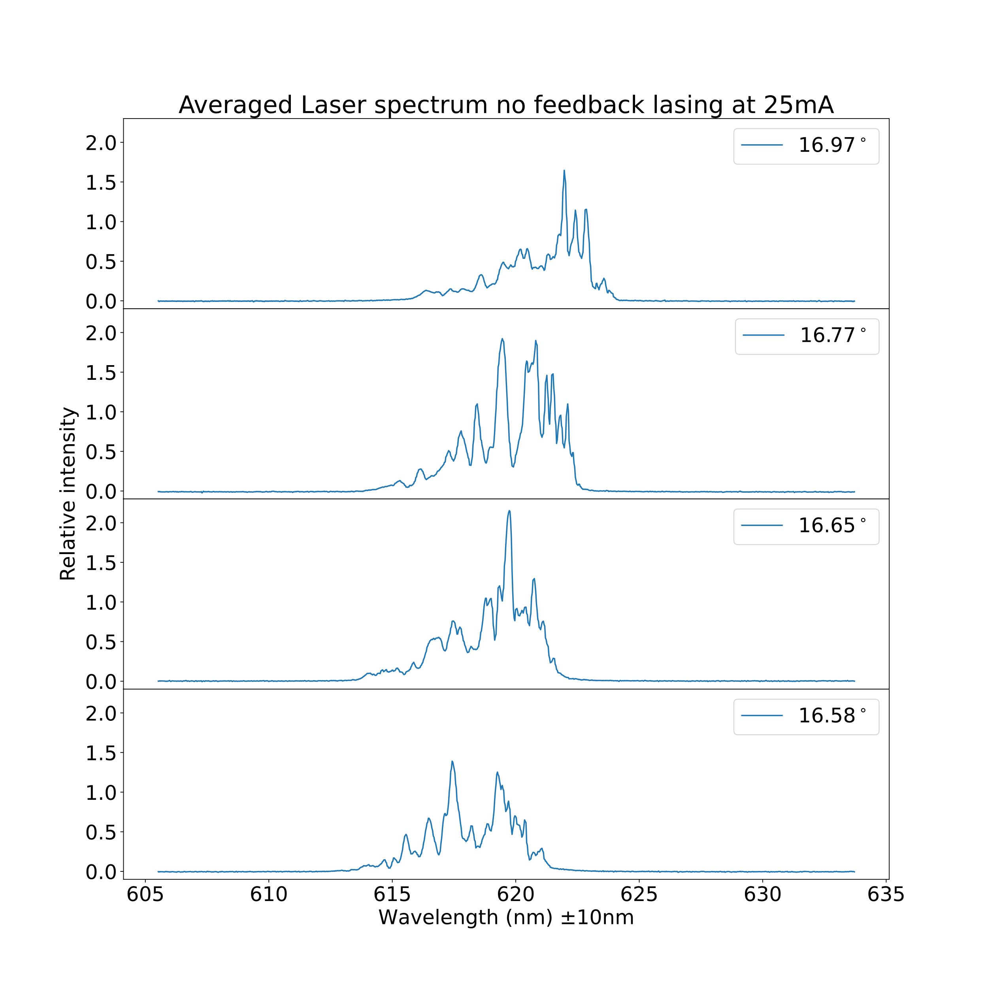
Optical Feedback
Introduction
Expectation
Optical feedback is the process in which a select band from the output of a laser is reflected back into the laser cavity. For this project we built our own external cavity diode laser (ECDL) and Czerny-Turner Spectrometer to measure the effect that feedback has on the output of the diode laser.
Diode lasers emit photons through the harmonic oscillation of electrons between energy levels. When provided with optical feedback, the incoming beam acts as a driving force for the oscillations of electrons between energy gaps equal to the energy of the beam’s constituent wavelengths. This stimulates the emission of photons with the same wavelengths as those in the reflected beam, which is what we expect to measure with our spectrometer.
Methodology
The ECDL makes use of a Littman-Metcalf configuration, where a mirror mounted on a high-precision rotation stage selects which wavelength(s) are being feedbacked into the diode laser. The zeroth order diffraction of the ECDL is directed into a spectrometer, which displays the wavelengths present in the beam. The spectrometer is calibrated with a neon lamp.
Measurement of the diode laser without feedback
Conclusion
When optical feedback was being provided the spectrum of the laser peaked and shifted. This can be attributed to the different wavelengths that are being stimulated by the feedback. The wavelengths that were being selected can seen in the whole spectrum in figure 1 when the laser was lasing.
Discussion
We had trouble calibrating the spectrometer due to the neon light not providing a clean spectrum. This caused our measurement wavelengths to have a large error on them. We attributed the many peaks of the diode laser to the cavity which is inside the laser itself. This cavity allows only the standing waves that fit in the cavity to be emitted.
References
I need to be written☹

