Slide 1
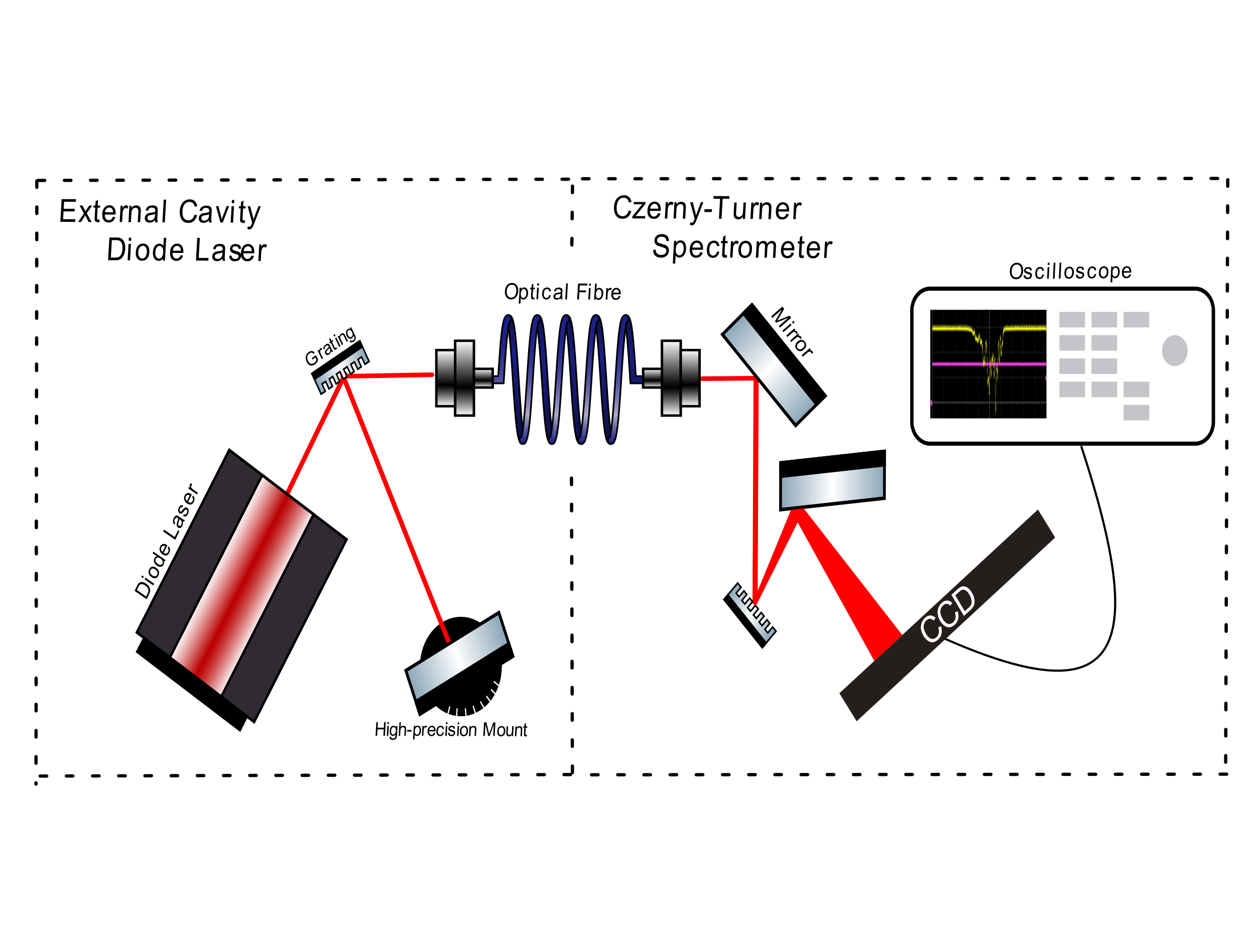
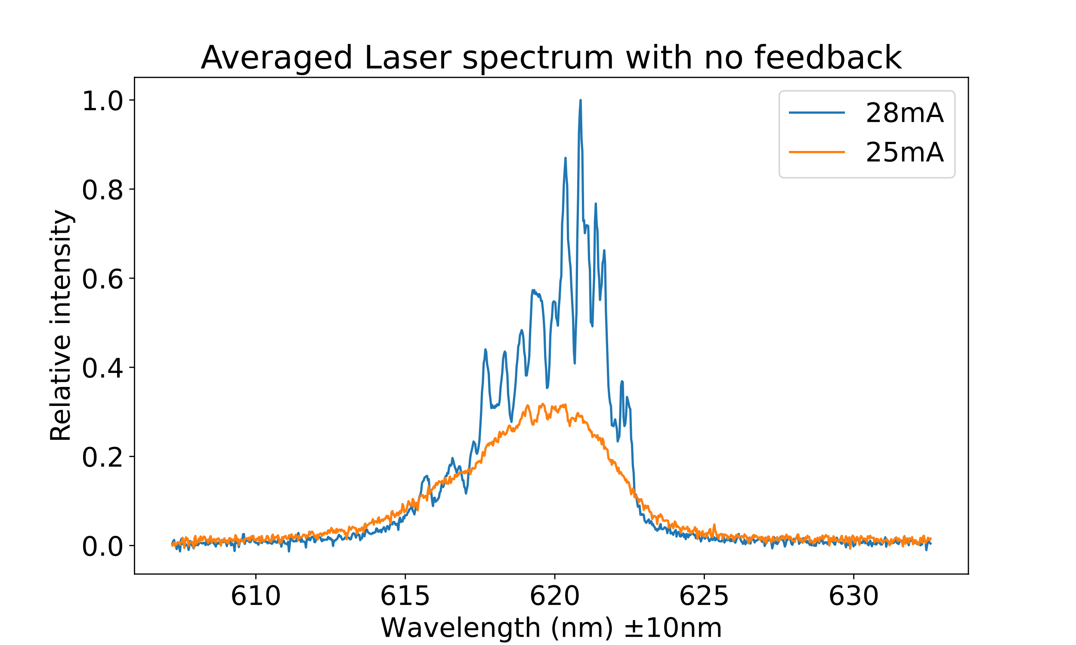
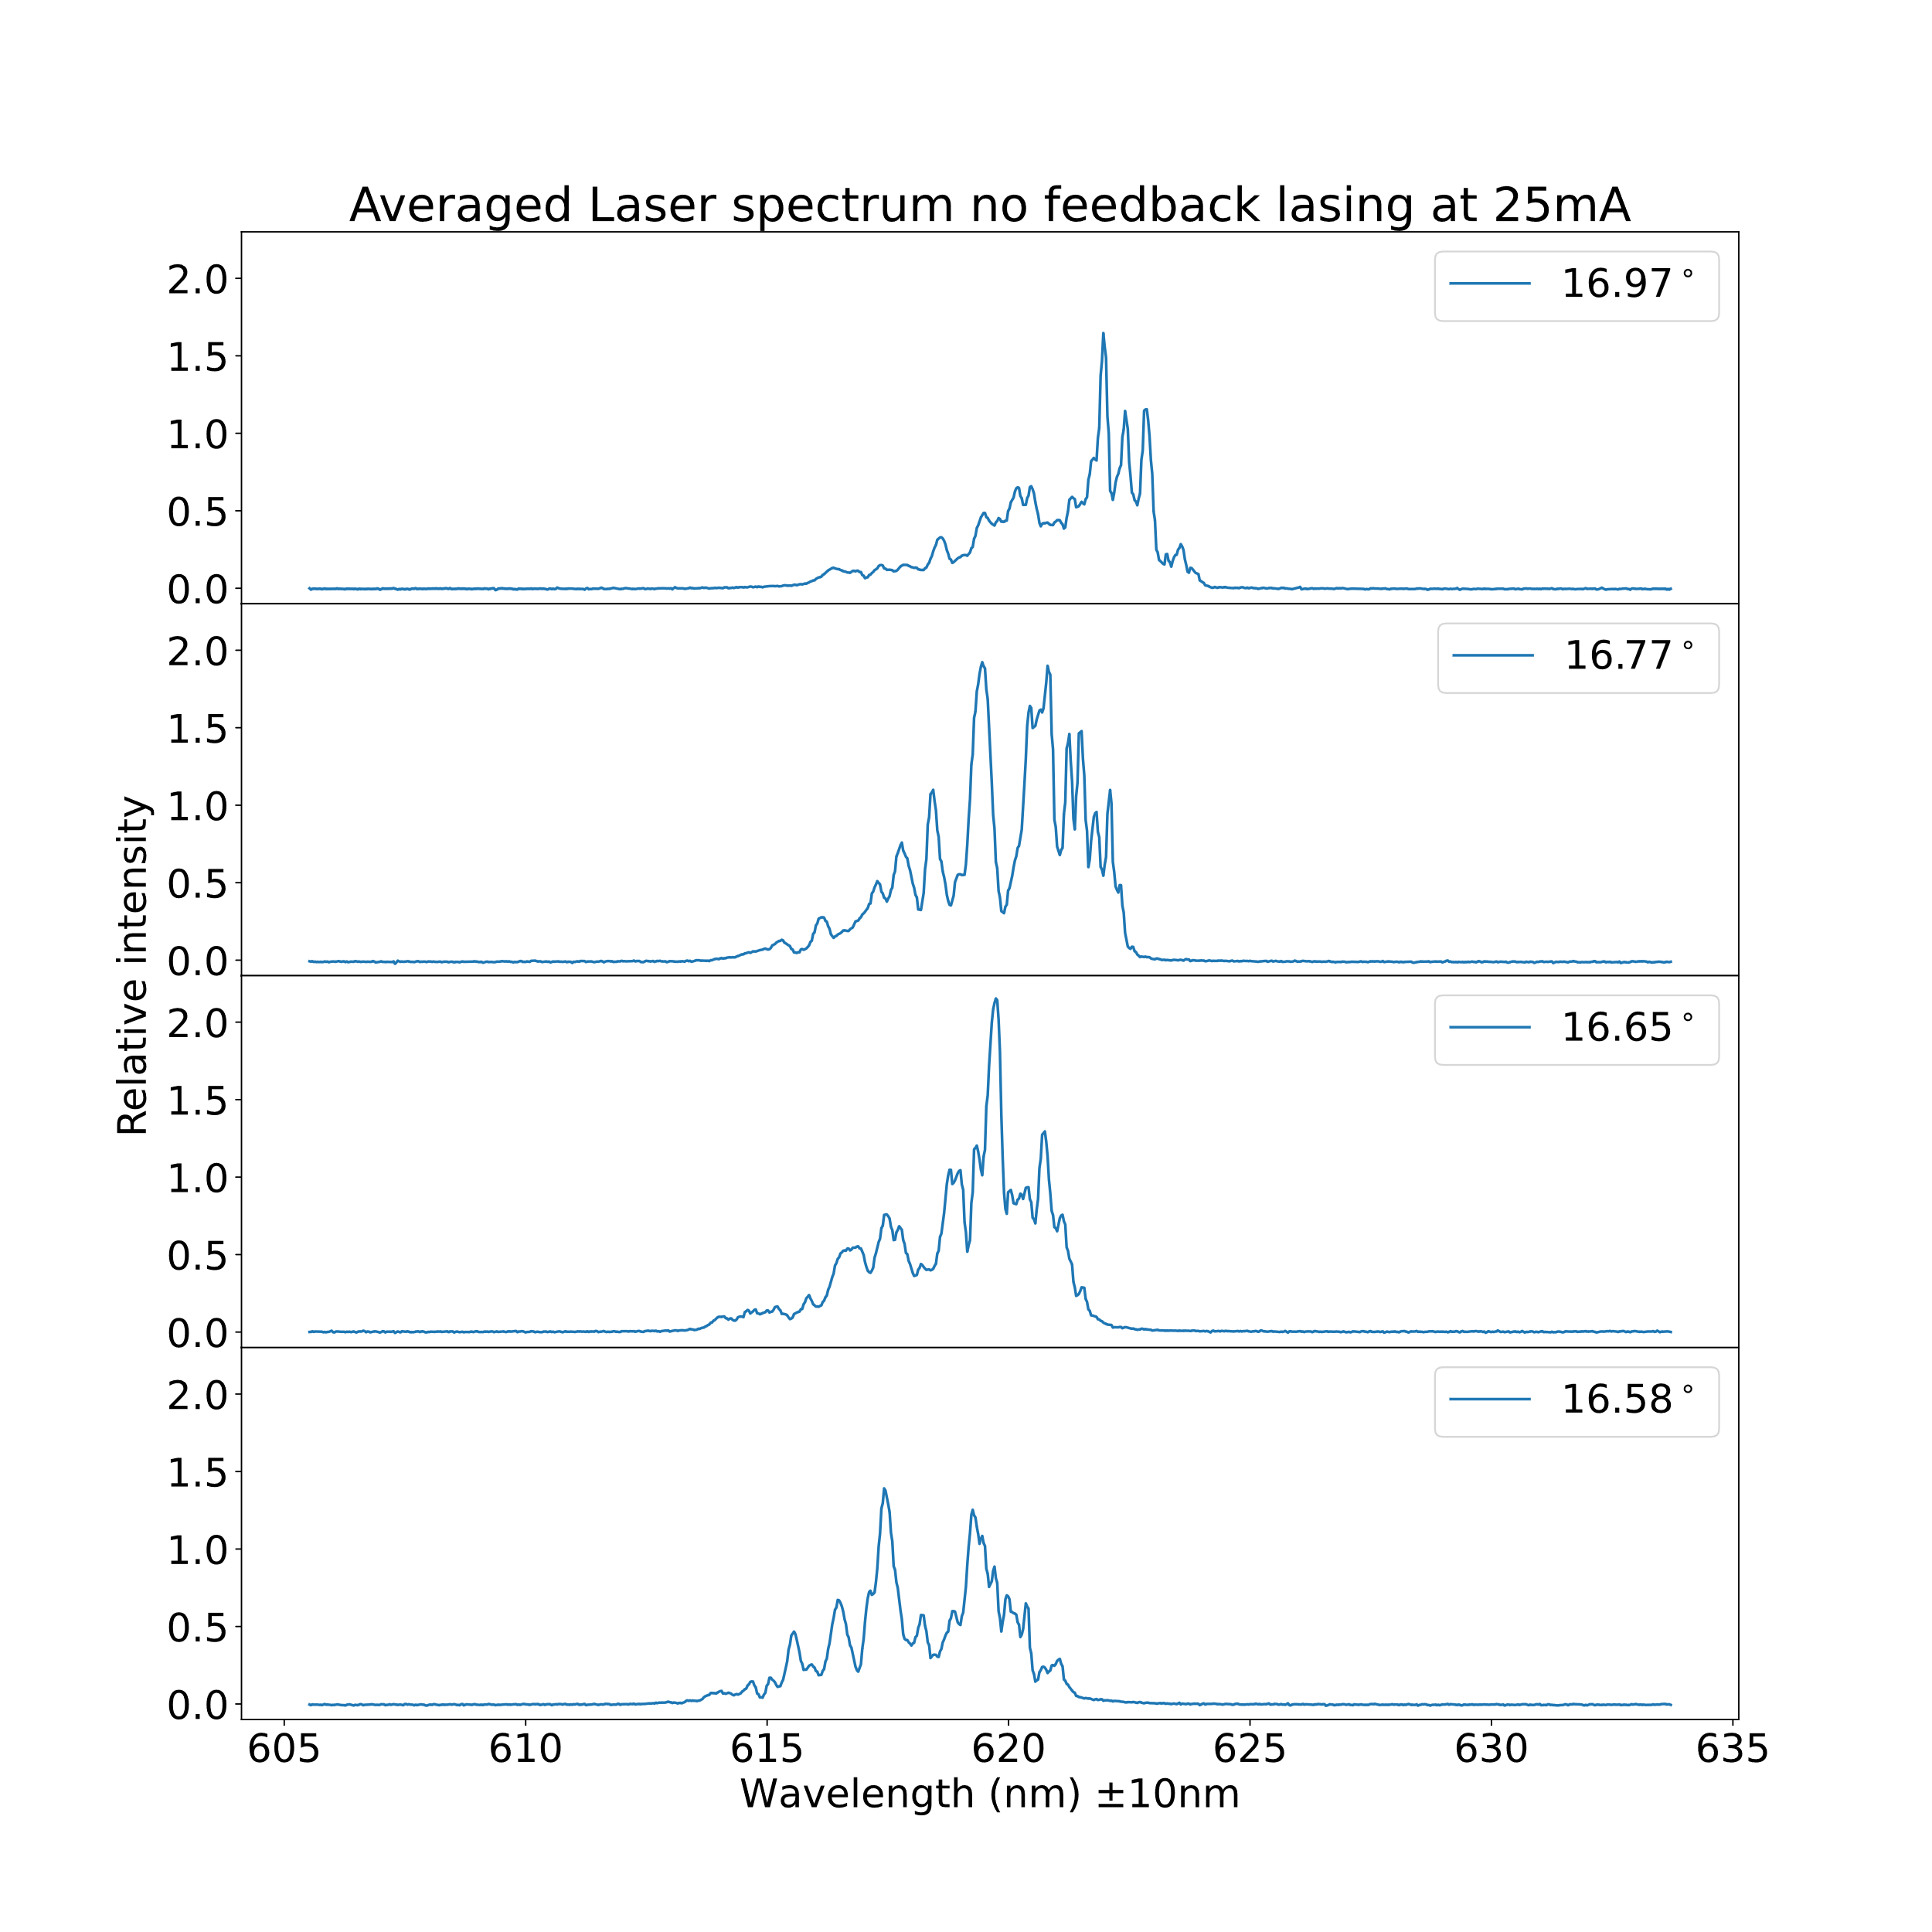
Optical Feedback
Introduction
Expectation
For this project we built our own external cavity diode laser (ECDL) and Czerny-Turner Spectrometer, to measure the effects that optical feedback has on the output of a diode laser. The output of the ECDL was used as an input for the spectrometer, which visualized our results using an oscilloscope and a CCD we programmed.
A diode laser emits light by sending electrons through a semiconductor-type material. This material lets excited electrons deexcite through an energy gap making them emit light with the wavelength of the energy that’s around or higher than the energy gap.
Light can influence the semiconductor-type material.
When a photon with more energy than the bandgap hits the semiconductor, the electrons act like a harmonic oscillator, making the emission a stimulated emission. This causes the diode to send out more light but with roughly the same wavelength as the incoming light.
This experiment measures how the optical feedback changes the output of the diode laser. According to the theory, we expect that the diode laser with feedback will have a narrower wavelength and will require less voltage to power because of the harmonic oscillation of the electrons.
Methodology
The ECDL made use of a Littman-Metcalf (laat figuur zien) configuration, where a mirror mounted on a rotation stage selects which wavelengths are being feedbacked into the diode laser.
The beam of a diode laser is pointed into a reflection grating, which separates the various component wavelengths of the beam. The first order diffraction is directed into a mirror mounted on a high-precision rotation stage, which reflects a certain wavelength back into the grating and subsequently into the diode laser, providing optical feedback. By adjusting the angle on the rotation stage, we select which wavelength is providing optical feedback. The zeroth order diffraction is used as the output for our ECDL after being directed into an optical fibre.
That zeroth order diffraction of the ECDL was put into a spectrometer to measure the wavelength range and the effect optical feedback has on the wavelength that the diode laser emits.
Conclusion
When optical feedback was being provided the spectrum of the laser peaked and shifted. This can be attributed to the different wavelengths that are being stimulated by the feedback. The wavelengths that were being selected can seen in the whole spectrum in figure 1 when the laser was lasing.
Discussion
We had trouble calibrating the spectrometer due to the neon light not providing a clean spectrum. This caused our measurement wavelengths to have a large error on them. We attributed the many peaks of the diode laser to the cavity which is inside the laser itself. This cavity allows only the standing waves that fit in the cavity to be emitted.
References
I need to be written☹

