Slide 1

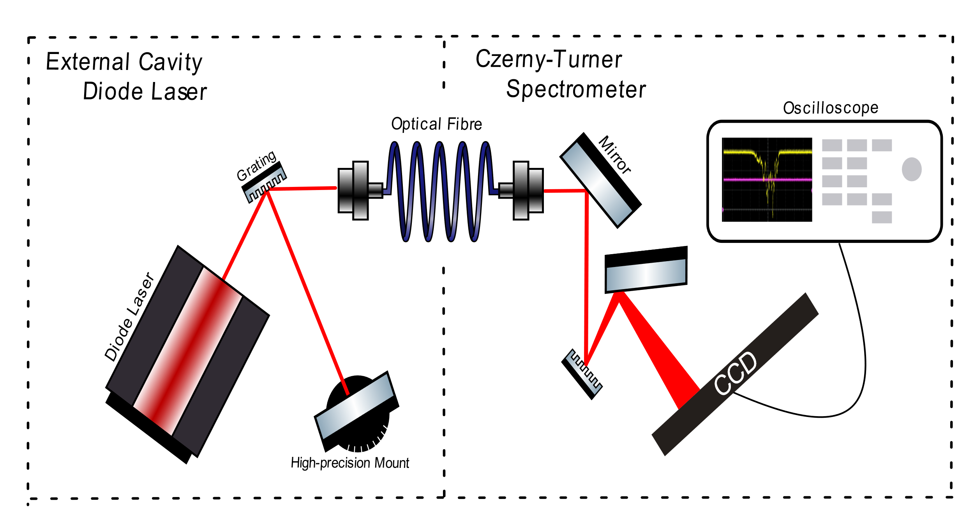
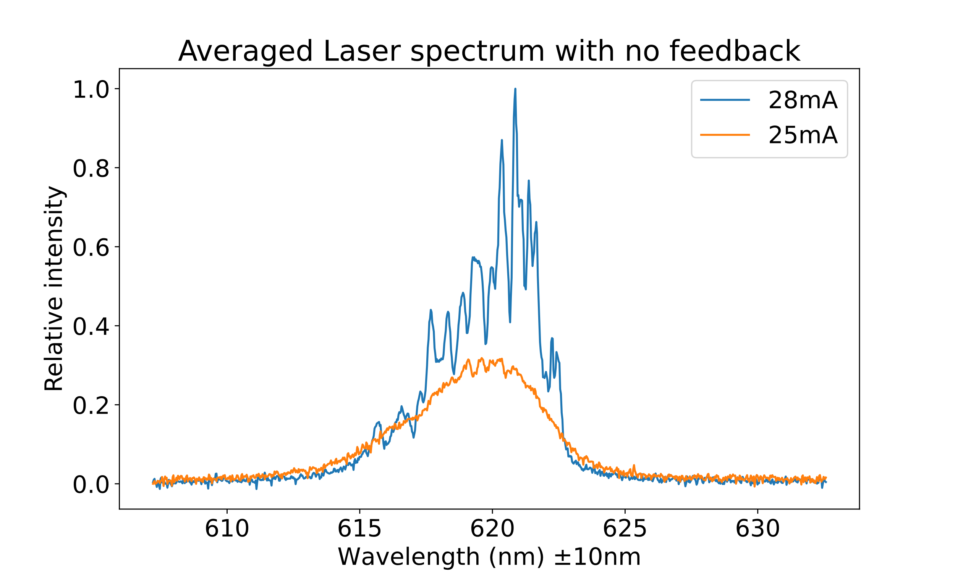
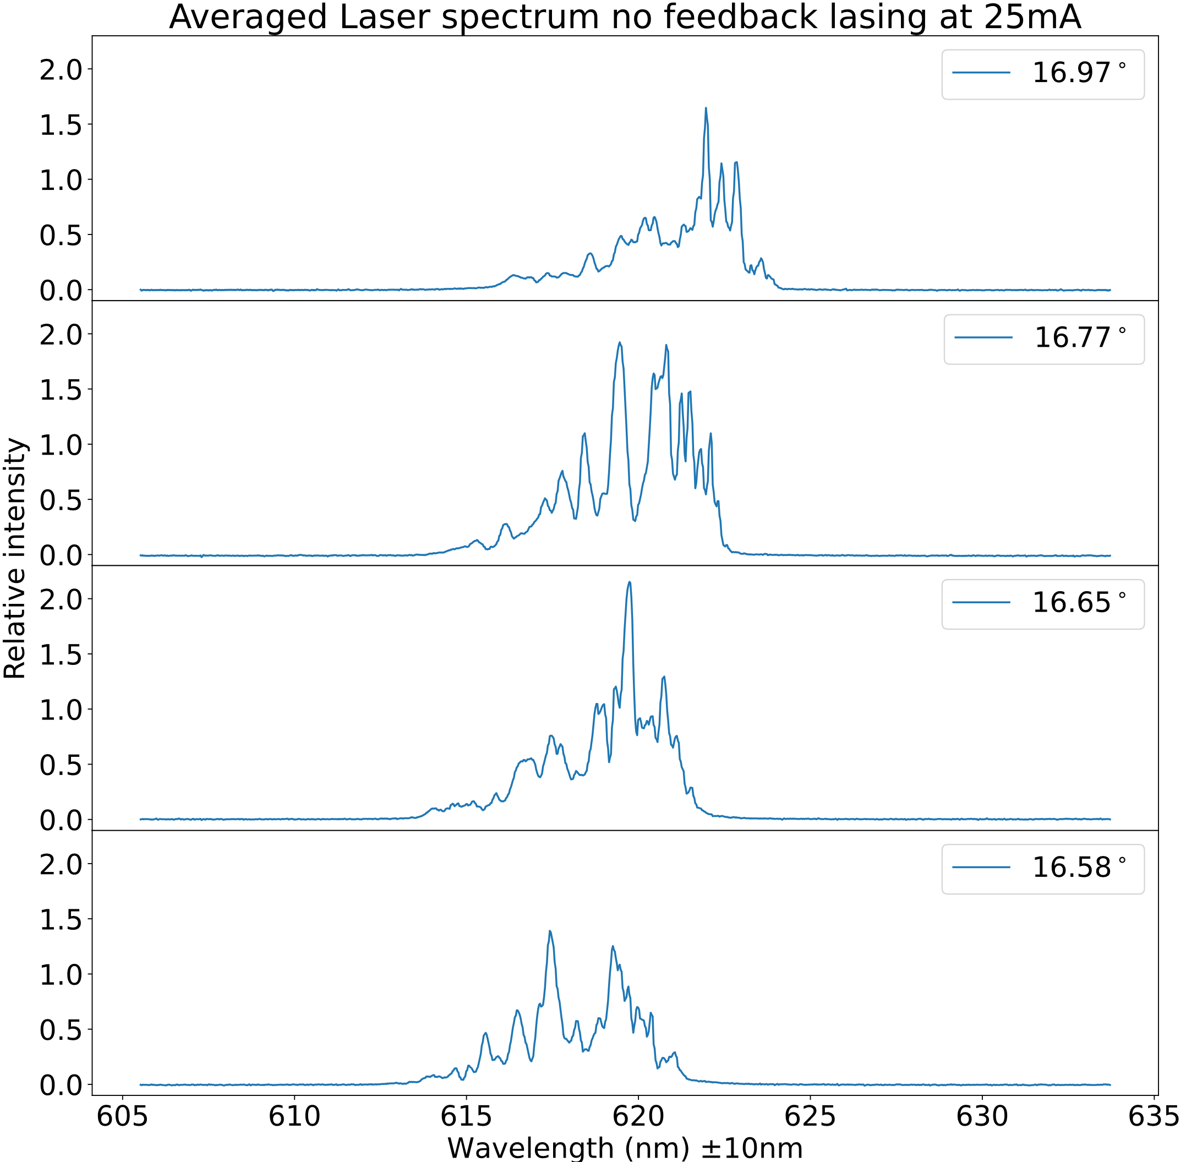
Measuring the effect of optical feedback on diode laser
Introduction
Expectation
Optical feedback is the process in which a select band from the output of a laser is reflected back into the laser cavity. For this project we built our own external cavity diode laser (ECDL) and Czerny-Turner Spectrometer to measure the effect that feedback has on the output of the diode laser.
Methodology
The ECDL makes use of a Littman-Metcalf configuration, where a mirror mounted on a high-precision rotation stage selects which wavelength(s) are being feedbacked into the diode laser. The zeroth order diffraction of the ECDL is directed into a spectrometer, which displays the wavelengths present in the beam. The spectrometer is calibrated with a neon lamp.
Figure 1: Measurement of the diode laser without feedback at different currents. The intensity is relative to the highest peak of the laser at 28mA without feedback.
Conclusion
When optical feedback was being provided the spectrum of the laser peaked and shifted. This can be attributed to the different wavelengths that are being stimulated by the feedback. The wavelengths that were being selected can seen in the whole spectrum in figure 1 when the laser was lasing.
Discussion
We had trouble calibrating the spectrometer due to the neon light not providing a clean spectrum. This caused our measurement wavelengths to have a large error on them. We attributed the many peaks of the diode laser to the cavity which is inside the laser itself. This cavity allows only the standing waves that fit in the cavity to be emitted.
References
Figure 2: Measurement of the diode laser with feedback at 28mA. The angle is the angle of the mirror normal with the grating normal. The intensity is relative to the highest peak of the laser at 28mA without feedback.
I need to be written☹

