Slide 1
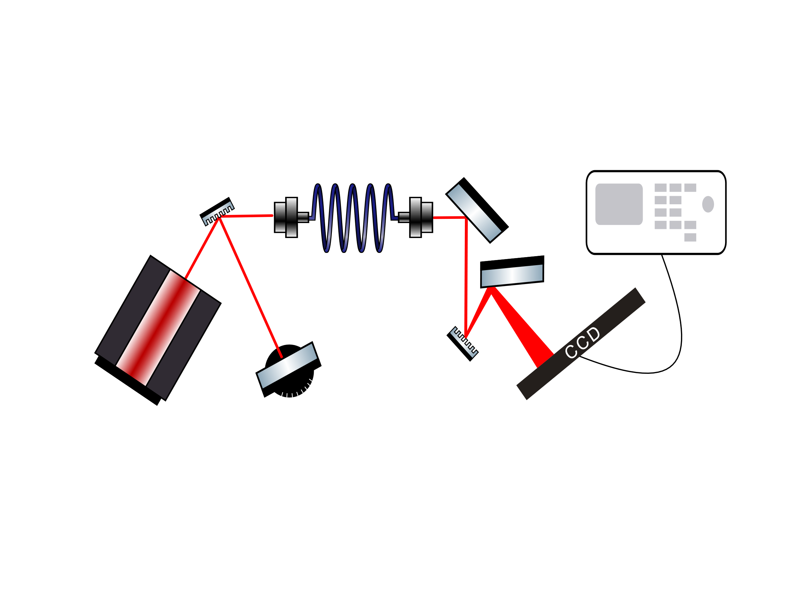
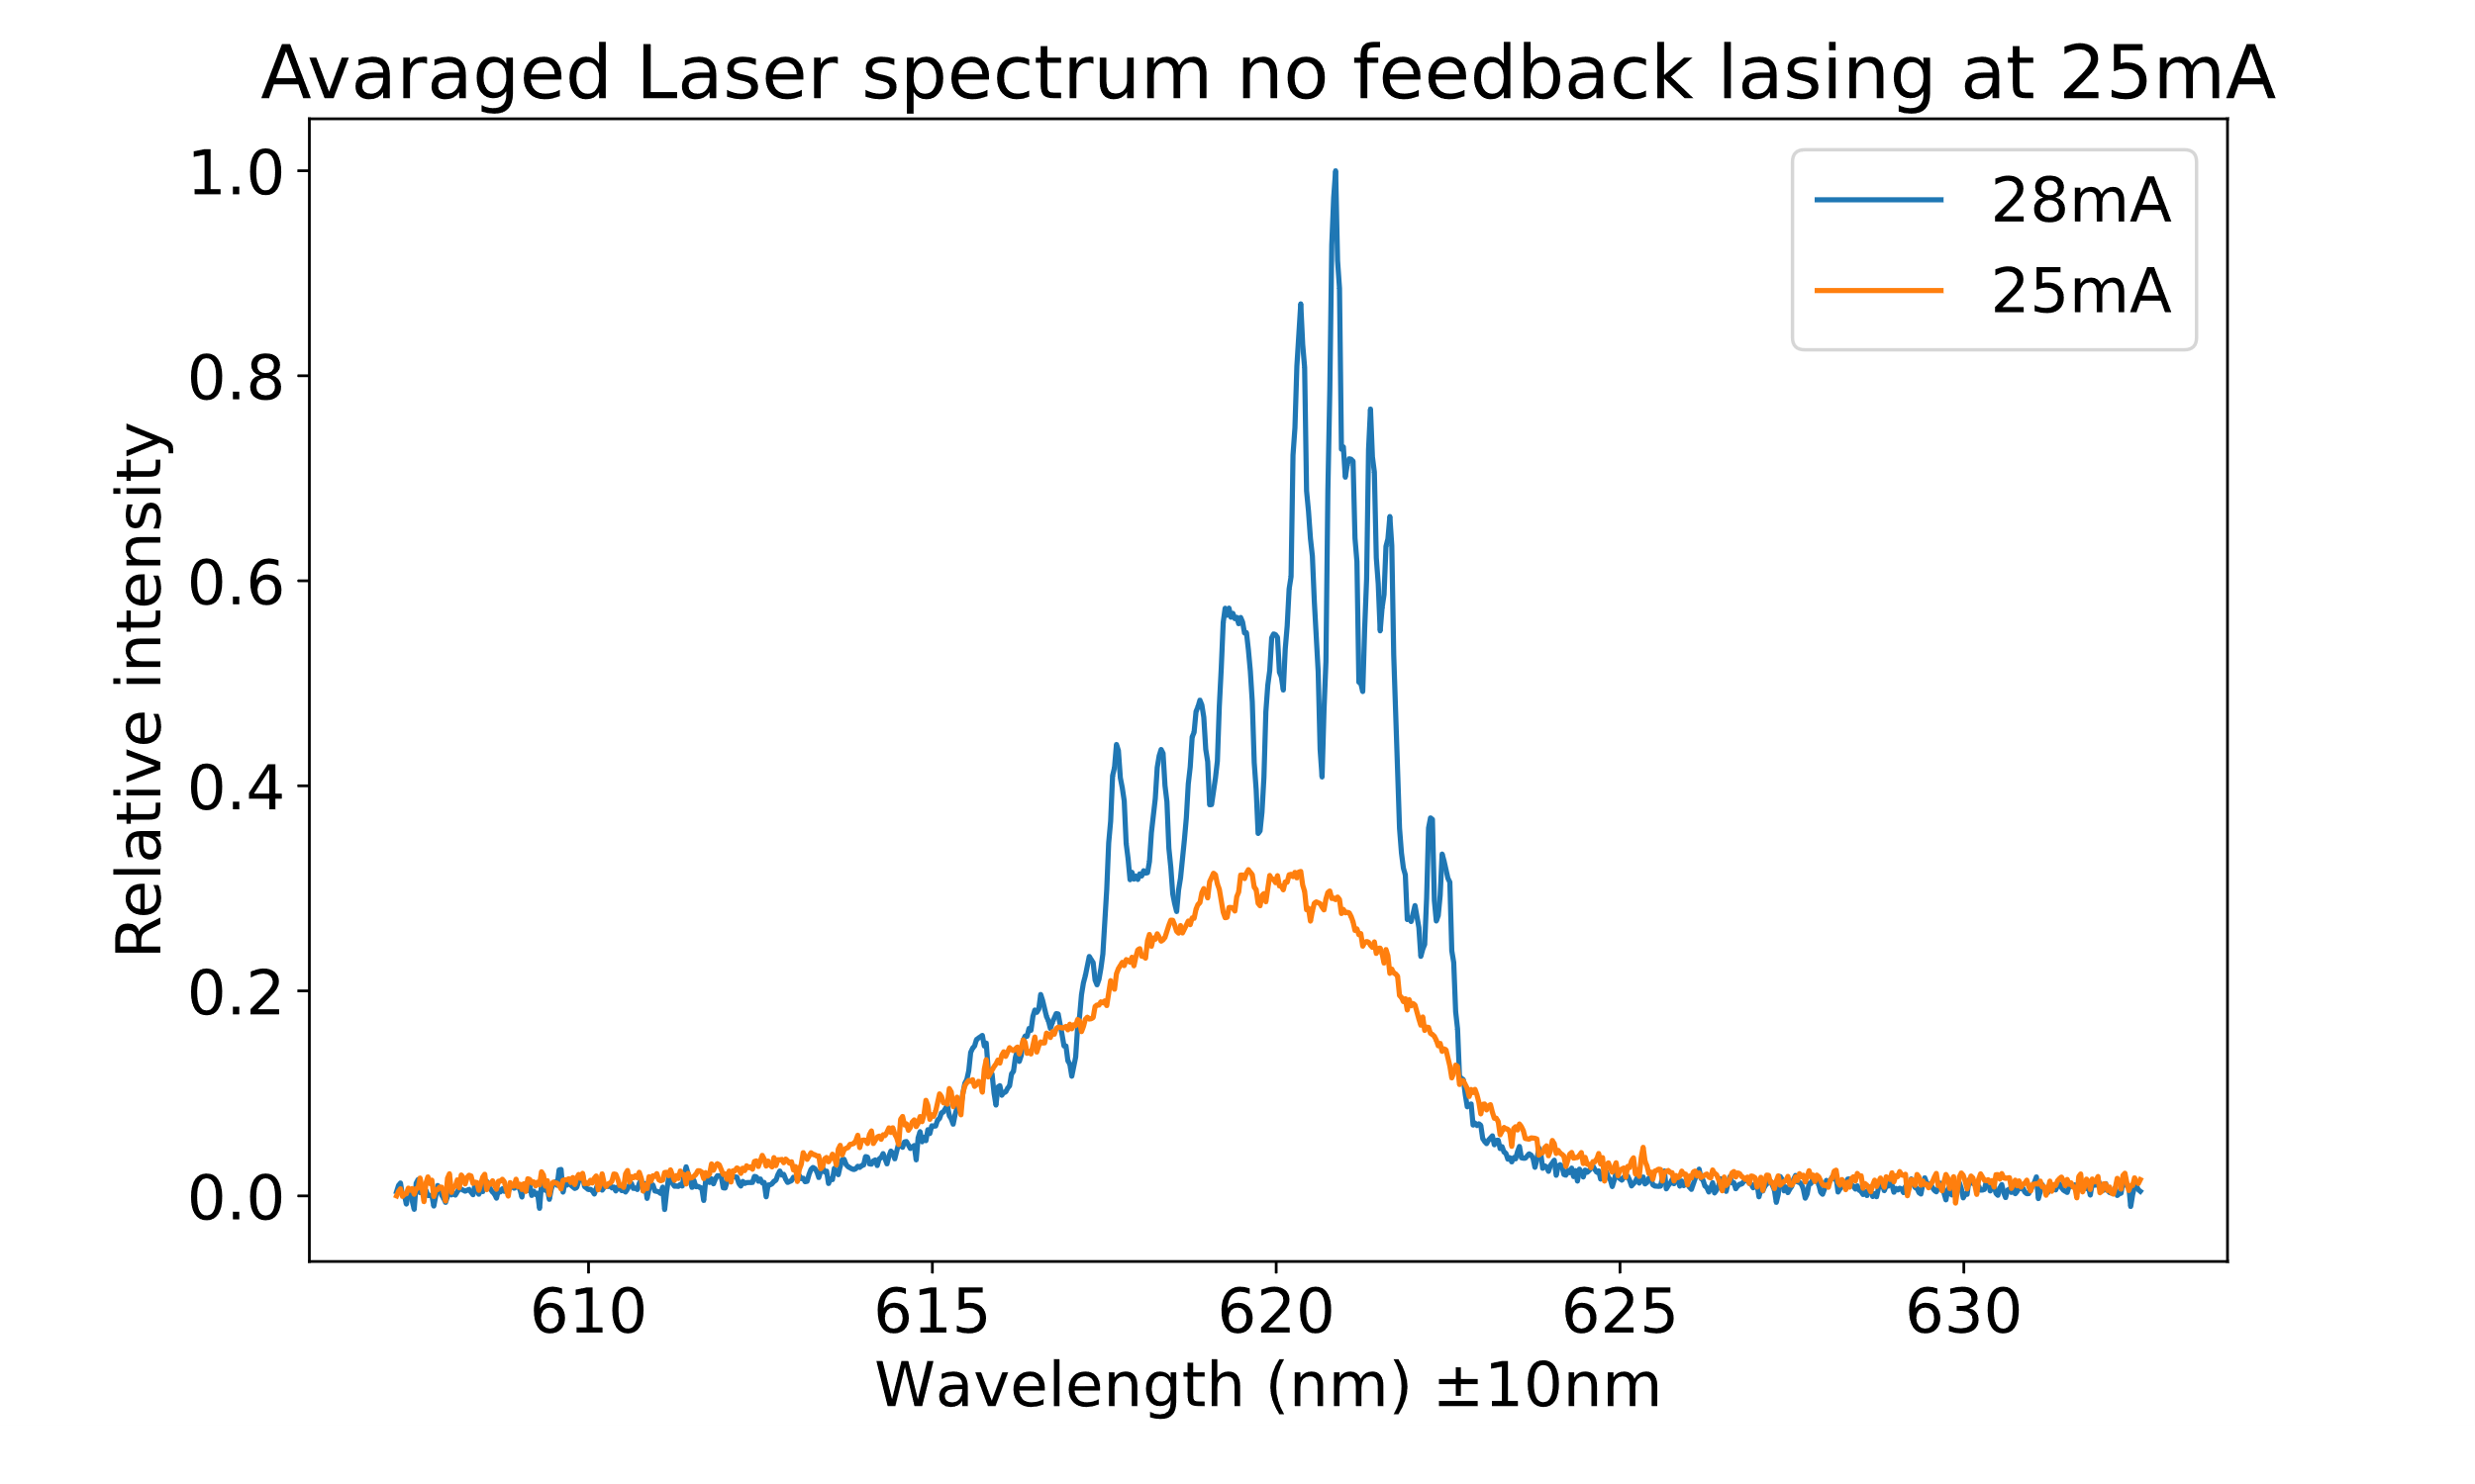
Optical Feedback
For this project we built our own external cavity diode laser (ECDL) and Czerny-Turner Spectrometer, to measure the effects that optical feedback has on the output of a diode laser. The output of the ECDL was used as an input for the spectrometer, which visualized our results using an oscilloscope and a CCD we programmed.
A diode laser emits light by sending electrons through a semiconductor-type material. This material lets excited electrons deexcite through an energy gap making them emit light with the wavelength of the energy that’s around or higher than the energy gap.

