Slide 1
Netflix

Slide 2
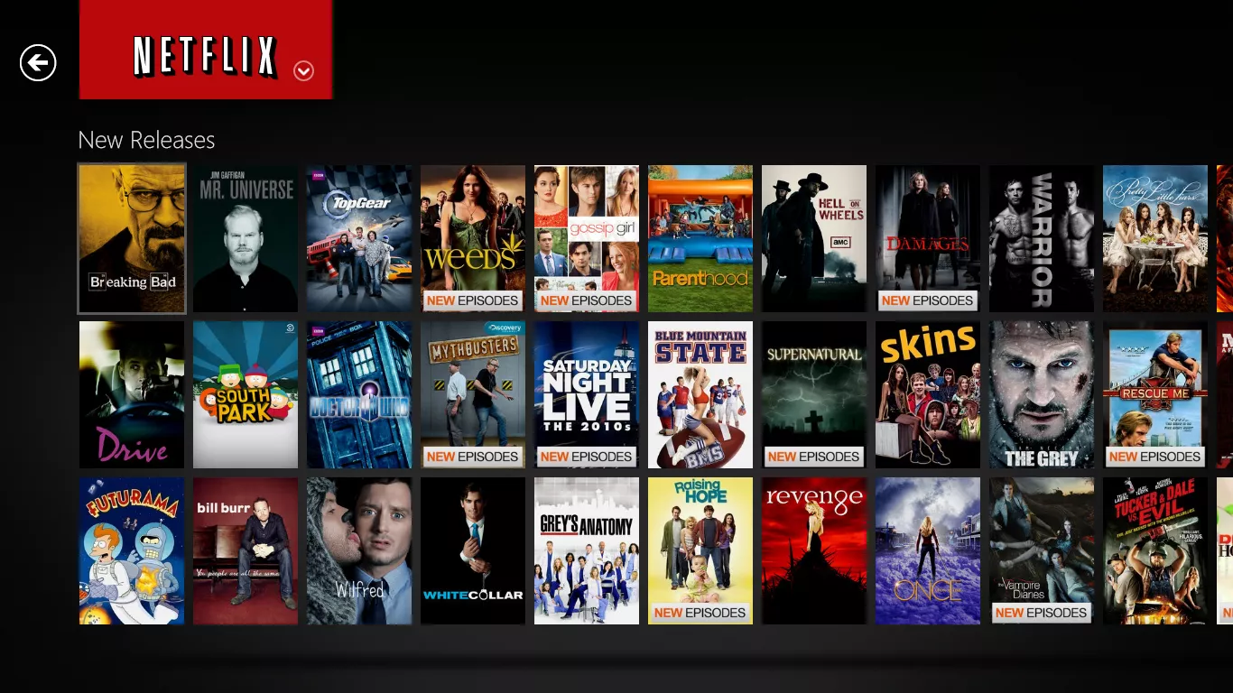
Netflix
Notes:
POSTIVE : Netflix has a wide selection of movies and tv shows making it easier to find something entertaining for everyone. Netlix allows for multiple profiles for multiple users to pick and choose what they want to watch when they want to. The monthly fee depending on your package is fairly cheap at around 10 euro. The website is nicely laid out with spacing between each cover art. When you hover on the cover art it displays information about the movie or tv show. There is also a rating system which is made from other users giving you an idea of what others have thought of the show/movie. Offline mode to watch movies or tv shows without Wifi.
NEGATIVES: With such a wide variety of shows/movies to choose from you can end up scrolling through the menu for a long time trying to find something to watch. The try to push Netflix original shows rather than other content. Netflix changes their library of movies/shows every month so one of your favourites could be taken off the site without you knowing. Netflix makes some content unavailable to its users, Netflix America has a different selection compared to Netflix Europe.

