Slide 1
Machine Learning for Diabetes Risk Prediction: Enhancing Early Detection in Public Health
IOD Mini Project 2 by Emily Huang
Aug. 2024

Slide 2
Introduction: Diabetes – A Growing Public Health Concern
Background:
Chronic disorder affecting millions globally
Major cause of kidney failure, blindness, and limb amputations
Often undiagnosed: ~100,000 New Zealanders unaware they have diabetes (2021)
US prevalence (2021): ~52.7% of adults have diabetes or prediabetes
Types:
Type 1 (autoimmune)
Type 2 (lifestyle-related) - most common
Gestational (during pregnancy)
Personal Connection:
Close family members affected by diabetes
Notes:
Diabetes in New Zealand:
Prevalence: Approximately 253,000 people (5% of the population) diagnosed with diabetes as of 2021
Type distribution: 90% have Type 2 diabetes
Undiagnosed cases: Estimated 100,000 New Zealanders have undiagnosed diabetes
Economic impact: Annual cost to the NZ health system estimated at $2.1 billion (2021)
Trend: Diabetes rates have doubled in the past 10 years, expected to keep rising
>> Personal Experience:
Close family members affected by diabetes
Observed impacts:
Increased healthcare costs (ongoing medication, injections)
Vision impairment
Mobility issues

Slide 3
Objective / Business Question
Objective:
Develop a predictive model to identify individuals at risk of diabetes based on non-clinical, easily obtainable factors, aiming to improve early detection, and prevention, and reduce healthcare costs.
Business Question:
How can we leverage a subset of risk factors and machine learning techniques to accurately predict if an individual has diabetes or is at high risk of developing it?
Notes:
>> Motivation to do this project:
Leveraging machine learning for early detection and prevention
Potential to reduce health complications and healthcare costs
Improve quality of life through timely interventions

Slide 4
Machine Learning Pipeline Overview
Data Collection
Data Cleaning / EDA
Feature Selection
Data Preprocessing
Model Development
Model Optimisation
Performance Evaluation
Insights & Future Development
Final Model Selection
Notes:
>I will use this flow chart to illustrate our approach to answering the business question using machine learning.
We started with data collection and cleaning, followed by exploratory data analysis and feature selection.
After preprocessing the data, we developed and optimized several models, evaluated their performance,
and selected the best models based on our criteria.
Finally, we derived insights and identified areas for future development.

Slide 5
Dataset Background
Dataset Source: Kaggle dataset on health indicators related to diabetes (survey year - 2015)
Based on the Behavioral Risk Factor Surveillance System (BRFSS) - US
Annual health-related telephone survey conducted by the Centers for Disease Control and Prevention (CDC) since 1984
Features Include:
Demographics: Age, Sex, Education, Income level
Health indicators: BMI, Blood Pressure, Cholesterol
Lifestyle factors: Smoking, Alcohol consumption, Physical activity
General health status and access to healthcare
Notes:
https://www.kaggle.com/datasets/alexteboul/diabetes-health-indicators-dataset/data

Slide 6
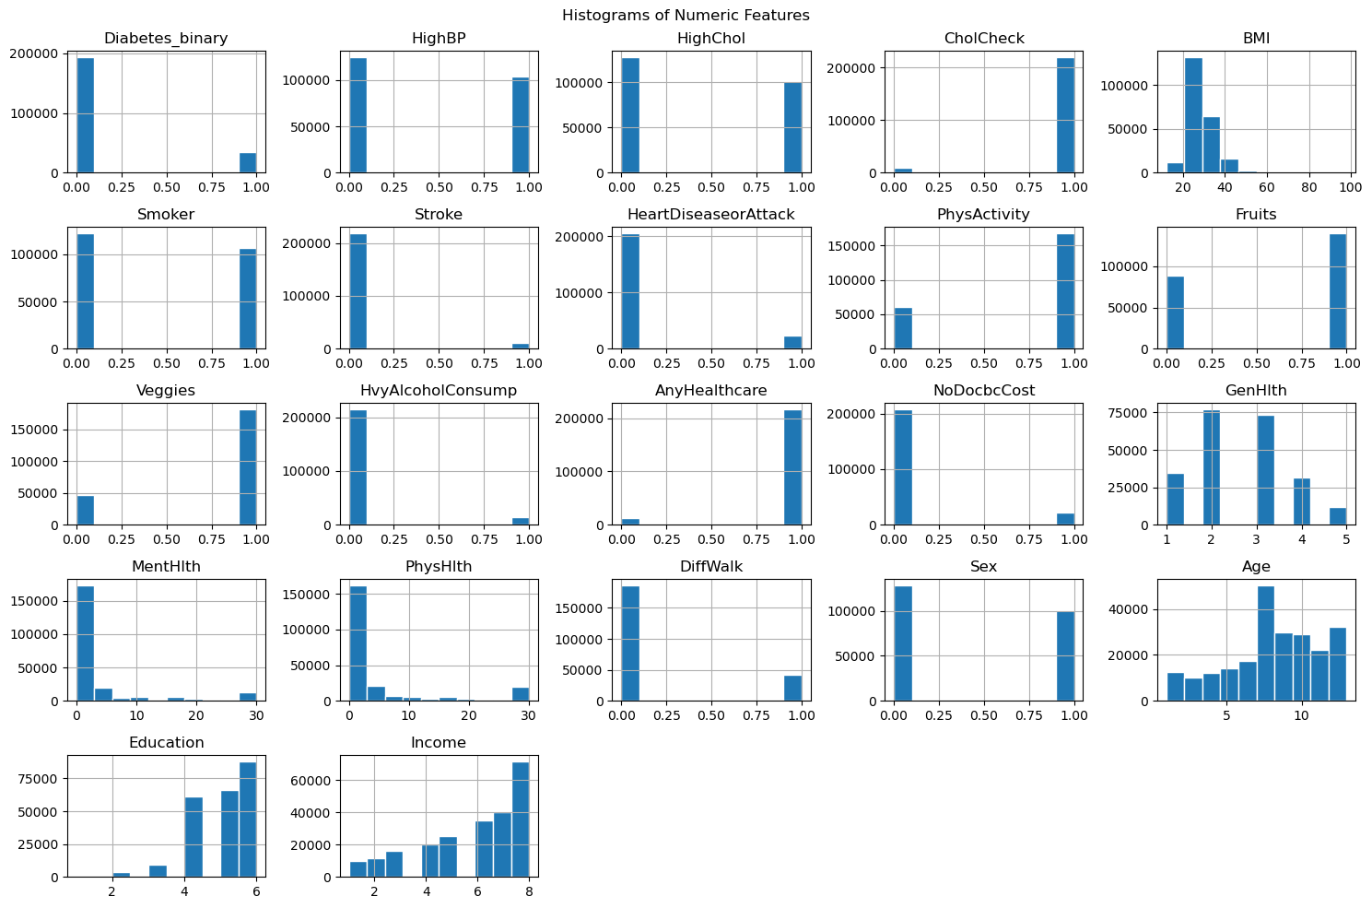
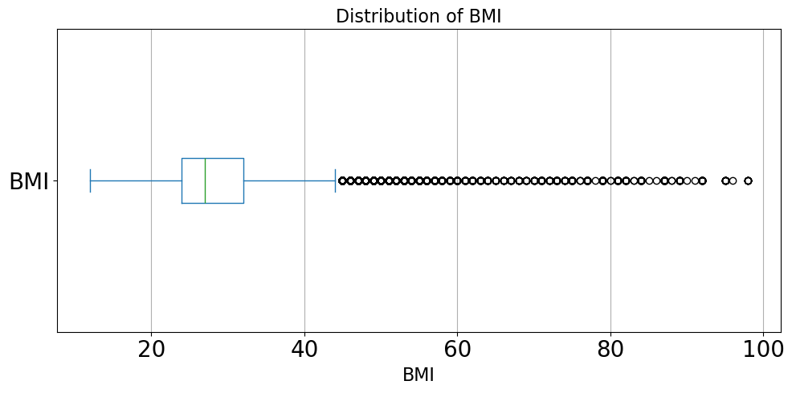
Dataset Overview and Cleaning
Total: 253,680 rows x 22 columns
Data types:
Mostly categorical (binary or ordinal)
All Numeric
Data Cleaning:
Checked for missing values (none found)
Removed duplicate entries (24,206)
Handled outliers in BMI to maintain data integrity (less than 1% removed)

Slide 7
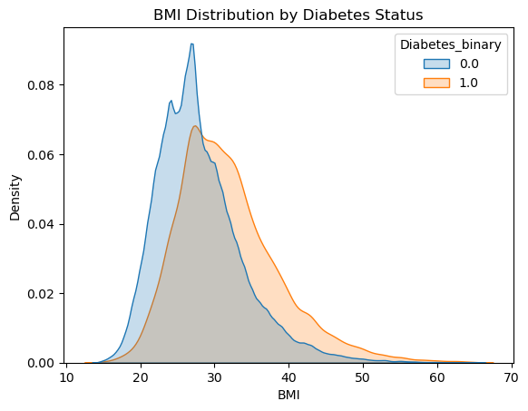
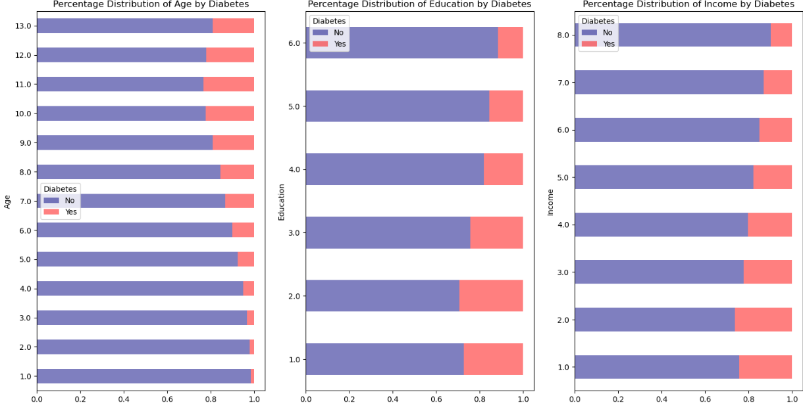
EDA - Initial Insights
Age
Education
Income
The diabetic group tends to have higher BMI values overall
All three categorical factors seem to have a noticeable relationship with diabetes risk.

Slide 8
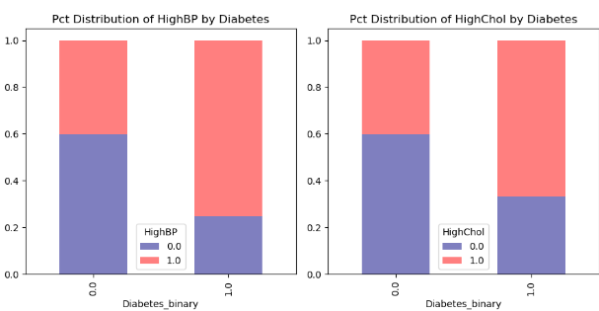
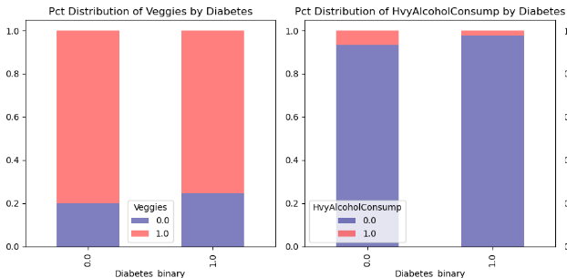
Both health conditions appear to be more prevalent among individuals with diabetes
* could be important predictors
High BP
High Chol
Daily Veggies
NOT Heavy Drinker
These lifestyle factors seem to show weak associations with diabetes status
Notes:
Veggies: Consume Vegetables 1 or more times per day 0 = no 1 = yes >>Heavy alcohol consumption is less common among diabetics than non-diabetics, though it's relatively uncommon in both groups.

Slide 9
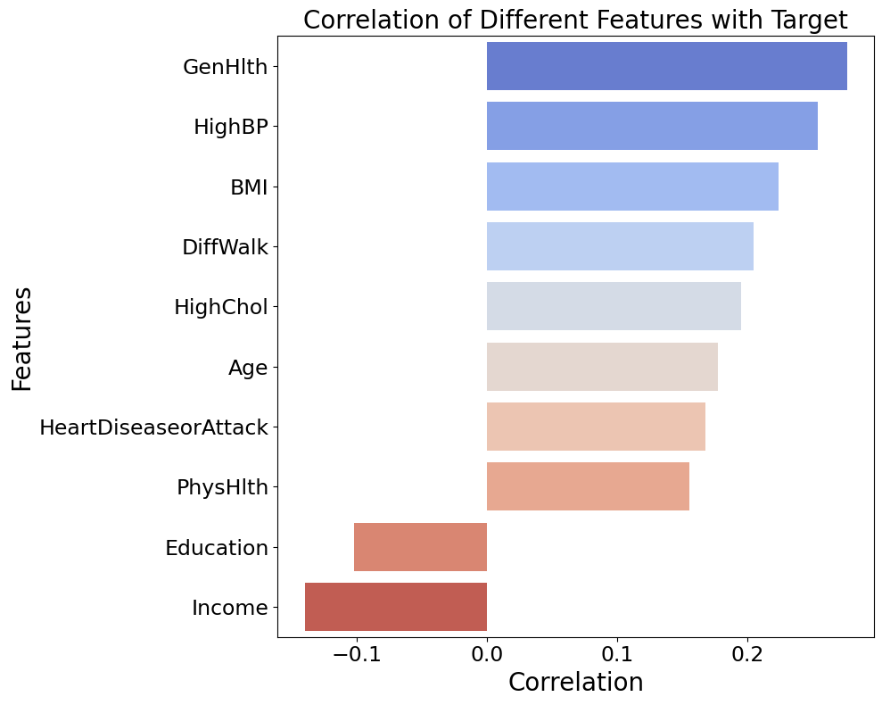
Feature Selection
Selected 10 features based on their correlation with the target variable, using a threshold of 0.1 for inclusion.
Decided not to proceed with feature engineering as initial attempts did not lead to improved model performance.

Slide 10
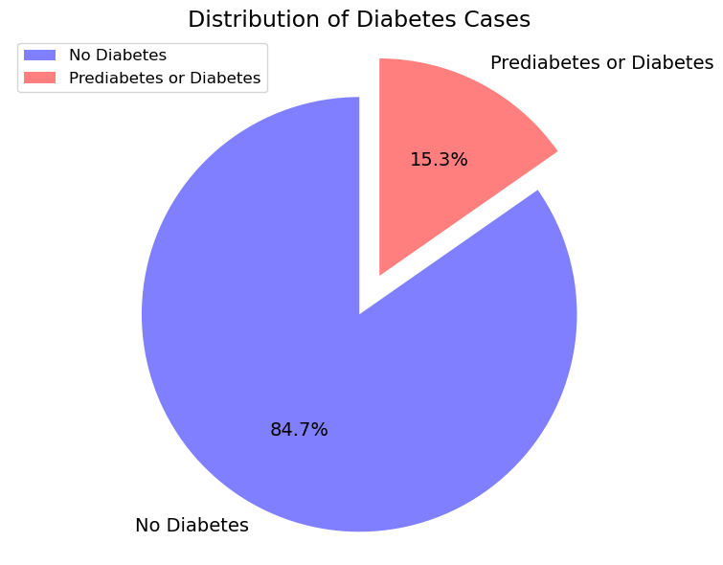
Data Preprocessing for Model Training
Train-Test Split:
70% training, 30% testing
Stratified Sampling is used to maintain the class distribution in both sets
Scaling:
Applied StandardScaler to both the training and test sets to ensure that features are on the same scale
SMOTE (Synthetic Minority Over-sampling Technique) :
Applied SMOTE on the training set.
Aim to balance dataset to a 1:1 ratio to reflect the estimated real-world prevalence in US adults.
Notes:
# Imbalanced dataset / Distribution in Target variable
# Diabetes Prevalence and Data Balancing Strategy:
U.S. Diabetes Statistics (CDC 2017-2020):
Combined prevalence: ~52.7% of adult population
Rationale for SMOTE:
Dataset likely underrepresents real-world diabetes prevalence
SMOTE used to synthesize minority class samples
Aim to balance dataset to a 1:1 ratio, approximating the combined diabetes and prediabetes prevalence in the population
>>> This approach ensures the model is trained on a more representative sample, potentially improving its ability to detect diabetes risk

Slide 11
Machine Learning Algorithms
Algorithms / Models Used:
Logistic Regression (LR) - Simple yet effective linear model for binary classification
Naive Bayes (NB) - Efficient for high-dimensional data
Decision Tree (DT) - Provides clear decision rules, handles non-linear relationships
Random Forest (RF) - Ensemble of decision trees that improves accuracy, handles complex interactions
Baseline and Optimised Models:
For each algorithm, both a baseline model and an optimised model (after applying SMOTE and hyperparameter tuning) were trained and evaluated.
Notes:
Machine Learning Algorithms:
Logistic Regression: A simple yet effective linear model that estimates the probability of a binary outcome, making it ideal for interpreting the influence of each feature on diabetes risk.
Naive Bayes: A probabilistic model that assumes feature independence. It’s particularly useful for large datasets and provides quick, interpretable results.
Decision Tree: A non-linear model that splits data based on feature values, creating a clear visual representation of decision rules. It’s flexible and handles both categorical and numerical data well.
Random Forest: An ensemble of decision trees that improves accuracy by reducing overfitting. It’s powerful for capturing complex relationships in data, particularly in larger datasets.
Rationale for Selection: Diverse approaches: From simple (Logistic Regression) to complex (Random Forest)
> Baseline and Optimised Models:
For each of these algorithms, I trained both a baseline model and an optimised model, where I applied SMOTE to address class imbalance and used hyperparameter tuning to improve performance. These models were chosen to balance interpretability, computational efficiency, and the ability to capture complex patterns in the data.

Slide 12
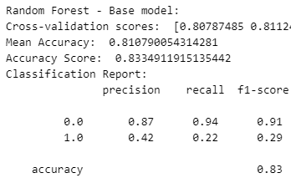
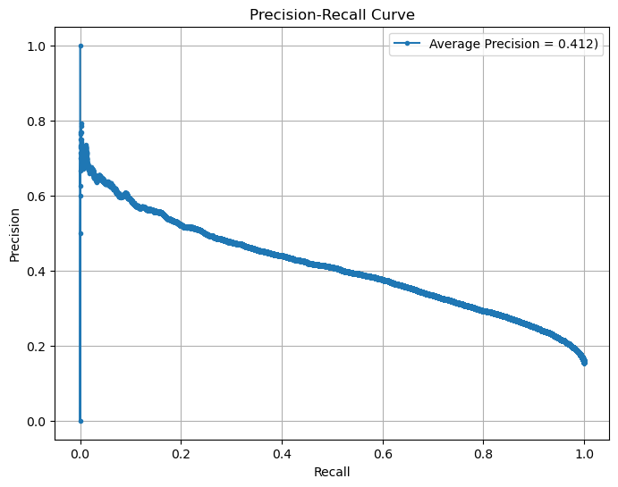
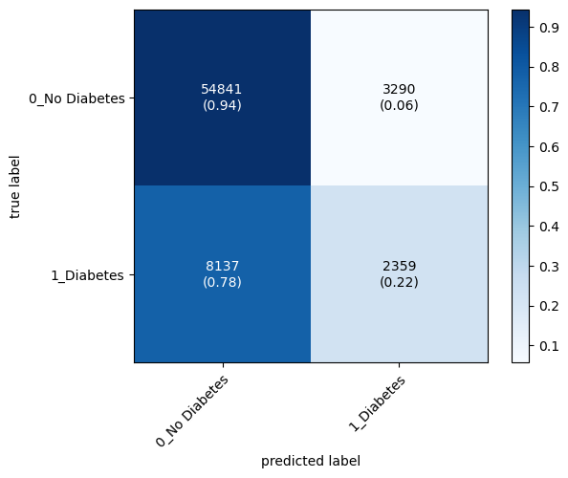
Key Metrics
Recall (Sensitivity) - ability to identify all positive cases (diabetes)
Average Precision - balanced view of model performance
Summarises precision-recall curve across all classification thresholds
Accuracy - Can be misleading for imbalanced datasets
Notes:
Recall (Sensitivity): Crucial for healthcare screening
Prioritizes minimizing missed diagnoses
Average Precision (AP): Comprehensive metric for imbalanced datasets
Precision and Average Precision Calculation:
Precision:
Formula: TP / (TP + FP)
TP = True Positives (correctly identified diabetics)
FP = False Positives (non-diabetics incorrectly classified as diabetic)
Measures the accuracy of positive predictions
Average Precision (AP):
Summarizes the precision-recall curve
Calculated as the weighted mean of precisions at each threshold: AP = Σ (R_n - R_n-1) * P_n Where R_n and P_n are recall and precision at nth threshold
Steps:
Calculate precision and recall at various thresholds
Plot precision vs recall
Calculate area under this curve
AP ranges from 0 to 1, with higher values indicating better performance
Classification Threshold:
Definition: The cutoff point that determines how a model's continuous predictions are converted into binary class labels (e.g., diabetic or non-diabetic).
Typical use:
Model outputs a probability (e.g., 0 to 1)
If probability > threshold, classify as positive (e.g., diabetic)
If probability ≤ threshold, classify as negative (e.g., non-diabetic)
Default: Often set at 0.5, but can be adjusted
Importance:
Affects balance between precision and recall
Lower threshold: More positive predictions, higher recall, lower precision
Higher threshold: Fewer positive predictions, lower recall, higher precision
In healthcare:
May be set lower to catch more potential cases, accepting more false positives
Threshold choice depends on the relative costs of false negatives vs false positives
Why not accuracy alone? Can be misleading for imbalanced datasets
May show high scores even if minority class (diabetes) is poorly predicted
AUC (Area Under ROC Curve): Measures model's ability to distinguish between classes
Less sensitive to class imbalance than accuracy
Useful, but recall and AP more directly relevant for diabetes screening

Slide 13
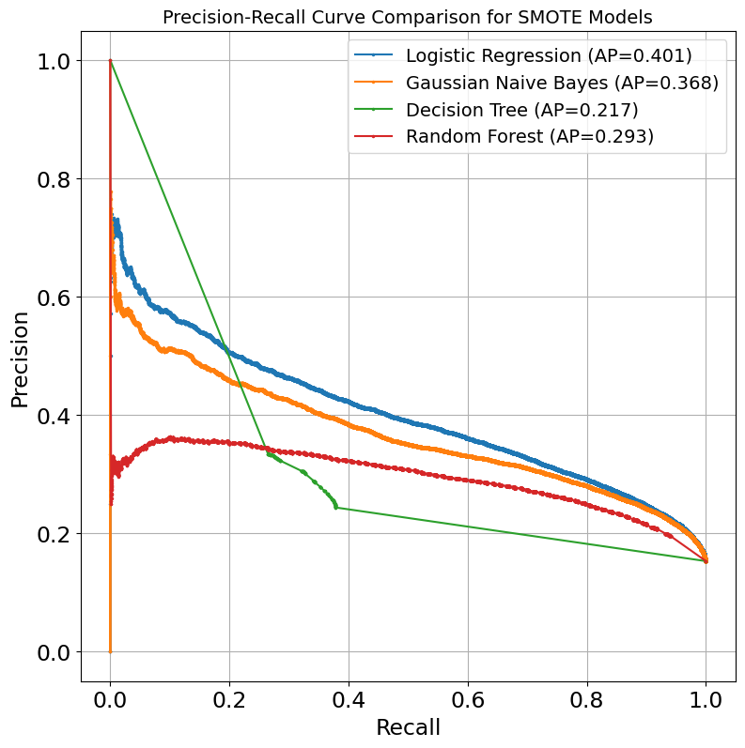
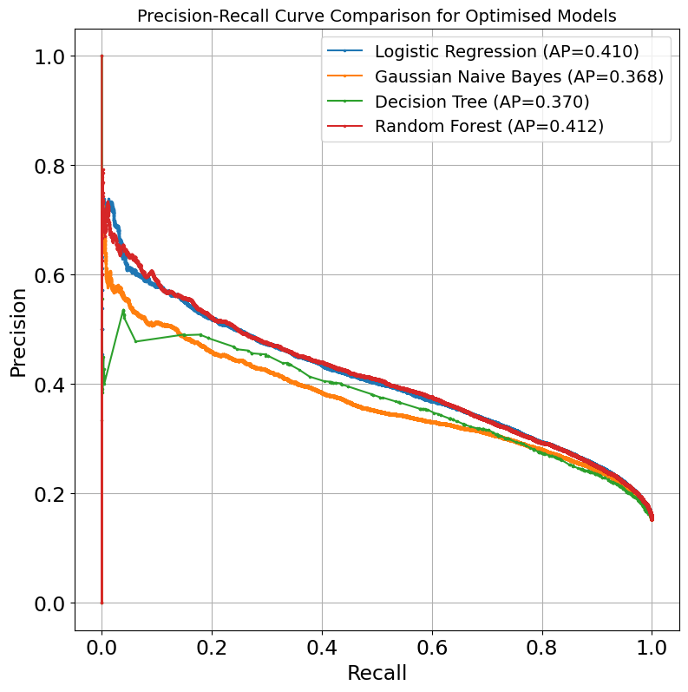
Hyperparameter Tuning
Method - Randomised search
To explore different combinations of key hyperparameters
More efficient than exhaustive grid search
Goal:
Identify optimal hyperparameters to maximise average precision score
Notes:
How Randomised Search Improves Efficiency:
Randomised Search improves efficiency by reducing the number of model evaluations required,
as it randomly samples from the hyperparameter space rather than exhaustively searching every combination like Grid Search.
This method enables quicker convergence to optimal or near-optimal solutions, making it particularly effective for large datasets or when computational resources are limited.
# Hyperparameter grids
lr_params = {
'penalty': ['l1', 'l2'],
'C': [0.01, 1, 10, 100],
'max_iter': [1000, 10000],
'solver': ['liblinear', 'saga'],
}
nb_params = {
'var_smoothing': [1e-9, 1e-8, 1e-7, 1e-6, 1e-5, 1e-4]
}
dt_params = {
'criterion': ['gini', 'entropy'],
'max_depth': [3, 5, 7, 10, 20],
'min_samples_split': [2, 10, 20, 50],
'min_samples_leaf': [1, 5, 10, 20],
'max_features': ['auto', 'sqrt', 'log2'],
'min_weight_fraction_leaf': [0.0, 0.01]
}
rf_params = {
'n_estimators': [10, 50, 100, 200],
'max_depth': [5, 7, 10, 15, 20],
'min_samples_split': [2, 10, 20, 100],
'min_samples_leaf': [2, 4, 8, 15],
'max_features': ['auto', 'sqrt', 'log2'],
'criterion': ['gini', 'entropy']
}

Slide 14
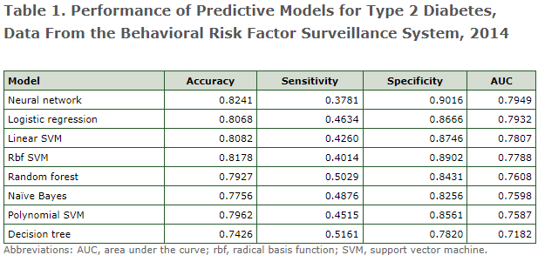
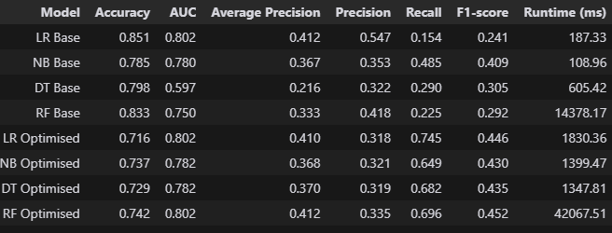
Performance Evaluation
Benchmark* (CDC research, 2014’s dataset, 27 features):
Highest Accuracy: 0.824 (Neural Network)
Highest AUC: 0.795 (Neural Network)
Highest Recall: 0.516 (Decision Tree)
Our models for this project (2015’s dataset, 10 features):
Highest Accuracy: 0.742 (Random Forest)
Highest AUC: 0.802 (LR & RF)
Highest Recall: 0.745 (Logistic Regression)
Highest Average Precision: 0.412 (Random Forest)
Performance of Predictive Models for Diabetes – BRFSS 2015
*Reference:
Xie Z, Nikolayeva O, Luo J, Li D. Building Risk Prediction Models for Type 2 Diabetes Using Machine Learning Techniques. Prev Chronic Dis 2019;16:190109. DOI: http://dx.doi.org/10.5888/pcd16.190109.
Notes:
>> Before I show my results, let’s look at the CDC’s research findings as our benchmark…..
This paper also states that:
Decision Tree model is preferred for initial screening for type 2 diabetes because it had the highest sensitivity (recall) and, therefore, detection rate
https://www.cdc.gov/pcd/issues/2019/19_0109.htm

Slide 15
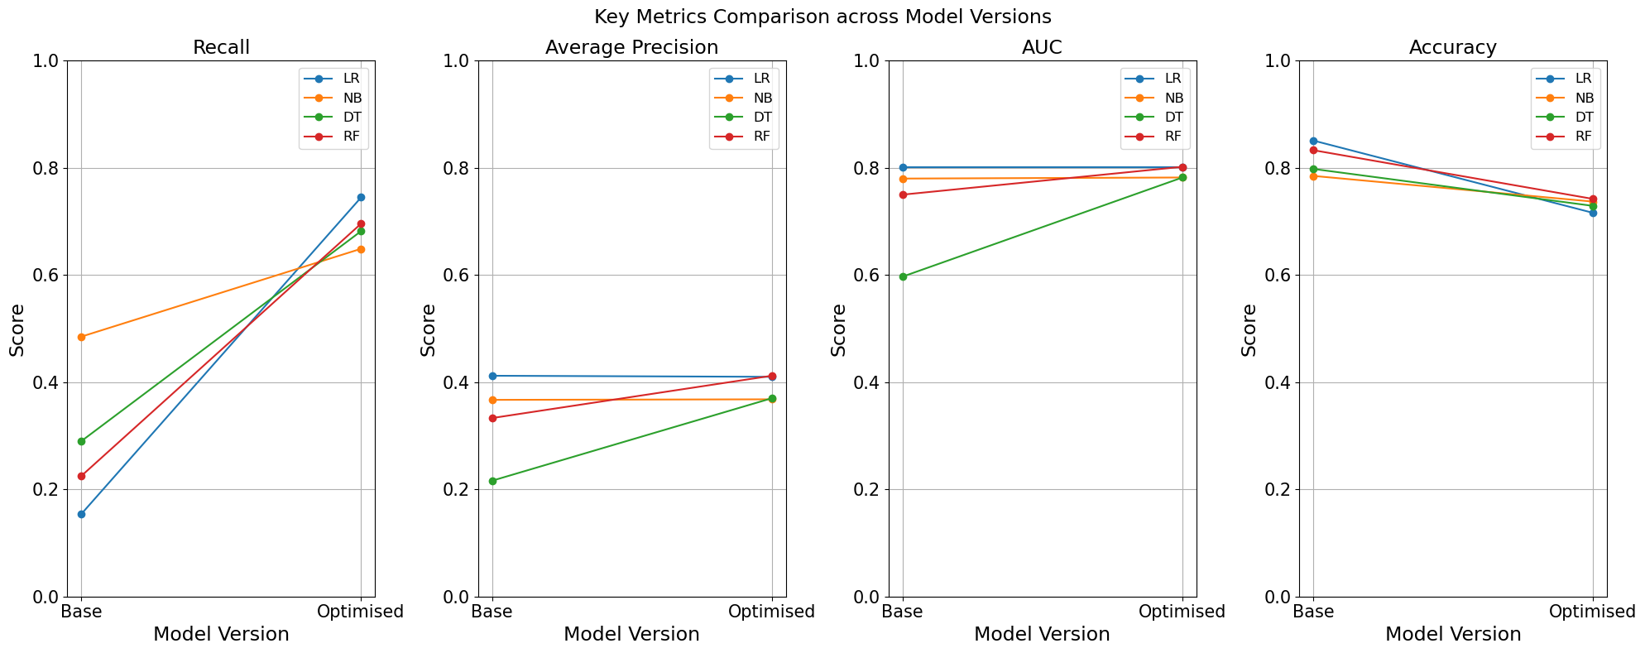
Performance Evaluation
Recall
AP
AUC
Accuracy
Notes:
>>These 4 charts compare the performance of baseline models (LHS) against their optimised counterparts (RHS in each plot), showing the impact of SMOTE and hyperparameter tuning.
Recall: All models saw a significant improvement in recall after optimisation. This indicates that the optimised models became better at identifying individuals with diabetes.
Average Precision and AUC: Both metrics remained relatively stable with some improvement after optimization → maintaining their overall classification capability.
- Average Precision (AP) measures the precision across all recall thresholds, reflecting the model’s ability to balance precision and recall.
- AUC (Area Under the Curve) represents the overall performance of the model in distinguishing between classes.
Accuracy: There was a slight decrease in accuracy for all models (though still over 70%), likely due to the trade-off with improved recall. This is a typical outcome when prioritising the detection of the minority class, as seen in imbalanced datasets.

Slide 16
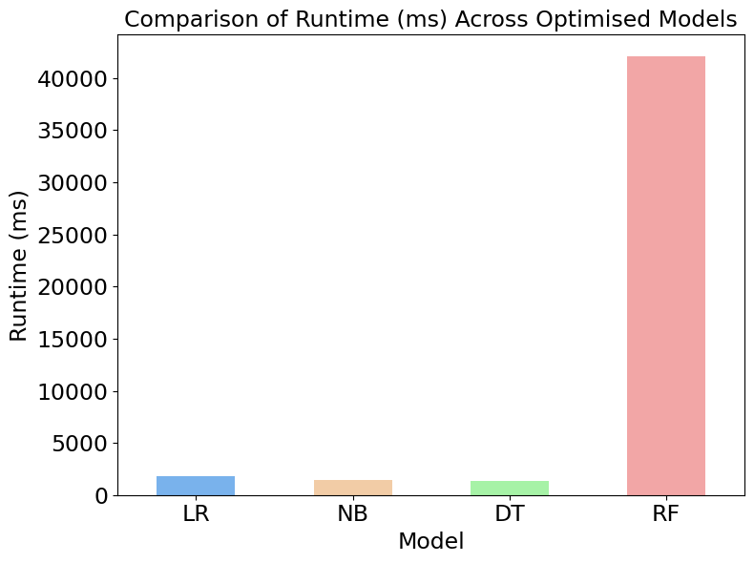
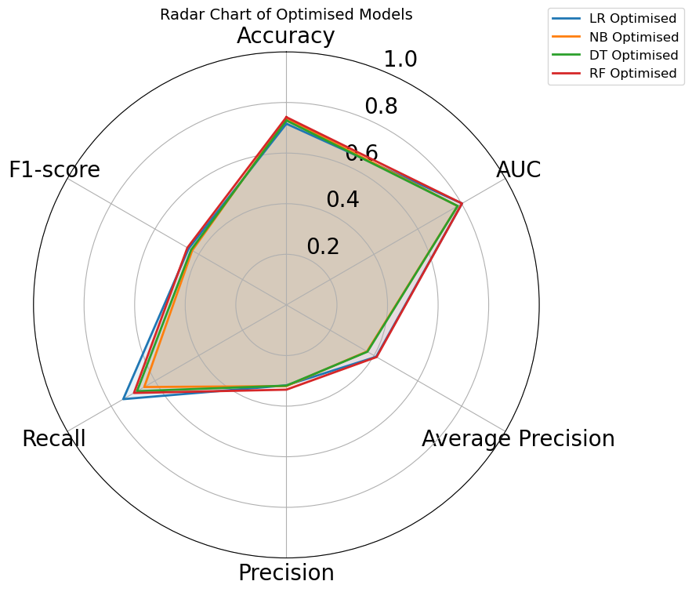
Best Model Selection
Random Forest (RF)
Best Overall Performance
Logistic Regression (LR)
Best Recall & AUC;
Much more efficient compared to RF
Notes:
Best Overall Model:
- The Random Forest Optimised model stands out with the best combination of metrics:
- This makes it a strong candidate for overall performance, particularly in a screening context where balancing different metrics is essential.
Best Model for Recall and Runtime:
- Logistic Regression Optimised excels in recall (0.745), which is higher than any other model, and has a reasonably fast runtime (1830.36 ms).
> This makes it the best choice if recall and speed are the priorities, especially in real-time or resource-constrained environments.
>> Considerations for Practical Implementation:
- If the goal is to minimise missed positive cases (high recall) while also considering processing time, Logistic Regression Optimised is likely the best option.
- For a more balanced approach with strong overall performance across multiple metrics, Random Forest Optimised would be preferable, despite its longer runtime.
Overall, while Random Forest Optimised may offer the best comprehensive performance, Logistic Regression Optimised provides an excellent balance of high recall and efficiency, making it a strong contender depending on the specific needs of the deployment environment.

Slide 17
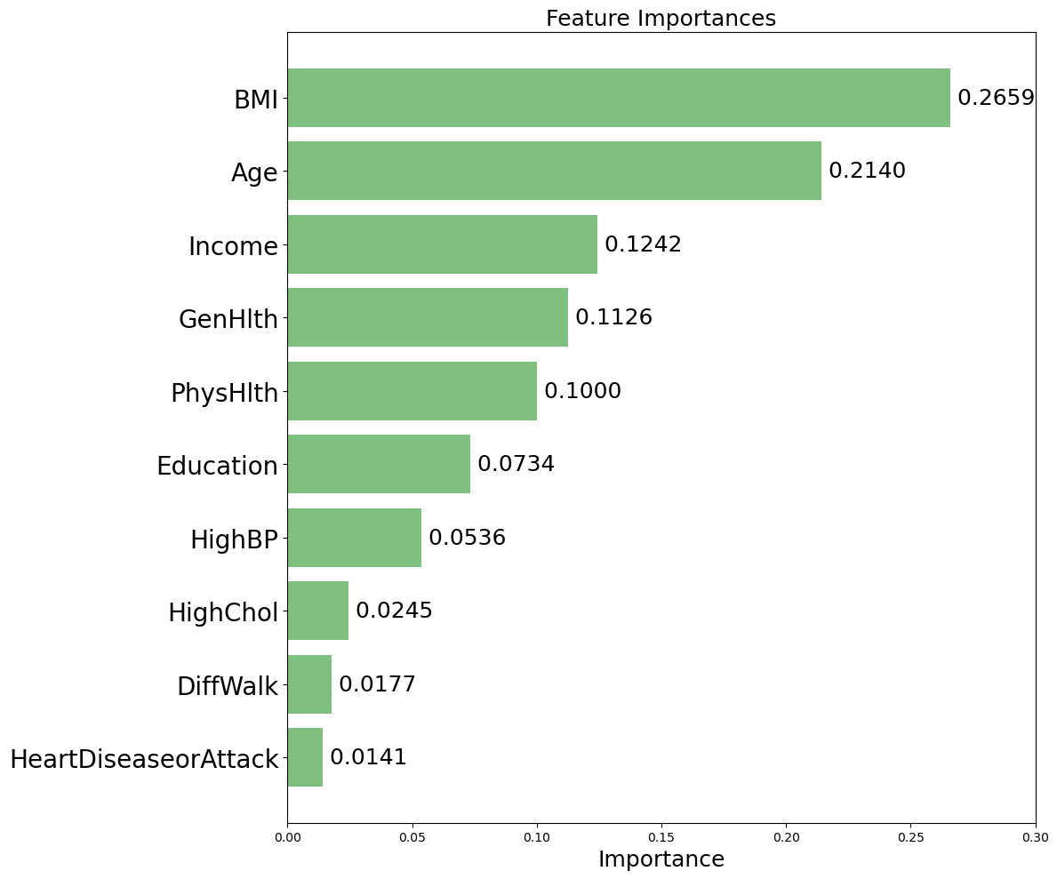
Risk Factors
Our Random Forest model ranked key risk factors for diabetes by their relative importance in predicting the condition.
Top Risk Factors: BMI & Age
about 48% of the total importance
Notes:
This bar chart illustrates the importance of each feature in the Random Forest model.
The higher the importance score, the more influence that feature has in predicting the target outcome (diabetes risk). Here's what the chart tells us:
BMI and Age are the most influential features in the model, suggesting that they have the strongest impact on predicting diabetes risk in this dataset.
Income, General Health (GenHlth), and Physical Health (PhysHlth) also contribute significantly, though to a lesser extent.
Features like High Blood Pressure (HighBP), High Cholesterol (HighChol), Difficulty Walking (DiffWalk), and History of Heart Disease or Attack (HeartDiseaseorAttack) have lower importance scores, indicating they contribute less to the model’s predictions.

Slide 18
Benefits of Implementing Machine Learning
A range of benefits - from individual patient care to broader public health impacts:
Early Disease Detection: Identify at-risk individuals before symptoms appear
Personalised Prevention: Tailor health interventions based on individual risk profiles
Resource Optimisation: Allocate healthcare resources more efficiently to high-risk groups
Health Policy Support: Inform evidence-based public health policies and initiatives

Slide 19
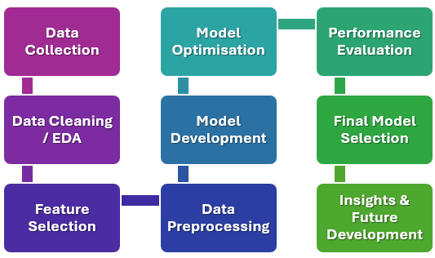
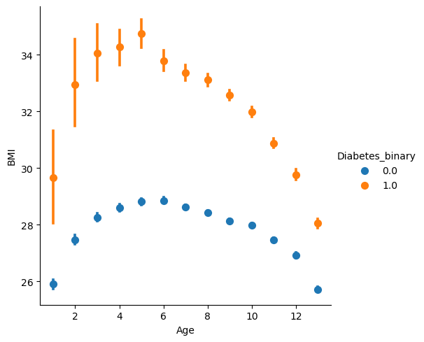
Improvement / Future Development
Feature Selection / Engineering
Reduce the number of features selected or try a different subset
Models:
Explore more advanced models / ensemble methods
Deployment:
Consider developing a real-time risk assessment tool for healthcare providers.
Broader Application:
Expand the model to predict other chronic diseases.

Slide 20

Questions?
Thank you for your time ^_^

