Slide 1
Human resources slide 1
Employee Attrition Analysis
Presented by Emily Huang from Institute of Data
Notes:
Role play: Emily: Data Scientist, Audience: Management team from ABC Group

Slide 2

Human resources slide 3
Employee Attrition
Definition:
The loss of employees in a company due to certain factors such as retirement, resignation, or termination of employment.
Importance:
Impacts costs (recruitment, training)
Affects productivity and morale
Influences organisational stability
Reference:
Canada Indeed. "What Is Employee Attrition?" https://www.indeed.com/career-advice/career-development/attrition-of-employees Accessed [July 2024].
Notes:
Today, I will be presenting our analysis on employee attrition, a critical issue that impacts our organisation's stability and growth.
Understanding why employees leave can help us implement effective retention strategies, improve overall employee satisfaction, and ultimately drive the company’s success.
High attrition rates can lead to increased recruitment and training costs, loss of institutional knowledge, and decreased morale among remaining staff. Understanding and managing attrition is crucial for maintaining a competitive edge in today's dynamic business landscape.

Slide 3
Human resources slide 3
Questions to Explore
What factors are associated with employee attrition, and how are they related to turnover patterns in our workforce?
Which employee segments show higher attrition rates, and what characteristics are associated with these segments?
What job-related factors are correlated with employee attrition and retention patterns?

Slide 4
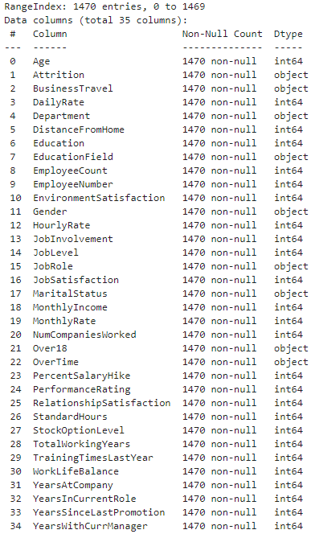
Human resources slide 3
Dataset Overview
Dataset:
IBM Data Science team (downloaded from Kaggle)
1,470 employees (rows)
35 features per employee (columns)
Features include:
Demographics (age, gender, marital status)
Professional background (education, experience)
Job details (role, level, tenure)
Compensation (salary, stock options)
Satisfaction metrics (job involvement, work-life balance)
Career progression (promotions, training)
Target: Attrition

Slide 5
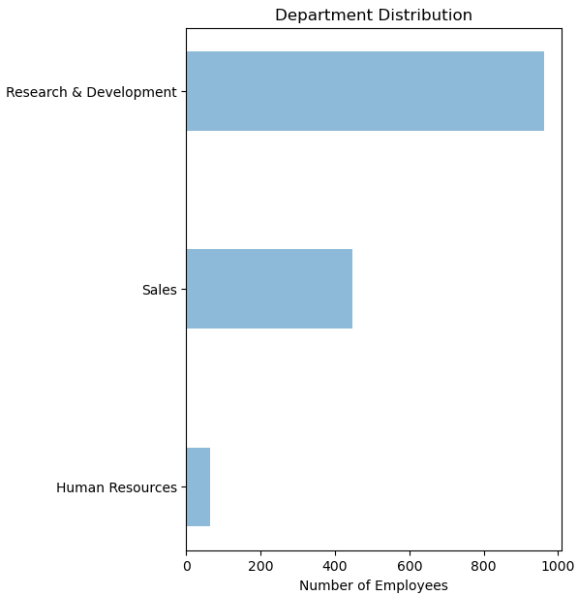
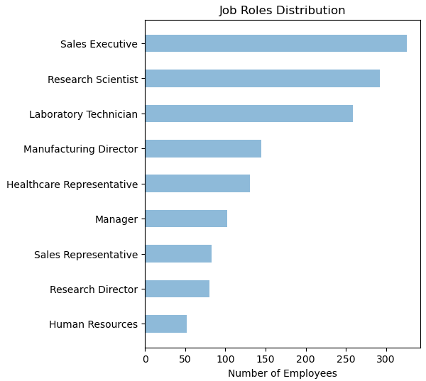
Human resources slide 3
Overview of Company Data
Notes:
Looking at departments, we can see that Research & Development is by far our largest, with nearly 1000 employees. Sales is our second biggest department, while Human Resources is much smaller.
When we break it down by job roles, we see a more diverse spread. Sales Executives, Research Scientists, and Laboratory Technicians are our top positions in terms of employee counts. We have fewer employees in specialized roles like Research Director and Human Resources.

Slide 6
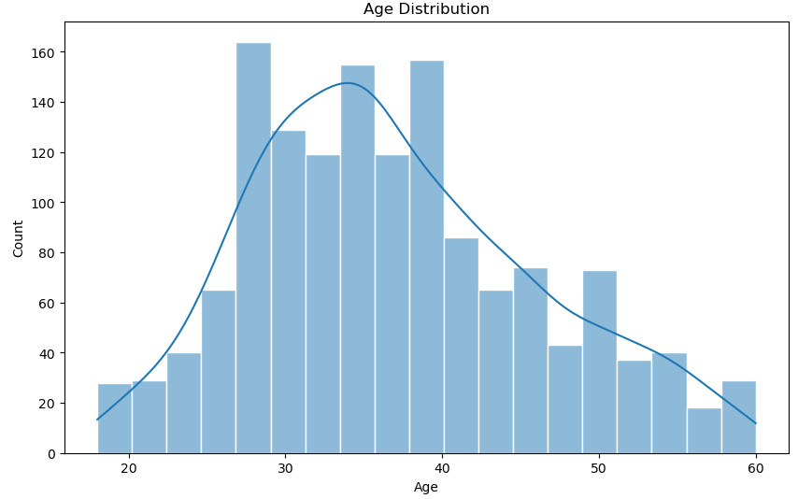
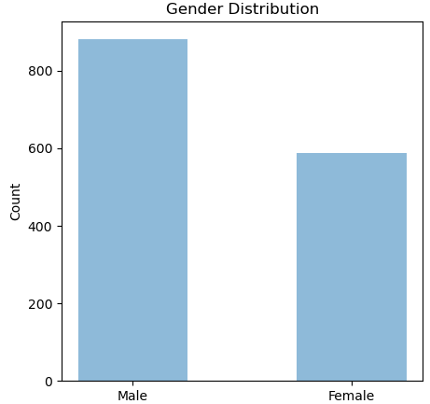
Human resources slide 3
Overview of Employee Data
Notes:
This slide gives us a quick look at who makes up our workforce in terms of age and gender. On the left, we see how old our employees are. Most of our team is between late 20s and 40 years old, with fewer people in their early 20s or over 50. This tells us we have a good mix of experience levels, with a strong core of mid-career professionals.
The chart on the right shows us the balance between men and women in our company. We have more men than women overall (looks like 6:4 in ratio), but there's still a significant presence of both genders in our workforce.
These insights help us understand the basic makeup of our team, which is important as we think about our company culture, recruitment strategies, and how we can best support our employees' needs and growth.

Slide 7
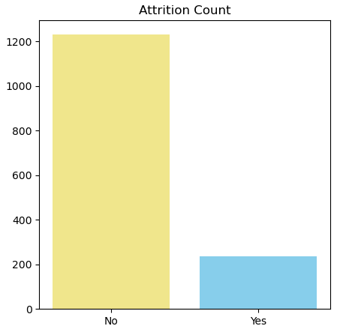
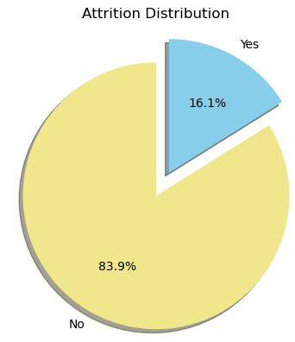
Human resources slide 3
Overview of Employee Attrition
Notes:
This slide gives us a clear picture of employee attrition in our company.
On the left, we have a bar chart showing how many employees are staying with us versus how many have left. The taller yellow bar represents employees who are still with the company, while the shorter blue bar shows those who have left.
The pie chart on the right puts this into percentages. It shows that about 84% of our employees are staying with us, while around 16% have left the company. These numbers help us understand our retention rate. While most of our employees are staying, we still have a noticeable portion leaving.
This information is crucial for our HR strategies and can help us focus on ways to keep more of our talented team members on board.

Slide 8
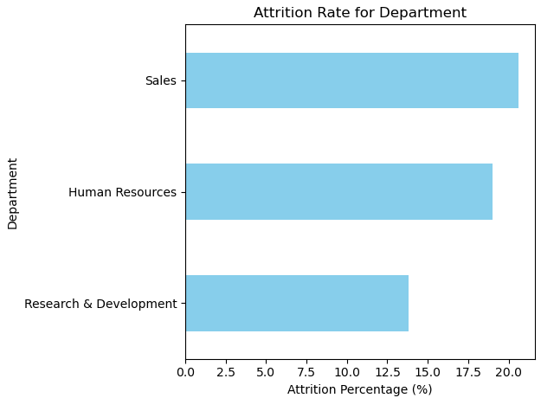
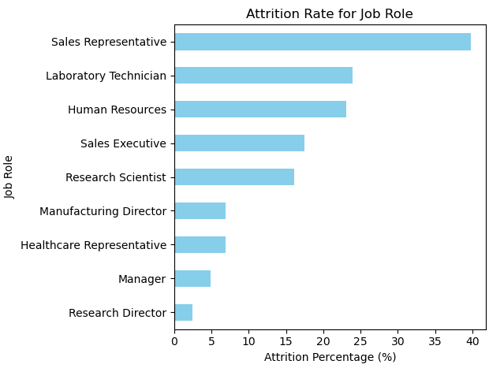
Human resources slide 3
Categorical Features
Notes:
Explain what Categorical & Numerical mean.
*Sales-related roles (both department and specific job roles) seem to have the highest attrition rates.
*While Sales has the highest attrition rate, Laboratory Technicians represent a larger portion of the workforce. Their 20-25% attrition rate, applied to a larger employee base, could result in a higher absolute number of departures. This creates a substantial operational challenge.
*Leadership positions like Managers and Directors tend to have lower attrition rates

Slide 9
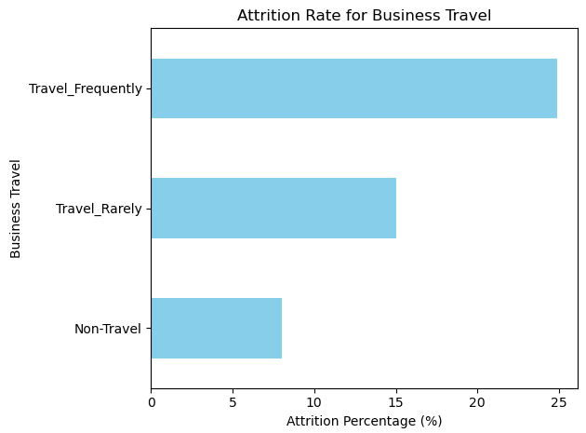
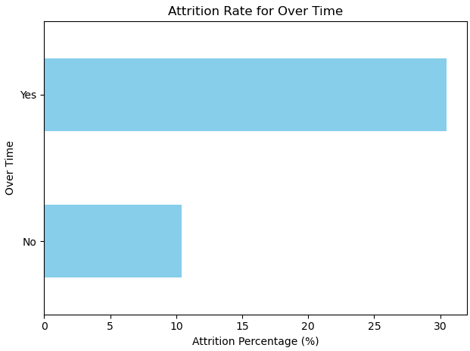
Human resources slide 3
Categorical Features
Notes:
Not all Features are included in this slide – some more will be shown later.
two factors related to employee attrition:
Business Travel: Frequent travelers have the highest attrition rate at 25%, while non-travelers have the lowest at under 10%.
Overtime: Employees working overtime show a 30% attrition rate, double that of those who don't work extra hours.
These findings suggest that managing travel demands and work hours could be key to improving employee retention.

Slide 10
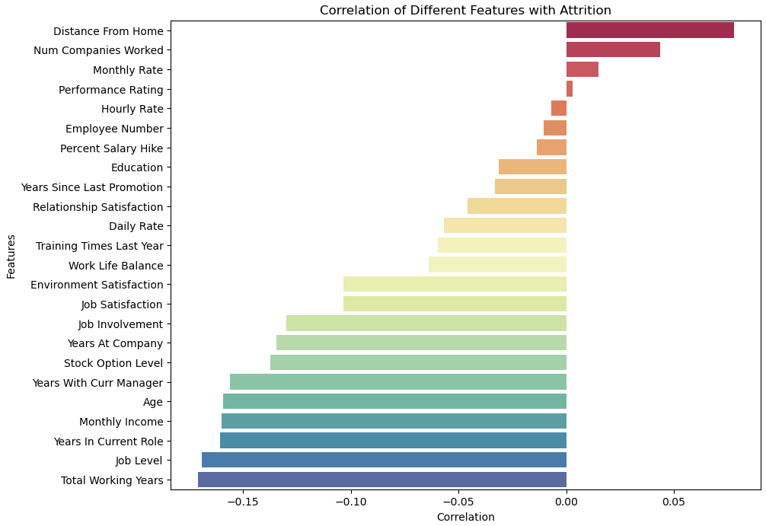
Numerical Features
*Correlation:
Strength and direction of the relationship between two features
*Key +ve influencers of attrition:
Distance From Home
Num of Companies Worked Before
*Key –ve influencers of attrition:
Total working years, and tenure-related metrics
Income & Job-related: Monthly income and job level
Notes:
Correlation measures how strongly two variables or features are related, ranging from -1 to 1. A positive correlation means as one variable increases, so does the attrition, while a negative correlation means they move in opposite directions.
The chart reveals that distance from home and number of companies worked have the strongest positive correlations with attrition. This means employees living farther from work or with more varied job histories are more likely to leave. On the flip side, total working years, job level, and years in current role have the strongest negative correlations, indicating that more experienced employees and those in higher positions tend to stay longer.

Slide 11
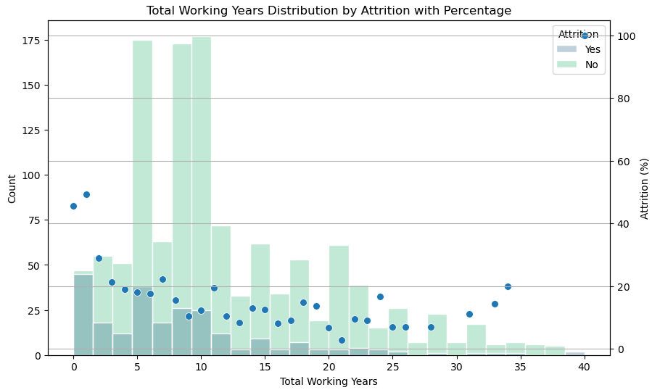
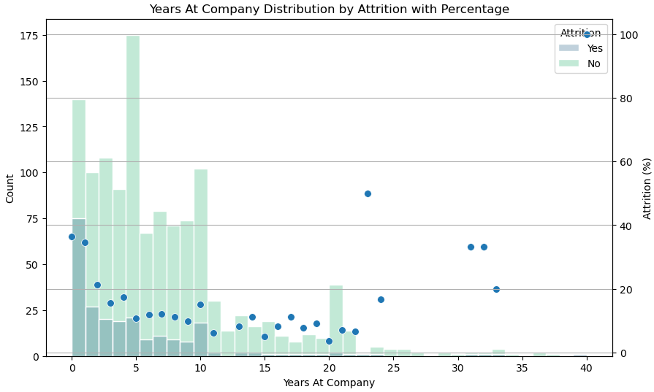
Years of Service Insights
Attrition generally decreases as total experience increases, with some fluctuations
Attrition tends to decrease with longer company service, though there are some spikes later on

Slide 12
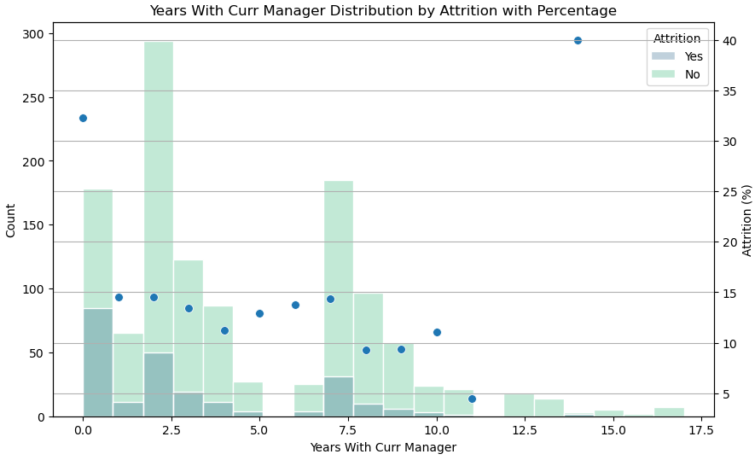
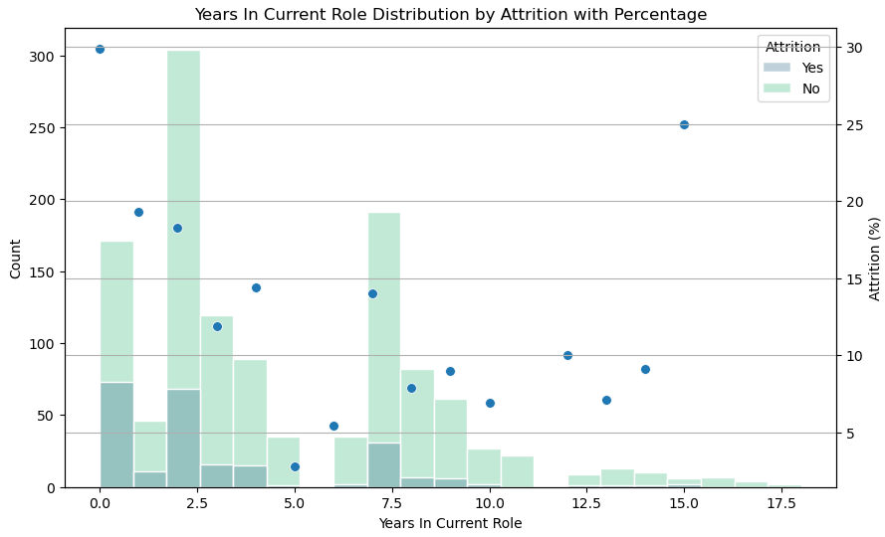
Years of Service Insights
*Attrition risk is highest in the first 2.5 years, whether with a new manager or in a new role
*Sample sizes for longer tenure groups are small, limiting the reliability of these trends
Notes:
Further investigation with larger datasets or over time is recommended for more robust conclusions about long-term employees

Slide 13
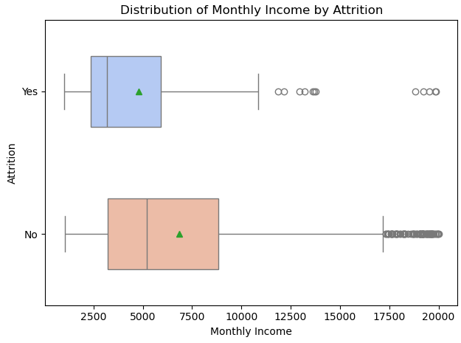
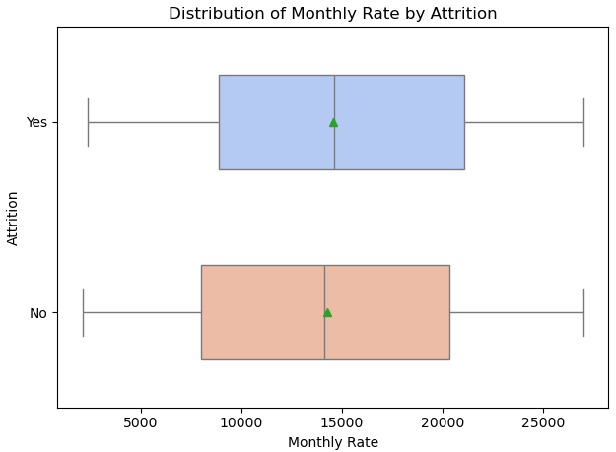
Income-Related Insights
Lower Monthly Income (actual) correlates with higher attrition
Monthly Rates of pay (theoretical) are similar between groups
Actual earnings rather than pay rates may be a stronger influencer
Notes:
These plots compare monthly income and theoretical monthly rate of pay for employees who left versus stayed. The boxplot for each shows the spread of income data with the box representing the middle 50% of employees. The line in the middle of the box represents the median income (the 50th percentile), and the green triangle marks the mean/average value.
Interestingly, while actual monthly income is lower for those who left, the theoretical monthly rates are similar or slightly higher.
This suggests that actual earnings (base pay plus bonus, overtime etc.), rather than pay rates, may be more influential in attrition decisions.
The discrepancy between rate and income also hints at potential differences in work hours or other factors affecting total compensation.

Slide 14
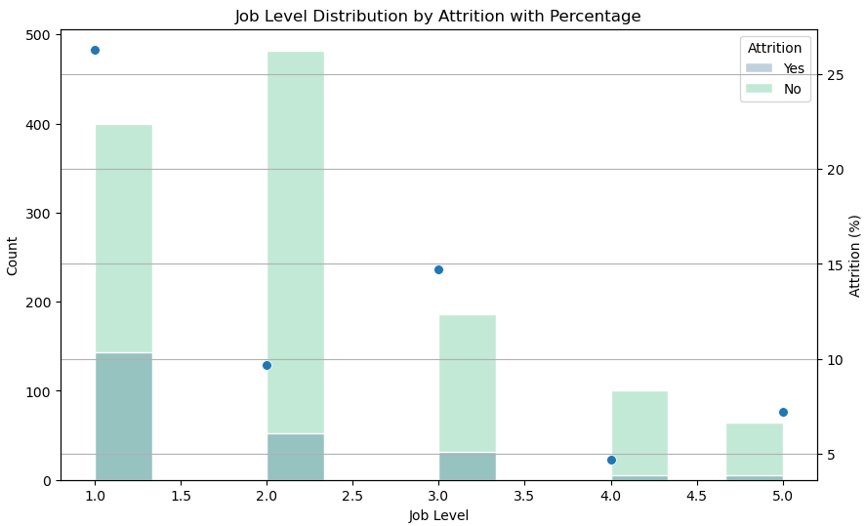
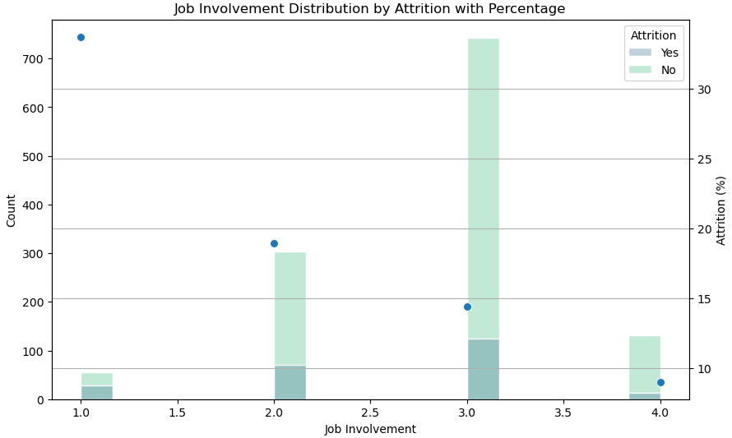
Job-Related Insights
Entry-level positions (Job Level 1) have the highest attrition risk (27%)
Attrition generally decreases as job level increases, with an exception at Level 3
Clear inverse relationship between job involvement and attrition

Slide 15
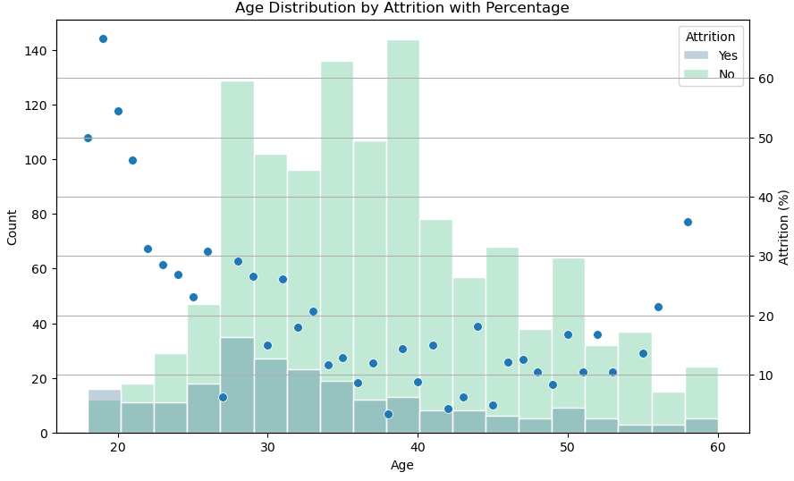
Employee Insights
Highest attrition among youngest employees
General trend of decreasing attrition with age
Lowest attrition rates for employees in 30s and 40s
Slight increase in attrition for employees in late 50s

Slide 16
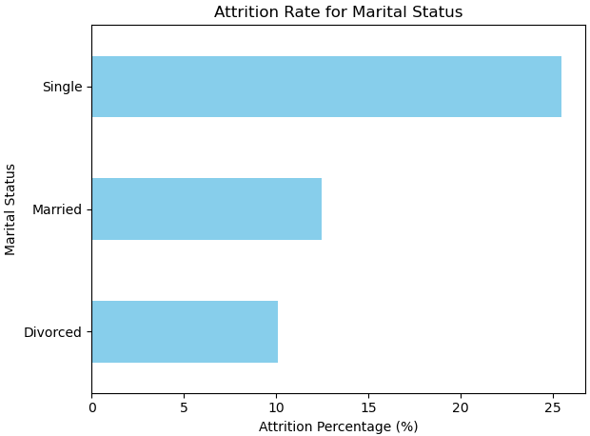
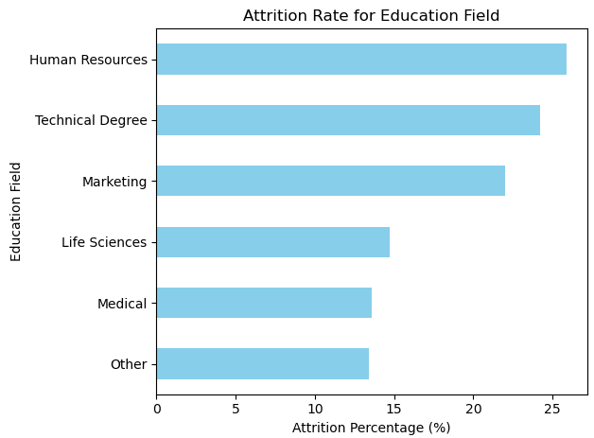
Employee Insights
Notes:
Single employees have highest attrition (25%), married lower (15%), divorced lowest (10%)
HR field shows unexpectedly high attrition
Technical and Marketing degrees associated with higher attrition
Life Sciences and Medical fields retain employees better
Consider targeted retention strategies for single employees and those in high-attrition fields

Slide 17
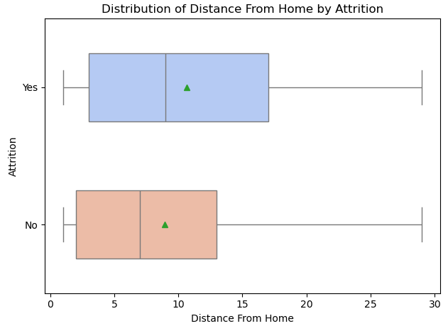
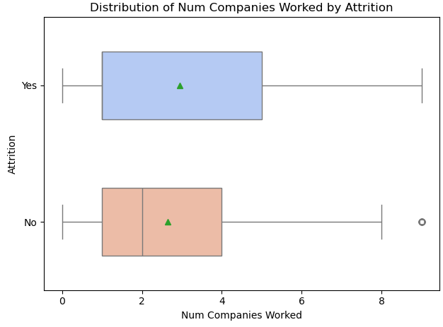
Employee Insights
Employees who left tend to live a bit farther from work
People who changed jobs before are somewhat more likely to do so again
Both factors show some differences between the 2 groups, as well as big overlap
Notes:
This slide compares two factors between employees who left and those who stayed: how far they live from work and how many companies they've worked for before.
For distance from home, those who left tend to live slightly farther away. The range of distances is also wider for this group. This suggests that a longer commute might play a role in people deciding to leave.
Looking at the number of companies worked for, employees who left have typically worked for more companies in the past. This could mean they're more likely to change jobs again. However, the difference isn't huge, so it's just one piece of the puzzle.
Both factors show some differences between the two groups, but there's a lot of overlap. This means these aren't the only things influencing whether someone stays or goes.

Slide 18
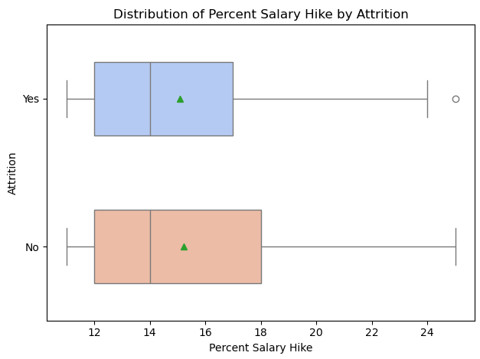
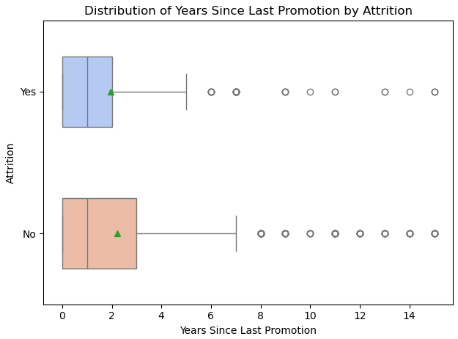
Strategies for Staff Retention?
Salary hikes alone do not seem to significantly impact retention
Recent promotions do not ensure retention
These may work for some groups but not others -> may need more personalised retention strategies
Notes:
1.Salary increases alone might not be enough to keep people.
2.Half of the people who left got promoted within the past 2 years -The company might want to investigate why recently promoted employees are leaving
*Individual factors likely play a crucial role, suggesting the need for personalised retention strategies
2b.Employees who stayed with the company tend to have gone longer without a promotion compared to those who left. This is contrary to what we might expect and suggests that the relationship between promotions and retention is more complex than initially thought.

Slide 19
Summary and Recommendations
Which employee segments show higher attrition rates, and what characteristics are associated with these segments?
Key findings: Sales representatives and Laboratory Technicians Young employees in their early 20s Single employees Employees with longer commutes or more varied job histories Recommendations: Targeted retention programmes for high-risk groups
Notes:
Recommendations:
Create targeted retention programmes for Sales and Laboratory Technician roles
Implement mentorship and career development initiatives specifically for young employees
Design work-life balance programmes that address the needs of single employees
Consider flexible work arrangements or relocation assistance for employees with long commutes

Slide 20
Summary and Recommendations
What job-related factors are correlated with employee attrition and retention patterns?
Key findings: Lower job levels, job involvement & monthly income Overtime work Critical period in the first 2.5 years Salary increases alone don't show strong correlation with improved retention 50% of employees who left were promoted within the past 2 years Recommendations: Strengthen onboarding and integration programmes Investigate factors beyond compensation
Notes:
Recommendations:
Develop strategies to increase job involvement across all levels
Review and optimize overtime policies and workload distribution
Provide clear job description & expectation before hiring.
Strengthen onboarding and integration programmes for the first 2.5 years of employment or new role transitions
Investigate factors beyond compensation that may influence retention, especially for recently promoted employees

Slide 21
Next Steps
Predictive modeling to forecast attrition.
Further analysis of other (or combination of) factors that may correlate with attrition, e.g. Job Satisfaction.
Data update: e.g. Reason for leaving, or increasing sample size

Slide 22

Human resources slide 8
Questions Welcome
Thank you

