Slide 1

Optimising Student Retention and Educational Outcomes: Early Identification and Tailored Support in Virtual Learning Using Data Science
Prepared by Emily Huang Nov. 2024

Slide 2

Business Background
My personal experience
Opportunities & challenges
Global market projected to reach USD $185.2 billion by 2029, driven by demand for flexible learning.
Challenges include engaging students and ensuring success, with financial pressures making retention critical post-COVID.
Business value
Boosts tuition revenue and reduces recruitment costs.
Enhances reputation, attracting more students and funding.
Supports a positive learning environment long-term.
Notes:
Let me start with my own personal experience.
Back in 2010, I attended NZ Tertiary College to study early childhood education, and their course was online, which allowed me to download almost all my learning resources from the internet. At that time, I was really amazed by this type of delivery. Fast forward to today, online learning has become even more common as technology rapidly advances. >the global online education market is projected to generate around $185.2 billion USD, with expected growth at an 8.56% annual rate through 2029. This trend is largely driven by an increased demand for flexible learning solutions that allow individuals to upskill or reskill, which is crucial in today’s evolving job market.
For example, I’m currently studying data science and AI at the Institute of Data and taking an advanced statistics course at the University of Auckland, both online, which gives me the flexibility I really value.
>But with this growth in online education, Many institutions are facing new challenges, especially around keeping students engaged and helping them succeed. Financial pressures, especially after COVID, mean that retaining students is critical,. This project is about exploring ways to identify students who might need extra support early in their courses. By using predictive analytics, we aim to help institutions provide timely and targeted interventions, improving both student outcomes and overall retention.
, >this boosts tuition revenue and reduces recruitment costs. >It also enhances the institution's reputation, attracting more students and funding. >Ultimately, it creates a more supportive environment that benefits both students and the institution's long-term success.

Slide 3

Business Question
How can we identify students at risk of failing or dropping out early in the term, in order to provide timely and tailored support?
Data Question
What data is needed to predict which students are at risk of failing or dropping out early in the term, and how can this data be used to improve their learning outcomes?

Slide 4
A Data Science Approach
Data Extraction
Data Preprocessing
Model Training
Deployment & Monitoring
Model Evaluation
Clustering
Feature Selection
Notes:
simplified data science workflow for solving the business and data questions:
Data Extraction: Collect raw data from various sources, including student demographics, VLE interaction logs, and early assessment scores.
Data Preprocessing /EDA: Clean and prepare the data by handling missing values, normalising numerical attributes, and encoding categorical features.
Feature Engineering: Create new features, such as weighted assessment scores, average engagement metrics, and proportions of VLE activity types, to capture deeper insights.
Clustering: Apply clustering algorithms (e.g., K-Means) to segment students into groups based on engagement and performance patterns for targeted analysis.
Feature Selection: Use methods like Lasso regression to select the most impactful features that contribute to predicting student outcomes.
Model Training: Train various machine learning models (e.g., Logistic Regression, LightGBM, Neural Networks) using a stratified split and cross-validation to optimise performance.
Hyperparameter Tuning: Fine-tune model parameters through grid search or other optimisation techniques to improve predictive accuracy and recall.
Model Evaluation: Assess model performance using metrics such as F1 Score, Recall, and ROC AUC to ensure reliability and effectiveness.
Deployment & Monitoring: Implement the model into a dashboard for weekly updates and tracking, enabling timely interventions and ongoing model monitoring for maintenance and retraining as needed.
This workflow outlines the comprehensive steps to answer the business and data questions using a data science approach.

Slide 5

Stakeholders
Course Tutors and Academic Advisors
University / Online Training Administration
Students
Expectations:
Actionable insights for early interventions, user-friendly dashboards with visual updates, personalised student support.
Notes:
People who can benefit from this project
Course Tutors and Academic Advisors Why they care: Tutors and advisors directly support students’ academic success, and effective, data-driven identification of at-risk students enables earlier interventions. Expectations: Accurate, actionable predictions on at-risk students and an accessible dashboard that supports proactive student engagement.
University / Online Training Administration Why they care: Administrators focus on improving retention rates and student satisfaction, which impact university funding and reputation. Expectations: A scalable tool that integrates with existing systems, offers data-driven insights, and supports institutional goals around retention and student success.
Students Why they care: Students benefit from personalised support to improve academic outcomes and avoid failure. Expectations: Meaningful feedback, early alerts for struggling students, and guidance on academic improvement strategies.

Slide 6
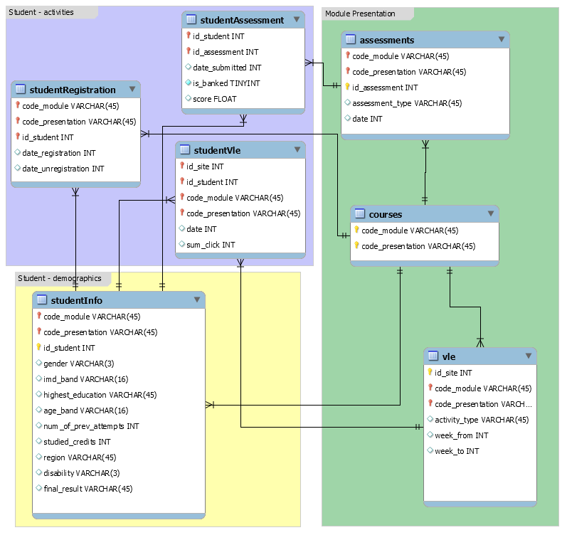
Dataset (OULAD)
Source: Open University (UK)’s website
Volume: Around 32,000 student records across various features.
Attributes:
Courses (called modules) / Assessments
Student demographic
Interactions with Virtual Learning Environment (VLE)
Binary Target: ‘at_risk' status derived from final_results (the “studentInfo” table).
Database Schema showing the structure and relationship between the seven tables from the Open University Learning Analytics dataset (OULAD)
Notes:
(Source: https://analyse.kmi.open.ac.uk/open_dataset#description)
This dataset comes from the Open University in the UK, which provides large-scale distance learning. Students access course materials and submit assignments via a Virtual Learning Environment, or VLE. The university uses various interventions to support at-risk students, like phone calls from support teams. The goal of the OU Analyse project is to predict students at risk of failing early on to enable meaningful and cost-effective interventions.
>As you can see from the db schema diagram, it has 7 csv files, including about 32,000 student records, covering demographics, assessments, VLE activity, and other attributes. Our binary target is the “at-risk” status, derived from final course results.

Slide 7
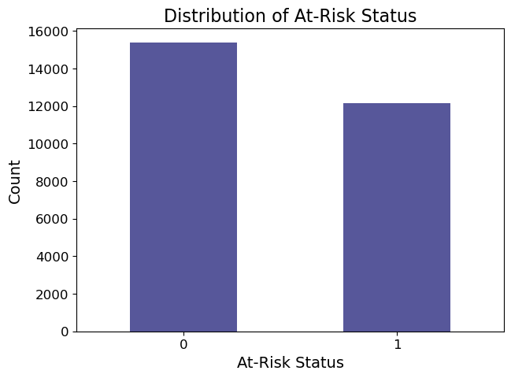
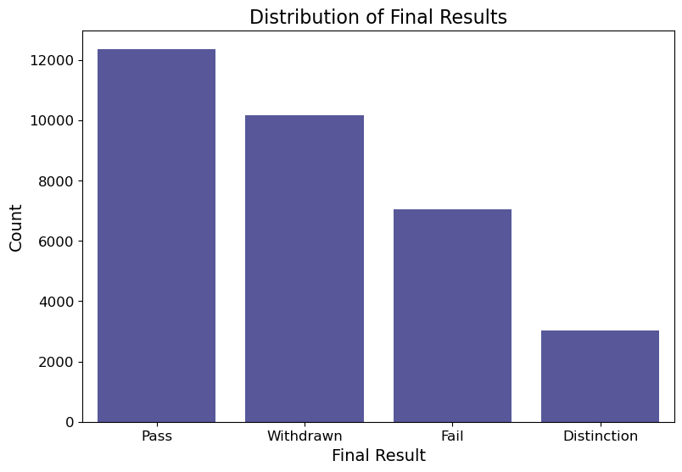
Exploratory Data Analysis (EDA)
At-risk (1): 12,168
Not at-risk (0): 15,385
Notes:
The original target has 4 different classes. For this project, we created a binary target called "at-risk." >because simplifying to a binary target helps make predictions more focused and aligns with the goal of identifying students who need early support.
>Students who failed or withdrew were marked as 1, meaning "at-risk,"
We also excluded students who unregistered within the first 4 weeks to have meaningful prediction. This gives us about 12,000 at-risk students and 15,000 not at-risk students.

Slide 8
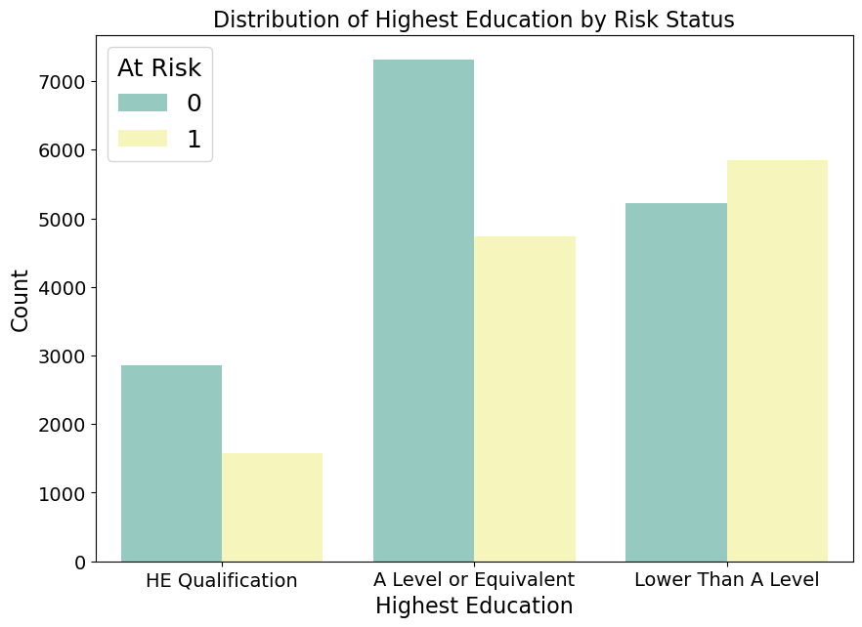
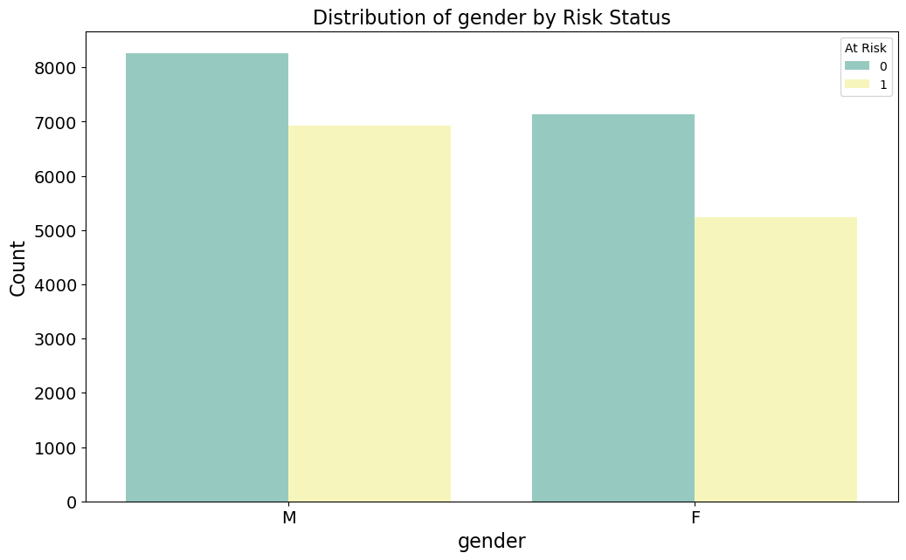
EDA - Distribution of key categorical features
Education Background
Gender
Notes:
There are many features in the dataset, but here we’re focusing on some key features. Let’s start with the categorical ones.
>In the first graph, we see that students with lower education levels have a higher proportion of at-risk status, especially those with qualifications lower than A-Level.
>The second graph shows gender distribution, where both males and females have similar proportions, but males slightly have more at-risk students.
This kind of insight helps us understand where additional support might be needed based on demographics.

Slide 9
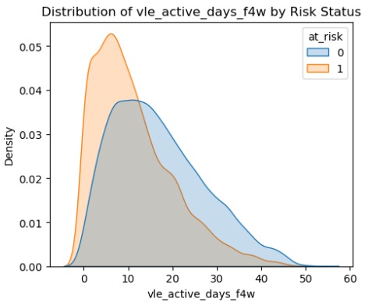
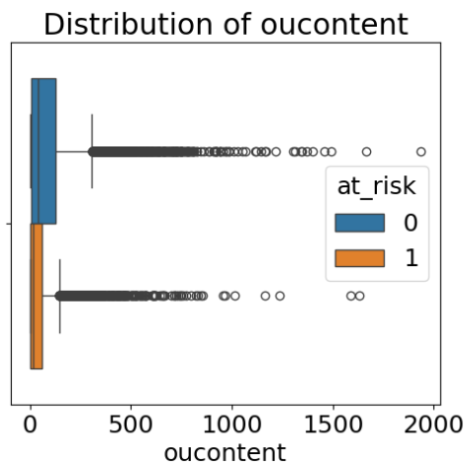
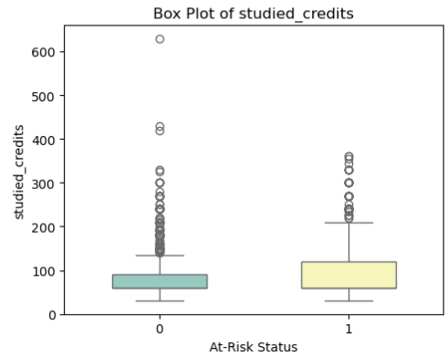
EDA - Distribution of key numeric features
VLE Active Days
- First 4 weeks
Total clicks on course content
studied_credits -> workload
Notes:
Here we see three key numeric features related to student risk.
First, vle_active_days_f4w shows that at-risk students (the orange one) tend to have fewer active days in the VLE, highlighting low engagement early on.
Next, the oucontent feature, which tracks clicks on course content, shows that not-at-risk students (the blue one on top) generally have more content interactions.
Finally, studied_credits reveals a trend where at-risk students (the yellow on the right) typically take for slightly more credits, potentially indicating higher course workloads.
These insights can help us identify students who may benefit from early interventions.

Slide 10
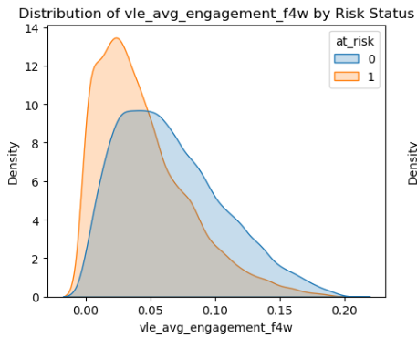
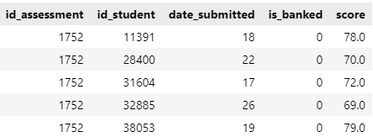
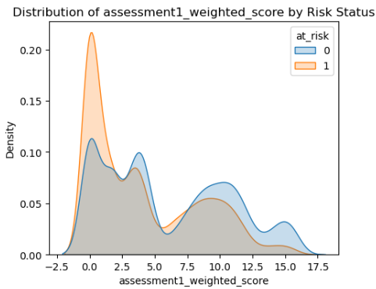
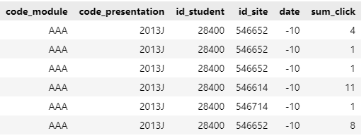
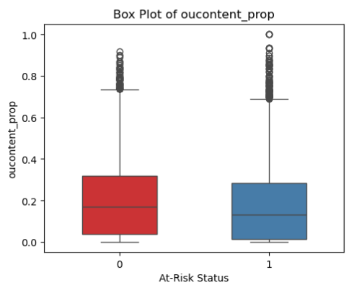
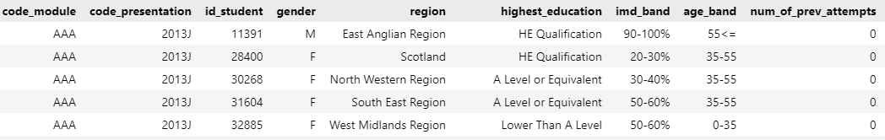
Feature Engineering
Notes:
The original data is scattered in 7 files at different granularity, so I aggregated the rows and joined the tables, >ensuring they all align at the module-presentation-student level. several features are engineered to capture meaningful engagement patterns, such as calculating various VLE metrics over the first four weeks and the proportion of total clicks by activity type. >For example, assessment1_weighted_score standardizes the first assessment performance, while > vle_avg_engagement_f4w normalises engagement over course length . >I also computed features such as oucontent_prop capturing student preferences for content types.
One-hot encoding is applied for categorical data, creating a fully numeric dataset for model training. These engineered features provide valuable insights into early student behaviours and performance.

Slide 11
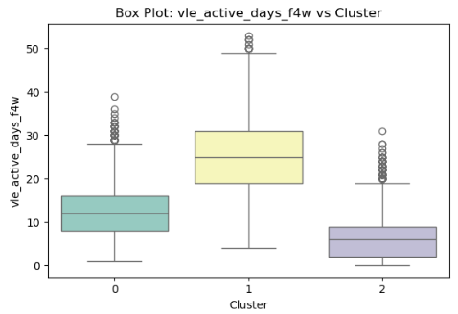
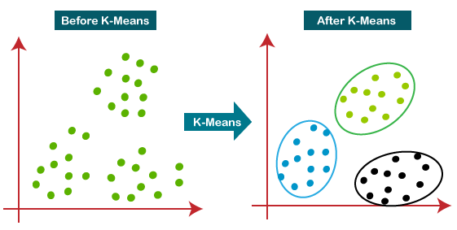
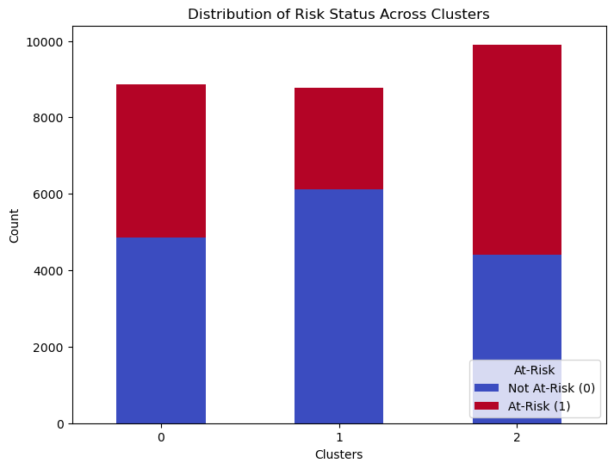
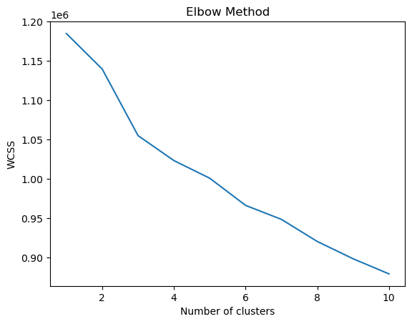
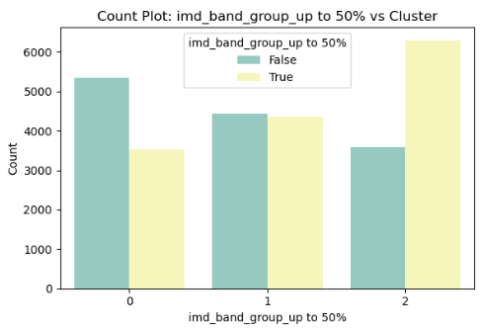
K-Means Clustering
Notes:
K-means clustering was used in this project. The purpose of clustering is to segment students based on shared characteristics, such as demographics, engagement, and performance. This segmentation helps identify groups with similar risk profiles, allowing support teams to provide more targeted interventions.
>To determine the optimal number of clusters, I used the elbow method, which led to choosing 3 clusters. Data used include only the static demographic and the fst 4 wks’s students data, and the target is not used during the clustering process to prevent data leakage. >As you can see from the distribution of risk status across clusters, certain groups like cluster 2 show a higher proportion of at-risk students. >The box plot of "vle_active_days_f4w" versus clusters and the > count plot of "imd_band_group_up to 50%" also illustrate distinct engagement and demographic patterns within each cluster. This clustering approach helps more personalised student support strategies.
*Kmeans top diagram source: https://www.kaggle.com/code/heeraldedhia/kmeans-clustering-for-customer-data

Slide 12

Feature Selection
Based on business understanding, trial-and-error, then LASSO regression to identify the top 25 features for modelling:
Course/Assessment Related Features
assessment1_weight
assessment1_weighted_score
cma_tma_weight_ratio
Student Demographic Information
cluster_1
cluster_2
disability
gender
highest_education_grouped_HE Qualification
highest_education_grouped_Lower Than A Level
imd_band_group_over 50%
imd_band_group_up to 50%
num_of_prev_attempts_capped
studied_credits
VLE Engagement Metrics (Online Activities)
forumng_prop
frequent_activity_variety_f4w
homepage_prop
oucollaborate_prop
oucontent_prop
ouwiki_prop
quiz_prop
resource_prop
subpage_prop
url_prop
vle_avg_engagement_f4w
weekly_avg_click_f4w
Notes:
Features were selected initially based on business relevance and validated through trial-and-error to assess impact on model performance.
Lasso regression was then applied to identify the top 25 predictive features.

Slide 13
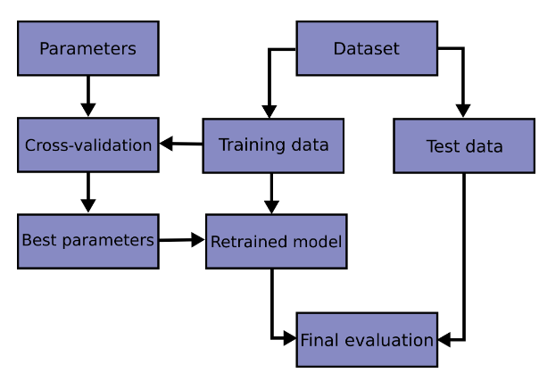
Machine Learning Workflow Overview
1
80 / 20 stratified split
2
3
4
Notes:
Before we dive into the exciting prediction part, let’s have a quick overview of the machine learning workflow - >it begins with the selected features as the dataset, >which is split into training and test sets using an 80/20 stratified split to maintain the class balance. >The training data then goes through a 5-fold cross-validation process for hyperparameter tuning, helping us find the best configuration for each model. >After identifying the optimal parameters, we retrain the model on the full training set. Finally, >the retrained model is evaluated on the test set to assess its performance. This approach ensures that our models are well-tuned and generalise effectively to unseen data, particularly for early risk prediction.
*Diagrams source: https://scikit-learn.org/stable/modules/cross_validation.html#cross-validation-iterators

Slide 14
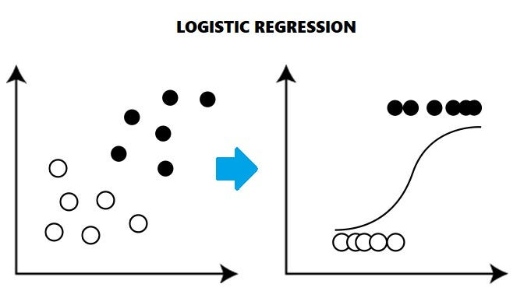
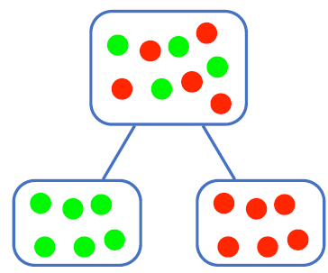
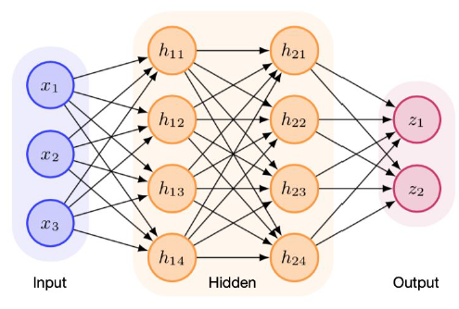
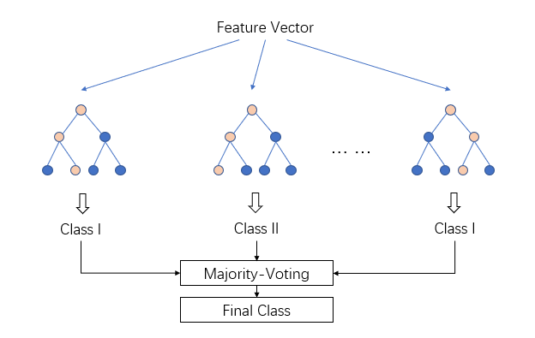
Models Used
Logistic Regression: Baseline model for interpretability.
Decision Tree: Simple yet interpretable model.
LightGBM: Chosen for its accuracy and handling of imbalanced data.
Neural Network: (2 hidden layers) Captures complex patterns in data.
class_weight: Used in each model to account for the slight imbalance in the target.
Notes:
Logistic Regression: Baseline interpretable model, providing a straightforward benchmark for predictive accuracy.
Decision Tree: Allows for intuitive interpretation of decision paths, with fast training and reasonable performance.
LightGBM: Ensemble / Boosting method that processes multiple trees sequentially to obtain high accuracy and handles imbalanced datasets well.
Neural Network (with 2 hidden layers): Capable of capturing complex patterns within data, with added flexibility in model architecture and tuning.
Note: Given the slight imbalance in the target classes, the "class_weight" parameter is applied in all models to ensure that both classes are represented fairly in training, improving the model’s sensitivity to the minority (at-risk) class.
+++
LR: https://medium.com/analytics-vidhya/understanding-logistic-regression-b3c672deac04
DT: IOD module slide
LightGBM: https://medium.com/@ilyurek/light-gbm-a-powerful-gradient-boosting-algorithm-fe145a1cd8a6

Slide 15
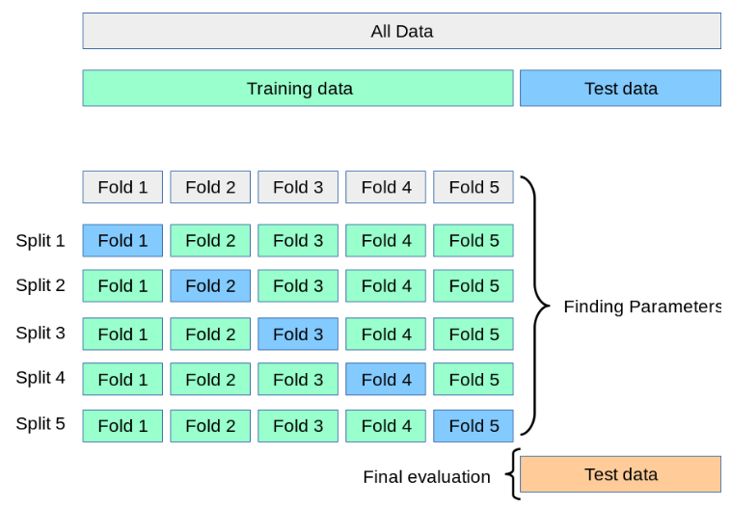
Hyperparameter Tuning
scoring = f1_score_class1
Notes:
Here’s recap about the process for hyperparameter tuning. After the data is split into training and test sets, > within the training set, 5 different folds are created. Each fold serves as a validation set while the remaining four are used for training. This rotation across all folds ensures the model's parameters are optimised effectively, reducing overfitting and improving generalisation. >We used the F1 score for class 1 (at-risk students) as the scoring metric, as it prioritises accurately identifying students who need intervention. >After finding the best parameters, we retrain on the full training set and then perform a final evaluation on the test data to check overall performance.
*Diagrams source: https://scikit-learn.org/stable/modules/cross_validation.html#cross-validation-iterators

Slide 16
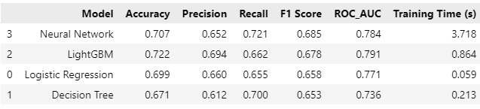
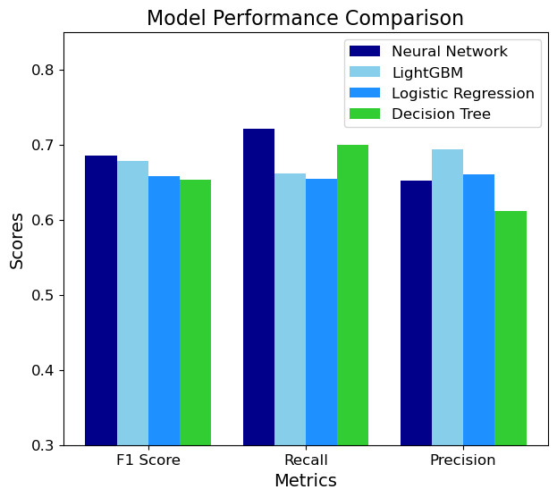
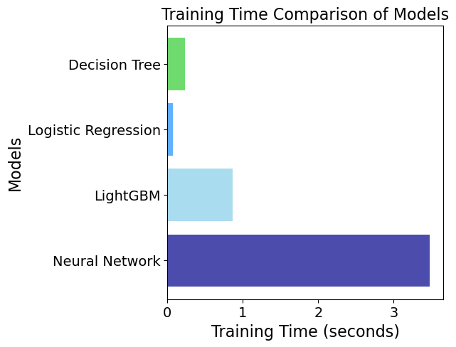
Model Evaluation and Comparison
Benchmark (from OU’s model)
Notes:
For this model evaluation, we started with a benchmark from Open University’s model, which had a F1 score of 50.1%. >As seen in our results, all four models surpassed this benchmark, >>starting from the top: the Neural Network achieved the highest recall at 72.1% and an F1 score of 68.5%. LightGBM also performed well, balancing accuracy and speed, while Logistic Regression offered high interpretability with decent performance. >The bar charts show that the Neural Network took the longest to train, while Logistic Regression was the fastest.

Slide 17
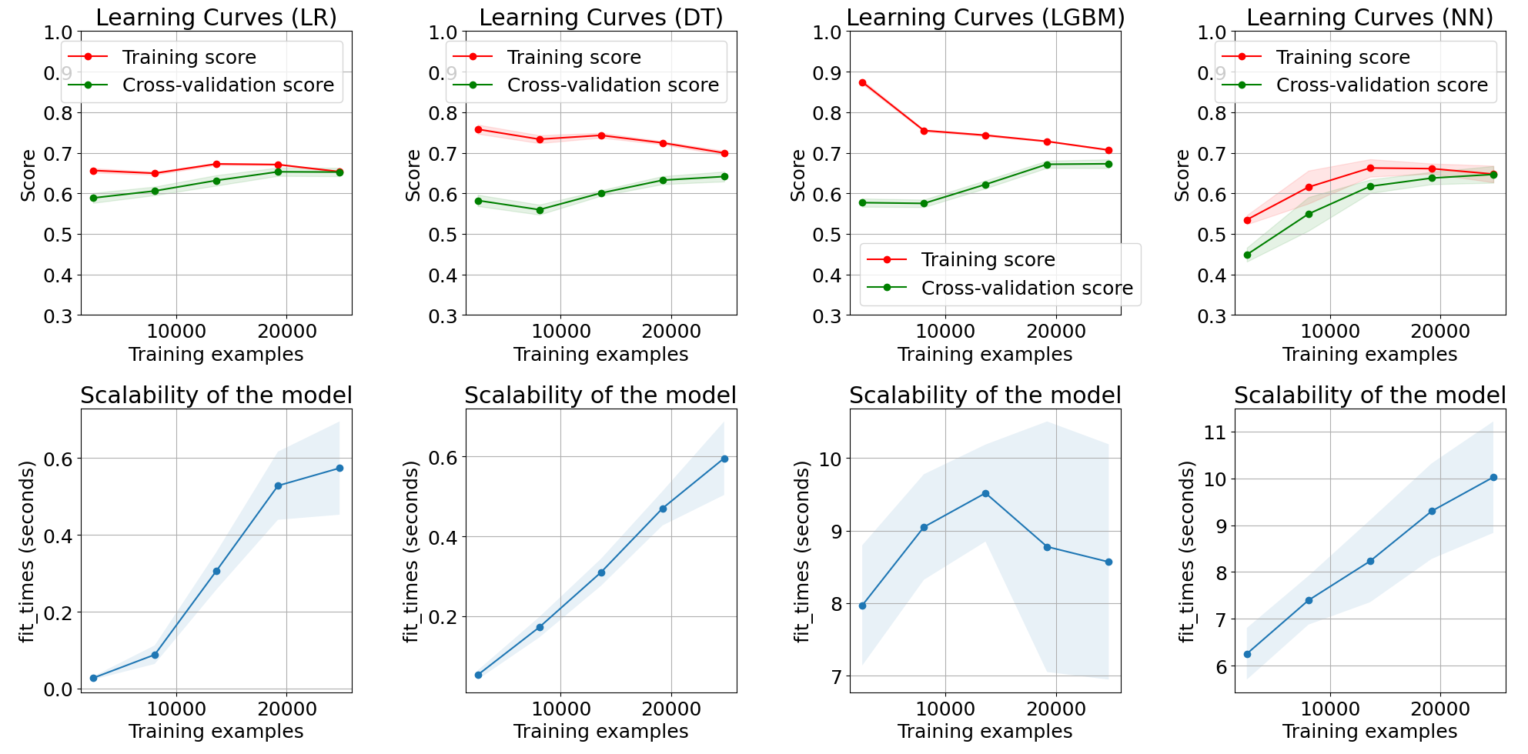
Learning Curves and Scalability
Notes:
These learning curves show model performance as training size increases. Logistic Regression (LR) and Decision Tree (DT) show stable generalisation, but DT’s higher training score hints at overfitting. LightGBM (LGBM) starts with overfitting, but improves with more data. Neural Network (NN) gradually converges, balancing training and validation scores well. In terms of scalability, LR and DT are the fastest, followed by LGBM, while NN requires significantly more time as data grows. This analysis helps us understand model performance trends and computational demands for practical deployment.
>Our top recommendations are LightGBM and Logistic Regression. LightGBM is the best choice for performance, while Logistic Regression offers a simpler, highly interpretable backup. Both models balance well across our key criteria: F1 score, training time, interpretability, and scalability.

Slide 18
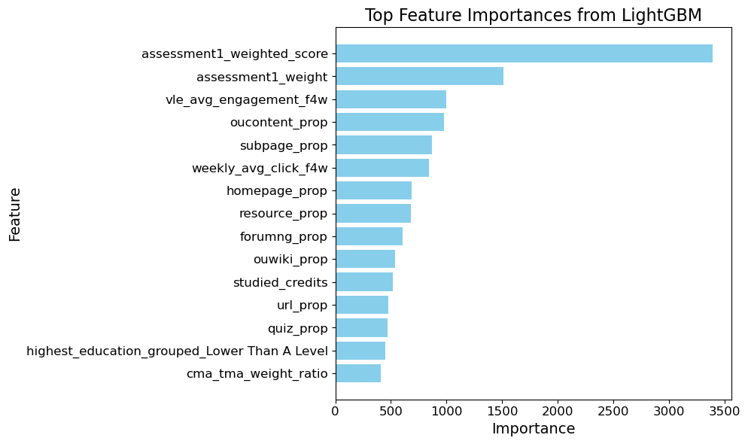
Feature Importance
Notes:
This chart shows the top features from our LightGBM model. Course-related features like assessment1_weighted_score are key, indicating that early assessment performance is a strong predictor of student outcomes. VLE engagement features—such as vle_avg_engagement_f4w and oucontent_prop—highlight the importance of active participation in online learning activities. Lastly, demographic features like studied_credits reveal that course load also is associated with success. Note that while these features are considered important for prediction by the model, they are not necessarily the cause of a student's success or failure. Nevertheless, these insights can help us identify students who may benefit from extra support early on.

Slide 19
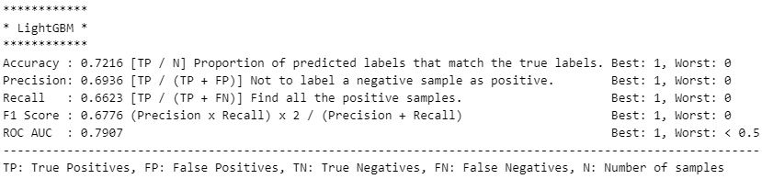
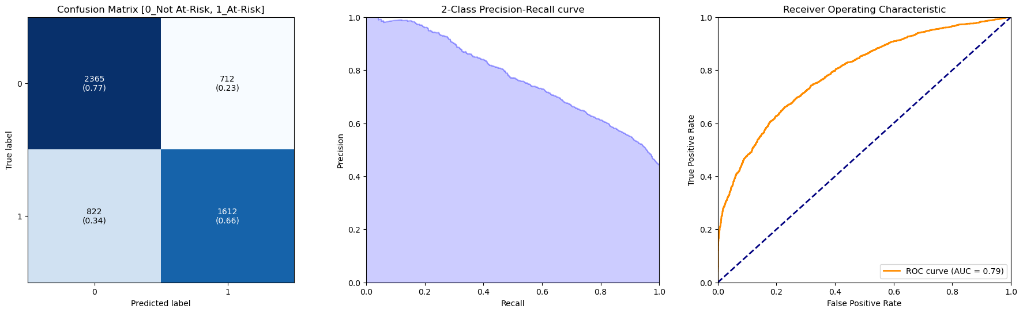
Conclusion
Notes:
In conclusion, this project has successfully developed a model to predict at-risk students early, leveraging a combination of demographic, assessment, and engagement data. With LightGBM as our best-performing model, we demonstrated that early predictions can enable timely, targeted interventions, which in turn can enhance student retention and success.

Slide 20

Future Work
Automate weekly data updates for timely predictions
Dashboard with at-risk visualisation and clustering insights
Continuous model monitoring and retraining
Potential adaptation for younger groups (primary, secondary, ECE)
Notes:
For future work, we aim to focus on deployment and monitoring to ensure the model remains effective over time. We'll automate a data pipeline to refresh weekly updates, keeping predictions up-to-date. The plan also includes integrating the model into a dashboard to visualise at-risk predictions and highlight important features. Clustering insights will be added, allowing advisors to access student profiles and patterns easily, making personalised support strategies more achievable. Ongoing model monitoring will be crucial to track performance and retrain as needed. Beyond tertiary education, this model could potentially be adapted for use in primary and secondary schools, and even in early childhood settings. As an ECE teacher myself, where individualised planning is key, this kind of tool could one day support group-level insights and proactive interventions for younger learners.

Slide 21

Your feedback is appreciated. Thank you!

