Slide 1






Propensity Score Diagnostics
Dr Emily Granger
Dr Jamie C. Sergeant
Dr Mark Lunt
41st Annual Conference of the International Society for Clinical Biostatistics, 26th August 2020
emily.granger@lshtm.ac.uk
@EGranger90

Slide 2
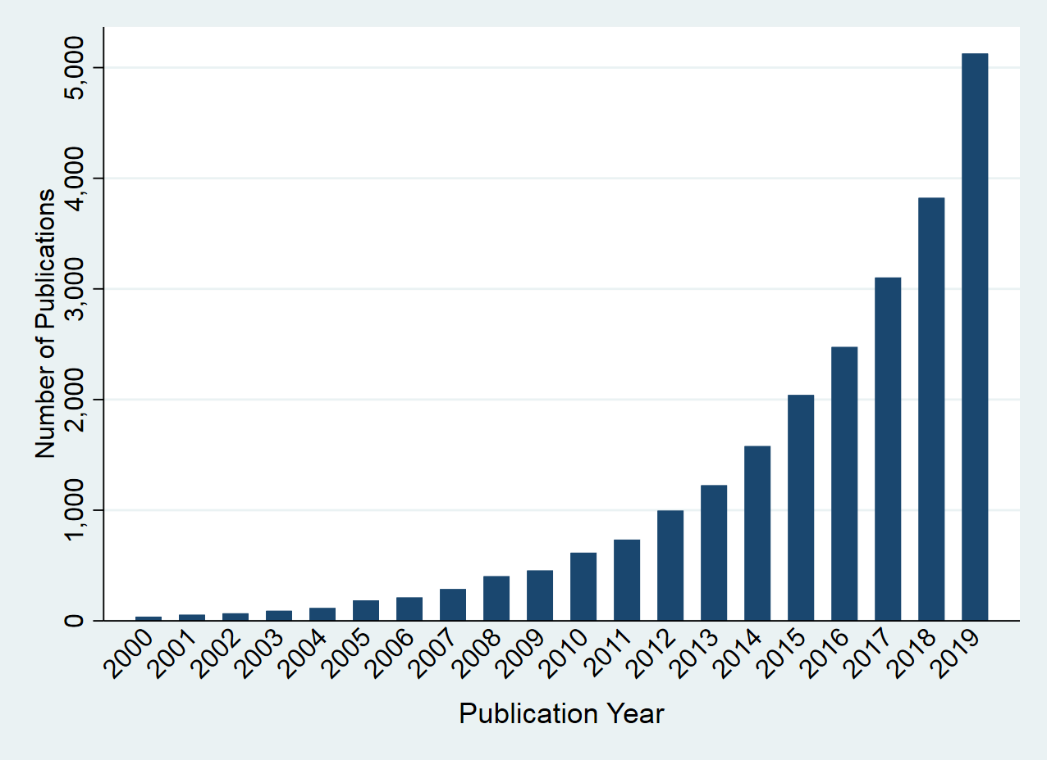
Background
Commonly used in observational data to deal with confounding bias.
Poorly estimated propensity scores may lead to biased estimates.
Use of diagnostics to assess propensity scores is important.
Currently unknown how best to assess propensity scores.
Figure 1: Number of propensity score publications in medical research by year

Slide 3
Background
Commonly used in observational data to deal with confounding bias.
Poorly estimated propensity scores may lead to biased estimates.
Use of diagnostics to assess propensity scores is important.
Currently unknown how best to assess propensity scores.
Figure 1: Number of propensity score publications in medical research by year

Slide 4
Aims of research
Aim 1:
Review and compare the existing propensity score diagnostics.
Aim 2:
Develop guidelines for how to build and assess propensity score models.

Slide 5
Aims of research
Individual Diagnostics
Aim 1:
Review and compare the existing propensity score diagnostics.
Aim 2:
Develop guidelines for how to build and assess propensity score models.
Overall
Diagnostics

Slide 6
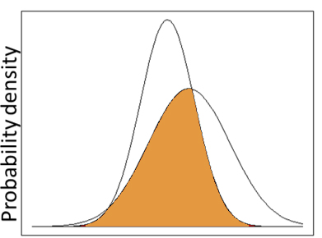
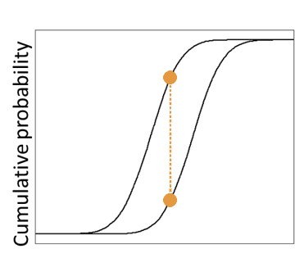
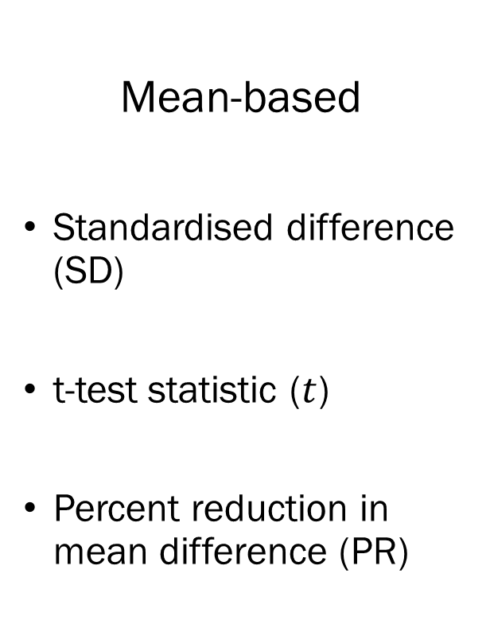
Propensity score diagnostics
Individual diagnostics
Mean-based
Standardised difference (SD)
t-test statistic ($t$)
Percent reduction in mean difference (PR)
Distribution-based
Overlapping coefficient (OVL)
Kolmogorov-Smirnov Statistic (KS)

Slide 7
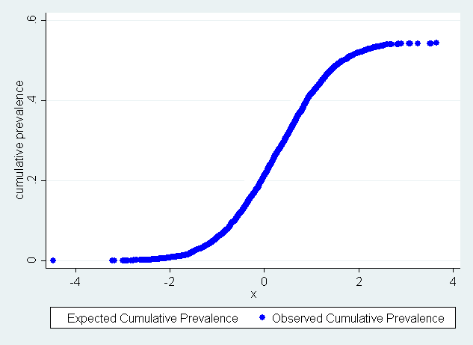
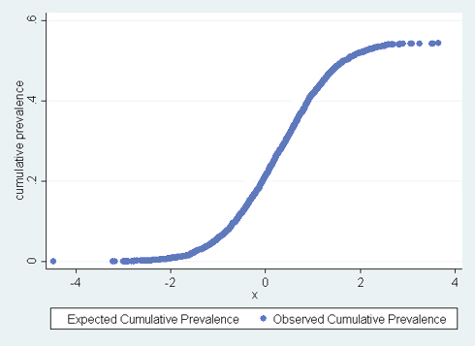

Cumulative prevalence of exposure
Notation: exposure indicator for subject $i$: $E_{i}$, propensity score for subject $i$: ${PS}_{i},$ sample size: $n$.
For continuous variable $X:$
${OCP}_{X}\left(X_{0}\right)=\frac{1}{n}\sum_{i:X_{i}≤X_{0}}{E_{i}}$
${ECP}_{X}\left(X_{0}\right)=\frac{1}{n}\sum_{i:X_{i}≤X_{0}}{{PS}_{i}}$
$D_{X}=| {OCP}_{X}−{ECP}_{X}$|

Slide 8
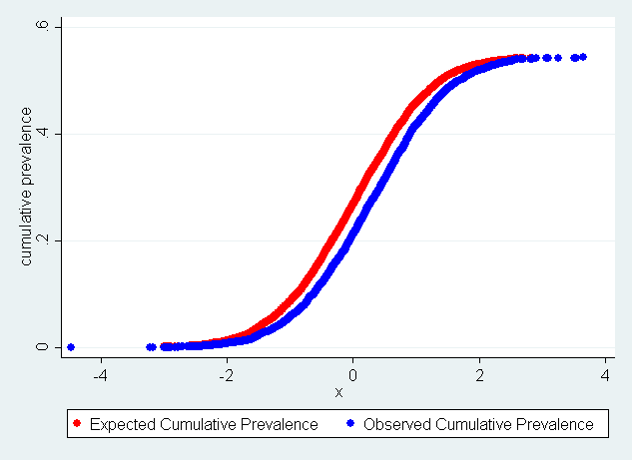
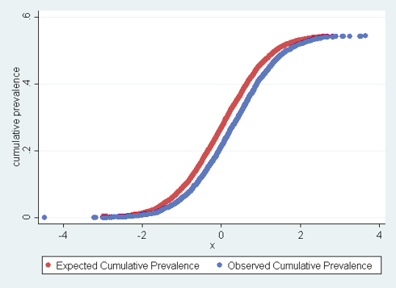

Cumulative prevalence of exposure
Notation: exposure indicator for subject $i$: $E_{i}$, propensity score for subject $i$: ${PS}_{i},$ sample size: $n$.
For continuous variable $X:$
${OCP}_{X}\left(X_{0}\right)=\frac{1}{n}\sum_{i:X_{i}≤X_{0}}{E_{i}}$
${ECP}_{X}\left(X_{0}\right)=\frac{1}{n}\sum_{i:X_{i}≤X_{0}}{{PS}_{i}}$
$D_{X}=| {OCP}_{X}−{ECP}_{X}$|

Slide 9

Cumulative prevalence of exposure
Notation: exposure indicator for subject $i$: $E_{i}$, propensity score for subject $i$: ${PS}_{i},$ sample size: $n$.
For continuous variable $X:$
${OCP}_{X}\left(X_{0}\right)=\frac{1}{n}\sum_{i:X_{i}≤X_{0}}{E_{i}}$
${ECP}_{X}\left(X_{0}\right)=\frac{1}{n}\sum_{i:X_{i}≤X_{0}}{{PS}_{i}}$
$D_{X}=| {OCP}_{X}−{ECP}_{X}$|

Slide 10

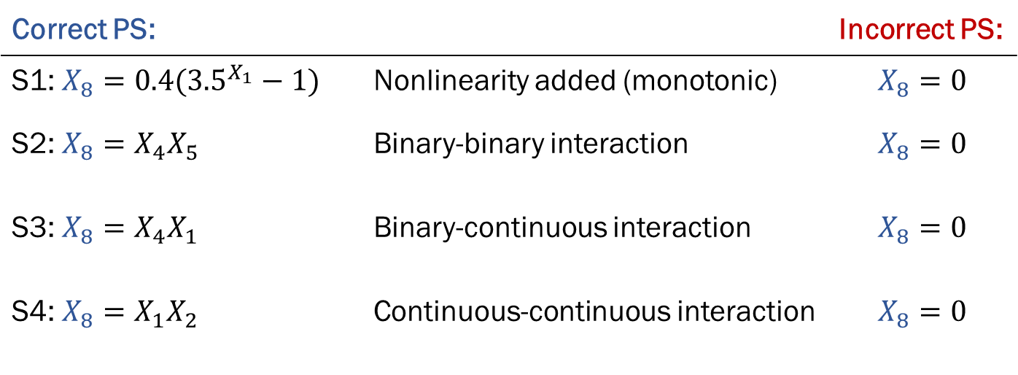
Simulated data
Propensity score model:
logit(PS)=$α_{0}+α_{1}X_{1}+α_{2}X_{2}+…+α_{7}X_{7}+ α_{8}X_{8}$
Variation between scenarios:
Logistic Regression: PS indicator ~ PS diagnostic
Correct PS: |  | Incorrect PS:
S1: $X_{8}=0.4({3.5}^{X_{1}}−1)$ | Nonlinearity added (monotonic) | $$X_{8}=0$$
S2: $X_{8}=X_{4}X_{5}$ | Binary-binary interaction | $$X_{8}=0$$
S3: $X_{8}=X_{4}X_{1}$ | Binary-continuous interaction | $$X_{8}=0$$
S4: $X_{8}=X_{1}X_{2}$ | Continuous-continuous interaction | $$X_{8}=0$$
Data Analysis:

Slide 11
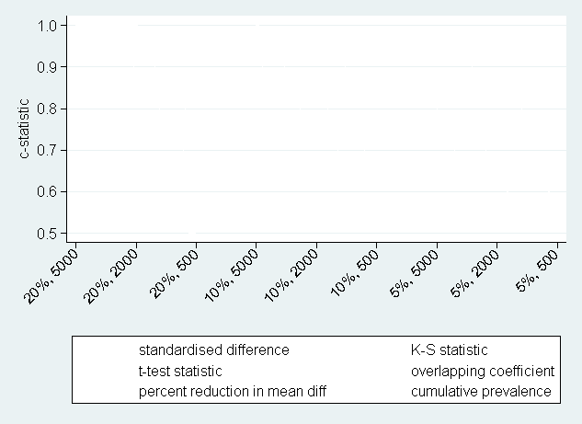
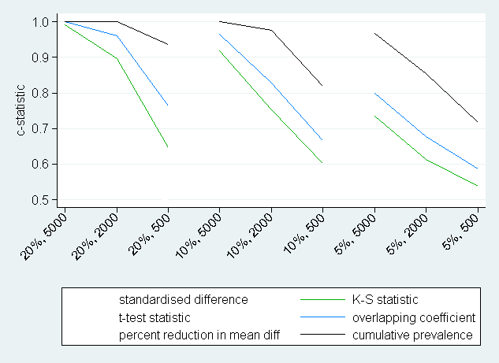
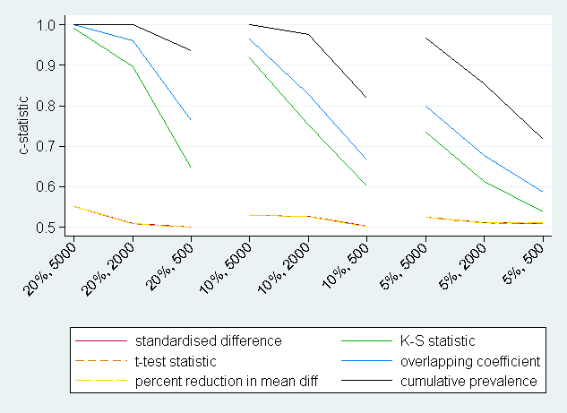
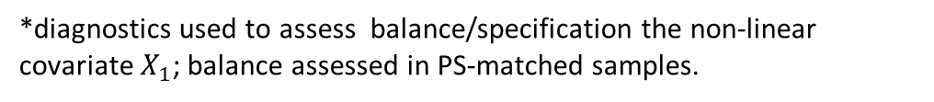
Scenario 2: Nonlinear term misspecified
Scenario 1: Misspecification of a non-linear term
*diagnostics used to assess balance/specification the non-linear covariate $X_{1}$; balance assessed in PS-matched samples.

Slide 12
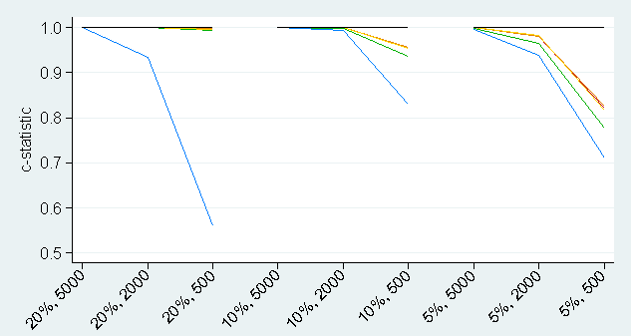
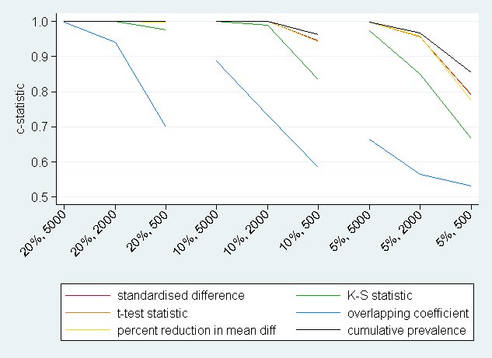
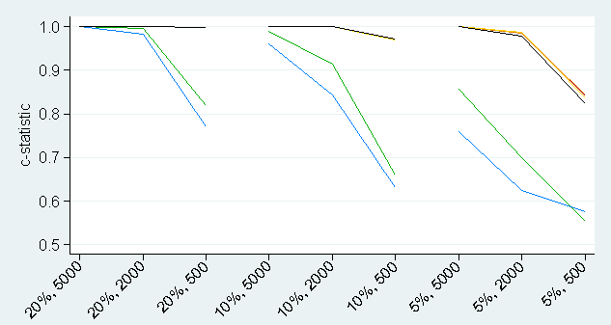
Scenarios 2-4: Omission of an interaction term
Figures:
- Scenario 2 (top left) | binary-binary
- Scenario 3 (top right) | binary-continuous
- Scenario 4 (bottom left) | continuous-continuous
*diagnostics used to assess balance/specification the interaction term; balance assessed in PS-matched samples.

Slide 13

Overall diagnostics
Disease risk score
Disease risk scores (DRS) defined as predicted outcome under the control condition
Standardised mean difference in DRS as a propensity score diagnostic [Stuart et al. 2013]
Weighted average of balance
Let $w_{j}$ denote the weight for covariate $X_{j}.$ Then:
$w_{j}=γ_{j}Std.Dev(X_{j})$ [Caruana et al. 2015]
$γ_{j}$is the coefficient for $X_{j}$obtained after regressing outcome on $X_{j}.$
Balance measured using either:
Standardised difference (SD)
Overlapping coefficient (OVL)
Kolmogorov-Smirnov Statistic (KS)

Slide 14

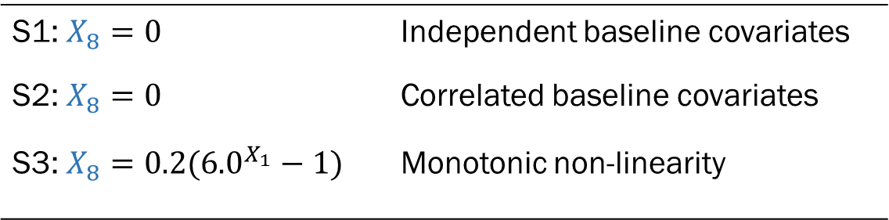
Simulated Data
Simulated data
Propensity score model:
logit(PS)=$α_{0}+α_{1}X_{1}+α_{2}X_{2}+…{+α}_{7}X_{7}$
Outcome model:
Y=$β_{0}+β_{1}X_{1}+β_{2}X_{2}+…{+β}_{7}X_{7}+ β_{8}X_{8}$
Variation between scenarios:
S1: $X_{8}=0$ | Independent baseline covariates
S2: $X_{8}=0$ | Correlated baseline covariates
S3: $X_{8}=0.2({6.0}^{X_{1}}−1)$ | Monotonic non-linearity

Slide 15
Scenarios 1 and 2: Linear outcomes
Table 1: Spearman rank correlation between overall diagnostics and bias (sample sizes 5000)
Scenario | Weighted SD | Weighted KS | Weighted OVL | SD(DRS)
Scenario 1 | 0.992 | 0.137 | 0.012 | 1.000
Scenario 2 | 0.129 | 0.102 | 0.031 | 1.000
*SD: Standardised difference; KS: Kolmogorov-Smirnov statistic; OVL: Overlapping coefficient; DRS: Disease risk score

Slide 16
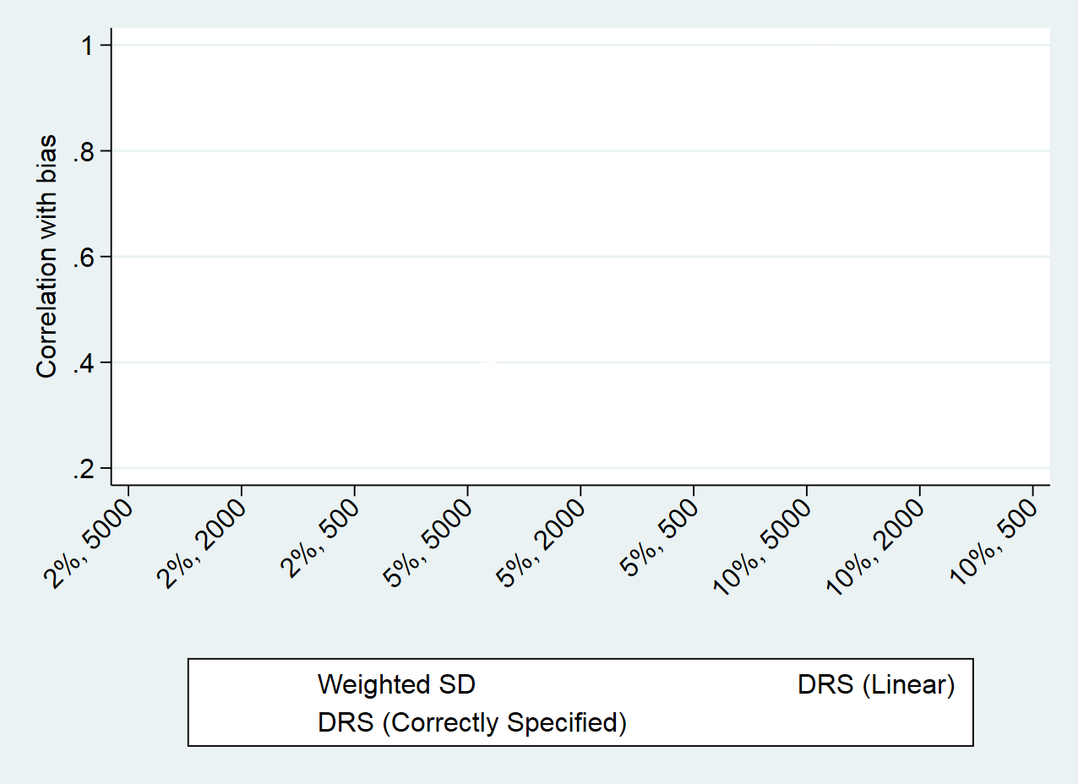
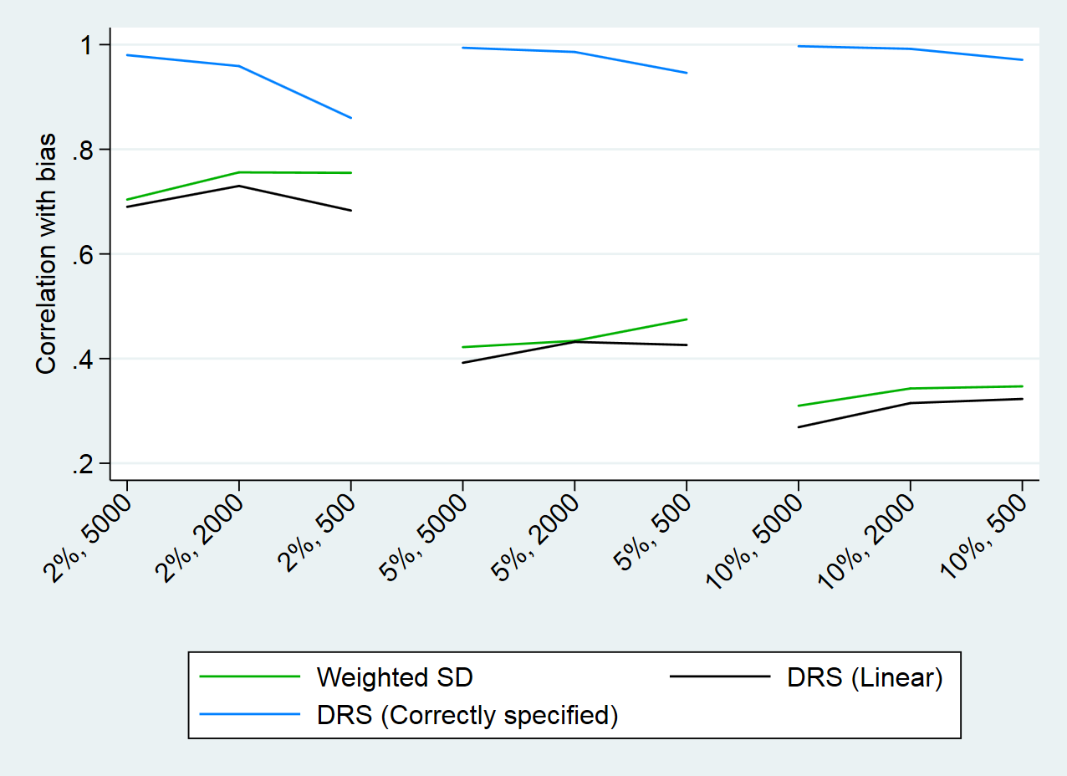
Scenario 2: Nonlinear term misspecified
Scenario 3: Non-linear term in outcome model

Slide 17
Scenario 2: Nonlinear term misspecified
Scenario 3: Non-linear term in outcome model

Slide 18
Conclusions
Cumulative prevalence (CP) diagnostic most useful for identifying all types of propensity score misspecification.
Standardised mean difference in the disease risk score (DRS) is a promising overall diagnostic.
Main limitation:
DRS not robust to misspecifications in the outcome model
Could use CP diagnostics to check specification
Future research into different estimation methods for the DRS.

Slide 19
Aims of research
Aim 1:
Review and compare the existing propensity score diagnostics.
Aim 2:
Develop guidelines for how to build and assess propensity score models.

Slide 20


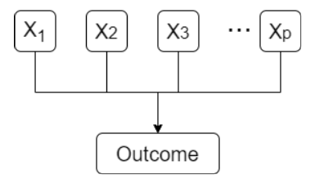
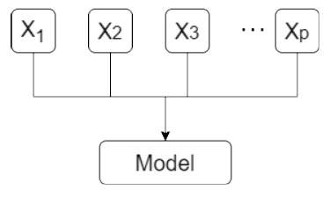
Proposed guidelines for propensity score assessment
STEP 1: STEP 2: STEP 3:
Choose variables Check individual covariates Check overall balance
using CP diagnostics using DRS

Slide 21
References
[1] Stuart, EA et al. Prognostic score-based balance measures for propensity score methods in comparative effectiveness research. Journal of Clinical Epidemiology. 2013
[2] Caruana, E et al. A new weighted balance measure helped to select the variables to be included in a propensity score model. Journal of Clinical Epidemiology. 2015.
[3] Belitser, SV et al. Measuring balance and model selection in propensity score methods. Pharmacoepidemiology and Drug Safety. 2011.
[4] Ali, MS et al. Reporting of covariate selection and balance assessment in propensity score analysis is suboptimal: a systematic review. Journal of Clinical Epidemiology. 2008.
[5] Granger, E et al. A review of the use of propensity score diagnostics in papers published in high-ranking medical journals. BMC Research Methodology. 2020.
emily.granger@lshtm.ac.uk
@EGranger90

