Slide 1




Propensity Score Diagnostics
Emily Granger
Jamie C. Sergeant
Mark Lunt
@EGranger90

Slide 2
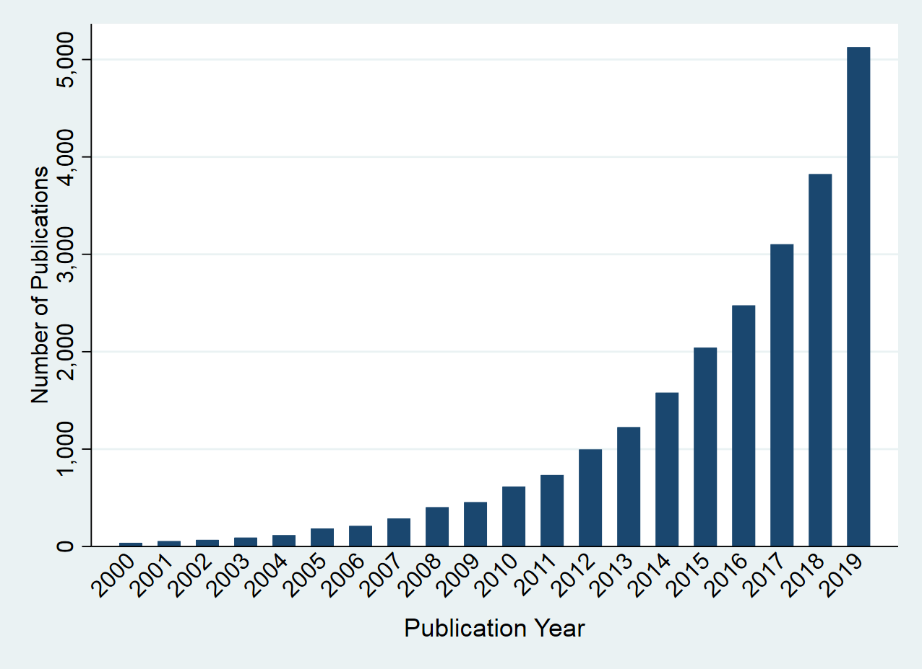
Propensity scores are becoming increasingly popular
Figure 1: Number of propensity score publications in medical research by year

Slide 3
Review on the use of propensity score diagnostics
Recent review on the use of propensity score diagnostics in the applied medical literature [Granger et al. 2020]
Inclusion criteria:
Publication years 2014-2016
High-impact journals (Impact Factor > 4)
Extracted data on:
Research area
Propensity score method used
Diagnostics used

Slide 4
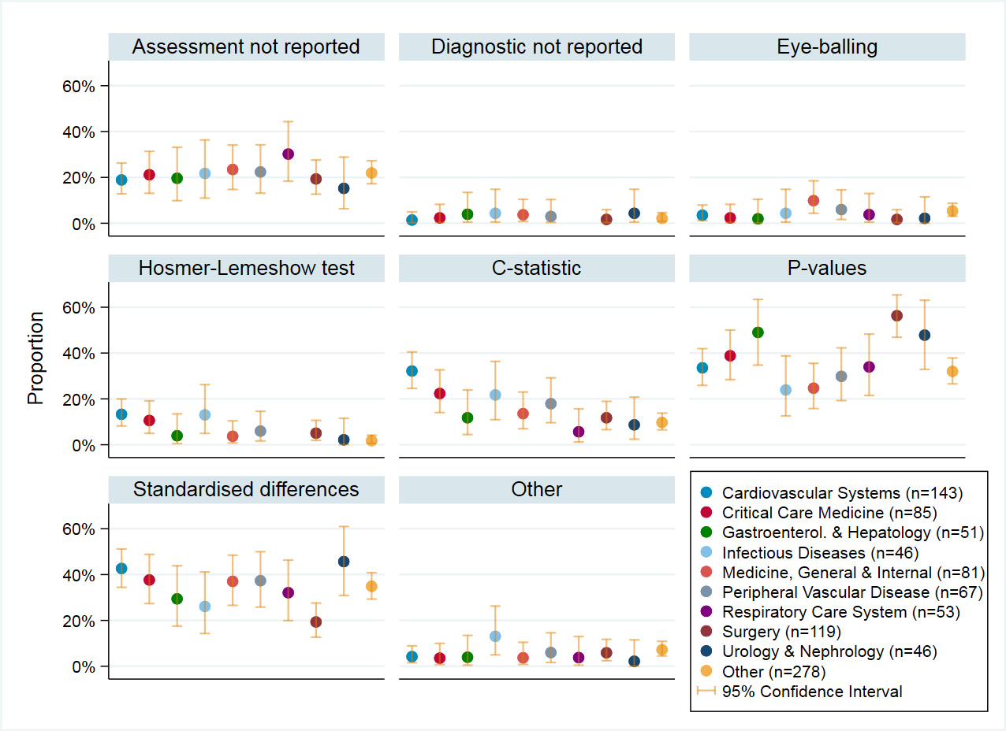
Review on the use of propensity score diagnostics
Key Findings:
894 studies included
20.9% did not report use of any diagnostic
36.6% used hypothesis tests

Slide 5
Aims of research
Aim 1:
Review and compare the existing propensity score diagnostics.
Aim 2:
Develop guidelines for how to build and assess propensity score models.

Slide 6
Aims of research
Individual Diagnostics
Aim 1:
Review and compare the existing propensity score diagnostics.
Aim 2:
Develop guidelines for how to build and assess propensity score models.
Overall
Diagnostics

Slide 7
Aims of research
Individual Diagnostics
Aim 1:
Review and compare the existing propensity score diagnostics.
Aim 2:
Develop guidelines for how to build and assess propensity score models.
Overall
Diagnostics

Slide 8
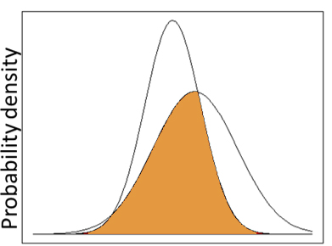
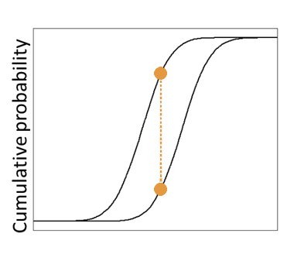
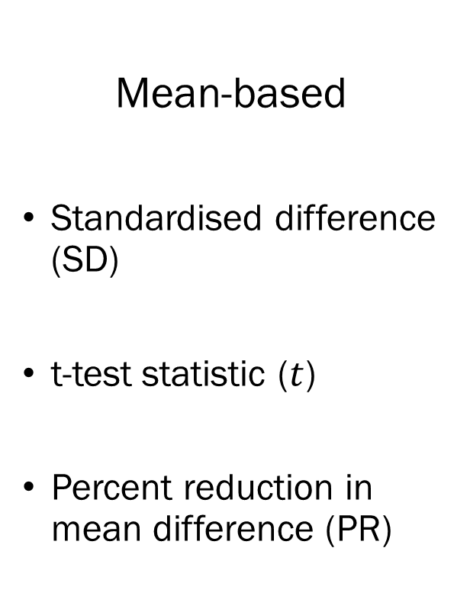
Propensity score diagnostics
Individual diagnostics
Mean-based
Standardised difference (SD)
t-test statistic ($t$)
Percent reduction in mean difference (PR)
Distribution-based
Overlapping coefficient (OVL)
Kolmogorov-Smirnov Statistic (KS)

Slide 9
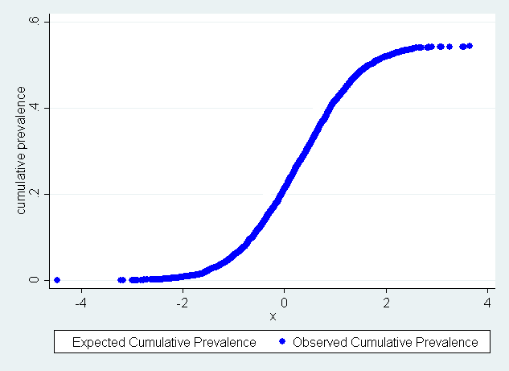
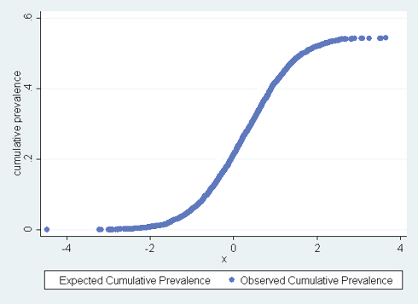

Cumulative prevalence of exposure
Notation: exposure indicator for subject $i$: $E_{i}$, propensity score for subject $i$: ${PS}_{i},$ sample size: $n$.
For continuous variable $X:$
${OCP}_{X}\left(X_{0}\right)=\frac{1}{n}\sum_{i:X_{i}≤X_{0}}{E_{i}}$
${ECP}_{X}\left(X_{0}\right)=\frac{1}{n}\sum_{i:X_{i}≤X_{0}}{{PS}_{i}}$
$D_{X}=| {OCP}_{X}−{ECP}_{X}$|

Slide 10
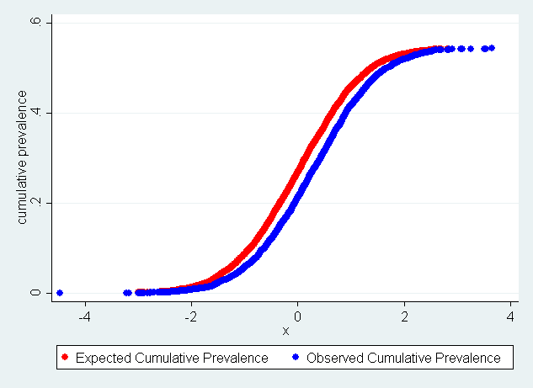
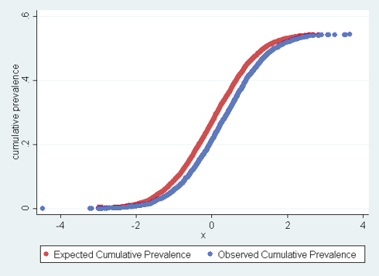

Cumulative prevalence of exposure
Notation: exposure indicator for subject $i$: $E_{i}$, propensity score for subject $i$: ${PS}_{i},$ sample size: $n$.
For continuous variable $X:$
${OCP}_{X}\left(X_{0}\right)=\frac{1}{n}\sum_{i:X_{i}≤X_{0}}{E_{i}}$
${ECP}_{X}\left(X_{0}\right)=\frac{1}{n}\sum_{i:X_{i}≤X_{0}}{{PS}_{i}}$
$D_{X}=| {OCP}_{X}−{ECP}_{X}$|

Slide 11

Cumulative prevalence of exposure
Notation: exposure indicator for subject $i$: $E_{i}$, propensity score for subject $i$: ${PS}_{i},$ sample size: $n$.
For continuous variable $X:$
${OCP}_{X}\left(X_{0}\right)=\frac{1}{n}\sum_{i:X_{i}≤X_{0}}{E_{i}}$
${ECP}_{X}\left(X_{0}\right)=\frac{1}{n}\sum_{i:X_{i}≤X_{0}}{{PS}_{i}}$
$D_{X}=| {OCP}_{X}−{ECP}_{X}$|

Slide 12
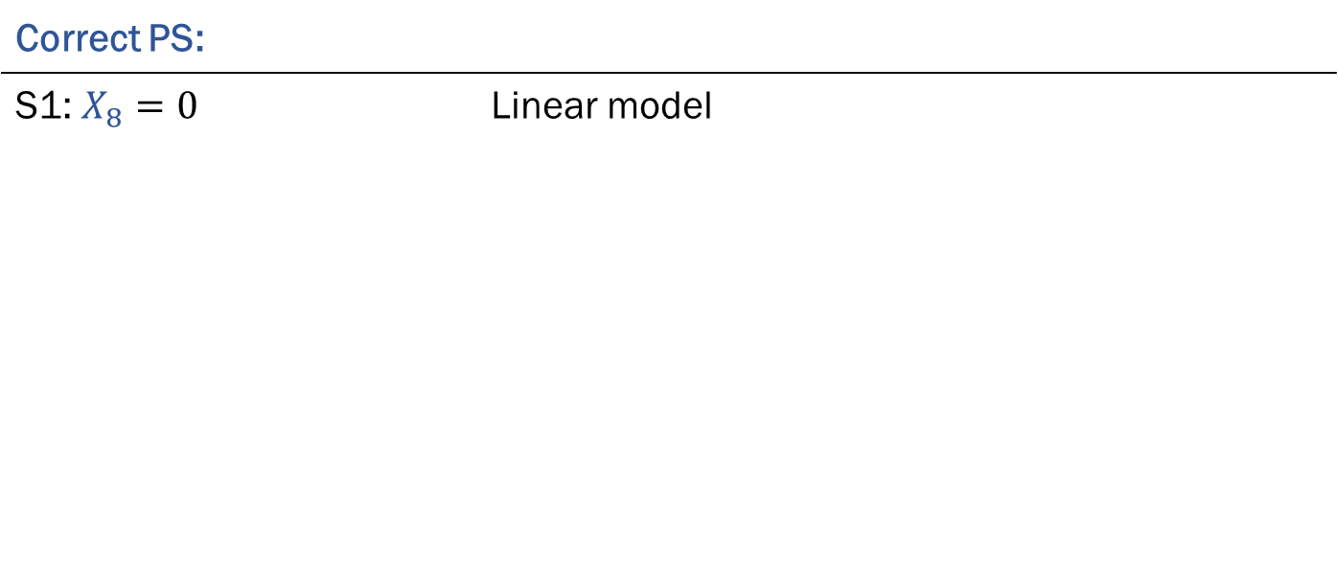

Simulated data
Propensity score model:
logit(PS)=$α_{0}+α_{1}X_{1}+α_{2}X_{2}+,…,α_{7}X_{7}+ α_{8}X_{8}$
Variation between scenarios:
Correct PS: |  | Incorrect PS:
S1: $X_{8}=0$ | Linear model | $$X_{1}=0$$
S2: $X_{8}=0.4({3.5}^{X_{1}}−1)$ | Nonlinearity added (monotonic) | $$X_{8}=0$$
S3: $X_{8}=X_{4}X_{5}$ | Binary-binary interaction | $$X_{8}=0$$
S4: $X_{8}=X_{4}X_{1}$ | Binary-continuous interaction | $$X_{8}=0$$
S5: $X_{8}=X_{1}X_{2}$ | Continuous-continuous interaction | $$X_{8}=0$$

Slide 13
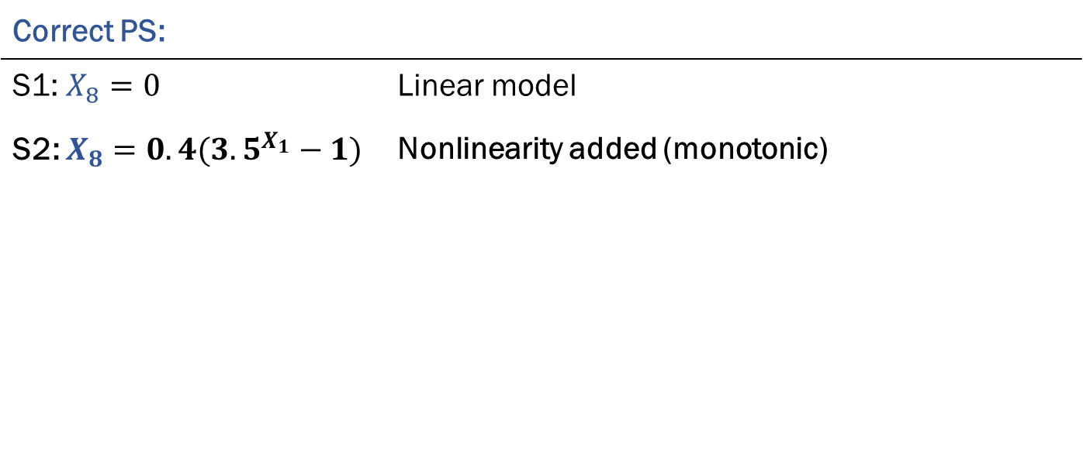
Simulated data
Propensity score model:
logit(PS)=$α_{0}+α_{1}X_{1}+α_{2}X_{2}+,…,α_{7}X_{7}+ α_{8}X_{8}$
Variation between scenarios:
Correct PS: |  | Incorrect PS:
S1: $X_{8}=0$ | Linear model | $$X_{1}=0$$
S2: $X_{8}=0.4({3.5}^{X_{1}}−1)$ | Nonlinearity added (monotonic) | $$X_{8}=0$$
S3: $X_{8}=X_{4}X_{5}$ | Binary-binary interaction | $$X_{8}=0$$
S4: $X_{8}=X_{4}X_{1}$ | Binary-continuous interaction | $$X_{8}=0$$
S5: $X_{8}=X_{1}X_{2}$ | Continuous-continuous interaction | $$X_{8}=0$$

Slide 14
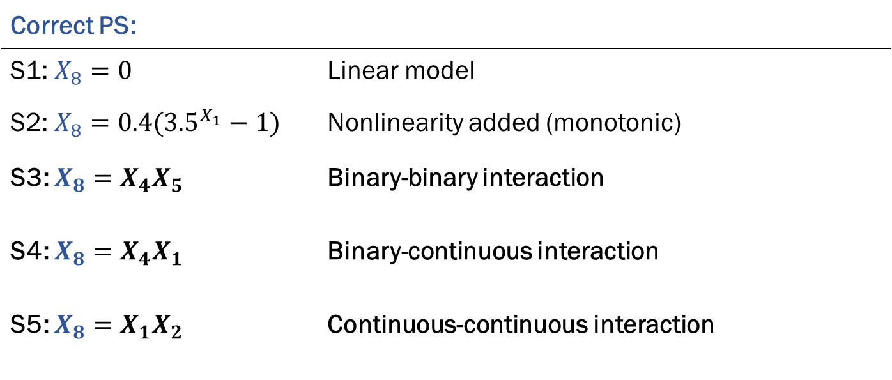
Simulated data
Propensity score model:
logit(PS)=$α_{0}+α_{1}X_{1}+α_{2}X_{2}+,…,α_{7}X_{7}+ α_{8}X_{8}$
Variation between scenarios:
Correct PS: |  | Incorrect PS:
S1: $X_{8}=0$ | Linear model | $$X_{1}=0$$
S2: $X_{8}=0.4({3.5}^{X_{1}}−1)$ | Nonlinearity added (monotonic) | $$X_{8}=0$$
S3: $X_{8}=X_{4}X_{5}$ | Binary-binary interaction | $$X_{8}=0$$
S4: $X_{8}=X_{4}X_{1}$ | Binary-continuous interaction | $$X_{8}=0$$
S5: $X_{8}=X_{1}X_{2}$ | Continuous-continuous interaction | $$X_{8}=0$$

Slide 15
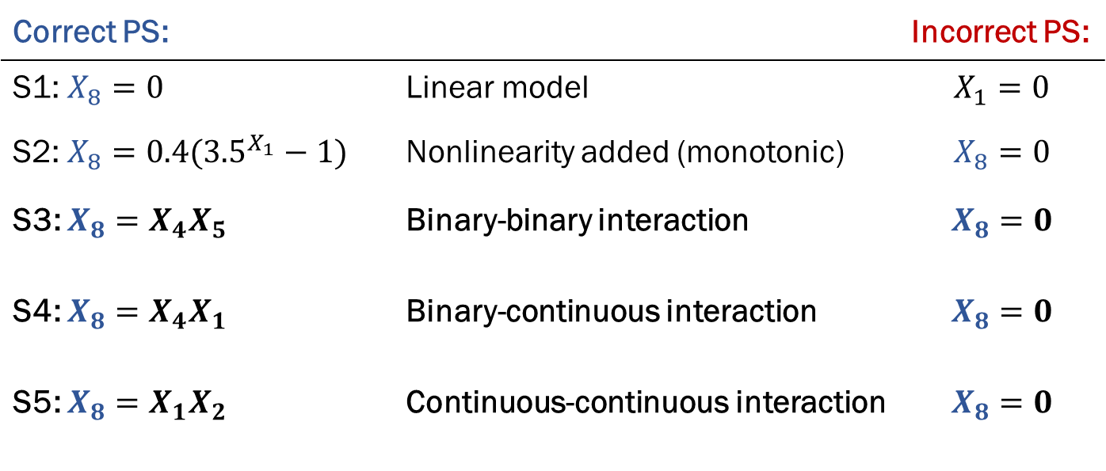
Simulated data
Propensity score model:
logit(PS)=$α_{0}+α_{1}X_{1}+α_{2}X_{2}+,…,α_{7}X_{7}+ α_{8}X_{8}$
Variation between scenarios:
Correct PS: |  | Incorrect PS:
S1: $X_{8}=0$ | Linear model | $$X_{1}=0$$
S2: $X_{8}=0.4({3.5}^{X_{1}}−1)$ | Nonlinearity added (monotonic) | $$X_{8}=0$$
S3: $X_{8}=X_{4}X_{5}$ | Binary-binary interaction | $$X_{8}=0$$
S4: $X_{8}=X_{4}X_{1}$ | Binary-continuous interaction | $$X_{8}=0$$
S5: $X_{8}=X_{1}X_{2}$ | Continuous-continuous interaction | $$X_{8}=0$$

Slide 16
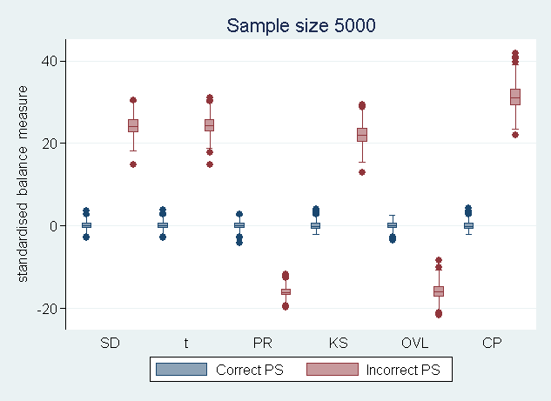
Scenario 1: Omission of a linear term
SD: standardised difference | KS: Kolmogorov-Smirnov statistic
t: t-test statistic | OVL: overlapping coefficient
PR: percent reduction in mean prevalence | CP: cumulative prevalence

Slide 17
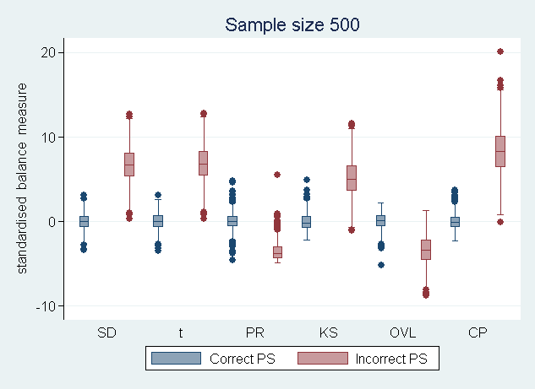
Scenario 1: Omission of a linear term
SD: standardised difference | KS: Kolmogorov-Smirnov statistic
t: t-test statistic | OVL: overlapping coefficient
PR: percent reduction in mean prevalence | CP: cumulative prevalence

Slide 18
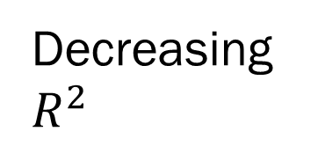
Simulated data
Decreasing sample size
1 20%, 5000 | 2 20%, 2000 | 3 20%, 500
4 10%, 5000 | 5 10%, 2000 | 6 10%, 500
7 5%, 5000 | 8 5%, 2000 | 9 5%, 500
Decreasing $R^{2}$

Slide 19
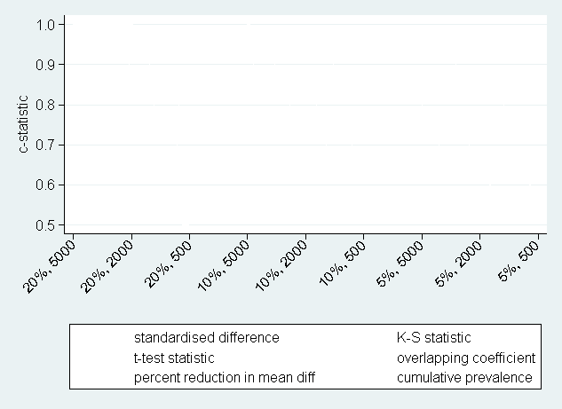
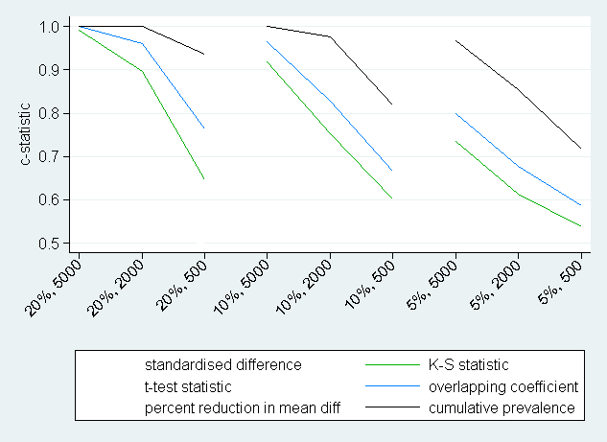
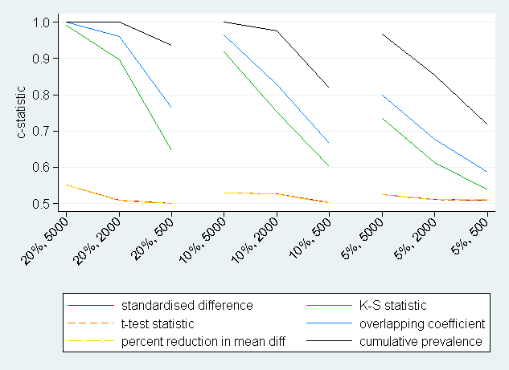
Scenario 2: Nonlinear term misspecified
Scenario 2: Misspecification of a non-linear term

Slide 20
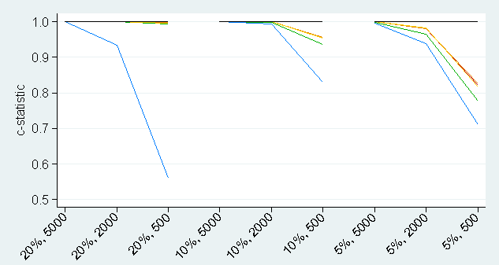
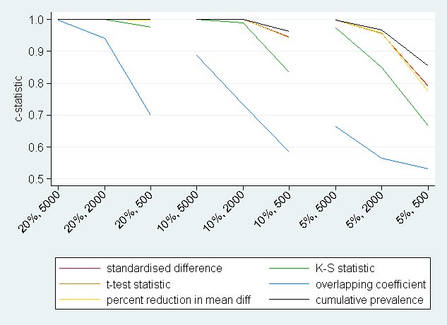
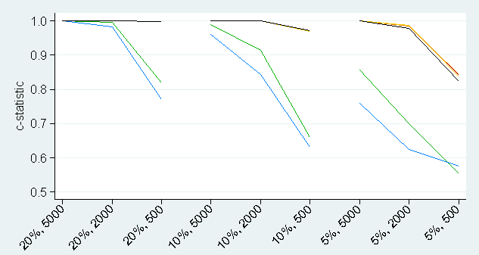
Scenarios 3-5: Omission of an interaction term
Figures:
- Scenario 3 (top left) | binary-binary
- Scenario 4 (top right) | binary-continuous
- Scenario 5 (bottom left) | continuous-continuous

Slide 21
Conclusions (so far)
Mean-based diagnostics can fail to identify nonlinear misspecifications in the propensity score
Distribution-based diagnostics least reliable at identifying omission of interactions terms.
Cumulative prevalence diagnostics most useful for identifying all types of propensity score misspecification.

Slide 22
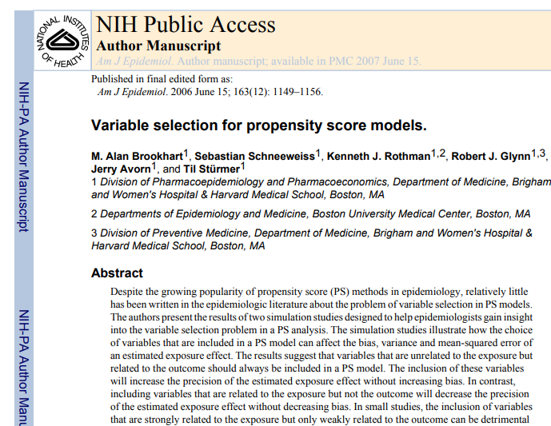
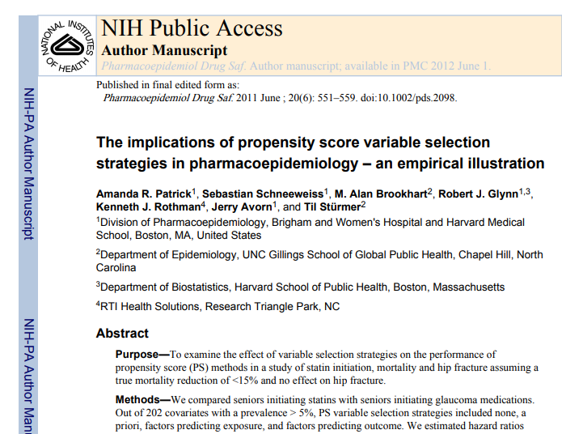

But……
What about the
outcome?

Slide 23
Aims of research
Individual Diagnostics
Aim 1:
Review and compare the existing propensity score diagnostics.
Aim 2:
Develop guidelines for how to build and assess propensity score models.
Overall
Diagnostics

Slide 24

Overall diagnostics
Which balance metric?
Standardised difference (SD)
Overlapping coefficient (OVL)
Kolmogorov-Smirnov Statistic (KS)
Which weighting scheme?
Let $w_{ji}$ denote the $j^{th}$ weight for covariate $i.$ Then:
$w_{1i}=γ_{i}Std.Dev(x_{i})$ [Caruana et al. 2015]
$γ_{i}$is the coefficient for $x_{i}$obtained after regressing outcome on $x_{i}.$
$w_{2i}=δ_{i}Std.Dev(x_{i})$
$δ_{i}$is the coefficient for $x_{i}$obtained after regressing outcome on all covariates.

Slide 25

Overall diagnostics
Which balance metric?
Standardised difference (SD)
Overlapping coefficient (OVL)
Kolmogorov-Smirnov Statistic (KS)
Which weighting scheme?
Disease risk scores (DRS) defined as predicted outcome under the control condition
Standardised mean difference in DRS as a propensity score diagnostic [Stuart et al. 2013]
Let $w_{ji}$ denote the $j^{th}$ weight for covariate $i.$ Then:
$w_{1i}=γ_{i}SD(x_{i})$ [Caruana et al. 2015]
$γ_{i}$is the coefficient for $x_{i}$obtained after regressing outcome on $x_{i}.$
$w_{2i}=δ_{i}SD(x_{i})$
$δ_{i}$is the coefficient for $x_{i}$obtained after regressing outcome on all covariates.

Slide 26

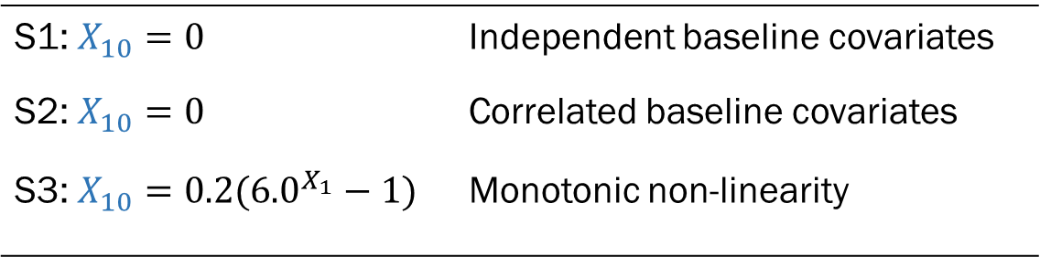
Simulated Data
Simulated data
Propensity score model:
logit(PS)=$α_{0}+α_{1}X_{1}+α_{2}X_{2}+,…,α_{9}X_{9}$
Outcome model:
Y=$β_{0}+β_{1}X_{1}+β_{2}X_{2}+,…,β_{9}X_{9}+ β_{10}X_{10}$
Linear and Non-linear Scenarios:
S1: $X_{10}=0$ | Independent baseline covariates
S2: $X_{10}=0$ | Correlated baseline covariates
S3: $X_{10}=0.2({6.0}^{X_{1}}−1)$ | Monotonic non-linearity

Slide 27

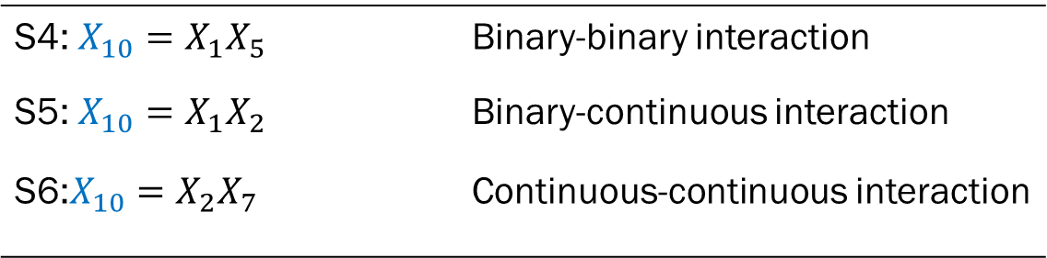
Simulated data
Propensity score model:
logit(PS)=$α_{0}+α_{1}X_{1}+α_{2}X_{2}+,…,α_{9}X_{9}$
Outcome model:
Y=$β_{0}+β_{1}X_{1}+β_{2}X_{2}+,…,β_{9}X_{9}+ β_{10}X_{10}$
Non-additive Scenarios:
S4: $X_{10}=X_{1}X_{5}$ | Binary-binary interaction
S5: $X_{10}=X_{1}X_{2}$ | Binary-continuous interaction
S6:$X_{10}=X_{2}X_{7}$ | Continuous-continuous interaction

Slide 28
Scenarios 1 and 2: Linear outcomes
Table 1: Spearman rank correlation between overall diagnostics and bias
Scenario | Balance Metric | Weights 1 | Weights 2 | SD(DRS)
Scenario 1 | SD | 0.992 | 0.996 | 1.000
 | KS | 0.137 | 0.134
 | OVL | 0.012 | 0.016
Scenario 2 | SD | 0.129 | 0.995 | 1.000
 | KS | 0.102 | 0.142
 | OVL | 0.031 | 0.053
*SD: Standardised difference; KS: Kolmogorov-Smirnov statistic; OVL: Overlapping coefficient; DRS: Disease risk score

Slide 29
Scenarios 1 and 2: Linear outcomes
Table 1: Spearman rank correlation between overall diagnostics and bias
Scenario | Balance Metric | Weights 1 | Weights 2 | SD(DRS)
Scenario 1 | SD | 0.992 | 0.996 | 1.000
 | KS | 0.137 | 0.134
 | OVL | 0.012 | 0.016
Scenario 2 | SD | 0.129 | 0.995 | 1.000
 | KS | 0.102 | 0.142
 | OVL | 0.031 | 0.053
*SD: Standardised difference; KS: Kolmogorov-Smirnov statistic; OVL: Overlapping coefficient; DRS: Disease risk score

Slide 30
Scenarios 1 and 2: Linear outcomes
Table 1: Spearman rank correlation between overall diagnostics and bias
Scenario | Balance Metric | Weights 1 | Weights 2 | SD(DRS)
Scenario 1 | SD | 0.992 | 0.996 | 1.000
 | KS | 0.137 | 0.134
 | OVL | 0.012 | 0.016
Scenario 2 | SD | 0.129 | 0.995 | 1.000
 | KS | 0.102 | 0.142
 | OVL | 0.031 | 0.053
*SD: Standardised difference; KS: Kolmogorov-Smirnov statistic; OVL: Overlapping coefficient; DRS: Disease risk score

Slide 31
Scenarios 1 and 2: Linear outcomes
Table 1: Spearman rank correlation between overall diagnostics and bias
Scenario | Balance Metric | Weights 1 | Weights 2 | SD(DRS)
Scenario 1 | SD | 0.992 | 0.996 | 1.000
 | KS | 0.137 | 0.134
 | OVL | 0.012 | 0.016
Scenario 2 | SD | 0.129 | 0.995 | 1.000
 | KS | 0.102 | 0.142
 | OVL | 0.031 | 0.053
*SD: Standardised difference; KS: Kolmogorov-Smirnov statistic; OVL: Overlapping coefficient; DRS: Disease risk score

Slide 32
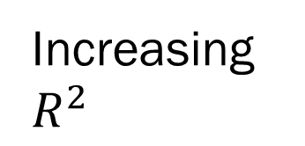
Simulated data
Decreasing sample size
1 2%, 5000 | 2 2%, 2000 | 3 2%, 500
4 5%, 5000 | 5 5%, 2000 | 6 5%, 500
7 10%, 5000 | 8 10%, 2000 | 9 10%, 500
Increasing $R^{2}$

Slide 33
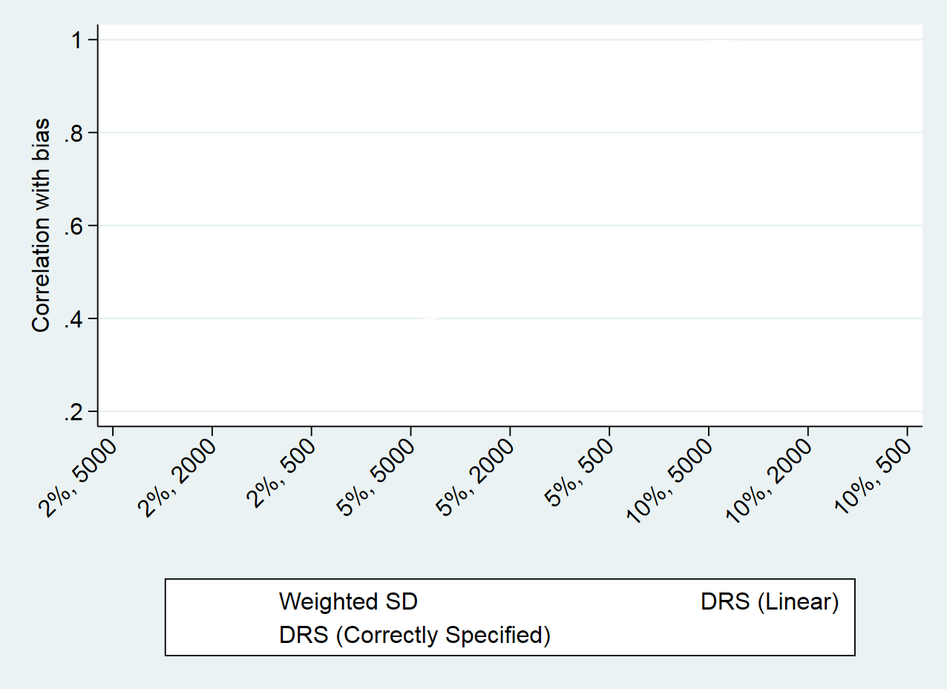
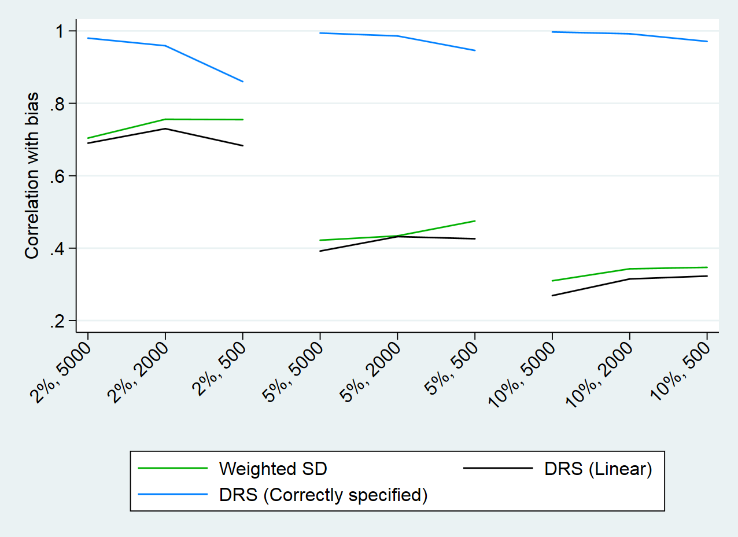
Scenario 2: Nonlinear term misspecified
Scenario 2: Non-linear term in outcome model

Slide 34
Scenario 2: Nonlinear term misspecified
Scenario 2: Non-linear term in outcome model

Slide 35
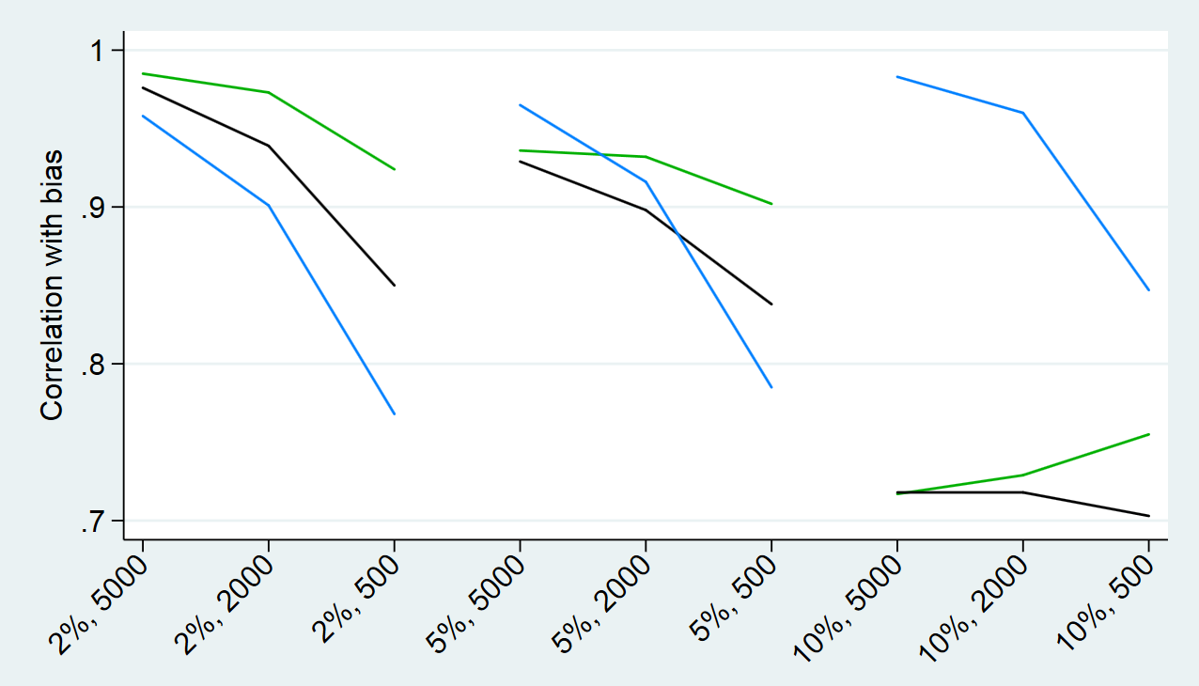
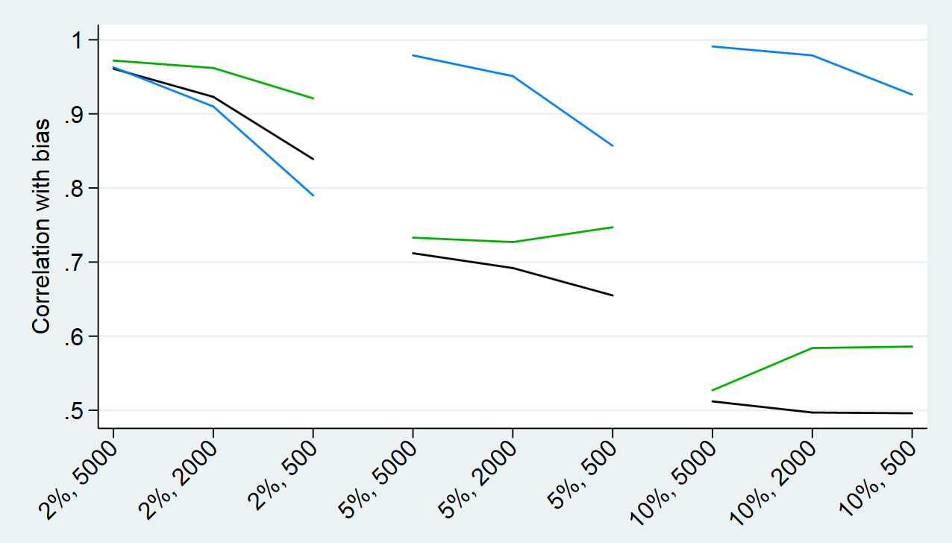
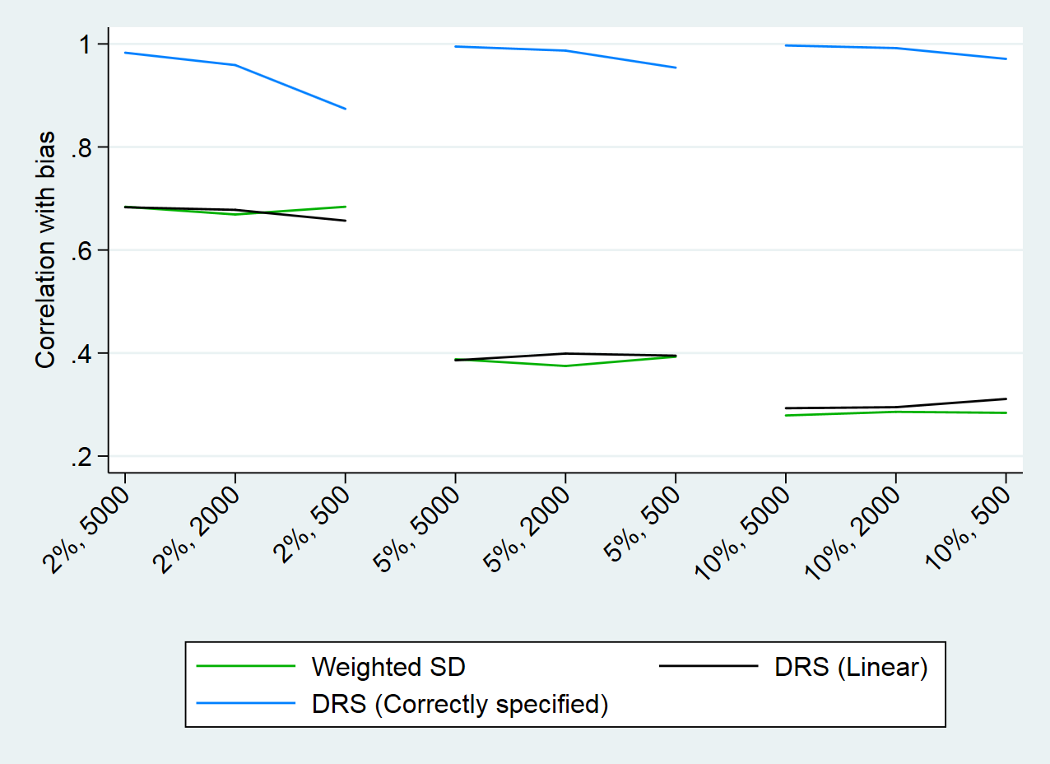
Scenarios 3-5: Interaction term in the outcome model
Figures:
- Scenario 3 (top left) | binary-binary
- Scenario 4 (top right) | binary-continuous
- Scenario 5 (bottom left) | continuous-continuous

Slide 36
Conclusions
Main finding: Standardised mean difference in the disease risk score is a promising overall diagnostic
Limitations:
Not robust to misspecifications in the outcome model
Performance dependent on sample size
Possible solutions:
Use of CP diagnostics to check specification
Using full sample or historic cohort to estimate DRS

Slide 37
Aims of research
Individual Diagnostics
Aim 1:
Review and compare the existing propensity score diagnostics.
Aim 2:
Develop guidelines for how to build and assess propensity score models.
Overall
Diagnostics

Slide 38


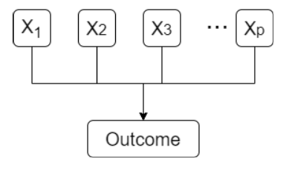
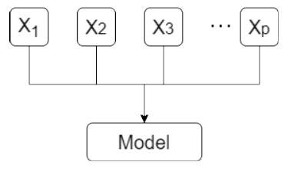
So, how best to assess propensity scores?
STEP 1: STEP 2: STEP 3:
Choose variables Check individual covariates Check overall balance
using CP diagnostics using DRS

Slide 39
So, how best to assess propensity scores?
STEP 1: STEP 2: STEP 3:
Choose variables Check individual covariates Check overall balance
using CP diagnostics using DRS

Slide 40
So, how best to assess propensity scores?
STEP 1: STEP 2: STEP 3:
Choose variables Check individual covariates Check overall balance
using CP diagnostics using DRS

Slide 41
So, how best to assess propensity scores?
STEP 1: STEP 2: STEP 3:
Choose variables Check individual covariates Check overall balance
using CP diagnostics using DRS

Slide 42

Thank you for listening
@EGranger90

Slide 43
References
[1] Granger, E et al. A review of the use of propensity score diagnostics in papers published in high-ranking medical journals. BMC Research Methodology. 2020.
[2] Brookhart, MA et al. Variable selection for propensity score models. American Journal of Epidemiology. 2006.
[3] Patrick, AR. The implications of propensity score variable selection strategies in pharmacoepidemiology: an empirical illustration. Pharmacoepidemiology and Drug Safety. 2011.
[4] Caruana, E et al. A new weighted balance measure helped to select the variables to be included in a propensity score model. Journal of Clinical Epidemiology. 2015.
[5] Stuart, EA et al. Prognostic score-based balance measures for propensity score methods in comparative effectiveness research. Journal of Clinical Epidemiology. 2013
@EGranger90

Slide 44
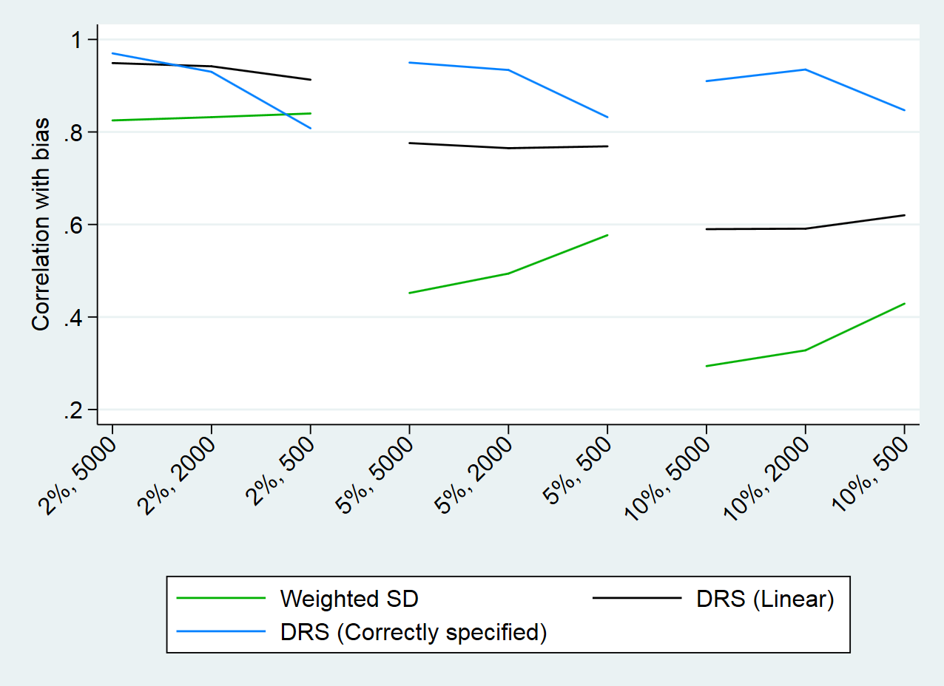
Scenario 2: Nonlinear term misspecified
Scenario 2: Non-linear (stratification)

Slide 45
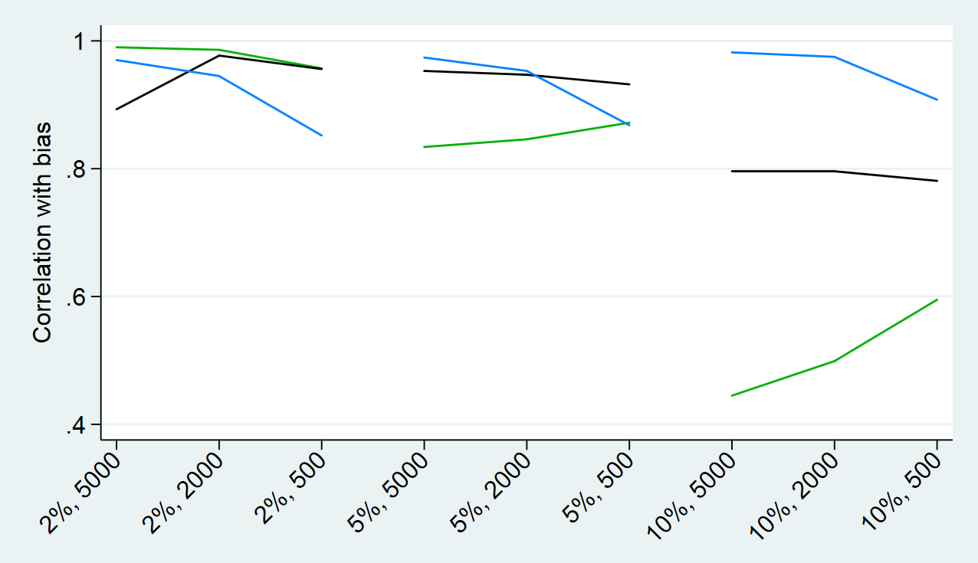
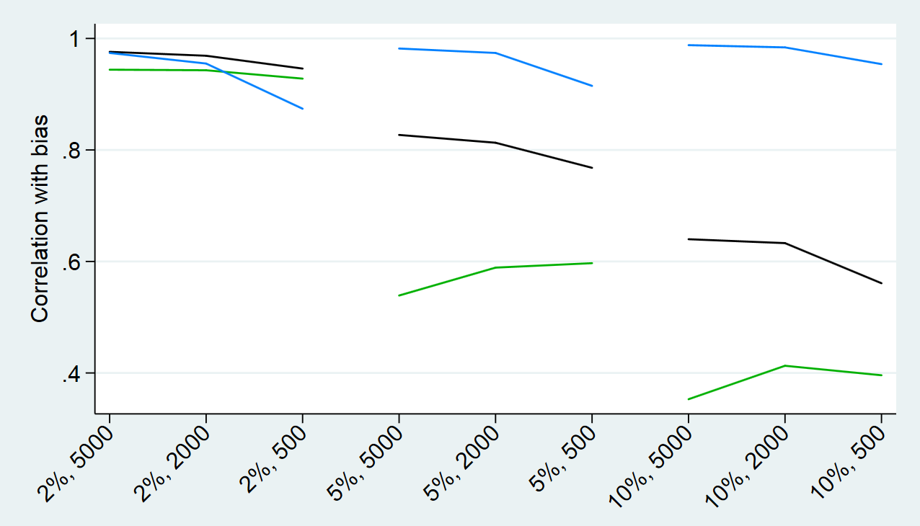
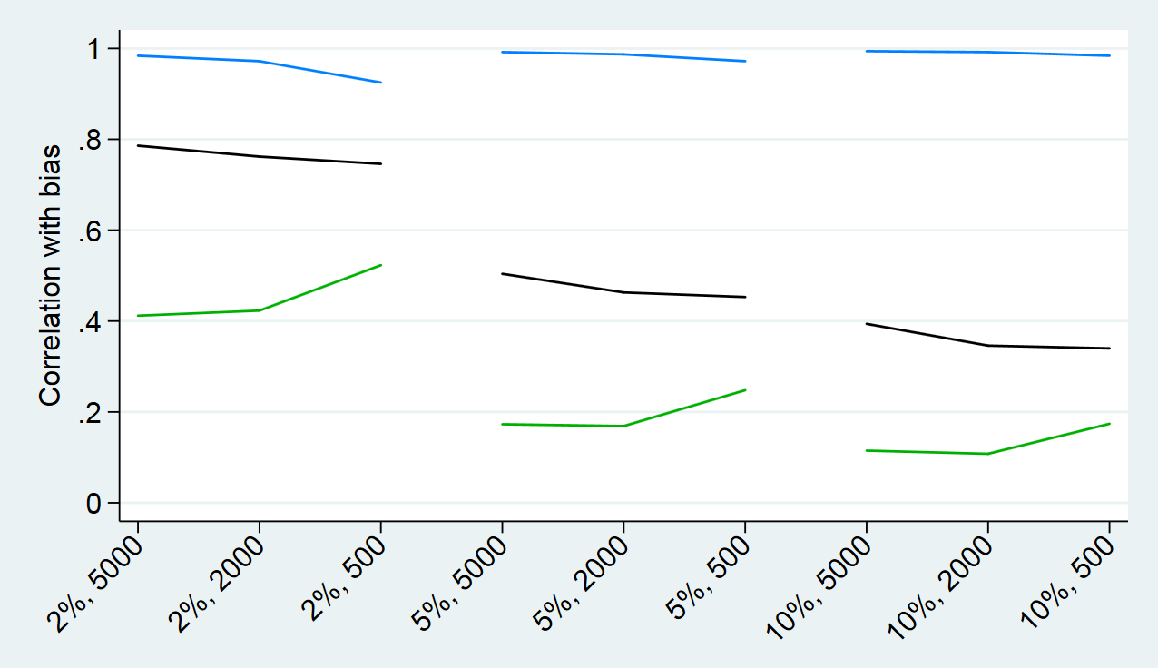
Scenarios 3-5: Interaction terms (stratification)
Figures:
- Scenario 3 (top left) | binary-binary
- Scenario 4 (top right) | binary-continuous
- Scenario 5 (bottom left) | continuous-continuous

Slide 46
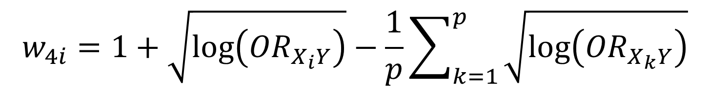
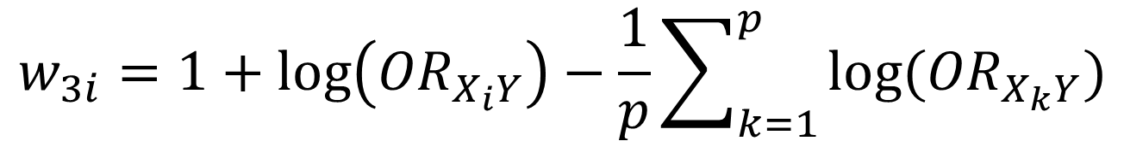
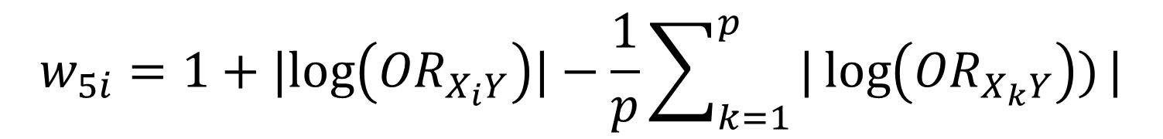
Scenario 2: Nonlinear term misspecified
Additional weights: Binary outcome
$$w_{3i}=1+\log\left({OR}_{X_{i}Y}\right)−\frac{1}{p}\sum_{k=1}^{p}{log⁡({OR}_{X_{k}Y})}$$
$$w_{4i}=1+\sqrt{\log\left({OR}_{X_{i}Y}\right)}−\frac{1}{p}\sum_{k=1}^{p}{\sqrt{\log\left({OR}_{X_{k}Y}\right)}}$$
$$w_{5i}=1+|log\left({OR}_{X_{i}Y}\right)|−\frac{1}{p}\sum_{k=1}^{p}{|\log\left({OR}_{X_{k}Y}\right))}|$$
Belitser, SV et al. Measuring balance and model selection in propensity score methods. Pharmacoepidemiology and Drug Safety. 2011

Slide 47
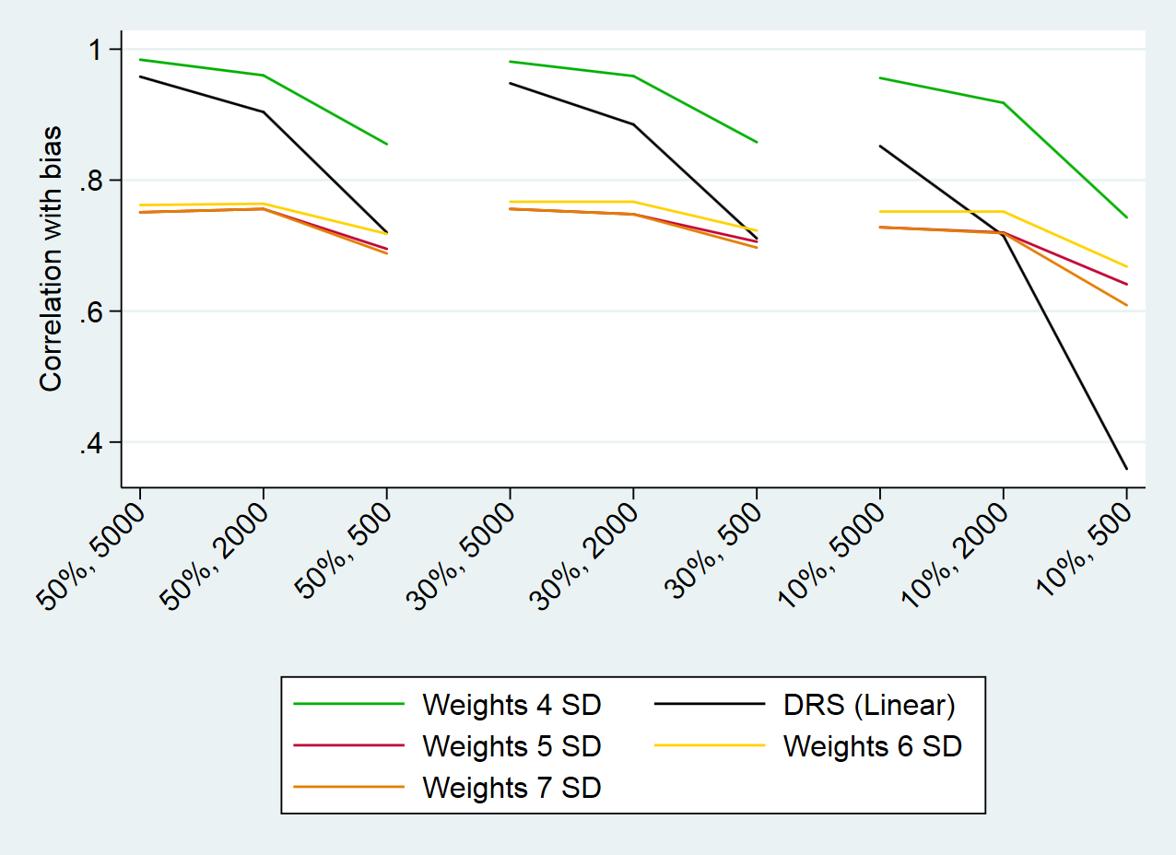
Scenario 2: Nonlinear term misspecified
Additional scenario: Binary outcome (matching)
2
3
5
4

Slide 48

Scenario 2: Nonlinear term misspecified
Additional scenario: Binary outcome (stratification)
2
3
5
4

