Slide 1




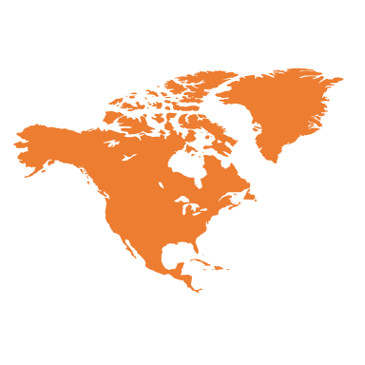




GAPsurvey
https://emilymarkowitz-noaa.github.io/GAPsurvey

