Slide 1
Measuring Output for U.S. Commercial Fisheries — From Theory to Practice

Slide 2
Measuring Output for U.S. Commercial Fisheries — From Theory to Practice

Slide 3
Study Purpose

Slide 4
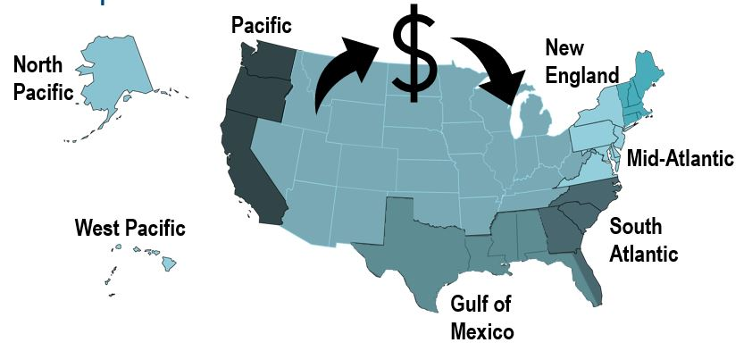
Develop alternative approaches to measure national and regional fishery outputs for productivity measurements.
Evaluate the impacts of missing data and other issues on output estimates.
Notes:
Here we want to Develop alternative approaches to measure fishery outputs for productivity measurements for the US and for each of the 7 regions. To do that appropriately, we really needed to explore the impacts of missing data and other issues on output estimates.

Slide 5
Regional Quantity Index

Slide 6
Regional Quantity Index

Slide 7
Quantity Index

Slide 8
Where can you find me?
email: Emily.Markowitz@noaa.gov
github: https://github.com/alexadibenedetto
linkedin: https://www.linkedin.com/in/alexadibenedetto/

