Slide 1
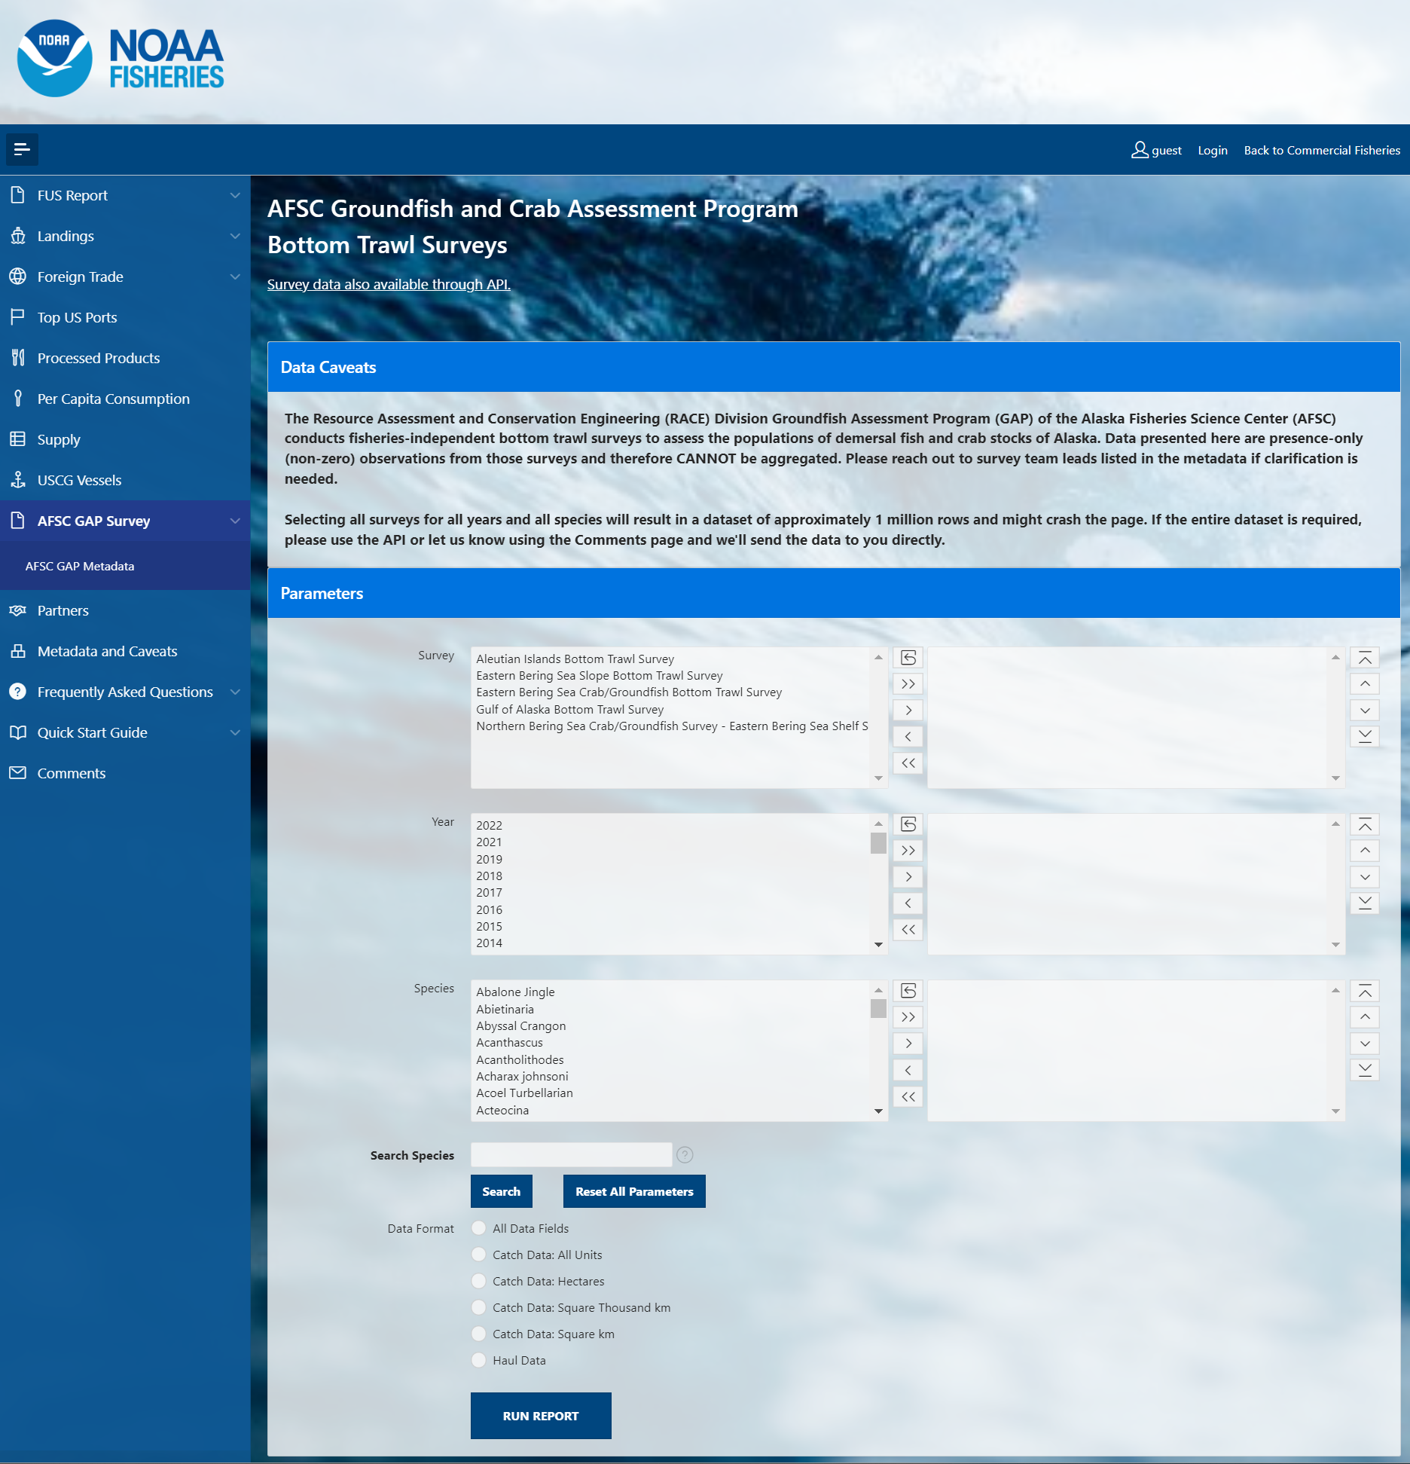
foss_1_interface.png

Slide 2
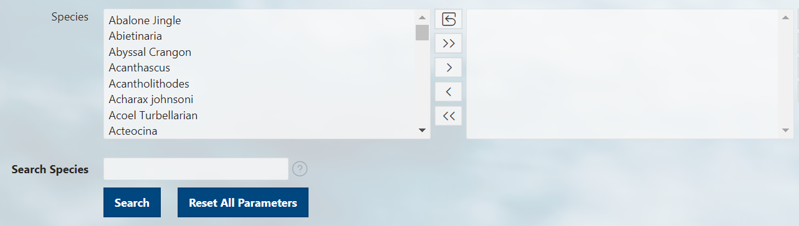
foss_2_select.png
Options box Selection box
Reset box options and selections boxes
Move all options from options box to selection box
Move specifically selected options from the options box to the selection box
Move specifically selected options from the selection box to the options box
Remove all options from selection box
Manually scroll through all options/selections
Type a term of the organism’s common name
Reset all parameters for entire form, not just species searches

Slide 3
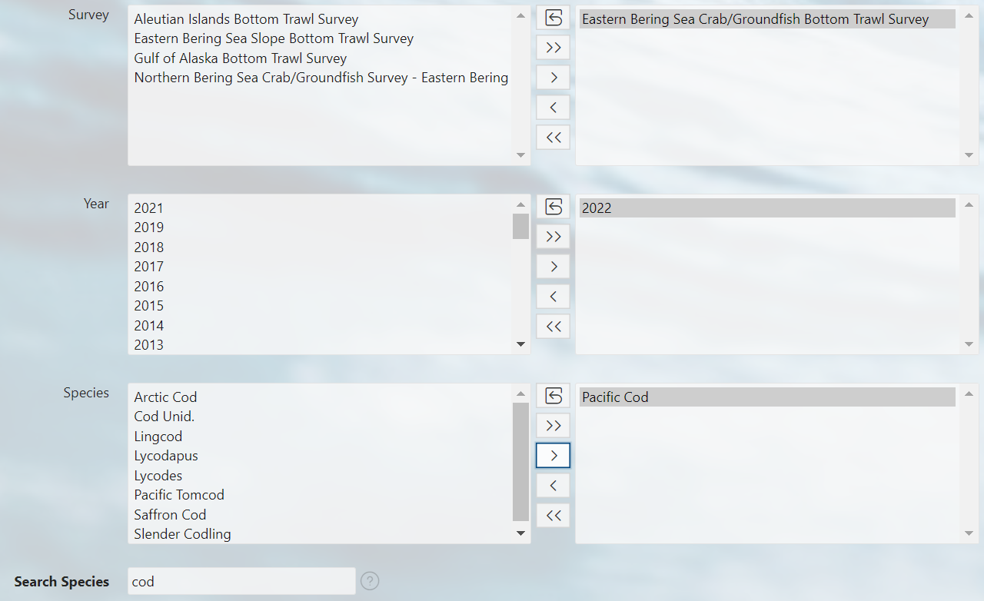
foss_3_selected.png

Slide 4
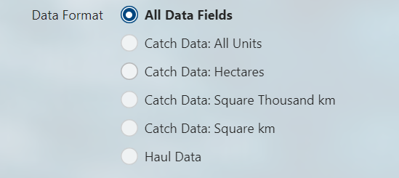
foss_4_data_format.png
All Data Fields: Presence and Absence (zero-filled)
All Data Fields: Presence-only (non-zero)
Catch data: Presence and Absence (zero-filled)
Catch data: Presence-only (non-zero)
Haul Data

Slide 5
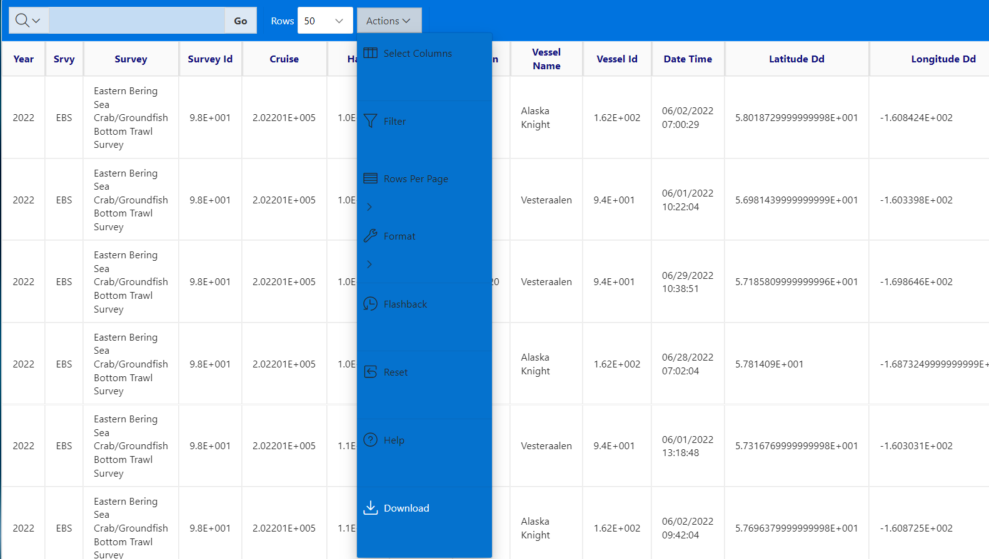
foss_5_run_report.png

