Slide 1
Relationship Duration and Hazard of Dissolution Among 15-29-year-olds in the National Survey of Family Growth
Emily Pollock
Network Modeling Group
27 Feb 2019

Slide 2
Why are we not looking at a poster?
CSDE lighting talk and poster
CSSS 544 final project and poster
Dissertation Chapter

Slide 3
Project Motivation
Modeling dynamic relationship persistence / dissolution is challenging!
relationship persistence is a complex social process
data is limited by practicality of study design
age ranges being modeled create weird boundary issues
Current practice in our network models:
Relationship persistence is governed by a homogenous constant hazard (conditional on covariates)
Q: Is this a reasonable simplifying assumption?
Notes:
What we would really need is a longitudinal study over the life course, but that’s impractical
Intuitively, I think we think of relationships over the their life course as having a high risk of dissolution at their beginning that may taper off over time, or spike during key transmissions like moving in together or getting married

Slide 4
Questions
Is the assumption of an exponential distribution (aka a constant hazard of dissolution) a reasonable simplifying assumption among age and race ego-alter subgroups?
What is the mean relationship duration among these subgroups? Are there significant differences in mean relational duration between the groups?
Notes:
Model comparison
You will notice that that statement about which covariates I want to model is a bit vague – intentional! More on that later

Slide 5
Data
National Survey of Family Growth, 2006-2015
Cross-sectional repeated in several waves (with different respondents)
Weights are nationally representative
Respondents aged 15-44 (my analysis limited to hets aged 15-29)
Detailed questions about sexual history and their partners
Marriage / cohab history
1st sexual partner
Up to 3 most recent sexual partners in the last year

Slide 6
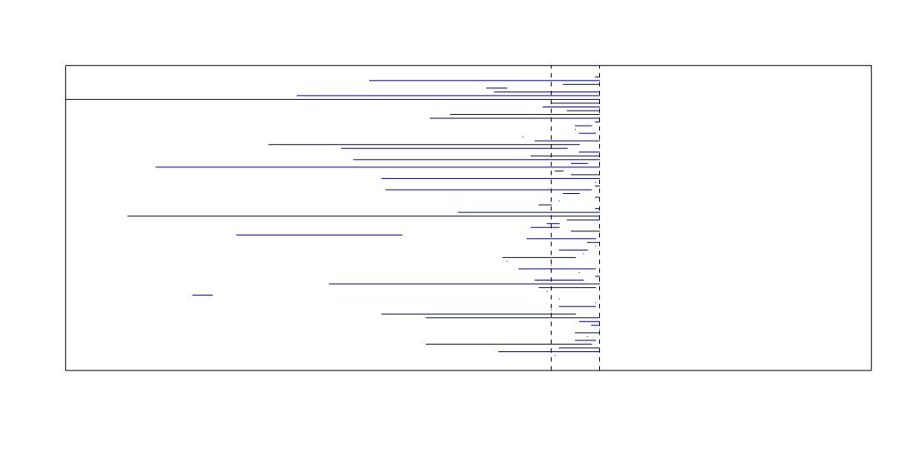
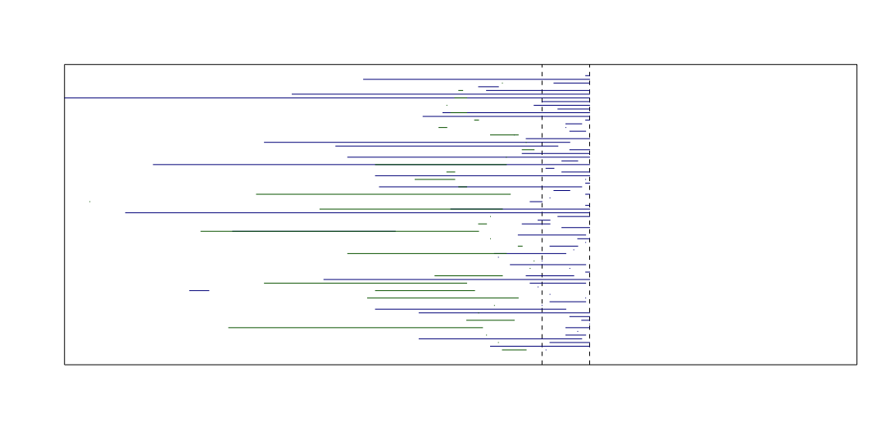
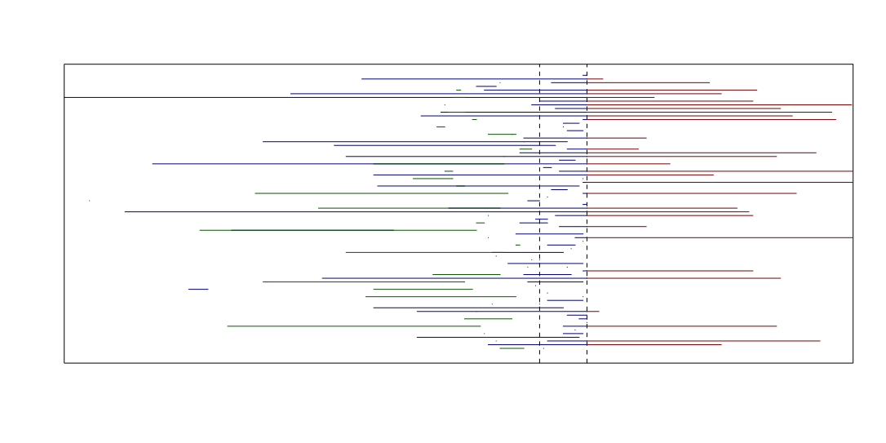
Data – Design Issues
Left Truncated
Observed
Right Censored
Notes:
There are corrections for both of these issues

Slide 7
Data – Other Issues
Alter Race
Asked if partner is active on date of interview
Not asked if partner is NOT active
A few exceptions for previous marriages/cohabs
Solution: imputation (in-progress)
Serial responses (aka people with multiple partners)
Solution: ?
Mixture model
Fixed or random effects
To be continued

Slide 8
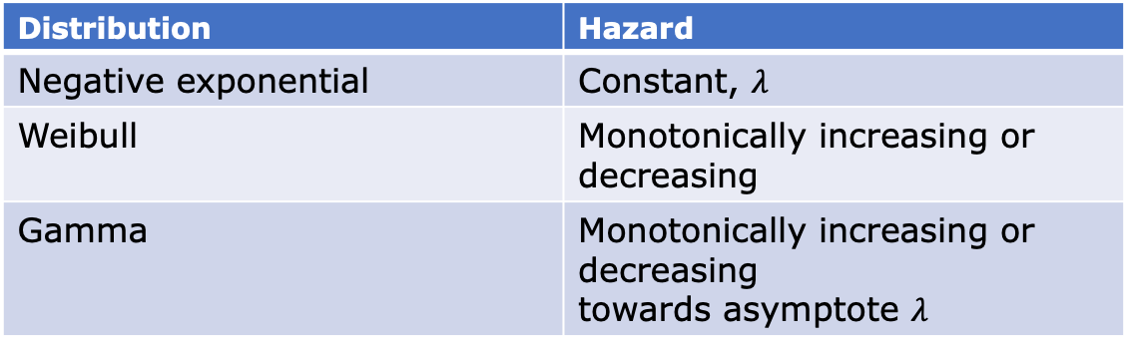
Proposed Method
Event history analysis / survival analysis
Methods designed with duration data in mind
Can adjust for left-truncated and right-censored data
Exploratory parametric model comparison & visualization
Model Type: Parameter Covariate (as opposed to accelerated failure time or parametric proportional hazards)
Distribution | Hazard
Negative exponential | Constant, $λ$
Weibull | Monotonically increasing or decreasing
Gamma | Monotonically increasing or decreasing towards asymptote $λ$
Notes:
EHA has developed methods dealing explicitly with duration data, and the missingness often associated with that type of data
Likelihood ratio test, other measures of model validation
Reserve sample for prediction?
PC models – assume model params (shape location and /or scale) are dependent on covariates, and change with them (calc using pdf, cdf/survival)
AFT models – assume that scale and shape of baseline PD is constant across as covariates change (calc using pdf, survival)
PH – baseline hazard is same for everyone, proportional changes to hazard function based on covariates (proportional across entire hazard function)

Slide 9
Possible Covariates
Ego age / ego age category
Ego race
Alter age / alter age category
Alter race
Ego-alter age-difference (sqrt)
Race-dyad (e.g. b-b, w-w, w-h, etc)
Others?
Dyad-dependent
Notes:
Dyad dependence not an issue for regression, but complicated / slow to incorporate into ergms
Other things we might consider in a formation model like degree not relevant here, using data as retrospective, not as cross-sectional

Slide 10



The End // Happy 1st bday Teddy

