Slide 1
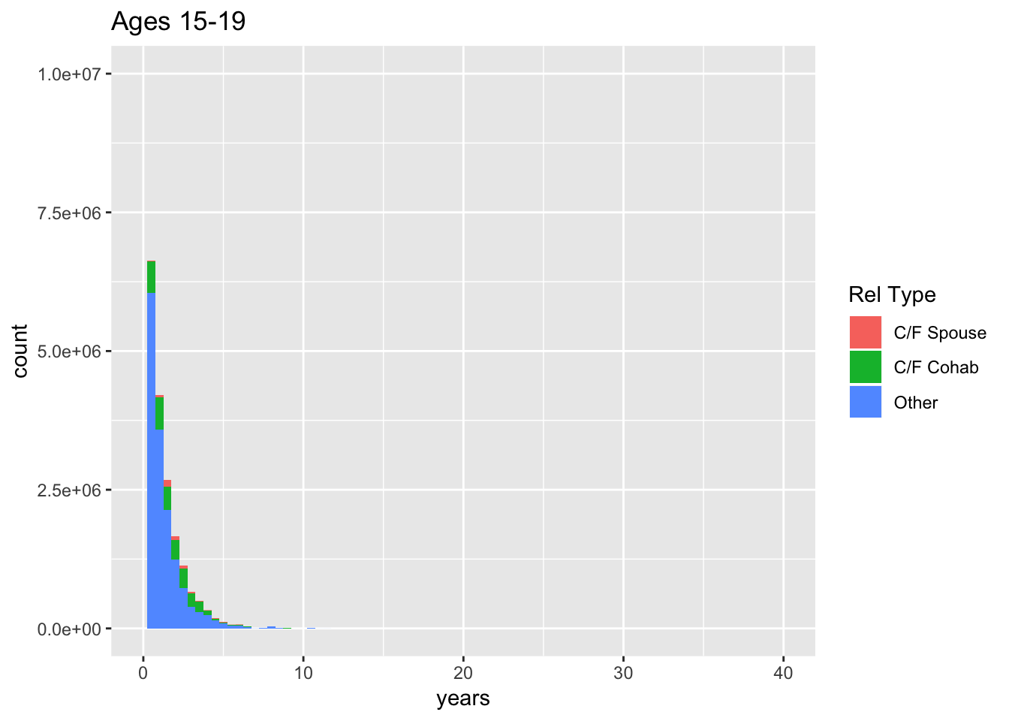
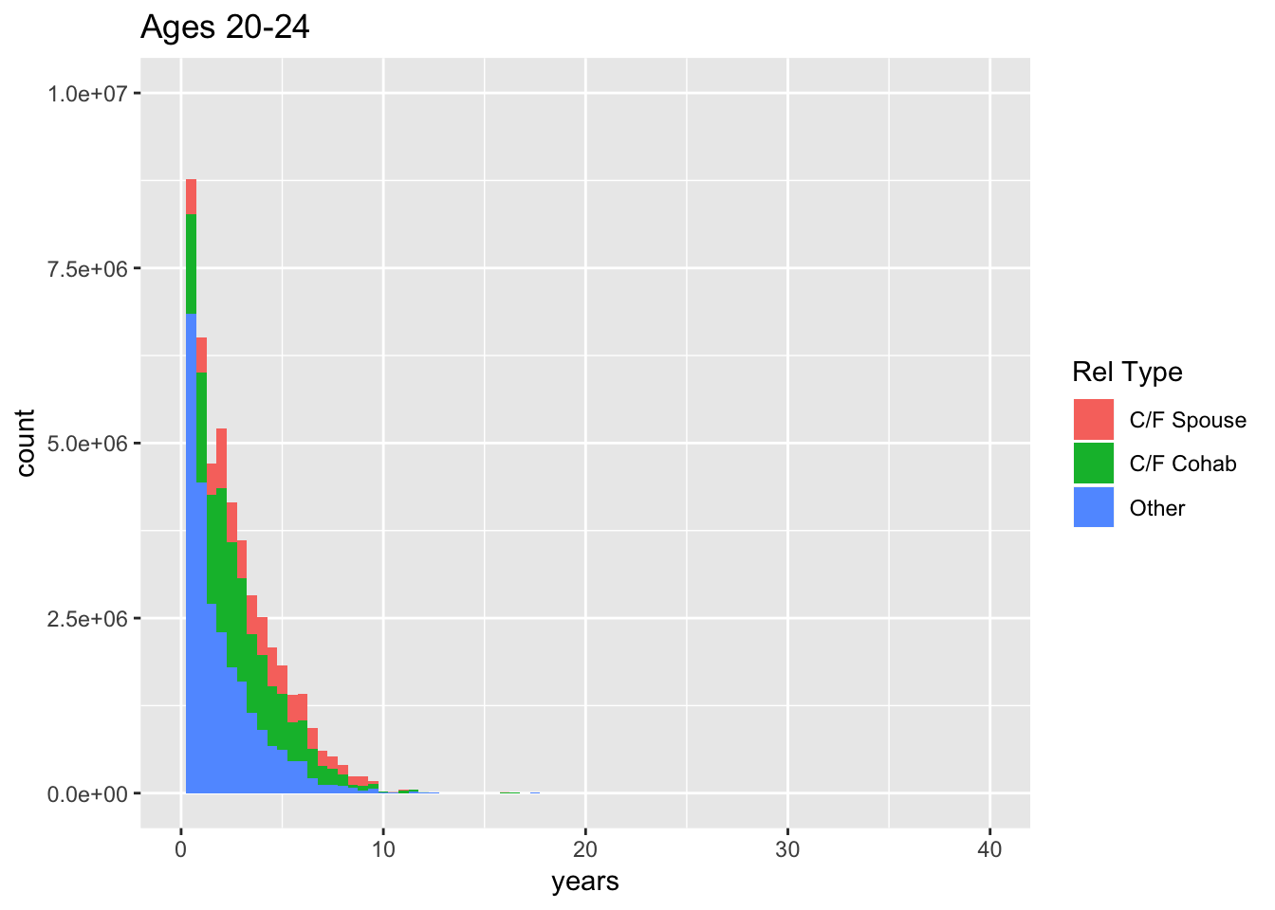
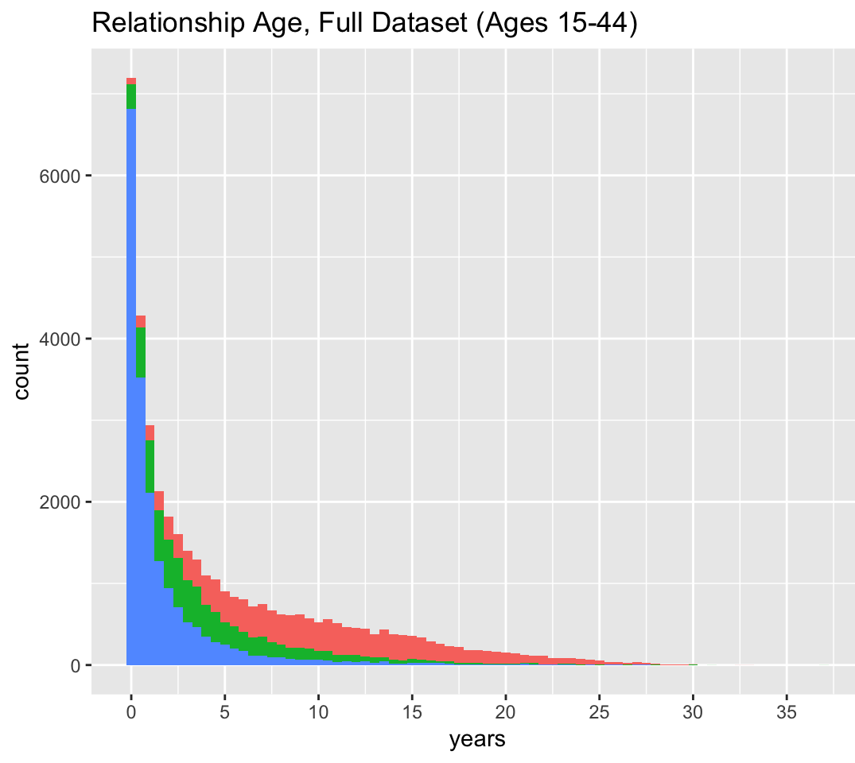
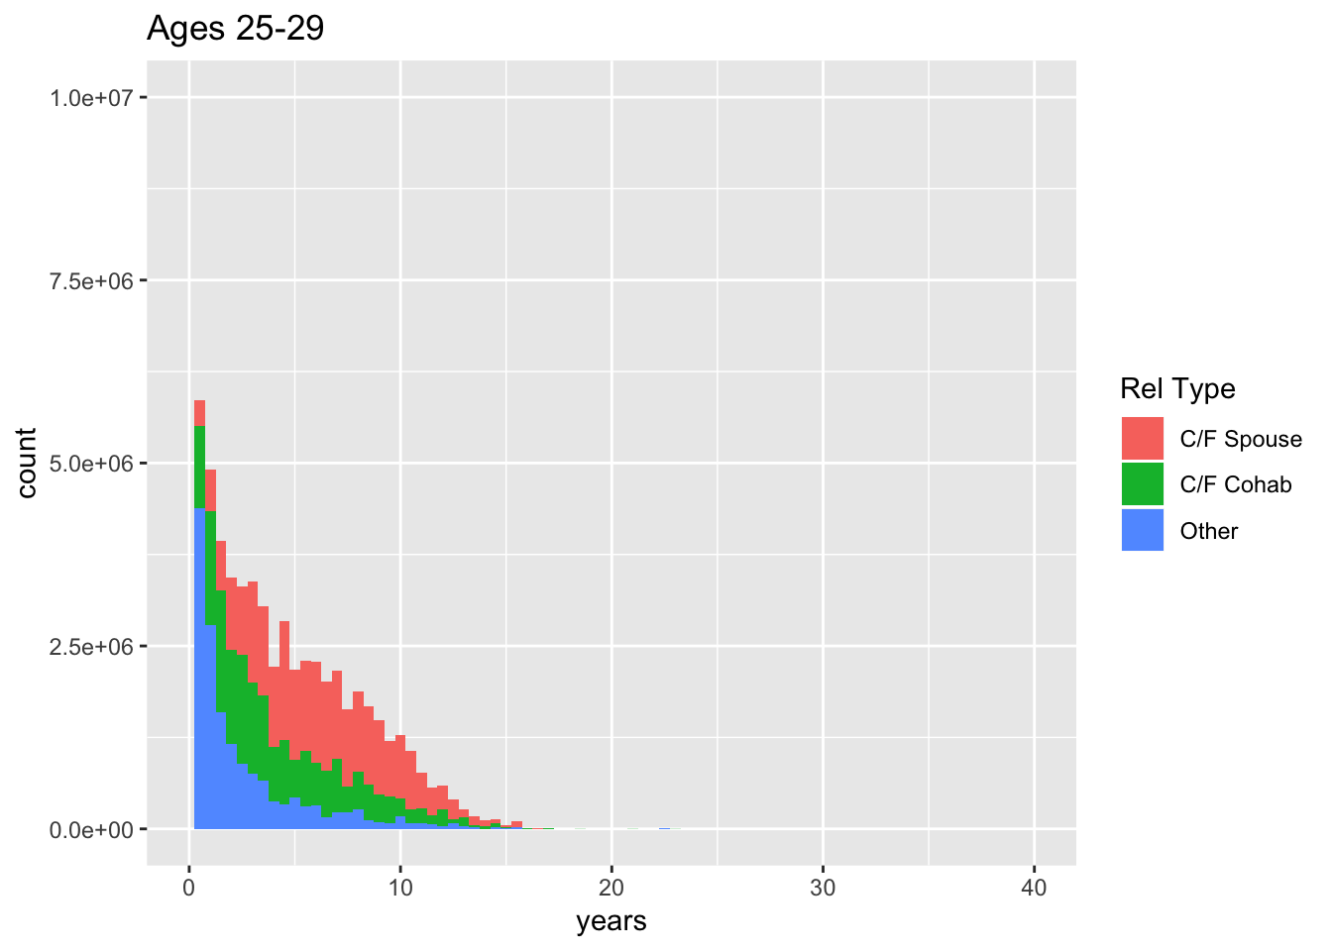
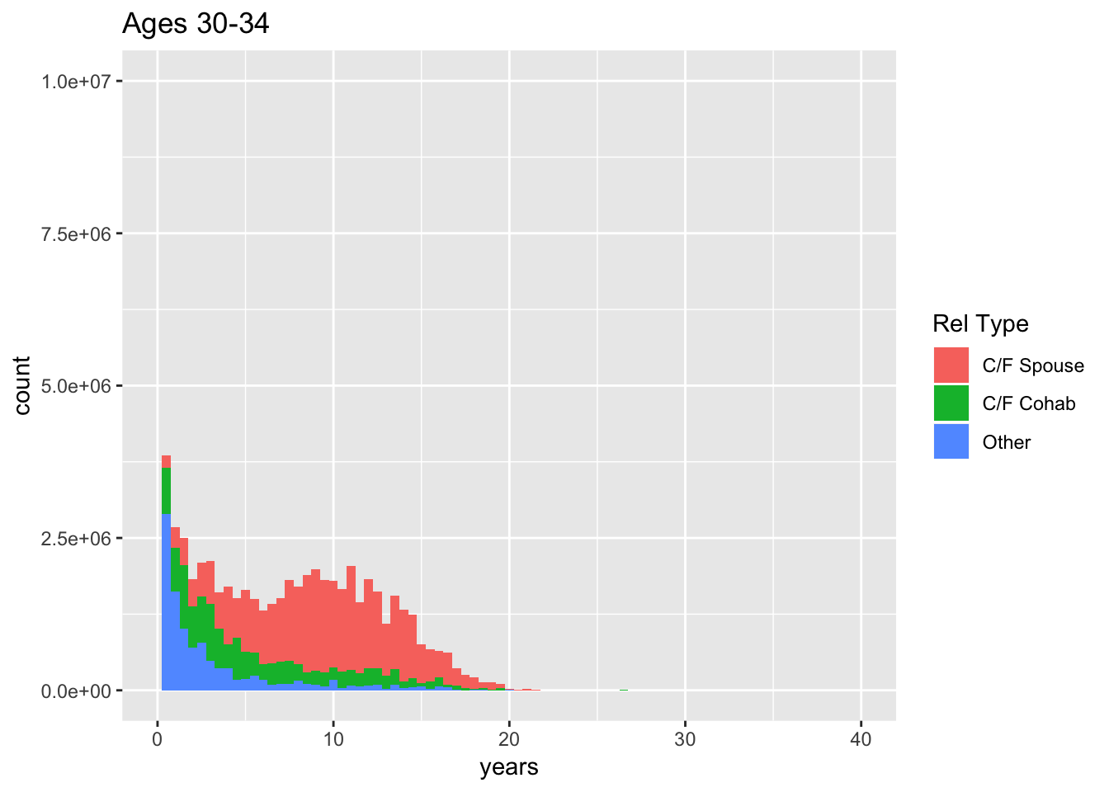
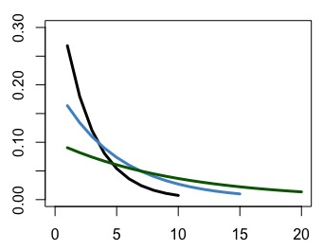
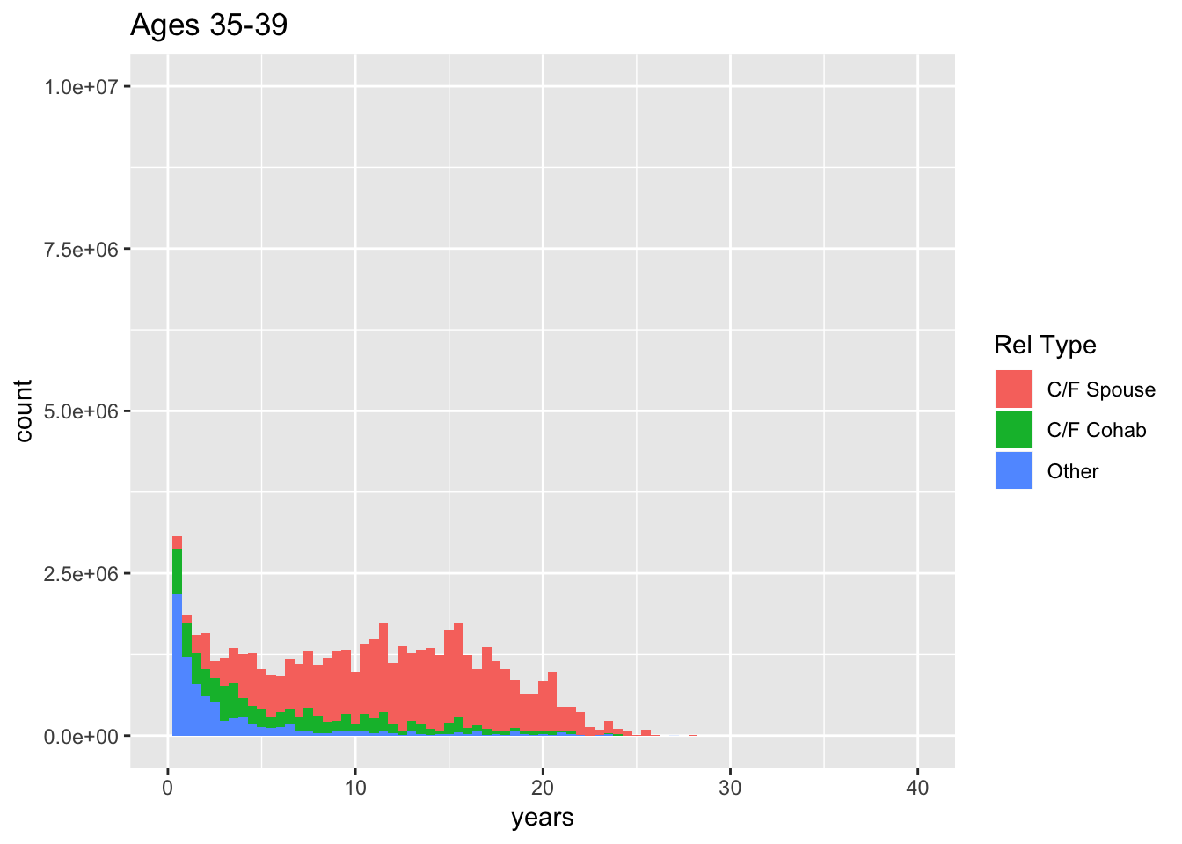
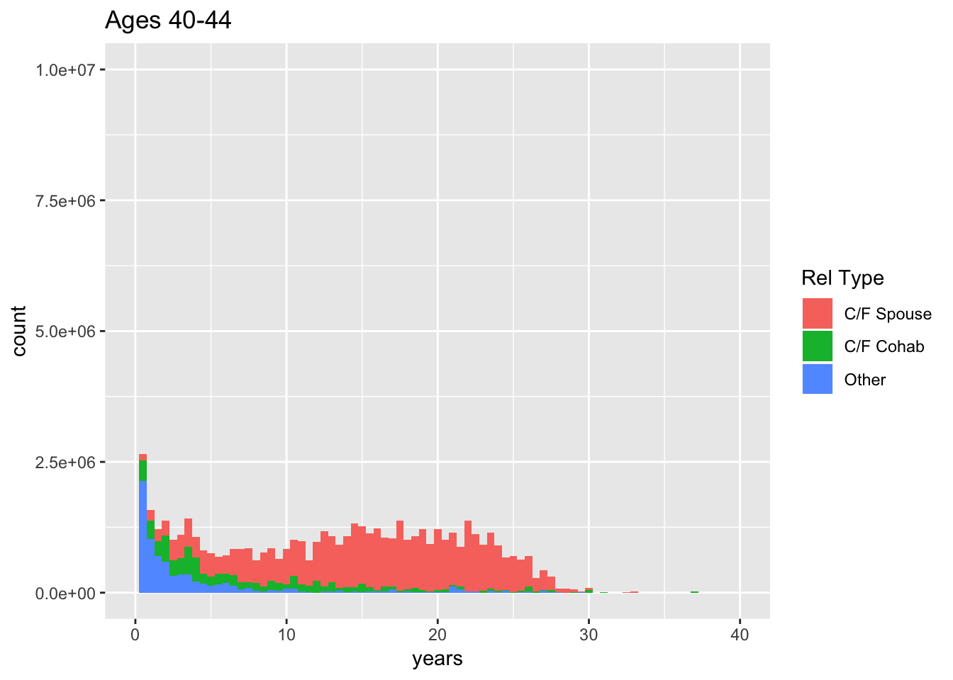
The challenges of representing the population-wide distribution of relationship ages in dynamic network models:
Insights from the National Survey of Family Growth
Emily Pollock, Department of Anthropology and The Center for Studies in Demography and Ecology
Background
This project is a preliminary dive within a larger research agenda about how network models, more specifically STERGMS (separable temporal exponential random graph models), represent relationship dynamics in an age-structured population over time.
STERGMs are a highly flexible class of network models capable of representing a variety of generative processes for the formation and dissolution of ties.
In the context of STI transmission across a network, an individual’s chances of acquiring an infection are not only a function of their behavior, but also the behavior of their partners, as well as the broader, often overlapping (concurrent), patterning of relationships across the network, Therefore crucial to faithfully represent relationship dynamics over time.
STERGMs often have complex relationship formation components but the current standard for the dissolution component assumes that once a relationship begins, its persistence is governed by a constant hazard. This is a convenient simplifying assumption but poses challenges for simultaneously representing the distribution of both the very short and the very long relationships observed in empirical data.
In this ongoing project, we aim to understand the changing distribution of relationship duration over the life-course using data from the National Survey of Family Growth, and to develop a framework for STERGM formation and dissolution parameters that more effectively represent these data over time.
Relational Age, By Age Category
Relational Age, Full Dataset
Initial Insights
The relational age distribution of the youngest age categories, respondents aged 15-19 and 20-24, looks reasonably exponential
As age increases however, the distribution begins to look uniform
The frequency of new and/or short relationships decreases in magnitude over time, but there is always a visible effect
Divorce & re-marriage likely drivers of more uniform distribution in older age categories
Examples of PDFs based on Exponential Dist.
Data
The data come from the 2006-2015 waves of the National Survey of Family Growth. The pooled dataset contains roughly 40,000 respondents aged 15-44. These respondents reported on their marriage and cohabitation history as well as their three most recent sexual partners of the opposite sex in the last 12 months (including demographic characteristics of their partners and the beginning and ending dates of the relationships).
Histograms:, center & left: C/F = CURRENT OR FORMER

