Slide 1

Emily Pollock
NMG
2 May 2019
Relationship Duration & Survival Analysis

Slide 2

Quick Guide to Censoring
Relationship Duration in NSFG

Slide 3
Guide to Censoring & Sampling Bias
Right Censoring
Type 1
Event is only observed if it occurs prior to a set time
e.g. study ends and patient has not experienced a cardiac event post-surgery, or
We have the start date of a relationship, but it is still active on the day of interview
Type 2
Study ends after X failures
Not usually present in social science data
If ignored, results in bias towards shorter time-to-event / duration
We have a minimum duration:
The time between surgery and study end or loss-to-follow-up

Slide 4
Guide to Censoring & Sampling Bias
Interval / Left Censoring
Interval
event occurs between observations
e.g. a patient seroconverts between HIV tests
Left*:
Special case of interval censoring
Event occurred prior to observation period at undetermined time
e.g. when did you first have sex? “I don’t know, but I have had sex”
Both results in bias towards longer time-to-event / duration
We have a maximum duration:
time between HIV tests, and the time between interview day and perhaps an assumption about average onset of sexual activity

Slide 5
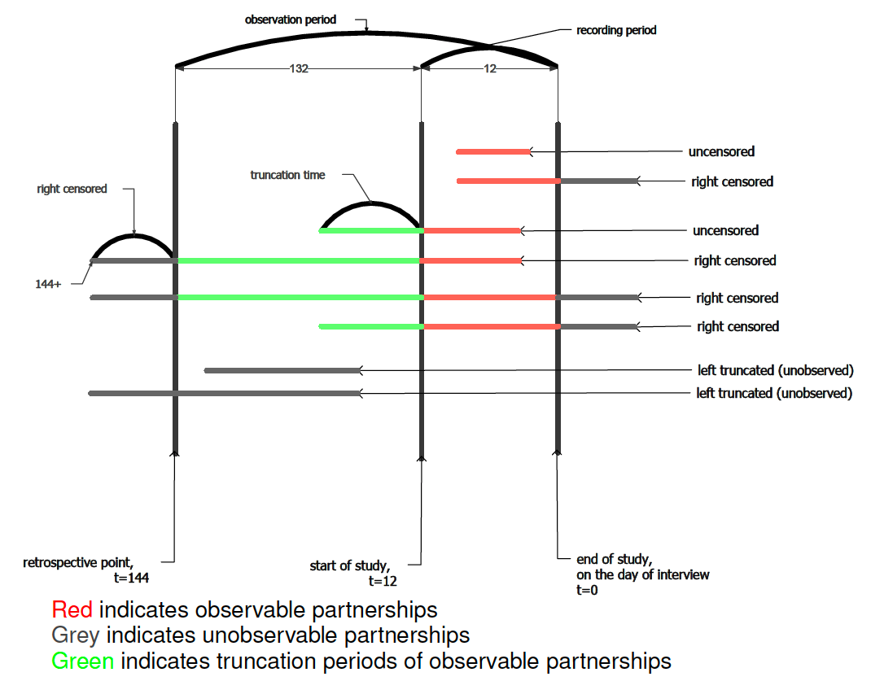
Guide to Censoring & Sampling Bias
Left Truncation
‘delayed time entry’
Bias towards longer duration

Slide 6
Guide to Censoring & Sampling Bias
not present in NSFG data
Graphic from Kirk Li’s dissertation, 2015

Slide 7
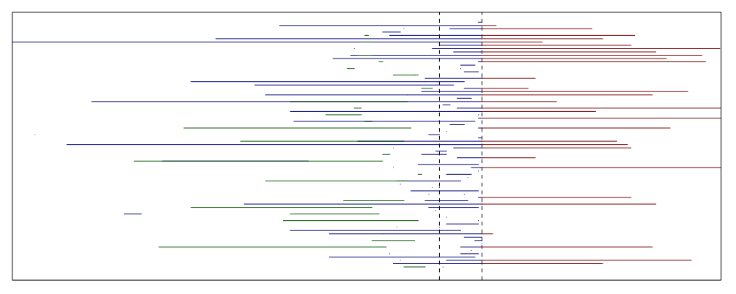
Censoring in NSFG
Describe up to 3 sexual partners in last 12 months (cross-sectional egocentric data) → right censoring
Report start and end dates (retrospective data)
→ left truncation
Left Truncated
Observed
Right Censored

Slide 8
Relationship Duration in NSFG

Slide 9

Motivation
What are the patterns of relationship duration by age, and is there a reasonably simple framework by which we can represent them in our ERGMs?
Is an exponential distribution, either homogenous across all nodes or heterogenous (homogenous within groups)
How does ego age influence the rate of both formation and dissolution?
How does the survey design influence how we understand patterns by age?
Notes:
Because the data is not over the lifecourse, the retrospective cross-sectional design messes with some of what could be useful intuition about initial age, current age, etc and what those ages tell us about the hazard of dissolution
Not just because someone is 20 that they’re not in a long-term relationship, but because they are 20 they can’t have been in a 20 year relationship – but they might already been in one what WILL last 20 years
Part 1 is going to inform the network model portion of my dissertation, the EPT & immunity model
Part 2 is going to keep going and become the meat of this section

Slide 10
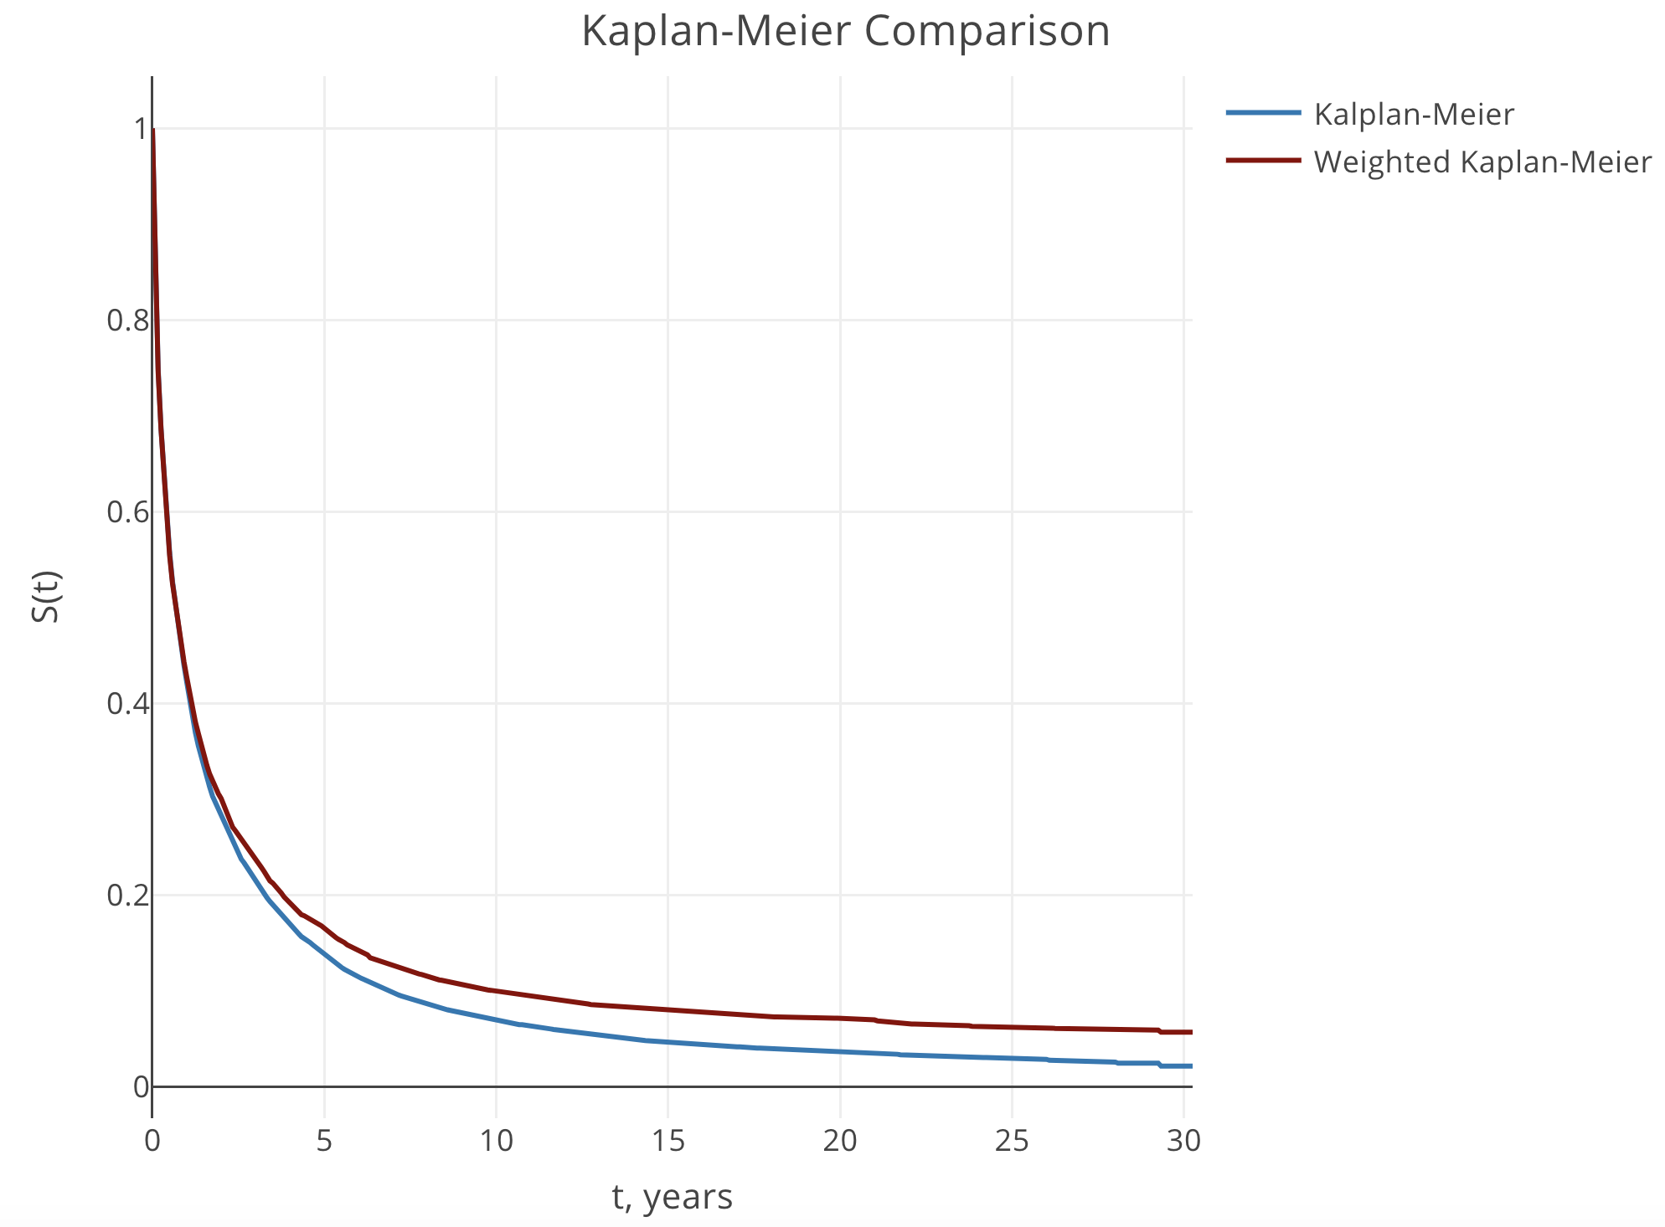
Modified Kaplan-Meier
Kaplan-Meier Curves as comparison
Weighted to NSFG weights vs Unweighted

Slide 11
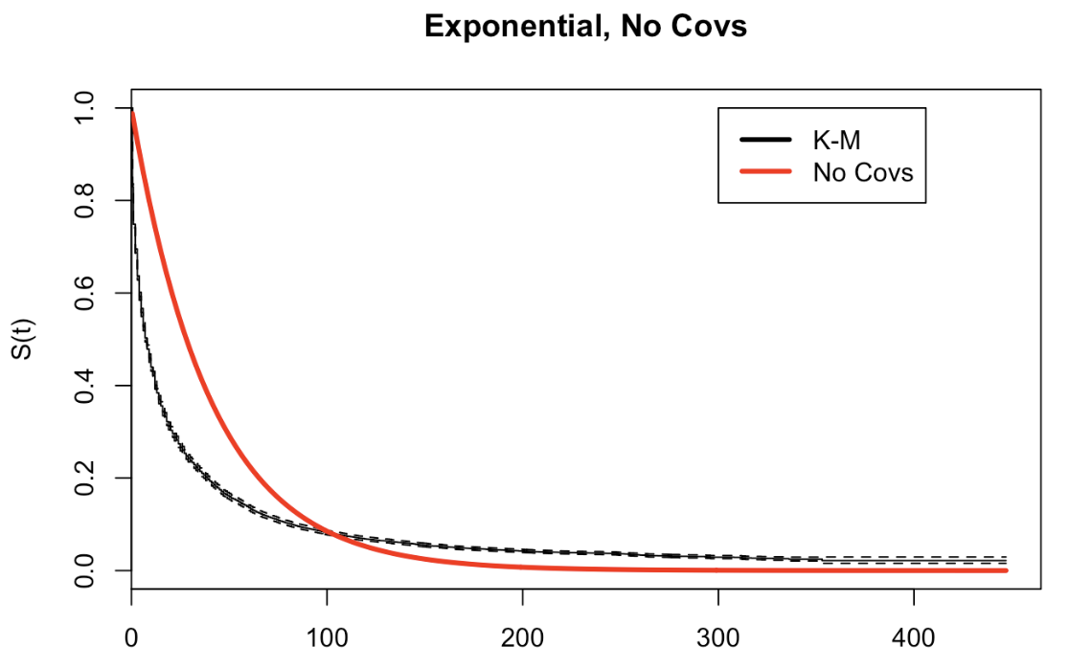
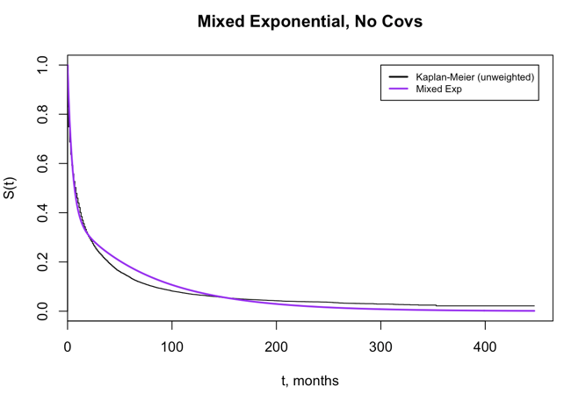
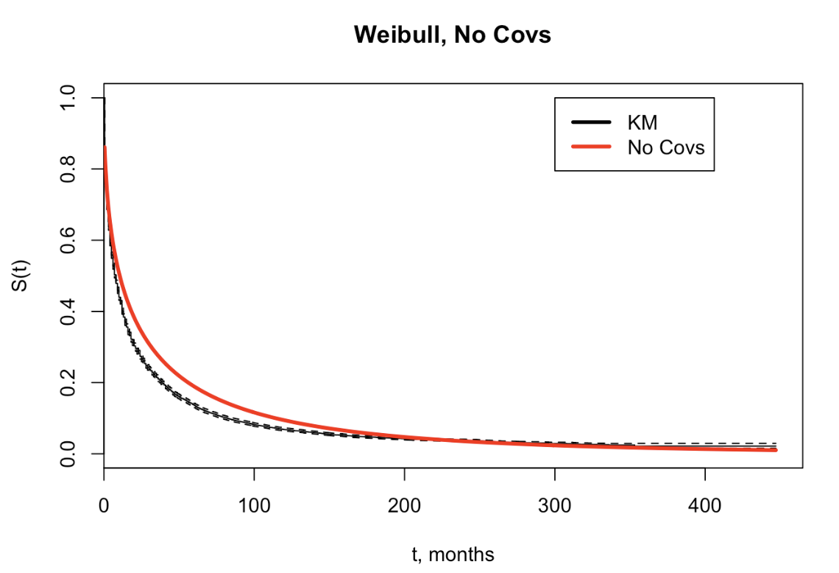
Duration-Only Models

Slide 12
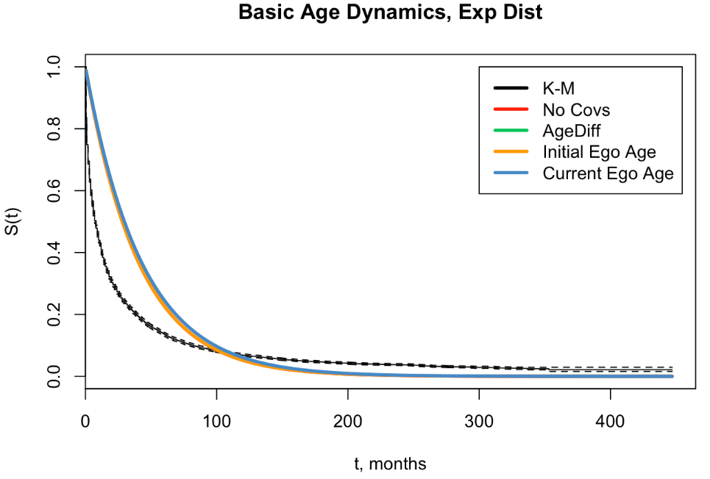
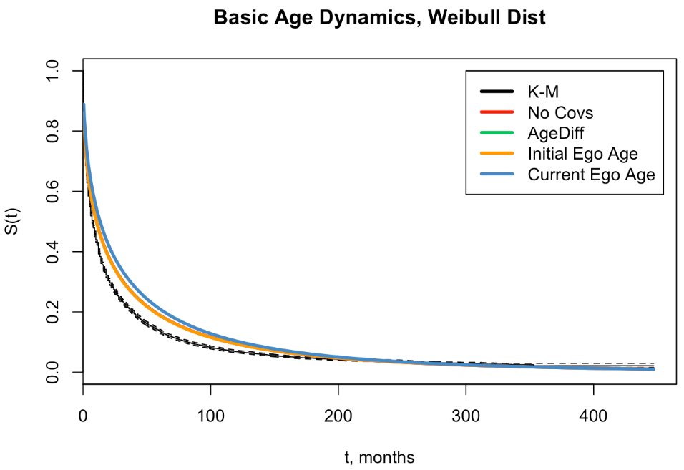
Age Models

Slide 13
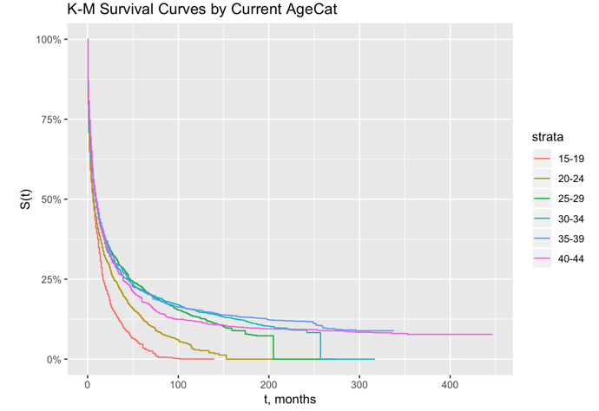
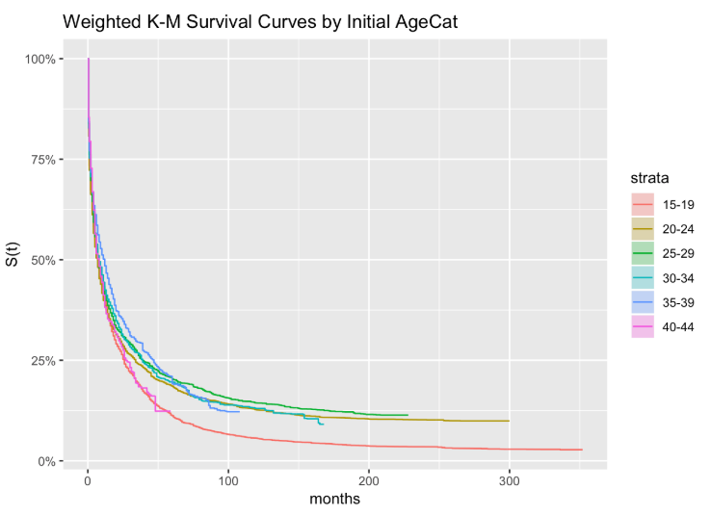
Gaining Some Intuition
Notes:
The patterns that we see are heavily influenced by how NSFG asked respondents to report their relationships – very much changes how we would interpret ‘initial age at relationship’

Slide 14
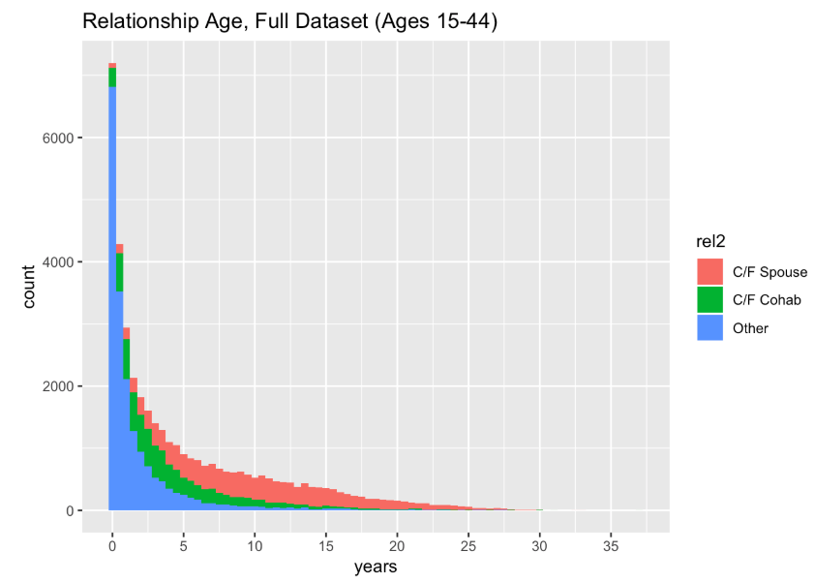
Gaining Some Intuition
Notes:
The patterns that we see are heavily influenced by how NSFG asked respondents to report their relationships – very much changes how we would interpret ‘initial age at relationship’

Slide 15
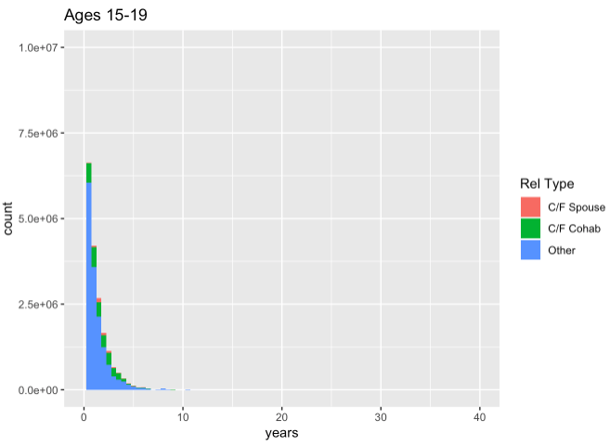
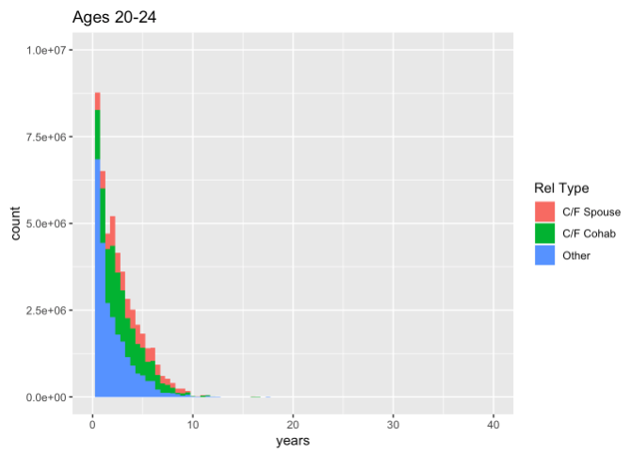
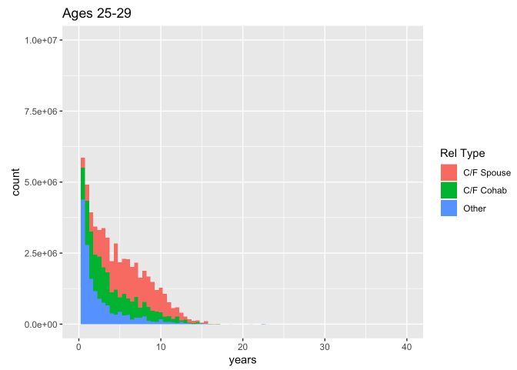
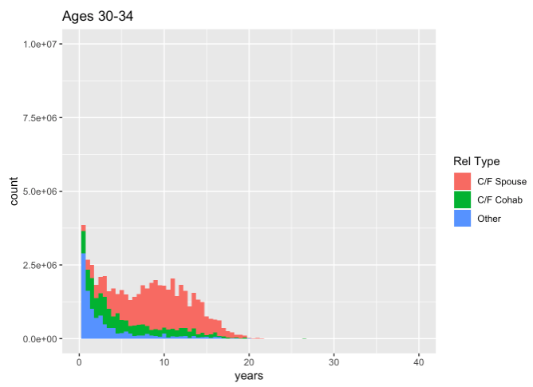
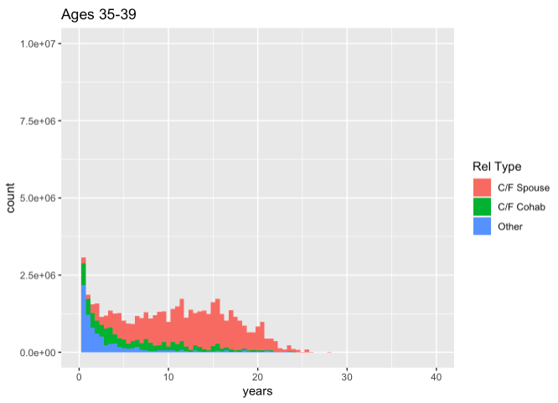
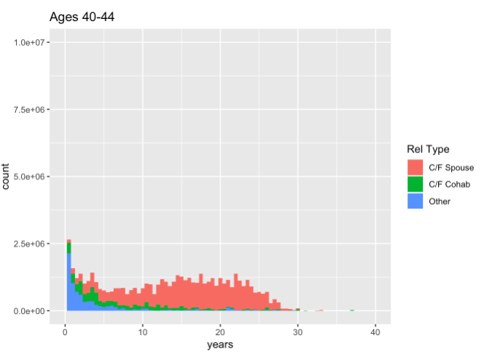
Gaining Some Intuition
Notes:
IGNORING EFFECTS OF RIGHT CENSORING AND TRUNCATION, WHAT DO THE HISTOGRAMS LOOK LIKE
The patterns that we see are heavily influenced by how NSFG asked respondents to report their relationships – very much changes how we would interpret ‘initial age at relationship’

Slide 16
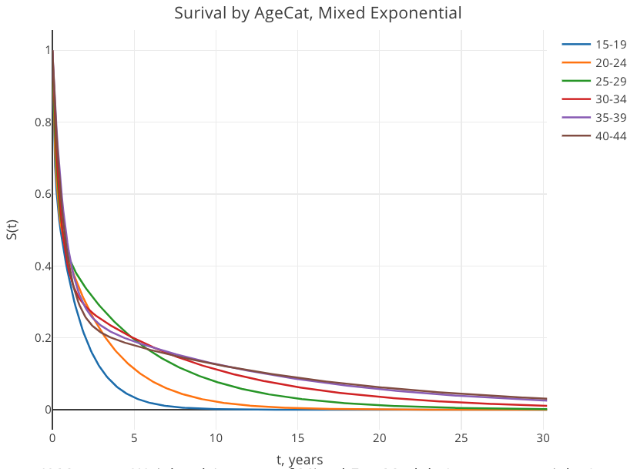
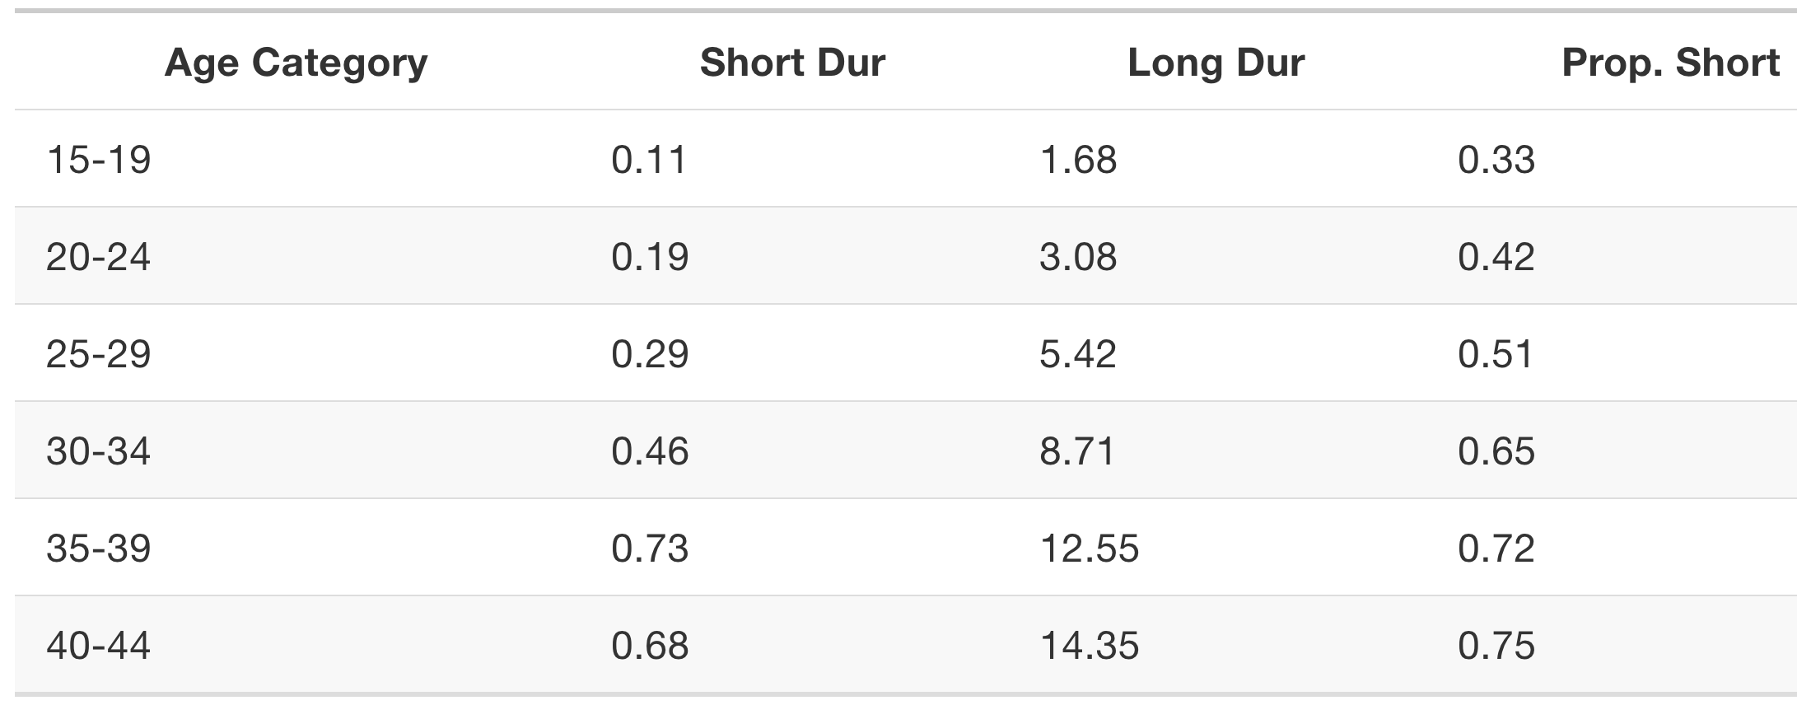
Mixture Models
Notes:
Intuition here is that latent components are capturing heterogenous frailties – some rels, regardless of what ego age they start at, are going to fail, and some are going to last

Slide 17
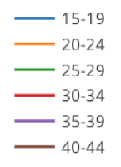
Mixture Models
Notes:
Intuition here is that latent components are capturing heterogenous frailties – some rels, regardless of what ego age they start at, are going to fail, and some are going to last

Slide 18
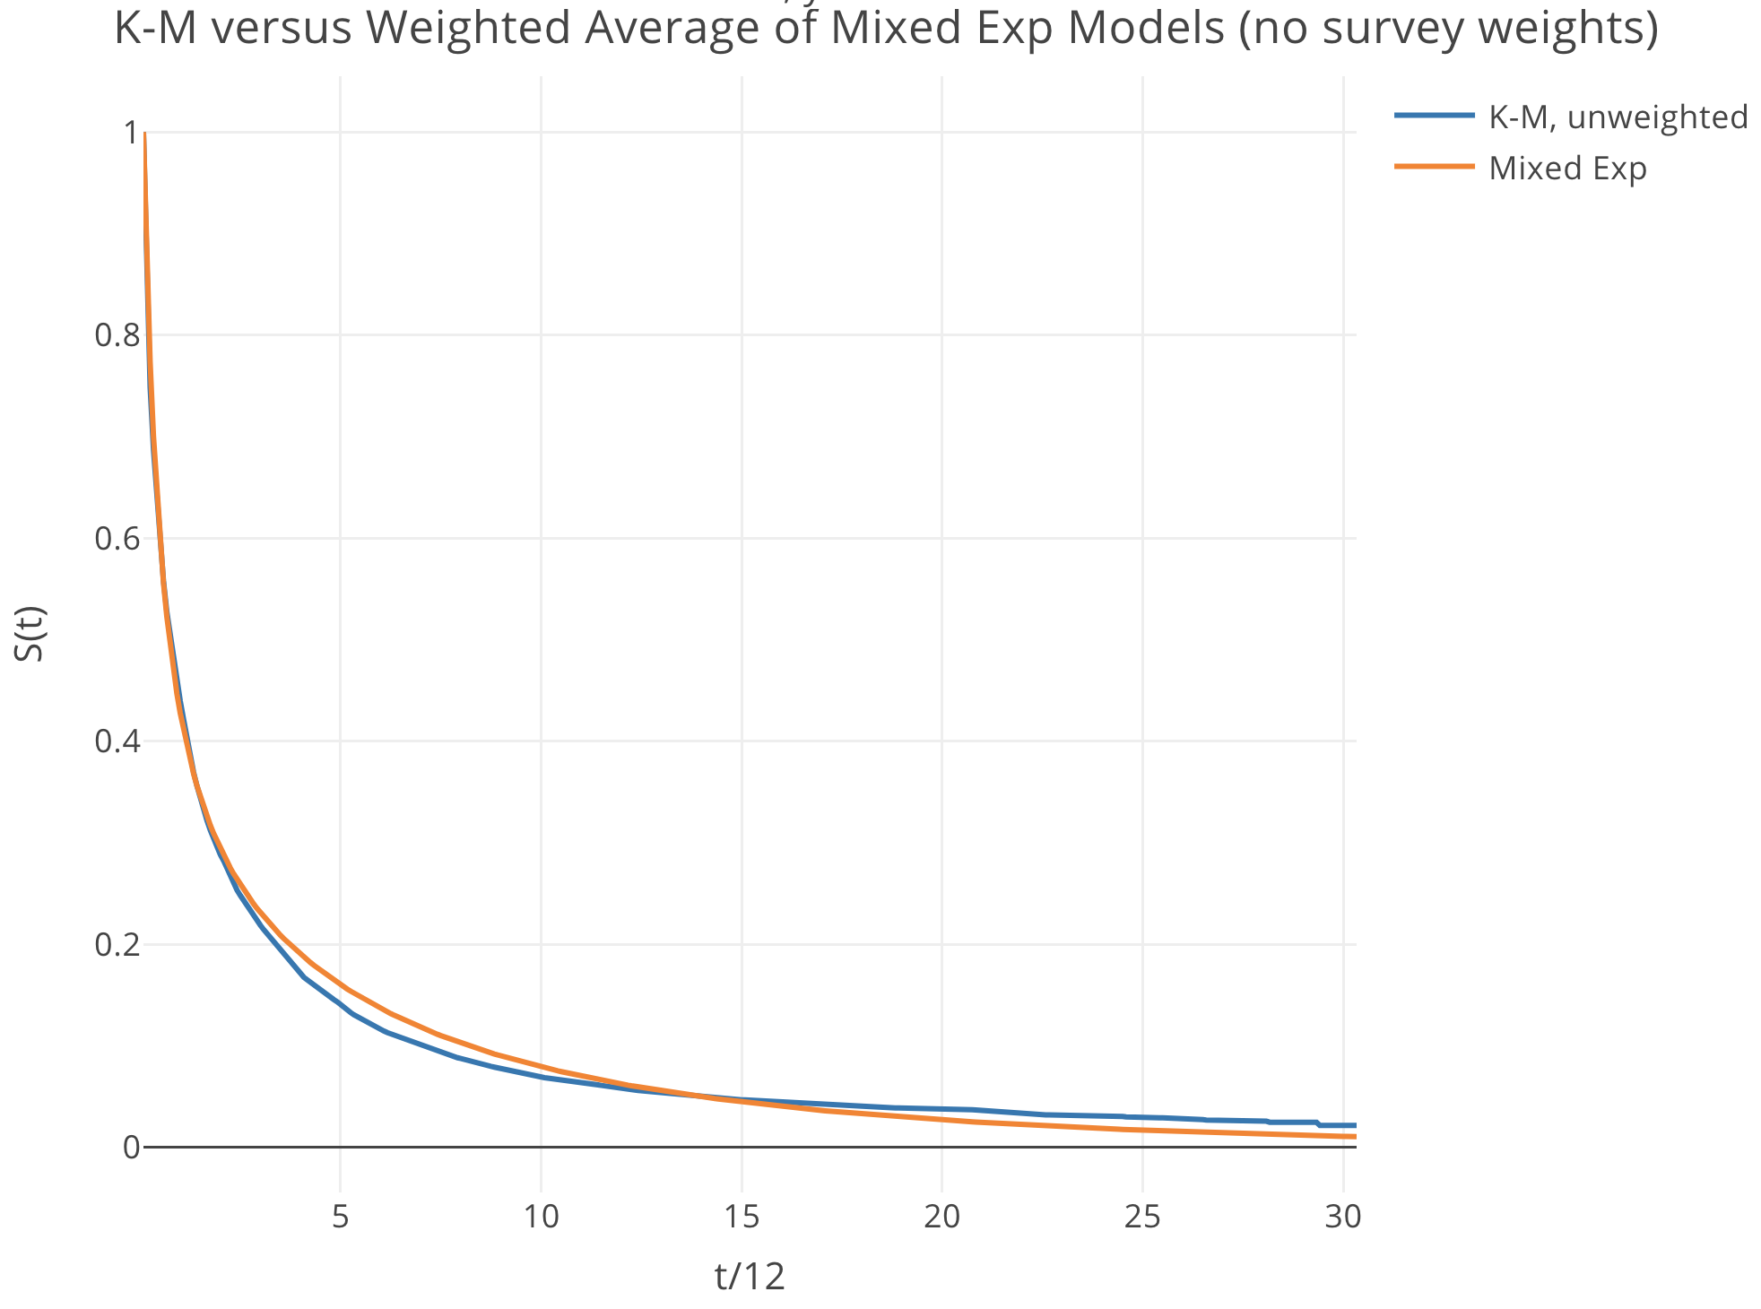
Mixture Models
Notes:
Intuition here is that latent components are capturing heterogenous frailties – some rels, regardless of what ego age they start at, are going to fail, and some are going to last

Slide 19
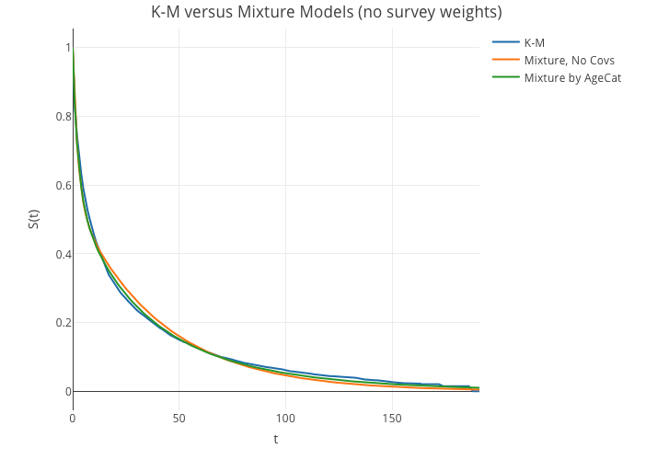
15-29-year-olds

Slide 20
Next Steps
Part 1 (EPT Model): use insights from mixture models to model dissolution among the 15-29 age group
Part 2:
Look into family demography literature for intuition and methods for better framework for generating very complex age dynamics (particularly at ages 30+)
Simulation modeling
Set up different scenarios based on different assumptions about relationship duration, formation rates over time, and degree distribution
Run sim, do a “look back” at the data in the same way NSFG asked respondents to report their relationships

