Slide 1
Web Services
TEAM 3
REST and SOAP for Data Streaming Web Services

Slide 2
Overview
Introduction
Understanding the problem
History
Assumptions
Solution 1: SOAP
Solution 2: REST
Decision Rationale
Solution Explained
Demo

Slide 3
Introduction
Web Services allow programs written in different languages on different platforms to communicate with each other in a standard-based way.
Open data initiatives is motivated by the desire to increase transparency and accountability, they also create substantial economic value.
While there are many strategies to connect distributed systems, services are arguably the most flexible option as they allow systems to remain independent and self-contained
Forward-looking companies are redesigning their systems realizing potential of services
Communication over networks needs standardized data formats and protocols.
Amazon and many other companies that followed such a strategy profited handsomely. Salesforce.com, e.g., generates nearly 50 percent of its revenue through Web services

Slide 4
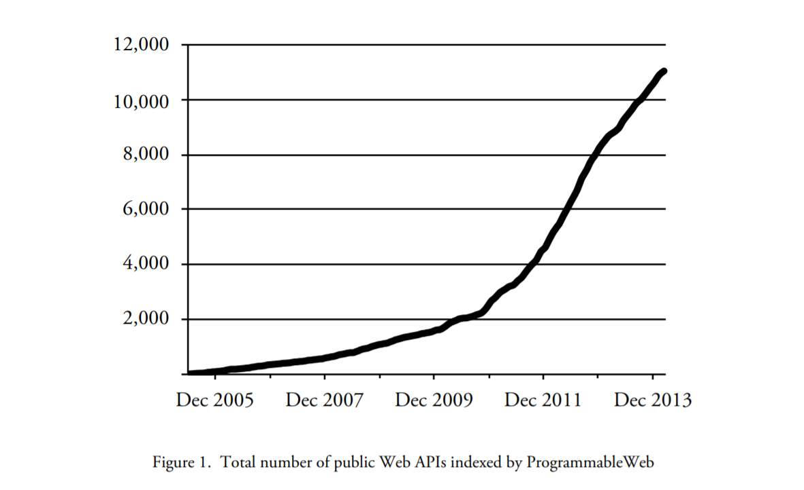
Reference: https://www.programmableweb.com/news/3000-web-apis-trends-quickly-growing-directory/2011/03/08

Slide 5
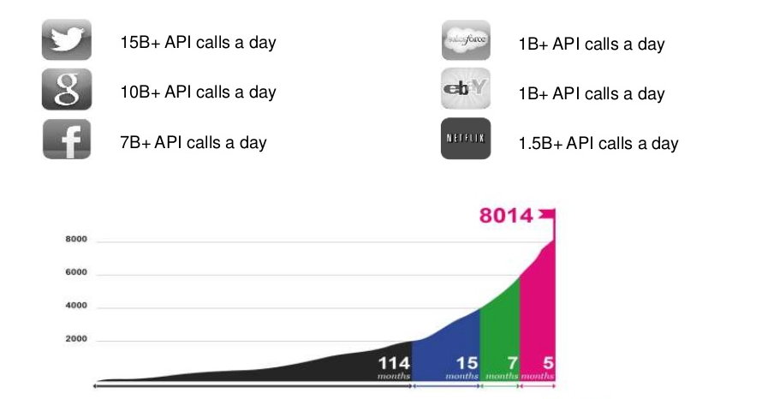
Reference: https://www.programmableweb.com

Slide 6
Understanding the Problem
Data streaming applications are an important category of web applications. Some examples are data/audio/video streaming, multiparty online games, social media feeds and distance learning.
Data streaming web services are growing significantly in the last few years.
Example: stock market prices, social media feeds, data streaming from IoT devices/sensors.
Hence there is a need to improve the performance and efficiency of such web services by selecting the right communication protocol.
This can be achieved by making the right architectural decision for data streaming web services.
The choice between REST vs. WS-* is an important architectural decision for integration projects

Slide 7
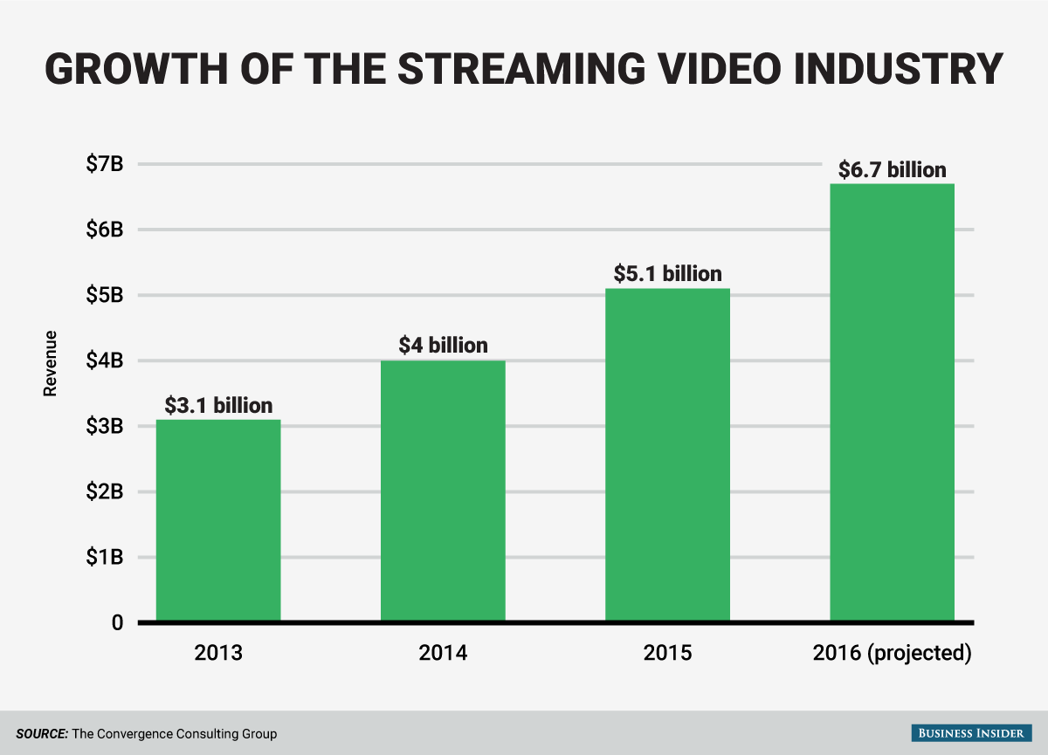
Problem relevance/importance
Today most of the web applications use data streaming functionality.
For example: Facebook constantly streams media feeds, Stock market web applications also need a way of streaming data constantly, Kayak used data feeds to update flight prices.
http://static2.businessinsider.com/image/570ba1ba91058425008bbc28-1200-865/bi_graphics_video-streaming-industry-chart.png

Slide 8
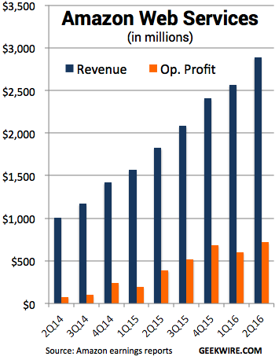
Data streaming web services has a significant impact on the economic growth of businesses.
A web application with good data streaming performance leads to happy end users and project managers.
Bandwidth and time are valuable assets in today’s world. The architectural decisions taken when developing a web service plays a crucial role in reducing the bandwidth and improving the performance.
Hence the need to develop an efficient data streaming web service.
http://static2.businessinsider.com/image/570ba1ba91058425008bbc28-1200-865/bi_graphics_video-streaming-industry-chart.png

Slide 9
History
Non standard hacky way.
No fixed communication payload format
No standard protocol
Client requests data using http and the server returns a csv or html
XML Remote Procedure Call (RPC) style.
XML payload format
HTTP as transport mechanism
XML-RPC standards

Slide 10
History
SOAP(Simple Object Access Protocol)
Modified version of XML-RPC
More powerful than XML-RPC
Based on WSDL and UDDI
soap standards
REST(representational state transfer).
Architectural approach
SML or modern JSON
Stateless
Uses HTTP

Slide 11
Assumptions
The web service is created to be consumed by other software products
Ex.1: Open Government data
Ex.2:Web service-oriented Tech businesses/products (e.g. Paypal, IBM Watson, Google Maps)
Use of open and well-established protocols used in different industry
The communication is Internet-based
HTTP protocol support to send data
Web service should provide scalability
As mentioned earlier, many businesses generate substantial revenue from it
The more the service is consumed, the higher the revenue

Slide 12
Solution 1: SOAP
How SOAP works?
Service Registry
Find
Service Description
Publish
SOAP
SOAP
WSDL
Service Consumer
Service description
SOAP
Service Interface
Service Provider
Bind

Slide 13
Solution 1:SOAP
HTTP envelope
SOAP envelope
Header
Service consumer
XML message
Header
Header
Object
<data>
1232434
</data>
<data>
1232434
</data>
Invoke service method
Data
<data>
1232434
</data>
INTERNET
Header
Service Provider
Header
Header
<data>
1232434
</data>
<data>
1232434
</data>
Service Endpoint
Data
<data>
1232434
</data>
Object
XML message
SOAP envelope
HTTP envelope

Slide 14
Advantages of SOAP
Can use different transport protocols. Example: SMTP.
Interoperability and Platform Independence.
There are established development kits for SOAP web service implementation

Slide 15
Drawbacks of SOAP
Changing services in SOAP web provisioning often means a complicated code change on the client side.
SOAP has heavy payload as compared to REST.
It consumes more bandwidth because a SOAP response could require more than 10 times as many bytes as compared to REST.
Does not scale well and are difficult to maintain

Slide 16
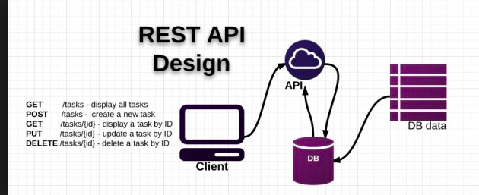
Solution2: REST
How REST Works:

Slide 17
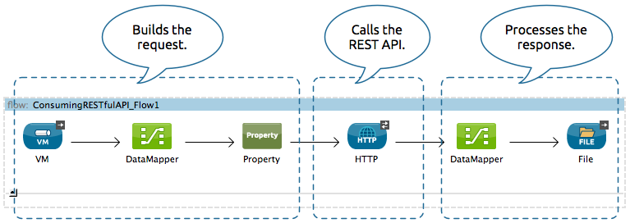
Solution 2: REST
The streams REST APIs were first introduced with IBM InfoSphere Streams 3.1, providing monitoring support for instances, jobs, and metrics. REST access to streaming data was added with Streams 3.2. The REST APIs are implemented using Hypertext Transfer Protocol Secure (HTTPS) with the results being returned in JavaScript Object Notation (JSON). Authentication is handled using either HTTP basic authentication or a client certificate; Streams permissions are also enforced.

Slide 18
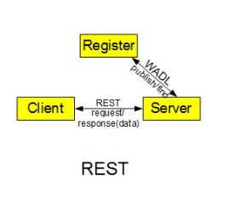
Restful architecture
REST style architecture is a client-server architecture in which client sends request to server then server process the request and return responses. These request and responses build around the transfer of representations of resources.
Clients and servers are loosely coupled. That is, clients and servers interact with a limited set of assumptions about each other.
Data and functionality are considered resources, and these resources are accessed using Uniform Resource Identifiers (URIs), typically links on the web. The resources are acted upon by using a set of simple, well- defined operations
Uses GET, PUT, POST and DELETE http methods to retrieve, create, update and delete the resources.

Slide 19
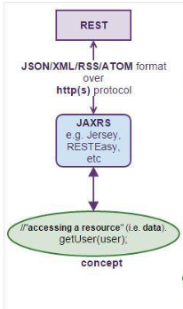
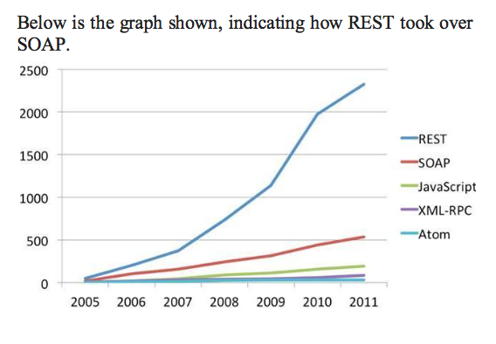
Why we need REST?
REST web services were developed largely as an alternative to some of the perceived drawbacks of SOAP-based web services.

Slide 20
Restful design principle
Addressability:
REST models the datasets to operate as resources where resources are marked with URI. A uniform and standard interface is used to access the rest resources i.e. using fixed set of HTTP methods.
Statelessness:
Every transaction is independent and unrelated to the previous transaction as all data required to process the request is contained in that request only; client session data is not maintained on server side, therefore server responses are also independent - making the REST application simple and lightweight.
Uniform interface:
Request and responses of SOAP-based web services are written in SOAP format and then enveloped in an HTTP message while RESTful web services do not use SOAP format and only uses HTTP as application layer protocol.

Slide 21
Drawbacks of REST
Public Availability
More prone to Attacks, especially DDoS
Needs more sophisticated Authorization and Authentication
Ex: OAuth

Slide 22
Decision Rationale
Performance
How fast/efficient can the solution be?
Scalability
Is the solution scalable in order to support rapid usage growth?
Compatibility
Is the solution supported by different technologies/tools/programming languages?
How easy is it to adopt/incorporate the web service?
Popularity
Is it used and understood by other developers?
Are there many tools and knowledge base available?

Slide 23
Decision Rationale Table - Data Streaming
Criteria |  | REST | SOAP
1.1) Speed and Efficiency | High Importance (x3) | 9 | 6
2.1) Scalability | High Importance (x3) | 10 | 6
3.1) Support by different languages/technologies | High Importance (x3) | 9 | 8
3.2) Adoption effort | Medium Importance (x2) | 10 | 6
4.1) Understandability | Medium Importance (x2) | 9 | 6
4.2) Knowledge available | Medium Importance (x2) | 10 | 10
Total: |  | 142 | 104
Scale: 0 - 10

Slide 24
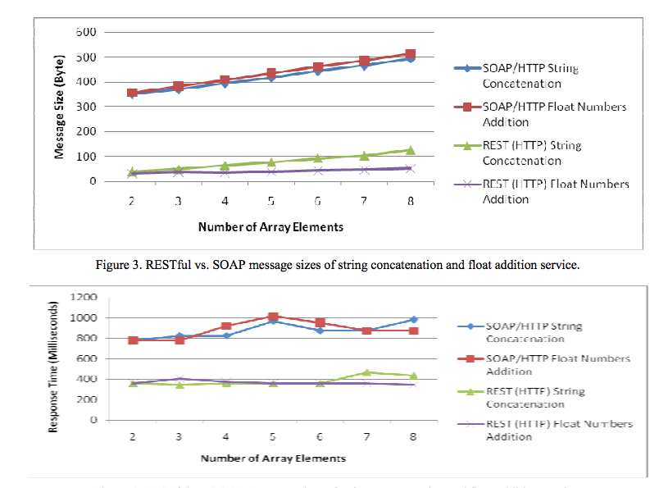
Performance
Message size in RESTful web services
(in both cases) is 9 to 10 times lesser than
size of SOAP based web services message.
Similarly time required for processing and
transmission is also 5 to 6 times lesser than
SOAP based web services.
Figure 1. RESTful vs. SOAP Response time of string concatenation and float addition service.

Slide 25
The improvements after using RESTful API
Simple,Lightweight, easy and with higher flexibility and lower overhead.
Transaction is independent and unrelated to the previous transaction as all data required to process the request is contained in that request only, client session data is not maintained on server side therefore server responses are also independent
Less strongly typed than SOAP
Does not require message format like envelope and header;
XML parsing is also not required;
Less bandwidth requirement;
Only uses HTTP as application layer protocol.
Light bandwidth: its passes message is JSON (javascript object notation) format also it can use multiple other formats.

Slide 26
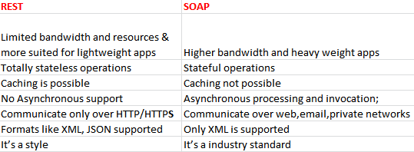
Comparison between Soap and Restful
https://blogs.sap.com/2015/03/30/soap-rest-based-webservices-what-are-they-when-to-use-each-of-them-or-use-both/

Slide 27
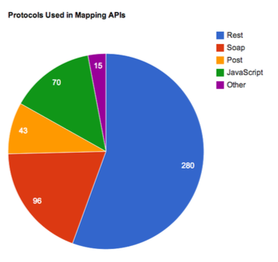
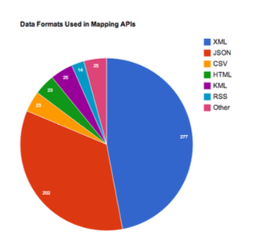
Popularity
Web Services Protocol: SOAP vs REST, Vibha Kumari,International Journal of Advanced Research in Computer Engineering & Technology (IJARCET) Volume 4 Issue 5, May 2015.

Slide 28
Solution Explained - Data Streaming
Message mostly coming from web service without additional need for client to request for data again (one-way messaging)
The client asks once and the web service keeps providing the data
Client reacts to the new message event and use the new data
Large data needs to be broken down into parts, then the parts are sent through the network and reconstructed in the client

Slide 29
Solution Explained - Data Streaming
The HTML5 Server-Sent Events specification is introduced to enable servers to push data to Web pages over HTTP.
Example: Web Service that provides stock price updates every 3 seconds
(See diagram in next slide for a GET Request using REST and HTML5 Server-Sent Events for the stock price web service)

Slide 30
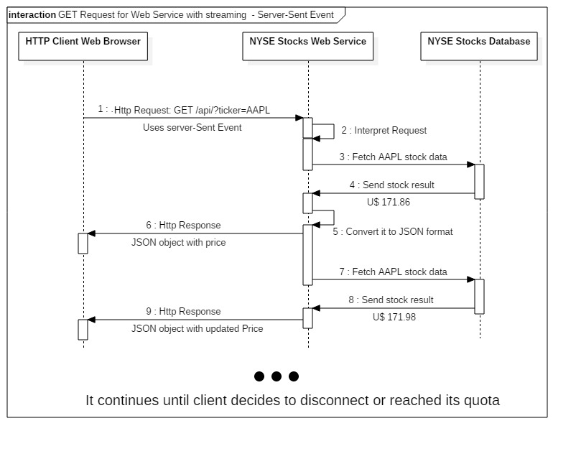

Slide 31
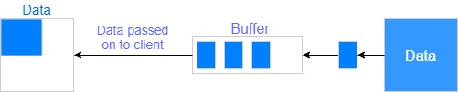
Solution Explained - Data Streaming
Data serialization is introduced to enable large data to be sent by breaking it down into parts, sent through the network and reconstructed on the client.

Slide 32
Demo

Slide 33
Conclusion
We can create request in Rest or SOAP
We create the response in JSON or XML (serializable) or in other format other than serializable
REST was used for the solution for its better performance, scalability and popularity
Server-sent events was used in solution to facilitate one-way messaging
Serialization and buffers were used for solution with big-sized data

Slide 34
Question?

Slide 35
Reference
Efficient Querying and Streaming of Multimedia Content Using Web Services,S. Gerald Christopher Isaac,The International Journal Of Science & Technology (ISSN 2321 – 919X),Indid
Web Services Protocol: SOAP vs REST, Vibha Kumari,International Journal of Advanced Research in Computer Engineering & Technology (IJARCET) Volume 4 Issue 5, May 2015.
Web Services Based On SOAP and REST Principles,Snehal Mumbaikar*, Puja Padiya**,International Journal of Scientific and Research Publications, Volume 3, Issue 5, May 2013 1 ISSN 2250-3153
Performance Evaluation of RESTful Web Services for Mobile Devices,Hatem Hamad, Motaz Saad, and Ramzi Abed,International Arab Journal of e-Technology, Vol. 1, No. 3, January 2010
Architectural Styles and the Design of Network-based Software Architectures, Thomas Fielding,2000.
Comparing Performance of Web Service Interaction Styles: SOAP vs. REST,Pavan Kumar Potti,Sanjay Ahuja,Karthikeyan Umapathy,Zornitza Prodanoff,2012 Proceedings of the Conference on Information Systems Applied Research,New Orleans Louisiana, USA ISSN: 2167-1508v5n2208
Mobile HTML5: Efficiency and Performance of WebSockets and Server-Sent Events. Estep, Elliot. KTH Information and Communication Technology, 2013.

