Slide 1
Emin Ferzeliyev Emotion AI
PPTX

Slide 2
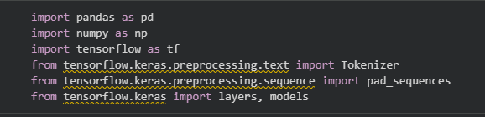
Framework , Library insertion

Slide 3

Seed configration

Slide 4
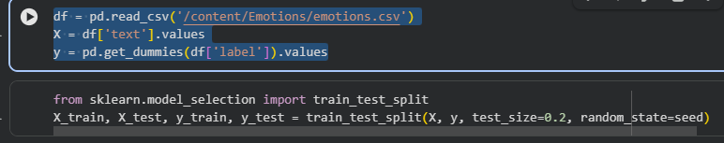
Downlaod Flowers Dataset

Slide 5
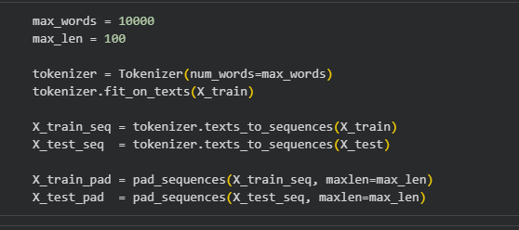
Preprocessing

Slide 6
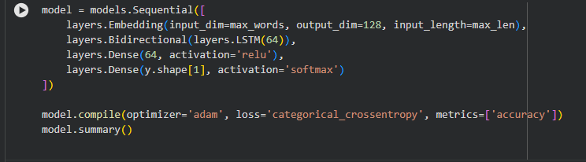
Create CNN Model

Slide 7
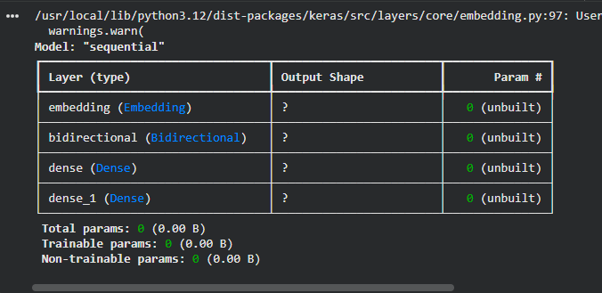
Model Summary

Slide 8
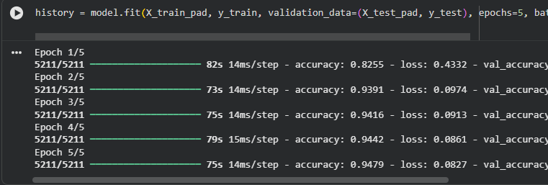
Train

Slide 9
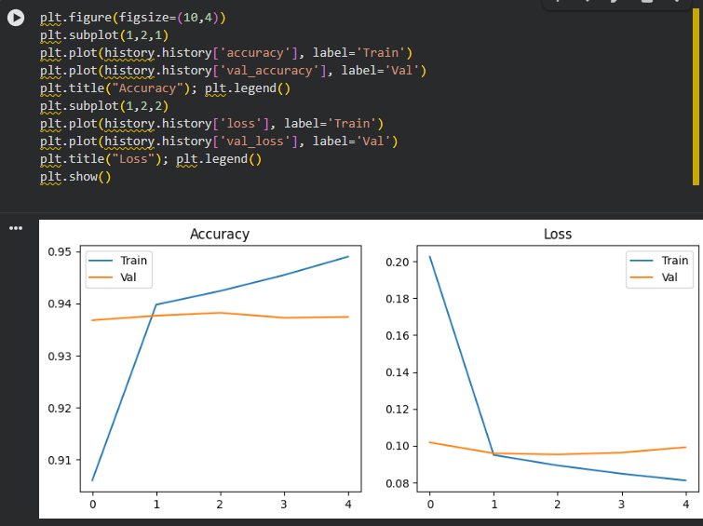
Plots with matplot

