Slide 1
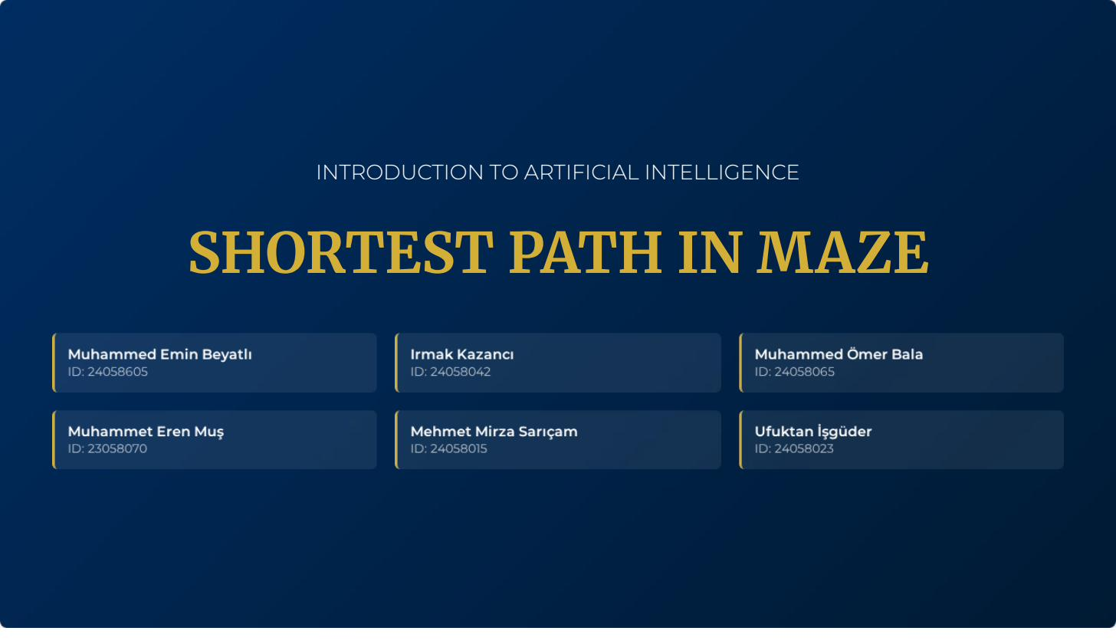

Slide 2
Table of Contents
01
Project Objectives
02
Methodology & Architecture
Goals, scope, and motivation
Maze generation, heuristic, explored set
03
Algorithms Implemented
04
Algorithm Properties
8 uninformed & informed search methods
Completeness, optimality, complexity
05
Implementation & Code
06
Results & Visualizations
Data structures, memory management
Program output & maze snapshots
07
Performance Data & Analysis
08
Key Findings & Conclusions
20×20 and 50×50 benchmark tables
Takeaways and algorithm rankings

Slide 3
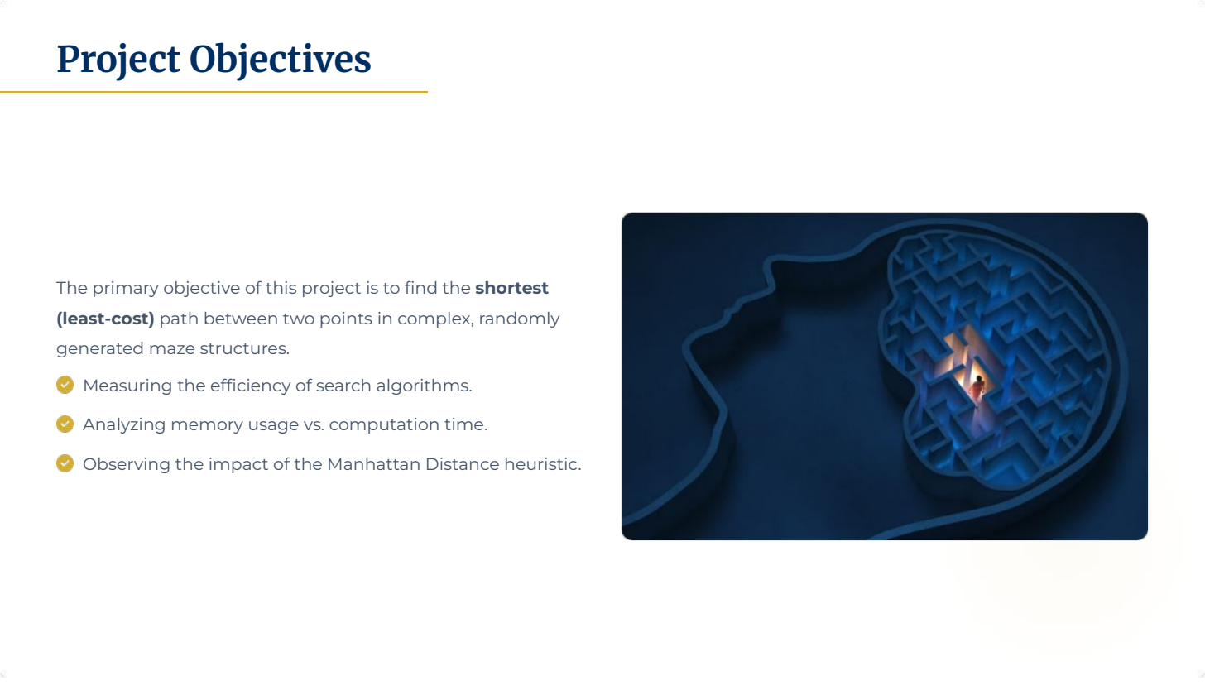

Slide 4
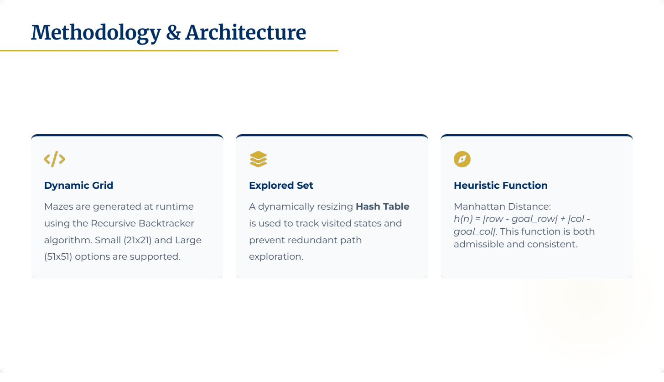

Slide 5
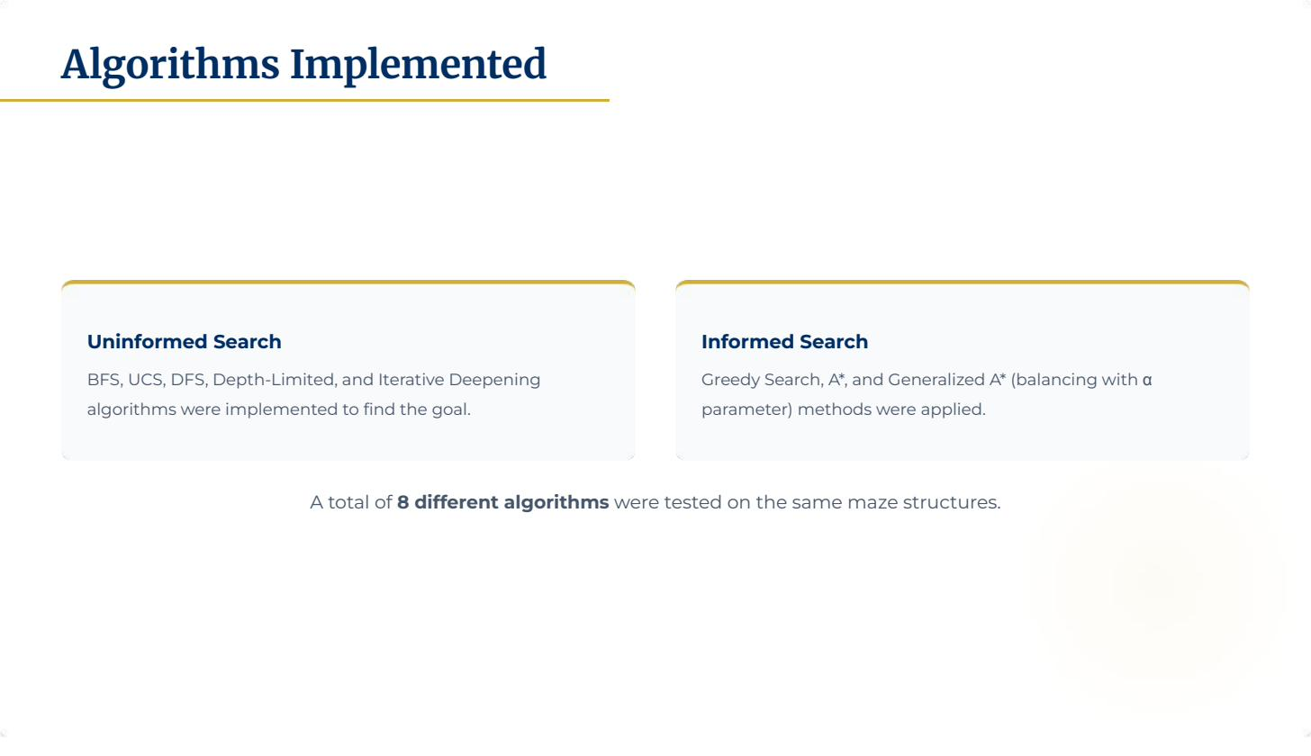

Slide 6
Algorithm Properties Comparison
Theoretical guarantees for each search strategy
Algorithm
Complete?
Optimal?
Time Complexity
Space Complexity
BFS
✓ Yes
✓ Yes*
O(b^d)
O(b^d)
UCS
✓ Yes
✓ Yes
O(b^(1+C*/ε))
O(b^(1+C*/ε))
DFS
✗ No
✗ No
O(b^m)
O(b·m)
Depth-Limited
✗ No
✗ No
O(b^l)
O(b·l)
Iterative Deepening
✓ Yes
✓ Yes*
O(b^d)
O(b·d)
Greedy Search
✗ No
✗ No
O(b^m)
O(b^m)
A* Search
✓ Yes
✓ Yes
O(b^d)
O(b^d)
Generalized A*
✓ Yes
Depends
O(b^d)
O(b^d)
* Optimal only for uniform step costs. b = branching factor, d = depth of shallowest goal, m = max depth, l = depth limit, C* = optimal cost, ε = min step cost

Slide 7
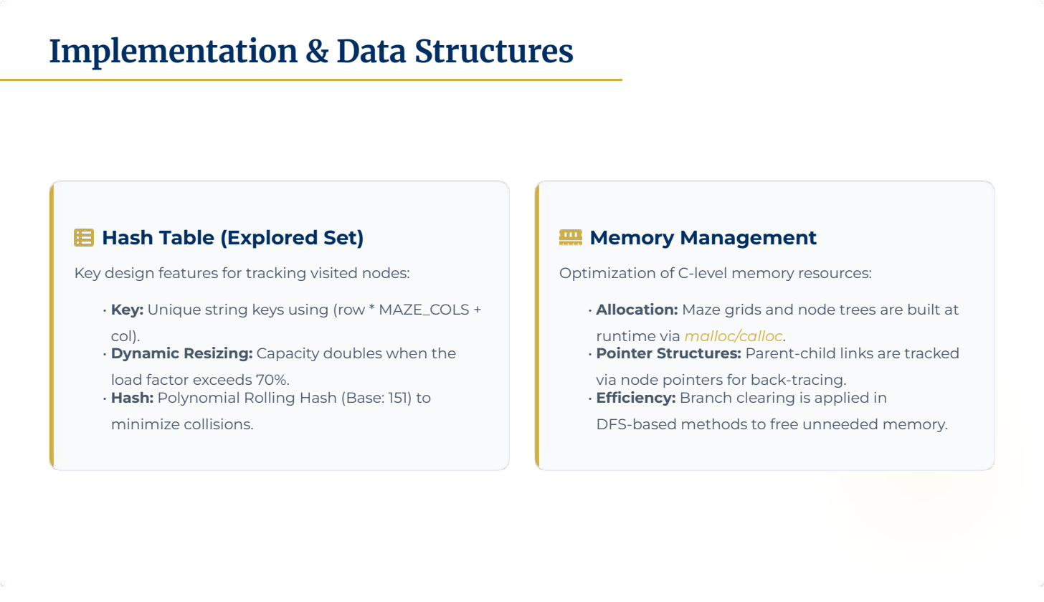

Slide 8
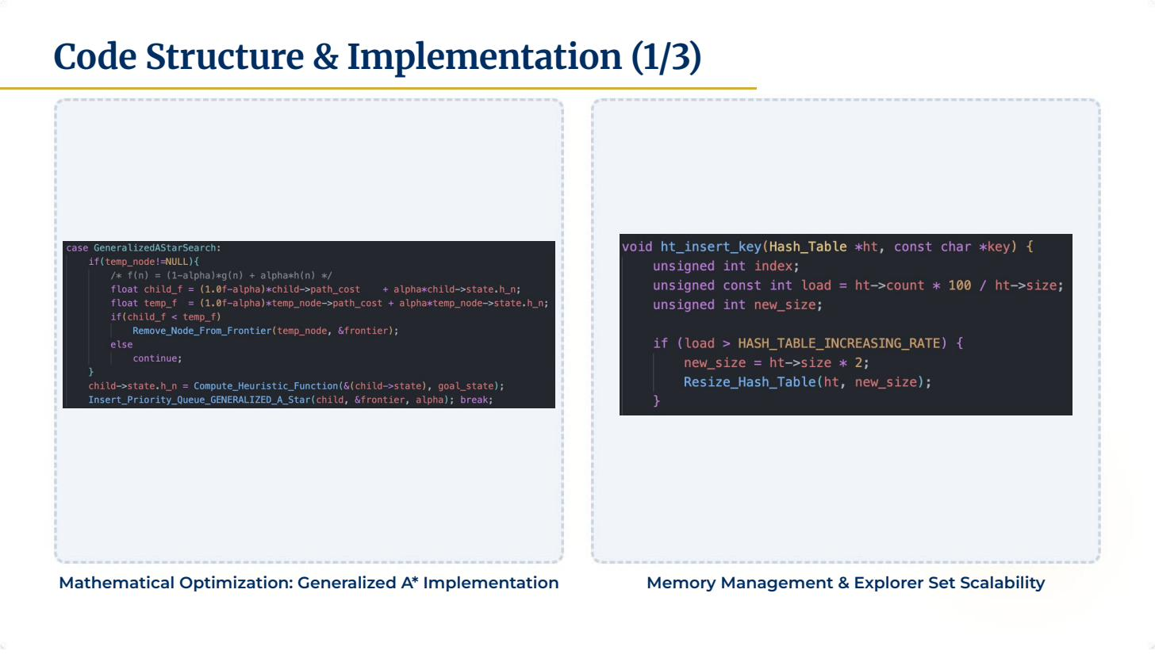

Slide 9
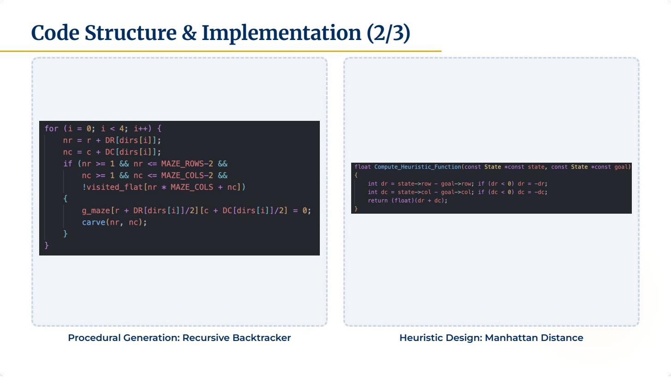

Slide 10
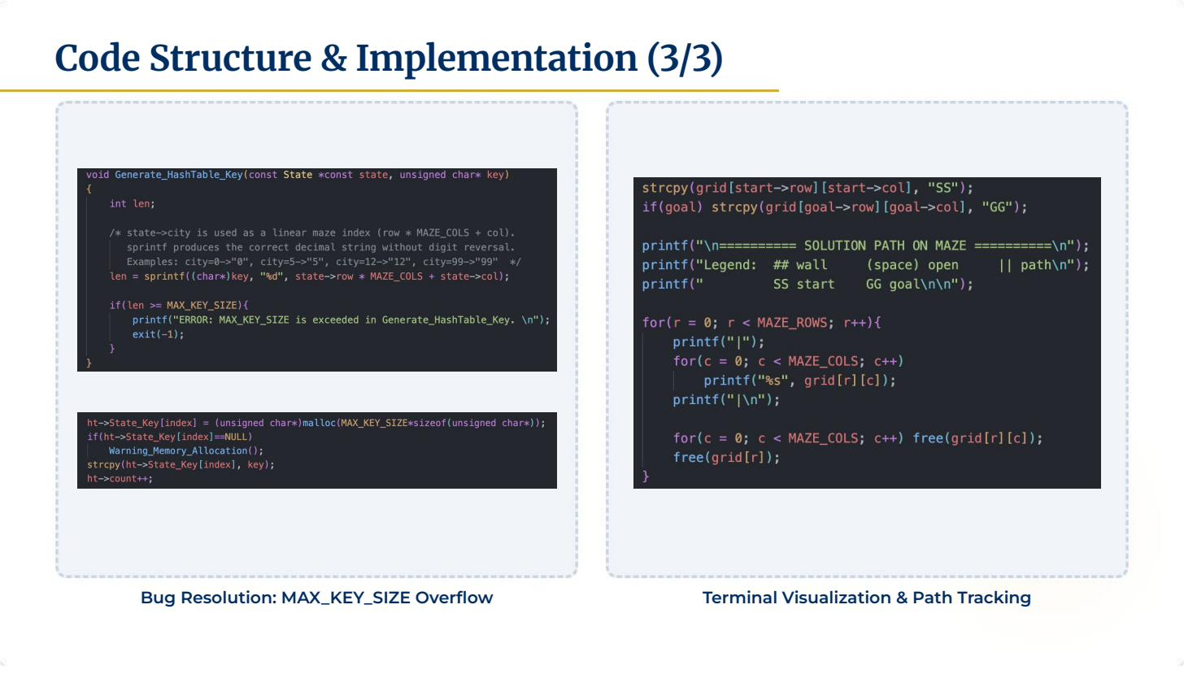

Slide 11
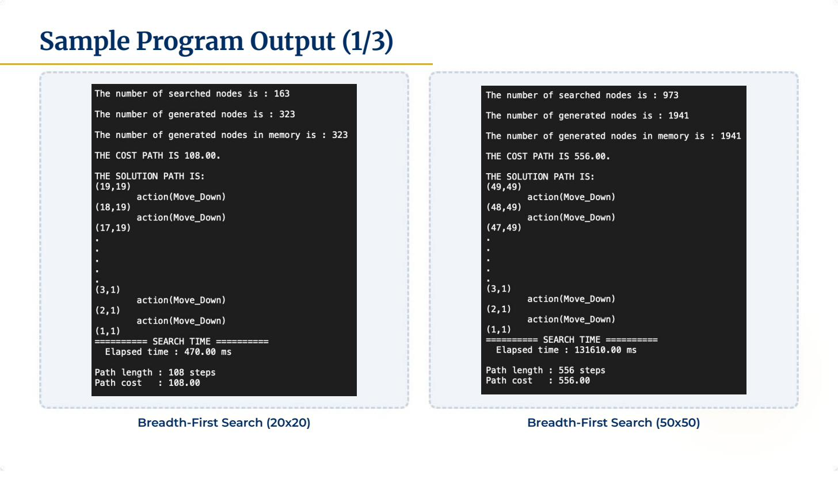

Slide 12
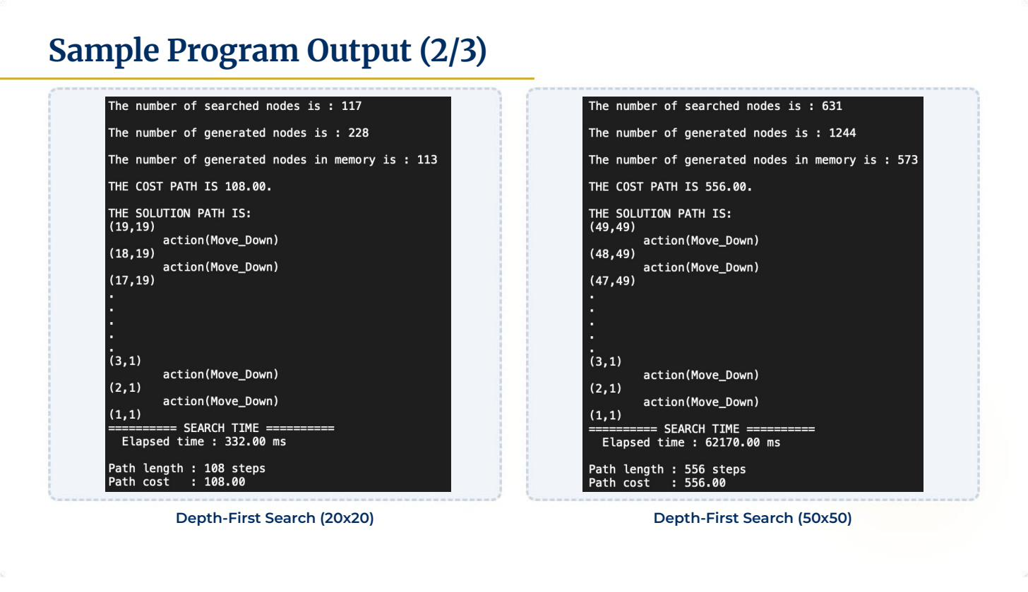

Slide 13
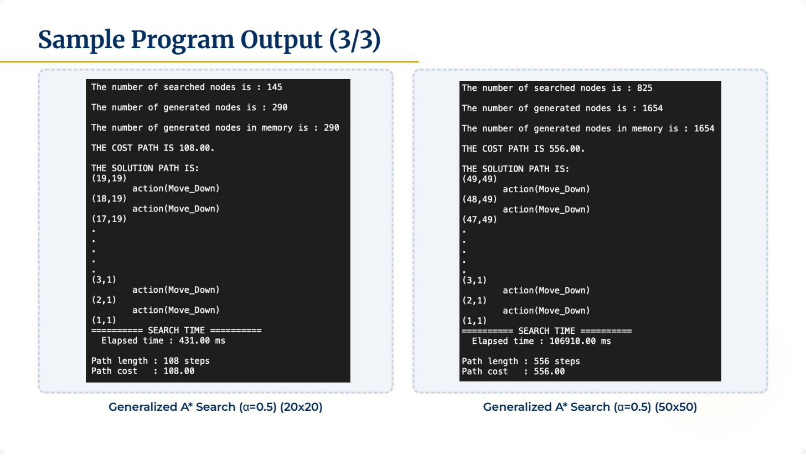

Slide 14
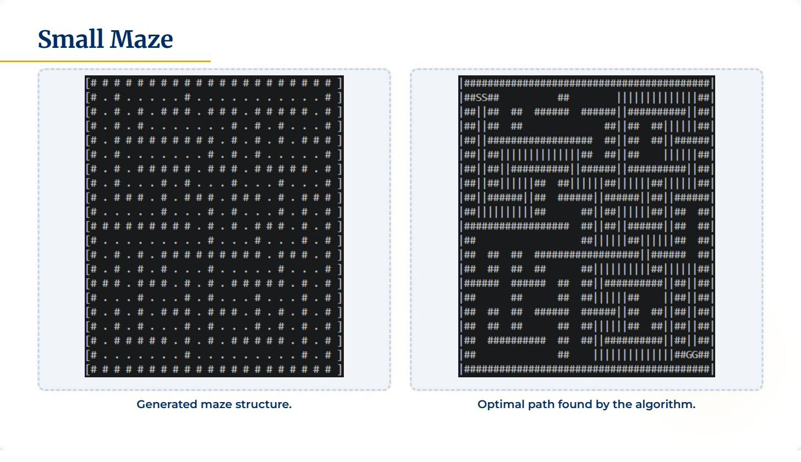

Slide 15
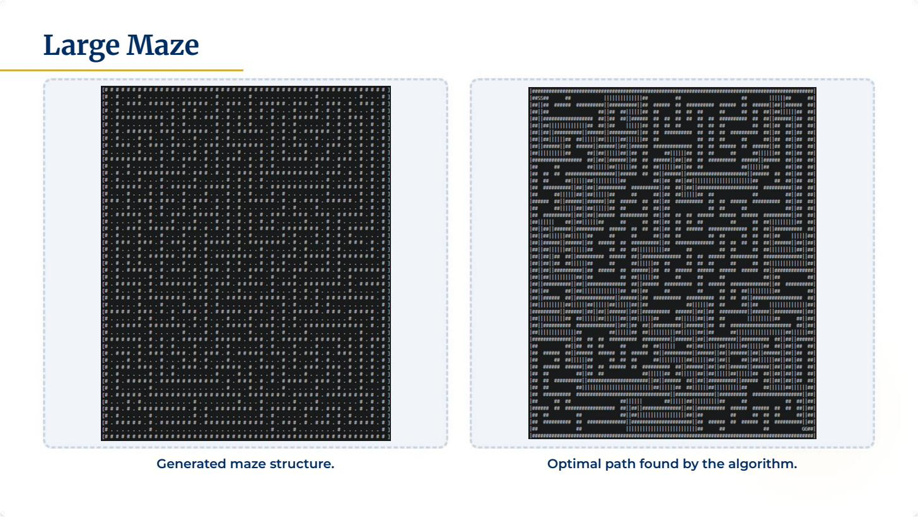

Slide 16
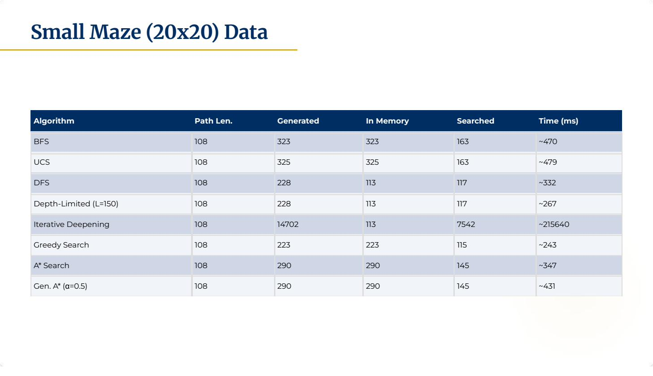

Slide 17
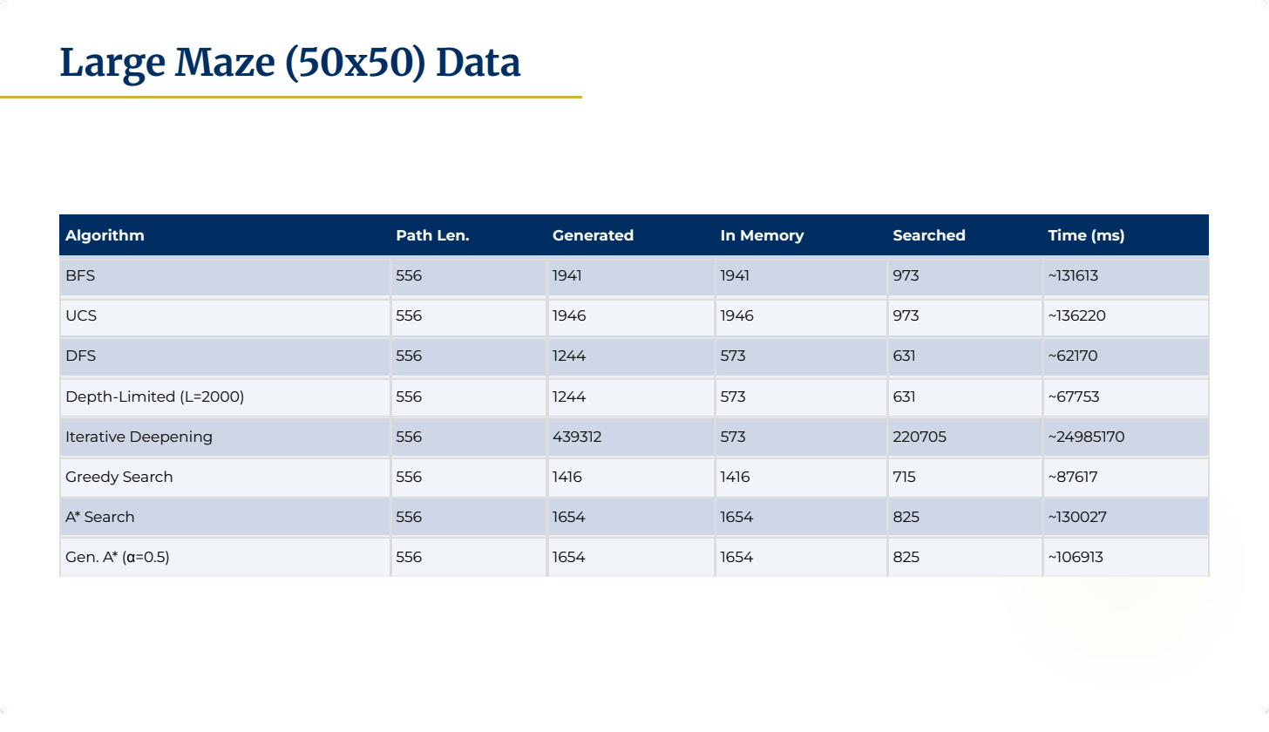

Slide 18
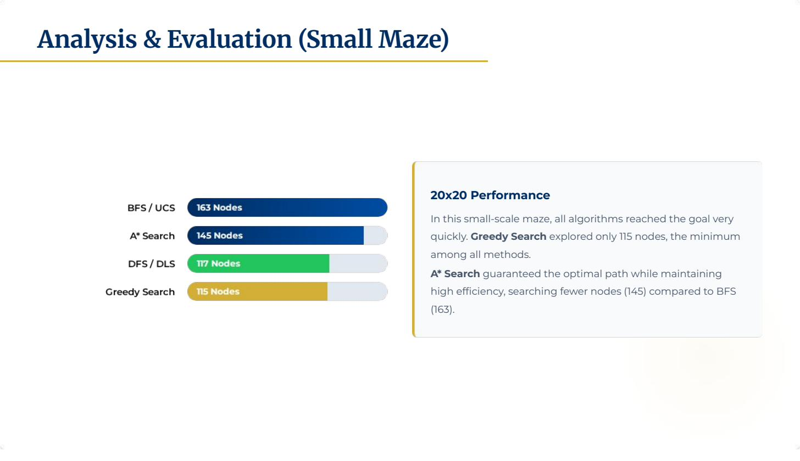

Slide 19
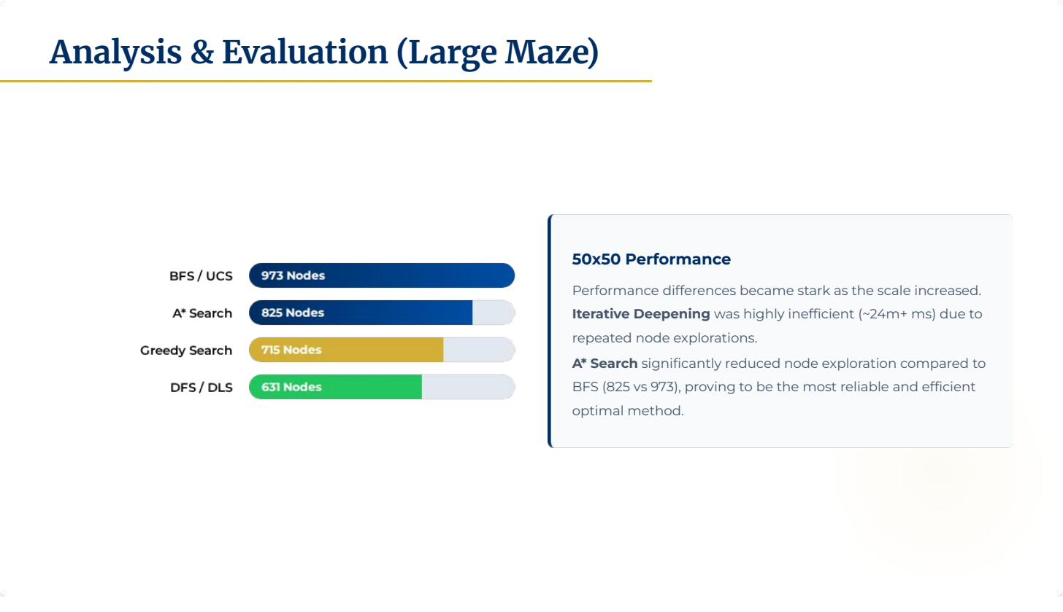

Slide 20
Key Findings & Conclusions
★
Best Optimal Algorithm
⚡
Fastest Heuristic Winner
A* Search delivered the optimal path with the fewest nodes explored — 145 (20×20) and 825 (50×50) — making it the most efficient complete and optimal method across both maze sizes.
Greedy Search was the fastest in terms of nodes searched (115 / 715), but sacrifices optimality guarantees. Best suited for speed-critical applications that tolerate sub-optimal paths.
⚠
Iterative Deepening Bottleneck
α
Generalized A* Insight
IDS explored 14,702 nodes (20×20) and 439,312 nodes (50×50) due to repeated re-expansion — resulting in ~24.9 seconds on the large maze, over 200× slower than A*.
The α parameter allows smooth tuning from UCS (α=0) to Greedy (α=1). At α=0.5 it matched A* node counts while reducing runtime by ~18% on the large maze — a useful practical trade-off.

Slide 21


