Slide 1

SMOKE & GAS DETECTOR
Emin Ždralović
Tarik Talić
Almina Raščić
Kenan kaknjo
Mirza Muj0vić

Slide 2
Introduction
For our project we decided to make something easy, simple yet widely used.
IN A Time where gas is everywhere around us, we need to have some kind of protection agains it.
Our project is the next step into achieving that and gaining protection.
It is fairly easy to understand how it works, and once it’s set up, it does all the work.

Slide 3
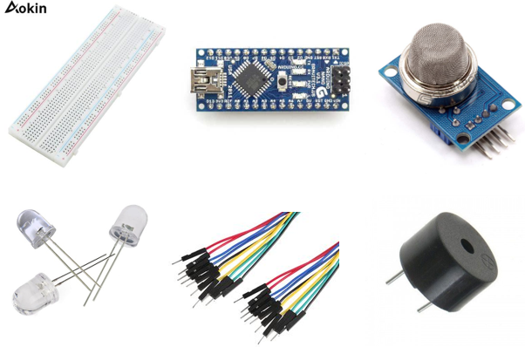
For this project we used:
Vero board
Arduino nano/Arduino uno
MQ-135 sensor (gas sensor)
LED lights
Connectors
Buzzer (speaker, connects directly to Arduino)

Slide 4
This type of project is done in phases:
Designing the project
Development of electircal schematics
Connecting components with the arduino board
programming the microcontroller
Testing

Slide 5

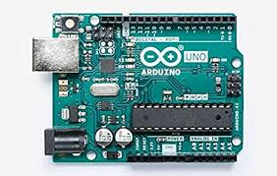
How it works?
As we mentioned before, main component of our project is arduino board. We programmed it and then connected all of the components so that is functionable. All the programming was done in arduino software so it made it easy to upload on arduino board.

Slide 6
references
Arduino details: https://www.arduino.cc/
Gas sensor details 1: https://lastminuteengineers.com/mq2-gas-senser-arduino-tutorial/
Gas sensor details 2: https://wiki.seeedstudio.com/Grove-Gas_Sensor-MQ2/
Picture: https://www.google.com/search?q=arduino+uno&rlz=1C1GCEA_enBA898BA898&sxsrf=ALeKk03llnT8MQ4q2Ev3_nWa9KH6q5bFfQ:1590593795846&source=lnms&tbm=isch&sa=X&ved=2ahUKEwiHs7vRr9TpAhXMXJoKHcKeABcQ_AUoAXoECA0QAw&biw=1366&bih=663#imgrc=C-AsBlWWG71ozM

