Slide 1
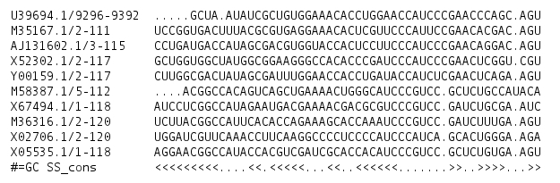
Q1:
GCUAAUAUCGCUGUGGAAACACCUGGAACCAUCCCGAACCCAGCAGU
A1:
S:
S1:
<<<<...<<.<<<<<...<<..<<<<<<.......>>..>>>>..>>

