Slide 1

ME algorithm
for Hierarchical Dirichlet Process
and extensions
Donglai Wei
Supervised by: Erik Sudderth

Slide 2
Part I: Model

Slide 3

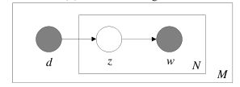
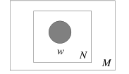
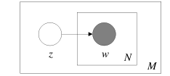
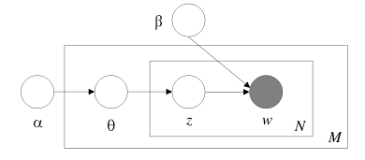
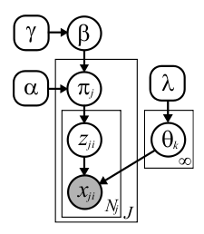
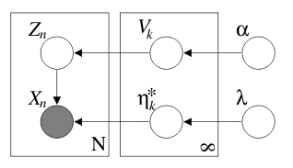

Evolution of the Model:
1)Unigram
2)Mixture of Unigram
3)Aspect Model
4) LDA
7) HPY (stick-breaking)
6) HDP (stick-breaking)
5) DP mixture(stick-breaking)

Slide 4
Part II: Algorithm

Slide 5

What is ME algorithm?
ME~EM?
EE? MM?

Slide 6
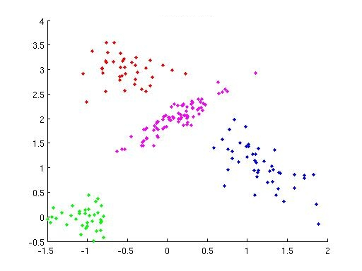
Cluster Problem:
Mixture of Gaussian:
X: observations
Z: cluster label
θ:(μ,Σ)
Kmean:
0) Initialization
1)M-step(Z):
Assign points to their nearest center
2)M-step(θ):
MLE estimator for (μ,Σ)
EM:
0) Initialization
1)E-step(Z):
p(z=k|x)~p(x|z=k)p(z=k)
2)M-step(θ):
MLE estimator for (μ,Σ,p(z))

Slide 7
First Look at ME :
X: observations
Z: cluster label
θ:parameter
0) Initialization
1)M-step(Z):
Point Estimation of Z
2)E-step(θ):
Distribution Estimation of θ

Slide 8

Learn q(W)=q(z,θ)
Goal:
min
? q(z,θ)
Gibbs Sampling
q(z,θ)=q(z)q(θ)
Distribution Estimation:
Point Estimation:
q(θ)=δ(θ,θ*)
E-Step:
M-Step:

Slide 9

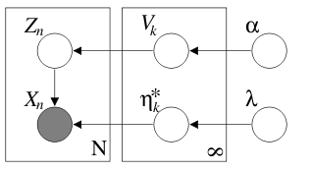
EE:
EE:
ME:
(Kurihara et.al)
Gibbs Sampling
(GS)
EM:
MM:
Mean Field (Variational Method):
0) Initialization
1)E-step(Z): q(z) Multinomial Distribution
2)E-step(θ): q(V) Beta; q(η):exponential family

Slide 10
Why ME algorithm?
What do we really want for Clustering Problems?

Slide 11
Second Look at ME :
1)Distribution Estimation of z:
Give Me the “BEST” Z !!!
2) Point Estimation of z:
min

Slide 12

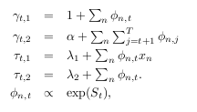
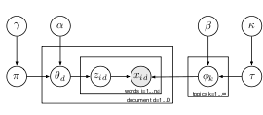

Why not EE algorithm?
DP:
Blei et.al
HDP:
Teh et.al

Slide 13

Why not EE algorithm?
DP:
Blei et.al
HDP:
Teh et.al

Slide 14

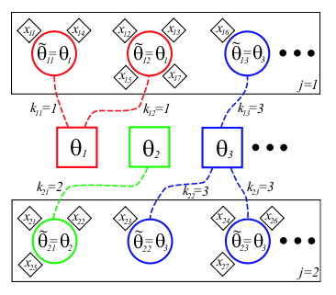
Why not Gibbs Sampling?
1) Search t and k
2) Direct Assignment

Slide 15
Part III: Result
(Preliminary)

Slide 16
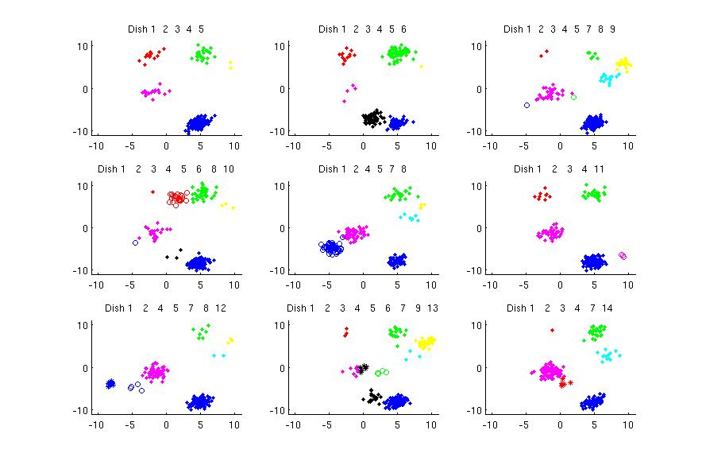
ME: Toy HDP Gaussian Mixture

Slide 17
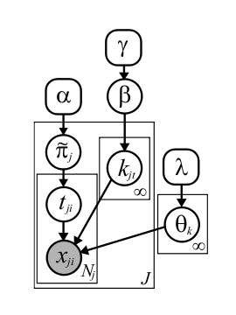
ME: Toy HDP Gaussian Mixture
Goal:

Slide 18

ME: Toy HDP Gaussian Mixture
Goal:
0) Initialization
1)M-step(Z):
Search Z
2)E-step(θ):
update θ

Slide 19
ME: Toy HDP Gaussian Mixture
Goal:
1)M-step(Z):
Search Z
a) Local Search: Find the best table for a customer
Find the best dish for a table
b) Split and Merge: Split 1 table(or dish) into 2
Merge 2 tables(or dishes) into 1

Slide 20
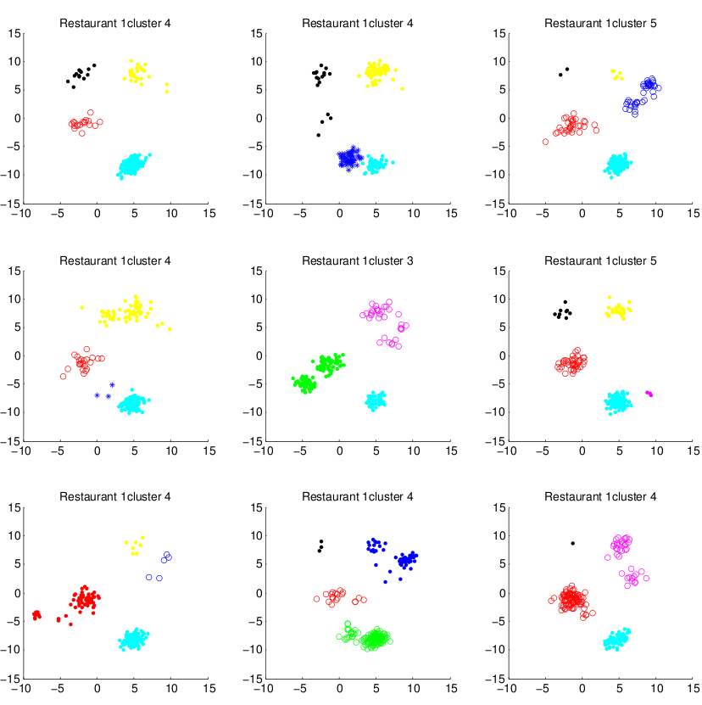
a)Local Search

Slide 21
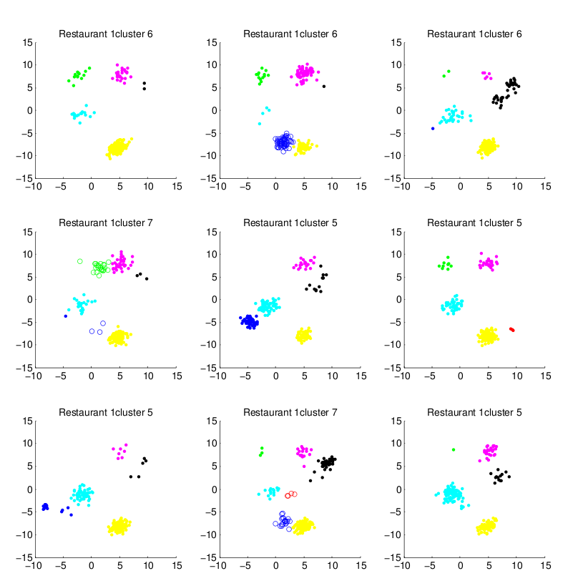
b)Split and Merge

Slide 22
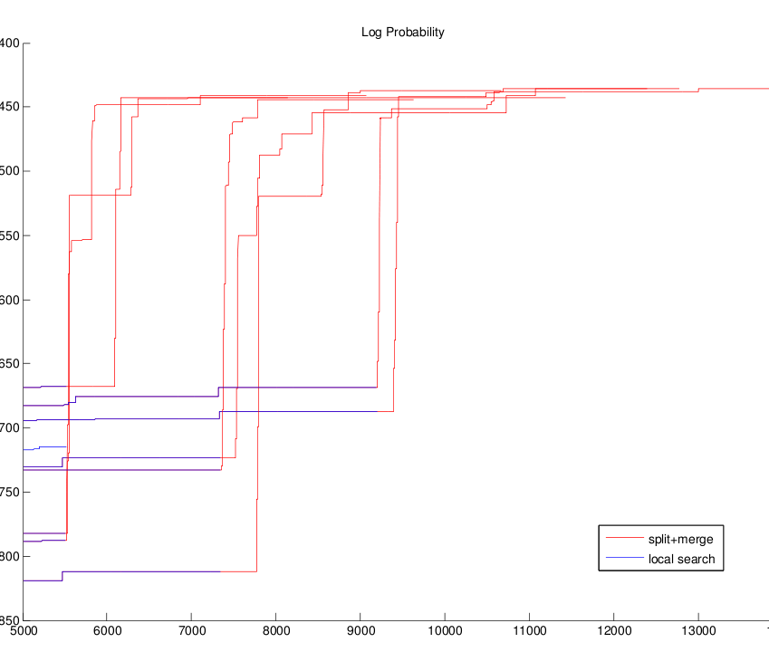

Slide 23
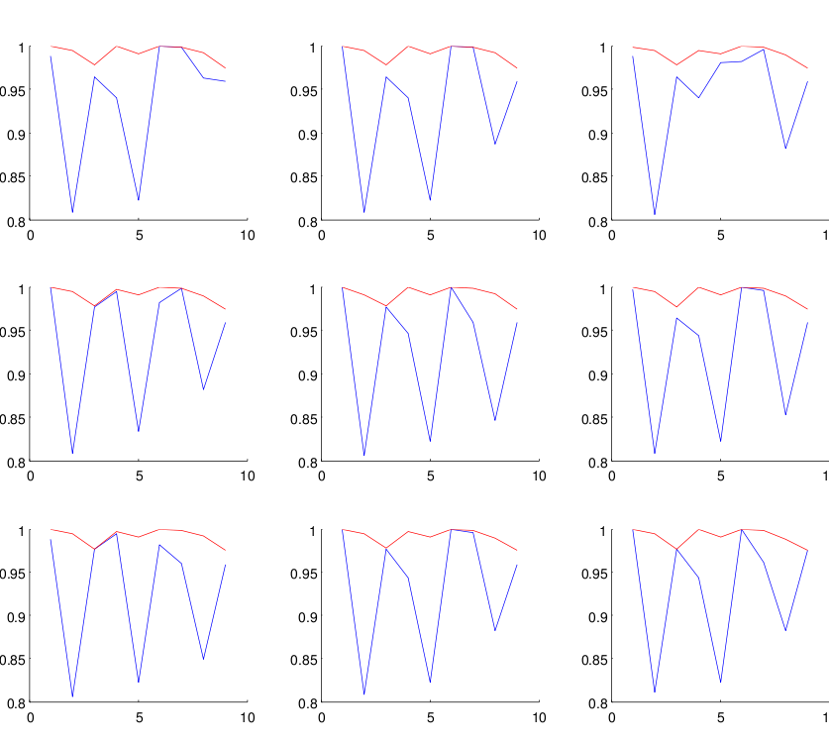
Rand Index

Slide 24
thanks

