Slide 1
Proposal:
ME algorithm
for Hierarchical Dirichlet Process
with Chinese Restaurant Franchise Interpretation
Donglai Wei, Erik Sudderth (Supervisor)

Slide 2
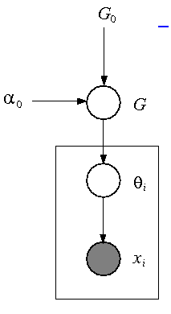
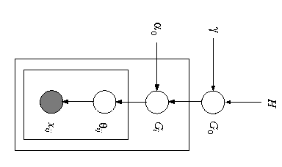
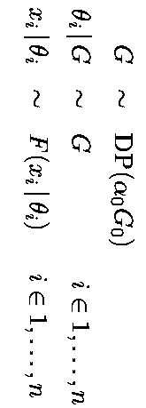
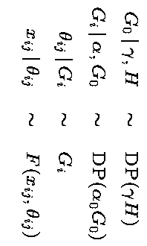
1) Graphical Model:
(Teh et.al)
Dirichlet Process Mixture
Hierarchical Dirichlet Process

Slide 3

2) Learning Algorithm:
Hidden Varialble:
Z: assignment
Ө: parameter
(Kurihara et.al)
Goal:
min
Expectation Expectation
(EE)
Maximization Expectation
(ME)
Gibbs Sampling
(GS)
Expectation Maximization
(EM)
Maximization Maximization
(MM)

Slide 4
Infinite Limit of LDA
ME: Kurihara et.al
Stick-Breaking
GS: Ishwaran et.al,
EE: Blei et.al, Kurihara et.al
Chinese Restaurant Process
GS: Neal et.al
DP
3) Construction of DP & HDP: (Teh et.al)
HDP
We Are Here
!!!
Infinite Limit of LDA
Stick-Breaking
EE:Teh et.al
Chinese Restaurant Franchise
GS Teh et.al,
ME:

Slide 5
HDP
+
ME
+
Chinese Restaurant Franchise

Slide 6
a) Pick a stochastic process:
HDP>>DP:
1) Share mixture components among groups
2)
3)
4)

Slide 7

b) Pick an algorithm
Approximation
Efficiency
1) Why not GS?
2) Why not MM?
3) Why not EE, EM?
4) ME
EE for HDP with stick-breaking (Teh et.al)

Slide 8
c) Pick a construction of HDP
1) Why not Infinite Limit of LDA?
2)Why not stick-breaking?

Slide 9
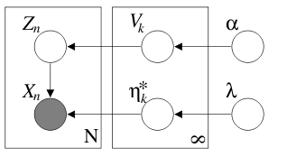
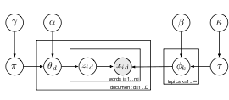
Why not Stick-Breaking for ME?
DP:
Blei et.al
HDP:
Teh et.al

Slide 10

ME: search z to minimize F(z,K)
Update:
Problem: Generative!
M-step:
E-step:
Local Search: the assignment of ith data @ t+1 th iteration
Hierarchical: the assignment of ith cluster @ t+1 th iteration

Slide 11
ME: Search Problem
1) Local-search: too easy to get stuck @ local minima
2) Bottom-up: O(N^2) Initialization,
3) Top-down: Heuristic split-merge

Slide 12
Chinese Restaurant Franchise

