Slide 1
0)Cluster Problem: want “best” z
Probabilistic Model:
1) Observation (x)
2) Hidden Variable(w): z(assignment), θ(parameter)
3) Hyperparameter(λ)
1) Approximate the distribution of z:
q(z)-> assignment z
2) Find z that maximizes the marginal probability

Slide 2
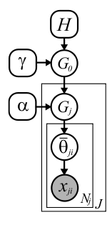
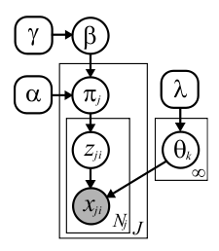
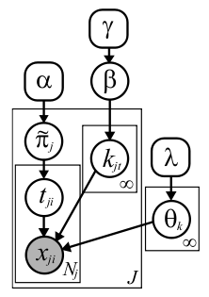
1) HDP Model:
Chinese Restaurant Franchise
Stick-Breaking:
?

Slide 3

2) Learning Algorithm:
Hidden Varialble:
Z: assignment
Ө: parameter
(Kurihara et.al)
Goal:
min
Expectation Expectation
(EE)
Maximization Expectation
(ME)
Gibbs Sampling
(GS)
Expectation Maximization
(EM)
Maximization Maximization
(MM)

Slide 4



Chinese Restaurant Franchise
1) Naïve assignment:
2) Direct assignment:
Stick-Breaking:
1) Naïve:
2) Auxilary+collapsed:

Slide 5
Proposal:
ME algorithm
for Hierarchical Dirichlet Process
with Chinese Restaurant Franchise Interpretation
Donglai Wei, Erik Sudderth (Supervisor)

Slide 6
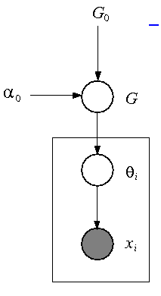
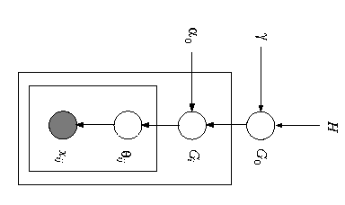
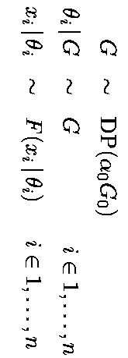
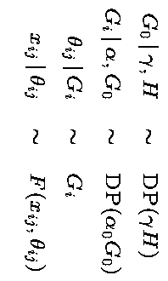
1) Graphical Model:
(Teh et.al)
Dirichlet Process Mixture
Hierarchical Dirichlet Process

Slide 7
Infinite Limit of LDA
ME: Kurihara et.al
Stick-Breaking
GS: Ishwaran et.al,
EE: Blei et.al, Kurihara et.al
Chinese Restaurant Process
GS: Neal et.al
DP
3) Construction of DP & HDP: (Teh et.al)
HDP
We Are Here
!!!
Infinite Limit of LDA
Stick-Breaking
EE:Teh et.al
Chinese Restaurant Franchise
GS Teh et.al,
ME:

Slide 8
HDP
+
ME
+
Chinese Restaurant Franchise

Slide 9
a) Pick a stochastic process:
HDP>>DP:
1) Share mixture components among groups
2)
3)
4)

Slide 10

b) Pick an algorithm
Approximation
Efficiency
1) Why not GS?
2) Why not MM?
3) Why not EE, EM?
4) ME
EE for HDP with stick-breaking (Teh et.al)

Slide 11
c) Pick a construction of HDP
1) Why not Infinite Limit of LDA?
2)Why not stick-breaking?

Slide 12
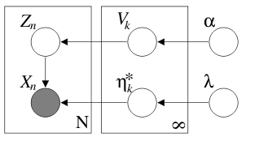
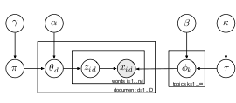
Why not Stick-Breaking for ME?
DP:
Blei et.al
HDP:
Teh et.al

Slide 13

ME: search z to minimize F(z,K)
Update:
Problem: Generative!
M-step:
E-step:
Local Search: the assignment of ith data @ t+1 th iteration
Hierarchical: the assignment of ith cluster @ t+1 th iteration

Slide 14
ME: Search Problem
1) Local-search: too easy to get stuck @ local minima
2) Bottom-up: O(N^2) Initialization,
3) Top-down: Heuristic split-merge

Slide 15
Chinese Restaurant Franchise

