Slide 1
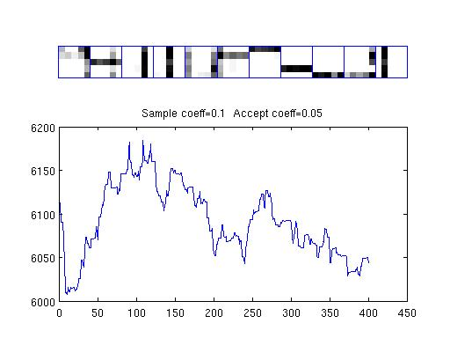
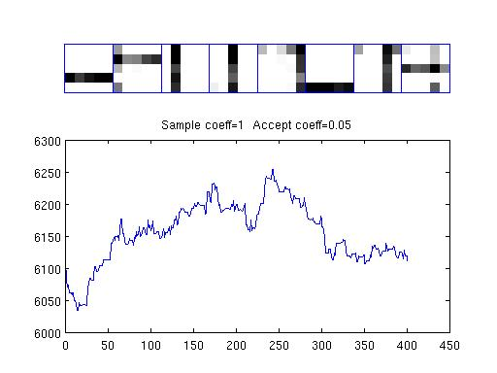
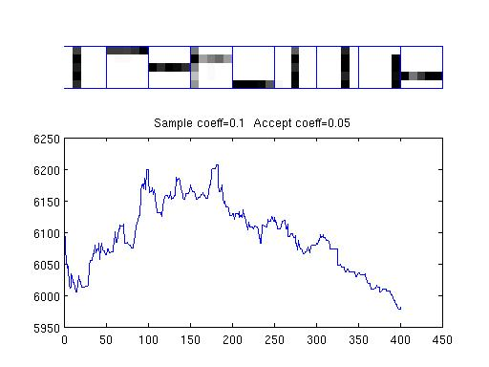
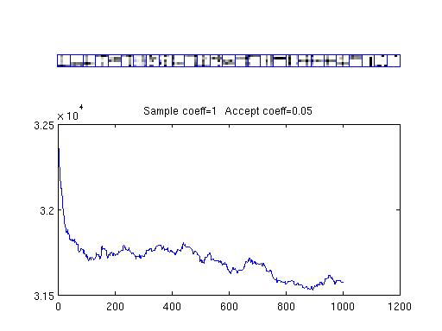
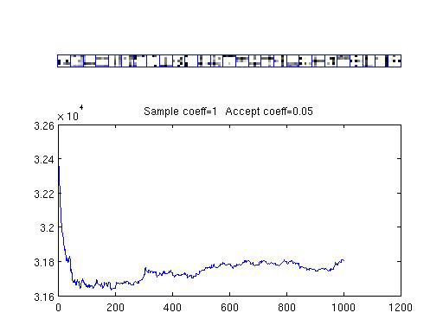
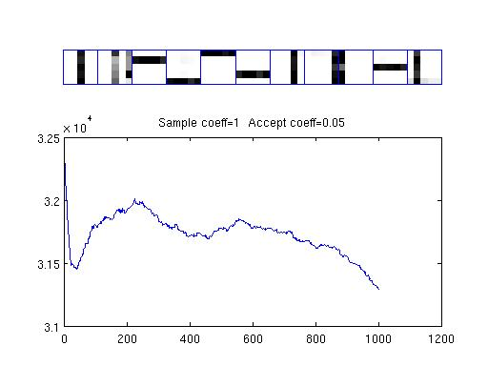
Decompose Restaurants
No threshold:
With threshold:
Sampling:
40 Restaurants:
(10 times)
r_acceptance=0.05
r_proposal=0.1
200 Restaurants:
(5 times)
r_acceptance=0.05
r_proposal=1

Slide 2
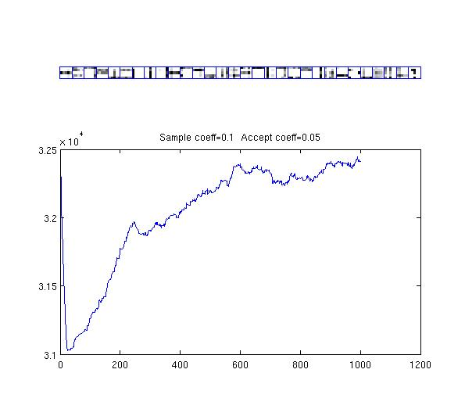
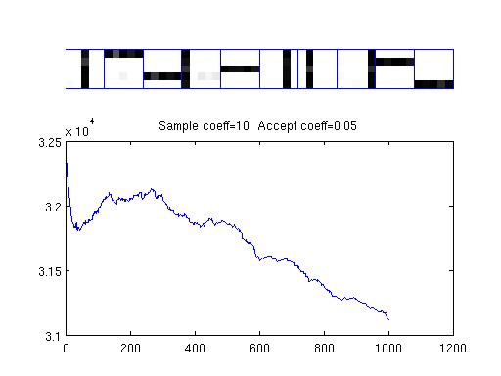
Strategy 1:
Peaky Proposal+More Acceptance
Settings:
1) 200 Restaurants
2) Decompose Restaurants 5 times
3) Sampling Proposal
4) r_accept=0.05
r_proposal=0.1
r_proposal=1
r_proposal=10

Slide 3
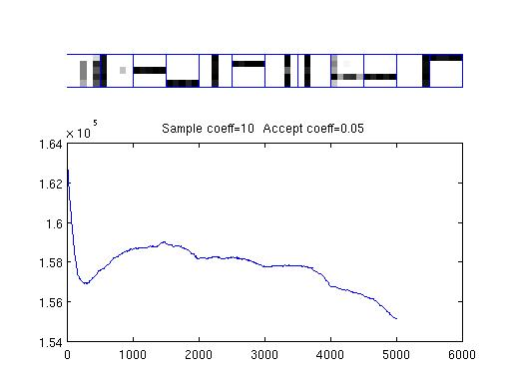
Strategy 1:
Peaky Proposal+More Acceptance
40 Restaurants:(10 times)
200 Restaurants:(5 times)
1000 Restaurants:(5 times)

Slide 4
Strategy 2:
Flat Proposal+Less Acceptance
Settings:
1) 200 Restaurants
2) Decompose Restaurants 5 times
3) Sampling Proposal
4) r_proposal=0.5
r_proposal=0.1
r_proposal=1
r_proposal=10

