Slide 1
Relationship Between Mental Health and Digital Media Usage
Sami emir arslan
32072

Slide 2
MOTIVATION
-Digital media usage has increased rapidly over the last decade
-Mental health disorders are an amplifying public concern
-We are trying to find an answer to that specific question:
- Is there any correlation between digital media usage and mental health trends?
-Our goal is to analyze trends using data science methods

Slide 3
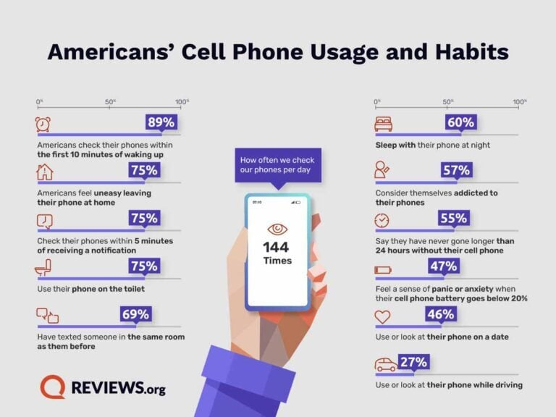
MY DATA SOURCES
My Mental Health Data: Our World in Data
Anxiety, Depression, Bipolar Disorder, Schizophrenia
My Digital Media Usage Data: Our World in Data
Internet Use Trends
Focused Time Interval: (2008-2017)

Slide 4
How I prepared the data
-Filtered the data by year and country (USA)
-Collected digital media usage across devices
-Managed missing values
-Make certain that convenient interpretation of data

Slide 5
Exploratory Analysıs (eda)
-Digital media usage increased frequently over time
-Mental Health trends vary across disorders
-Used bar-plots to avoid deceiving trends

Slide 6
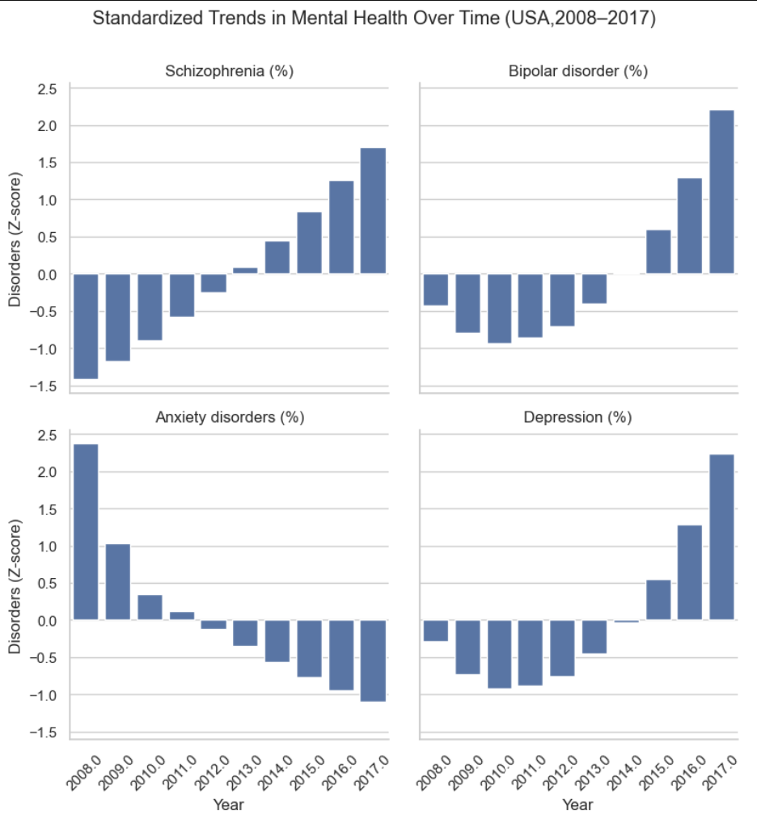
Standardized trends
-Used Z scores to standardize mental health variables
-Makes it possible to compare relative changes over time
- Showed distinctive patterns across mental disorders

Slide 7
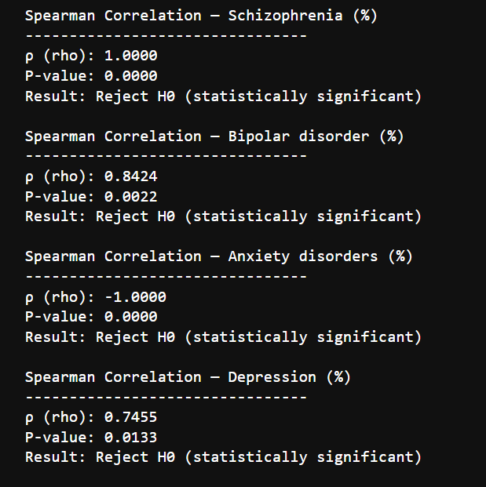
Statıstıcal analysis
-Used Spearman Correlation Analysis
-Used hypothesis testing to see the relationships significance
-The result is digital media usage shows important association with depression trends

Slide 8
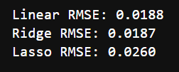
MACHINE LEARNING (ML)
METHODS
-Used: Linear Regression, Ridge Regression, Lasso Regression
-Used Leave-One-Out Cross Validation to evaluate the results and my metric was RMSE
Those are my results:
Digital media usage and time can be used to forecast depression prevalence trends, and the ridge regression shows the most correct results.

Slide 9
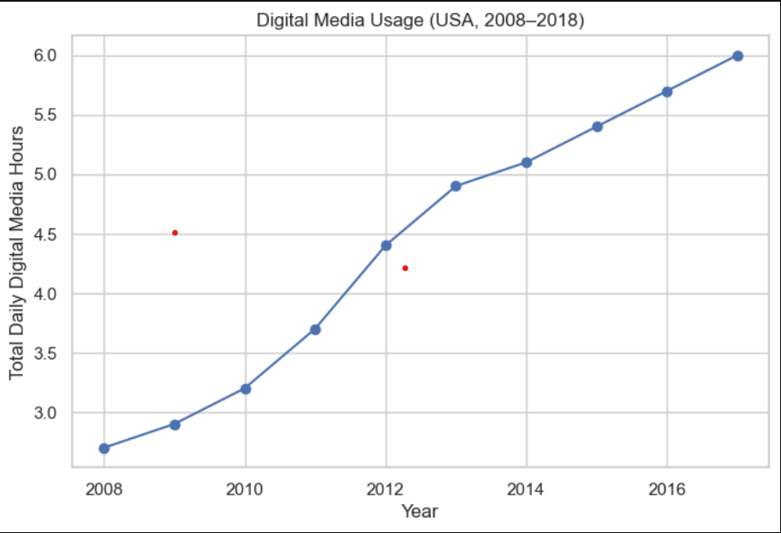
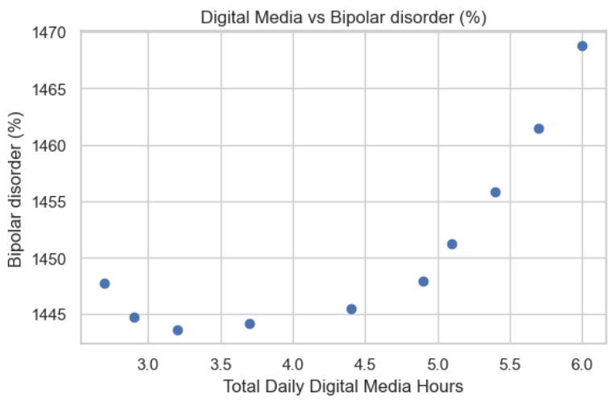
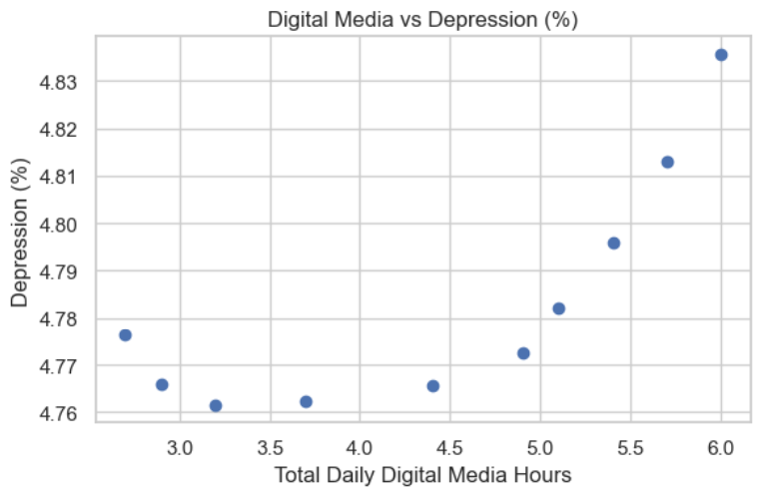
My results
Digital media usage increased over time
Depression and bipolar disorder have upwards trends
Simple regression models perform well
Relationship is predictive but not casual

Slide 10
LIMITATIONS AND FUTURE WORK
Limitations:
Sample size could be bigger
No causal inference can be made
Future:
-If more reliable and advanced data is available to use:
-It is possible to use more countries and include more variables.
-Getting effective results -> more improved models

Slide 11
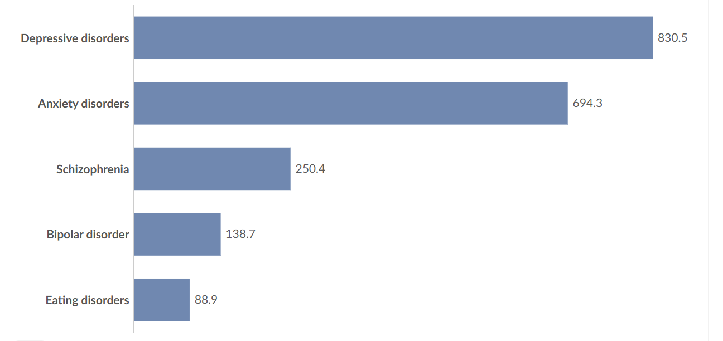
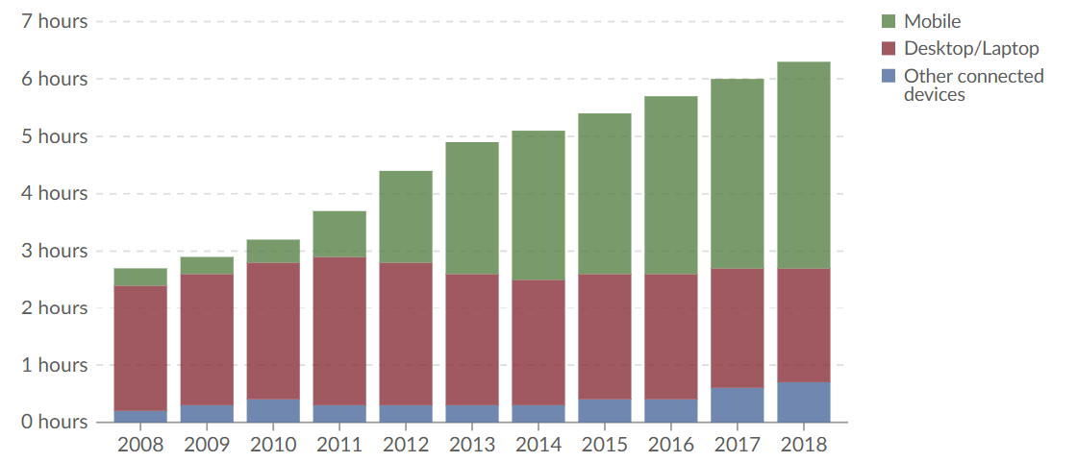
CONCLUSION
-The consume of digital media could be linked with trends in mental health.
-Depression prevalence can be accurately predicted by machine learning models.
-My work shows how we can practically use data in real world to make implications.

Slide 12
References
IHME, Global Burden of Disease (2024) – with major processing by Our World in Data
BOND Internet Trends (2019) – processed by Our World in Data
https://www.bondcap.com/report/it19/#view/41
https://ourworldindata.org/grapher/daily-hours-spent-with-digital-media-per-adult-user
https://ourworldindata.org/mental-health

Slide 13
THANK YOU for your tıme

