Slide 1
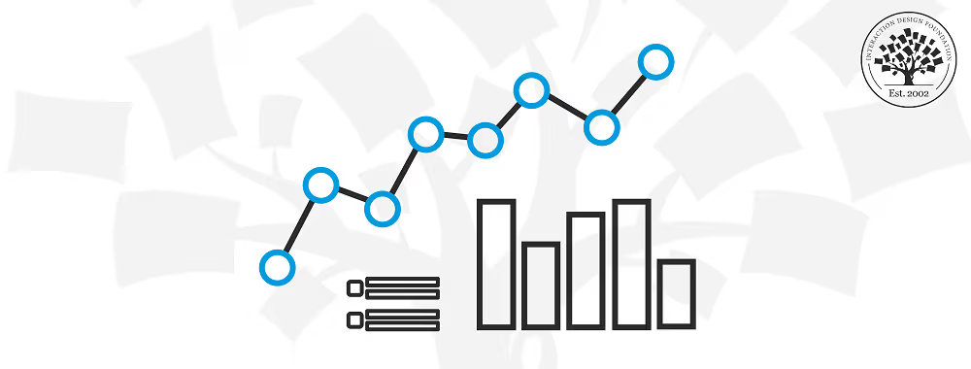
EATİNG HABİTS AND SLEEP PATTERN ANALYSIS
An analysis of the relationship between the disrupted eating habit and sleep pattern in exam periods.
EMİR KEREM YILMAZ - 31785

Slide 2

MOTİVATİON
Academic stress may effect our daily lifes and habits in unwanted ways. With this project, I aimed to explore how exam periods influence my daily habits and routines from my sleep and eating data I collected.
Understanding these pattern helps me uncover the hidden connection between stress, well-being and health. By giving examples from my habits, I hope to inspire healthier routines and encourage others to be careful of their own behaviours during stressful times.

Slide 3

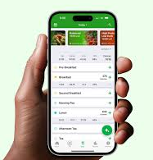

INTRODUCTİON
FatSecret, analyzing my meals on daily basis to understand the possible deterioration in my eating habits.
Sleep Tracking Application, analyzing my sleep pattern in a different dimensions which are duration and interruption. They are the main factors led to the quality.
Visualization Methods, investigating the potential relationship between eating habits and sleep pattern to uncover insight about my behaviour in exam periods
This presentation aims to provide valuable insights about well-being in stressful times like exam period.

Slide 4
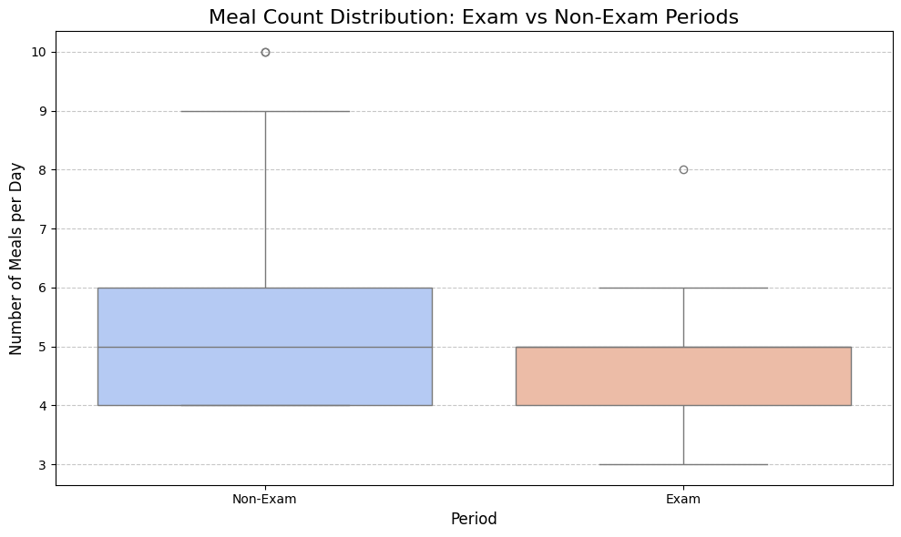
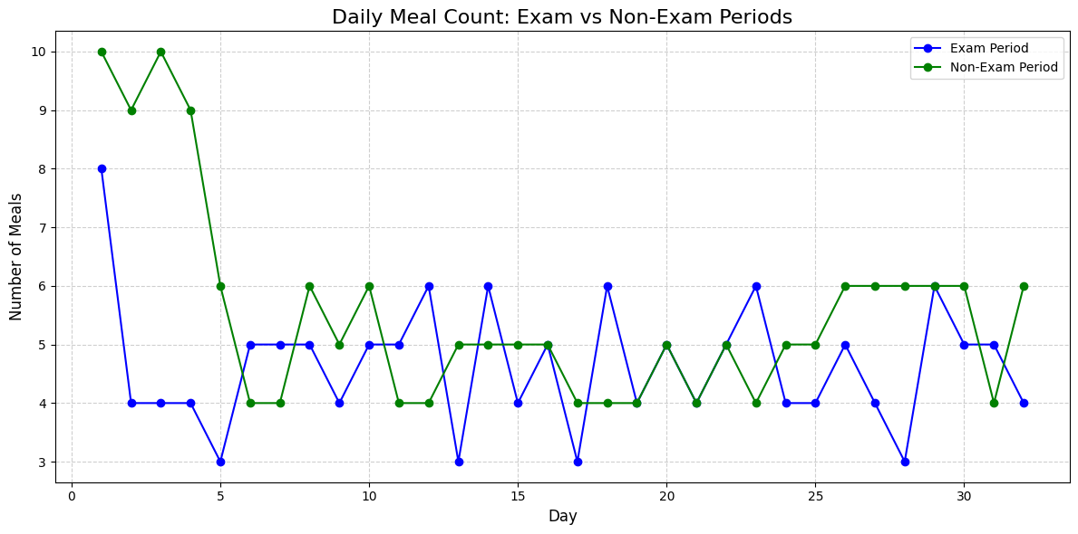
MY EATİNG HABİTS
First, I started with analyzing my eating data in the exam periods versus non-exam periods. In the data, I analyze through step by step. For example, first I focused on the meal number I ate daily. From the graph below, we can see the variation of the meal count is bigger which means there have been unconsistency in non-exam period.

Slide 5
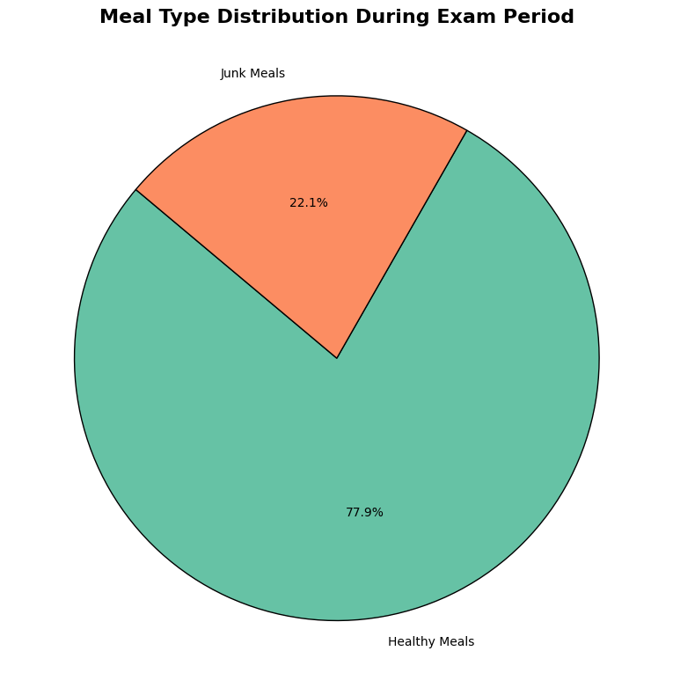
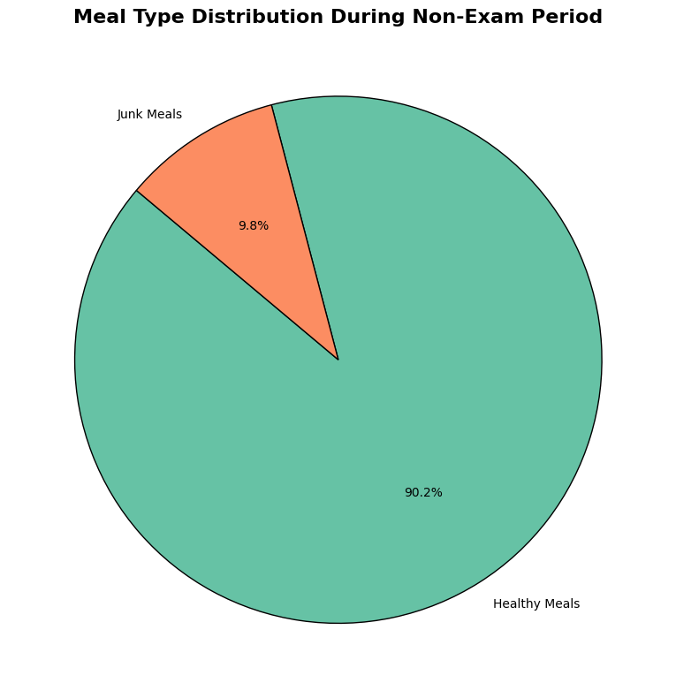
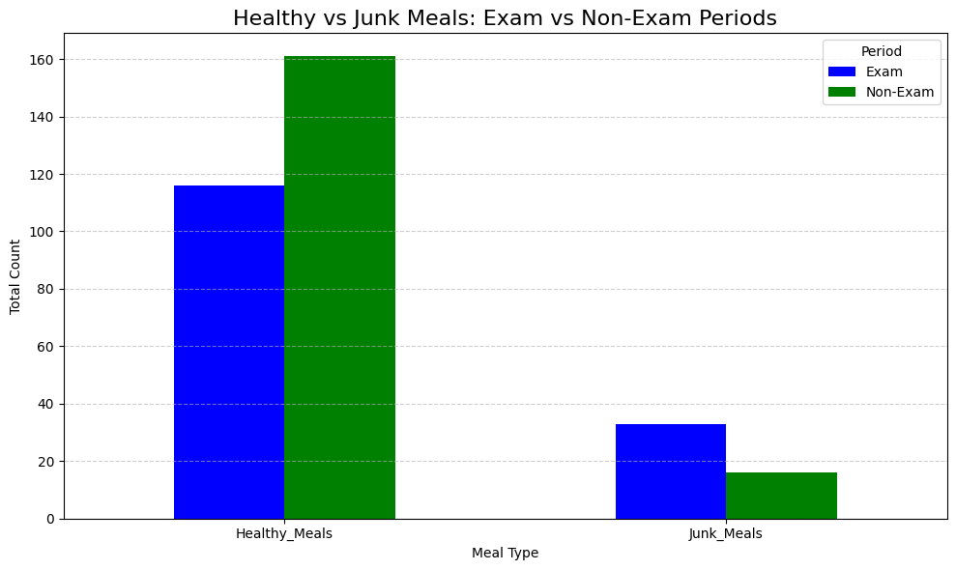
WHAT ARE THESE MEALS?
In these counted meals, we need to know how many of them were junk food and how many of them were healthy food. We need these data to compare if there has been shift to unhealhty behaviour in exam period.
As wee see in the graphs below, there had been an increase on junk food consumption in exam periods.

Slide 6
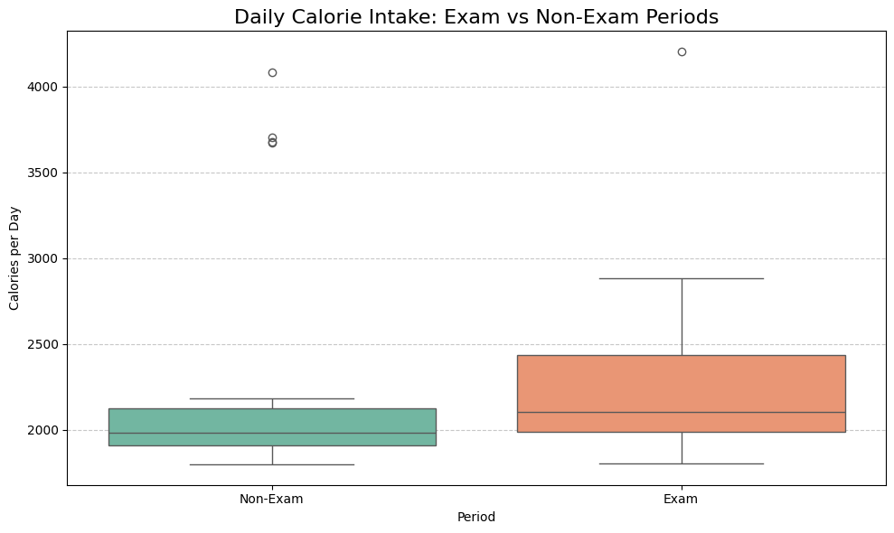
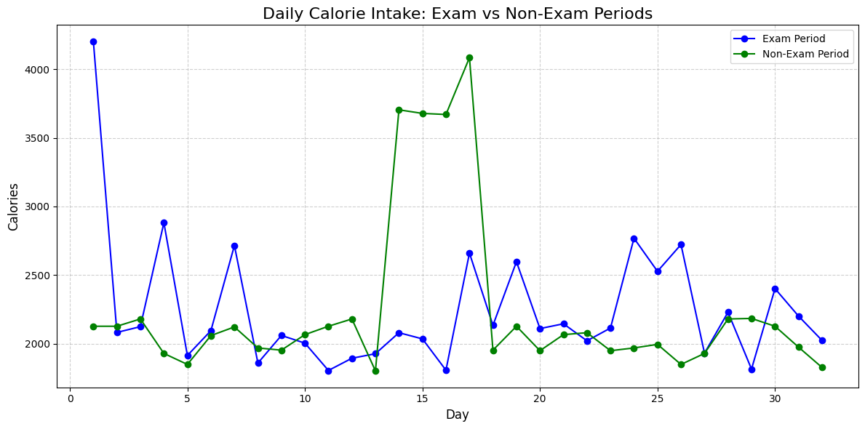
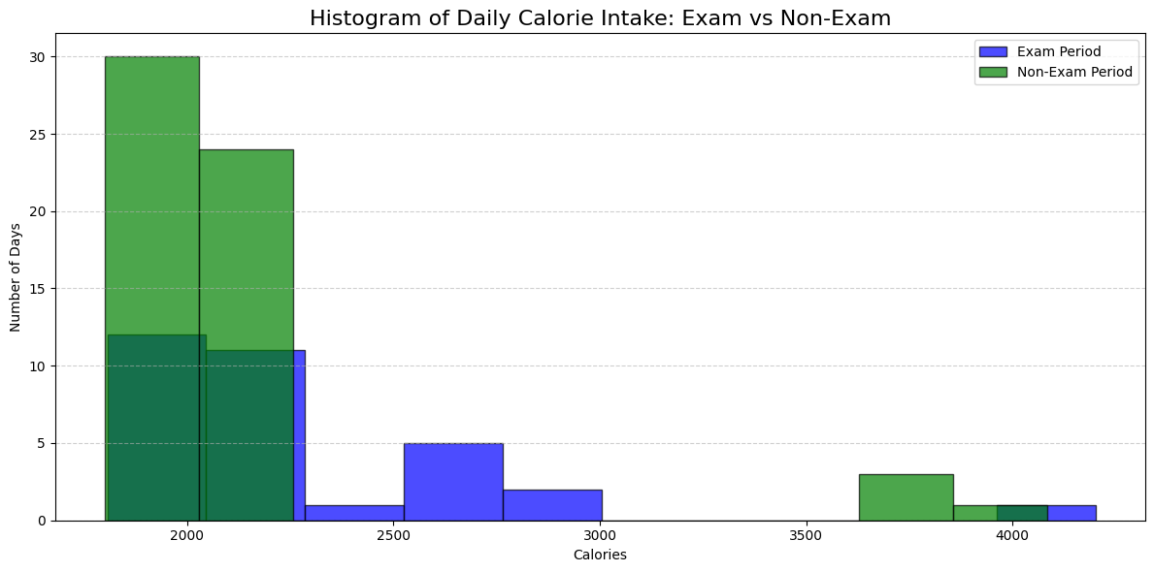
TOTAL CALORİE İNTAKE
Total calorie intake data is very distinctive and important to understand if there has been a negative change in eating behaviour in general. As wee see in the below, there has been a significant changes in exam period based on our calorie intake. Also unconsistency occurred as we see clearly in boxplot.

Slide 7
CONCLUSİON FOR EATİNG DATA
For proper analyzing, I selected my exam period from the academic calendar and non-exam period randomly because of the randomization rule for testing my hypothesis.
From the previous slides, we can understand that my eating habits changes significantly in a negative way. The reasons for that conclusion are increase in total calorie intake, consuming more junk food and inconsistency in daily eating habit.

Slide 8
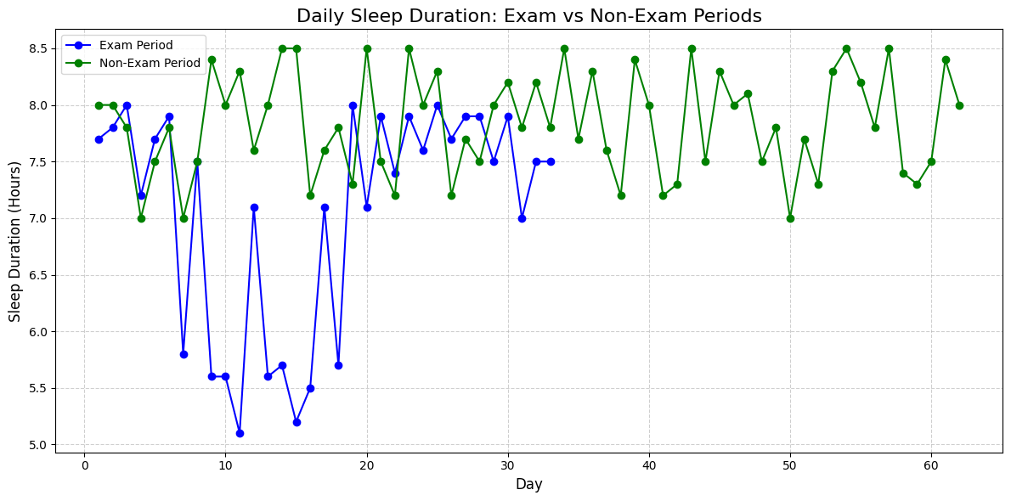
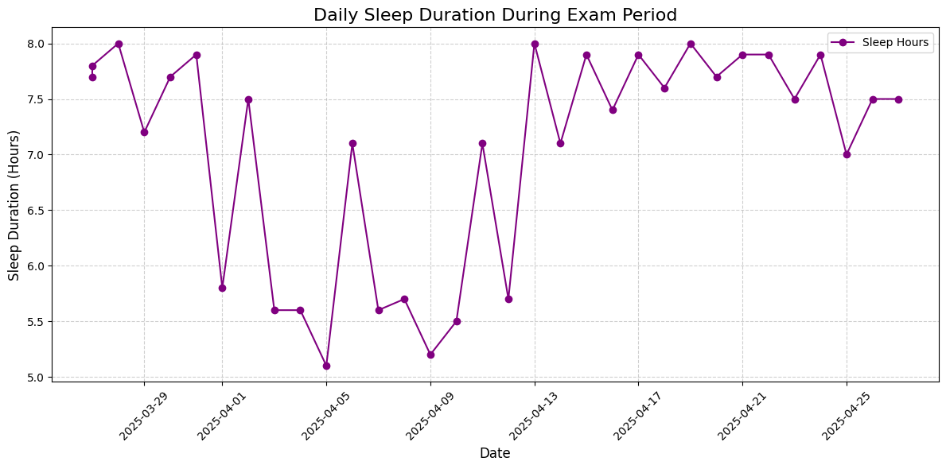
SLEEP PATTERN DATA
First thing I wanted to look at it my sleep duration. After tracking my sleep durations during exam week, I wanted to compare them with the non-exam week. It is obvious as wee see in the graphs too that, duration is much longer in non-exam periods. Late night works and the stress reduced the duration in exam periods.

Slide 9
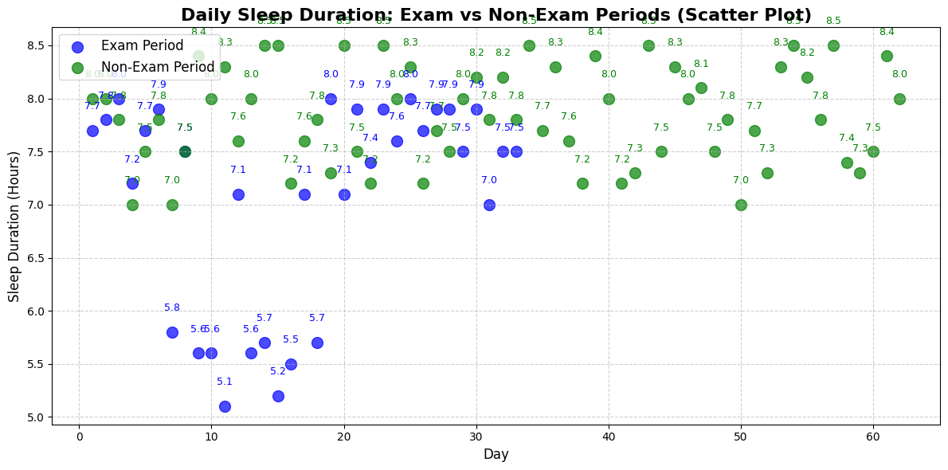
VİSUALİZE THE POSSİBLE RELATİONSHİP
When we look at the scatter plot for understand the possible relationship, exam week visiblely effected the total duration time . So, my argument about exam week reduce duration and sleep quality tend to be true.

Slide 10
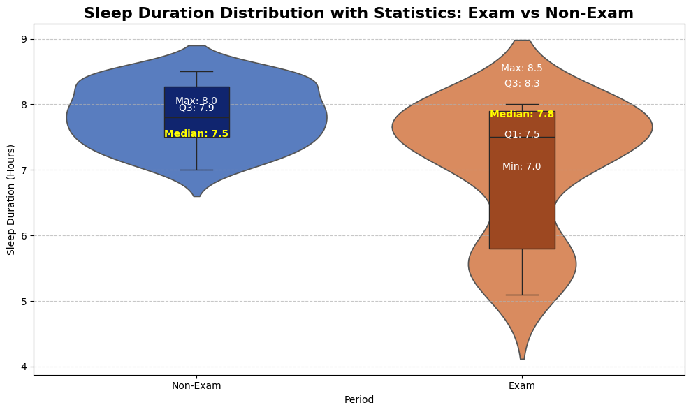
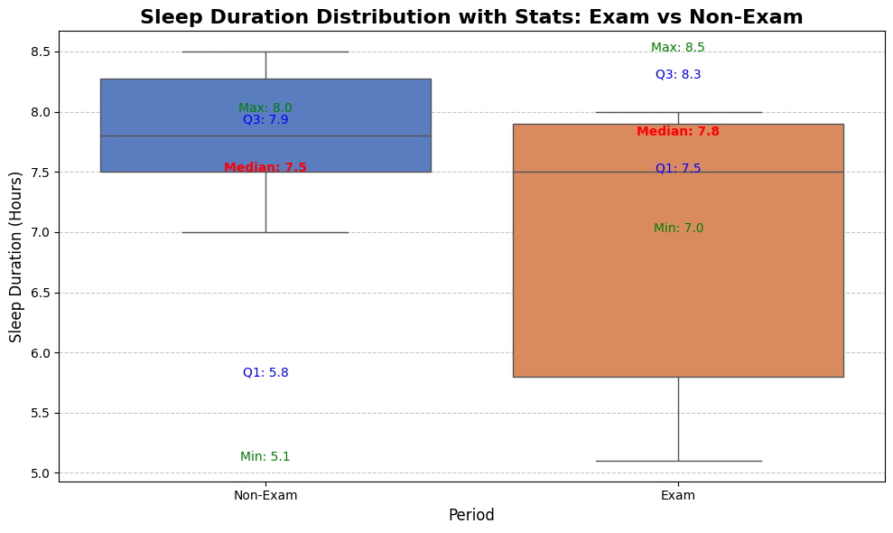
ADDİTİONAL GRAPHS FOR STATİSTİCS
The boxplot shows us that my sleep duration is much higher and the variation of durations is much lower in the non-exam period. Unconsistent sleep durations in exam period effected my well-being.
I also added a violin plot for showing different type of plot.

Slide 11
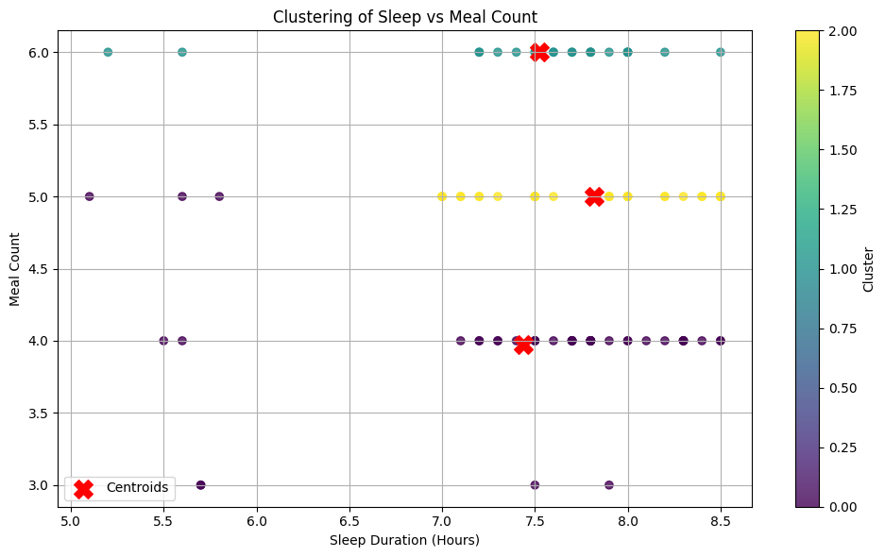
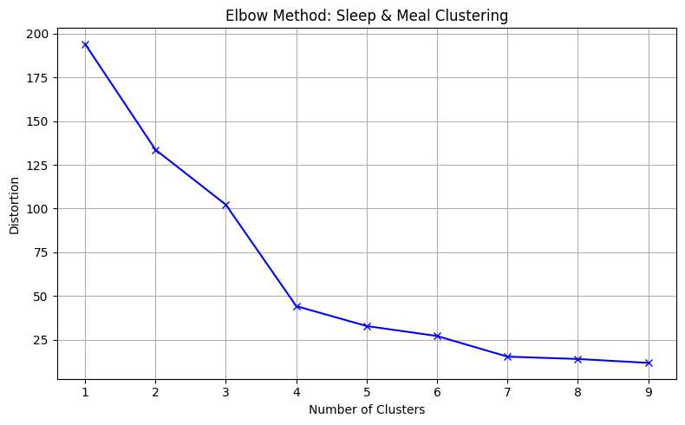
MACHİNE LEARNİNG METHODS
I came up with the k-means clustering. With the elbow method, I found the optimal k and then I did a clustered plot.

Slide 12
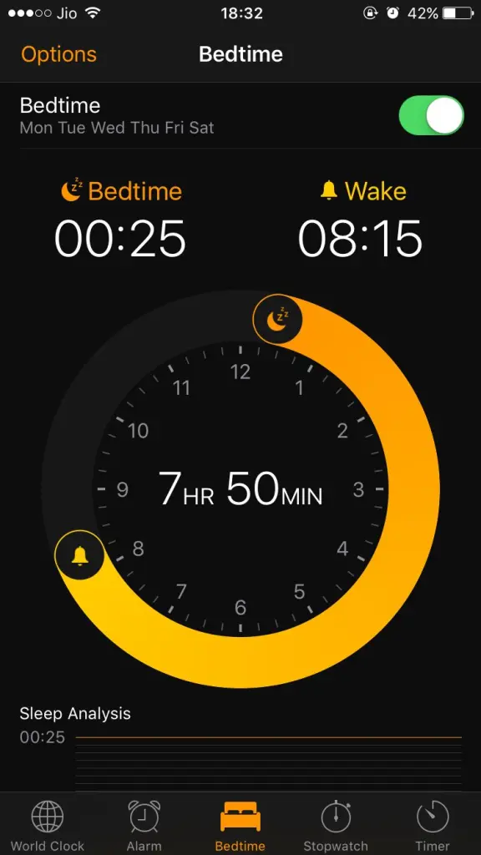
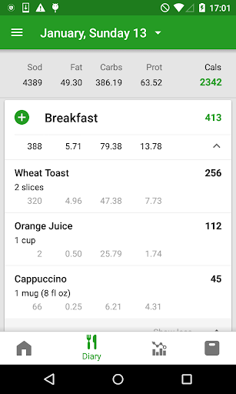
CASUAL INFERENCE
The causal inference analysis indicates a positive treatment effect, with an average increase of 0.02 hours in the treatment group (those eating more than 3 meals daily) compared to the matched control group. This suggests that higher food consumption may be associated with increased sleep duration levels, highlighting a potential trade-off between sleep duration and eating habits. But we have to say that, this might not be that significant when we look at the value we get.

Slide 13
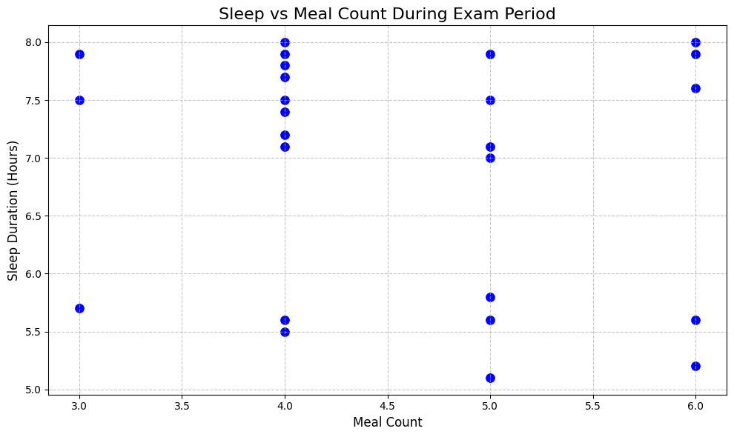
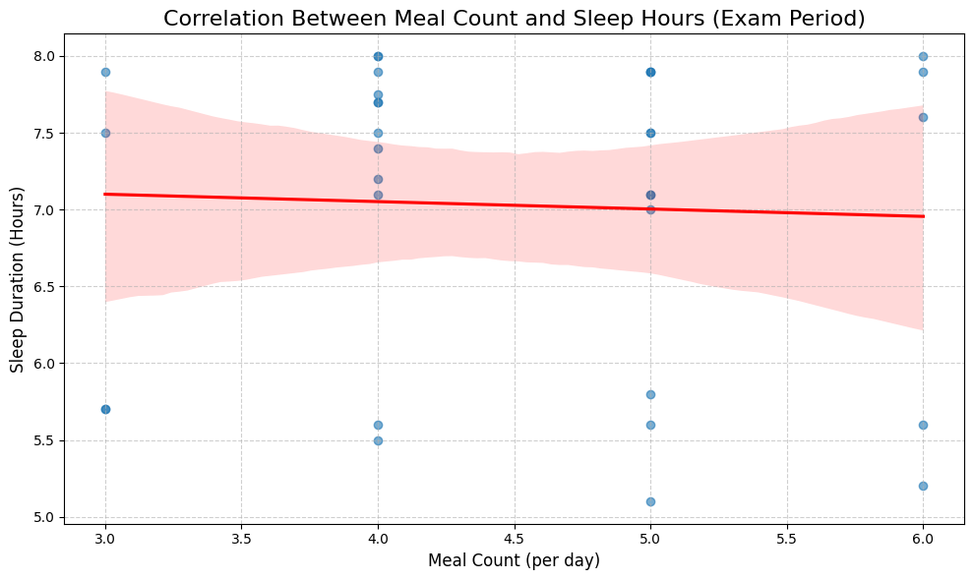
POSSİBLE CORRELATİON BETWEEN TWO VARİABLES
After looking at the plot and the plot with regression line, it is hard to tell there is a correlation. After calculating the correlation coefficient, we can say that there is no correlation between two variables.

Slide 14
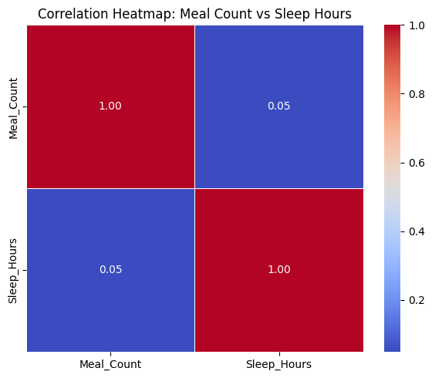
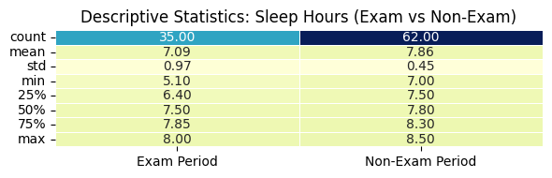
ADDİTİONAL STATİSTİCS AND CORRELATİON HEATMAP
We can see the basic descriptive statistics and the correlation heatmap for interpretation.

Slide 15
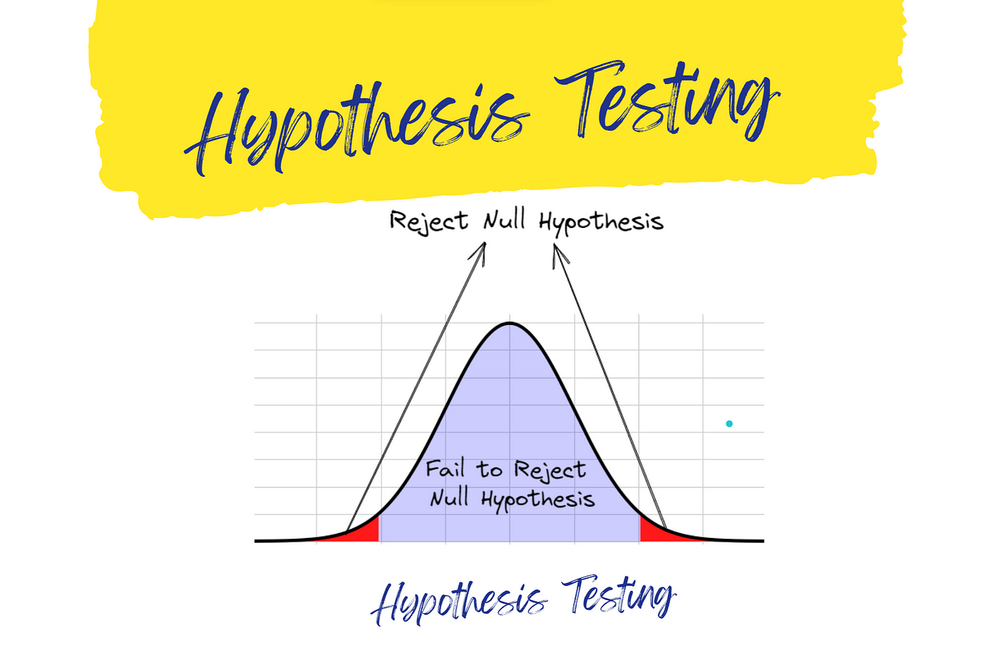
HYPOTHESİS TESTİNG
First, defined hypotheses of mine are: Null Hypothesis = There is no significance difference in average sleep duration between exam and non-exam period. Alternative Hypothesis = There is a significance difference in average sleep duration between exam and non-exam period. Also, I selected the ındependent sample T-tests because we are comparing the means of sleep durations between two independent groups (exam and non-exam period).

Slide 16
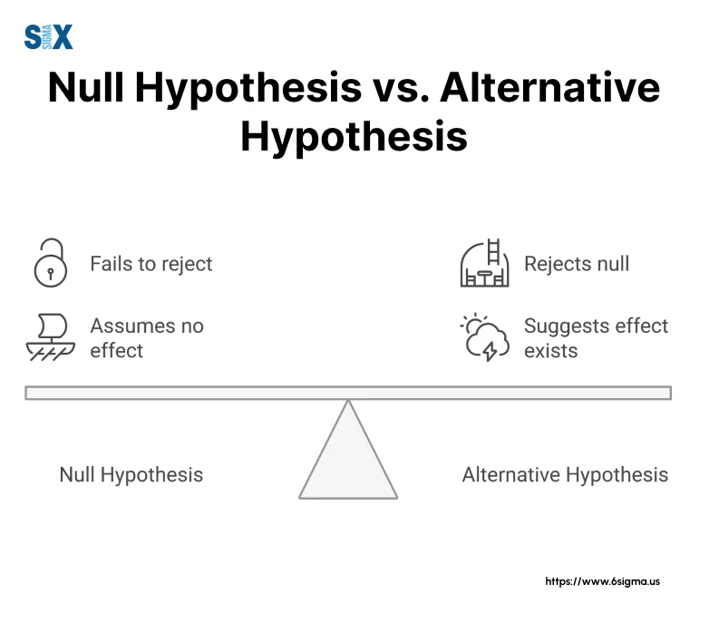
RESULTS OF THE HYPOTHESİS TESTİNG
T-statistic = -4.442
P-value = 0.0001
As a result of the results we get, we reject the null hypothesis. Rejecting null hypothesis indicates that there is significant difference in sleep durations between exam and non-exam period. To conclude, we can say that academic stress in the exam period totally effect our well-being in a badway.

Slide 17
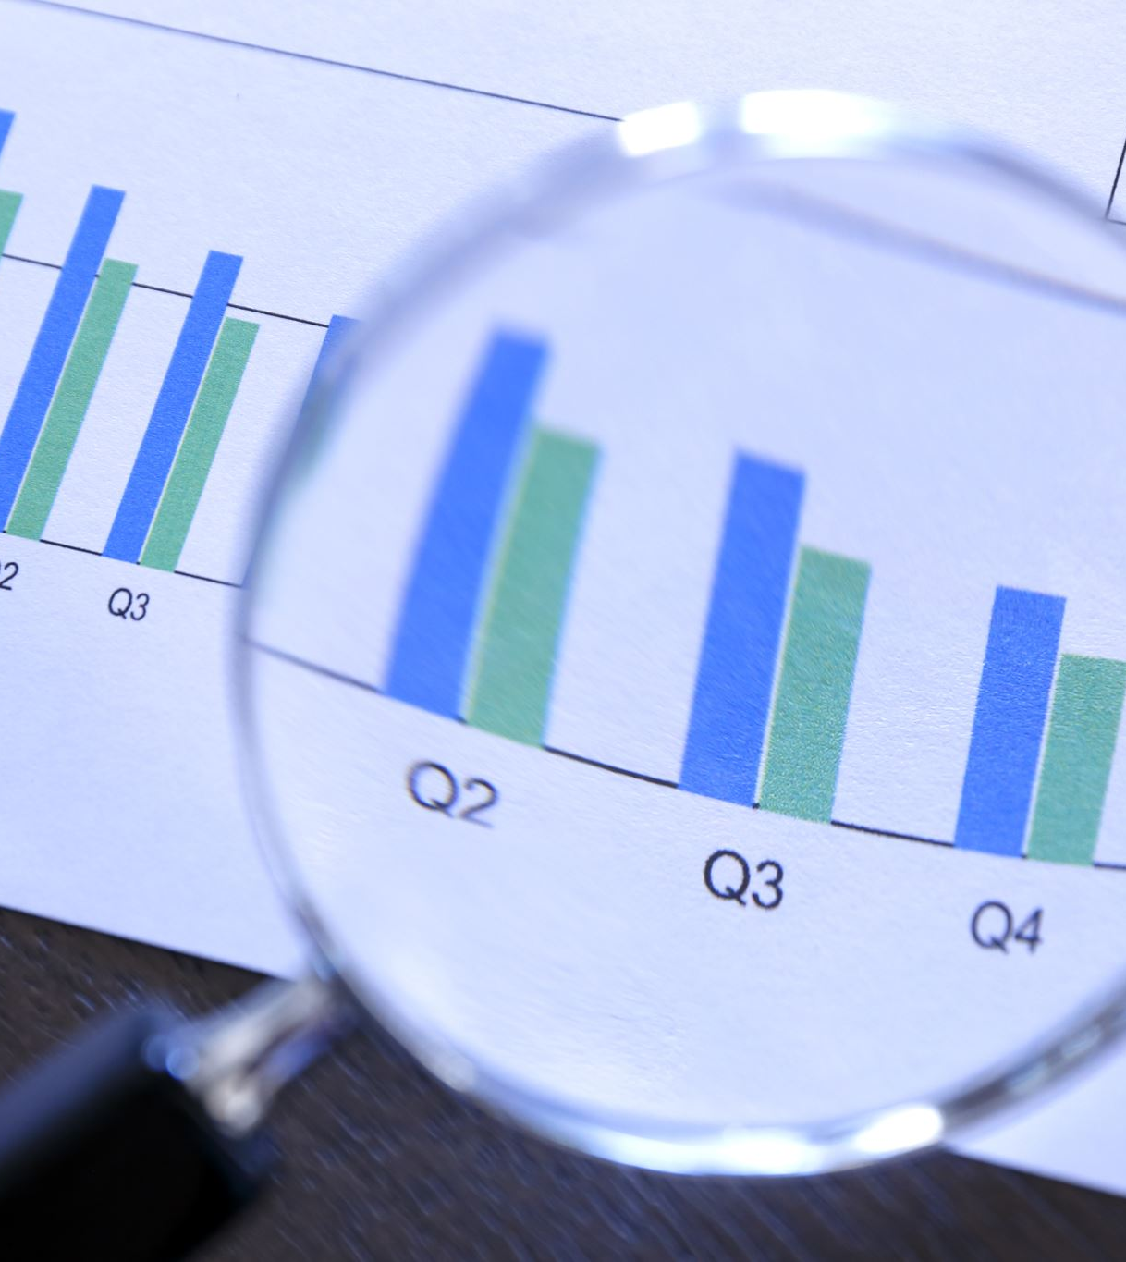
FİNDİNGS OF THE PROJECT
This analysis revealed that our hypothesis , which is that academic stress in exam periods damages our well-being and healthy routines, was totally supported with the data I collected. T-test and the p-value we get supported this claim. As we supported with the all graphs and the tests, this situation occurred for both of the variables we check: Eating Habits and Sleep Pattern

Slide 18
LİMİTATİONS AND FUTURE WORK
This project had some limitations that may have affected the results. First of all, the data covered a short period, which is not showing long-term patterns or seasonal changes in behaviour.
Also, the process of categorizing genres and content done manually, which could led to the occurrence of some errors and bias.
Finally, for the analysis mostly basic statistical methods was used and could be improved with more advanced machine learning techniques.

Slide 19
END
Thank you all for your time and attention you give to this project ☺

