Slide 1

Advanced C Programming Lab
Session I – Mar 12

Slide 2
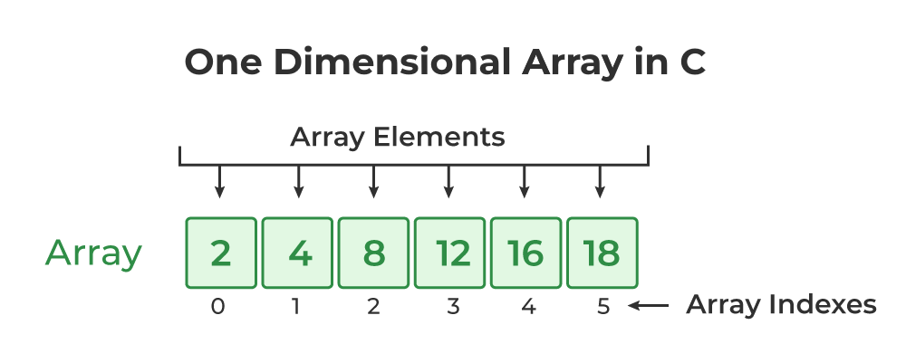
Welcome to Lab!
Today’s goal:
Going from “Single Data” to “Data Sets.”
Topics:
One-Dimensional Arrays: Efficiently managing lists of data
Strings: How C handles text (The char array)
Two-Dimensional Arrays: Visualizing data in tables and grids

Slide 3
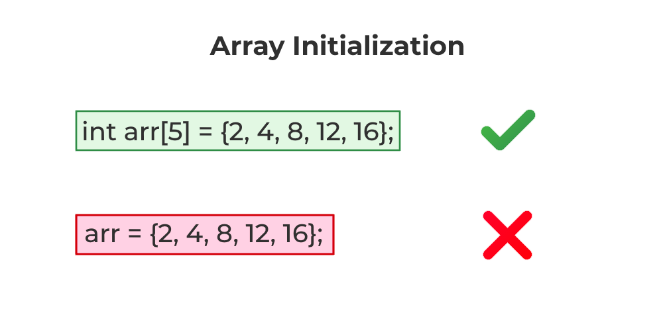
One-Dimensional Array
An array is a linear data structure that stores a fixed-size sequence of elements of the same data type in contiguous memory locations.
Arrays can also be of different types depending upon the direction/dimension they can store the elements. It can be 1D, 2D, 3D, and more.
A one-dimensional array can be viewed as a linear sequence of elements. We can only increase or decrease its size in a single direction.

Slide 4
One-Dimensional Array
To correctly declare and assign data in a 1D Array we require a few different values.
elements_type array_name[array_size] = {value1, value2, ... };

Slide 5
One-Dimensional Array
Example: Illustrating of creation of an array.
#include <stdio.h>
int main()
{
// declaring and initializing array
int arr[5] = { 1, 2, 4, 8, 16 };
// printing it
for (int i = 0; i < 5; i++) {
printf("%d ", arr[i]);
}
printf("\n");
// updating elements
arr[3] = 9721;
// printing again
for (int i = 0; i < 5; i++) {
printf("%d ", arr[i]);
}
return 0;
}
Output:
1 2 4 8 16
1 2 4 9721 16

Slide 6
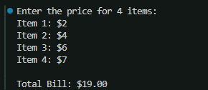
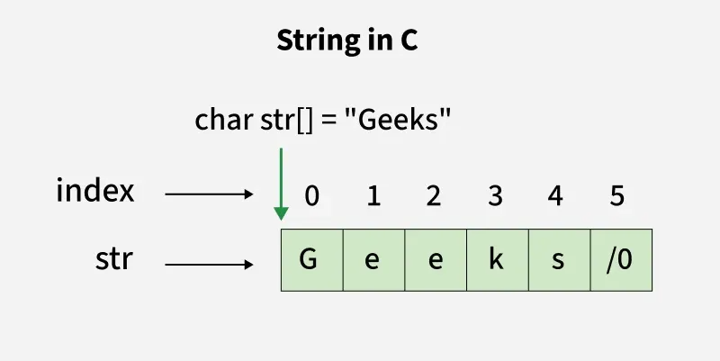
One-Dimensional Array
Example: A code that calculates user's inputs.
#include <stdio.h>
int main() {
float prices[4]; // Array to store prices of 4 items
float total = 0;
int i;
// Input: Entering prices for 4 items
printf("Enter the price for 4 items:\n");
for(i = 0; i < 4; i++) {
printf("Item %d: $", i + 1);
scanf("%f", &prices[i]);
}
// Processing: Calculating the total
for(i = 0; i < 4; i++) {
total = total + prices[i];
}
printf("\nTotal Bill: $%.2f\n", total);
return 0;
}

Slide 7
Strings
A string is an array of characters terminated by a special character '\0' (null character). This null character marks the end of the string and is essential for proper string manipulation.
Unlike many other programming languages, C does not have a String type to easily create string variables. Instead, you must use the char type and create an array of characters to make a string in C.

Slide 8
Strings
#include <stdio.h>
int main() {
// declaring and initializing a string
char str[] = “Codes";
// printing the string
printf("The string is: %s\n", str);
return 0;
}
#include <stdio.h>
int main() {
char str[] = “Codes";
// Update the second
// character of string
str[1] = ‘W';
printf("%c", str[1]);
return 0;
}
Output:
The string is: Codes
Output:
W
Notes:
The Empty Brackets []: Tell the students that when they provide the text "C Programming" immediately, they don't have to put a number in the brackets. The compiler is smart enough to count: 1 space + 12 letters + 1 Null Terminator = 14 slots.
Accessing Parts: Point out that even though we call it a "string," we can still access individual letters using message[0] or message[2] just like we did with numbers in the 1D array.
The Format Specifiers: Remind them that %s prints the whole sequence until it hits the Null, while %c prints only one single character.

Slide 9
Strings
#include <stdio.h>
int main() {
// The compiler counts the letters and adds +1 for the '\0' automatically
char message[] = "C Programming";
int i;
printf("The full string is: %s\n", message);
// Let's look at the string character by character
printf("Broken down:\n");
for(i = 0; i < 13; i++) {
printf("Index [%d] is character: %c\n", i, message[i]);
}
return 0;
}

Slide 10
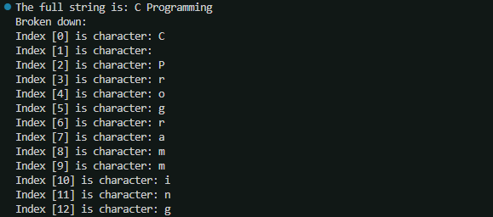
Strings
#include <stdio.h>
int main() {
// The compiler counts the letters and adds +1 for the '\0' automatically
char message[] = "C Programming";
int i;
printf("The full string is: %s\n", message);
// Let's look at the string character by character
printf("Broken down:\n");
for(i = 0; i < 13; i++) {
printf("Index [%d] is character: %c\n", i, message[i]);
}
return 0;
}
Notes:
The Empty Brackets []: Tell the students that when they provide the text "C Programming" immediately, they don't have to put a number in the brackets. The compiler is smart enough to count: 1 space + 12 letters + 1 Null Terminator = 14 slots.
Accessing Parts: Point out that even though we call it a "string," we can still access individual letters using message[0] or message[2] just like we did with numbers in the 1D array.
The Format Specifiers: Remind them that %s prints the whole sequence until it hits the Null, while %c prints only one single character.

Slide 11
Strings
#include <stdio.h>
int main() {
// The compiler counts the letters and adds +1 for the '\0' automatically
char message[] = "C Programming";
int i;
printf("The full string is: %s\n", message);
// Let's look at the string character by character
printf("Broken down:\n");
for(i = 0; i < 13; i++) {
printf("Index [%d] is character: %c\n", i, message[i]);
}
return 0;
}

Slide 12
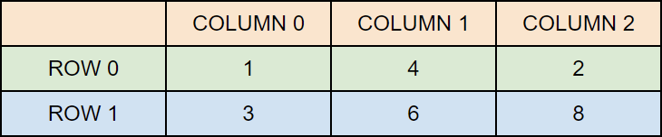
Multidimensional Arrays
As we learned earlier simple arrays are single dimensional. Although useful, if you want to store data as a tabular form, like a table with rows and columns, you need to get familiar with multidimensional arrays.
A multidimensional array is basically an array of arrays.
Arrays can have any number of dimensions. In this chapter, we will introduce the most common; two-dimensional arrays (2D).
int matrix[2][3] =
{ {1, 4, 2}, {3, 6, 8} };

Slide 13
Multidimensional Arrays
#include <stdio.h>
int main() {
int matrix[2][3] = { {1, 4, 2}, {3, 6, 8} };
printf("%d", matrix[0][2]);
return 0;
}
Output:
3
#include <stdio.h>
int main() {
int matrix[2][3] = { {1, 4, 2}, {3, 6, 8} };
printf("%d", matrix[?][?]);
return 0;
}
Output:
8
2 3
Notes:
int arr[3][4] = {0, 1 ,2 ,3 ,4 , 5 , 6 , 7 , 8 , 9 , 10 , 11};
int arr[3][4] = {{0, 1, 2, 3}, {4, 5, 6, 7}, {8, 9, 10, 11}};

Slide 14
Multidimensional Arrays
#include <stdio.h>
int main() {
// Create and initialize an array with 3 rows
// and 2 columns
int arr[3][2] = { { 0, 1 }, { 2, 3 }, { 4, 5 } };
// Print each array element's value
for (int i = 0; i < 3; i++) {
for (int j = 0; j < 2; j++) {
printf("arr[%d][%d]: %d ", i, j, arr[i][j]);
}
printf("\n");
}
return 0;
}
2D Array Traversal
Traversal means accessing all the elements of the array one by one. We will use two loops, outer loop to go over each row from top to bottom and the inner loop is used to access each element in the current row from left to right.
Output:
arr[0][0]: 0 arr[0][1]: 1
arr[1][0]: 2 arr[1][1]: 3
arr[2][0]: 4 arr[2][1]: 5

Slide 15
Thank you for you time and attention!
Contact:
cprogramming666@gmail.com
Subject: C programming
References:
https://www.geeksforgeeks.org/c/
https://www.w3schools.com/c/
Gemini Thinking

