Slide 1

Advanced C Programming Lab
Session III – Mar 26

Slide 2
Objectives
We will be talking about;
Input/Output Library
“scanf()” Funtion

Slide 3
Input/Output Library
In C, there are multiple libraries for different use cases. For now, we will just be focusing on <stdio.h>. Some example functions are;
Function | Description
fopen() | Opens a file and returns a file pointer for use in file handling functions
fclose() | Closes a file
remove() | Deletes a file
rename() | Changes the name of a file
fgetc() | Returns the ASCII value of a character in a file and advances the position indicator
getc() | The same as fgetc()
getchar() | Reads one character of user input and returns its ASCII value
scanf() | Reads formatted data from user input and writes it into a number of memory locations
printf() | Writes a formatted string to the console

Slide 4
Input/Output Library
#include <stdio.h>
int main() {
// Create an integer variable that will
//store the number we get from the user
int myNum;
// Ask the user to type a number
printf("Type a number and press enter: \n");
// Get and save the number the user types
scanf("%d", &myNum);
// Print the number the user typed
printf("Inputted number is: %d", myNum);
return 0;
}
Output:
Type a number and press enter: …
Inputted number is: …

Slide 5
Input/Output Library
#include <stdio.h>
int main() {
// Create an integer variable that will
//store the number we get from the user
int myNum;
// Ask the user to type a number
printf("Type a number and press enter: \n");
// Get and save the number the user types
scanf("%d", &myNum);
// Print the number the user typed
printf("Inputted number is: %d", myNum);
return 0;
}
An important note is that the scanf() function takes two arguments:
The format specifier of our variable (%d).
The reference operator, which stores the memory address of out variable (&myNum instead of myNum).

Slide 6
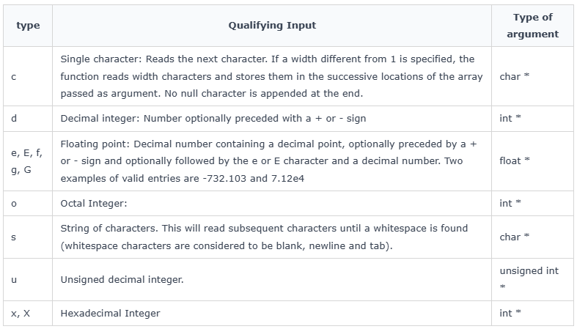
scanf()
There are many format specifiers recognized by scanf but we will be focusing on the most used ones for now in the list below:

Slide 7
scanf()
In C, scanf() is a standard input function used to read formatted data from the standard input stream (stdin), which is usually the keyboard.
#include <stdio.h>
int main() {
int n;
// Reading an integer input
scanf("%d", &n);
printf("%d", n);
return 0;
}
Output:
(inputted number by user will be printed after pressing Enter)

Slide 8
scanf()
A program with single type input.
#include <stdio.h>
int main() {
int num;
printf("Enter an integer: ");
int result = scanf("%d", &num);
if (result == 1) {
printf("You entered: %d\n", num);
} else {
printf("Failed to read an integer.\n");
}
return 0;
}
Output:
Enter an integer: …
You entered: …

Slide 9
scanf()
A program with different types of input.
#include <stdio.h>
int main() {
int age;
float height;
char initial;
printf("Enter your age, height (in meters), and first initial: ");
int result = scanf("%d %f %c", &age, &height, &initial);
if (result == 3) {
printf("You entered: Age = %d, Height = %.2f, Initial = %c\n", age, height, initial);
} else {
printf("Failed to read all values.\n");
}
return 0;
}
Output:
Enter your age, height (in meters), and first initial: 20 170 JB
You entered: Age = 20, Height = 170.00, Initial = JB

Slide 10
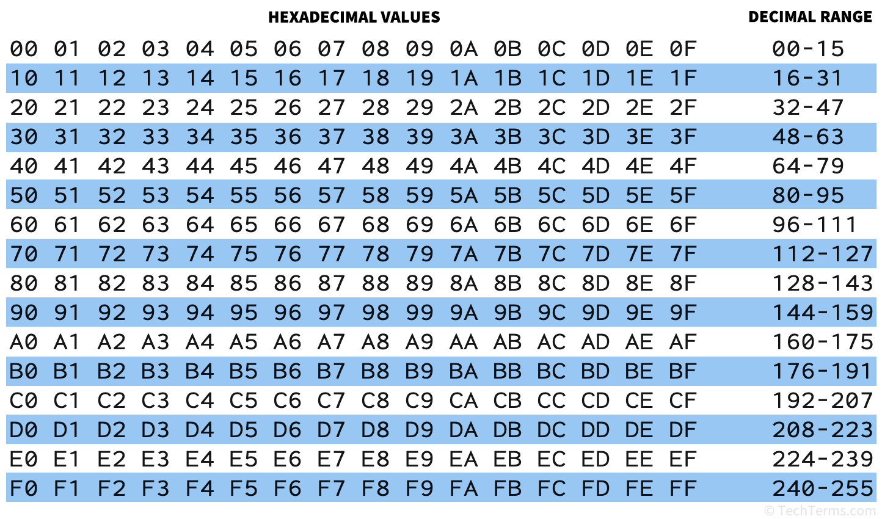
scanf()
Hexadecimal to Decimal number convertor.
#include <stdio.h>
int main() {
int num;
scanf("%x", &num);
printf("%d", num);
}
Input:
0A
Output:
10

Slide 11
scanf()
Using scanf() to print multiple words.
#include <stdio.h>
int main() {
char name[40];
// Reading an inputted string
printf("Type your full name: \n");
scanf("%s", name);
printf("Hello! %s", name);
return 0;
}
Input:
Johny Blaze
Output:
Hello! Johny
*When working with string in scanf(), make sure to specify an array size large enough to fit your data. Here we have used 40 to make sure it can handle long names.

Slide 12
scanf()
Fixing scanf() limitations.
The issue with scanf() is that it stops scanning for characters when it encounters whitespace, tabs, etc. So, to display more than a single word, we can use:
A feature of scanf() called scanset characters %[] which allows us to read a sequence of characters until certain a condition is met.
We can use another function in stdio.h library called fgets(), which is capable of reading a line of text. Don’t forget to provide the name of string, sizeof(string_name), and stdin in the parentheses.

Slide 13
scanf()
Fixing scanf() limitations.
#include <stdio.h>
int main() {
char name[40];
// Reading an inputted string
printf("Type your full name: \n");
scanf("%[^\n]", name);
printf("Hello! %s", name);
return 0;
}
#include <stdio.h>
int main() {
char name[40];
// Reading an inputted string
printf("Type your full name: \n");
fgets(name, sizeof(name), stdin);
printf("Hello! %s", name);
return 0;
}
Input:
Johny Blaze
Output:
Hello! Johny Blaze

Slide 14
Thank you for you time and attention!
Contact:
cprogramming666@gmail.com
Subject: C programming
References:
https://www.geeksforgeeks.org/
https://www.w3schools.com/
https://www.tutorialspoint.com/
https://gemini.google.com/

