Slide 1




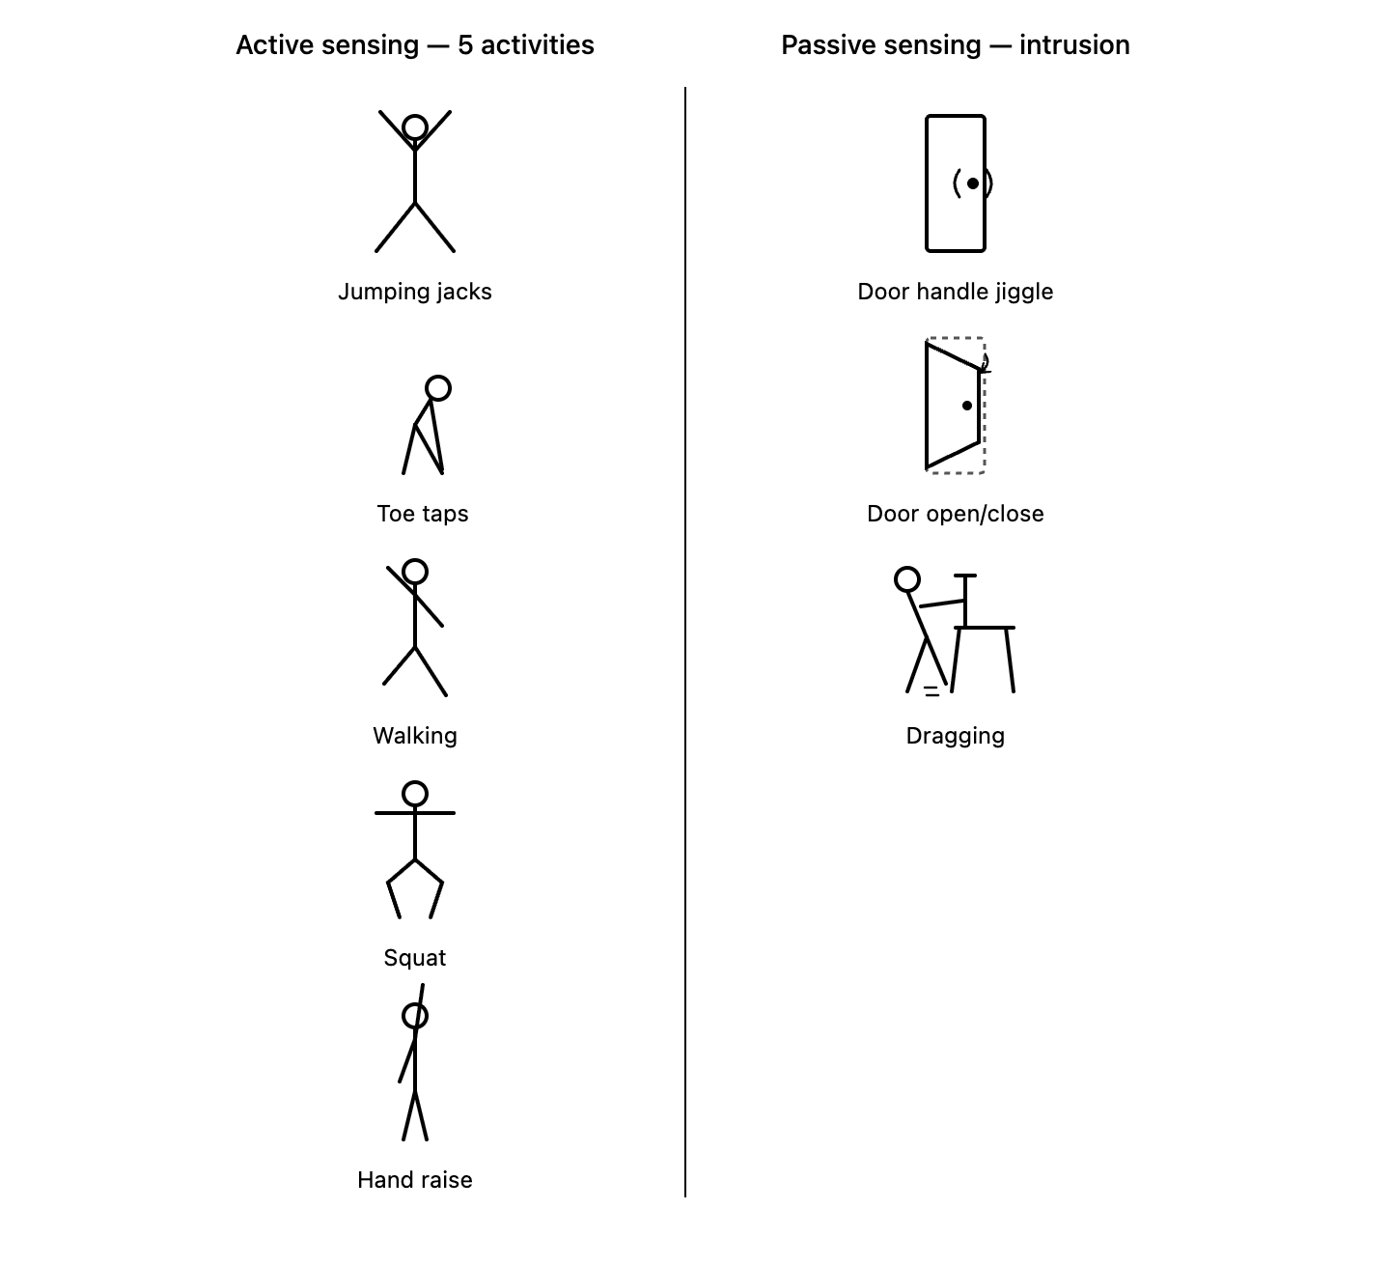
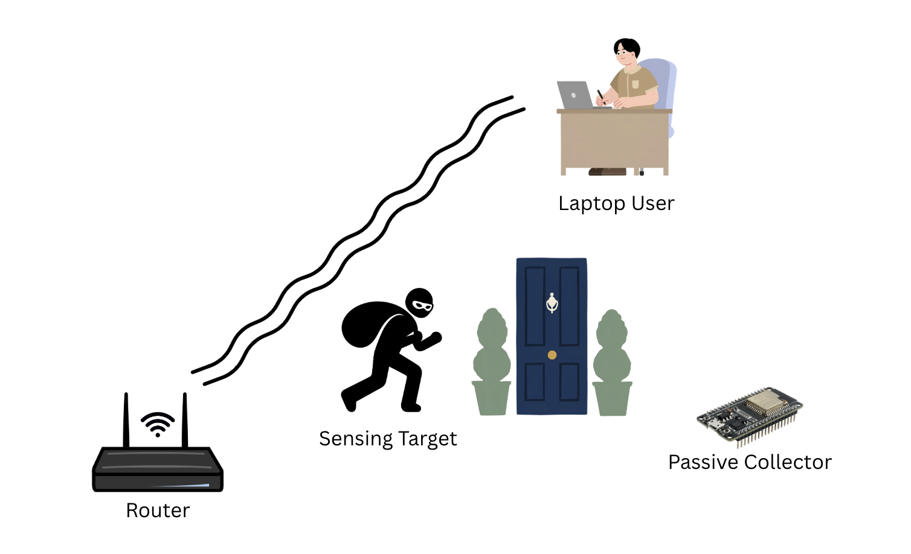
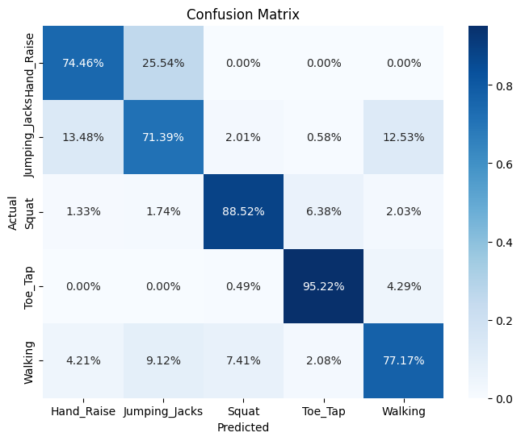
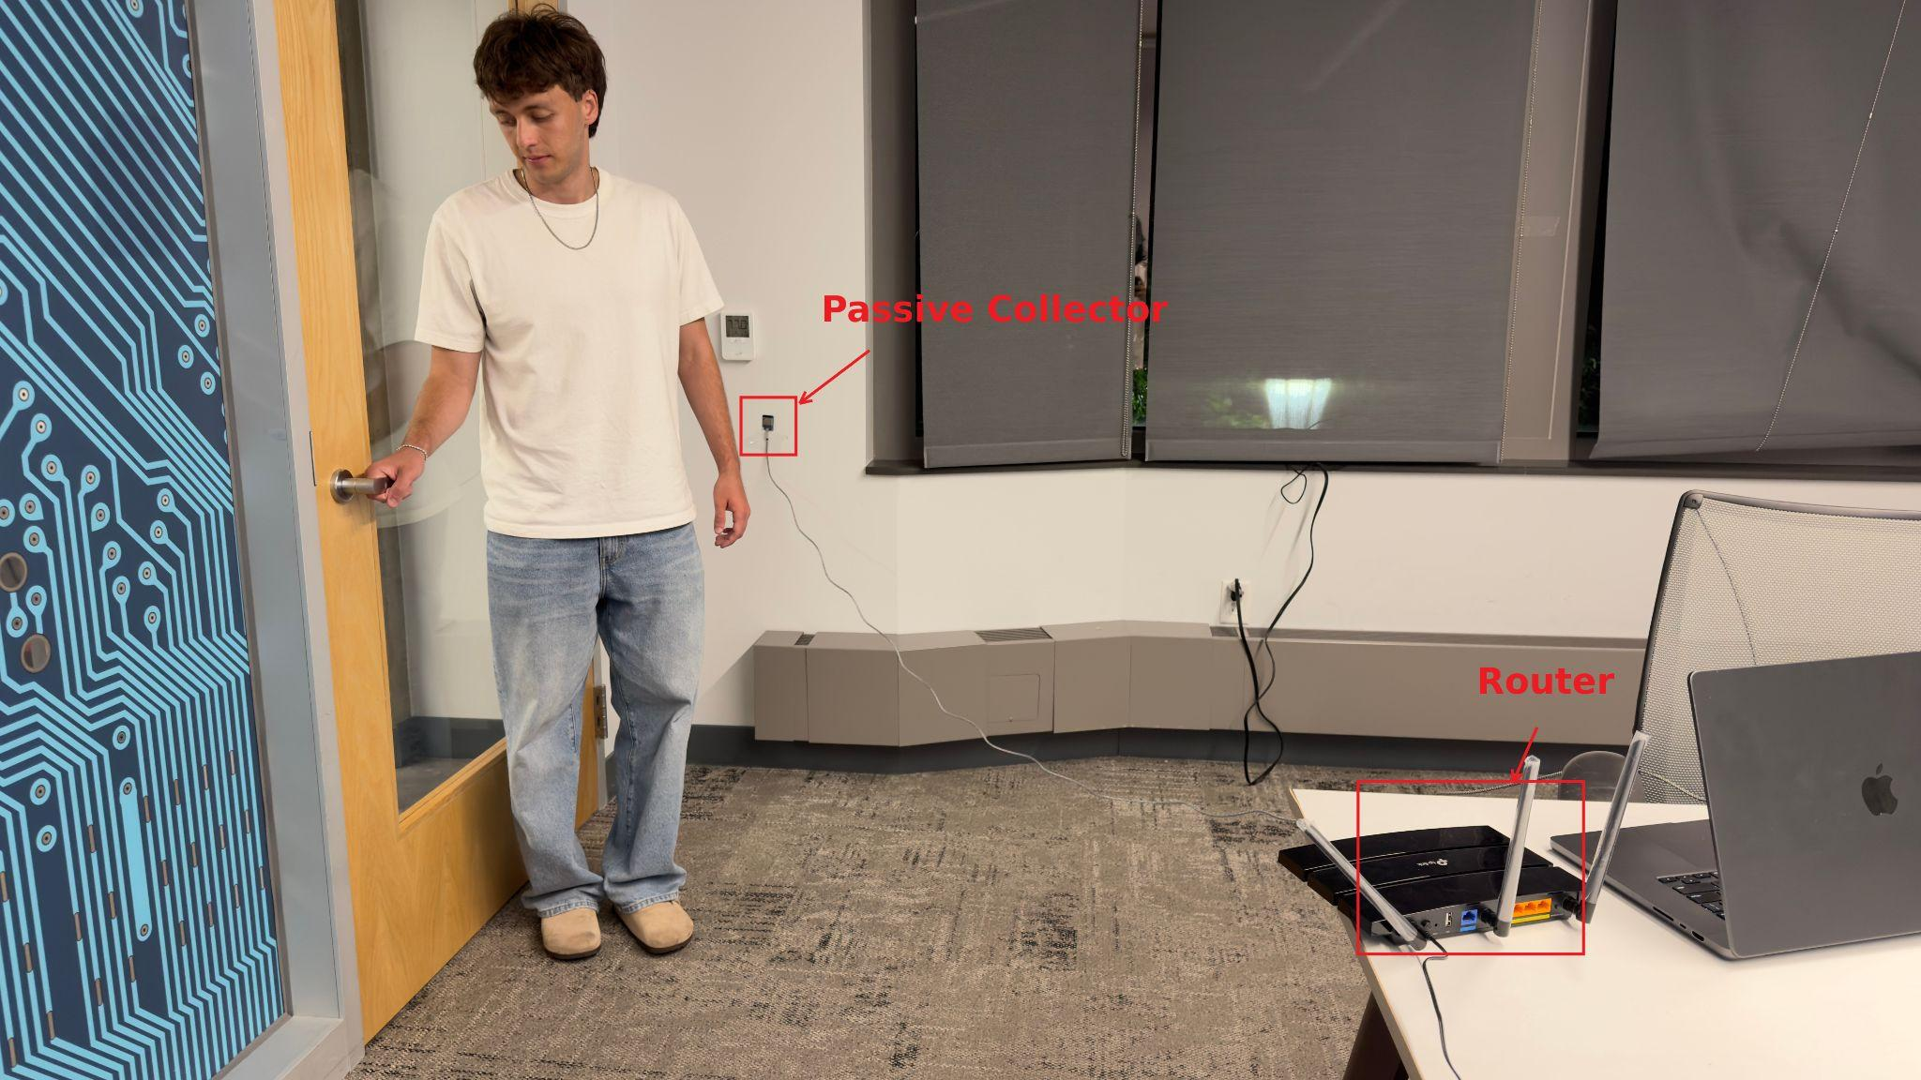
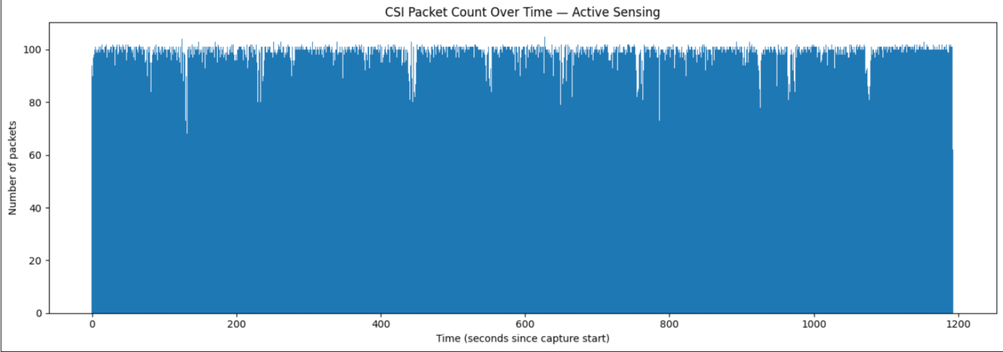
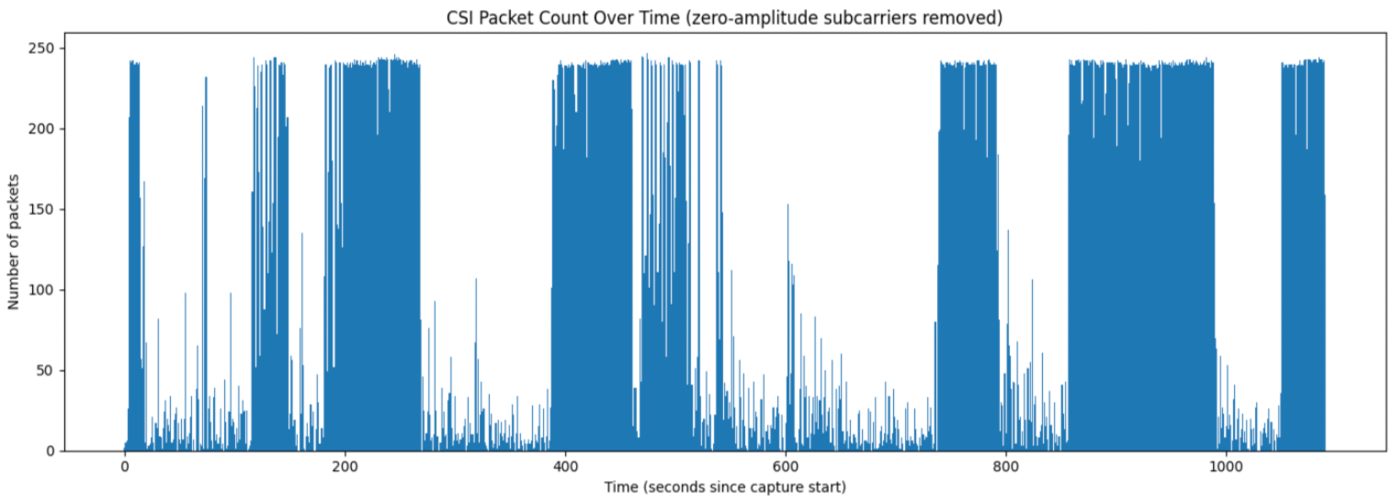
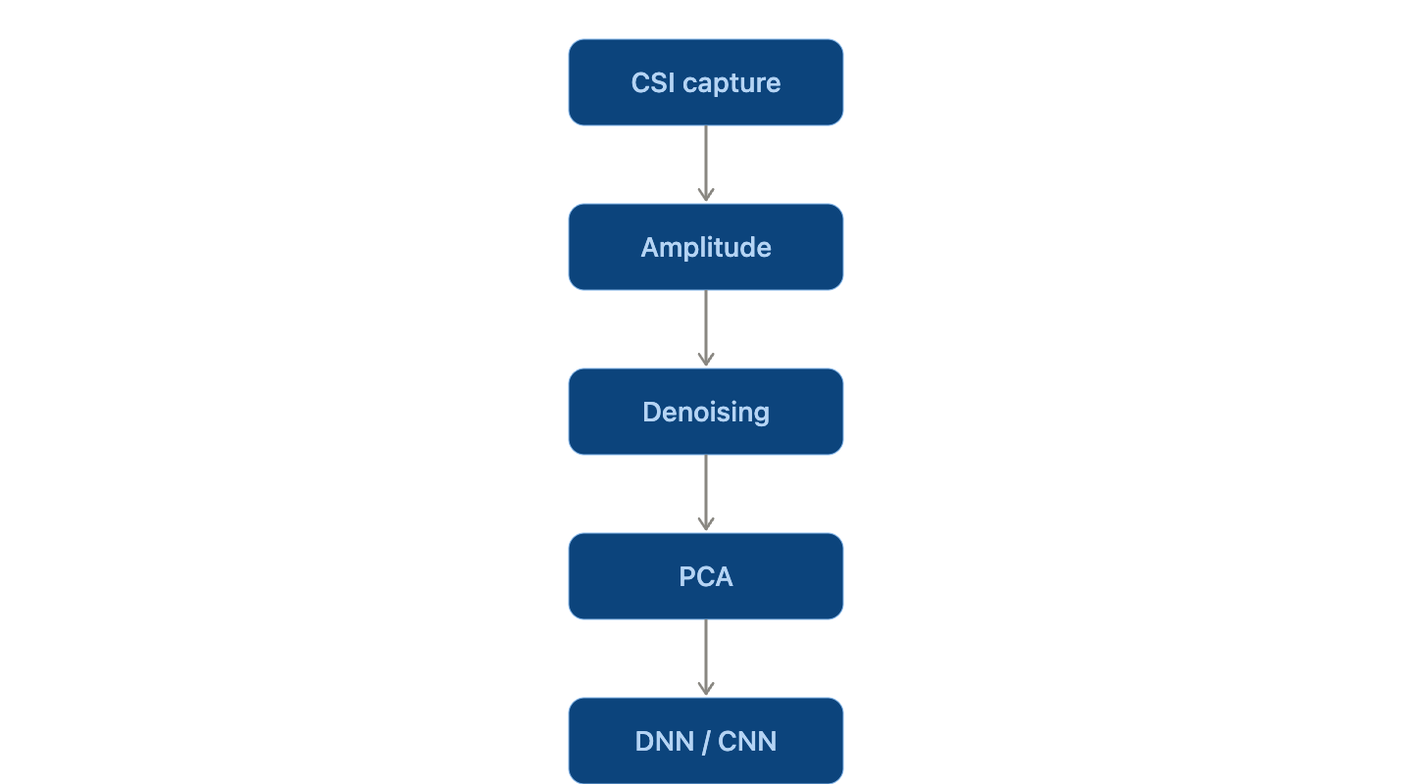
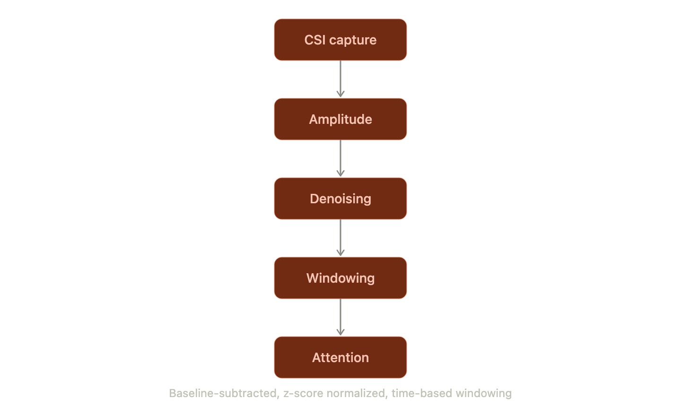
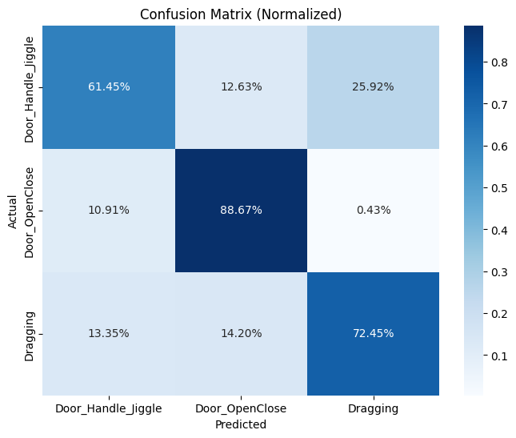
Communication-Aware Passive Wi-Fi Sensing Under Dynamic Traffic Conditions
Emirhan Kir [1], Nafeez Fahad [2], Eyuphan Bulut [2]
[1] Rowan University, Glassboro NJ
[2] Virginia Commonwealth University, Richmond VA
Introduction
Activities to Recognize
Suspicious Behaviour Detection
Passive Wi-Fi sensing is an emerging approach for inferring human activity from ambient Channel State Information (CSI), using existing Wi-Fi infrastructure without any dedicated sensors. While prior work has shown this is feasible in controlled settings, real world environments involve constantly shifting background network traffic that can distort CSI signals in ways largely unstudied.
Motivation:
Passive sensing depends entirely on ambient signals it cannot control, unlike active sensing setups
Background traffic such as streaming, downloads, and uploads is present in nearly every real deployment
No prior work has systematically measured how traffic type affects sensing accuracy
Contributions:
Systematic study of how traffic type (streaming, download, upload) impacts passive Wi-Fi sensing accuracy
Evaluation across multiple traffic conditions using a passive CSI sniffer to detect suspicious activities
Active Sensing Activities:
Passive Sensing Activities:
Figure 4. Sensing environment overview: router, sensing target, and passive collector.
Key Findings
Active sensing: whole-body motion using an ESP32 TX-RX link
Passive sensing: intrusion-relevant behaviors using only ambient Wi-Fi packets
10 repetitions per activity in randomized order, with rest periods for per-cycle baselines
Mixed background traffic (browse, upload, download, streaming, idle) active during all passive captures
Same room and equipment layout across both modes for direct comparison
Active sensing (5 activities): 81% accuracy
Passive sensing (3 intrusion behaviors): 75% accuracy, using only ambient WiFi packets with no dedicated transmitter
Traffic type causes a large swing in passive sensing accuracy. Streaming traffic starves the sniffer of packets, capturing about 10 times fewer than active sensing captures in the same amount of time.
Experimental Setup
Hardware:
ESP32 microcontroller running ESP32 CSI Tool in passive sniffer mode
Router configured to generate controlled background traffic conditions
Traffic conditions tested:
Mixed background traffic (browse, upload, download, streaming, idle) during all passive captures
Router-generated via scripted scenario generator
Detection Results
Traffic-Aware CSI Signal
Figure 1. Data collection setup
Figure 2. CSI packet count over time, active sensing
Sensing Pipeline
Figure 5. Confusion matrix: general activity recognition (81% accuracy)
Controlled Active Sensing:
Communication-Aware passive sensing:
Toe_Tap (95% recall) and Squat (89% recall) are detected most reliably. Jumping_Jacks is the weakest class (68% F1) and is most often confused with Hand_Raise, since both involve similar arm motion.
Figure 3. CSI packet count over time, passive sensing under traffic conditions
 | Active Sensing | Passive Sensing
Packet rate | ~100 pps, stable | 14–241 pps, bursty
Signal timing | Controlled by TX | Dictated by traffic
Depends on network? | No | Yes
Figure 6. Confusion matrix: intrusion behavior detection (75% accuracy)
Door_OpenClose is detected most reliably (88% recall). Door_Handle_Jiggle and Dragging are weaker (61–72% recall) and get confused with each other more often, since both are subtler, sustained motions.
This work is partially supported by the National Science Foundation under Grant Award Number 2447453
Table 1. Active vs. passive sensing characteristics (packet rate, signal timing, network dependence)

