Slide 1
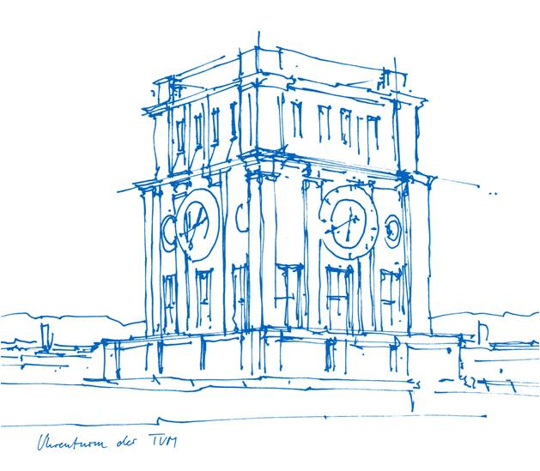
A Pipeline for Extracting Simple Rules from Medical Literature
for Automatic Disease Detection in Histopathology
Master‘s Thesis in Informatics
Emirhan Nadir Karaman
Technische Universität München
School of Computation, Information and Technology
Chair of Connected Mobility
Supervisor: Frederic Mrozinski, M.Sc.
Examiner: apl. Prof. Dr. Georg Groh
Munich, 11. August 2026
Notes:
Good morning, and thank you for coming. I'm Emirhan Karaman, and this is my Master's thesis,
supervised by Frederic Mrozinski and examined by Professor Groh.
The title is long, so let me split it. The input is medical literature - histopathology papers.
The output is "simple rules": small, typed, subject-outcome statements a pathologist could
actually check. The word doing the most work in that sentence is CHECK. Everything in the next
eighteen minutes follows from taking that word seriously.
[0:25] -> "Let me start with why that's hard."

Slide 2
Diagnostic knowledge is trapped in prose, and an LLM's word for it is not enough
Motivation and research gap
• Facts live in text: biomarker expression, morphology, prognostic direction
• LLMs can read at scale; but they hallucinate, omit qualifiers, and paraphrase
• A claim you cannot trace back to a source is not usable
• Components are mature in isolation; the audited end-to-end system is not
Auditability is a hard requirement, not a feature added afterwards
Notes:
Histopathology diagnosis rests on facts that live in prose. Which biomarker is expressed in which
tumour subtype; which morphological features support a diagnosis; whether a finding means a
better or a worse prognosis. Those facts exist - they are just scattered across thousands of
papers, and no pathologist can read all of them.
Large language models can. That is genuinely new. But the failure modes are exactly the ones that
matter here: they invent claims that look plausible, they drop the qualifier that made the claim
true, and they paraphrase until you can no longer find the original sentence. In a clinical
setting, a claim you cannot verify is not a weak result - it is not a result.
So the requirement is traceability, and here is the gap. Layout-aware PDF parsing, biomedical
entity linking, entailment checking, cost-aware model cascading - every one is mature on its own,
with its own benchmark and its own definition of success. What is rare is all of them combined
into a single auditable system, evaluated under a joint cost AND quality constraint.
(OPTIONAL - cut if behind: that combination is what this thesis asks about: where do off-the-shelf
tools already suffice, where does calibrated agreement help, and where does it justify its cost?)
[1:10] -> "I turned that into five questions, each with a number attached."

Slide 3
An LLM will answer. The problem is knowing whether to believe it
The research gap
• Modern models extract these claims fluently — and also hallucinate, omit, and paraphrase away the qualifier that mattered
• For a clinical use case, an unsourced claim is worthless. You need the sentence, the page, the coordinates.
• So provenance is not a feature bolted on at the end — it is a hard constraint that shapes the whole architecture
• And it forces two pipelines: you cannot trace a rule to a paragraph if the parser silently dropped the table that paragraph refers to
Notes:
[VISUAL DECK · unique — the provenance requirement, stated as the research gap]
This is the slide that justifies everything downstream. Land the last bullet properly — it is why document extraction is measured separately rather than assumed. [1:10]

Slide 4
Five research questions, each answered by a measurement
RQ1: Document extraction. How faithfully are text, tables, figures and captions recovered, and how much does the pipeline add over an off-the-shelf baseline?
RQ2: Knowledge extraction & provenance. What is the quality of the extracted findings and rules, and is provenance preserved end-to-end?
RQ3: Cost–quality trade-off. Is the agreement-based cascade worth its cost against a single strong model?
RQ4: Grounding & relation classification. How does one shared biomedical NLI model perform in both roles?
RQ5: Held-out generalization. Does a configuration calibrated on one set of papers transfer, or does it overfit?
RQ2–RQ5 are measured against LLM-generated silver labels: agreement with the labeler, not with ground truth
Notes:
Five questions. RQ1 is the document layer: how faithfully do we recover text, tables, figures and
captions, and - importantly - how much of that is MY pipeline rather than the off-the-shelf tool
underneath it. RQ2 asks about the knowledge layer and about provenance. RQ3 is the cost question,
and it is where the interesting result lives. RQ4 asks whether one frozen NLI model can do two
different jobs. RQ5 asks whether the calibration overfits.
One caveat up front, because it conditions everything after RQ1. The reference labels for RQ2
through RQ5 were generated by a strong LLM - Claude Opus 4.7 - not by a human expert. So those
scores measure AGREEMENT WITH THE LABELLER. I will flag that again where it bites, and I have a
slide on it at the end. RQ1 is the exception: those labels are human, annotated against a written
rubric.
[0:50] -> "Here is the system those questions are asking about."
JUMPS — if asked:
the exact RQ wording → B1, slide 25

Slide 5
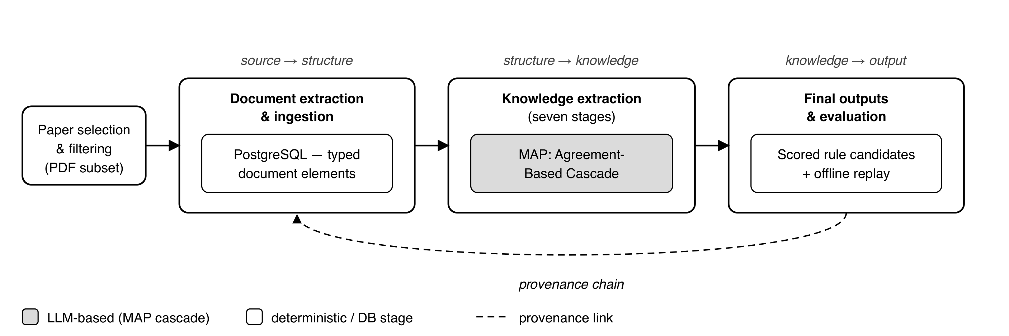
Two pipelines, joined by a database that carries provenance
End-to-end architecture
PMC Open Access PDFs → 977 ingested papers → typed, traceable rule candidates
Provenance chain: final rule → canonical rule → normal finding → MAP finding → text element → document (page, span, coordinates)
Notes:
Four stages. We select and filter histopathology papers from the PMC Open Access subset - 977 make
it into the database. Document extraction turns each PDF into hierarchical text, figure crops and
table crops. Knowledge extraction turns sentences into typed findings and then into rules. And
everything is written to artifacts that let me replay the whole evaluation offline.
The thing I want you to take from this diagram is the database in the middle. It is not storage -
it is the provenance backbone. Every object carries back-pointers, the chain at the bottom of the
slide. That chain is enforced by the data model, so it cannot silently break.
One honest caveat I will repeat later: provenance enables auditability. It is NOT proof of
correctness. It tells you where a claim came from, not that the claim is true.
(OPTIONAL: the system deliberately emits rule CANDIDATES for expert review; it does not aim to
produce clinical rules autonomously.)
[1:15] -> "Let's start at the bottom of that stack - turning a PDF into something structured."
JUMPS — if asked:
corpus size, the page cap → B2, slide 26

Slide 6
Two pipelines, joined by a database that carries provenance
End-to-end architecture
Only the MAP stage is stochastic. Everything else is deterministic or a database operation.
Notes:
[VISUAL DECK · figure — architecture diagram]
Walk left to right once. Document extraction turns PDFs into typed elements in PostgreSQL; knowledge extraction turns those into scored rules. The dashed line is the provenance chain — the thing that makes RQ2 answerable.
Say explicitly that the grey box is the only place a language model is involved. [1:10]

Slide 7
Docling plus three targeted fixes, each aimed at a named failure
Docling backbone: sole source of body text, section structure and figure regions
• Hybrid table detection: Docling + TATR, overlapping boxes merged by union
targets tables Docling never proposes, e.g. split across a page boundary
• Footnote expansion: table crop extended downward ×1.2
targets footnotes cut off below a tight crop
• Figure post-processing: icon filter (<50 pt) and a geometric caption matcher
targets logos emitted as figures, and captions attached to the wrong figure
• Two-pass ghost-text removal: invisible text redacted, layout re-extracted
Input is the PDF only: never JATS-XML, by design
Notes:
The backbone is Docling, an open-source layout-aware parser, and it stays the sole source of body
text, section structure and figure regions. I did not replace it - I measured it and then fixed
what it got wrong.
Three fixes. First, table detection: I run Microsoft's Table Transformer alongside Docling and
take the union of overlapping boxes. Threshold-free - any two boxes that overlap at all are merged
into their bounding union. Second, footnote expansion: Docling crops tables tightly and cuts the
footnotes off, so I extend the crop downward by twenty percent. That sounds trivial. It is the
single biggest lever in the entire document layer, and I will show you the number shortly. Third,
figure post-processing: a size filter dropping anything under fifty points and my own geometric
caption matcher instead of Docling's default. (A sub-figure merge step also exists in the code.
After submission I found it never executes - see the sub-figure audit slide - so I do not claim it as
a contributor.)
The fourth item is the two-pass extractor. Some publisher PDFs carry invisible OCR text underneath
the visible text. I detect those elements by rendering the region and testing the pixels, redact
the underlying text objects, and re-run Docling on the cleaned PDF.
(OPTIONAL: one deliberate choice - the pipeline never reads JATS-XML, even when PMC provides it.
It is built to work from the PDF alone, so it transfers to literature where structured XML does
not exist.)
[1:00] -> "That's the description. Here is what one of those failures actually looks like."
JUMPS — if asked:
the icon filter → E1, slide 41
caption matching → E2, slide 42
header/footer/sidebar masking → E7, slide 47
the sub-figure merge correction — volunteer this → the audit slide, slide 24

Slide 8
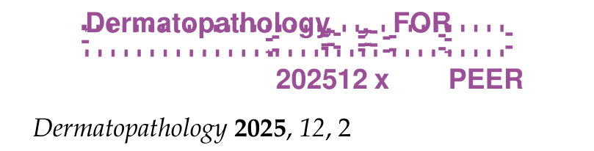
Two-pass extraction removes an invisible “FOR PEER REVIEW” header
PMC11755463 p2 · rule R1_blank_pixels · 45 of 67 nodes on this page rejected
The purple boxes are text Docling extracted. None of it is visible in the rendered page.
The publisher left the pre-publication header “Dermatopathology 2025, 12, x FOR PEER REVIEW” in an invisible layer, on top of the real one.
Detection is pixel-based: render the element's bounding box, test whether anything was actually drawn. 7,595 of 9,836 rejections corpus-wide come from this rule.
Notes:
This is the fault mode nobody sees, because by definition you cannot see it.
The purple boxes are text elements Docling extracted from this page. Render the page and none of
it is there. What happened is that the publisher left the pre-publication running header in the
file as an invisible layer - "Dermatopathology 2025, 12, x FOR PEER REVIEW" - sitting directly on
top of the real published header, which reads "2025, 12, 2". The "x" is the unassigned article
number.
Docling has no way to know. It reads the text layer, and the text layer says both.
My detection is pixel-based rather than font-based: for each element, render its bounding box and
test whether anything was actually drawn there. If the region is blank, the text is invisible, and
the underlying text objects get redacted before a second Docling pass. That rule -
R1_blank_pixels - accounts for 7,595 of 9,836 rejections across the corpus.
Why this matters for the thesis rather than just being tidy: every one of those fragments would
otherwise become a sentence, get chunked, and be sent to a language model as if it were content.
[1:15]
JUMPS — if asked:
how ghost text is detected → E3, slide 43
what else gets redacted → E7, slide 47

Slide 9
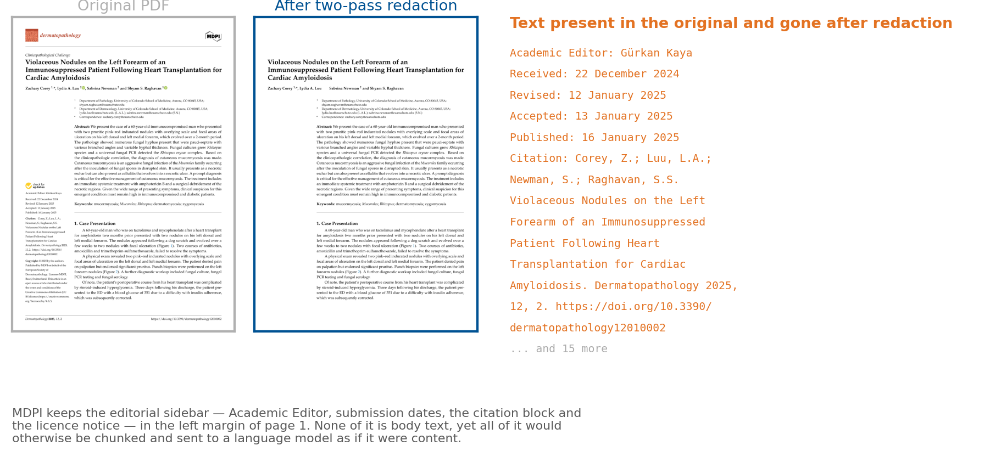
Published PDFs are adversarial in ways nobody warns you about
Left: the page as published. Right: what the pipeline redacts before reading it.
Running headers, footers and side matter are removed geometrically, before any text assembly.
Notes:
[VISUAL DECK · figure — header/footer/sidebar redaction]
This is the slide that earns the document-extraction half of the thesis. Nobody expects a PDF to be hostile.
Point at the sidebar: 'Academic Editor', received and accepted dates, the citation block. All of it would otherwise land in the body text and be extracted as if it were a finding. [1:10]

Slide 10
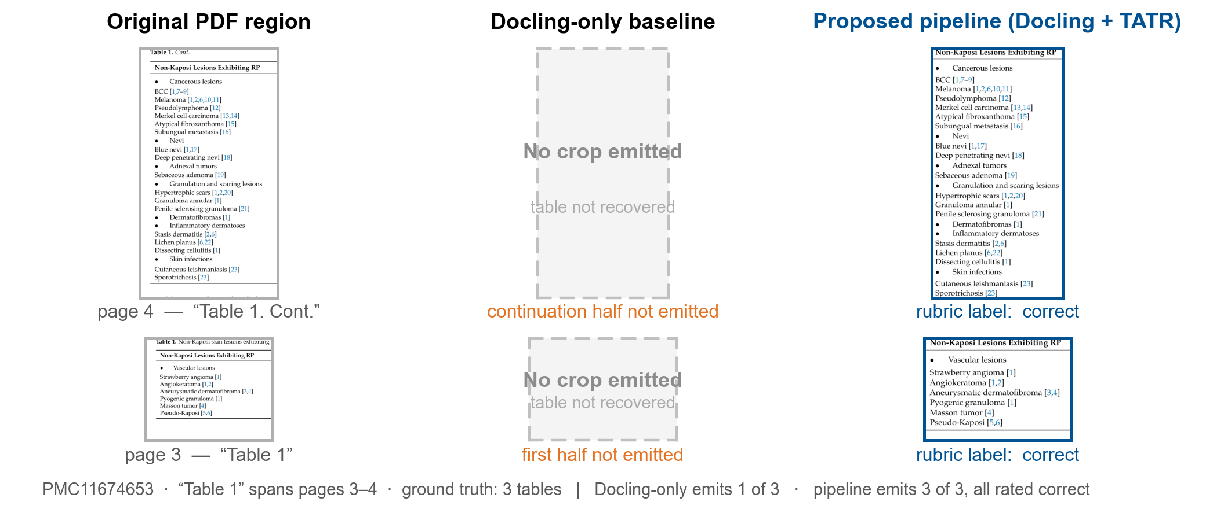
Illustrative extraction example from the evaluation corpus
Illustration only, not additional evaluation evidence. The quantitative result is on the next slide.
Notes:
This slide is an illustration, not evidence - and it says so at the bottom. The evidence is the
rubric numbers on the next slide. What this does is show you what those numbers MEAN.
One paper from the 27-paper rubric set. It has three tables. One of them, Table 1, starts on page
3 and continues onto page 4 under the heading "Table 1. Cont." - a completely ordinary journal
convention.
Left column: the region as it appears in the PDF. Middle: what the Docling-only configuration
emitted for those two regions - nothing. It emitted one table for this paper, the one on page 7.
Both halves of Table 1 were never recovered. Right: the hybrid detector emits both halves, and my
annotation of them under the rubric is "correct" for each.
The failure mode generalises: page-by-page detection means a table spanning a page boundary looks
like two partial tables, and a detector tuned for whole tables proposes neither. That is precisely
the gap the second detector fills.
[1:20] -> "Multiply that across 27 papers and four scoring dimensions, and you get RQ1."
JUMPS — if asked:
paragraph stitching → E4, slide 44
citation stripping → E10, slide 50

Slide 11
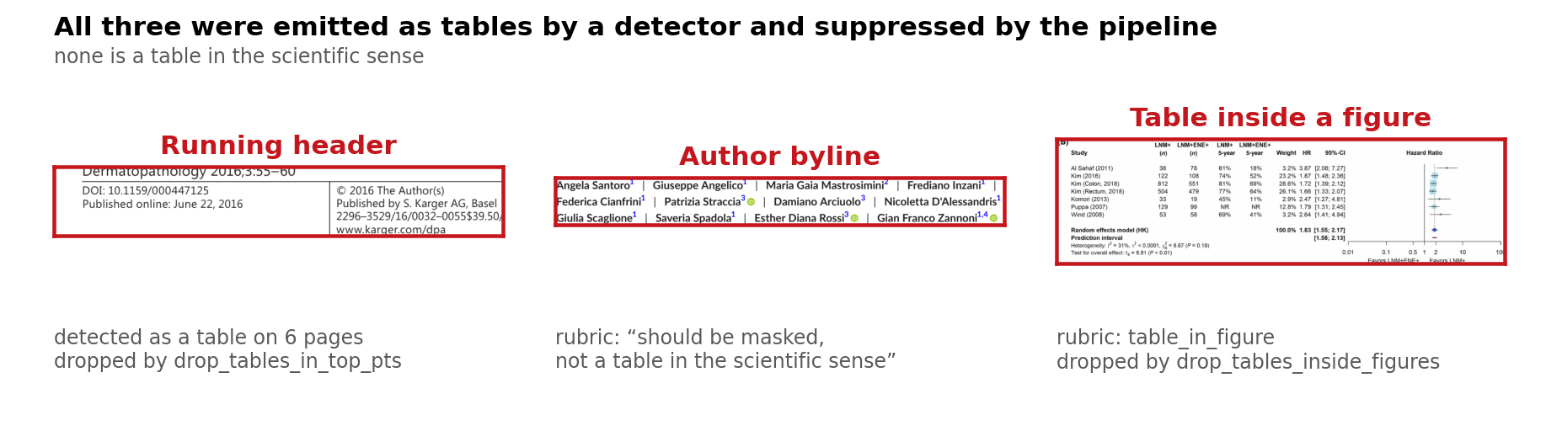
Three things a detector called a table, and none of them is one
Detector false positives, suppressed by the pipeline
A journal masthead, an author byline, and a table nested inside a figure.
Notes:
[VISUAL DECK · figure — three detector false positives]
Precision matters as much as recall here. Every false table is a region of text removed from the body — so a spurious detection does not just add noise, it deletes real content. [1:00]

Slide 12
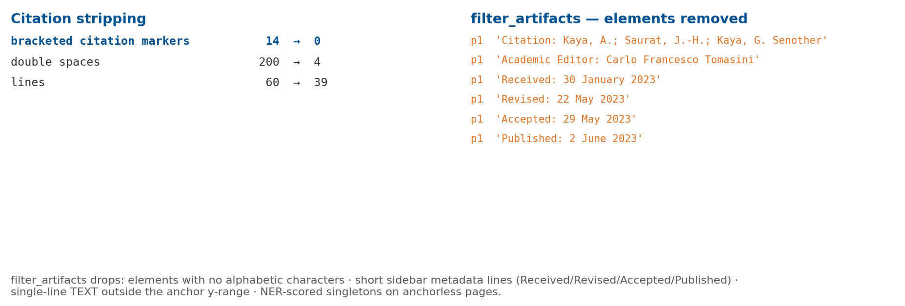
Text assembly also strips citations and layout artifacts
out/text_raw (pre-assembly) vs out/text (assembled)
Citation markers, hyphenation across column breaks, and ligature codepoints are all normalised before a sentence reaches the model.
Notes:
[VISUAL DECK · figure — citation and artifact stripping]
Small, unglamorous, and load-bearing: the model sees clean sentences, so a verbatim quote it returns can actually be matched back against the source. Without this, provenance checking fails on formatting noise. [1:00]

Slide 13
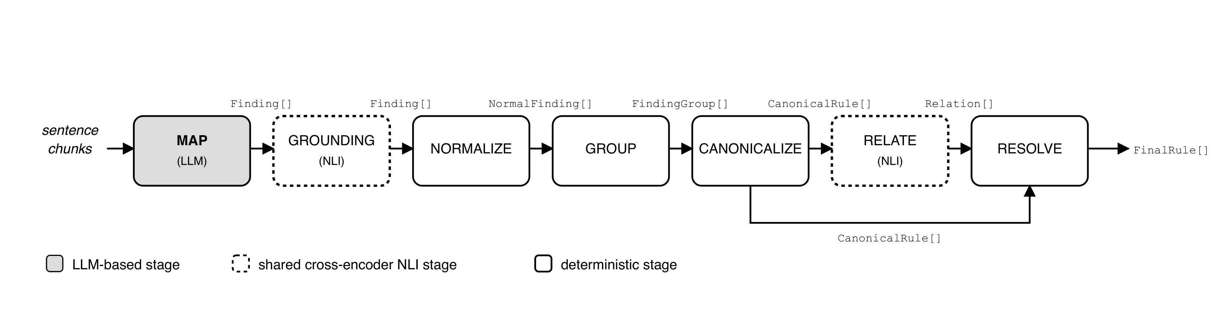
Seven stages, only the MAP stage is stochastic
MAP → GROUNDING → NORMALIZE → GROUP → CANONICALIZE → RELATE → RESOLVE
Only MAP calls a language model. Every later stage merges, selects or scores; it never invents.
Typed MAP finding: claim · subject/outcome entity · relation type · direction · category · scope · verbatim evidence · confidence
The verbatim support is overwritten with the source text looked up from the database. A quoted span cannot be hallucinated.
Notes:
Seven stages. MAP is the only one that calls a language model - it reads a window of ten
consecutive sentences and emits typed findings against a strict Pydantic schema: a claim, subject
and outcome entities, a relation type, a polarity direction, a category, scope fields like tissue
site and assay method, and a verbatim evidence span.
Then GROUNDING checks each claim against the paragraph it cites, using an NLI model. NORMALIZE
maps entity names to canonical forms and UMLS concept IDs and deduplicates. GROUP collects
findings sharing subject, outcome, relation type and category. CANONICALIZE picks one
representative per polarity direction - one bin per direction, including "unclear", which makes it
lossless. RELATE finds support and contradiction between claims. RESOLVE scores the final rules.
The line to underline is the bold one. After MAP, nothing generates text. Every downstream stage
is deterministic - it merges, selects, or scores. That is the structural reason the provenance
chain survives to the end. And one specific safeguard: after MAP returns, I overwrite the model's
verbatim quote with the actual source text from the database, so the evidence string reflects the
real paragraph rather than a possibly invented quotation.
[1:05] -> "MAP is the stochastic step and the expensive one - so that's where the cascade goes."

Slide 14
Seven stages, and only the first one is stochastic
MAP → GROUNDING → NORMALIZE → GROUP → CANONICALIZE → RELATE → RESOLVE
Everything after MAP is deterministic — the same inputs give the same rules, every run.
Notes:
[VISUAL DECK · figure — the seven-stage pipeline]
The design principle: push all the nondeterminism into one stage, then make everything downstream reproducible.
NORMALIZE resolves entity names through a curated synonym dictionary, then UMLS — the biomedical terminology database — then an identity fallback. That ordering is deliberate: a clinician's mapping beats the automated linker. [1:10]

Slide 15
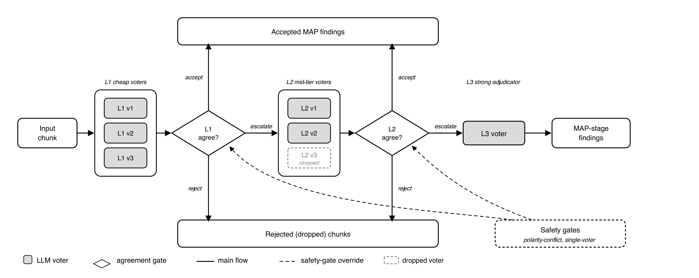
Cheap voters decide; the strong model is called on disagreement
Agreement-based cascading at the MAP stage, integrated and calibrated after Kolawole et al. (2025)
L1 – 3 cheap voters
Gemini Flash-Lite · GPT-4o mini · GPT-4.1 nano: parallel, every chunk
L2 – 2 mid voters
Gemini Flash · GPT-4.1 mini: only on L1 disagreement
L3 – Claude Sonnet 4.6
unconditional accept, no scorer applied
accept if s ≥ θ · reject if s ≤ θ_reject · otherwise escalate
All voters at temperature 0: diversity comes from providers, not from sampling
Notes:
The cascade sits on MAP. Three cheap voters from OpenAI and Google run in parallel on every chunk.
A scorer measures how much they agree: it builds a pairwise similarity matrix, takes each voter's
mean similarity to the others, and the agreement score is the MAXIMUM of those means - so the
winning output is the one most aligned with the consensus.
That score drives a three-way decision. Above theta, accept the winner and stop. Below a reject
threshold, emit nothing. In between, escalate. Escalation runs the two mid-tier voters, and if
they still disagree it goes to Claude Sonnet, whose output is accepted unconditionally - no scorer
is applied at level three.
Two design points that matter for the results. First, every voter runs at temperature zero. The
diversity here is PROVIDER diversity, not sampling noise - a deliberate choice, and it turns out
to be the cascade's most defensible property. Second, and I flag it now because it predicts the
negative result: if the cheap voters disagree often, you pay for them AND for the strong model.
The cascade is only cheaper than always calling the strong model if agreement is common. Hold that
thought.
(OPTIONAL: there are also three safety gates - a polarity-conflict hard-fail forcing escalation
when two voters give opposite polarity, a single-voter policy, and a citation-provenance screen.
Their purpose is safety, not strict-F1; backup slide B8 has the numbers.)
[1:10] -> "That's the system. Now - how do you evaluate it honestly?"
JUMPS — if asked:
the pinned cascade config → B7, slide 31

Slide 16
Cheap voters decide; the strong model is called only on disagreement
Agreement-based cascading at the MAP stage
Five voters across three providers. Escalation happens when they disagree, not on a schedule.
Notes:
[VISUAL DECK · figure — the ABC cascade]
This is the core mechanism, so take it slowly.
Three cheap models read the same chunk. If they agree, we accept and stop. If they disagree, two mid-tier models get it. If those disagree, Claude Sonnet adjudicates and always emits.
The bet is that agreement among cheap models is a usable proxy for confidence — and the whole cost argument rests on whether that bet pays. [1:20]

Slide 17
How the agreement scorer picks a winner
Max-consensus over an N×N similarity matrix, no ground truth involved
• Each voter returns a set of typed findings for the chunk
• Align every pair of voters one-to-one, then score the alignment: the `hybrid` scorer blends four signals:
0.50 biomedical entity overlap 0.30 claim-embedding similarity
0.15 category agreement 0.05 cited-evidence overlap
• Each voter's score = its mean similarity to the others; the chunk's agreement score = the maximum of those means
• The winner is the most consensus-aligned voter. Ties break on grounding quality: fraction of findings with a non-empty evidence chain, then sources per finding.
The score measures agreement, not correctness. Voters can agree, and all be wrong, which is exactly why GROUNDING runs afterward.
Notes:
This is the machinery behind the accept/reject/escalate decision, and it is worth being precise
because the whole cost argument rests on it.
Every voter returns a set of typed findings - not a string, a set of structured records. So
"do they agree?" is not string comparison. I align the two sets one-to-one and score the
alignment. The scorer that won calibration blends four signals, and the weights are on the slide:
entity overlap dominates at 0.50, claim embedding 0.30, category agreement 0.15, and cited
evidence 0.05. That entity-heavy weighting was selected empirically, not chosen by hand.
Then, for each voter, take its mean similarity to all the others. The chunk's agreement score is
the maximum of those means, and the winner is the voter that achieved it - the most
consensus-aligned output. Ties break on grounding quality: how many findings carry a real evidence
chain.
The line I would underline is the last one. This measures agreement, not correctness. If all five
voters share a misconception they will agree strongly and the cascade will accept confidently and
cheaply. Nothing in the scorer detects that. That is precisely why grounding runs afterwards
against the source text, and why I kept the grounding filter even though it costs six strict-F1
points.
[1:15]
JUMPS — if asked:
scorer internals, degenerate voter counts → E11, slide 51

Slide 18
Grounding: every claim is checked against the sentence it cites
One frozen NLI model, no fine-tuning
• MAP returns a claim plus the verbatim sentence it came from
• An NLI model scores entailment on that pair; below 0.5 the finding is dropped
• The model is PubMedBERT-MNLI-MedNLI, frozen — no fine-tuning, and the same model is reused later for relation classification
• This is the check that catches a fluent, well-formed, unsupported claim
Notes:
[VISUAL DECK · unique — grounding as its own slide]
Grounding is where an unsupported claim dies, and it costs real recall — six strict-F1 points, which I report rather than hide.
I kept it anyway. An ungrounded rule in this domain is worse than a missing one. [1:00]

Slide 19
Four frozen datasets: one human-labeled, three LLM-labeled
Dataset | Size | Construction | Labels | RQ
Ingested corpus | 977 papers | PMC OA keyword filter, single-PDF, ≤30 pages | — | —
Doc-extraction rubric set | 27 PDFs | manually selected, frozen, disjoint | human (1 annotator) | RQ1
related15 calibration | 15 papers · 454 cases · 2,223 silver | exhaustive ILP over inter-paper relatedness | silver (Opus 4.7) | RQ2, RQ3
heldout15 evaluation | 15 papers · 285 cases · 1,657 silver | random sample, disjoint from calibration | silver (Opus 4.7) | RQ5
Relation claim pairs | 300 pairs (100 per class) | generated label-first, independent of corpus | synthetic silver | RQ4
Only RQ1 rests on human labels. RQ2–RQ5 measure agreement with Claude Opus 4.7.
Notes:
Four frozen datasets, and I want the disclosure on the table before any result.
The corpus is 977 histopathology papers from PMC Open Access. The rubric set for RQ1 is 27 PDFs I
annotated by hand against a written four-dimension rubric - the only human labels in the thesis,
and I annotated them alone, which I come back to as a limitation.
The calibration cluster is fifteen papers selected by an integer linear program maximising
pairwise relatedness, so the cascade is calibrated on papers that genuinely share vocabulary. The
held-out set is fifteen more, sampled randomly and disjoint. And the relation-classifier set is
three hundred synthetic claim pairs, a hundred per class, generated label-first - the label was
chosen and then a pair was written to fit it.
The orange column is the honest part. For everything except RQ1, the reference labels come from
Claude Opus 4.7. So when I say strict-F1 of 0.716, that means agreement with Opus. It is not
agreement with a pathologist. That bound cannot be lifted by any experiment in this thesis, and it
is the first thing I would fix with more time.
Note also: 2,223 is the count of SILVER findings. The 2,294 you will see on the next slide is the
count of PIPELINE findings. Different quantities.
[1:10] -> "Starting with the one place I do have human labels - RQ1."
JUMPS — if asked:
why these 15 papers → B3, slide 27
how a finding is matched to silver → B6, slide 30
Chain: this slide → B6 → B3 if they push on whether silver is trustworthy.

Slide 20
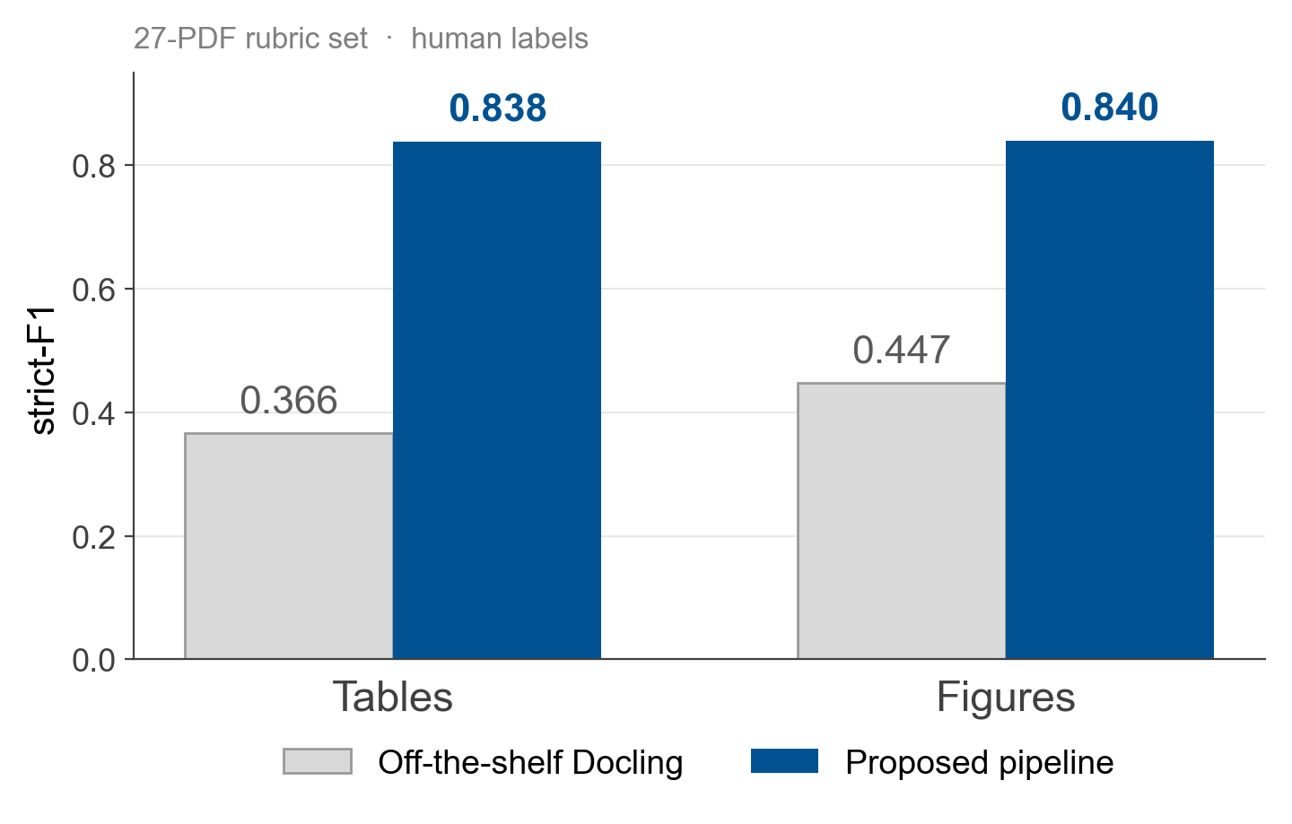
RQ1: Footnote capture and figure post-processing roughly double strict-F1
27-PDF rubric set · human labels · strict-F1 requires every applicable dimension to be perfect
• Tables 0.366 → 0.838. The lever is footnote precision, 43.8% → 91.4%
• Detector alone 0.400 → 0.420 · + footnote expansion 0.800 · + hybrid and geometry fixes 0.838
• Figures 0.447 → 0.840. Icon filter (63 crops) and caption matching (16 fixes)
• Decorative-icon false positives 73 → 14; emitted crops 139 → 76
Cost of footnote expansion: table mask-F1 94.3% → 91.9%
Notes:
This is the only slide backed by human labels, and the metric is deliberately harsh. Strict-F1
counts a table as a true positive only if it scores perfectly on EVERY applicable dimension - crop
geometry, caption, footnote, and masking. A near-miss earns zero. No partial credit.
Tables go from 0.366 to 0.838. Figures from 0.447 to 0.840. Roughly double, on both.
But the attribution matters more than the headline. Adding the second table detector on its own
moves strict-F1 from 0.400 to 0.420 - almost nothing. Adding footnote expansion on its own gets
you to 0.800. The two together give 0.838. So the dominant lever is FOOTNOTES: footnote precision
goes from 43.8 to 91.4 percent. The hybrid detector is not what produced the headline - it
recovers tables missed entirely, like the split table you just saw, which is a smaller population
but the one that matters for recall.
For figures the gain is post-processing rather than detection: the decorative-icon filter cuts
false positives from 73 to 14, and my caption matcher takes correct captions from 61 to 90 percent.
Those two mechanisms account for the whole 139 -> 76 reduction. The thesis names a third,
sub-figure merging; after submission I verified it never runs. The sub-figure audit slide has the evidence.
One honest cost on the bottom line: expanding table crops downward slightly hurts masking -
mask-F1 drops from 94.3 to 91.9 - because a larger crop sometimes covers text that should have
stayed. I took that trade knowingly.
[1:10] -> "So the document layer works. What does the knowledge layer produce on top of it?"
JUMPS — if asked:
the rubric → B4, slide 28
the full sweep → B5, slide 29
detector false positives → E8, slide 48
what the baseline missed → E9, slide 49
the figure-gain correction — volunteer this → the audit slide, slide 24
Chain: this slide → B4 → B5 → E8/E9 for depth on document extraction.

Slide 21
RQ1: the targeted fixes roughly double strict-F1 on tables and figures
27-PDF rubric set · human labels · strict-F1 requires every applicable dimension to be correct
Strict means no partial credit: a crop with the right region but a missing footnote scores zero.
Notes:
[VISUAL DECK · figure — RQ1 strict-F1]
Name the rubric first — four dimensions, no partial credit, human-labelled. Then the numbers.
If asked whether the rubric was designed after seeing the results: it was fixed first, and the sweep was run against it. [1:10]

Slide 22
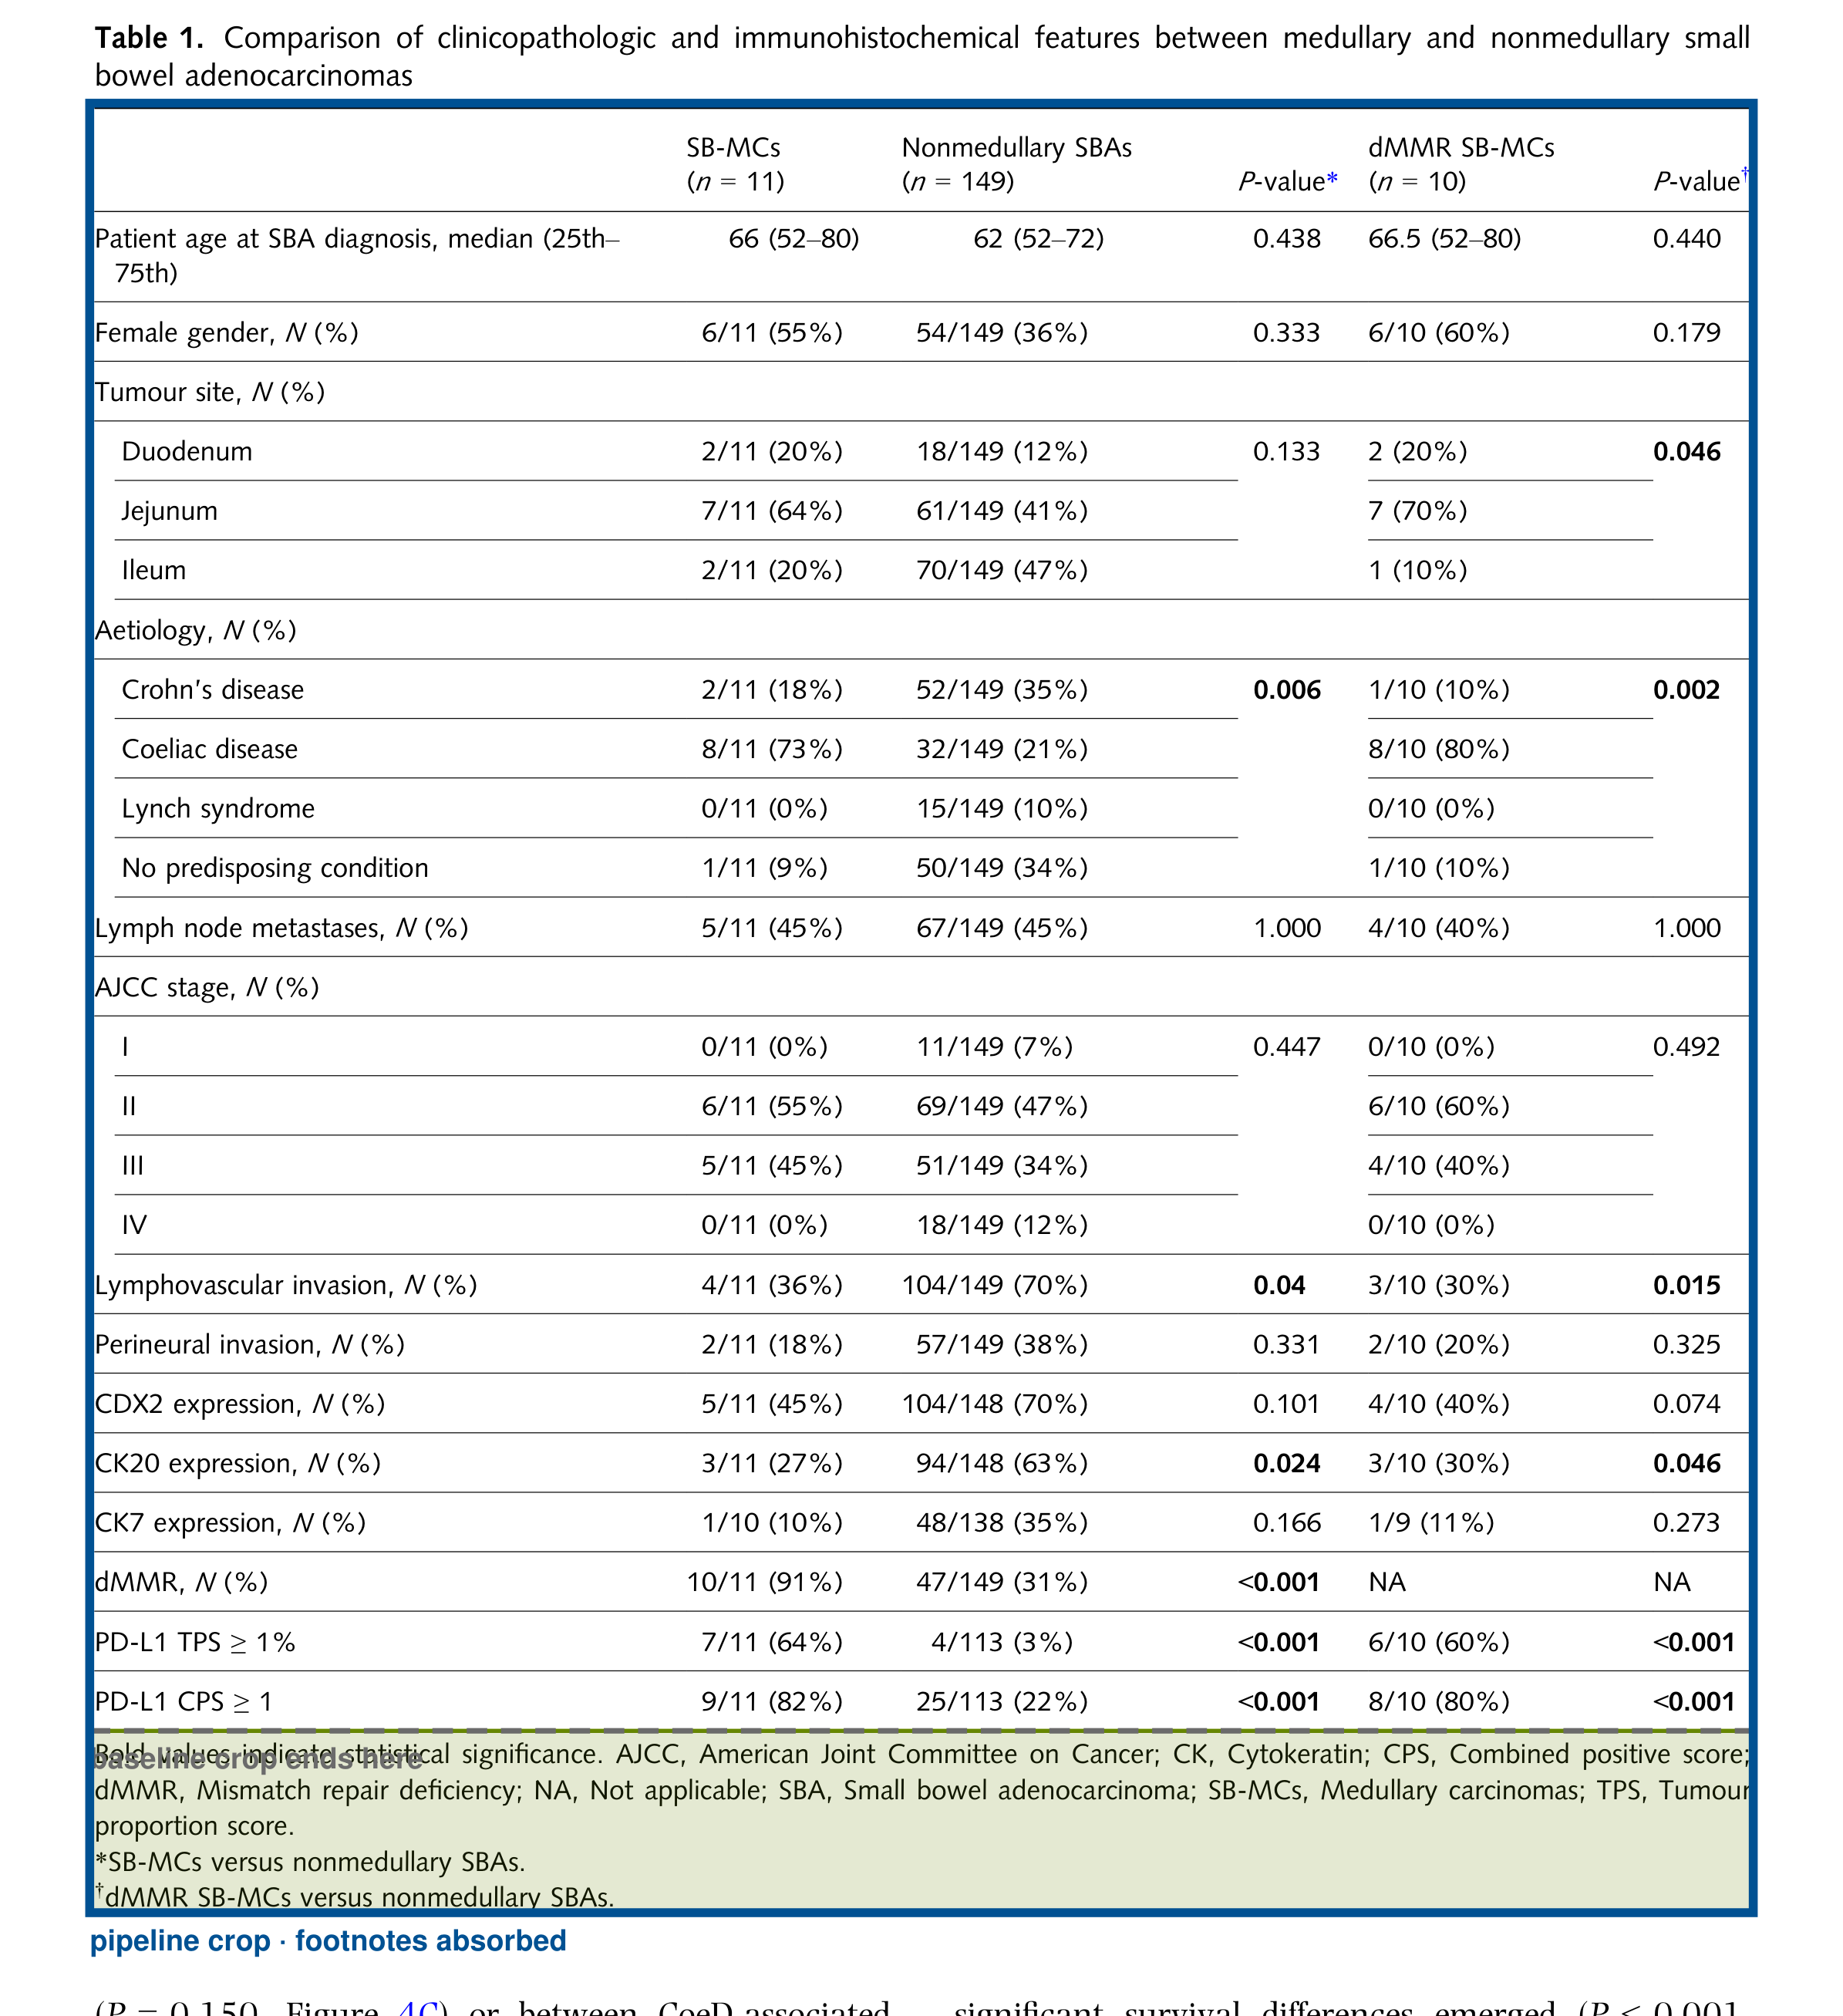
Footnote expansion is the single biggest lever in the document layer
PMC11649516_HIS-86-236 p5 · rubric label 'missing footnotes' → 'correct'
43.8% → 91.4%
footnote precision, 27-PDF rubric
• Crop grows 1320 → 1468 px (+11%)
• 14 regions fixed on the rubric set
• Alone it takes strict-F1 to 0.800
Cost: mask-F1 94.3% → 91.9%, because a larger crop sometimes covers text that should have stayed.
Notes:
This is the mechanism behind the RQ1 headline, and it is almost embarrassingly simple: extend the
table crop downward by twenty percent and re-check what falls inside.
The green band is what the pipeline added. Everything in it is the footnote block - the
significance note, the abbreviation key, the two dagger footnotes. Docling's crop stops at the
last data row, which is a perfectly reasonable definition of "the table" and completely wrong for
downstream use: those footnotes carry the abbreviation expansions and the significance markers
that make the numbers interpretable.
Footnote precision goes from 43.8 to 91.4 percent. On its own this one change takes table
strict-F1 from 0.400 to 0.800 - it is worth more than the second detector by a wide margin.
And the honest cost is on the right in orange: a bigger crop sometimes swallows body text that
should have stayed in the running text, so mask-F1 drops about two and a half points. I took that
trade knowingly.
[1:15]

Slide 23
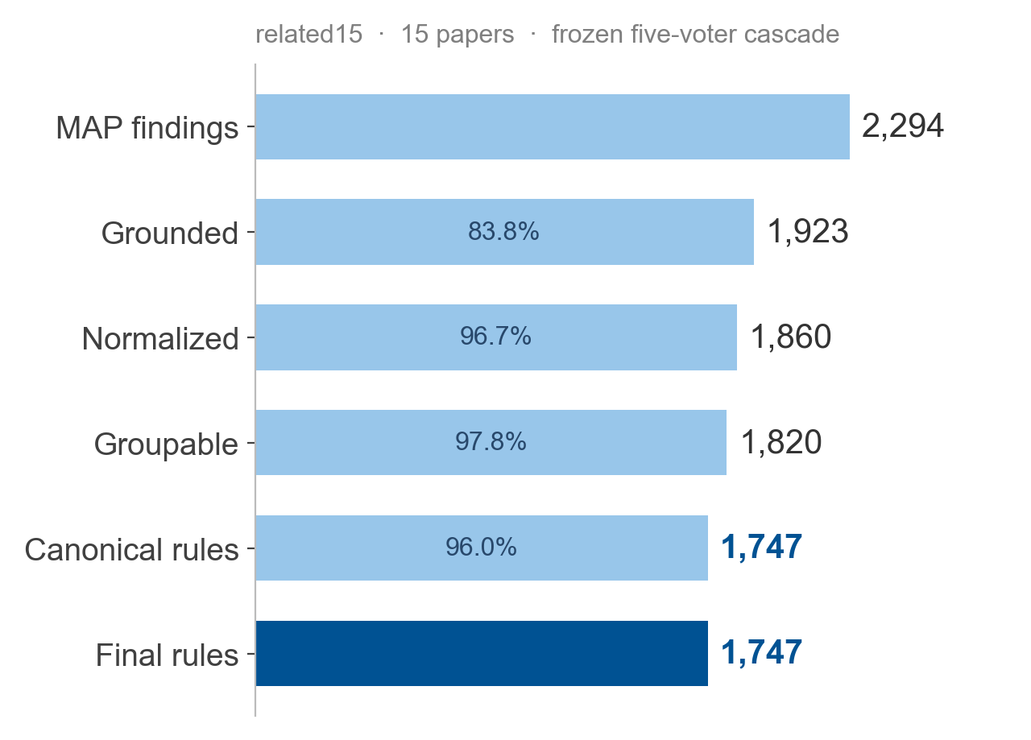
RQ2: 1,747 rules, and every one traces back to a source paragraph
related15 · frozen five-voter cascade · θ = 0.9, θ_reject = 0.2, grounding 0.5
100%
of final rules resolve to ≥ 1 source paragraph in their own paper (1,747 / 1,747)
• Figures and tables carry page + bounding box: 100%
• All tables carry a caption; figures with captions 86.3%
• Measured corpus-wide: 977 documents · 35,896 text elements · 4,479 figures · 1,960 tables
Cross-reference linking resolves for 53.6% of figures and 58.9% of tables, but is not used downstream
Notes:
Fifteen papers, frozen configuration. MAP produces 2,294 findings - note this is the count of
PIPELINE findings, not the 2,223 silver labels. Grounding removes about sixteen percent.
Everything after that barely moves the count - deduplication removes three percent, grouping two
percent - and we end with 1,747 canonical rules, which are also the 1,747 final rules. About 117
rules per paper.
That shallow funnel is itself a finding. It says the findings coming out of MAP are already mostly
atomic and distinct - not redundant restatements of each other. If they had been, consolidation
would have collapsed them.
The number on the right is the one I would defend hardest. All 1,747 final rules resolve to at
least one source paragraph in their own paper. Not 99 percent - all of them. And that is not luck;
it is structural. A rule cannot exist in the data model without its back-pointer chain. Figures and
tables likewise carry page and bounding box a hundred percent of the time.
Two honest gaps in grey. Only 86 percent of figures have a caption attached - rotated figures and
side captions defeat the geometric matcher. And cross-reference linking, connecting "as shown in
Figure 3" to the actual figure, resolves only around half the time. That one is not used
downstream, so it does not affect the rules - but it is not solved.
[1:00] -> "Those rules came out of the cascade. Was the cascade worth it? First, how it's tuned."
JUMPS — if asked:
provenance chain and offline replay → B14, slide 38
the corpus graph, contradictions → E5, slide 45

Slide 24
RQ2: 1,747 rules, and every one traces back to a source paragraph
related15 · frozen five-voter cascade · θ = 0.9, grounding 0.5
The funnel is lossy by design — each stage removes findings that cannot be supported.
Notes:
[VISUAL DECK · figure — the provenance funnel]
Two things to say. First the carry-rate: provenance survives all seven stages, which is the RQ2 answer.
Second, do not apologise for the funnel narrowing. Every drop is a claim that failed a check — that is the system working. [1:10]

Slide 25
What one extracted rule actually looks like
Field | Value
subject_entity / outcome_entity | PHH3 → Continuance of life
relation_type / direction / category | prognostic / negative / prognosis
predicate_text | PHH3 → independent predictor of survival in a Cox regression model
mean_grounding_score | 0.9997 (NLI entailment against the cited paragraph)
final_score / score_mode | 0.6198 / relations_present
finding_count / support_count | 2 / 1 study_coverage: single_study
member_normal_ids | NF_PMC10100421_…_ff259926, NF_PMC10100421_…_4a2e8baa
supporting_pmcids | PMC10100421_HIS-82-393
is_conflicted | True — the group holds more than one polarity
Every ID is a live back-pointer: final rule → canonical rule → normal findings → MAP findings → text elements → page and coordinates.
Notes:
Abstractions are easy to nod along to, so here is one actual rule, taken verbatim from the frozen
output.
The subject is PHH3, a mitosis marker. The outcome is survival. The relation type is prognostic,
the direction negative, the category prognosis. The predicate is the model's own compressed
statement: PHH3 is an independent predictor of survival in a Cox regression model.
The grounding score is 0.9997 - that is the NLI model checking the claim against the paragraph it
cites, and it is about as confident as it gets.
Two fields I want to draw out. First, the ID chain. member_normal_ids points at the two normalized
findings this rule was built from; those point back at MAP findings, which point at text elements,
which carry page and bounding box. That is the provenance chain, and it is data, not documentation
- you can follow it in the database.
Second, is_conflicted is True. That means the group this rule came from contained more than one
polarity - somewhere in the source there is a statement pointing the other way. The system does
not silently pick a winner and hide that; it flags the group and keeps both directions, because
the point is to surface candidates for a human, not to adjudicate.
And the final score of 0.62 is a ranking signal. It is not a probability, and the thesis says so.
[1:15]

Slide 26
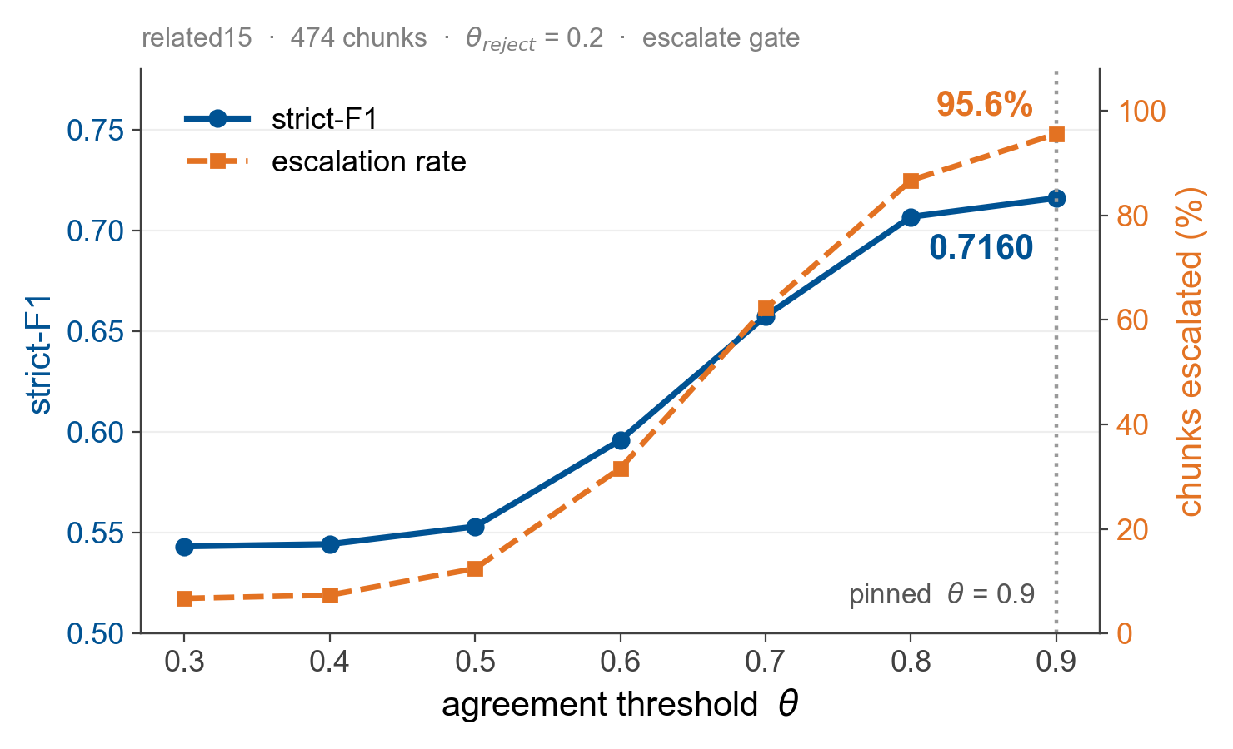
RQ3a: Top cascade quality requires near-universal escalation
Calibration on related15 · 474 chunks · strict-F1 vs Opus silver, optimal (Hungarian) matcher
Pinned operating point
θ = 0.9, θ_reject = 0.2
strict-F1 0.7160
at 95.6% escalation
θ 0.7 → 0.8: +≈0.05 strict-F1
θ 0.8 → 0.9: +0.0085 strict-F1, +8.5% cost
At θ = 0.9 the cheap voters resolve about 1 chunk in 20 on their own.
Notes:
Calibration, on the fifteen related papers, 474 chunks.
The blue line is quality against the agreement threshold theta. It rises and then flattens - going
from 0.7 to 0.8 buys about five points of strict-F1, but 0.8 to 0.9 buys 0.0085. Less than one
point.
The orange line is why this slide exists. Escalation rate climbs with theta, and at the operating
point I pinned - theta of 0.9 - 95.6 percent of chunks escalate. Almost every chunk ends up at
Claude Sonnet anyway.
I want to state the implication plainly rather than let you find it: at that setting the cascade is
barely a cascade. It is a strong model with an expensive pre-filter attached. The cheap voters are
still paid for on every chunk, and they resolve only about one chunk in twenty on their own. That
is not a tuning bug - it is what agreement looks like on this task, where the schema is rich and
the voters genuinely disagree about direction and category.
So the obvious question is: should you just call the strong model directly?
[1:00] -> "That question is RQ3, and it's the thesis's central negative result."
JUMPS — if asked:
θ sweep and the gate ablation → B8, slide 32
how findings are matched → B6, slide 30

Slide 27
RQ3a: top cascade quality requires near-universal escalation
Calibration on related15 · 474 chunks · strict-F1 vs Opus silver labels
At the shipped operating point, 95.6% of chunks reach the strong model.
Notes:
[VISUAL DECK · figure — θ vs escalation]
This is the uncomfortable finding and the setup for the next slide.
The cascade's best quality arrives only when almost everything escalates — which means the cheap tier is doing very little work at the quality end. Say it plainly; the next slide draws the consequence. [1:10]

Slide 28
How the shipped configuration was chosen: six experiments, in order
# | Question | Outcome
E05 | Which embedder, scorer and alignment? | hybrid scorer beats plain embedding on every embedder
E06 | How should the hybrid signals be weighted? | Gemini + hybrid + greedy, entity-heavy blend → 0.7133
E06b/c | Can any voter be dropped? | drop Claude Haiku: F1-neutral, −18% cost per chunk
E07 | Where should θ and θ_reject sit? | θ = 0.9, θ_reject = 0.2 → 0.7147
E08 | Do the accept/escalate gates matter? | escalate 0.7160 vs keep 0.7147 (within noise)
E08b | Final curve at the shipped setting | 0.7160 at 95.6% escalation
Order matters: each experiment fixes one knob and passes the rest forward, so the search is linear rather than combinatorial.
Every one of these replays from cached voter outputs: no new API calls, no cost, byte-identical results.
Notes:
A reasonable question is whether the shipped configuration was tuned or just picked. This is the
audit trail.
Six stages, in this order, each fixing one knob and handing the rest forward. E05 screens the
structural choices - which embedder, which scorer, which alignment strategy - twelve combinations,
and the structured hybrid scorer beats plain embedding similarity on every embedder, which is the
cleanest result in the whole calibration. E06 refines the blend weights and lands on the
entity-heavy mix. E06b and E06c ask whether any voter is carrying its weight, and dropping Claude
Haiku turns out to be quality-neutral at eighteen percent lower cost, which is how the six-voter
pool became five. E07 sweeps the thresholds. E08 ablates the gates. E08b produces the final curve.
Two things I would defend here. First, the order is deliberate: fixing one knob at a time makes
the search linear instead of combinatorial, at the cost of assuming the knobs are roughly
separable. That assumption is not tested, and I would list it as a limitation.
Second, and this is the part I am proudest of: all six replay from cached voter outputs. Every
number on this slide can be regenerated on a laptop with no network and no spend, byte-identical.
That is what makes the calibration auditable rather than a story about what I did in June.
[1:15]
JUMPS — if asked:
the config of record → B7, slide 31

Slide 29
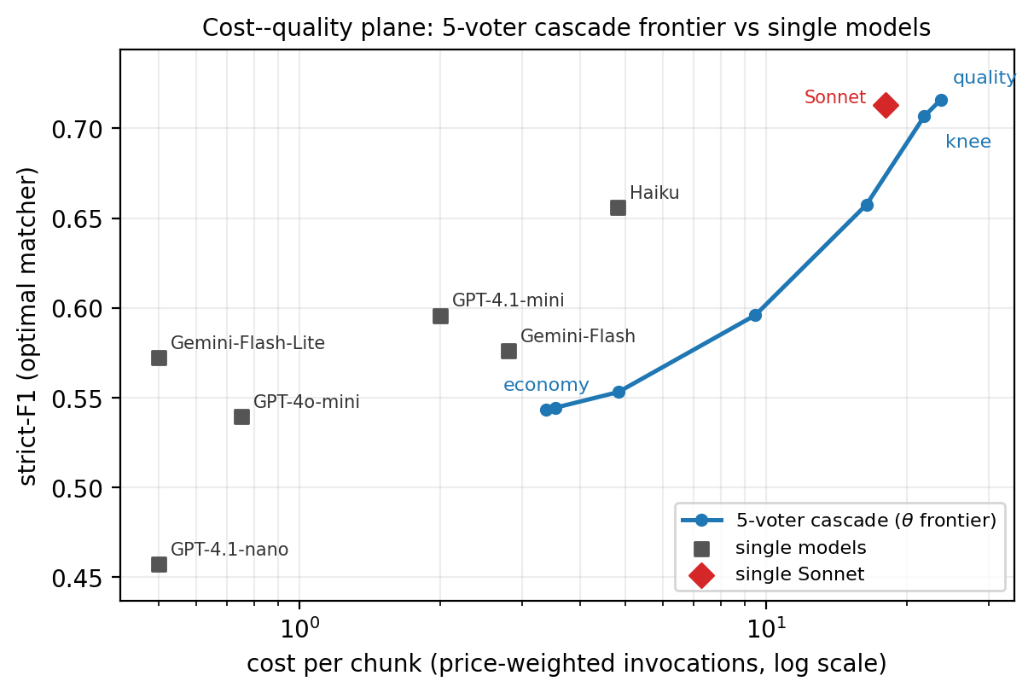
RQ3b: The cascade ties the best single model, which costs 24% less
Paper-level clustered paired bootstrap, B = 10,000 · cost in price-weighted units per chunk (the thesis states no currency)
Cascade 0.7160 at 23.66
Single Sonnet 0.7129 at 18.00
Δ = +0.0031 95% CI [−0.0002, +0.0068]
not statistically significant
• vs. every cheaper model: +0.060 to +0.26, all significant
Not cost-justified against the single strong model. Decisively better than every cheap one.
Counter-consideration: Sonnet shares a model family with the Opus silver labeler, so the measured gap is arguably conservative.
Notes:
This is the result I would lead with if I could only report one, and it is a negative one.
The cascade at its best setting reaches 0.7160 at a cost of 23.66 per chunk. A single Claude
Sonnet call reaches 0.7129 at 18.00. The difference is +0.0031, and the ninety-five percent
confidence interval from a paper-level clustered paired bootstrap - ten thousand resamples, papers
as the sampling unit - runs from minus 0.0002 to plus 0.0068. It crosses zero. THIS IS NOT A
STATISTICALLY SIGNIFICANT IMPROVEMENT. And the single model is about twenty-four percent cheaper.
So under the silver cost-quality criterion, the cascade is not cost-justified against the strong
single model. I say that in those words because it would be easy to describe 0.7160 versus 0.7129
as "the cascade wins" and technically not be lying.
The other half is real too, and the plot shows it. Against every OTHER single model the cascade
wins by between six and twenty-six points, all significant. The next best single model, Haiku,
trails by more than six strict-F1 points. So this is not "the cascade doesn't work" - it is "the
cascade doesn't beat the one model that is already very good and already cheaper".
One counter-consideration, stated carefully. The silver labels come from Claude Opus; the Sonnet
baseline is also Anthropic. There is a plausible family-resemblance advantage for Sonnet, and the
cascade's five voters are entirely non-Anthropic. So the measured gap is arguably conservative.
But I did NOT measure that effect - I cannot quantify it, and it does not turn a null result into
a positive one. Removing it needs human labels.
If asked about cost units: it is a price-weighted unit from a hand-compiled price book of provider
list prices. The thesis does not state a currency - a genuine gap in the write-up.
(OPTIONAL: the knee point, theta = 0.8, is 0.7067 for 21.80 - knee to quality buys one point of
strict-F1 for 8.5 percent more cost, and the knee is itself dominated by single-Sonnet on both
axes.)
[1:30] -> "RQ4 is a cleaner result: one frozen model doing two jobs."
JUMPS — if asked:
cost model, operating points, baselines → B9, slide 33
why nothing sits between cheap and expensive → B15, slide 39
significance testing → B10, slide 34
Chain: this slide → B9 → B15 is the likeliest sequence in the deck.

Slide 30
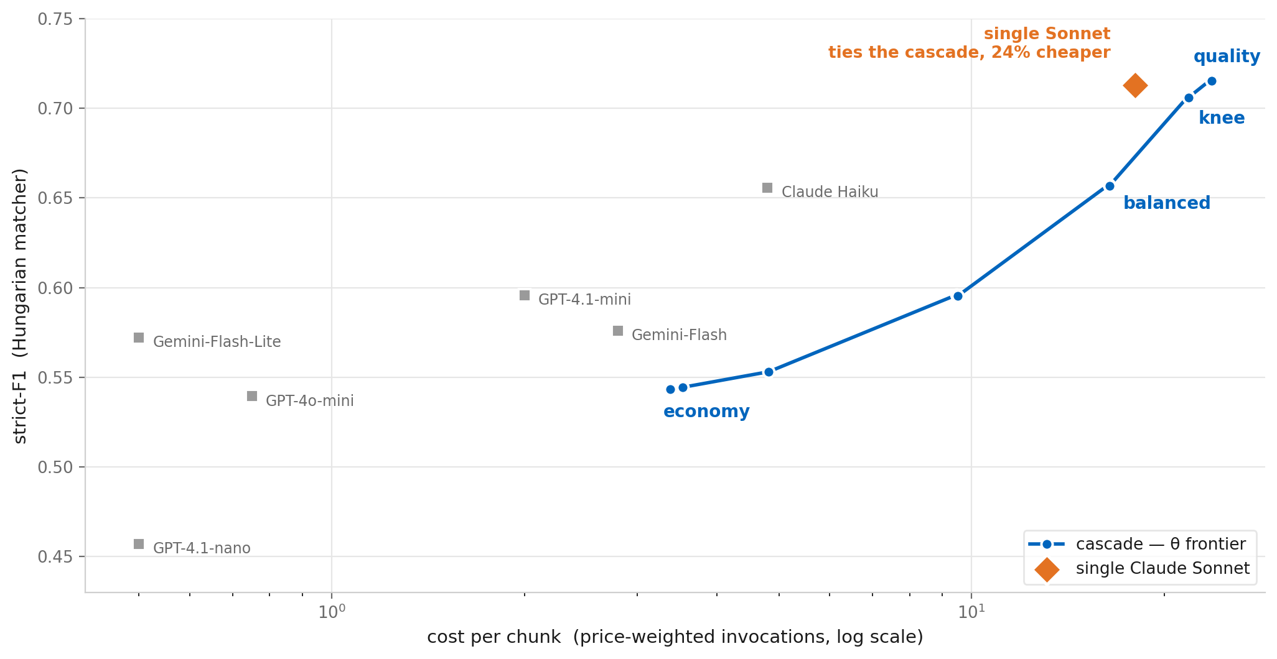
RQ3b: the cascade ties the best single model, which costs 24% less
The thesis's central negative result — reported, not buried
Four operating points on the cascade's θ-curve. A single Sonnet sits above the frontier's knee at lower cost.
Notes:
[VISUAL DECK · figure — cost–quality plane, with `balanced`]
Give this the full ninety seconds. It is the most honest slide in the deck and the committee will respect it more than a win.
The cascade reaches 0.7160. A single Sonnet call reaches 0.7129 — within noise — at 24 percent lower cost. On this corpus, at these prices, the cascade is not the cost-effective deployment.
What survives is the framework: provenance by construction, cost and quality as calibrated knobs, and an offline replay that reproduces every number here without a new API call. The calibration numbers are corpus- and price-specific. The method is not.
If asked why the middle of the curve looks empty — the knee is chosen by weighted-sum scalarization, which only reaches convex-hull vertices. 'balanced' is an ε-constraint point that fills it. [1:30]

Slide 31
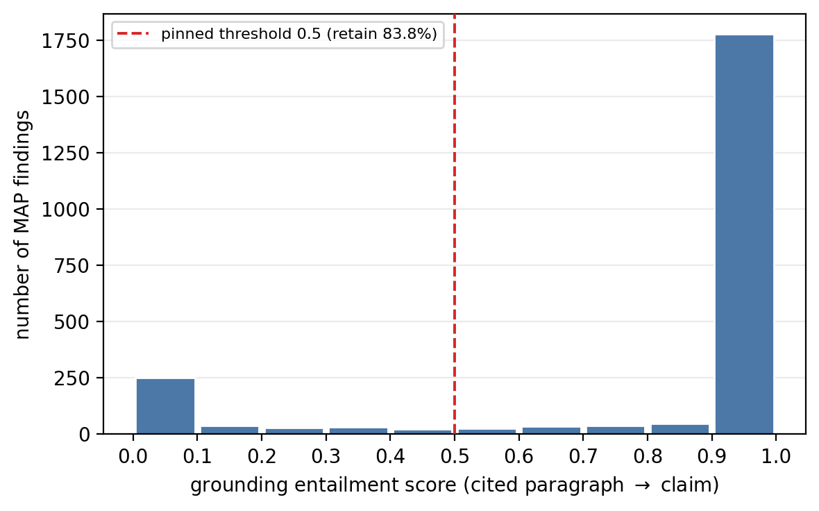
RQ4: One frozen NLI model, two roles: grounding costs 6 F1 points
pritamdeka/PubMedBERT-MNLI-MedNLI — frozen, no fine-tuning, shared by GROUNDING and RELATE
Relation classification
synthetic 300 pairs, 100 per class, thresholds frozen at 0.50 / 0.50
accuracy 0.923
macro-F1 0.924 (production scope_aware mode)
• SUPPORT precision 1.000, F1 0.953
• CONTRADICT F1 0.922
• UNRELATED F1 0.897
Class-balanced synthetic set: an optimistic ceiling, not a corpus-representative estimate.
Grounding
Bimodal: 77.5% score ≥ 0.9, ≈ 14% < 0.3. Threshold 0.5 retains 83.8%; strict-F1 0.716 → 0.652; precision flat (0.872 → 0.875).
Of the 371 findings removed, ≈ 86% agreed with the Opus silver: traded knowingly for source faithfulness.
Notes:
One model, frozen, no fine-tuning: a PubMedBERT cross-encoder fine-tuned on MNLI and MedNLI. It
does two different jobs.
Job one is grounding. For each extracted claim I run entailment against the paragraph the claim
cites. The left panel shows the distribution, strongly bimodal - 77.5 percent above 0.9, about 14
percent below 0.3. Very little in the middle, which is reassuring: the model is mostly confident,
in both directions.
Now the honest part. Turning the filter OFF gives the best strict-F1 - 0.716. Setting it at 0.5
drops that to 0.652. Six points. And of the 371 findings the filter removes, about 86 percent
actually agreed with the Opus silver labels.
I kept the filter anyway, and I want to defend that rather than apologise for it. What the filter
enforces is that a claim is entailed by the text it points at. A finding that agrees with Opus but
is not supported by its own cited paragraph is exactly the failure mode this thesis exists to
prevent. Six points of agreement-with-a-labeller, traded for a property the labeller cannot
measure. The right panel of the figure shows what it buys: recall falls as the threshold rises,
precision stays flat.
Job two is relation classification - SUPPORT, CONTRADICT, UNRELATED between two claims. About 92
percent accuracy on three hundred synthetic pairs. But read that with the orange caveat: the set
is class-balanced, synthetic, and generated label-first, which makes it easier than reality. It is
an optimistic ceiling. Relations extracted from the real corpus have no labels at all, so I could
not measure this on production output.
[1:05] -> "One question left: does any of this survive on papers I didn't calibrate on?"
JUMPS — if asked:
grounding threshold trade-off → B11, slide 35
relation classification per class → B12, slide 36

Slide 32
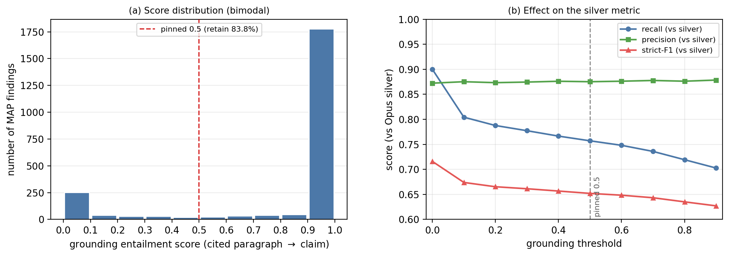
RQ4: one frozen NLI model, two roles — grounding costs six F1 points
Same model for claim-level grounding and pairwise relation classification
The grounding filter is a deliberate precision-for-recall trade, quantified rather than assumed.
Notes:
[VISUAL DECK · figure — NLI in two roles]
One model, two jobs, no fine-tuning for either — that is the reusability claim.
The six-point cost is the price of refusing to emit unsupported rules. I report it as a trade, not as a loss. [1:00]

Slide 33
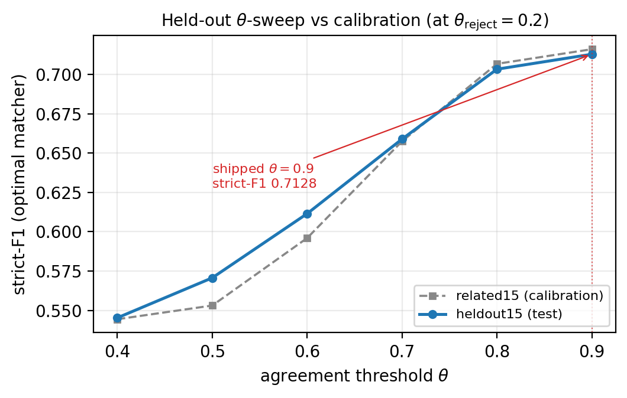
RQ5: Held-out performance sits within noise of calibration
Heldout15: 15 papers, disjoint, random sample · configuration frozen before evaluation
 | related15 | heldout15
Strict-F1 | 0.7160 | 0.7128
Loose-F1 | 0.886 | 0.884
Precision | 0.872 | 0.880
Recall | 0.900 | 0.888
Escalation | 95.6% | 99.0%
Rule provenance | 100% | 100%
Gap = 0.0032: within the bootstrap noise band
Escalation rises to 99.0%: on unfamiliar papers the cheap voters agree even less often. θ was fixed after calibration, so the sweep is descriptive only.
Notes:
Fifteen new papers, sampled randomly, disjoint from calibration. The configuration was frozen
before I ran this - theta, the voter set, the weights, the thresholds, all fixed.
Strict-F1 goes from 0.7160 to 0.7128. A gap of 0.0032, inside the bootstrap noise band. Loose-F1,
precision, recall all track. The funnel keeps its shape, and provenance is again a hundred percent
- 1,273 out of 1,273 rules.
One thing to read carefully: the curve on the left is DESCRIPTIVE. I did not tune theta on the
held-out set - that would defeat the purpose. It is shown so you can see the two curves have the
same shape and the same diminishing-returns knee above 0.8.
And one number that moved: escalation goes from 95.6 to 99.0 percent. On papers the calibration
never saw, the cheap voters agree even less often. That reinforces the RQ3 conclusion rather than
softening it - the cascade's economics get WORSE on unfamiliar material.
Finally, the claim this licenses is narrow, and I bound it myself: this shows the configuration
does not overfit related15. It does NOT show generalization to other biomedical subfields, to
non-PMC papers, or to non-English literature. Those are untested.
[0:50] -> "Which brings me to what these numbers do not support."
JUMPS — if asked:
the held-out funnel → B13, slide 37
significance testing → B10, slide 34

Slide 34
RQ5: held-out performance sits within noise of calibration
heldout15 — 15 papers, disjoint from calibration, randomly sampled, configuration frozen before evaluation
Two physically separate clusters, so the held-out set is structurally impossible to tune on.
Notes:
[VISUAL DECK · figure — held-out θ curve]
The configuration was frozen before this set was touched, and the two clusters are physically disjoint rather than a seeded split of one pool — which is what makes the claim defensible.
The honest reading: this shows the calibration did not overfit. It does not show the system generalises to a different corpus. [1:00]

Slide 35
Every number after RQ1 measures agreement with an LLM, not a pathologist
Limitations and threats to validity
• Silver labels bound everything.
RQ2–RQ5 measure agreement with Claude Opus 4.7. No experiment in this design can lift that ceiling.
• Model-family overlap threatens RQ3 specifically.
Sonnet and the Opus labeler are both Anthropic; the cascade's voters are not. Direction is arguable, but magnitude is unmeasured.
• RQ1's human labels are 27 papers, one annotator.
No inter-annotator agreement. Read as trends, not exact values.
• RQ4's relation set is synthetic and class-balanced.
An optimistic ceiling; real corpus relations have no labels at all.
Scope: English, open-access, histopathology. Outputs are rule candidates for expert review; confidence scores are not clinical probabilities.
Notes:
I would rather state these than be asked them.
The first bounds everything after RQ1. Strict-F1 measures agreement with Claude Opus. If Opus is
systematically wrong about something, my pipeline is rewarded for being wrong the same way, and no
experiment inside this design detects that. It needs expert annotation - the top item in future
work.
The second is sharper and aimed at RQ3. My level-three fallback is Sonnet, my silver labeller is
Opus - same provider, same model family. So a Sonnet-heavy system may match the silver partly
through family resemblance. I argued earlier this makes my null result conservative; that is a
REASONED EXPECTATION, not a measurement. I did not quantify it.
Third, the one place I have human labels is small: 27 papers, annotated by me alone, no second
annotator and therefore no inter-annotator agreement. Those results show a clear trend -
near-doubling is not a rounding artefact - but the individual percentages should not be read to
the decimal.
Fourth, the 92 percent relation accuracy is on synthetic, class-balanced, label-first data. A
ceiling.
And the scope line: English, open-access, histopathology. The system emits candidates for a domain
expert to validate. The confidence scores are ranking signals - not clinical probabilities, and
nothing here should be read as a diagnostic claim.
[0:55] -> "So - five questions. Here are the five answers."
JUMPS — if asked:
novelty vs related work → E6, slide 46

Slide 36
Four questions answered; one negative result reported, not buried
RQ | Answer | Evidence
RQ1 | Targets met | tables 0.366 → 0.838, figures 0.447 → 0.840 (human rubric)
RQ2 | Quality reached; provenance structural | strict-F1 0.7160; 100% rule carry-rate (1,747 / 1,747)
RQ3 | Not cost-justified vs. the strong single model | Δ +0.0031, CI [−0.0002, +0.0068]; Sonnet 24% cheaper
RQ4 | Both NLI roles behave as designed | grounding 0.716 → 0.652 by choice; relations 0.923 (synthetic)
RQ5 | Does not overfit the calibration cluster | 0.7160 → 0.7128, gap 0.0032
The lasting contribution is the framework, not this operating point:
provenance by construction · cost and quality as calibrated knobs · full offline replay with no API calls
Notes:
Five questions, five answers.
RQ1 - met. Document extraction roughly doubles strict-F1 on both tables and figures against human
labels.
RQ2 - met. 0.7160 strict-F1 at the MAP stage, and provenance is complete: every one of 1,747 rules
resolves to a source paragraph. Structural, not incidental.
RQ3 - negative, and I will not soften it. The cascade reaches the same quality as a single Sonnet
call, the difference is not statistically significant, and Sonnet is twenty-four percent cheaper.
Not cost-justified. What survives is that the cascade beats every cheaper model decisively, and
that its five governing voters are entirely non-Anthropic - so the defensible value is PROVIDER
INDEPENDENCE, not accuracy. If a provider changes prices, deprecates a model, or you cannot send
data to one vendor, that property is worth something. It is just not the property I set out to
demonstrate.
RQ4 - the NLI backbone works in both roles, with the grounding trade made deliberately.
RQ5 - no meaningful overfitting.
And the closing line is what I would actually defend as the contribution. Not this operating point
- theta of 0.9 with those five voters is specific to this corpus and to today's prices, and it
will be stale within a year. What lasts is the framework: provenance guaranteed by the data model
rather than by discipline, cost and quality exposed as explicit knobs you recalibrate for a new
corpus or budget, and an offline replay protocol that reproduces every number in the thesis from
cached artifacts without a single new API call.
Thank you - I'm happy to take questions.
[1:15] -> END OF MAIN TALK. Stay on this slide during questions.
JUMPS — if asked:
positioning against related work → E6, slide 46
the correction, if not already raised → the audit slide, slide 24

Slide 37
Backup
Notes:
No speech. Land on the conclusion slide during questions and jump here by slide number.

Slide 38
Post-submission audit: the sub-figure merge step never executes
A correction to the thesis's figure-gain attribution
The thesis credits the figure gain to three mechanisms: icon filtering, sub-figure merging, and caption matching.
Sub-figure merging cannot have contributed: the branch is unreachable.
Once a figure claims a caption, that caption is removed from the candidate pool. The merge triggers only when a caption is found that is already claimed, which can then never happen.
Evidence | Result
Instrumented the real PyMuPDFMediaCropper, 27 rubric PDFs | 76 figures emitted, union_bbox() called 0 times
Replayed the loop over all 977 papers | merge branch entered 0 times
Synthetic ideal case: 2 panels, 10 pt apart, shared caption | 2 crops emitted, not 1
No reported number changes: the code that never ran also never affected any measurement. Figures 0.447 → 0.840 stands, driven by icon filtering and caption matching.
Notes:
I want to volunteer this rather than wait to be asked.
After submission I went back through the figure path to build worked examples, and found that one
of the three mechanisms the thesis credits for the figure improvement never actually runs.
The logic is this. The cropper walks picture elements, finds each one's nearest caption, and
claims it. Sub-figure merging is supposed to fire when a second panel finds a caption that has
already been claimed - then it merges into the owner. But when a caption is claimed it is removed
from the candidate pool, so the next panel can never find it. The condition that triggers the
merge is unreachable.
Three independent checks, on the slide. I instrumented the actual cropper class and ran all 27
rubric PDFs: 76 figures, and the union function that performs the merge is called zero times. I
replayed the loop over all 977 papers: the branch is entered zero times. And I built the textbook
case by hand - two panels ten points apart sharing one caption - and it emits two crops, not one.
Now the important part, and I would say this plainly: no reported number changes. Code that never
executed cannot have affected a measurement. The figure result of 0.447 to 0.840 stands exactly as
published; the attribution in one sentence over-counts by one mechanism. The gain is icon
filtering and caption matching.
I would rather have found this than not, and it is the kind of thing the provenance and
offline-replay design is supposed to make findable.
[1:15]

Slide 39
B1 · Research questions, and their answers
RQ | Question (as stated in the thesis) | Answer
RQ1 | How faithfully does the document-extraction pipeline recover the text, tables, figures, captions and related layout information, and how much does it improve on the off-the-shelf document-extractor baseline? | tables 0.366 → 0.838; figures 0.447 → 0.840
RQ2 | What is the quality of the extracted findings and rules against strong-model-generated silver labels, and is provenance preserved end-to-end for every extracted figure, table and rule? | strict-F1 0.7160; provenance 100%
RQ3 | Is the agreement-based cascade worth its cost, relative to sending each text chunk to a single strong model? | No — Δ +0.0031, not significant
RQ4 | How does the shared biomedical NLI model perform in its grounding and relation-classification roles? | as designed; 0.652 / 0.923
RQ5 | Does the performance of the configuration calibrated on one set of papers generalize to a held-out set, or does it overfit the calibration cluster? | 0.7128 — no meaningful overfit
The silver metrics depend on silver labels generated by a strong LLM, so the resulting scores measure agreement with the labeler, not ground truth.
Notes:
Use when asked to restate a research question exactly. The answers column is from the thesis's own summary-of-findings section, not from Chapter 6, which is narrative.

Slide 40
B2 · Corpus acquisition and the page-cap trade-off
Acquisition funnel
1,132 downloaded PDF files
1,093 targeted PMC identifiers
1,070 single-PDF papers
981 candidates after the ≤30-page filter
977 ingested into the database
4 papers fail Docling conversion (missing page-dimension metadata).
Cap | Papers | % papers | Pages | % volume
≤15 | 876 | 81.9 | 6,757 | 41.5
≤20 | 932 | 87.1 | 7,731 | 47.5
≤25 | 963 | 90.0 | 8,436 | 51.8
≤30 | 981 | 91.7 | 8,929 | 54.9
≤40 | 1,000 | 93.5 | 9,602 | 59.0
≤50 | 1,014 | 94.8 | 10,237 | 62.9
none | 1,070 | 100.0 | 16,277 | 100.0
The 30-page cap is the 92nd percentile: it keeps 91.7% of papers and 54.9% of total page volume.
Notes:
The cap exists to bound Docling runtime and memory. It drops under a tenth of papers while removing nearly half the page volume.

Slide 41
B3 · Why these 15 calibration papers: an integer linear program
• Fingerprint buckets: disease · biomarker · method · outcome · gene · tissue · generic · CUI
• Relatedness = weighted Jaccard sum; disease weighted most, generic down-weighted, penalty for zero disease overlap
• Eligibility: 20–350 sentences, ≥1 non-empty disease/biomarker/gene bucket, ≥ 3 distinct non-empty entities → drops 56 papers, 977 → 921
• Exhaustive solve at k = 15 with PuLP / CBC, with no candidate cap, no time limit
• All 105 pairs in the selected cluster have relatedness > 0
The cluster is deliberately related, which makes it a favorable case for assessing voter agreement. The randomly sampled held-out set serves as the control.
Notes:
Expect: 'isn't that cherry-picking?' Answer: yes, deliberately, and disclosed. The cluster maximises relatedness so cross-paper relations are possible at all. The held-out set is random precisely to test whether that choice inflated the result. It did not inflate strict-F1 (0.7128 vs 0.7160) but it did inflate relation counts (25 vs 4).

Slide 42
B4 · The document-extraction rubric: four dimensions, no partial credit
Four dimensions, each scored in [0,1]; n/a excluded from the average
• crop: is the emitted region geometrically right?
• caption: is the correct caption attached?
• footnote: are the table's footnotes inside the crop? (tables only)
• mask: was the region correctly removed from the body text?
Strict-F1 counts an artifact as a true positive only if it receives the top rubric label on every applicable dimension. Near-misses get no partial credit.
Staged sweep over 4 axes: backend, confidence threshold, footnote multiplier, region handling ∈ {drop, pre-mask, reconstruct, merge} + header clipping = 31 variants
Notes:
The harshness is the point: it is the metric under which a 'mostly right' table crop still fails, which is the standard a downstream auditor would apply.

Slide 43
B5 · Full document-extraction sweep, all key variants
Configuration | Crop F1 | Mask F1 | Caption P | Footnote P | Strict-F1
Off-the-shelf Docling | 90.1% | 95.8% | 90.6% | 43.8% | 36.6%
Pipeline, Docling-only tables (v01) | 91.4% | 94.3% | 93.8% | 43.8% | 40.0%
Hybrid @0.99, no footnote-expand (v07) | 86.4% | 97.7% | 94.3% | 48.6% | 42.0%
Docling + footnote-expand ×1.2 (v16) | 88.6% | 91.4% | 93.8% | 90.6% | 80.0%
TATR + footnote-expand ×1.2 (v17) | 91.9% | 91.9% | 94.3% | 71.4% | 64.9%
Hybrid + footnote-expand ×1.2 (v18, pinned) | 91.9% | 91.9% | 94.3% | 91.4% | 83.8%
Figures (identical across all sweep variants) | Crop F1 | Mask F1 | Caption P | Strict-F1 | Icon FPs
Off-the-shelf Docling | 61.7% | 98.5% | 60.6% | 44.7% | 73 of 99
Production pipeline | 89.9% | 100.0% | 90.3% | 84.0% | 14 of 21
Crop and mask are F1; caption and footnote are precision. v17 and v18 also apply the caption/crop-geometry family fixes. The sweep varies table handling only, so figure metrics are constant across variants.
Notes:
The ablation the committee will want. Read down the strict-F1 column: detection alone 40.0 → 42.0; footnotes alone 80.0; both 83.8.

Slide 44
B6 · How a pipeline finding is matched to a silver label
• Six concatenated fields are embedded; eligibility requires cosine > 0.55
• One-to-one assignment: optimal (Hungarian) is the reported matcher; greedy is kept as a sensitivity diagnostic and never drives selection
• loose TP = matched at all. loose P = n_matched / n_pipeline, loose R = n_matched / n_silver
• strict TP requires relation type, direction, and category to ALL agree; disagreement on ≥1 of the three contributes 0.5
Calibration decomposition: recall 0.900, precision 0.872, loose-F1 0.886 → tightening to strict gives 0.7160
Notes:
The strict/loose gap is where the schema bites: the pipeline usually finds the right claim (loose 0.886) but disagrees with the labeller about direction or category often enough to drop to 0.716.

Slide 45
B7 · The pinned cascade configuration of record
Knob | Value | Fixed by
Voter set | 5 voters — Claude Haiku 4.5 dropped from Level 2 | E06b / E06c
Scorer / alignment | hybrid / greedy | E05 / E06
Hybrid blend | 0.15 category · 0.30 embedding · 0.50 entity · 0.05 evidence (entity-heavy) | E06
Embedder / τ | Gemini / 0.15 | E06
θ / θ_reject | 0.9 / 0.2 | E07 / E08b
Single-voter policy / polarity hard-fail | escalate / true | E08
Grounding threshold | 0.5 | E03
Headline operating point | strict-F1 0.7160 at 95.6% escalation (before grounding) | E08 / E08b
L1 Gemini Flash-Lite · GPT-4o mini · GPT-4.1 nano
L2 Gemini Flash · GPT-4.1 mini
L3 Claude Sonnet 4.6
All production voters run at temperature 0.
Notes:
If asked why Haiku was dropped: E06b/E06c showed dropping it was strict-F1-neutral (0.7147 five-voter vs 0.7131 six-voter, inside the noise band) at 18% lower cost per chunk.

Slide 46
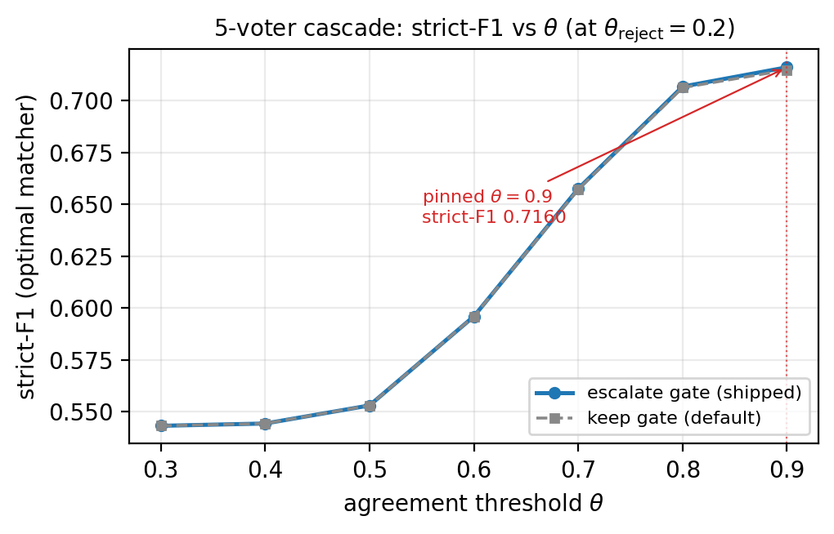
B8 · θ sweep and the gate ablation
Threshold sensitivity
• θ 0.7 → 0.8: ≈ +0.05 strict-F1
• θ 0.8 → 0.9: +0.0085 strict-F1
• optimal θ_reject = 0.2
Gate ablation
• single-voter escalate 0.7160 vs keep 0.7147: the gain is within noise
• polarity hard-fail fires on 15 of 474 chunks (3.16%)
• at θ = 0.9 it changes exactly one routing decision: 453 L3 invocations instead of 452, moving strict-F1 by 0.0001
These gates exist for safety, not for improving strict-F1.
Notes:
Use if asked whether the gates are doing anything. Answer honestly: measurably almost nothing on strict-F1, and that was never their purpose. The polarity gate is a guard against silently emitting two contradictory polarities for the same claim.

Slide 47
B9 · Cost model, operating points, and all single-model baselines
System | Strict-F1 | Cost / chunk
Cascade, five voters | 0.7160 | 23.66
Single Claude Sonnet | 0.7129 | 18.00
Single Claude Haiku | 0.6558 | 4.80
Single GPT-4.1-mini | 0.5957 | 2.00
Single Gemini Flash | 0.5761 | 2.80
Single Gemini Flash Lite | 0.5721 | 0.50
Single GPT-4o-mini | 0.5394 | 0.75
Single GPT-4.1-nano | 0.4570 | 0.50
Operating point | θ / θ_r | Strict-F1 | Cost | Escal.
economy | 0.3 / 0.0 | 0.5433 | 3.38 | 0.07
balanced | 0.7 / 0.2 | 0.6575 | 16.40 | 0.62
knee | 0.8 / 0.2 | 0.7067 | 21.80 | 0.87
quality | 0.9 / 0.2 | 0.7160 | 23.66 | 0.96
• economy = ε-constraint (lowest cost meeting a minimum strict-F1)
• balanced = ε-constraint at a higher floor (0.60), the middle the knee cannot reach
• knee = weighted-sum scalarization maximizing strict-F1 − λ·cost
• quality = maximum strict-F1
balanced → knee: +7% strict-F1 for +33% cost · knee → quality: +1% for +8.5%
Notes:
Concede the missing currency unit immediately if asked; do not improvise one. The numbers are internally consistent and comparable across systems, which is what the frontier needs, but the axis should have been labelled.
Four operating points, ascending cost. Quality is the shipped configuration - it is simply the
maximum, no coefficient and no threshold involved. Economy and balanced are the same method, the
epsilon-constraint: cheapest configuration clearing a quality floor, at 0.50 and 0.60 respectively.
The knee is the odd one out - it maximises strict-F1 minus lambda times cost.
Read the bold line rather than the table if you are short of time: a third more spend buys seven
percent, and a third again buys one. That is the diminishing-returns shape, and it is the same
point the cost-quality argument rests on.
If asked why nothing sits between economy at 3.38 and the knee at 21.80 - which is the sharpest
question this slide invites - jump to B15. Short answer: the knee is chosen by a weighted sum, and
a weighted sum can only ever return a vertex of the convex hull. Seven configurations here are
Pareto-optimal but only three are on that hull, so theta 0.4 through 0.7 are unreachable by any
lambda at all. Balanced exists because the epsilon-constraint has no such blind spot. Nothing about
the shipped configuration changes - quality depends on neither lambda nor a floor.

Slide 48
B10 · Significance testing: paper-level clustered paired bootstrap
Cascade compared with | Δ strict-F1 | 95% CI | Significant
Single Claude Sonnet | +0.0031 | [−0.0002, +0.0068] | No
Single Claude Haiku | +0.060 | > 0 | Yes
Single GPT-4.1-mini | +0.120 | > 0 | Yes
Remaining cheaper models | +0.14 to +0.26 | > 0 | Yes
• B = 10,000 resamples, papers as the sampling unit
• Clustered because findings within one paper are not independent: resampling findings would understate the variance
• Paired because both systems are evaluated on the identical chunk set
Only the Sonnet comparison is inconclusive. Every cheaper-model comparison is unambiguous.
Notes:
If pushed on 'the CI is only just crossing zero': agreed, it is marginal — the upper bound is positive and the lower bound is barely negative. But a marginal interval is not evidence of an effect, and I will not present it as one.

Slide 49
B11 · Grounding score distribution and threshold trade-off
2,294 frozen-config MAP findings on related15 · NLI run on (claim, cited paragraph)
(a) Bimodal: 77.5% of findings score ≥ 0.9, ≈ 14% score < 0.3. The 0.5 threshold (dashed) retains 83.8%.
(b) Recall and strict-F1 fall as the threshold rises; precision stays flat (0.872 → 0.875). The filter trades recall for groundedness, not for precision.
Notes:
0.5 was pinned as a design decision for source faithfulness, not chosen to maximise F1 — the F1-maximising choice is to switch the filter off entirely.

Slide 50
B12 · Relation classification, per class, both input modes
Class | predicate_only P | R | F1 | scope_aware P | R | F1
SUPPORT | 1.000 | 0.920 | 0.958 | 1.000 | 0.910 | 0.953
CONTRADICT | 0.904 | 0.940 | 0.922 | 0.896 | 0.950 | 0.922
UNRELATED | 0.885 | 0.920 | 0.902 | 0.883 | 0.910 | 0.897
Macro average | 0.930 | 0.927 | 0.927 | 0.926 | 0.923 | 0.924
Accuracy | 0.927 |  |  | 0.923
• scope_aware is the production mode. Thresholds frozen at 0.50 / 0.50, not tuned.
• A diagnostic joint sweep found the frozen thresholds are within a fraction of a percent of optimal (0.4 / 0.9 → macro-F1 0.9307)
• scope_aware's intended mechanism cannot be tested on this set: both claims in every synthetic pair share the same disease context, so they receive the same prefix
Notes:
The honest reading: predicate_only actually scores marginally higher, and the mode the pipeline ships cannot demonstrate its own mechanism on this dataset. Both facts are in the thesis.

Slide 51
B13 · Held-out knowledge-extraction funnel, side by side
Stage | related15 (calibration) | heldout15 (test)
MAP findings | 2,294 | 1,672
Grounded at threshold 0.5 | 1,923 (83.8%) | 1,379 (82.5%)
Normalized after deduplication | 1,860 (−3.3%) | 1,342 (−2.7%)
Groupable findings | 1,820 | 1,314
Canonical rules | 1,747 | 1,273
Canonical rules per normalized finding | 0.939 | 0.949
Relations, intra + cross | 25 (13 + 12) | 4 (4 + 0)
Final rules per paper | 116.5 | 84.9
Rule provenance carry-rate | 100% (1,747 / 1,747) | 100% (1,273 / 1,273)
The funnel keeps its shape. The one number that collapses is relations: the held-out papers were sampled randomly, so they share far less vocabulary and produce no cross-paper relations at all.
Notes:
This is the clearest evidence that the ILP cluster choice mattered for relations but not for strict-F1. Do not oversell the knowledge-graph angle on randomly sampled papers.

Slide 52
B14 · Provenance chain and offline replay
Provenance chain
final rule
→ canonical rule
→ normal finding
→ MAP finding
→ text element
→ document (page, span, coordinates)
Enforced by the data model: a rule cannot exist without its back-pointers.
“Provenance enables auditability, but it is not proof of correctness.”
Offline replay
• All voter outputs cached per tier per chunk, so any escalation path replays offline
• Cache invalidates on changes to the voter pool, model IDs, temperatures or MAP prompts
• One offline batch driver produces every Chapter 4 result: each analysis emits one CSV, one JSON, and a global manifest.json
• Replay fidelity validated by comparing live-cascade and replay findings per paper
Every number in this talk can be regenerated with no API calls and no cost.
Notes:
The reproducibility answer. The command is `nlp-histo replay results` and it is free — it reads cached artifacts, it does not call any provider.

Slide 53
B15 · Operating points: why the knee misses the middle
Weighted-sum reaches 3 of 7 Pareto points; an ε-constraint floor reaches all 7
ε floor ≤ | config | strict-F1 | $ / chunk | reachable by a weighted sum?
0.5433 | θ0.3 | 0.5433 | 3.38 | yes — this is economy
0.5444 | θ0.4 | 0.5444 | 3.53 | no
0.5531 | θ0.5 | 0.5531 | 4.82 | no
0.5960 | θ0.6 | 0.5960 | 9.48 | no
0.6575 | θ0.7 | 0.6575 | 16.40 | no — this is balanced, ε ≥ 0.60
0.7067 | θ0.8 | 0.7067 | 21.80 | yes — this is the knee
0.7160 | θ0.9 | 0.7160 | 23.66 | yes — this is quality, the shipped config
• knee = argmax(strict-F1 − λ·cost) with λ = 0.20. That winner holds only for λ ∈ [0.119, 0.210); above it the knee collapses onto economy
• A weighted sum returns only convex-hull vertices, so the four concave configs are unreachable at any λ. ε-constraint has no such blind spot.
The shipped configuration is the quality point: argmax strict-F1, no λ, no floor. None of this moves it.
Notes:
This is the slide for "how did you choose the operating points", and the honest answer has a
methodological wrinkle worth owning.
Quality is just argmax strict-F1 - no coefficient, no threshold. That is the shipped configuration.
Economy and the knee are reporting points that summarise the rest of the curve.
The knee uses weighted-sum scalarization: maximise strict-F1 minus lambda times cost, with lambda
at 0.20. I swept lambda afterwards. The chosen cell only holds for lambda between roughly 0.12 and
0.21, and above 0.21 the knee stops being a knee - it collapses straight onto the economy point.
But the more interesting finding is that re-tuning lambda would not have helped. A weighted sum can
only ever return a vertex of the upper convex hull of the cost-quality points. Any Pareto-optimal
point sitting in a concave stretch loses to a blend of its neighbours for every lambda. On this
curve seven cells are Pareto-optimal and only three are on the hull, so theta 0.4 through 0.7 are
unreachable by any lambda whatsoever. That is the standard limitation of the method, stated in
Boyd, which is the source I cite for it.
The practical consequence: the knee sits at ninety-two percent of the quality cost. It is not
really a middle ground. Everything between 3.38 and 21.80 was unrepresented.
The fix is not a better lambda, it is a different selection rule. Epsilon-constraint - cheapest
configuration clearing a quality floor - does not blend the objectives, so it reads the concave
region directly. I was already using it for the economy point at a 0.50 floor; balanced is the
same method at 0.60, and it selects theta 0.7: thirty-one percent cheaper than quality for about
six strict-F1 points.
If asked whether this changes any result: no. The shipped configuration is the quality point, which
depends on neither lambda nor a floor. No published number moves.
[1:15]

Slide 54
Expansion slides
Notes:
Divider. Everything after this point is written to main-slide standard and can be moved into the main line for a 30- or 45-minute slot. See PRESENTATION.md, 'Scaling the talk to the slot'.

Slide 55
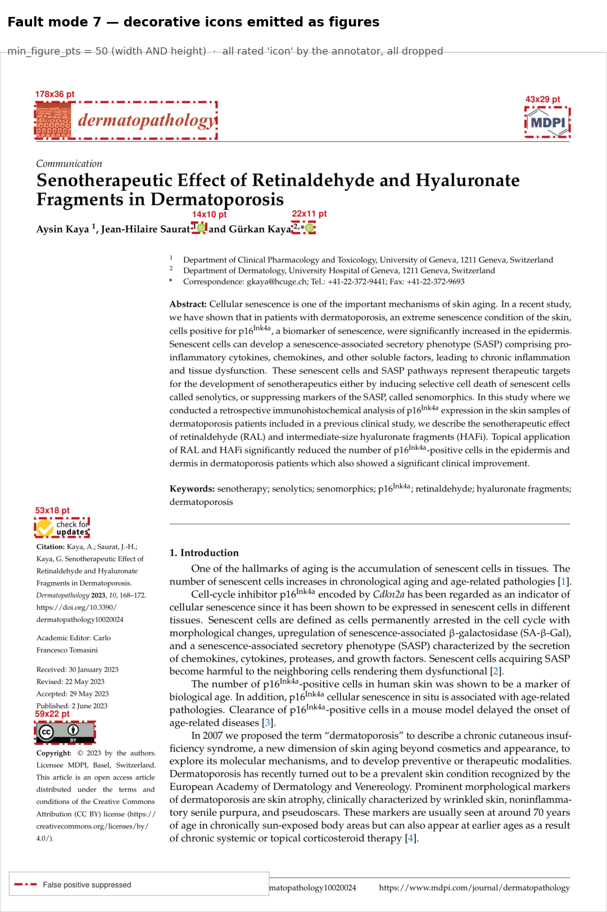
E1 · The icon filter removes journal furniture, not science
PMC10297671 p1 · every boxed region was rated 'icon' by the annotator
min_figure_pts = 50
width AND height must both reach 50 pt
What Docling emitted as scientific figures:
• two ORCID marks: 14×10 pt and 22×11 pt
• a “check for updates” badge: 53×18 pt
• the CC-BY licence badge: 59×22 pt
• the journal masthead: 178×36 pt
Corpus-wide: 3,065 of 7,544 picture elements dropped (40.6%)
Notes:
This is the other half of the figure story, and it is the least glamorous fix in the thesis.
Off-the-shelf Docling emitted 139 figure crops on the rubric set. 73 of them were rated "icon" by
the annotator. Look at what they actually are: two ORCID marks next to the author names, the
"check for updates" badge, the Creative Commons licence badge, and the journal masthead. Every
open-access paper has these, on page one, every time.
The rule is a size filter - both width and height must reach fifty points. Note the masthead is
178 points wide but only 36 tall, so it fails on height. That is why the rule uses AND rather than
area.
Corpus-wide this drops 3,065 of 7,544 picture elements, about forty percent. Combined with the
caption matcher on the next slide, these two mechanisms account for the entire 139 to 76
reduction and the whole figure strict-F1 gain.
[1:00]

Slide 56
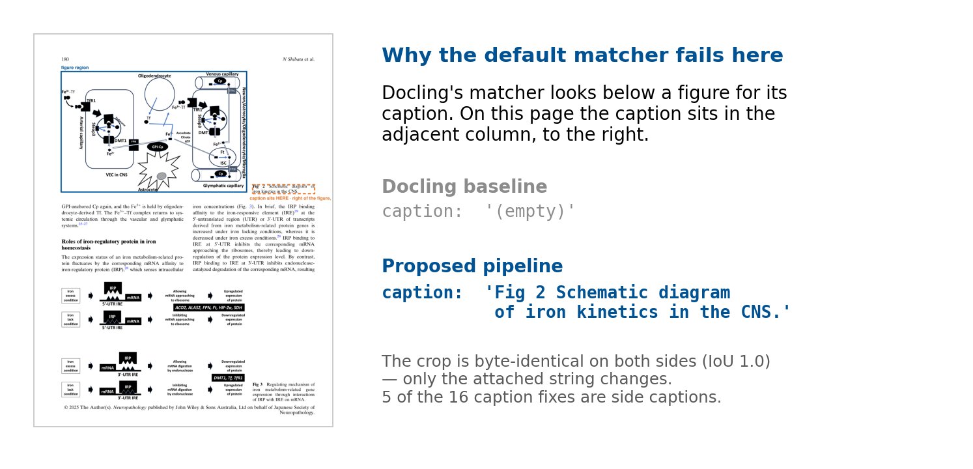
E2 · Same pixels, correct caption: the geometric matcher
PMC12129649_NEUP-45-177 p4 · identical bounding box (IoU 1.0), caption string differs
Notes:
This is the subtlest of the document-layer fixes and the easiest to under-rate.
Look at the page layout, because that is what defeats the default matcher. The figure sits in the
left column; its caption is in the right column, beside it rather than beneath it. Docling's
matcher searches downward, finds nothing, and returns an empty string.
The crop is byte-identical between baseline and pipeline - same bounding box, IoU exactly 1.0. The
figure was never the problem. What changed is the string attached to it. Docling's default matcher
returned nothing; mine returns "Fig 2, Schematic diagram of iron kinetics in the CNS."
Why it matters: this figure's caption sits to the RIGHT of the image rather than below it, which
is a common journal layout and breaks a matcher that only looks downward. My matcher scores
candidates by edge-to-edge gap in both axes and parses the figure number out of the caption text
to check consistency.
Sixteen caption labels were corrected this way on the rubric set - eleven figures with no caption
at all, five with the caption to the side. Correct captions go from 60.6 to 90.3 percent.
And a caption is not cosmetic here. It is the only human-readable description of what a figure
shows, and it is what an auditor reads first when checking a rule that cites that figure.
[1:00]

Slide 57
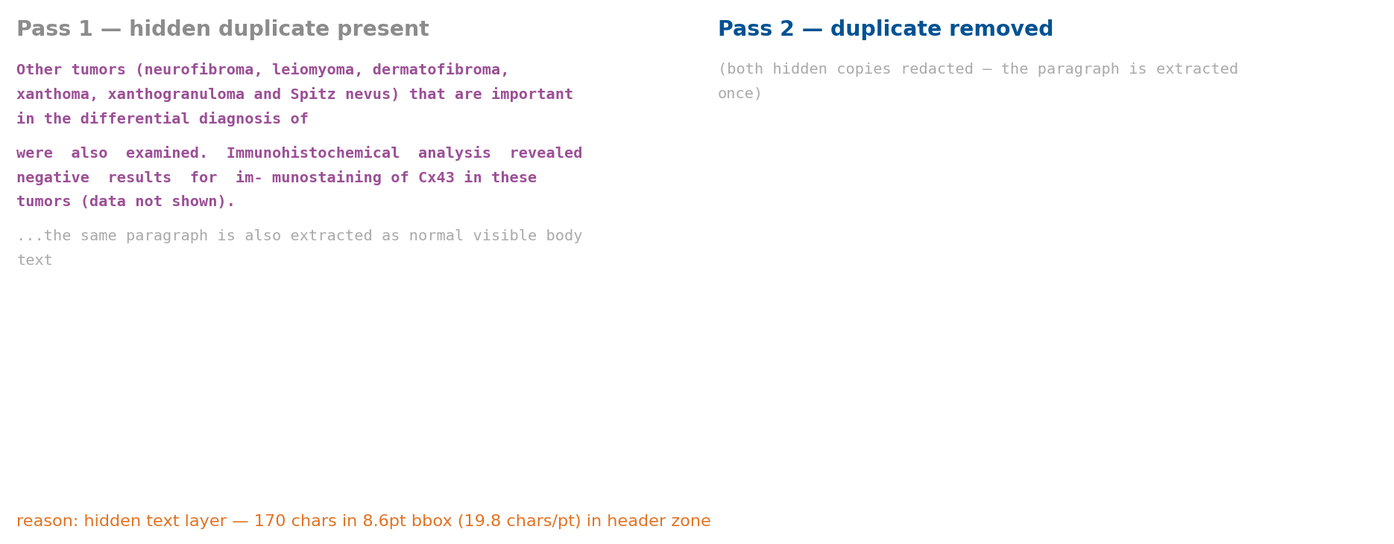
E3 · A hidden duplicate paragraph would have been extracted twice
PMC10296831 p4 · rule R3_dense_text · “170 chars in an 8.6 pt box = 19.8 chars/pt”
Notes:
A second, nastier variant of the same problem - and this one is not journal furniture, it is real
scientific text.
This paper carries a hidden duplicate of a genuine body paragraph, about granular cell tumours and
their immunohistochemical profile. The visible copy is there; a second copy sits underneath it in
a compressed, invisible layer.
The pixel test does not always catch this one, because the hidden copy can overlap real ink. So
there is a second rule: character density. This node claims 170 characters inside a bounding box
8.6 points tall - about twenty characters per point, which is physically impossible for rendered
type. That is R3_dense_text, and it fires 2,228 times across the corpus.
The consequence if you skip this: the paragraph reaches MAP twice, the model extracts the same
finding twice, and the two copies agree perfectly. So the cascade sees strong agreement, accepts
cheaply, and the deduplication stage merges them back into one rule with an inflated evidence
count. A duplicate looks exactly like corroboration.
That is the honest reason this stage exists. It is not about text tidiness - it is about not
manufacturing false support.
[1:00]

Slide 58
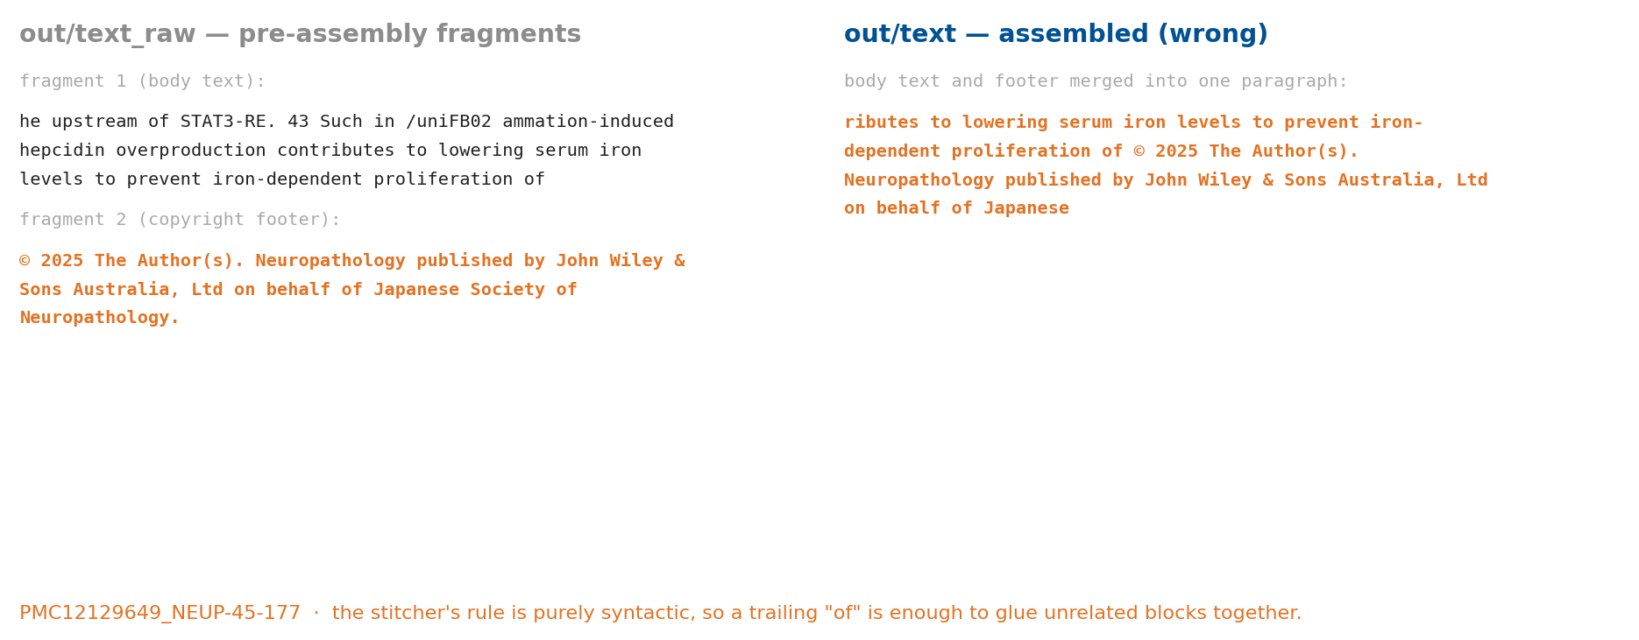
E4 · Paragraph stitching is purely syntactic, which cuts both ways
ContextAwareStitcher · out/text_raw vs out/text
This is the thesis's own stated limitation, with a concrete instance: merge errors leave no signal in the rubric, because the rubric only scores crops.
Notes:
Layout parsers return text in fragments - a paragraph broken by a column boundary, a page break,
or a floating figure arrives as two or three separate elements. The stitcher rejoins them using
syntactic cues: a trailing hyphen, comma, or connective word; a fragment that starts lower-case.
It works. I verified ten clean joins on the rubric set alone - for example a sentence about tumour
nodule shape that spans a column break and is correctly reassembled.
But the rule is purely syntactic, and this slide shows the failure. A body sentence ends
"...to prevent iron-dependent proliferation of" - a trailing "of", so the stitcher looks for a
continuation. The next element in reading order is the journal copyright footer. It glues them
together, and the knowledge extractor receives a sentence that reads "...proliferation of © 2025
The Author(s), Neuropathology published by John Wiley and Sons".
I want to be clear about the status of this. The thesis already states that paragraph-merging
errors happen "without leaving a signal in the rubric-based evaluation" - the rubric scores crops,
not prose, so this class of error is invisible to my own RQ1 metric. What I am adding is a
concrete instance, found by auditing the artifacts afterwards. I do not know the rate.
[1:15]

Slide 59
E5 · The corpus graph is small, but one contradiction is real
Relation | Scope | Count
SUPPORT | intra-paper | 12
SUPPORT | cross-paper | 10
CONTRADICT | intra-paper | 1
CONTRADICT | cross-paper | 2
The intra-paper contradiction, in full
PMC2253716 — subject: MUCL1 gene · outcome: tumor grade
• “SBEM expression does NOT correlate with tumor grade”
• “Increased SBEM levels strongly associated with higher tumor grade; P = 0.0015”
NLI contradiction score 0.9991 and 0.9997 in both directions
Two statements in the same paper, pointing opposite ways. The system does not resolve it, it flags it for a human.
Honest limit: 25 edges from 1,747 rules. The comparability gate is strict by design, and on randomly sampled papers it produces almost nothing (4 edges on heldout15).
Notes:
The relation layer is the smallest part of the output and I want to present it honestly: 46 rule
nodes participate in any edge at all, 25 edges, 22 connected components, the largest with three
nodes. This is not a knowledge graph in the ambitious sense.
But look at the contradiction on the right, because it is the single best illustration of what the
system is for. Both statements come from the SAME paper. One says SBEM expression does not
correlate with tumour grade. The other says increased SBEM levels are strongly associated with
higher grade, with a p-value of 0.0015. The NLI model scores the contradiction above 0.99 in both
directions, so this is not a threshold artefact.
That is a genuine internal inconsistency in a published paper - possibly a different cohort, a
different assay, or an error - and it surfaced automatically, with both source sentences attached
and traceable to their paragraphs. The system does not adjudicate; it hands a pathologist two
sentences and says "these disagree, look".
The honest limit is at the bottom. 25 edges from 1,747 rules is sparse, and that is the
comparability gate doing its job - both claims must be polarity-bearing and share subject,
outcome, category and relation type. On the randomly sampled held-out set it produces four edges
and no cross-paper links at all. So I would not oversell this as a corpus-scale graph.
[1:15]

Slide 60
E6 · Every component is mature; the audited integration is not
Positioning against related work
• Layout-aware PDF parsing: mature (Docling, TATR, pdffigures2)
• Biomedical entity normalization: mature (UMLS, scispaCy)
• Entailment / grounding: mature (MNLI, MedNLI, biomedical NLI)
• Cost-aware cascading: mature (agreement-based cascading, Kolawole et al. 2025)
Each has its own benchmark and its own definition of success. What is rare is all of them in one auditable system, evaluated under a joint cost and quality constraint.
OCR-free end-to-end document models (Donut, mPLUG-DocOwl2) are deliberately rejected: they do not return token-level bounding boxes, so provenance could not be structural.
Also rejected: chain-of-thought self-checking and LLM self-repair, in favor of cross-provider agreement plus entailment against the source.
Notes:
If you want the one-sentence positioning: nothing in this pipeline is a new algorithm, and that is
deliberate.
Layout-aware parsing is mature. Entity normalization against UMLS is mature. Biomedical entailment
is mature. Cost-aware cascading has an established literature, and I integrate a published
framework rather than proposing one. Each of these has its own benchmark and its own definition of
success, and each is evaluated in isolation.
What is rare - and what the thesis actually contributes - is the combination: all of them in a
single system where every output is traceable, evaluated under cost AND quality at the same time.
Two rejections worth stating because they were real forks. First, OCR-free end-to-end document
models - Donut, mPLUG-DocOwl2 - can read a page image directly and skip the layout stage entirely.
I did not use them because they do not return token-level bounding boxes, and without coordinates
provenance stops being structural and becomes a claim. That would have undercut the central design
commitment.
Second, I rejected chain-of-thought self-checking and LLM self-repair loops. Both ask a model to
audit itself. I preferred cross-provider agreement plus entailment against the actual source text,
because both of those are external checks.
[1:00]

Slide 61
E7 · Header, footer and sidebar are redacted before text assembly
PMC11755463 p1 · original vs the pipeline's own *_twopass_masked.pdf
Notes:
The two-pass extractor does more than remove invisible text. It also masks the parts of the page
that are visible but are not the paper: the running header, the page footer, and the editorial
sidebar.
This is a real before-and-after - the right-hand page is the pipeline's own redacted PDF, not a
mock-up. Everything highlighted on the right is gone: the journal masthead, the "check for
updates" badge, the licence block, the DOI footer, and the whole left margin.
The strings in orange are what disappeared: "Academic Editor: Gurkan Kaya", the four submission
dates, the full self-citation, the copyright notice. MDPI puts all of that in the left margin of
page one. It is perfectly legitimate metadata and it is not body text.
Why this matters rather than being housekeeping: every one of those lines would otherwise be
turned into a sentence, chunked, and sent to a language model as if it were scientific content.
The model would dutifully extract findings from a copyright notice. On the rubric set this
mechanism removes 92 header and footer elements - the second-largest removal after captions.
Method note if asked: I did not re-implement the masking geometry for this slide. I rendered the
original page and the redacted PDF the pipeline actually wrote, and diffed the text layers.
[1:00]

Slide 62
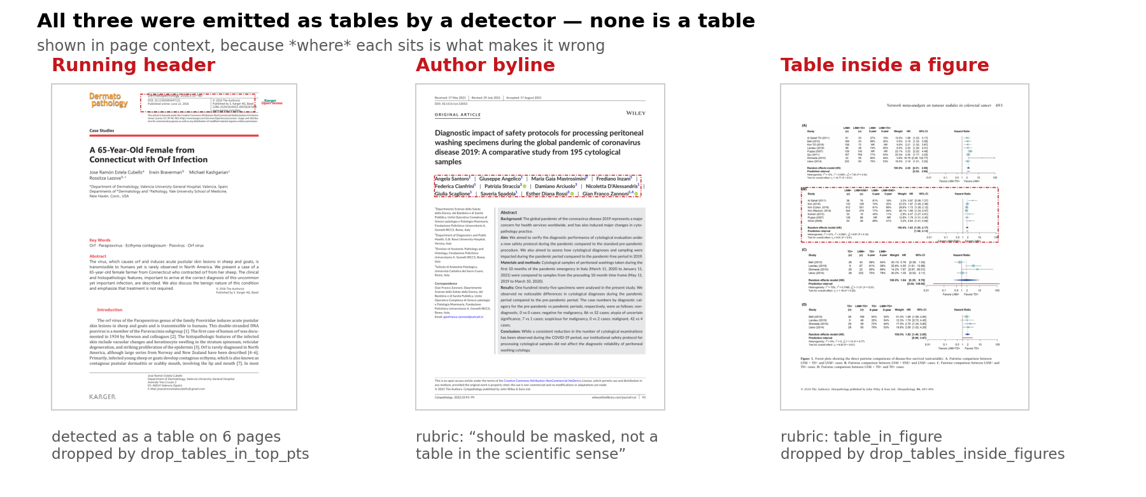
E8 · Three things a detector called a table, and none of them is one
Detector false positives suppressed by the pipeline
Corpus-wide: 666 regions dropped by drop_tables_in_top_pts, 67 by drop_tables_inside_figures.
A table detector is a shape detector: ruled boxes with aligned text look like tables whatever they contain.
Notes:
Table detection is shape detection. TATR in particular finds ruled boxes with aligned text, and
it does not know or care what is written inside them.
I am showing these in page context rather than as crops, because *where* each sits is what makes
it wrong - a cropped byline looks like a small table, and only the page tells you it is the author
block.
Three real false positives. On the left, a journal running header - the Karger banner with the
DOI, the publication date and the copyright line. It has rules and columns, so it looks exactly
like a small table, and it was detected as one on six consecutive pages of the same paper. The
fix is blunt and effective: drop any table region whose top edge is within fifty points of the
page top. That rule fires 666 times across the corpus.
In the middle, the author byline from a different paper - names separated by vertical bars, which
is a grid. My annotation for it under the rubric was "should be masked, not a table in the
scientific sense", which I think is the right description.
On the right, a forest plot. There genuinely is a table inside that figure - study names, sample
sizes, hazard ratios - but it belongs to the figure, and emitting it separately double-counts the
content and breaks the figure crop. That is dropped by a containment rule: any table region 80
percent or more inside a figure element is discarded. 67 corpus-wide.
The honest framing is that none of these is a clever fix. They are three narrow geometric rules
that each remove one recurring class of nonsense.
[1:15]

Slide 63
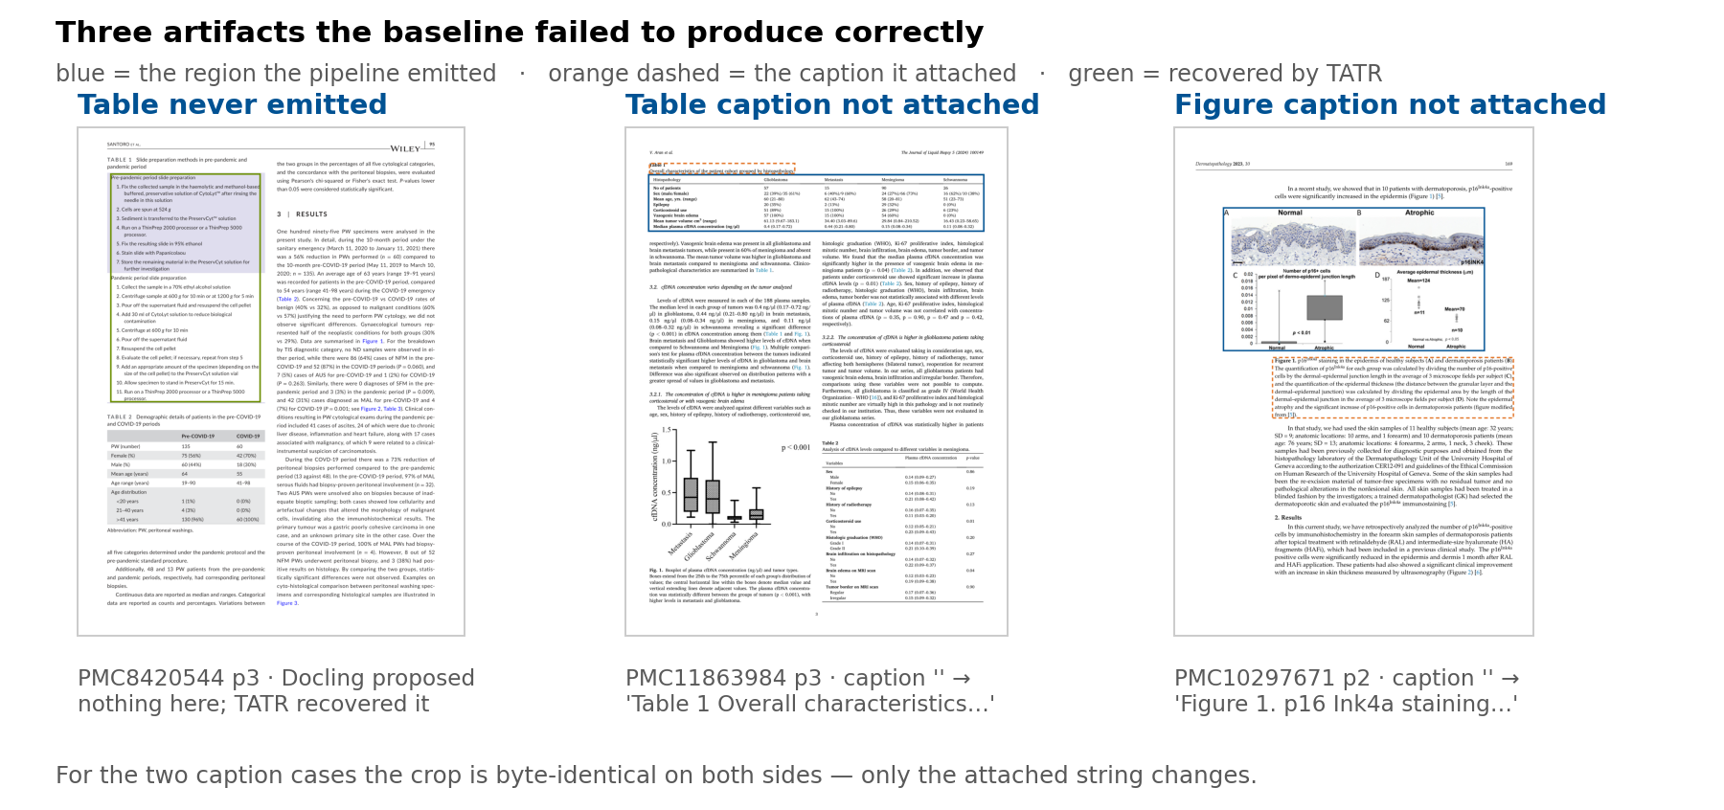
E9 · Three artifacts the baseline failed to produce correctly
One table never emitted; two captions never attached
Notes:
Three more cases, all from the rubric set, all verified against my own annotations.
On the left, a table the Docling-only configuration never emitted at all. TATR proposes it, the
union keeps it, and the rubric rates the resulting crop correct. This is the same mechanism as the
split table on slide six, on a simpler case - an ordinary single-page table that one detector
happened to miss.
The middle and right panels are caption failures. Blue marks the region the pipeline emitted;
orange dashed marks the caption it attached. You can see the spatial relationship the matcher has
to solve - caption above the table in one case, below the figure in the other. The crop itself is
byte-identical to the baseline's; only the attached string changes.
I show a table case and a figure case together because the matcher is the same code and both
failure modes are common. Eleven figures on the rubric set had no caption at all; five more had
the caption to the side; and one table had none.
The line at the bottom is the point I would make if pressed on why captions deserve a slide. A
caption is the only human-readable description of what a table or figure contains. If a rule cites
Table 2 and Table 2 has no caption, the auditor has to reconstruct from the crop what the table
was even measuring. Provenance without a caption is a coordinate, not an explanation.
[1:00]

Slide 64
E10 · Text assembly also strips citations and layout artifacts
out/text_raw (pre-assembly) vs out/text (assembled)
Notes:
Two smaller cleanup stages that run during text assembly, shown together because neither warrants
a slide alone.
On the left, citation stripping. Bracketed reference markers are removed - fourteen to zero on
this paper - along with collapsed double spaces and the line-level fragmentation. The reason is
that a citation marker sitting mid-sentence corrupts the sentence segmentation that MAP depends
on: "expression correlates with grade [12,14]" splits badly, and the marker itself carries no
meaning once the paper is out of context.
On the right, filter_artifacts. It drops elements with no alphabetic characters at all, short
sidebar metadata lines like Received / Revised / Accepted / Published, single-line text elements
that fall outside the vertical range of the page's anchor blocks, and, on pages with no anchors,
single lines that fail a named-entity check.
Two honest caveats. First, this overlaps with the header/footer masking on E13 - the same
editorial metadata is caught by both, which is belt-and-braces rather than elegance. Second, the
NER-based rule is the only place in the document layer where a model decides what to keep, and I
did not evaluate it separately. It is a heuristic that survived because the rubric numbers were
acceptable with it on.
[0:50]

Slide 65
E11 · The agreement scorer, end to end
One method: eligible voter outputs in, a deferral score and a winner out
• Input: the voter outputs that passed the schema and provenance gates, each a set of typed findings, not a string
• No voters → REJECT · exactly one → score 1.0 by construction (hence legacy_single_voter_policy = escalate)
• Voters with zero findings are dropped before the matrix; fewer than two survive → ESCALATE at 0.0
• Pairwise similarity over the survivors. The `hybrid` scorer blends four signals:
0.50 biomedical entity overlap 0.30 claim-embedding similarity
0.15 category agreement 0.05 cited-evidence overlap
• Each voter scores its mean similarity to the others; the chunk score is the maximum of those means
• Winner = the argmax, ties broken on grounding quality. θ = 0.9 / θ_reject = 0.2 are applied downstream, not here.
Max, not mean: one agreeing pair carries the chunk. Agreement is not correctness, which is why GROUNDING runs afterwards.
Notes:
This is the whole scoring method in one slide, and it is worth walking because every accept,
escalate and reject decision in the cascade comes out of it.
Start with what goes in. Not raw model text - the voter outputs that already survived the schema
and provenance gates, each one a set of typed findings. So "do these voters agree?" is a question
about structured records, not string overlap.
Two degenerate cases are handled before any matrix exists. Zero eligible voters is a reject. Exactly
one voter is scored 1.0 - by construction, because a single output trivially agrees with itself.
That number is an artifact, not evidence, and it is exactly why the shipped configuration sets
legacy_single_voter_policy to escalate: a lone survivor has no agreement signal, so it goes up the
cascade rather than being accepted on a synthetic score.
Voters that returned nothing are then dropped, because leaving them in would drag every real
voter's average down and manufacture disagreement. If fewer than two survive, the chunk escalates.
Only then is the matrix built, pairwise over the survivors, using the hybrid scorer whose weights
are on the slide - entity overlap dominant at 0.50, claim embedding 0.30, category 0.15, cited
evidence 0.05. Each voter takes its mean similarity to the others; the chunk's score is the maximum
of those means, and the winner is the voter that achieved it. Ties break on grounding quality.
Two things I would emphasise. First, maximum rather than mean: one tightly agreeing pair carries the
chunk even if a third voter dissents completely. That is deliberate - it is a consensus detector,
not a unanimity detector. Second, this method returns a score, not a verdict. Theta at 0.9 and
theta-reject at 0.2 are applied one layer up, which is what let me sweep those thresholds offline
without re-running a single voter.
And the caveat from E10 stands: this measures agreement, not correctness. Voters can agree and all
be wrong. Nothing here detects that, which is why grounding runs against the source text afterwards.
[1:15]

Slide 66
A Pipeline for Extracting Simple Rules from Medical Literature
for Automatic Disease Detection in Histopathology
Master's Thesis in Informatics
Emirhan Nadir Karaman
Supervisor: Frederic Mrozinski, M.Sc.
Examiner: apl. Prof. Dr. Georg Groh
Chair of Connected Mobility | Munich, 11. August 2026
Notes:
Good morning, and thank you for coming. I'm Emirhan Karaman, and this is my Master's thesis,
supervised by Frederic Mrozinski and examined by Professor Groh.
The title is long, so let me split it. The input is medical literature - histopathology papers.
The output is "simple rules": small, typed, subject-outcome statements a pathologist could
actually check. The word doing the most work in that sentence is CHECK. Everything in the next
eighteen minutes follows from taking that word seriously.
[0:25] -> "Let me start with why that's hard."

