Slide 1
A Pipeline for Extracting Simple Rules from Medical Literature
for Automatic Disease Detection in Histopathology
Emirhan Nadir Karaman
Supervisor: Frederic Mrozinski, M.Sc. · Examiner: apl. Prof. Dr. Georg Groh
Chair of Connected Mobility · Department of Informatics · TUM
Notes:
Keep this short. Name the two halves of the title — extracting rules, and the histopathology setting — and move on. [0:20]

Slide 2
Diagnostic criteria are written for humans, one paper at a time
Motivation
• Histopathology diagnosis rests on rules of the form: this marker, in this tissue, points to this outcome
• Those rules are stated in prose, scattered across tens of thousands of papers, and never collected anywhere machine-readable
• A pathologist cannot read 1,000 papers. A model can — but then you have to trust what it says it read.
• Two domain terms used throughout: IHC — a stain showing whether a protein is present. Morphology — what the tissue looks like.
Notes:
Set up the domain in one breath. The audience knows NLP, not pathology, so define IHC and morphology now and never again.
The key move: the knowledge exists, it is just not in a form anything can query. [1:10]

Slide 3
An LLM will answer. The problem is knowing whether to believe it
The research gap
• Modern models extract these claims fluently — and also hallucinate, omit, and paraphrase away the qualifier that mattered
• For a clinical use case, an unsourced claim is worthless. You need the sentence, the page, the coordinates.
• So provenance is not a feature bolted on at the end — it is a hard constraint that shapes the whole architecture
• And it forces two pipelines: you cannot trace a rule to a paragraph if the parser silently dropped the table that paragraph refers to
Notes:
This is the slide that justifies everything downstream. Land the last bullet properly — it is why document extraction is measured separately rather than assumed. [1:10]

Slide 4
Five research questions, each answered by a measurement
Scope
• RQ1 — how much does targeted post-processing improve document extraction over a strong off-the-shelf parser?
• RQ2 — can every extracted rule be traced back to a source paragraph?
• RQ3 — what does an agreement-based cascade of cheap and expensive models buy, in quality and in cost?
• RQ4 — how well does one frozen NLI model serve two different roles?
• RQ5 — does any of it hold on papers the system was not tuned on?
Notes:
Read them once, quickly. They are the spine — every results slide from here on answers exactly one of these, and I will name which. [1:00]

Slide 5
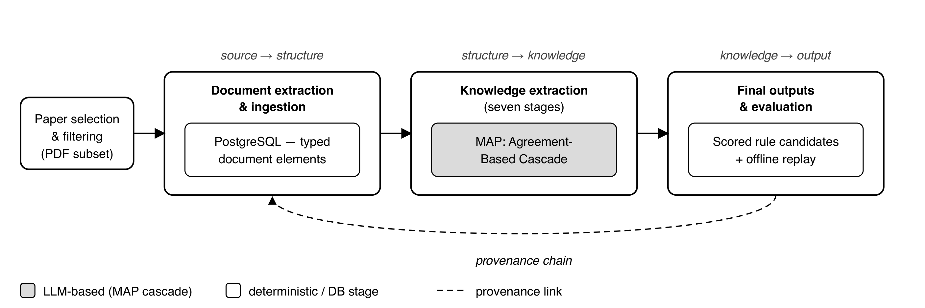
Two pipelines, joined by a database that carries provenance
End-to-end architecture
Only the MAP stage is stochastic. Everything else is deterministic or a database operation.
Notes:
Walk left to right once. Document extraction turns PDFs into typed elements in PostgreSQL; knowledge extraction turns those into scored rules. The dashed line is the provenance chain — the thing that makes RQ2 answerable.
Say explicitly that the grey box is the only place a language model is involved. [1:10]

Slide 6
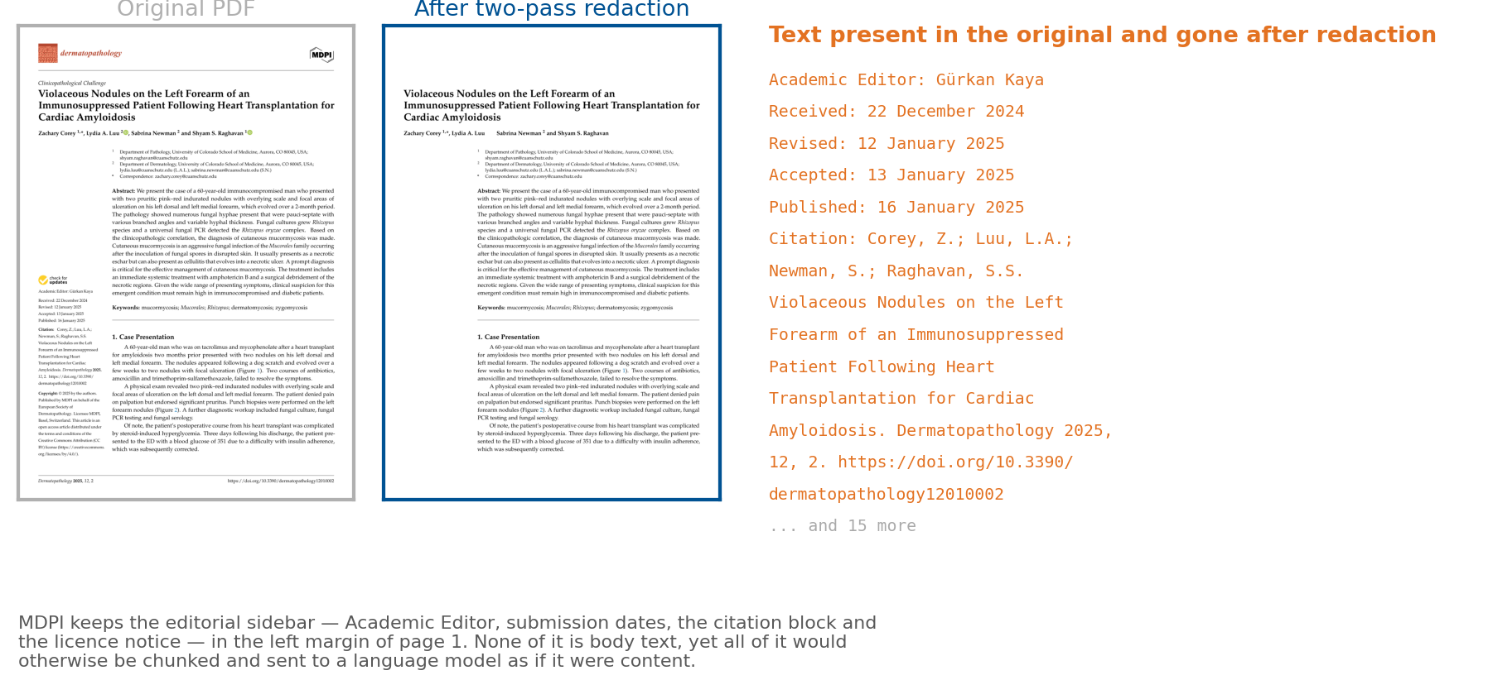
Published PDFs are adversarial in ways nobody warns you about
Left: the page as published. Right: what the pipeline redacts before reading it.
Running headers, footers and side matter are removed geometrically, before any text assembly.
Notes:
This is the slide that earns the document-extraction half of the thesis. Nobody expects a PDF to be hostile.
Point at the sidebar: 'Academic Editor', received and accepted dates, the citation block. All of it would otherwise land in the body text and be extracted as if it were a finding. [1:10]

Slide 7
Docling as the backbone, plus three targeted fixes
Each fix aims at a named, measured failure
• Docling — an open-source layout-aware PDF parser. It stays the sole source of body text, section structure and figure regions.
• Hybrid table detection — Docling ∪ TATR (Microsoft's Table Transformer), any overlap merged into the bounding union, per page
• Footnote expansion — table crops extended downward ×1.2, because Docling crops tightly and cuts the footnotes off
• Figure post-processing — a <50 pt icon filter and a geometric caption matcher
• Two-pass ghost-text removal — invisible text redacted, layout re-extracted
Notes:
I did not replace Docling. I measured it and then fixed what it got wrong, and each fix targets a failure I can show you. The next three slides show three of them. [1:00]

Slide 8
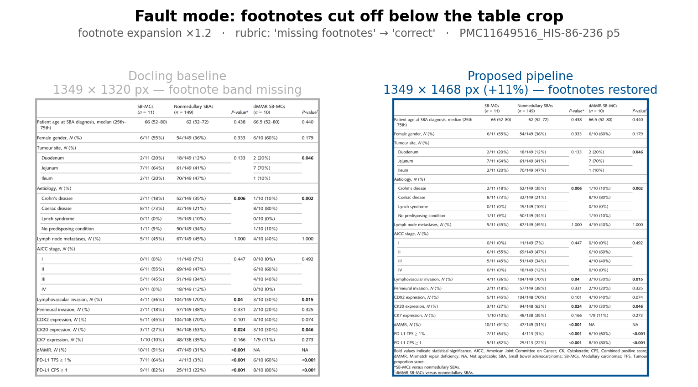
Footnote expansion is the single biggest lever in the document layer
Same table, off-the-shelf crop vs the pipeline's
Rubric label moves from 'missing footnotes' to 'correct'. The crop grows downward to absorb the footnote block.
Notes:
Table footnotes carry the abbreviation expansions and the statistical caveats — exactly the qualifiers a downstream rule needs. A tight crop silently discards them.
This one change accounts for more of the RQ1 gain than anything else. [1:00]

Slide 9
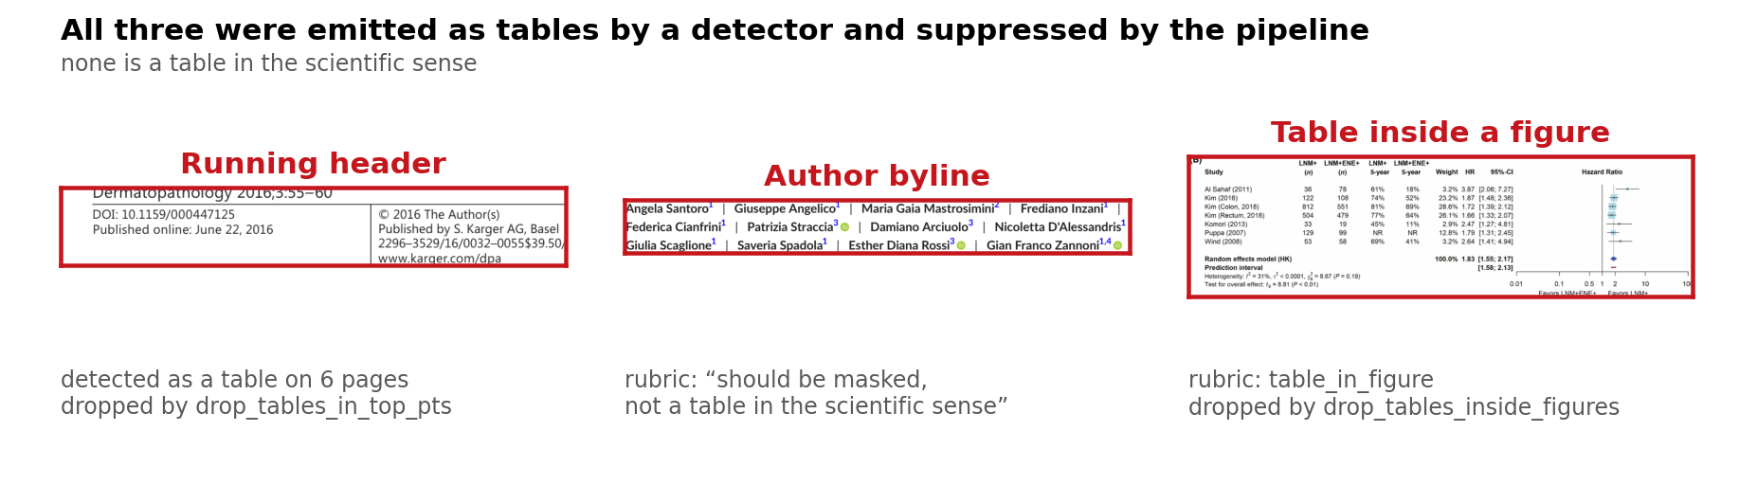
Three things a detector called a table, and none of them is one
Detector false positives, suppressed by the pipeline
A journal masthead, an author byline, and a table nested inside a figure.
Notes:
Precision matters as much as recall here. Every false table is a region of text removed from the body — so a spurious detection does not just add noise, it deletes real content. [1:00]

Slide 10
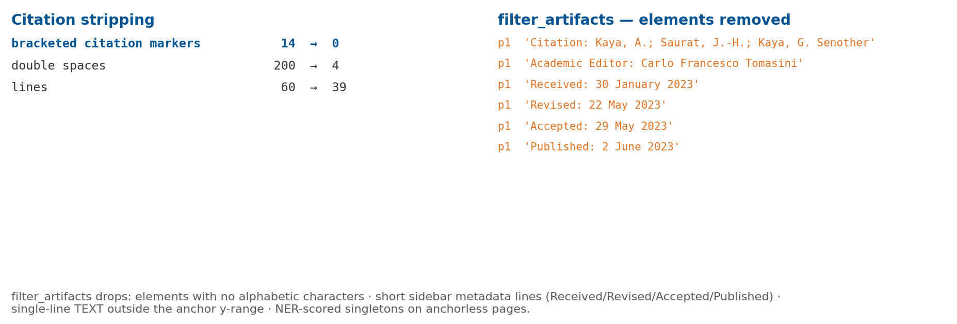
Text assembly also strips citations and layout artifacts
out/text_raw (pre-assembly) vs out/text (assembled)
Citation markers, hyphenation across column breaks, and ligature codepoints are all normalised before a sentence reaches the model.
Notes:
Small, unglamorous, and load-bearing: the model sees clean sentences, so a verbatim quote it returns can actually be matched back against the source. Without this, provenance checking fails on formatting noise. [1:00]

Slide 11
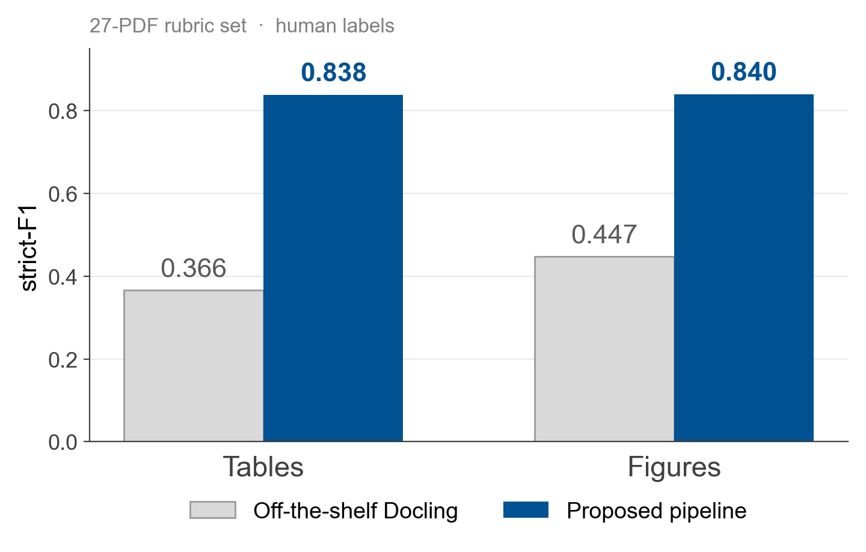
RQ1: the targeted fixes roughly double strict-F1 on tables and figures
27-PDF rubric set · human labels · strict-F1 requires every applicable dimension to be correct
Strict means no partial credit: a crop with the right region but a missing footnote scores zero.
Notes:
Name the rubric first — four dimensions, no partial credit, human-labelled. Then the numbers.
If asked whether the rubric was designed after seeing the results: it was fixed first, and the sweep was run against it. [1:10]

Slide 12
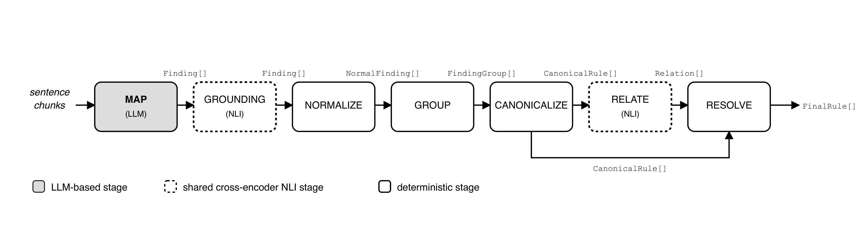
Seven stages, and only the first one is stochastic
MAP → GROUNDING → NORMALIZE → GROUP → CANONICALIZE → RELATE → RESOLVE
Everything after MAP is deterministic — the same inputs give the same rules, every run.
Notes:
The design principle: push all the nondeterminism into one stage, then make everything downstream reproducible.
NORMALIZE resolves entity names through a curated synonym dictionary, then UMLS — the biomedical terminology database — then an identity fallback. That ordering is deliberate: a clinician's mapping beats the automated linker. [1:10]

Slide 13
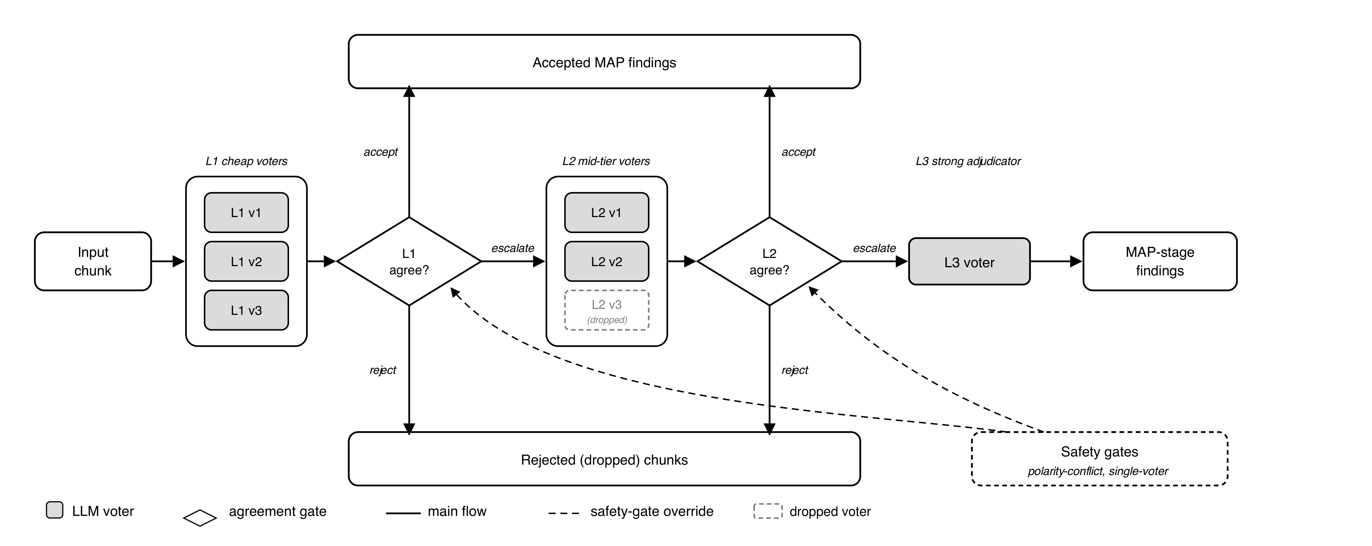
Cheap voters decide; the strong model is called only on disagreement
Agreement-based cascading at the MAP stage
Five voters across three providers. Escalation happens when they disagree, not on a schedule.
Notes:
This is the core mechanism, so take it slowly.
Three cheap models read the same chunk. If they agree, we accept and stop. If they disagree, two mid-tier models get it. If those disagree, Claude Sonnet adjudicates and always emits.
The bet is that agreement among cheap models is a usable proxy for confidence — and the whole cost argument rests on whether that bet pays. [1:20]

Slide 14
Agreement is max-consensus over a similarity matrix, not a vote count
No ground truth is involved at this step
• Each voter returns a set of typed findings — structured records, not a string, so 'do they agree?' is not string comparison
• Align every pair of voters one-to-one, then blend four signals: 0.50 biomedical entity overlap · 0.30 claim-embedding similarity · 0.15 category agreement · 0.05 cited-evidence overlap
• Each voter scores its mean similarity to the others; the chunk's score is the maximum of those means, and the winner is the voter that achieved it
• Accept at θ = 0.9, drop below 0.2, escalate in between
Notes:
The entity-heavy weighting was selected empirically, not chosen by hand.
The line to underline: this measures agreement, not correctness. Five voters can share a misconception and agree confidently. Nothing in the scorer detects that — which is exactly why grounding runs afterwards. [1:10]

Slide 15
Grounding: every claim is checked against the sentence it cites
One frozen NLI model, no fine-tuning
• MAP returns a claim plus the verbatim sentence it came from
• An NLI model scores entailment on that pair; below 0.5 the finding is dropped
• The model is PubMedBERT-MNLI-MedNLI, frozen — no fine-tuning, and the same model is reused later for relation classification
• This is the check that catches a fluent, well-formed, unsupported claim
Notes:
Grounding is where an unsupported claim dies, and it costs real recall — six strict-F1 points, which I report rather than hide.
I kept it anyway. An ungrounded rule in this domain is worse than a missing one. [1:00]

Slide 16
What one extracted rule actually looks like
Every field is either extracted or derived — nothing is free text
• subject CD30 · outcome overall survival · relation prognostic · direction negative
• scope — the cohort and disease subtype the claim applies to
• evidence — PMCID, text-element id, sentence index, and the verbatim quote
• scores — grounding score, support count, contradiction count, final score
• From that chain you can reopen the source PDF at the right paragraph
Notes:
Show the shape rather than reading the fields. The point is that the rule is a typed record with a pointer back into the corpus, not a sentence of generated prose. [1:00]

Slide 17
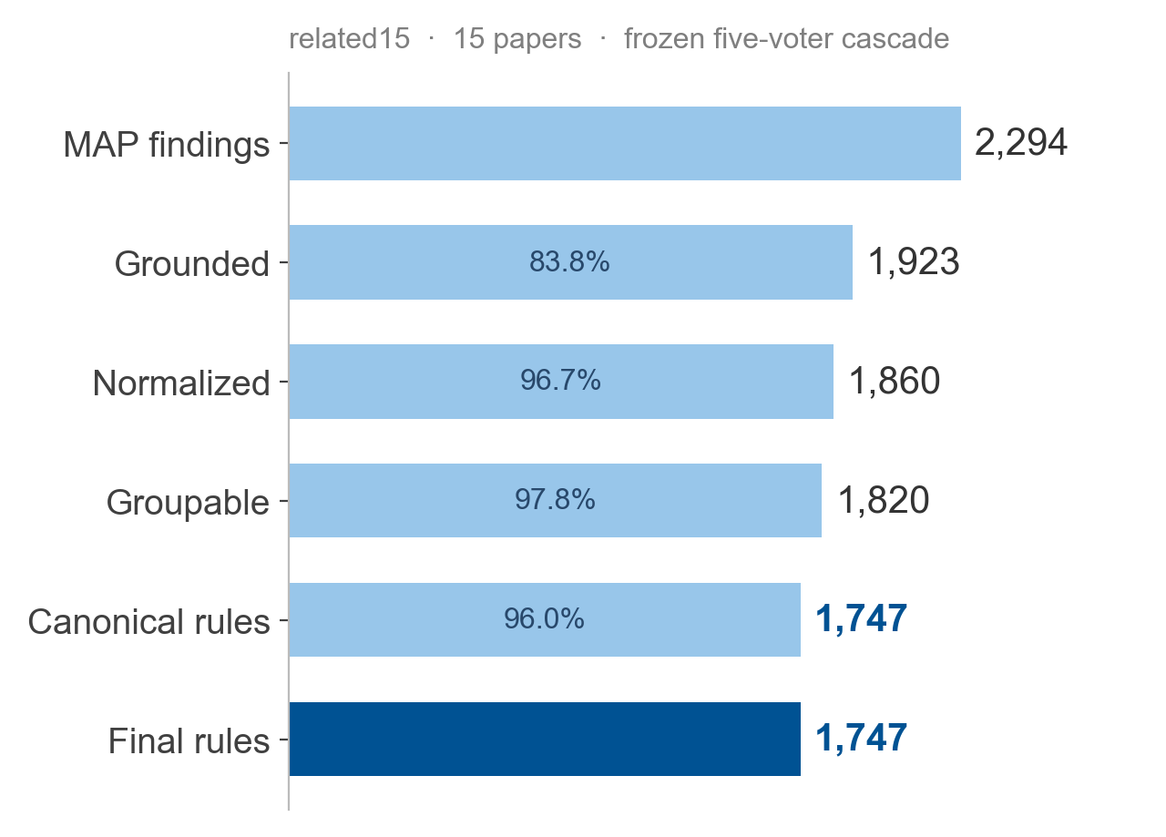
RQ2: 1,747 rules, and every one traces back to a source paragraph
related15 · frozen five-voter cascade · θ = 0.9, grounding 0.5
The funnel is lossy by design — each stage removes findings that cannot be supported.
Notes:
Two things to say. First the carry-rate: provenance survives all seven stages, which is the RQ2 answer.
Second, do not apologise for the funnel narrowing. Every drop is a claim that failed a check — that is the system working. [1:10]

Slide 18
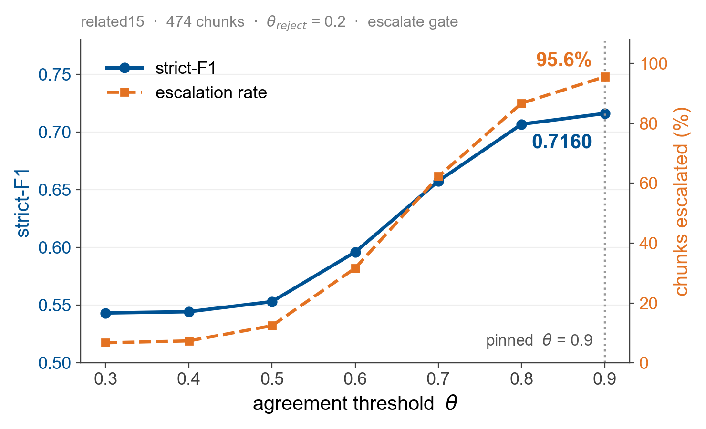
RQ3a: top cascade quality requires near-universal escalation
Calibration on related15 · 474 chunks · strict-F1 vs Opus silver labels
At the shipped operating point, 95.6% of chunks reach the strong model.
Notes:
This is the uncomfortable finding and the setup for the next slide.
The cascade's best quality arrives only when almost everything escalates — which means the cheap tier is doing very little work at the quality end. Say it plainly; the next slide draws the consequence. [1:10]

Slide 19
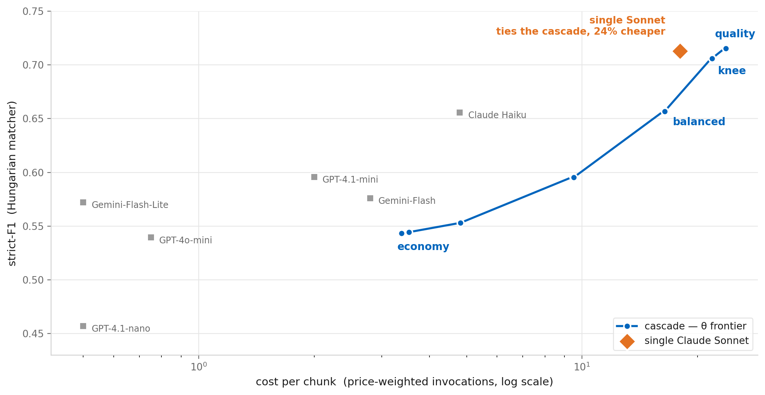
RQ3b: the cascade ties the best single model, which costs 24% less
The thesis's central negative result — reported, not buried
Four operating points on the cascade's θ-curve. A single Sonnet sits above the frontier's knee at lower cost.
Notes:
Give this the full ninety seconds. It is the most honest slide in the deck and the committee will respect it more than a win.
The cascade reaches 0.7160. A single Sonnet call reaches 0.7129 — within noise — at 24 percent lower cost. On this corpus, at these prices, the cascade is not the cost-effective deployment.
What survives is the framework: provenance by construction, cost and quality as calibrated knobs, and an offline replay that reproduces every number here without a new API call. The calibration numbers are corpus- and price-specific. The method is not.
If asked why the middle of the curve looks empty — the knee is chosen by weighted-sum scalarization, which only reaches convex-hull vertices. 'balanced' is an ε-constraint point that fills it. [1:30]

Slide 20
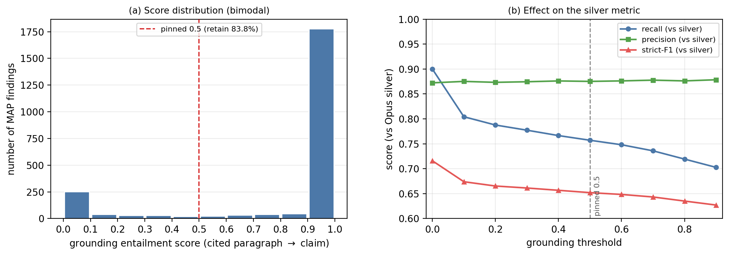
RQ4: one frozen NLI model, two roles — grounding costs six F1 points
Same model for claim-level grounding and pairwise relation classification
The grounding filter is a deliberate precision-for-recall trade, quantified rather than assumed.
Notes:
One model, two jobs, no fine-tuning for either — that is the reusability claim.
The six-point cost is the price of refusing to emit unsupported rules. I report it as a trade, not as a loss. [1:00]

Slide 21
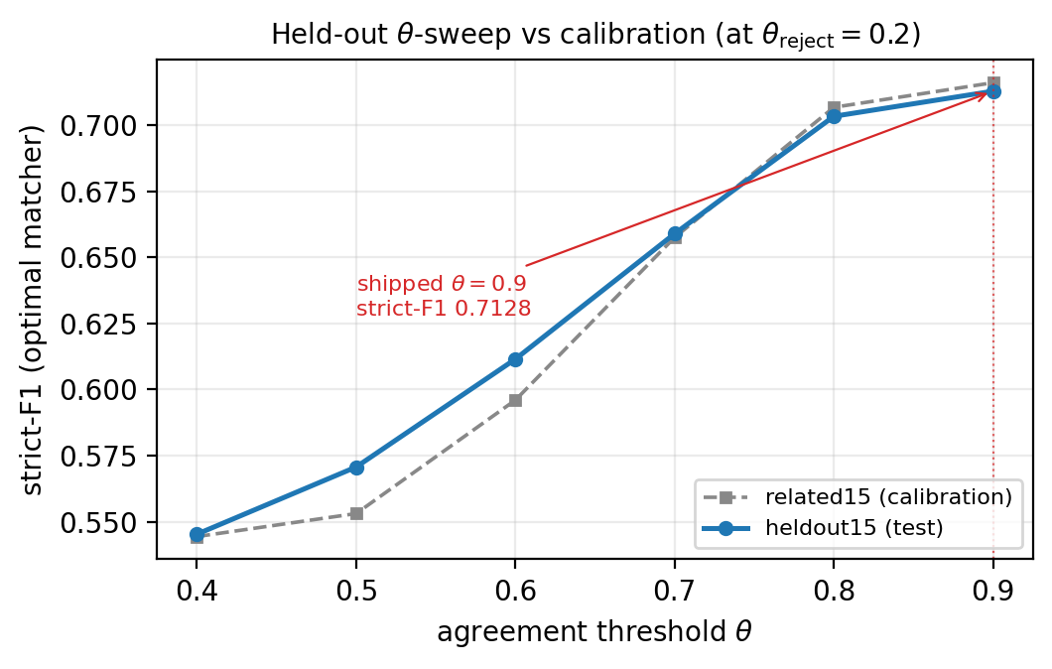
RQ5: held-out performance sits within noise of calibration
heldout15 — 15 papers, disjoint from calibration, randomly sampled, configuration frozen before evaluation
Two physically separate clusters, so the held-out set is structurally impossible to tune on.
Notes:
The configuration was frozen before this set was touched, and the two clusters are physically disjoint rather than a seeded split of one pool — which is what makes the claim defensible.
The honest reading: this shows the calibration did not overfit. It does not show the system generalises to a different corpus. [1:00]

Slide 22
Every number after RQ1 measures agreement with an LLM, not a pathologist
Limitations and threats to validity
• The reference labels are silver — generated by Claude Opus. They are not clinical ground truth and I never call them that.
• A clinician-labelled evaluation is the obvious next step, and the one thing that would change the standing of every knowledge-extraction number here
• Calibration used 15 related papers; held-out is 15 more from the same corpus and the same journals
• Cost is a price-weighted unit from a hand-compiled price book of list prices — the thesis states no currency, which is a genuine gap in the write-up
Notes:
Do not rush this slide and do not sound defensive. Raising these yourself is worth more than surviving them in questions.
The silver-label point is the one that matters: RQ1 is human-labelled, everything after it is agreement with a strong model. [1:10]

Slide 23
Four questions answered, one negative result reported rather than buried
Conclusion
• Document extraction and provenance meet their targets — RQ1 and RQ2, decisively
• The cascade is calibrated, reproducible, and ties a single strong model at higher cost — RQ3
• One frozen NLI model serves two roles; held-out sits within noise — RQ4, RQ5
• The contribution is not the calibration numbers, which are corpus- and price-specific. It is the framework: provenance by construction, cost and quality as explicit calibrated knobs, and an offline replay protocol that reproduces every reported number without a single new API call.
Notes:
Close on the framework, not the numbers. The negative result is part of the contribution — it is what makes the rest credible.
Then stop talking. [1:10]

