Slide 1
HSQL vs MYSQL
A Comparison Study

Slide 2
Hyper SQL
HyperSQL Database (HSQLDB) is a modern relational database manager that conforms closely to the SQL:2011 standard and JDBC 4 specifications. It supports all core features and RDBMS.
HSQLDB uses in-memory structure for fast operations against DB server. It uses disk persistence as per user flexibility, with a reliable crash recovery.
HSQLDB is also suitable for business intelligence, ETL, and other applications that process large data sets.
HSQLDB has a wide range of enterprise deployment options, such as XA transactions, connection pooling data sources, and remote authentication.
HSQLDB is written in the Java programming language and runs in a Java Virtual Machine (JVM). It supports the JDBC interface for database access.

Slide 3
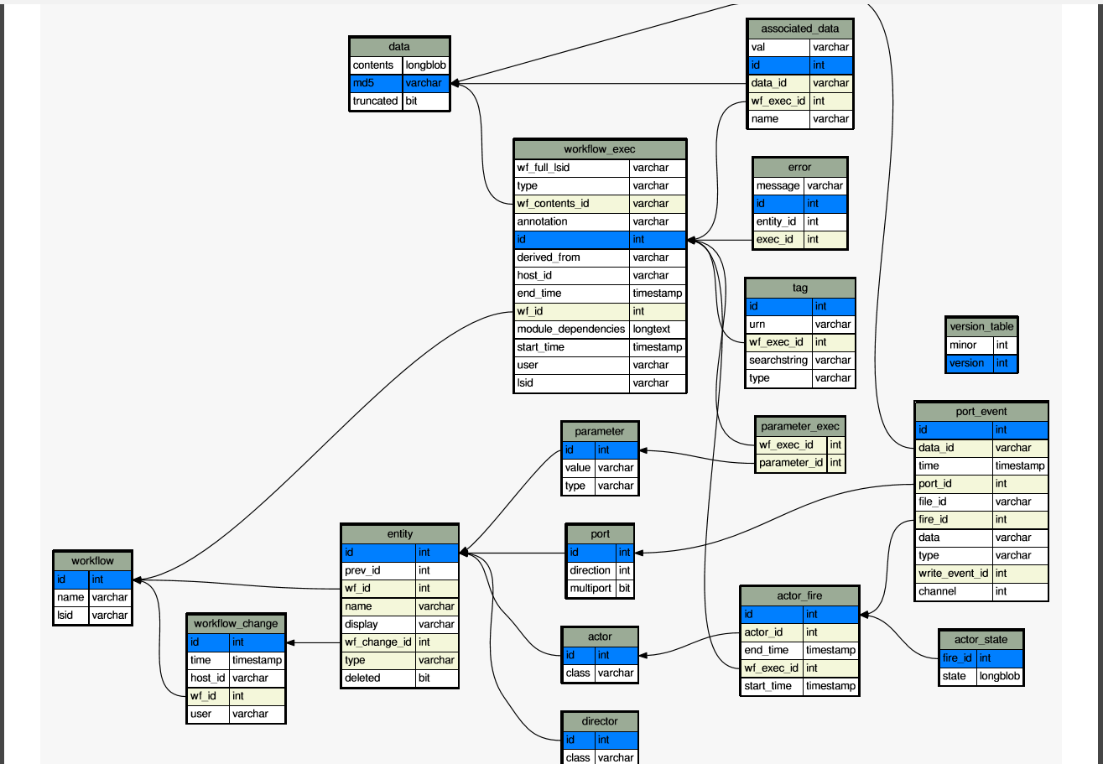
Schema

Slide 4
Hyper SQL Provenance Tables
PUBLIC.ACTOR-- Maps an actor to its implementation class.
PUBLIC.ACTOR_FIRE—Actor firings for a particular actor in a workflow
Name | Type | References | Recorded By
Class | varchar |  | regActor()
id | long | Entity(id) | regActor()
Name | Type | References | Recorded By
actor_id | long | actor(id) | actorFire()
end_time | datetime |  | actorFire()
id | long |  | actorFire()
start_time | datetime |  | actorFire()
wf_exec_id | long | workflow_exec(id) | actorFire()

Slide 5
Hyper SQL Provenance Tables
PUBLIC.ACTOR_STATE—Actor state for a particular actor in a workflow
Name | Type | References | Recorded By
Fire_id | long | Actor_fire(id)
State | BLOB

Slide 6
Hyper SQL Provenance Tables
PUBLIC.DIRECTOR-Maps a director to its implementation class
PUBLIC.ENTITY-Each entity in a workflow-actors,parameters-is a row
Name | Type | References | Recorded By
class | varchar |  | regDirector()
Id | long | entity(id) | regDirector()
Name | Type | References | Recorded By
deleted | boolean |  | regNNN()
display | Varchar |  | regNNN()
id | Long |  | regNNN()
name | Varchar |  | regNNN()
prev_id | Long |  | regNNN()
type | Varchar |  | regNNN()
wf_change_id | Long | workflow_change(id) | regNNN()
wf_id | Long | workflow(id) | regNNN()

Slide 7
Hyper SQL Provenance Tables
When a parameter’s value changes a new row is added to Entity table and Parameter table.
The entity(id) of the new row can be used to look up Parameter table.
Previous values of the parameter can be found by Entity(prev_id).
Deleted is always false.

Slide 8
Hyper SQL Provenance Tables
PUBLIC.PARAMETER-Parameter type and value changes
PUBLIC.PARAMETER_EXEC-Initial values of parameters of a workflow
Name | Type | References | Recorded By
id | Long | entity(id) | regParameter()
type | Varchar |  | regParameter()
Value | Varchar |  | regParameter()
Name | Type | References | Recorded By
parameter_id | Long | parameter(id) | executionStart()
wf_exec_id | Long | workflow_exec(id) | executionStart()

Slide 9
Hyper SQL Provenance Tables
PUBLIC.PORT
Actors read and write tokens via ports. The direction column says if port is input, output or both.
Multiport is true if the port allows more than one connection.
Name | Type | References | Recorded By
direction | Int |  | Report()
id | Long | entity(id) | regPort()
multiport | boolean |  | regPort()

Slide 10
Hyper SQL Provenance Tables
PUBLIC.PORT_EVENT-Each token read or wrote is a row.
Name | Type | References | Recorded By
channel | long |  | portEvent()
data | varchar |  | portEvent()
data_id | varchar | data | portEvent()
file_id | Varchar | data | portEvent()
fire_id | long | actor_fire(id) | portEvent()
id | long |  | portEvent()
port_id | long | port(id) | portEvent()
time | datetime |  | portEvent()
type | varchar |  | portEvent()
write_event_id | long |  | portEvent()

Slide 11
Hyper SQL Provenance Tables
PUBLIC.ASSOCIATED_DATA-Files and other data objects of a workflow.
PUBLIC.DATA-Data used by the workflow.
Name | Type | References | Recorded By
data_id | varchar | data(md5) | addFileForExecution()
Id | long |  | addFileForExecution()
Name | varchar |  | addFileForExecution()
val | varchar |  | addFileForExecution()
wf_exec_id | long | workflow_exec(id) | addFileForExecution()
Name | Type | References | Recorded By
contents | BLOB |  | portEvent(),executionStart()
md5 | Varchar |  | portEvent(),executionStart()
Truncated | Boolean |  | portEvent(),executionStart()

Slide 12
Hyper SQL Provenance Tables
PUBLIC.WORKFLOW-A row for each workflow
PUBLIC.WORKFLOW_CHANGE- User driven workflow update
Name | Type | References | Recorded By
Id | Long |  | Provenance events
lsid | varchar |  | Provenance events
name | varchar |  | Provenance events
Name | Type | References | Recorded By
id | long |  | Evolution/specificationStart()
host_id | varchar |  | Evolution/specificationStart()
time | datetime |  | Evolution/specificationStart()
user | varchar |  | Evolution/specificationStart()
wf_id | long | workflow(id) | Evolution/specificationStart()

Slide 13
Hyper SQL Provenance Tables
PUBLIC.WORKFLOW_EXEC-Each row corresponds to a workflow.
Name | Type | References | Recorded By
annotation | varchar |  | executionStart()
derived_from | varchar |  | insertRunReferralList()
end_time | datetime |  | executionStop()
host_id | varchar |  | executionStart()
lsid | varchar |  | executionStart()
Id | long |  | executionStart()
module_dependencies | varchar |  | executionStart()
start_time | datetime |  | executionStart()
user | varchar |  | executionStart()
wf_contents_id | varchar | data(md5) | executionStart()
wf_full_lsid | varchar |  | executionStart()
wf_id | long | workflow(id) | executionStart()

Slide 14
Hyper SQL Provenance Tables
PUBLIC.ERROR-Errors that occur during workflow executions.
PUBLIC.VERSION_TABLE
Name | Type | References | Recorded By
entity_id | long
id | long
exec_id | long | workflow_exec(id)
message | varchar
Name | Type | References | Recorded By
minor | long
version | long

Slide 15
Hyper SQL Provenance Tables
PUBLIC.TAG-tags associated with either workflows or workflow executions.
Name | Type | References | Recorded By
id | long
searchstring | varchar
type | varchar
urn | Varchar
wf_exec_lsid | varchar | workflow_exec(lsid)

Slide 16
Hyper SQL vs MYSQL
HSQL Pros:
Connection successful but
Cons:
Bugs/Learning curve:-
https://sourceforge.net/p/hsqldb/bugs/
MySQL in general
Pros:
is better if more than 50 concurrent users and large volume of data
Cons:
But need to administer

Slide 17
Thanks!
Get started and find more details at-
https://code.kepler-project.org/code/kepler/trunk/modules/provenance/docs/provenance.pdf

