Slide 1
R vs. Python Preference Analysis through the RStudio Community Survey
Xiaolong Ge
251172095

Slide 2
1. Goal
- Understand factors influencing the preference for R or Python.
- Predict future trends in preferences for these languages.

Slide 3
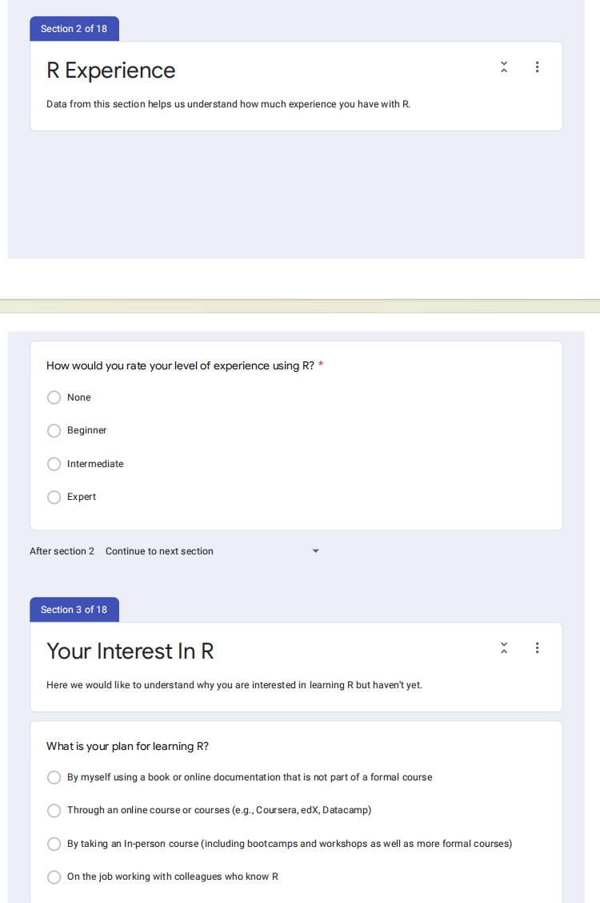
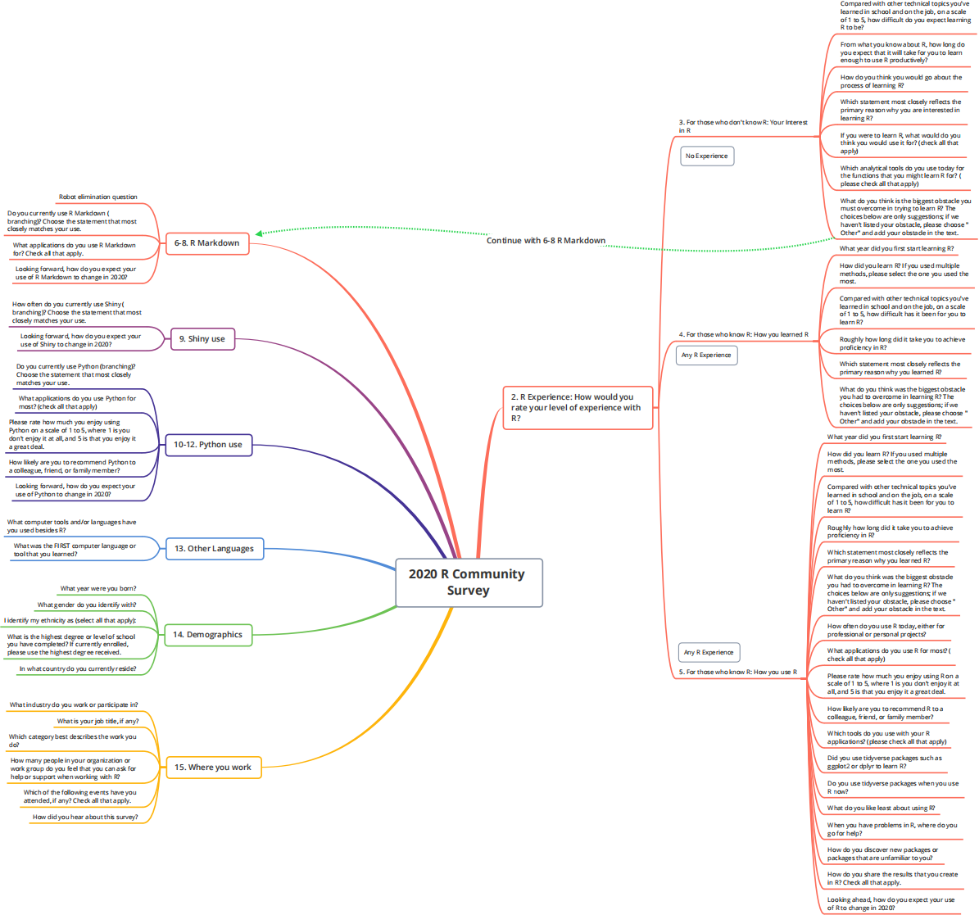
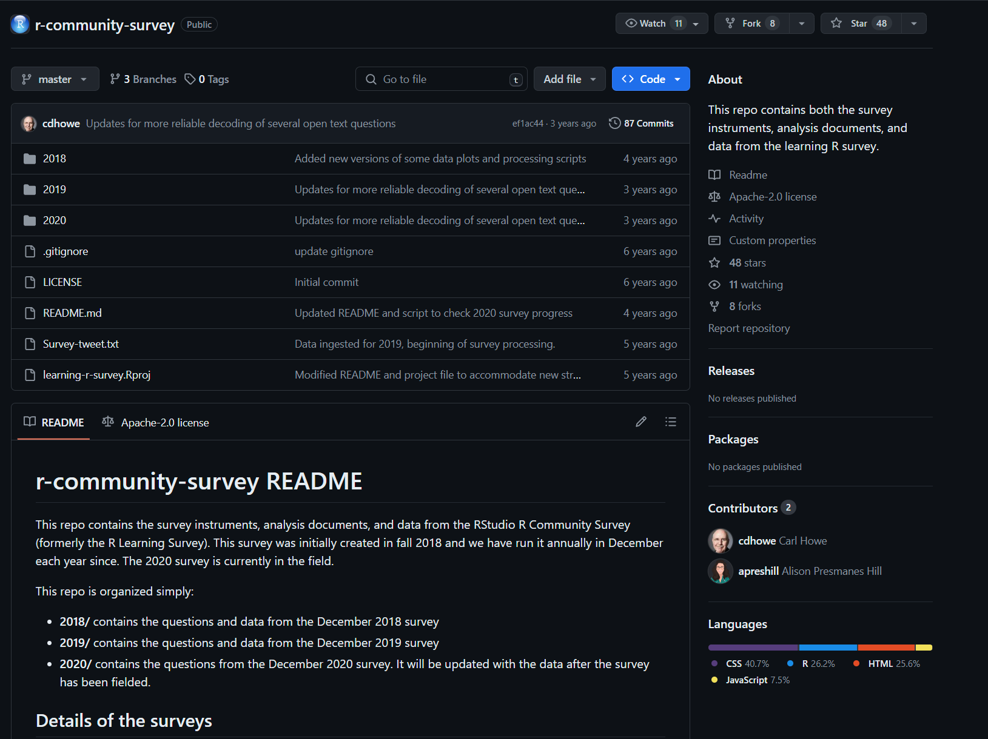
2. Data Source
- Annual R Community Survey by RStudio.
- Data in TSV format, including demographic information and R usage patterns.
- Combined multiple years of survey data for comprehensive analysis.
fig 3. question form example
fig 1. GitHub repository
fig 2. question examples mindmap for 2020

Slide 4
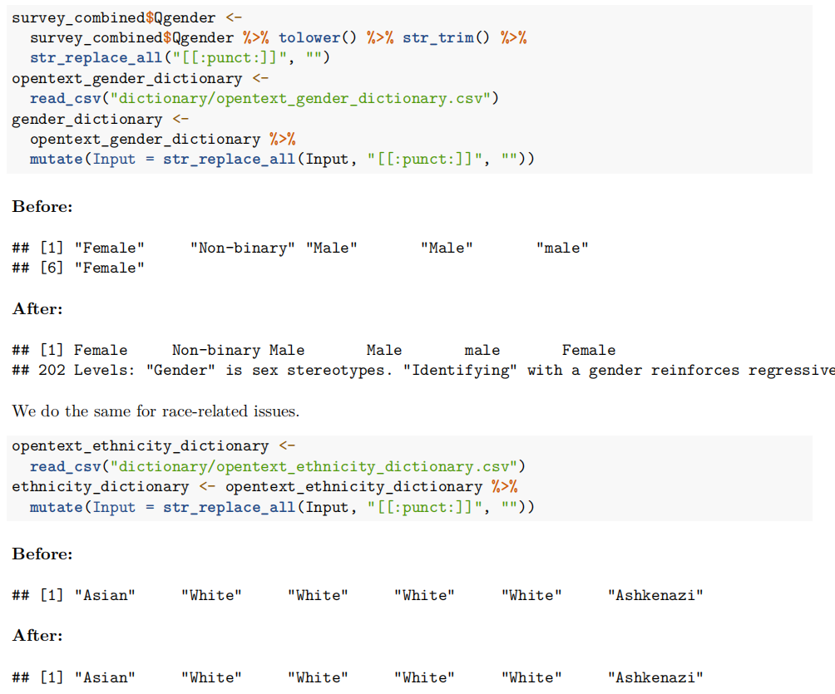
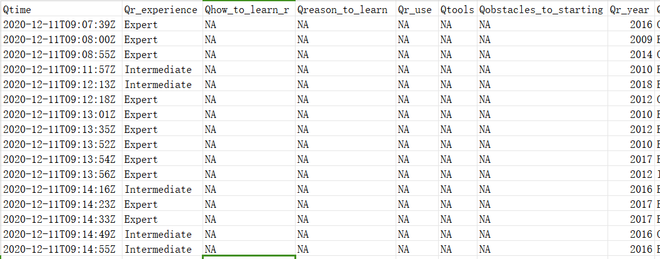
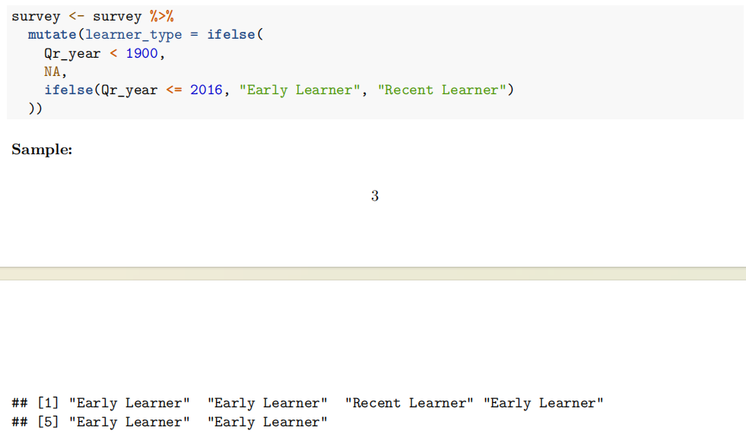
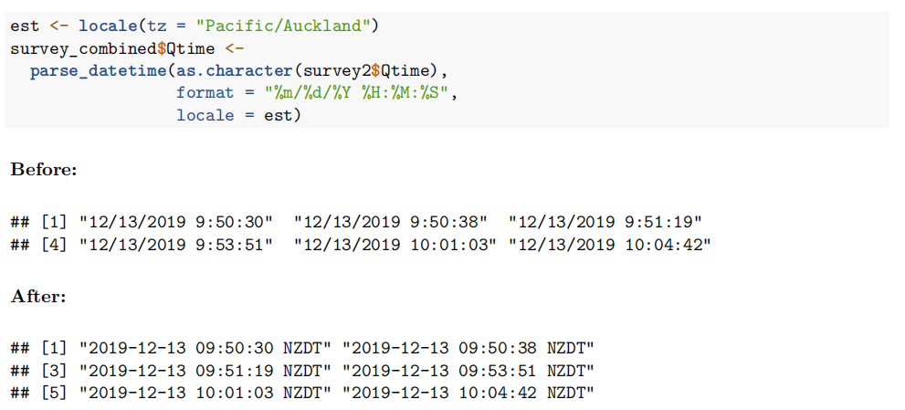
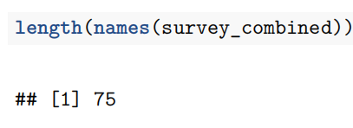
3. Data Processing
- Converted Qtime to datetime object (Auckland timezone).
- Standardized open text answers for gender and ethnicity.
- Categorized learners by year (Early Learners, Recent Learners).
fig 4. raw data example
fig 7. learner categorization
fig 6. gender/ethnicity standardization
fig 8. length of combined results
fig 5. time convert

Slide 5
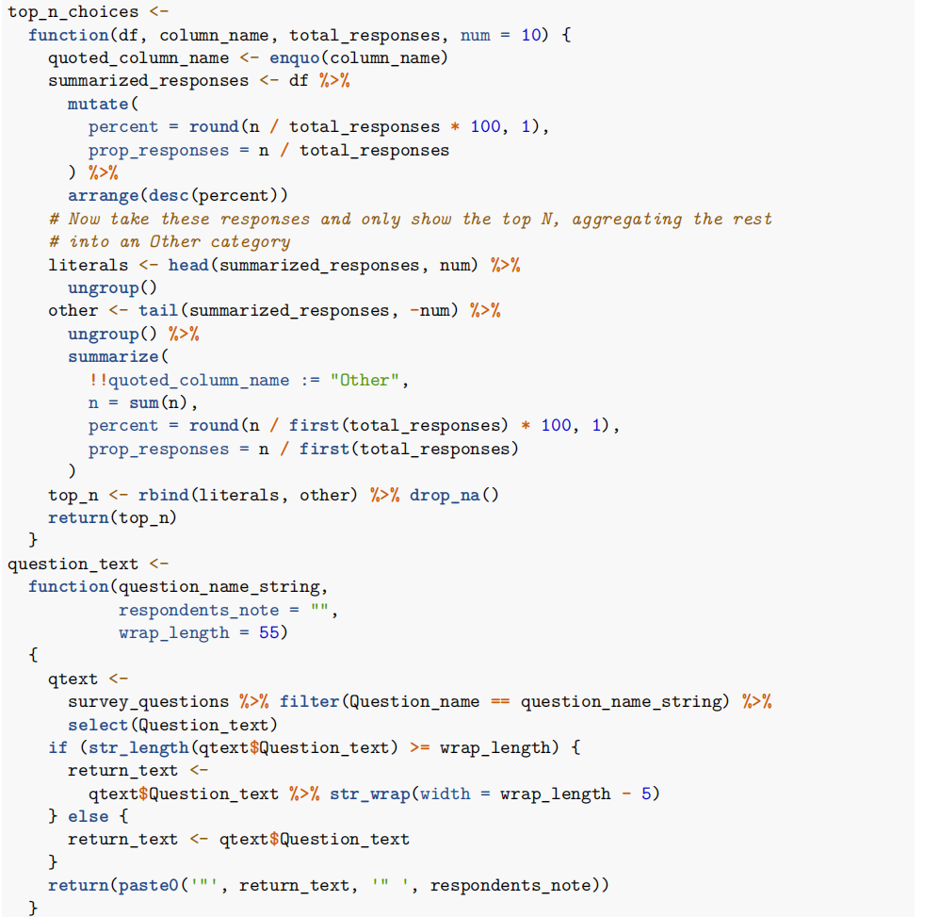
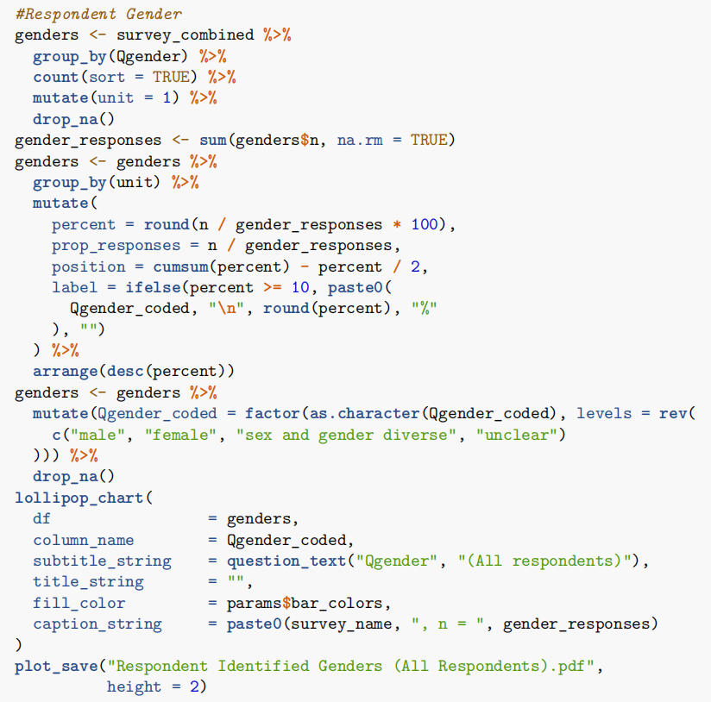
4. Data Processing(Continued)
- Created functions to handle responses:
- `rm.na`: Exclude or include NA values.
- `sort`: Order results by frequency.
- `split-and-summarize`: Handle multiple-choice questions.
- Extract top 'N' results for detailed analysis.
fig 10. example of processing
fig 9. example of plotting

Slide 6
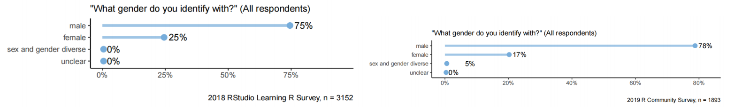
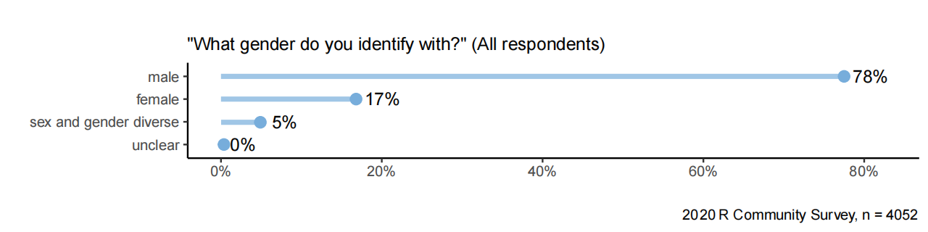
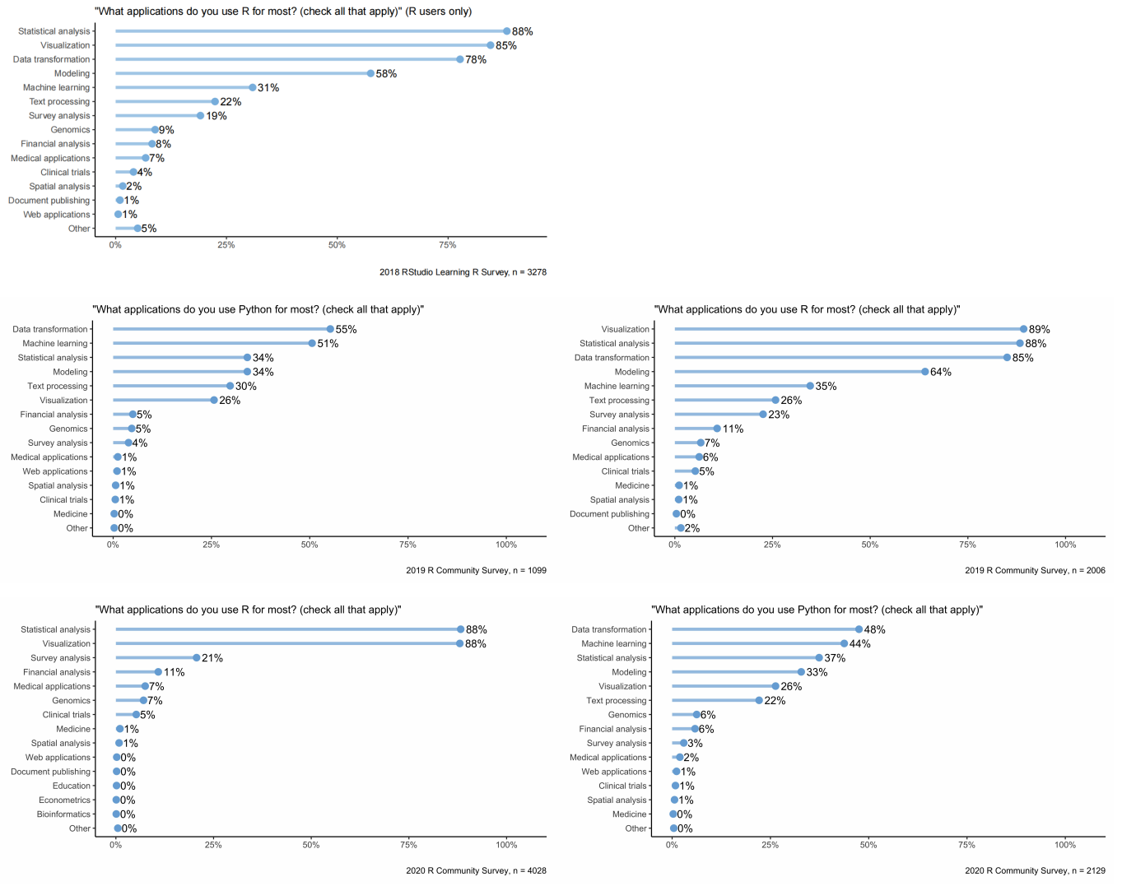
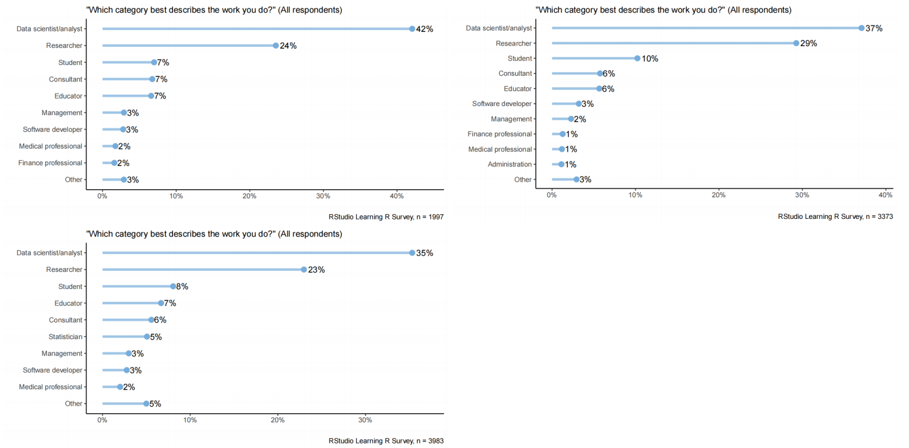
5. Data Exploration
- Analyzed types of work and usage patterns:
- Data Scientists/Analysts as the largest group.
- Gender preferences: Male majority, slight increase over years.
- Key applications of R vs. Python:
- R: Statistical analysis, visualization.
- Python: Machine learning.

Slide 7
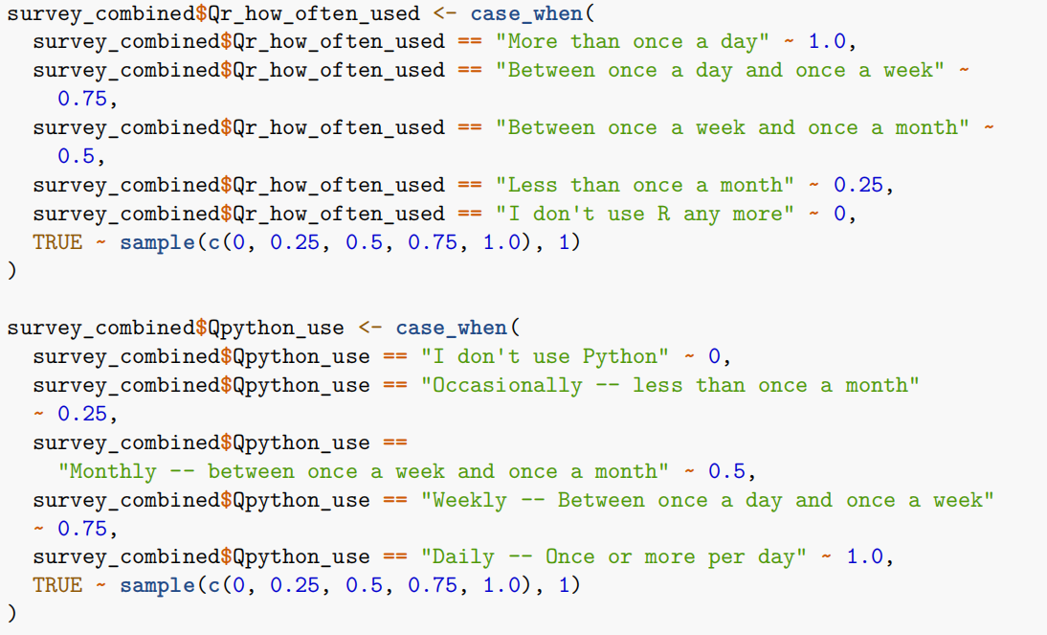
6. Analytical Plan
- Detailed statistical modeling and predictive analytics.
- Created a new binary outcome, Prefer, for nuanced insights.
- Built models:
- Random Forest
- Decision Tree
- Neural Network
- Logistic Regression
survey_combined$Prefer <- case_when(
survey_combined$Qr_enjoyment * 0.5 + survey_combined$Qrecommend * 0.2 +
survey_combined$Qr_how_often_used * 0.3 >=
survey_combined$Qpython_enjoy * 0.5 + survey_combined$Qpython_recommend *
0.2 + survey_combined$Qpython_use * 0.3 ~ 1,
24
survey_combined$Qr_enjoyment * 0.5 + survey_combined$Qrecommend * 0.2 +
survey_combined$Qr_how_often_used * 0.3 <
survey_combined$Qpython_enjoy * 0.5 + survey_combined$Qpython_recommend *
0.2 + survey_combined$Qpython_use * 0.3 ~ -1
)
fig 11. results mapping

Slide 8
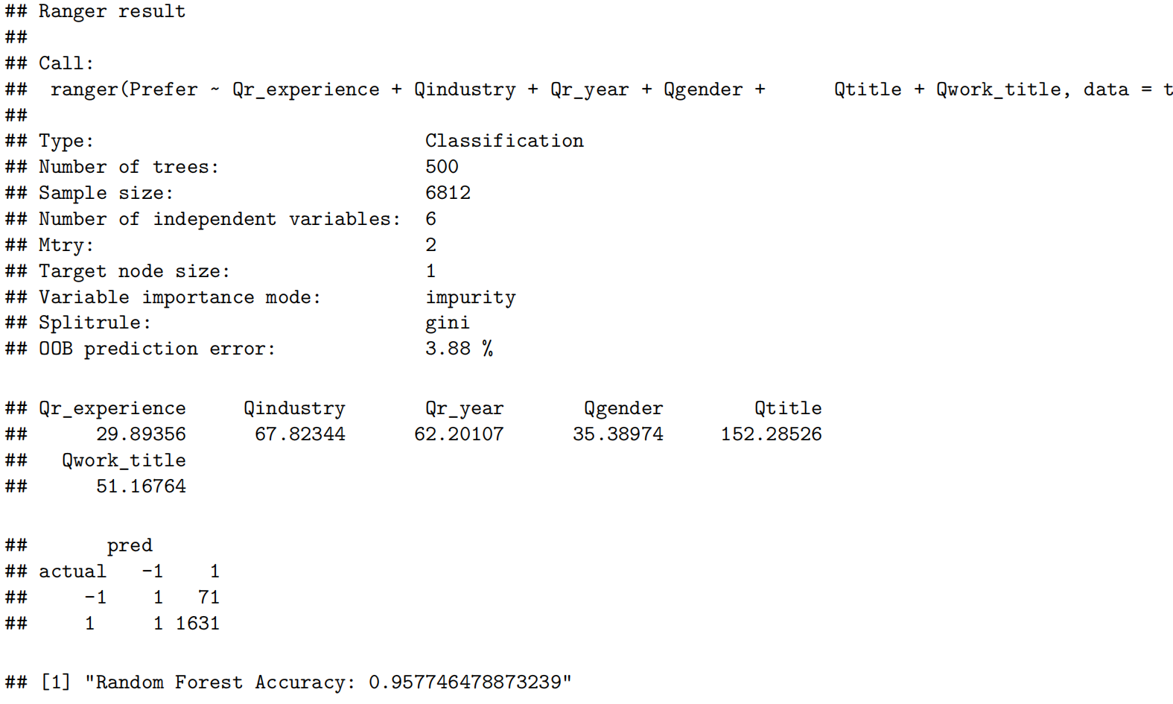
7. Results - Random Forest Model
- High accuracy (95.60%).
- Important variables: Qtitle, Qindustry, Qr_year.
- Performed well in classifying the Prefer variable.

Slide 9
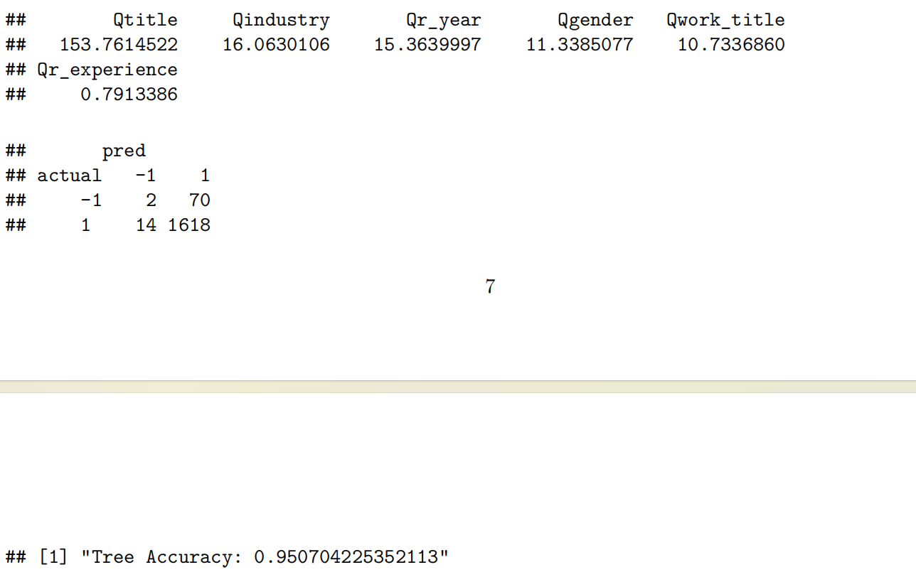
8. Results - Decision Tree Model
- Accuracy: 95.07%.
- Important variables: Qtitle, Qindustry, Qr_year.
- Compared with Random Forest: Slightly lower accuracy, similar variable importance.

Slide 10
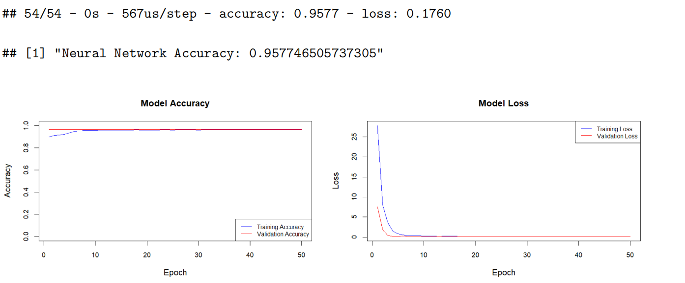
9. Results - Neural Network Model
- Accuracy: 95.77%.
- Components:
- Input layer: Same number of nodes as input features.
- Hidden layers: 64 and 32 nodes, relu activation, dropout to prevent overfitting.
- Output layer: 3 nodes, softmax activation.

Slide 11
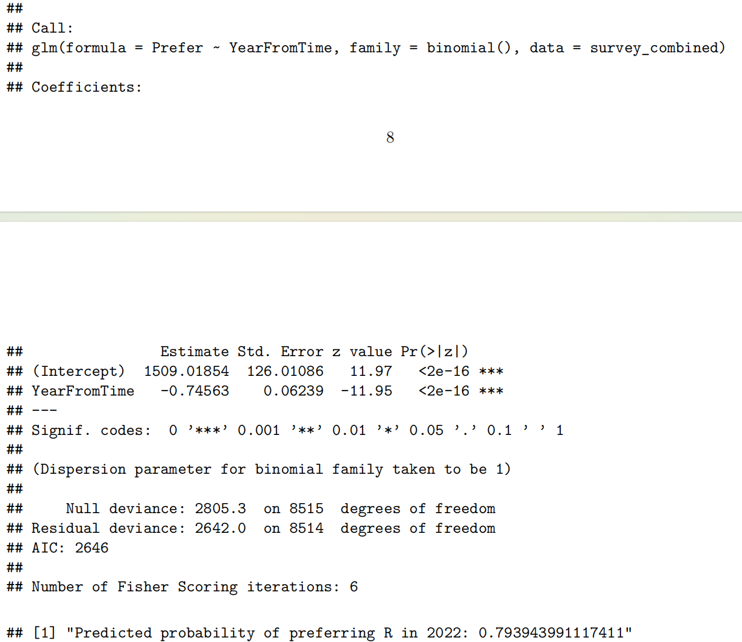
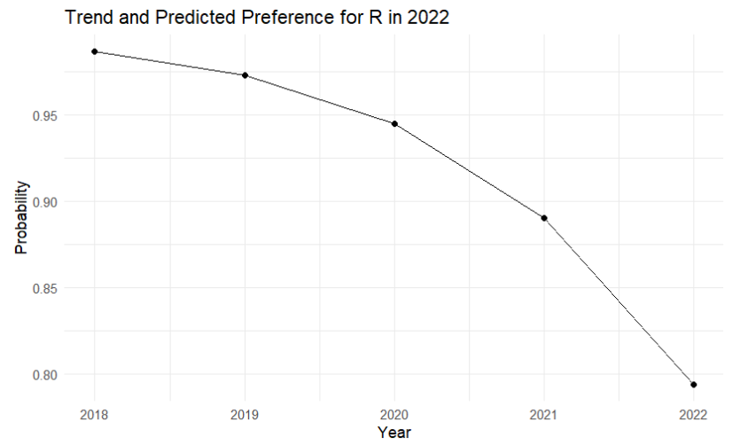
10. Results - Logistic Regression Model
- Analyzed effect of time on language preferences.
- Strong negative trend for R over time.
- Predicted probability of preferring R in 2022: 79.3%.

Slide 12
11. Discussion
Strengths:
- Comprehensive data.
- Weighted preference calculations.
- Temporal analysis.
- Variety of analytical methods.
Limitations:
- Self-selection bias.
- Data imputation and translation complexities.
- Binary outcome simplification.
- Survey design changes.

Slide 13
12. Conclusion
- Successfully analyzed preferences for R vs. Python.
- Detailed cohort analysis and weighted preference calculations provided nuanced insights.
- Future work: Use penalized regression models or advanced neural network architectures for improved accuracy and robustness.

Slide 14
Thank You

