Slide 1
Bhoomi Rakshak
Automated Crop Insurance Claim Intake & Duplicate Detection System

Slide 2

The Problem: Manual Verification Flaws
Current Challenges in the Block Office:
• Claims are verified one at a time in isolation.
• Exact duplicates easily slip through (same survey number claimed twice).
• Over-claiming extent goes unnoticed until post-sanction.
• Near-duplicates evade simple checks.

Slide 3
Solution Architecture & Tech Stack
A simple, explainable, locally-hosted web application.
• Backend: Python & Flask for the REST API.
• Database: SQLite (Raw SQL) for a highly normalized, robust schema.
• Machine Learning: Scikit-Learn Logistic Regression.
• Frontend: Vanilla HTML/CSS/JS with a premium, responsive 'Ledger' aesthetic.

Slide 4
Normalized Database Schema
Key Entities:
• survey_numbers: The ground-truth village register.
• claims: Incoming claims to be verified.
• flags: 1-to-Many relationship with claims. Stores specific human-readable reasons.
• decisions: Enforces a strict UNIQUE constraint on claim_id to prevent double-processing by officers.

Slide 5
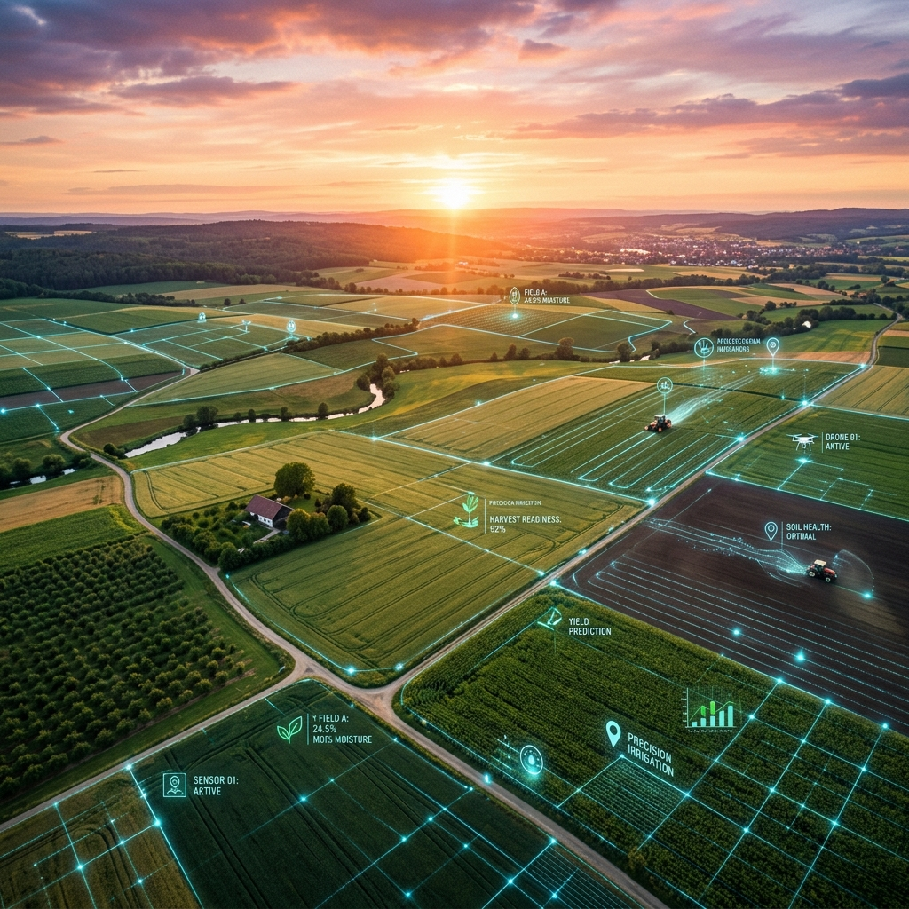
Automated Rule-Based Checks
Runs instantly at the counter upon submission:
1. Exact Duplicate: Rejects if an active claim already exists.
2. Extent Exceeds: Flags if claimed acreage > ground-truth acreage.
3. Crop Mismatch: Flags if the claimed crop differs from the registered crop.

Slide 6
ML: Near-Duplicate Detection
Algorithm: Logistic Regression (class_weight='balanced')
Engineered Features:
• String Similarity: Jaro-Winkler distance on Cultivator Name and Survey Number.
• Transposition Boolean: Explicitly checks for adjacent transposed digits (e.g., 145 vs 154).
• Crop Match Boolean.
• Extent Closeness: Normalized mathematical difference in acreage.

Slide 7
ML Model Performance
Evaluated using rigorous Leave-One-Out Cross-Validation:
• Recall: 100% (Caught 5 out of 5 planted near-duplicate claims).
• False Positives: Only 42 out of 1,760 non-duplicate pairs scanned.
• Explainability: Officers are shown the exact confidence score and the matched claim side-by-side.

Slide 8
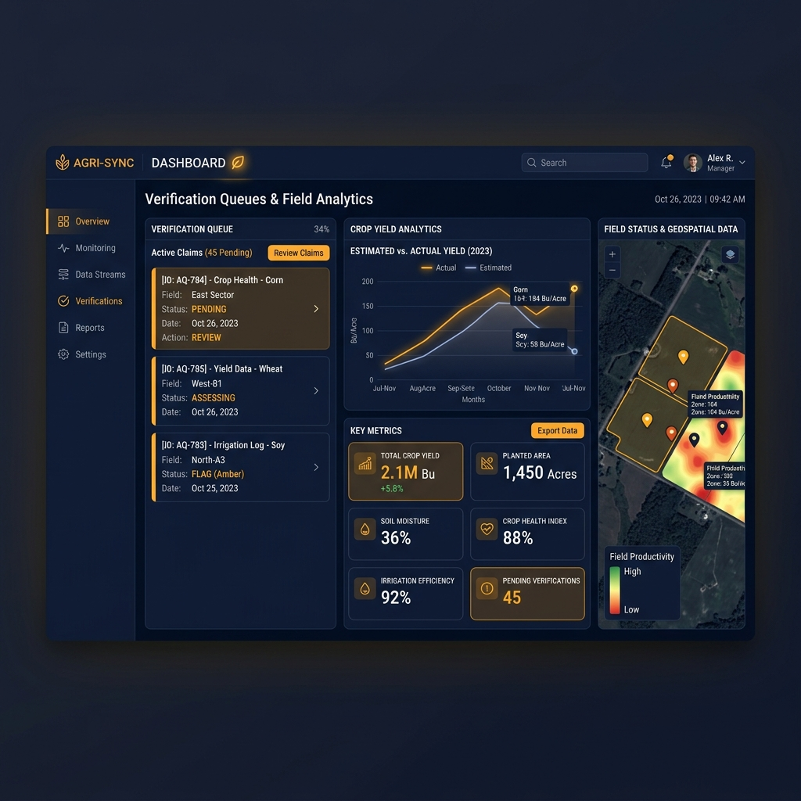
The Verification Queue
Officer Dashboard Workflow:
• Queue: Displays all flagged claims chronologically.
• Optimistic Locking: Prevents race conditions.
• Comparison: UI renders a side-by-side view.
• Decision: Requires a mandatory remark.

Slide 9
Conclusion
Bhoomi Rakshak achieves:
• Data Integrity: Strict SQLite enforcement.
• Operational Efficiency: Live ground-truth lookups prevent errors at the point of entry.
• Fraud Prevention: Blending deterministic rules with statistical ML to catch sophisticated duplicates.

