Slide 1
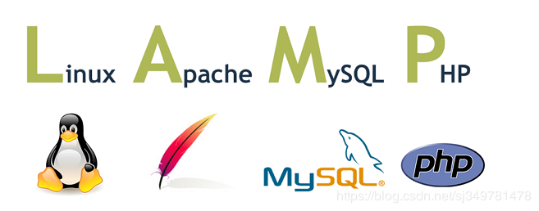
Introduction

Slide 2
Linux + Apache+ MySQL + Python

