Slide 1
CC Web organization
ROADMAP 2024
Updated : 26/01/2024 – Version : 2
Jan
Feb
Mar
Apr
May
Jun
Jul
Aug
Sep
Oct
Nov
Dec
Decomissioning ALTEN Campus
Webfactory CORE MODEL
DEPLOYMENT
ALTEN CANADA : start study in MARCH
ACS (Alten Consulting Services) : STUDY
ORION ENGINEERING
NEXEO / FINAXIUM
ALTEN POLAND
Webfactory
V2 Migration
ALTEN MOROCCO
ALTEN INDIA
ALTEN JAPAN
Castor Network
Pre-Study
Study
BUILD + BI
New web offer
Study
BUILD + BI
/!\ CAPA PLAN MANAGEMENT : Security and Architecture actions
RUN &
Enhancement
SEO/SEA setting and KPIs follow up
E-accessibility
Webfactory Core Model enhancement
Webfactory Analytics
BREVO
Study
DEPLOYMENT
1
On going project

Slide 2
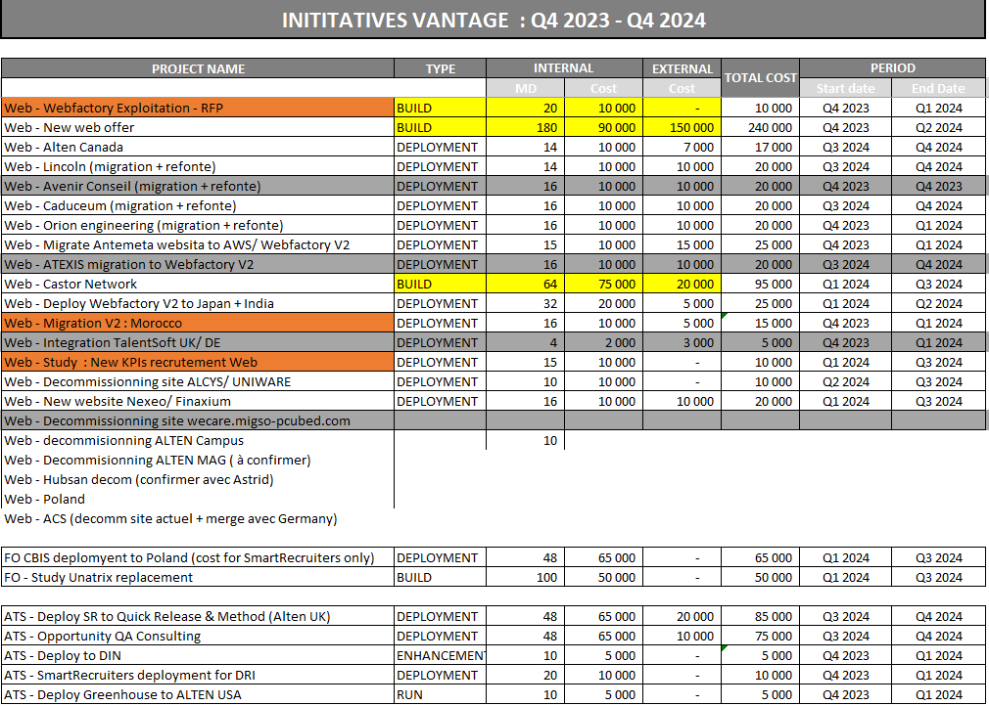

Slide 3
