Slide 1



HHS 2025-2026 Robotics Season DECODE
By Alistair Taylor (Emma), Miles Clarke, Lilly Salter, Flynn Lambley, Benjamin Hosé, Toby Parish, Jamie Dunn, Thomas Jones, Elijah Sutton
Team 21126

Slide 2
Holmfirth High Robotics - Background
The team has been in place since 2019 and successfully competed at York STEM centre, placing third in the regional competition. We have competed twice at the Midlands regional competition in 2022 and 2023 and currently compete in the Yorkshire regionals at Sheffield Hallam university.
Each year the team is made up of a number of students from year 7 to 11 with the majority of them in years 10 and 11. In 2025, we were able to enter two teams.
Team 21126

Slide 3
Alistair(Emma): Programmer
Meet the Team
Brief: Upskilled programming language to java from blocks.
Programmed omnidirectional motion.
Programmed flywheel launcher and “artefact gate” servo.
Programmed distance sensor and camera for autonomous period.
Miles: Project Manager, Design
Brief: Program and design consultant responsible for ensuring that the group stays on task and there is always a cross pollination of ideas and gracious professionalism and drafting and producing our final engineering portfolio. Help to coordinate ideas and keep everybody focused.
Lilly: Design and Construction
Brief: Update drivetrain. Design and build scaffolding/support for flywheel launcher and ramp.
Team 21126

Slide 4
Elijah: Design and Construction
Meet the Team
Brief: Update drivetrain.
Design and build scaffolding/support for flywheel launcher and ramp.
Flynn: Output designer
Brief: Update drivetrain.
Design and build scaffolding/support for flywheel launcher and ramp.
Invented original idea of flywheel mechanism.
Benjamin: Advisor and Support
Brief: Critically analyse design and construction.
Team 21126

Slide 5
Thomas Jones: Design and construction
Meet the Team
Brief: Update drivetrain.
Design and build scaffolding/support for flywheel launcher and ramp.
Toby Paris: Advisor/Support
Brief: Critically analyse design and construction.
Jamie: General Assistance
Brief: Help other team members with tasks to help the team work together
Worked hard to organise team equipment and keep the space tidy
Team 21126

Slide 6
The Robot
Summary:
The robot is built up in four main parts:
Drivetrain
Artefact Launcher/Gate
Remote Sensing
Programming
We have worked on the drivetrain for a long time but designed the artefact launcher and gate mechanism, as well as their programming, specifically for this year. We have also introduced a new camera, which we have worked hard on to integrate it into the programming.
Team 21126

Slide 7
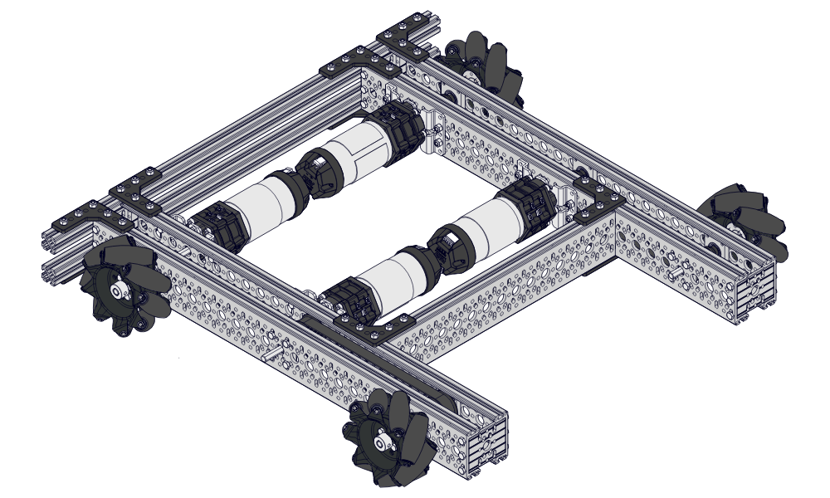
Drivetrain
Our current drivetrain is two years old. Initially made from extruded aluminium t slots, we were able to get a grant from our Parent Teacher Association to buy a number of c channels, planetary motors and omnidirectional wheels. The current drivetrain is built around the design of the Meccanum drivetrain kit with 90-degree boxes enabling the motors to sit inside the c channels for a more compact design.
Team 21126

Slide 8
Drivetrain
Improvements:
We now built the frame out of aluminium c channel and hex bars. This makes the frame stronger, lighter and smaller. This helps us by allowing our robot to be more agile, which is useful within the competition. This improves our robot by making it faster. These improvements make our robot more corrosion resistant, which is good for the environment because we won’t have to replace the channels as often. This shows our journey towards environmental conscience, which is very important within our local community.
Team 21126

Slide 9
Artefact launcher
Design and construction team – Tom Jones + Lilly Salter + Flynn Lambley + Miles Clarke
We considered a spring mechanism but decided to use a flywheel mechanism to propel the artefacts along the ramp and up out of the robot. This means we can fire multiple balls in quick succession, but we need some time to spin it up to full speed. It also means that the angle the balls exit the tube at is slightly unpredictable. We set the ramp at a specific angle so that the balls would come out at the right trajectory to hit the target. We also used a distance sensor so that the robot could automatically stop when it got close enough to the wall that the ball would go in.
Team 21126

Slide 10
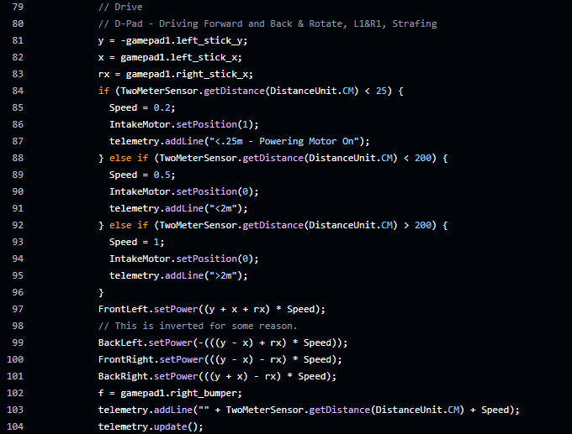
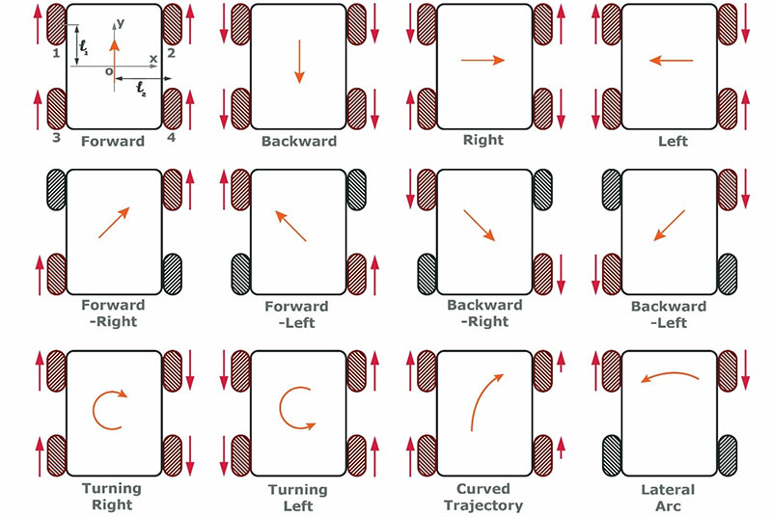
Programming - Drive
Our robot is split into two sections: the drive & the launcher section.
First, the drive section: the code to the left is responsible for the driving of the omni directional robot. This allows the robot to move in all four directions as well as diagonally and pivot on the spot.
This next screenshot shows the code we use to stop the motors when we are too close to an object.
Confusingly, the Back Left motor is reversed.
Team 21126

Slide 11
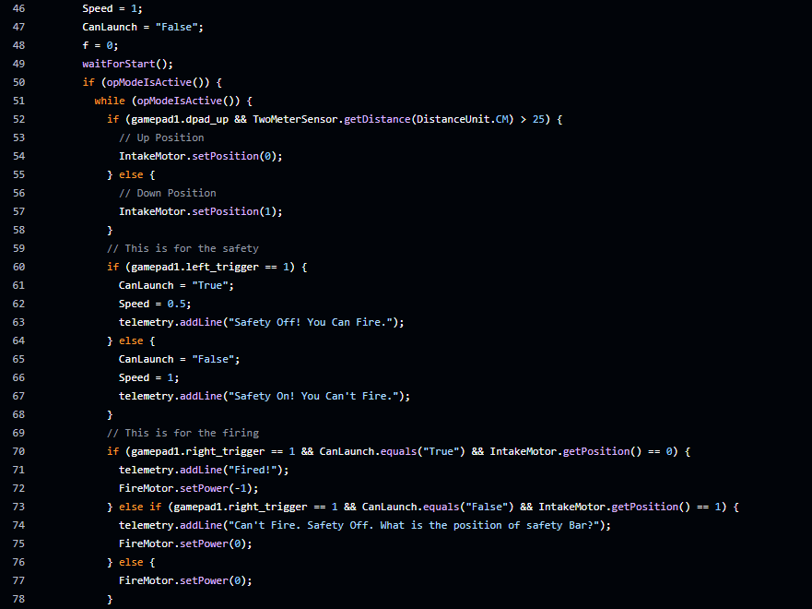
Programming - Launcher
Secondly, the launcher:
This extract of code is responsible for activating the firing motor when a trigger is pressed and turning it off if not. This code was made by our talented programmer: Alistair (Emma) Taylor. It checks if the correct trigger is pressed and the right conditions are met before allowing the user to spin up the firing wheel and then release the artefact gate to drop an artefact down into the firing chamber.
Team 21126

